Slide 1

Advances in Large Language Models
ELL8299 · AIL861
Alignment of Language Models –
Reward Maximization
Gaurav Pandey
Senior Research Scientist, IBM Research

Slide 2
Reward Maximization
Best-of-N policy
Reward Maximization Objective Formulation
Vanilla Policy Gradient
  The REINFORCE gradient estimator
  The problem of high variance - Baseline subtraction
  Final algorithm
Towards Actor/Critic methods
  The problem of credit assignment
  Q-functions, Value functions and advantage
  Estimating the value function and advantage
  Actor-Critic Family of algorithms

Slide 3
Reward Maximization
Best-of-N policy
Reward Maximization Objective Formulation
Vanilla Policy Gradient
  The REINFORCE gradient estimator
  The problem of high variance - Baseline subtraction
  Final algorithm
Towards Actor/Critic methods
  The problem of credit assignment
  Q-functions, Value functions and advantage
  Estimating the value function and advantage
  Final algorithm

Slide 4
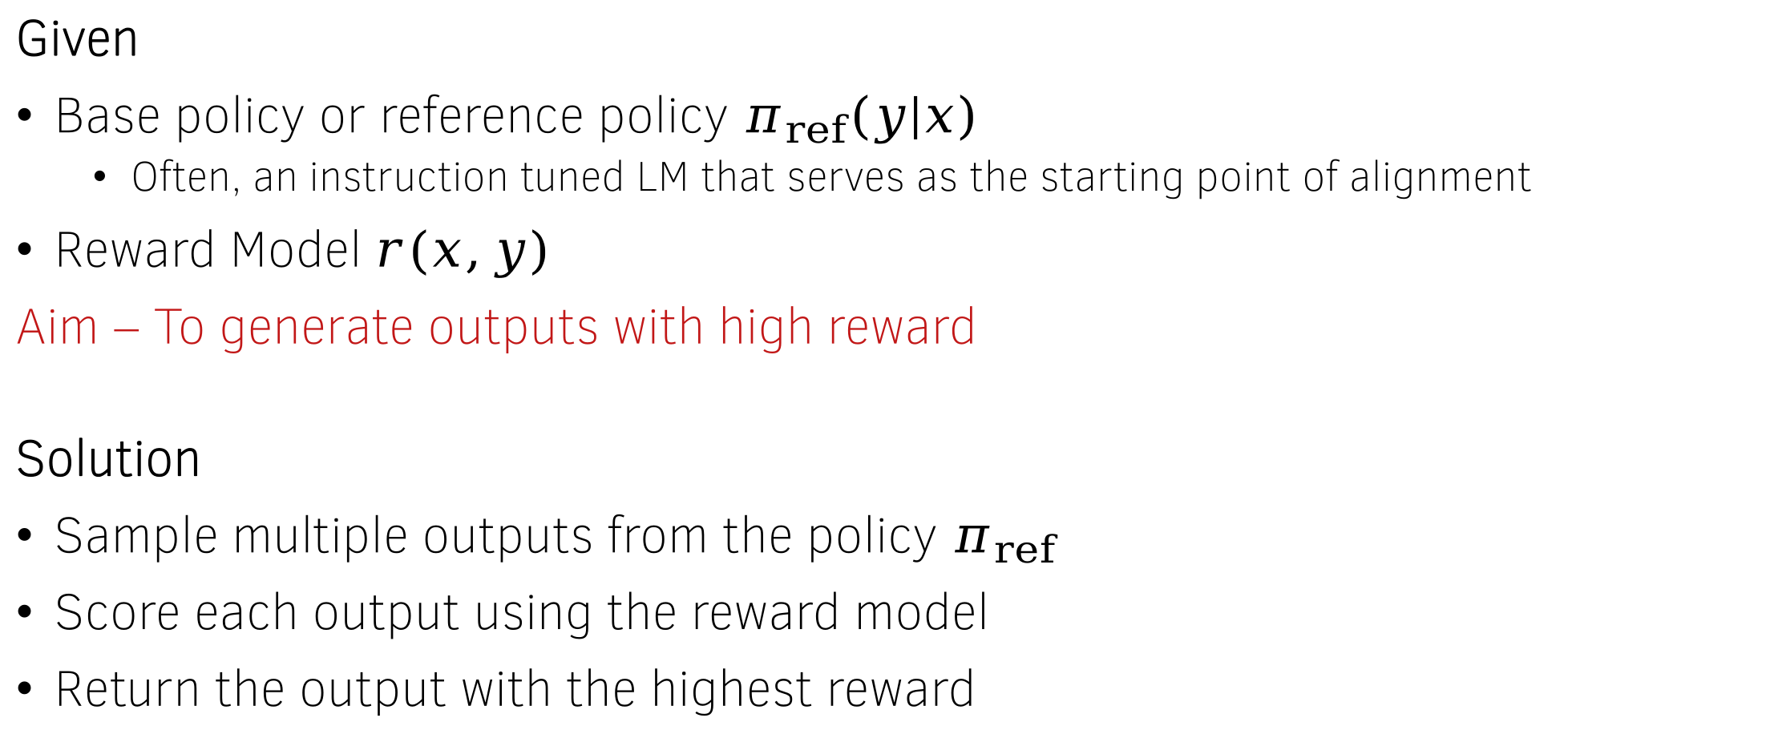
Best-of-N policy
Given
Base policy or reference policy $π_{ref}\left(y | x\right)$
  Often, an instruction tuned LM that serves as the starting point of alignment
Reward Model $r(x,y)$
Aim – To generate outputs with high reward
Solution
Sample multiple outputs from the policy $π_{ref}$
Score each output using the reward model
Return the output with the highest reward

Slide 5



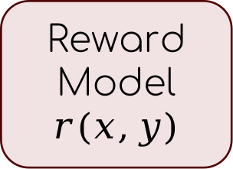
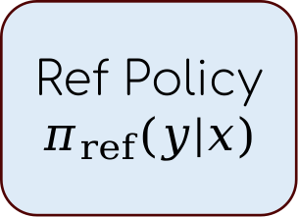
Best-of-n policy
Samples
Poem 1
$$r_{poem1}$$
Ref Policy $π_{ref}(y|x)$
Poem 2
$$r_{poem2}$$
Pick the one with
the highest reward
Reward
Model
$$r(x,y)$$
Prompt:
Write a poem
Poem n
$$r_{poemn}$$
Challenge:
Too expensive during inference
Can’t get better iteratively
Reward Model may not be available during inference
  Verifiable rewards

Slide 6
Reward Maximization
Best-of-N policy
Reward Maximization Objective Formulation
Vanilla Policy Gradient
  The REINFORCE gradient estimator
  The problem of high variance - Baseline subtraction
  Final algorithm
Towards Actor/Critic methods
  The problem of credit assignment
  Q-functions, Value functions and advantage
  Estimating the value function and advantage
  Final algorithm

Slide 7
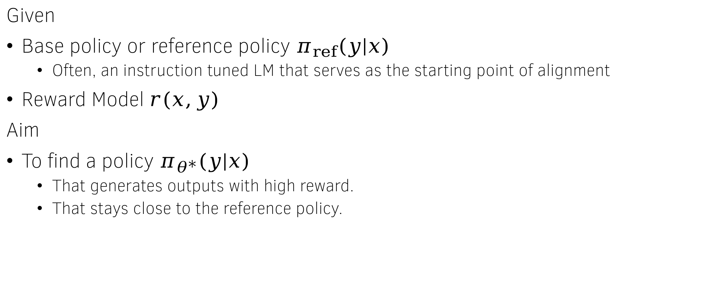
The reward-maximization objective
Given
Base policy or reference policy $π_{ref}\left(y | x\right)$
  Often, an instruction tuned LM that serves as the starting point of alignment
Reward Model $r(x,y)$
Aim
To find a policy $π_{θ^{∗}}(y|x)$
  That generates outputs with high reward.
  That stays close to the reference policy.

Slide 8
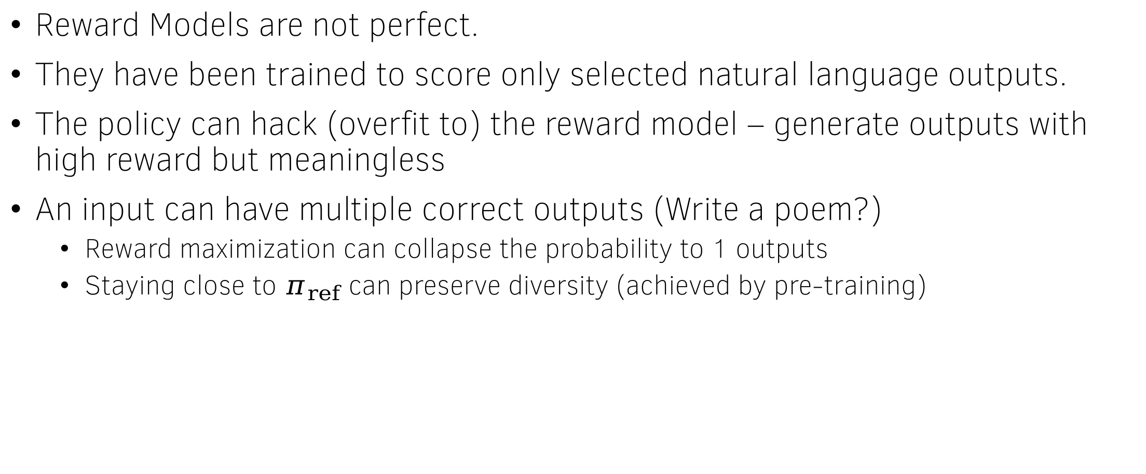

Why care about closeness to $π_{ref}$?
Reward Models are not perfect.
They have been trained to score only selected natural language outputs.
The policy can hack (overfit to) the reward model – generate outputs with high reward but meaningless
An input can have multiple correct outputs (Write a poem?)
  Reward maximization can collapse the probability to 1 outputs
  Staying close to $π_{ref}$ can preserve diversity (achieved by pre-training)

Slide 9
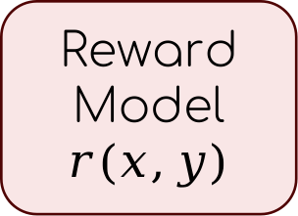
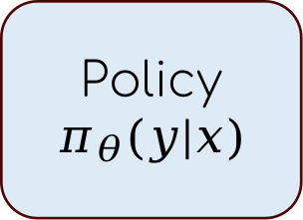
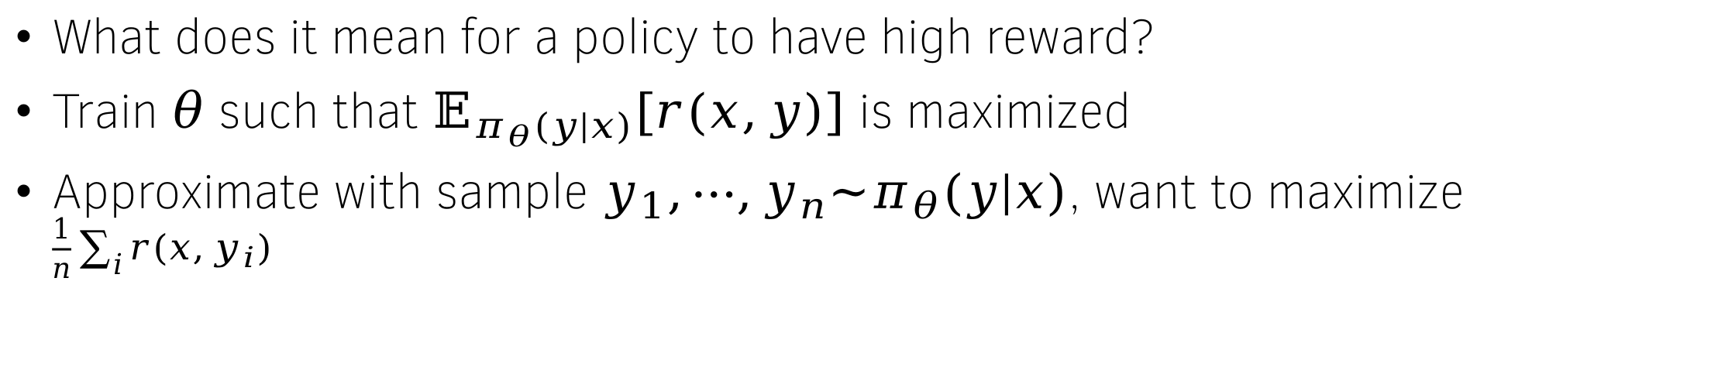
Formulating the objective – Reward Maximization part
Samples
Poem 1
$$r_{poem1}$$
Policy $π_{θ}(y|x)$
Poem 2
$$r_{poem2}$$
The average of these numbers needs to be high
Reward
Model
$$r(x,y)$$
Prompt:
Write a poem
Poem n
$$r_{poemn}$$
What does it mean for a policy to have high reward?
Train $θ$ such that $𝔼_{π_{θ}(y|x)}\left[r(x,y)\right]$ is maximized
Approximate with sample $y_{1},⋯,y_{n}\sim π_{θ}(y|x)$, want to maximize $\frac{1}{n}\sum_{i}{r\left(x,y_{i}\right)}$

Slide 10



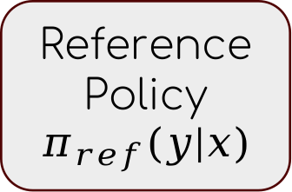

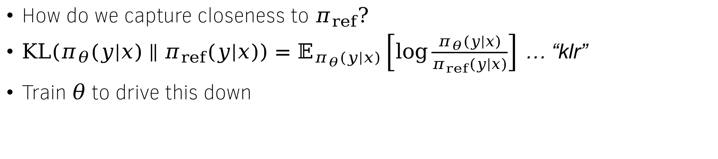

Formulating the objective – closeness to $π_{ref}$
How do we capture closeness to $π_{ref}?$
$KL\left(π_{θ}(y|x)∥π_{ref}(y|x)\right)=𝔼_{π_{θ}(y|x)}\left[\log{\frac{π_{θ}(y|x)}{π_{ref}(y|x)}}\right]$ … “klr”
Train $θ$ to drive this down
Poem 1
$${klr}_{poem1}$$
Policy $π_{θ}(y|x)$
Poem 2
$${klr}_{poem2}$$
The average of these numbers needs to be low
Reference
Policy
$$π_{ref}(y|x)$$
Prompt:
Write a poem
Poem n
$${klr}_{poemn}$$

Slide 11

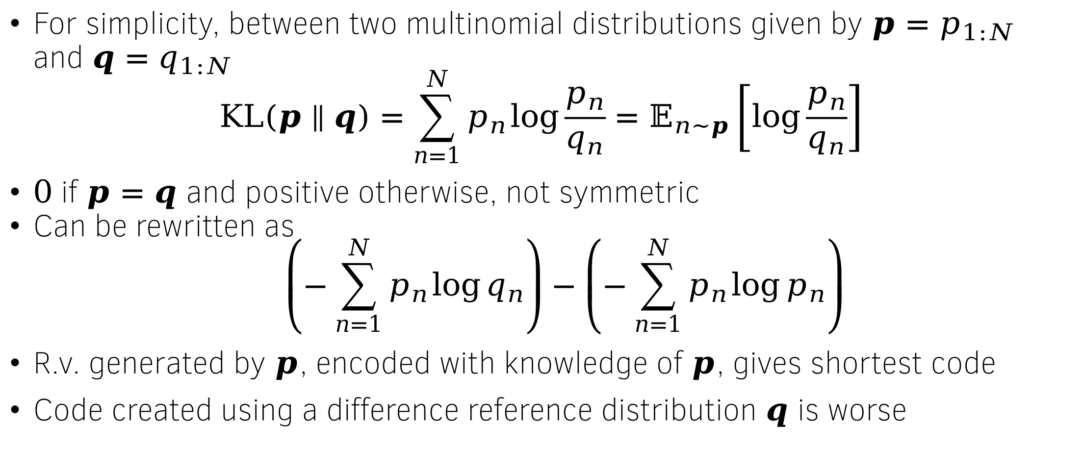
KL divergence
For simplicity, between two multinomial distributions given by $p=p_{1:N}$ and $q=q_{1:N}$
$$KL\left(p∥q\right)=\sum_{n=1}^{N}{p_{n}\log{\frac{p_{n}}{q_{n}}}}=𝔼_{n\sim p}\left[\log{\frac{p_{n}}{q_{n}}}\right]$$
$0$ if $p=q$ and positive otherwise, not symmetric
Can be rewritten as
$$\left(−\sum_{n=1}^{N}{p_{n}\log{q_{n}}}\right)−\left(−\sum_{n=1}^{N}{p_{n}\log{p_{n}}}\right)$$
R.v. generated by $p$, encoded with knowledge of $p$, gives shortest code
Code created using a difference reference distribution $q$ is worse
Shannon entropy of $p$

Slide 12
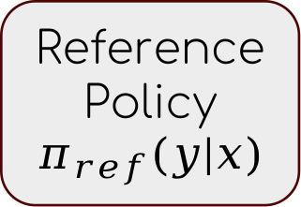

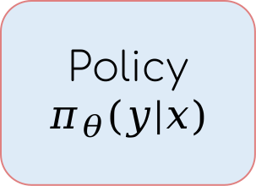
Combining the objective
$$r_{poem1}$$
$$r_{poem2}$$
Reward
Model
$$r(x,y)$$
Average reward
Poem 1
$$r_{poemn}$$
Policy $π_{θ}(y|x)$
Poem 2
Difference
Prompt:
Write a poem
$${klr}_{poem1}$$
Poem n
$${klr}_{poem2}$$
Average KL
Reference
Policy
$$π_{ref}(y|x)$$
Multiply by $β$
$${klr}_{poemn}$$

Slide 13
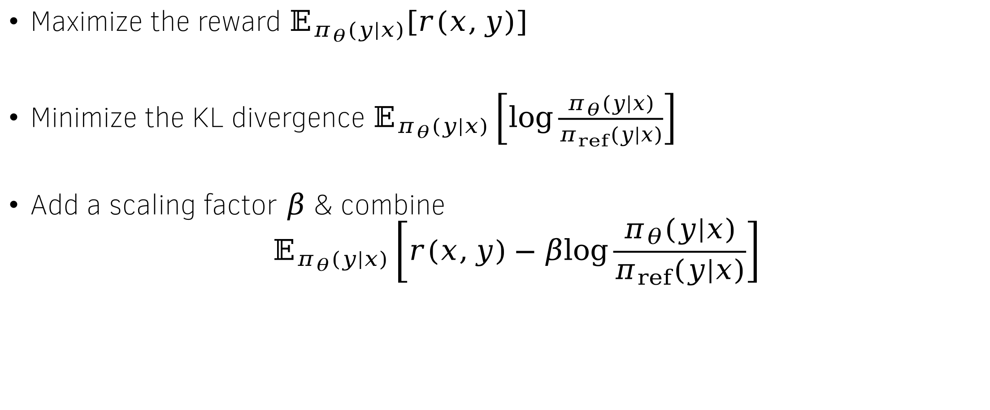
Regularized reward maximization
Maximize the reward $𝔼_{π_{θ}(y|x)}\left[r(x,y)\right]$
Minimize the KL divergence $𝔼_{π_{θ}(y|x)}\left[\log{\frac{π_{θ}(y|x)}{π_{ref}(y|x)}}\right]$
Add a scaling factor $β$ & combine
$$𝔼_{π_{θ}(y|x)}\left[r(x,y)−β\log{\frac{π_{θ}(y|x)}{π_{ref}(y|x)}}\right]$$

Slide 14
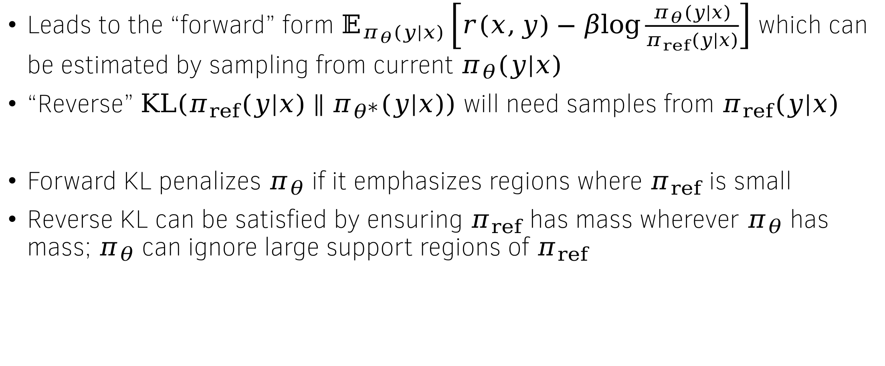
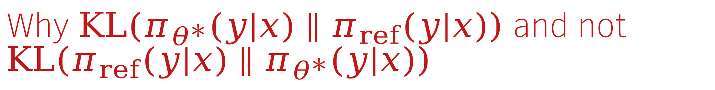
Why $KL\left(π_{θ^{∗}}(y|x)∥π_{ref}(y|x)\right)$ and not $KL\left(π_{ref}(y|x)∥π_{θ^{∗}}(y|x)\right)$
Leads to the “forward” form $𝔼_{π_{θ}(y|x)}\left[r(x,y)−β\log{\frac{π_{θ}(y|x)}{π_{ref}(y|x)}}\right]$ which can be estimated by sampling from current $π_{θ}(y|x)$
“Reverse” $KL\left(π_{ref}(y|x)∥π_{θ^{∗}}(y|x)\right)$ will need samples from $π_{ref}(y|x)$
Forward KL penalizes $π_{θ}$ if it emphasizes regions where $π_{ref}$ is small
Reverse KL can be satisfied by ensuring $π_{ref}$ has mass wherever $π_{θ}$ has mass; $π_{θ}$ can ignore large support regions of $π_{ref}$

Slide 15
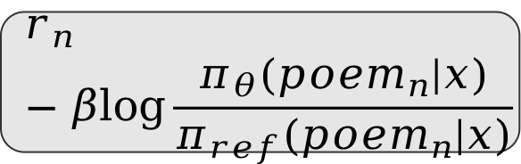

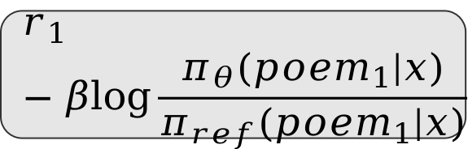
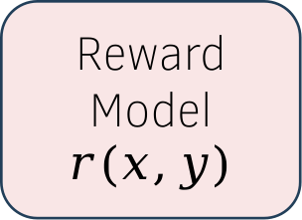
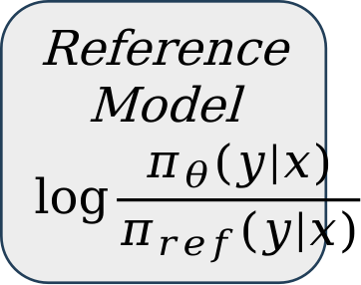
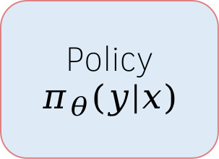
The regularized reward maximization objective
$$r_{1}−β\log{\frac{π_{θ}(poem_{1}|x)}{π_{ref}(poem_{1}|x)}}$$
Reward
Model
$$r(x,y)$$
Poem 1
Poem 2
$$r_{2}−β\log{\frac{π_{θ}(poem_{2}|x)}{π_{ref}(poem_{2}|x)}}$$
Policy $π_{θ}(y|x)$
Prompt:
Write a poem
Average
.
.
.
Poem n
Reference
Model
$$\log{\frac{π_{θ}(y|x)}{π_{ref}(y|x)}}$$
$$r_{n}−β\log{\frac{π_{θ}(poem_{n}|x)}{π_{ref}(poem_{n}|x)}}$$
Non differentiable sampling
Regularized reward

Slide 16
Reward Maximization
Best-of-N policy
Reward Maximization Objective Formulation
Towards Vanilla Policy Gradient
  The REINFORCE gradient estimator
  The problem of high variance - Baseline subtraction
  Final algorithm
Towards Actor/Critic methods
  The problem of credit assignment
  Q-functions, Value functions and advantage
  Estimating the value function and advantage
  Final algorithm

Slide 17
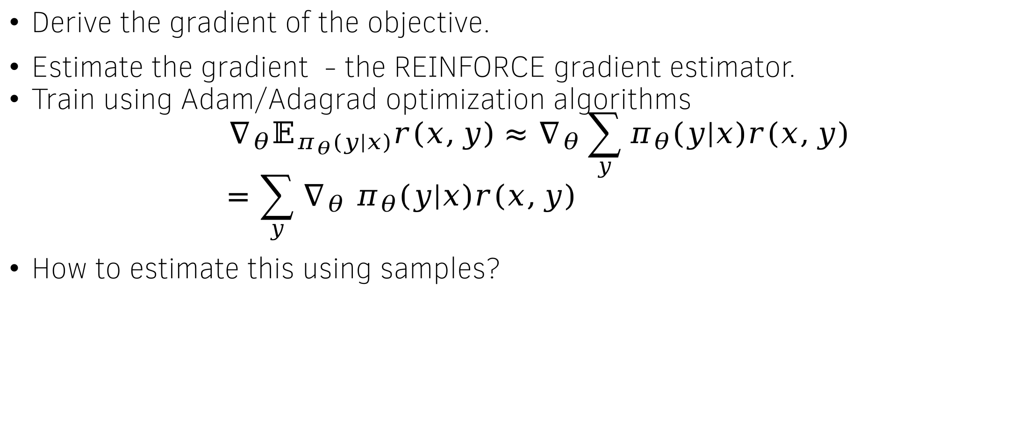
How to maximize the (reward) objective?
Derive the gradient of the objective.
Estimate the gradient - the REINFORCE gradient estimator.
Train using Adam/Adagrad optimization algorithms
$$∇_{θ}𝔼_{π_{θ}(y|x)}r\left(x,y\right)≈∇_{θ}\sum_{y}{π_{θ}\left(y | x\right)r\left(x,y\right)} \\ =\sum_{y}{∇_{θ} π_{θ}\left(y | x\right)r\left(x,y\right)}$$
How to estimate this using samples?

Slide 18
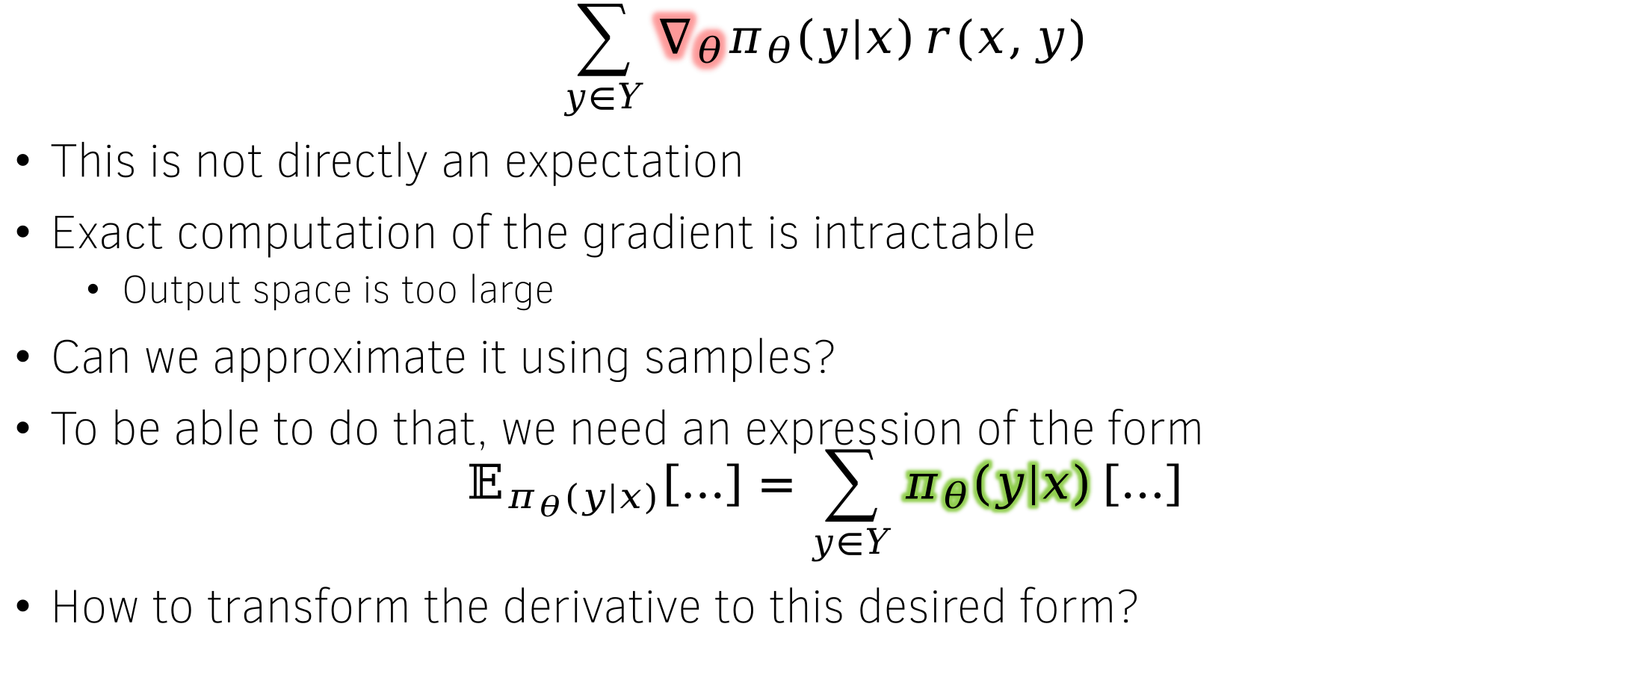
Computing the gradient
$$\sum_{y∈Y}{∇_{θ}π_{θ}\left(y | x\right)}r(x,y)$$
This is not directly an expectation
Exact computation of the gradient is intractable
  Output space is too large
Can we approximate it using samples?
To be able to do that, we need an expression of the form
$$𝔼_{π_{θ}(y|x)}\left[…\right]=\sum_{y∈Y}{π_{θ}\left(y | x\right)}\left[…\right]$$
How to transform the derivative to this desired form?

Slide 19
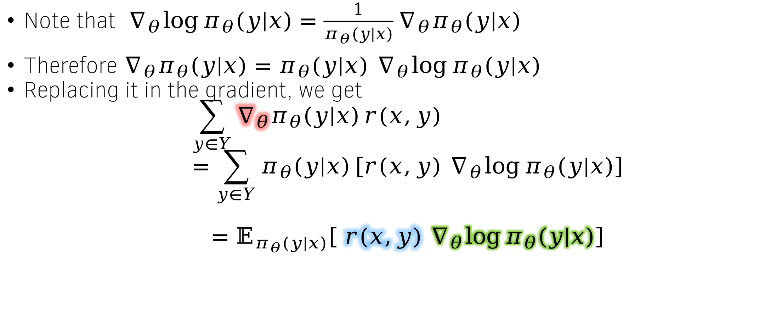
The log-derivative trick
Note that $∇_{θ}\log{π_{θ}(y|x)}=\frac{1}{π_{θ}(y|x)}∇_{θ}π_{θ}(y|x)$
Therefore $∇_{θ}π_{θ}(y|x)=π_{θ}(y|x) ∇_{θ}\log{π_{θ}(y|x)}$
Replacing it in the gradient, we get
$$\sum_{y∈Y}{∇_{θ}π_{θ}\left(y | x\right)}r(x,y) \\ =\sum_{y∈Y}{π_{θ}\left(y | x\right)}\left[{r(x,y) ∇}_{θ}\log{π_{θ}(y|x)}\right]$$
$$=𝔼_{π_{θ}(y|x)}\left[ r(x,y) ∇_{θ}\log{π_{θ}(y|x)}\right]$$

Slide 20
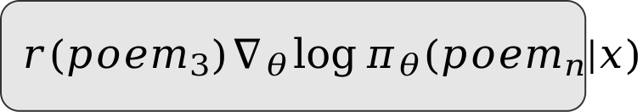
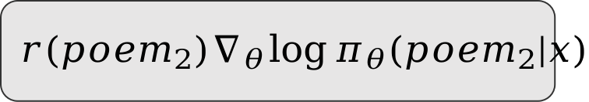
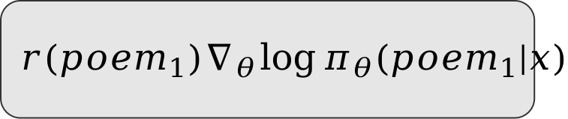
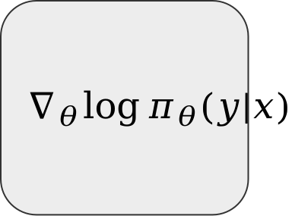
Estimating the gradient – REINFORCE
Reward
Model
$$r(poem_{1})∇_{θ}\log{π_{θ}({poem}_{1}|x)}$$
Poem 1
Poem 2
$$r(poem_{2})∇_{θ}\log{π_{θ}({poem}_{2}|x)}$$
Policy $π_{θ}(y|x)$
Average
Prompt:
Write a poem
$$∇_{θ}\log{π_{θ}(y|x)}$$
$$r(poem_{3})∇_{θ}\log{π_{θ}({poem}_{n}|x)}$$
Poem n

Slide 21
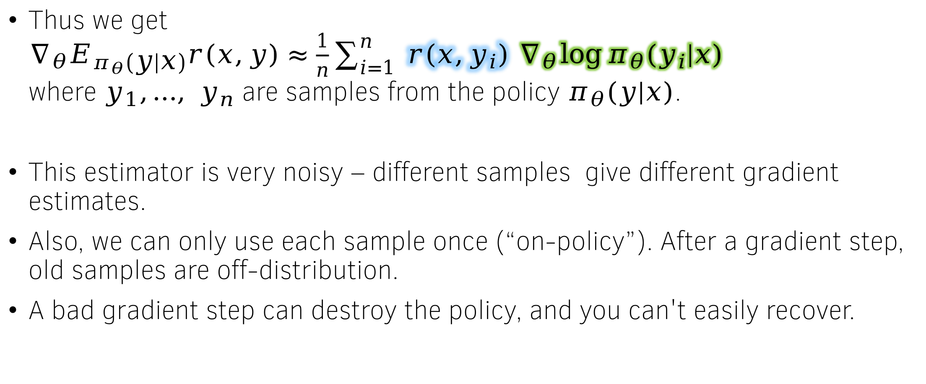
Estimating the gradient – REINFORCE
Thus we get
$∇_{θ}E_{π_{θ}\left(y | x\right)}r\left(x,y\right)≈\frac{1}{n}\sum_{i=1}^{n}{ r\left(x,y_{i}\right) ∇_{θ}\log{π_{θ}(y_{i}|x)}}$
where $y_{1},…, y_{n}$ are samples from the policy $π_{θ}(y|x)$.
This estimator is very noisy – different samples give different gradient estimates.
Also, we can only use each sample once (“on-policy”). After a gradient step, old samples are off-distribution.
A bad gradient step can destroy the policy, and you can't easily recover.

Slide 22
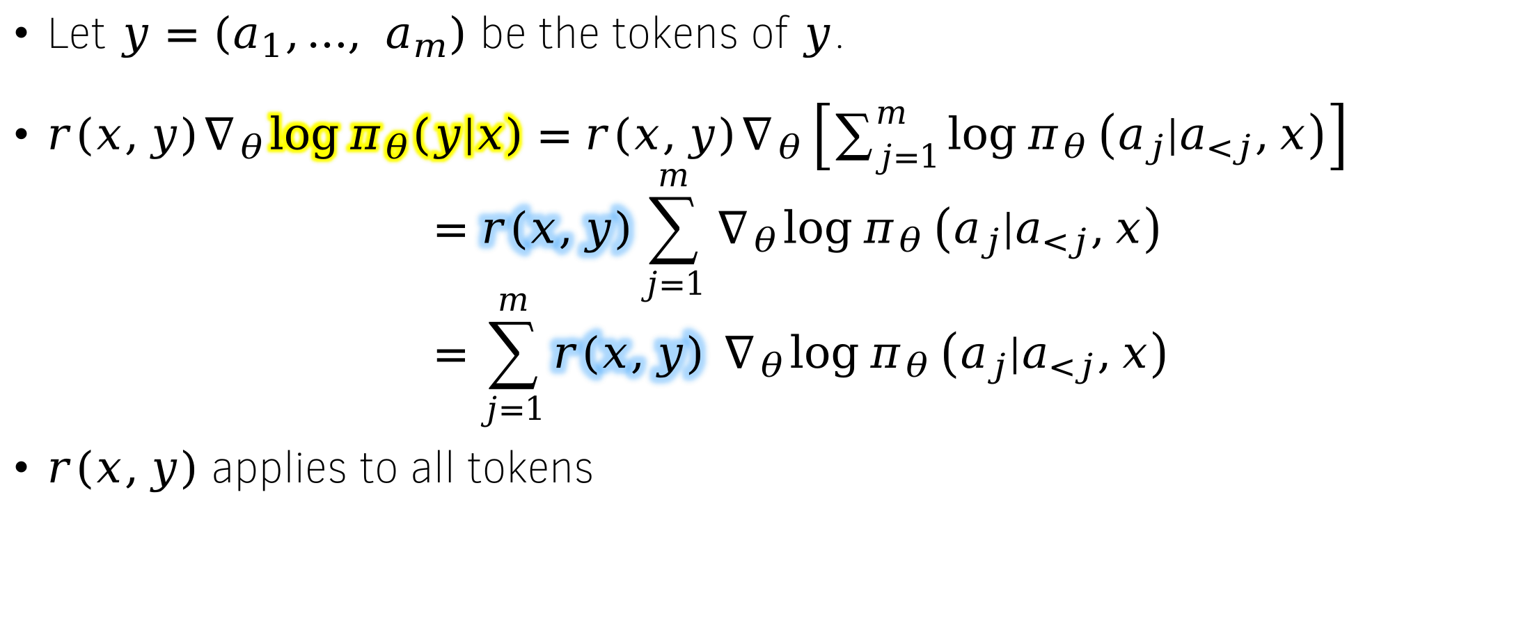
Expanding the gradient
Let $y=\left(a_{1},…, a_{m}\right)$ be the tokens of $y$.
$r\left(x,y\right)∇_{θ}\log{π_{θ}\left(y | x\right)}=r\left(x,y\right)∇_{θ}\left[\sum_{j=1}^{m}{\log{π_{θ}}\left(a_{j}|a_{<j},x\right)}\right]$
$$=r\left(x,y\right)\sum_{j=1}^{m}{∇_{θ}\log{π_{θ}}\left(a_{j}|a_{<j},x\right)} \\ =\sum_{j=1}^{m}{r\left(x,y\right) ∇_{θ}\log{π_{θ}}\left(a_{j}|a_{<j},x\right)}$$
$r\left(x,y\right)$ applies to all tokens

Slide 23
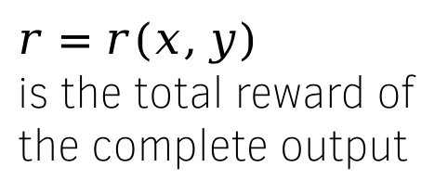






Implementing the REINFORCE gradient estimate
Sum & backpropagate
$r=r(x,y)$
is the total reward of
the complete output
$$r log{π_{θ}(eot|s_{5})}$$
$$r log{π_{θ}(Mahal|s_{1})}$$
$$r log{π_{θ}(in|s_{3})}$$
$$r log{π_{θ}(Taj|s_{0})}$$
$$r log{π_{θ}(is|s_{2})}$$
$$r log{π_{θ}(Agra|s_{4})}$$
LLM Policy $π_{θ}(a|s_{t})$
User: Where is Taj Mahal? Assistant:
Taj Mahal is in Agra

Slide 24
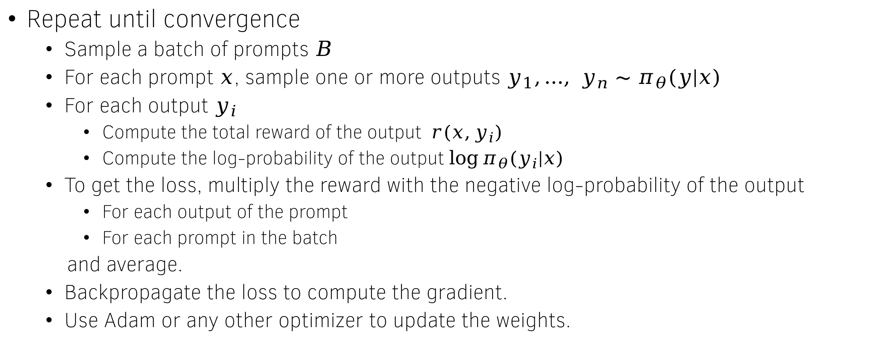
The Vanilla Policy Gradient Algorithm
Repeat until convergence
  Sample a batch of prompts $B$
  For each prompt $x$, sample one or more outputs $y_{1},…, y_{n}∼π_{θ}(y|x)$
  For each output $y_{i}$
    Compute the total reward of the output $r(x,y_{i})$
    Compute the log-probability of the output $\log{π_{θ}(y_{i}|x)}$
  To get the loss, multiply the reward with the negative log-probability of the output
    For each output of the prompt
    For each prompt in the batch
  and average.
  Backpropagate the loss to compute the gradient.
  Use Adam or any other optimizer to update the weights.

Slide 25
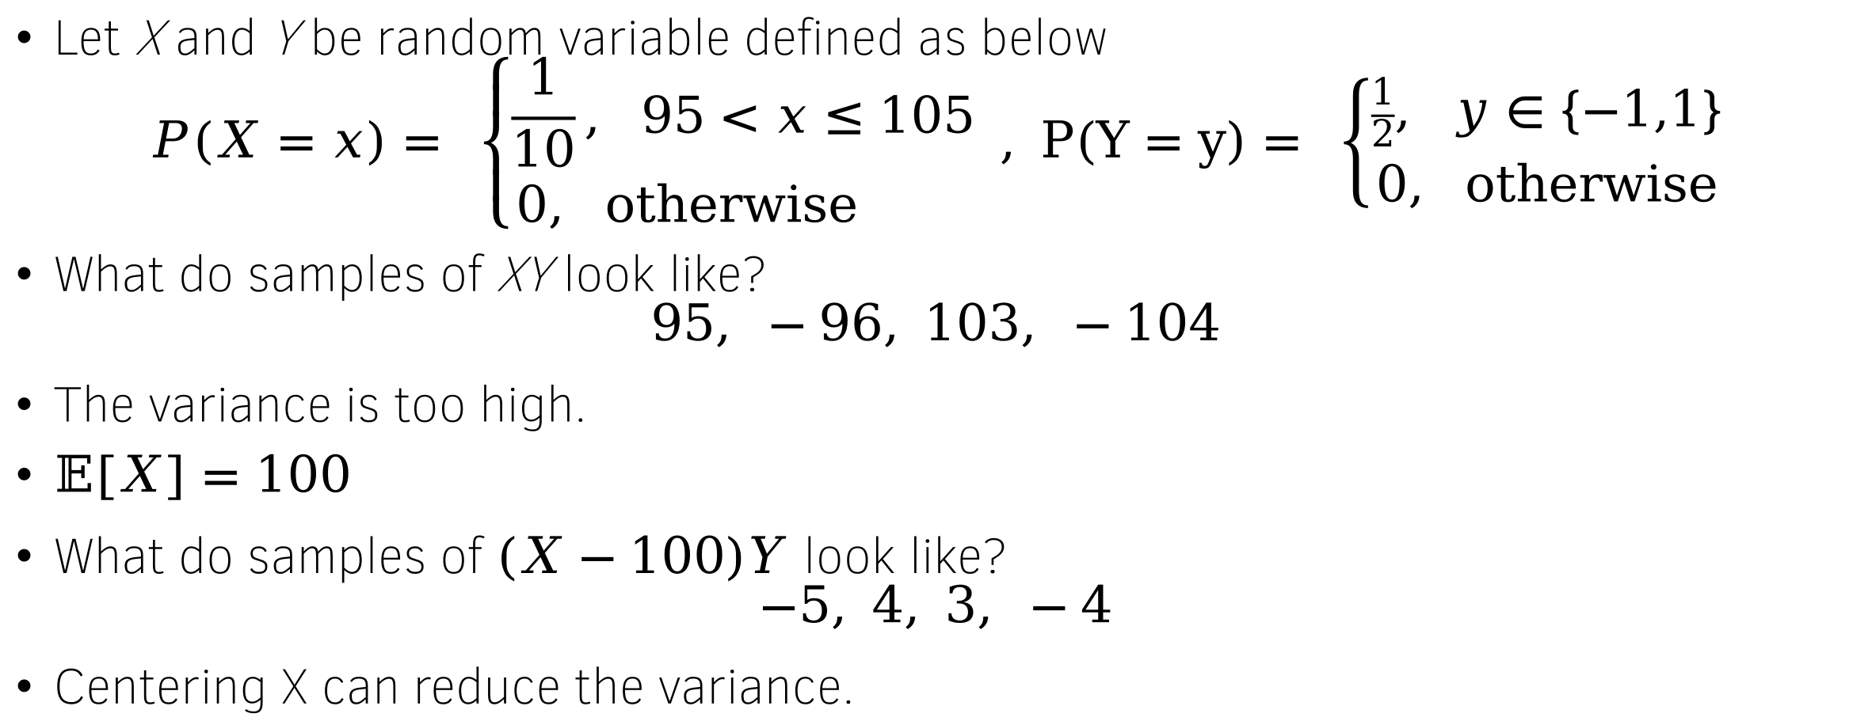
Motivating the baseline
Let X and Y be random variable defined as below
$$P\left(X=x\right)= \left\{\begin{aligned}\frac{1}{10}, 95<x≤105 \\ &0, otherwise \end{aligned}\right. , P\left(Y=y\right)= \left\{\begin{aligned}\frac{1}{2}, y∈\{−1,1\} \\ &0, otherwise\end{aligned}\right.$$
What do samples of XY look like?
$$95, −96, 103, −104$$
The variance is too high.
$𝔼\left[X\right]=100$
What do samples of $\left(X−100\right)Y$ look like?
$$−5, 4, 3, −4$$
Centering X can reduce the variance.

Slide 26
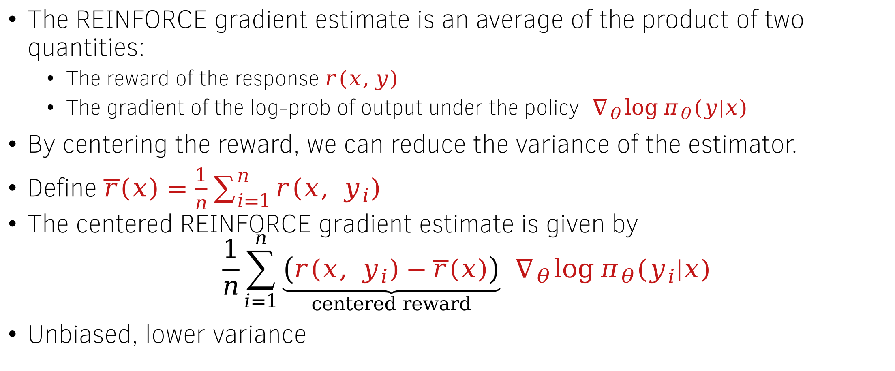
Baseline subtraction to reduce variance
The REINFORCE gradient estimate is an average of the product of two quantities:
  The reward of the response $r(x,y)$
  The gradient of the log-prob of output under the policy $∇_{θ}\log{π_{θ}(y|x)}$
By centering the reward, we can reduce the variance of the estimator.
Define $\overline{r}\left(x\right)=\frac{1}{n}\sum_{i=1}^{n}{r\left(x, y_{i}\right)}$
The centered REINFORCE gradient estimate is given by
$$\frac{1}{n}\sum_{i=1}^{n}{\underset{centered reward}{\underbrace{\left(r\left(x, y_{i}\right)−\overline{r}\left(x\right)\right)}}} ∇_{θ}\log{π_{θ}(y_{i}|x)}$$
Unbiased, lower variance

Slide 27
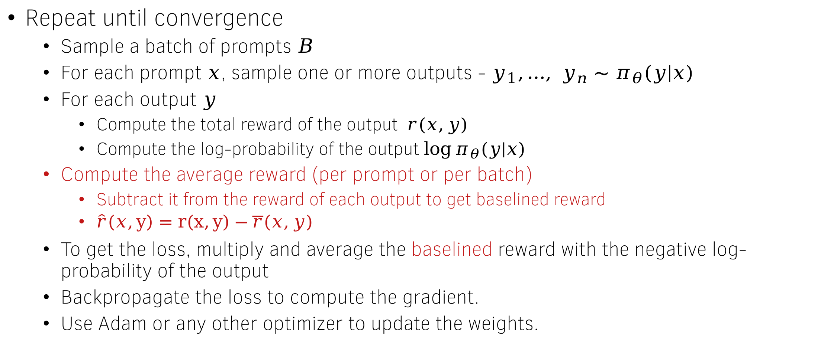
Policy Gradient Algorithm (with baseline)
Repeat until convergence
  Sample a batch of prompts $B$
  For each prompt $x$, sample one or more outputs - $y_{1},…, y_{n}∼π_{θ}(y|x)$
  For each output $y$
    Compute the total reward of the output $r(x,y)$
    Compute the log-probability of the output $\log{π_{θ}(y|x)}$
  Compute the average reward (per prompt or per batch)
    Subtract it from the reward of each output to get baselined reward
    $\hat{r}\left(x,y\right)=r\left(x,y\right)−\overline{r}(x,y)$
  To get the loss, multiply and average the baselined reward with the negative log-probability of the output
  Backpropagate the loss to compute the gradient.
  Use Adam or any other optimizer to update the weights.

Slide 28
Reward Maximization
Best-of-N policy
Reward Maximization Objective Formulation
Vanilla Policy Gradient
  The REINFORCE gradient estimator
  Baseline subtraction
  Final algorithm
Towards Actor/Critic methods
  The problem of credit assignment
  Q-functions, Value functions and advantage
  Estimating the value function and advantage
  Actor-Critic Family of algorithms

Slide 29
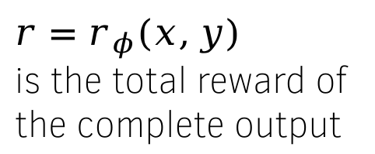






The REINFORCE gradient estimate
Sum & backpropagate
$r=r_{φ}(x,y)$
is the total reward of
the complete output
$$r log{π_{θ}(eot|s_{5})}$$
$$r log{π_{θ}(Mahal|s_{1})}$$
$$r log{π_{θ}(in|s_{3})}$$
$$r log{π_{θ}(Taj|s_{0})}$$
$$r log{π_{θ}(is|s_{2})}$$
$$r log{π_{θ}(Agra|s_{4})}$$
LLM Policy $π_{θ}(a|s_{t})$
User: Where is Taj Mahal? Assistant:
Taj Mahal is in Agra

Slide 30
The problem of credit assignment
The reward of generating a token (like “Taj”) depends on how the future sequence unfolds.
  Example: “Taj Mahal is in Paris” → negative reward.
  Example: “Taj Mahal is in Agra” → positive reward.
This makes credit assignment hard: should “Taj” be encouraged or discouraged?
The Q-function solves this by taking the expected reward of generating “Taj” and then continuing according to the policy.
In other words, the Q-function averages over all possible continuations that follow “Taj,” giving a stable estimate for learning.
The cumulative discounted reward at time t is also known as reward-to-go or return at time t

Slide 31
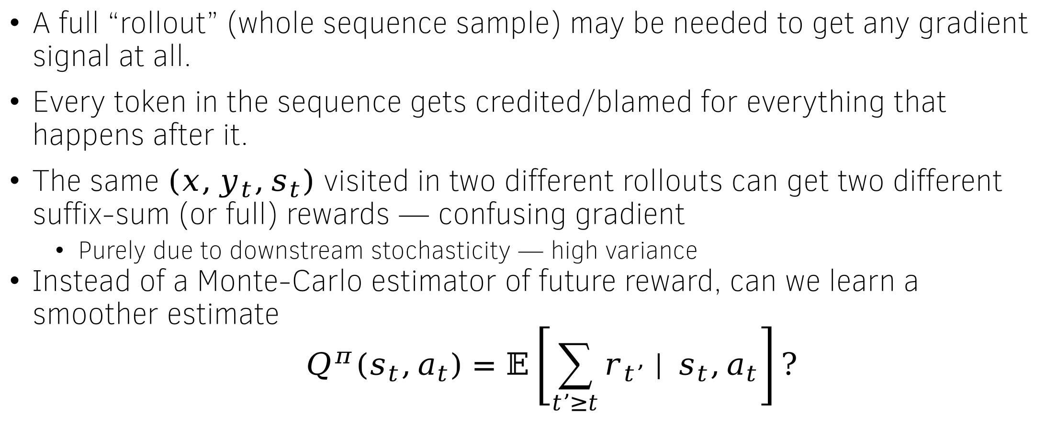
Summary of problems, and a way out
A full “rollout” (whole sequence sample) may be needed to get any gradient signal at all.
Every token in the sequence gets credited/blamed for everything that happens after it.
The same $\left(x,y_{t},s_{t}\right)$ visited in two different rollouts can get two different suffix-sum (or full) rewards — confusing gradient
  Purely due to downstream stochasticity — high variance
Instead of a Monte-Carlo estimator of future reward, can we learn a smoother estimate
$$Q^{π}\left(s_{t},a_{t}\right)=𝔼\left[\sum_{t’≥t}{r_{t’} | }s_{t},a_{t}\right]?$$

Slide 32
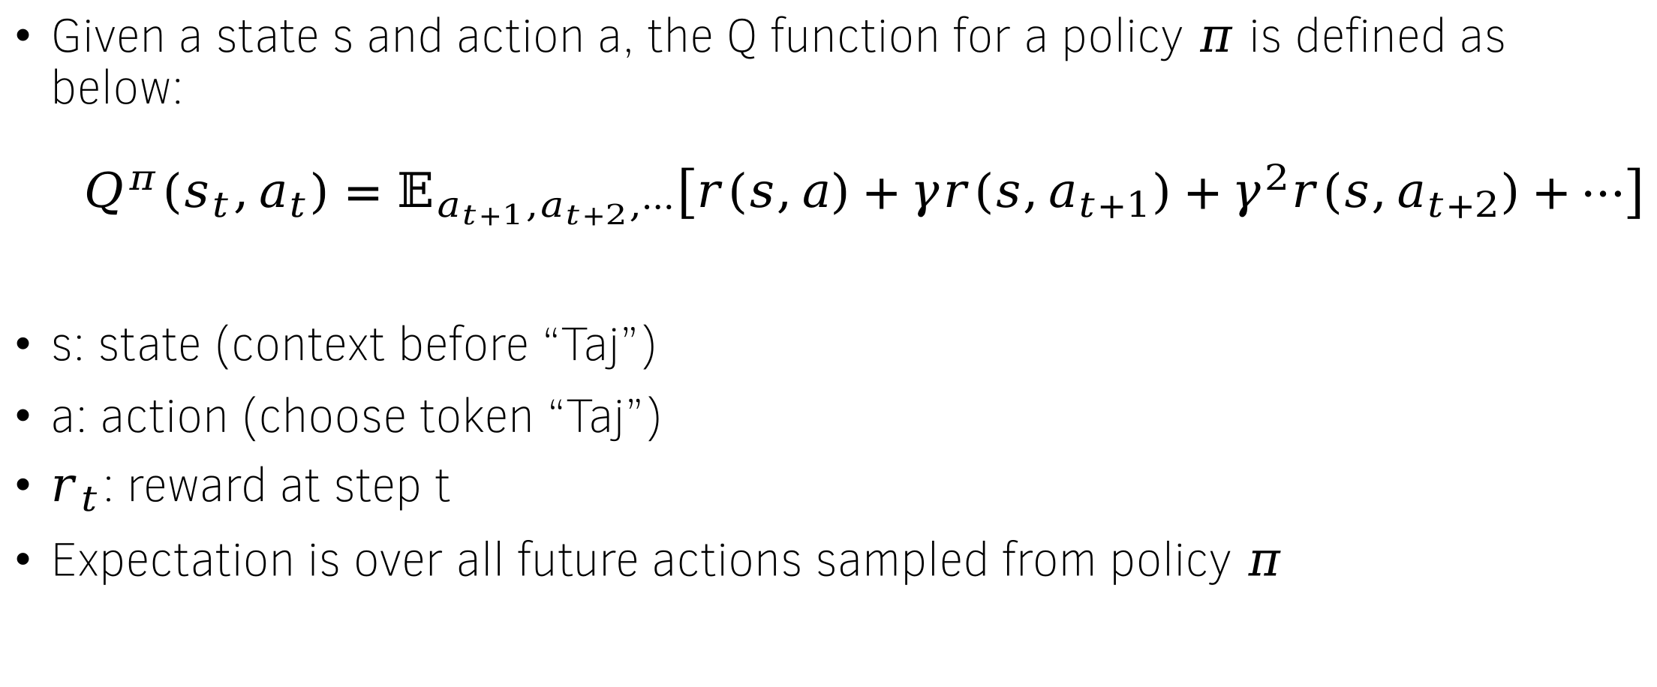
The Q-function
Given a state s and action a, the Q function for a policy $π$ is defined as below:
$$Q^{π}\left(s_{t},a_{t}\right)=𝔼_{a_{t+1},a_{t+2},⋯}\left[r\left(s,a\right)+γr\left(s,a_{t+1}\right)+γ^{2}r\left(s,a_{t+2}\right)+⋯\right]$$
s: state (context before “Taj”)
a: action (choose token “Taj”)
$r_{t}$​: reward at step t
Expectation is over all future actions sampled from policy $π$

Slide 33
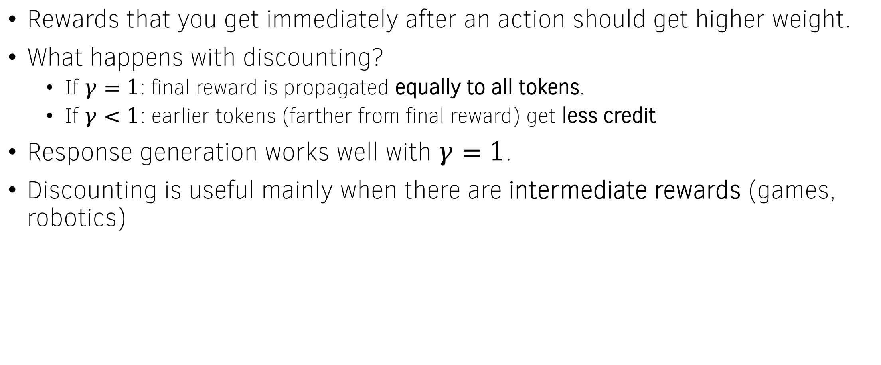
Why discounting?
Rewards that you get immediately after an action should get higher weight.
What happens with discounting?
  If $γ=1$: final reward is propagated equally to all tokens.
  If $γ<1$: earlier tokens (farther from final reward) get less credit
Response generation works well with $γ=1$.
Discounting is useful mainly when there are intermediate rewards (games, robotics)

Slide 34








The Q-function for LLMs
Reward to go $Q$
$a_{2}=$ is
$$r_{3}$$
$$r_{4}$$
$r_{2}$ = 0
$$r_{5}$$
LLM Policy $π_{θ}(a|s_{t})$
User: Where is Taj Mahal? Assistant: Taj Mahal
$$s_{2}$$

Slide 35
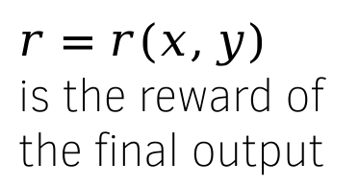





REINFORCE gradient estimation with Q functions
Sum & backpropagate
$r=r(x,y)$
is the reward of
the final output
$$Q^{π_{θ}}(s_{1}, Mahal) log{π_{θ}(Mahal|s_{1})}$$
$$Q^{π_{θ}}(s_{3}, in) log{π_{θ}(in|s_{3})}$$
$$Q^{π_{θ}}(s_{5},eot) log{π_{θ}(eot|s_{5})}$$
$$Q^{π_{θ}}(s_{0}, Taj) log{π_{θ}(Taj|s_{0})}$$
$$Q^{π_{θ}}(s_{2}, is) log{π_{θ}(is|s_{2})}$$
$$Q^{π_{θ}}(s_{4},Agra) log{π_{θ}(Agra|s_{4})}$$
LLM Policy $π_{θ}(a|s_{t})$
User: Where is Taj Mahal? Assistant:
Taj Mahal is in Agra
Doesn’t matter what gets generated in the future. The “reward” at token “Taj” is fixed.

Slide 36
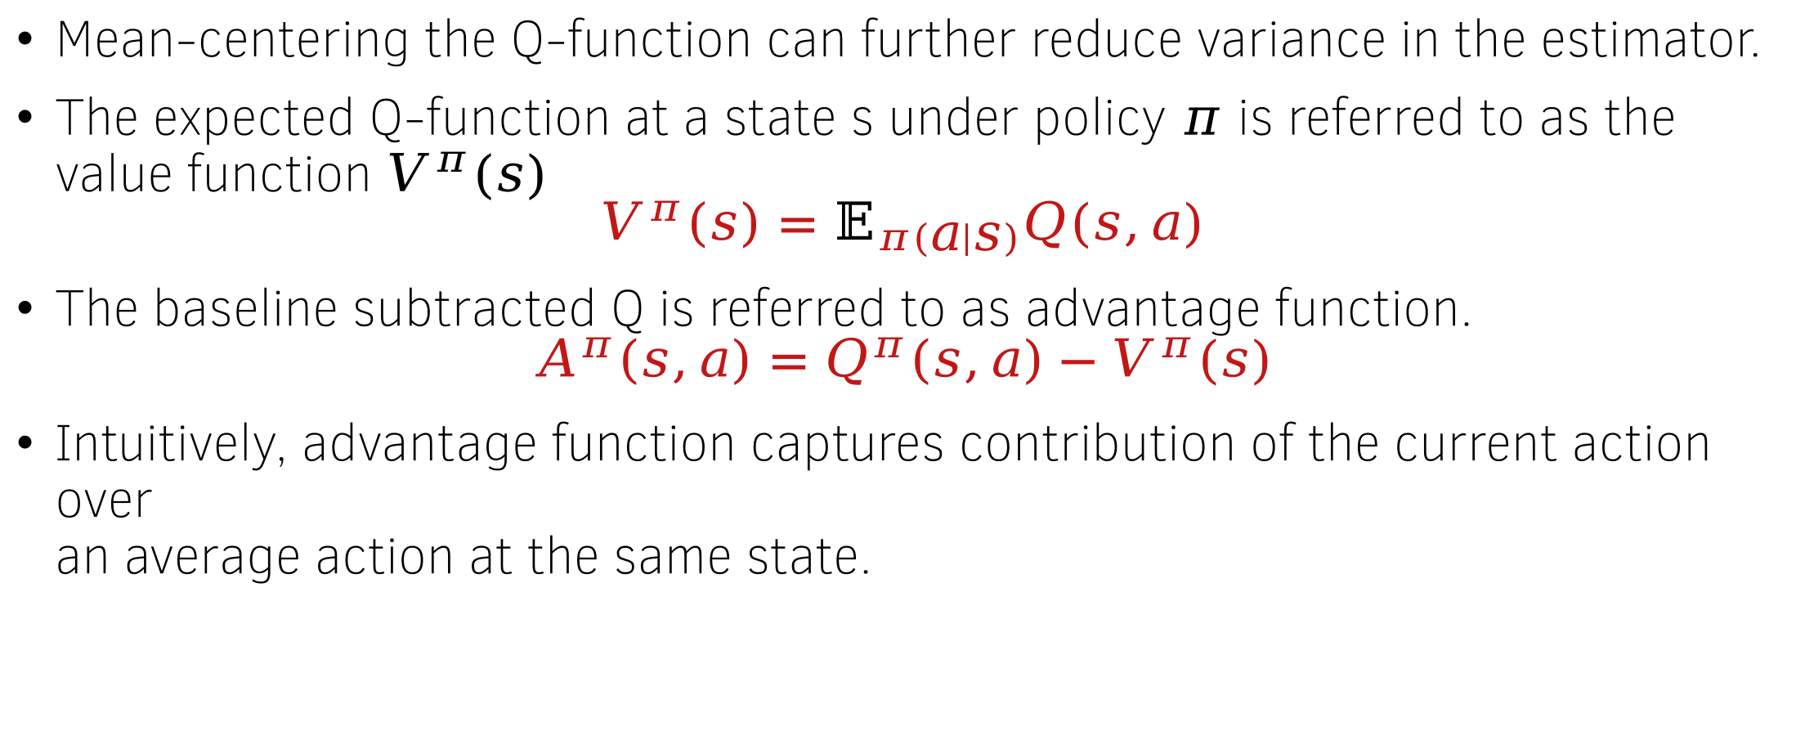
Value function – A baseline for the Q function
Mean-centering the Q-function can further reduce variance in the estimator.
The expected Q-function at a state s under policy $π$ is referred to as the value function $V^{π}(s)$
$$V^{π}\left(s\right)=𝔼_{π\left(a | s\right)}Q(s,a)$$
The baseline subtracted Q is referred to as advantage function.
$$A^{π}\left(s,a\right)=Q^{π}\left(s,a\right)−V^{π}(s)$$
Intuitively, advantage function captures contribution of the current action over
an average action at the same state.

Slide 37





REINFORCE with advantage functions
Sum & backpropagate
$$A^{π_{θ}}(s_{1}, Mahal) log{π_{θ}(Mahal|s_{1})}$$
$$A^{π_{θ}}(s_{3}, in) log{π_{θ}(in|s_{3})}$$
$$A^{π_{θ}}(s_{5},eot) log{π_{θ}(eot|s_{5})}$$
$$A^{π_{θ}}(s_{0}, Taj) log{π_{θ}(Taj|s_{0})}$$
$$A^{π_{θ}}(s_{2}, is) log{π_{θ}(is|s_{2})}$$
$$A^{π_{θ}}(s_{4},Agra) log{π_{θ}(Agra|s_{4})}$$
LLM Policy $π_{θ}(a|s_{t})$
User: Where is Taj Mahal? Assistant:
Taj Mahal is in Agra
Doesn’t matter what gets generated in the future. The “reward” at token “Taj” is fixed.

Slide 38
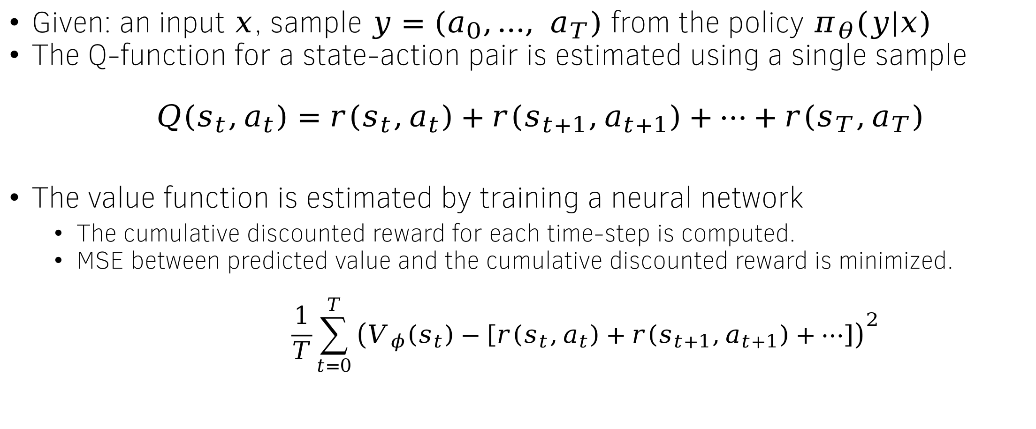
Estimating Q and Value functions for an LLM
Given: an input $x$, sample $y=(a_{0},…, a_{T})$ from the policy $π_{θ}(y|x)$
The Q-function for a state-action pair is estimated using a single sample
$$Q\left(s_{t},a_{t}\right)=r\left(s_{t},a_{t}\right)+r\left(s_{t+1},a_{t+1}\right)+⋯+r\left(s_{T},a_{T}\right)$$
The value function is estimated by training a neural network
  The cumulative discounted reward for each time-step is computed.
  MSE between predicted value and the cumulative discounted reward is minimized.
  $$\frac{1}{T}\sum_{t=0}^{T}{{\left(V_{φ}\left(s_{t}\right)−\left[r\left(s_{t},a_{t}\right)+r\left(s_{t+1},a_{t+1}\right)+⋯\right]\right)}^{2}}$$

Slide 39
















The Value function network $V_{φ}$
$$p(a_{0}|s_{0})$$
$$p(a_{T}|s_{T})$$
$$V(s_{0})$$
$$V(s_{T})$$
Linear
Layer
Linear
Layer
Linear layer
Linear layer
$$embedding(s_{0})$$
$$embedding(s_{T})$$
…….
LLM Policy
$$x_{1}$$
$$x_{2}$$
$$x_{3}$$
$$x_{4}$$
$$x_{5}$$
$$y_{1}$$
$$y_{2}$$
$$y_{3}$$
$$y_{4}$$

Slide 40
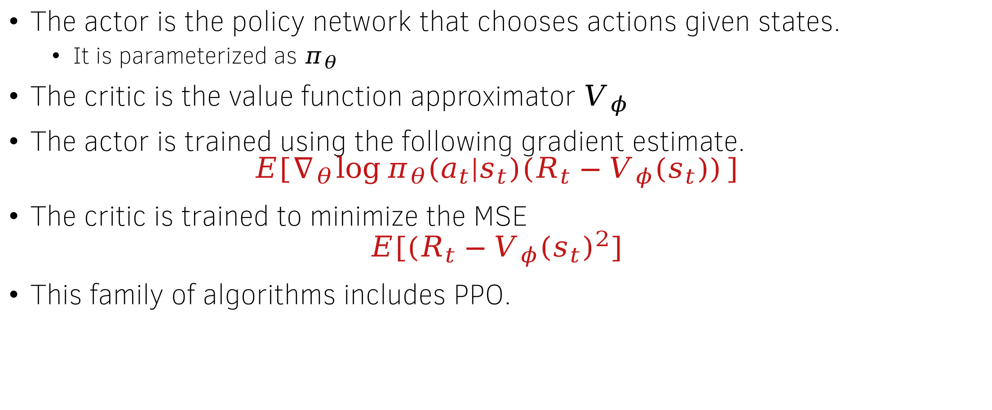
The Actor-Critic Family
The actor is the policy network that chooses actions given states.
  It is parameterized as $π_{θ}$
The critic is the value function approximator $V_{φ}$
The actor is trained using the following gradient estimate.
$$E[∇_{θ}\log{π_{θ}(a_{t}|s_{t})(R_{t}−V_{φ}(s_{t}))}]$$
The critic is trained to minimize the MSE
$$E[(R_{t}−V_{φ}{\left(s_{t}\right)}^{2}]$$
This family of algorithms includes PPO.

