Slide 1

Advances in Large Language Models
ELL8299 · AIL861
Gaurav Pandey
Senior Research Scientist, IBM Research

Slide 2
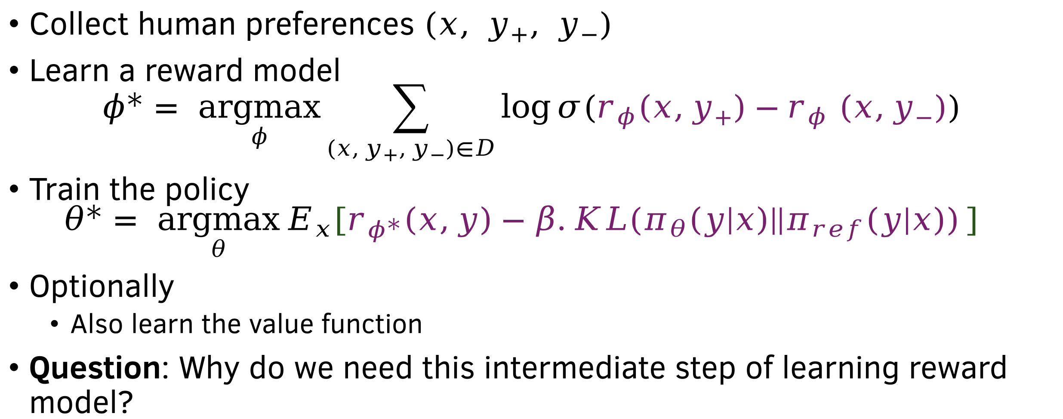
PPO/GRPO for LLM alignment
Collect human preferences $(x, y_{+}, y_{−})$
Learn a reward model
$$φ^{∗}= \underset{φ}{argmax}{\sum_{\left(x,y_{+},y_{−}\right)∈D}{\log{σ(r_{φ}\left(x,y_{+}\right)−r_{φ} (x,y_{−}))}}}$$
Train the policy
$$θ^{∗}= \underset{θ}{argmax}{E_{x}[r_{φ^{∗}}\left(x,y\right)−β.KL(π_{θ}\left(y | x\right)||π_{ref}(y|x))}]$$
Optionally
  Also learn the value function
Question: Why do we need this intermediate step of learning reward model?

Slide 3
Why go beyond PPO/GRPO?
Rollouts are expensive.
Reward Models add bias (trained separately).
Training loop = Complex RL pipeline.
Desire: direct optimization on preference pairs (chosen vs rejected responses).

Slide 4
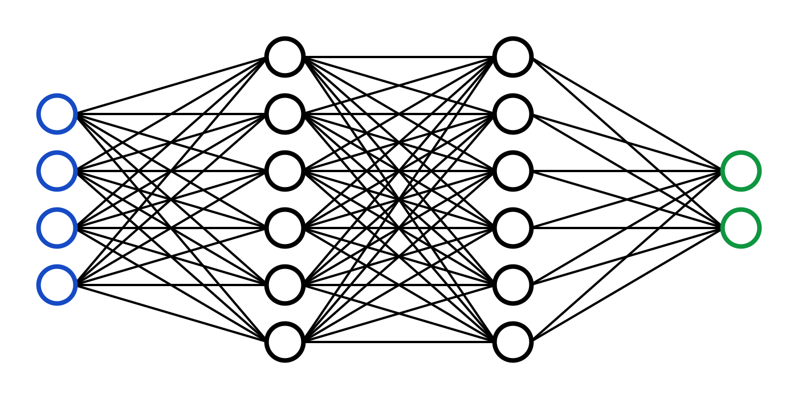
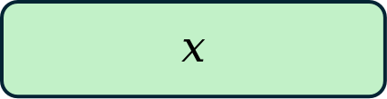



Policy learning without rewards
$$x$$
$$y_{w}$$
$$≻$$
$$y_{l}$$
Maximum
Likelihood
PPO/GRPO
Reward Model
LLM Policy
$$x$$
DPO
$$y_{w}$$
$$≻$$
$$y_{l}$$
Maximum
Likelihood
LLM Policy

Slide 5
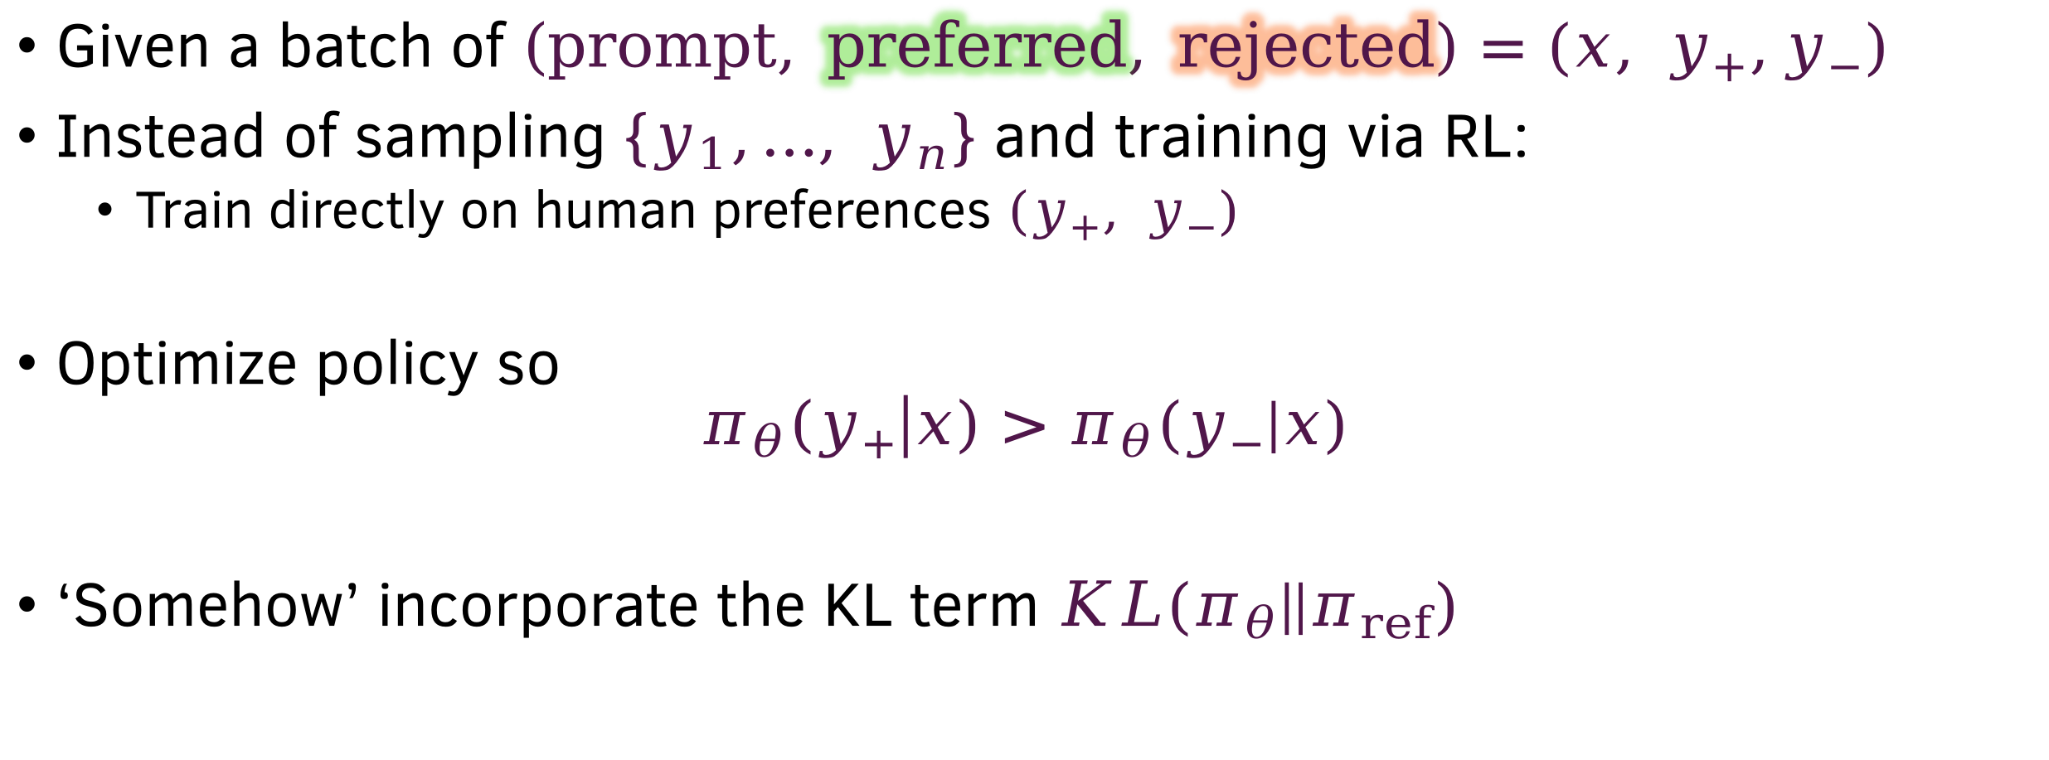
Desirable scenario
Given a batch of $\left(prompt, preferred, rejected\right)=(x, y_{+},y_{−})$
Instead of sampling $\{y_{1},…, y_{n}\}$ and training via RL:
  Train directly on human preferences $(y_{+}, y_{−})$
Optimize policy so
$$π_{θ}\left(y_{+} | x\right)>π_{θ}(y_{−}|x)$$
‘Somehow’ incorporate the KL term $KL(π_{θ}||π_{ref})$

Slide 6
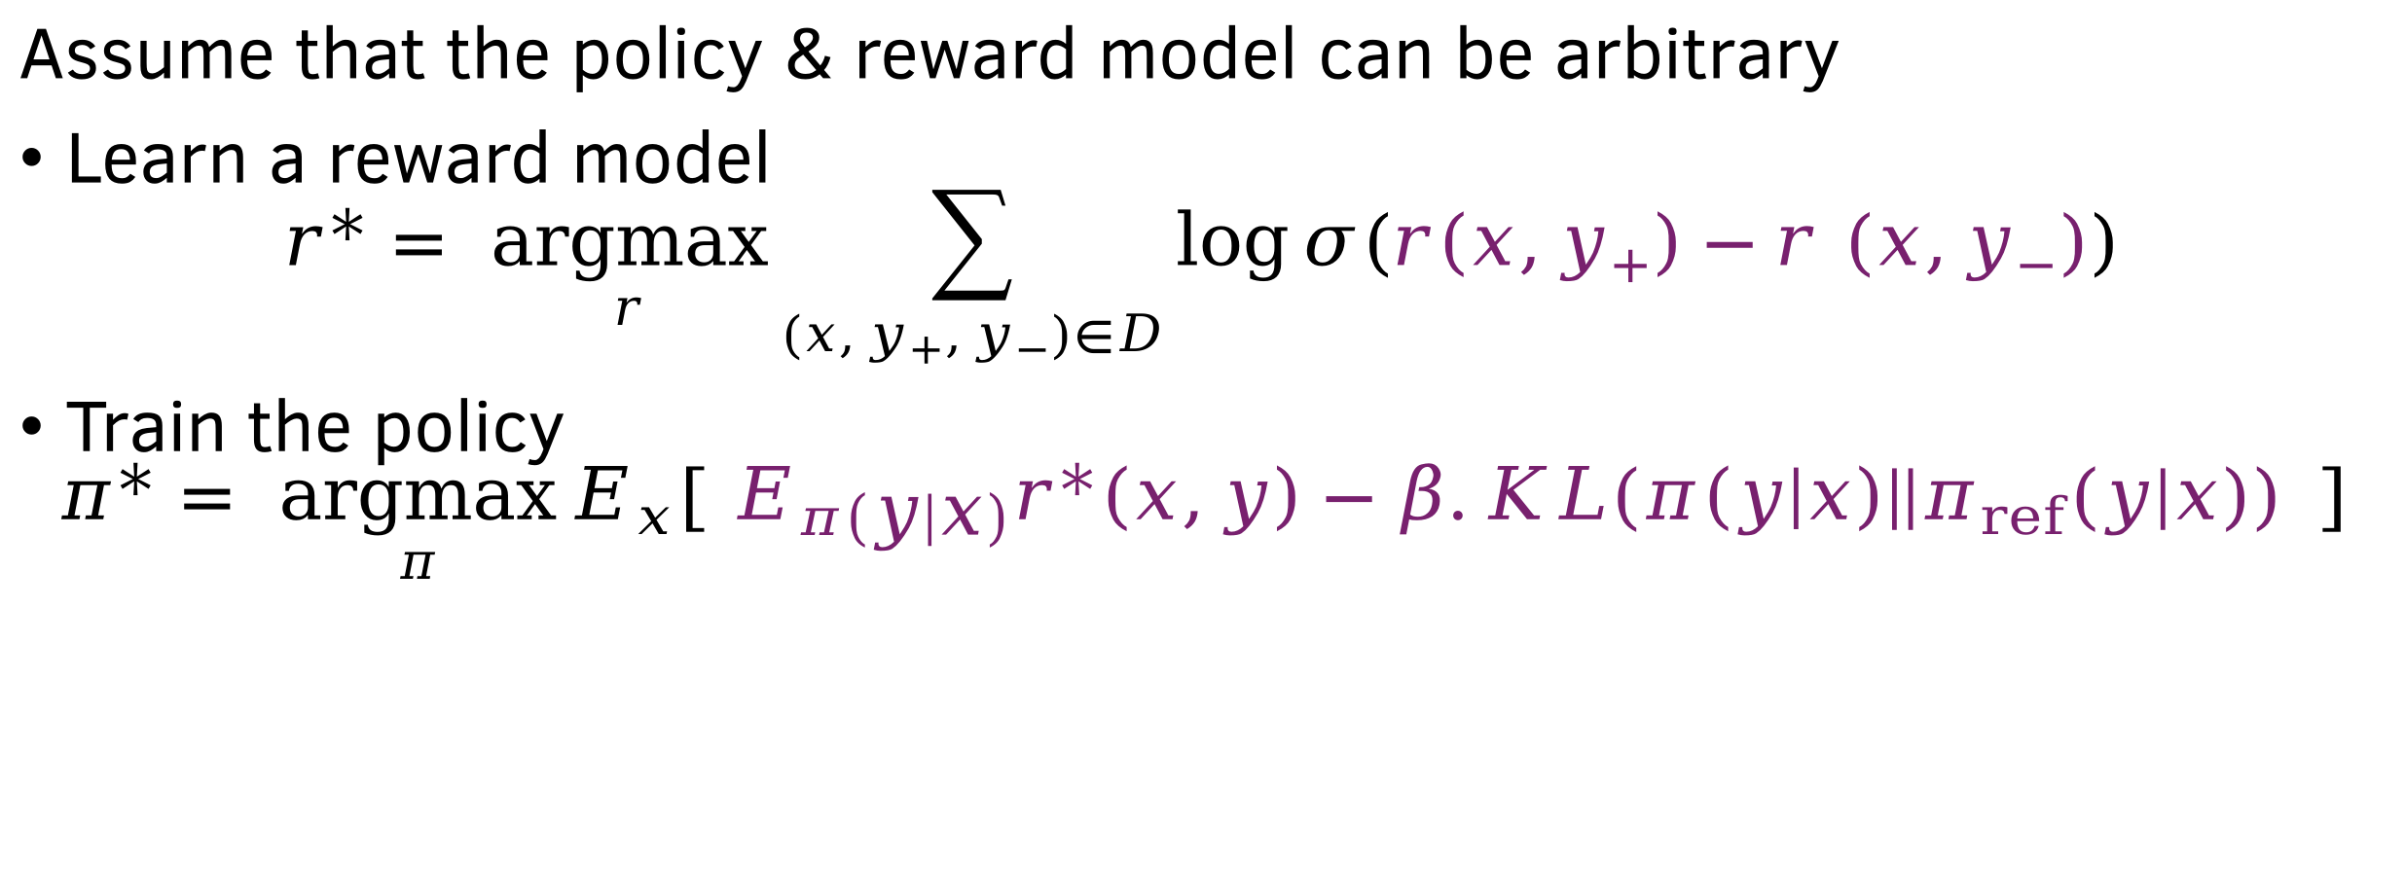
The two optimization problems
Assume that the policy & reward model can be arbitrary
Learn a reward model
$$r^{∗}= \underset{r}{argmax}{\sum_{\left(x,y_{+},y_{−}\right)∈D}{\log{σ(r\left(x,y_{+}\right)−r (x,y_{−}))}}}$$
Train the policy
$$π^{∗}= \underset{π}{argmax}{E_{x}[{ E}_{π\left(y | x\right)}r^{∗}\left(x,y\right)−β.KL(π\left(y | x\right)||π_{ref}(y|x))} ]$$
Primary idea of DPO: Cut out the middle-man $r^{∗}$

Slide 7
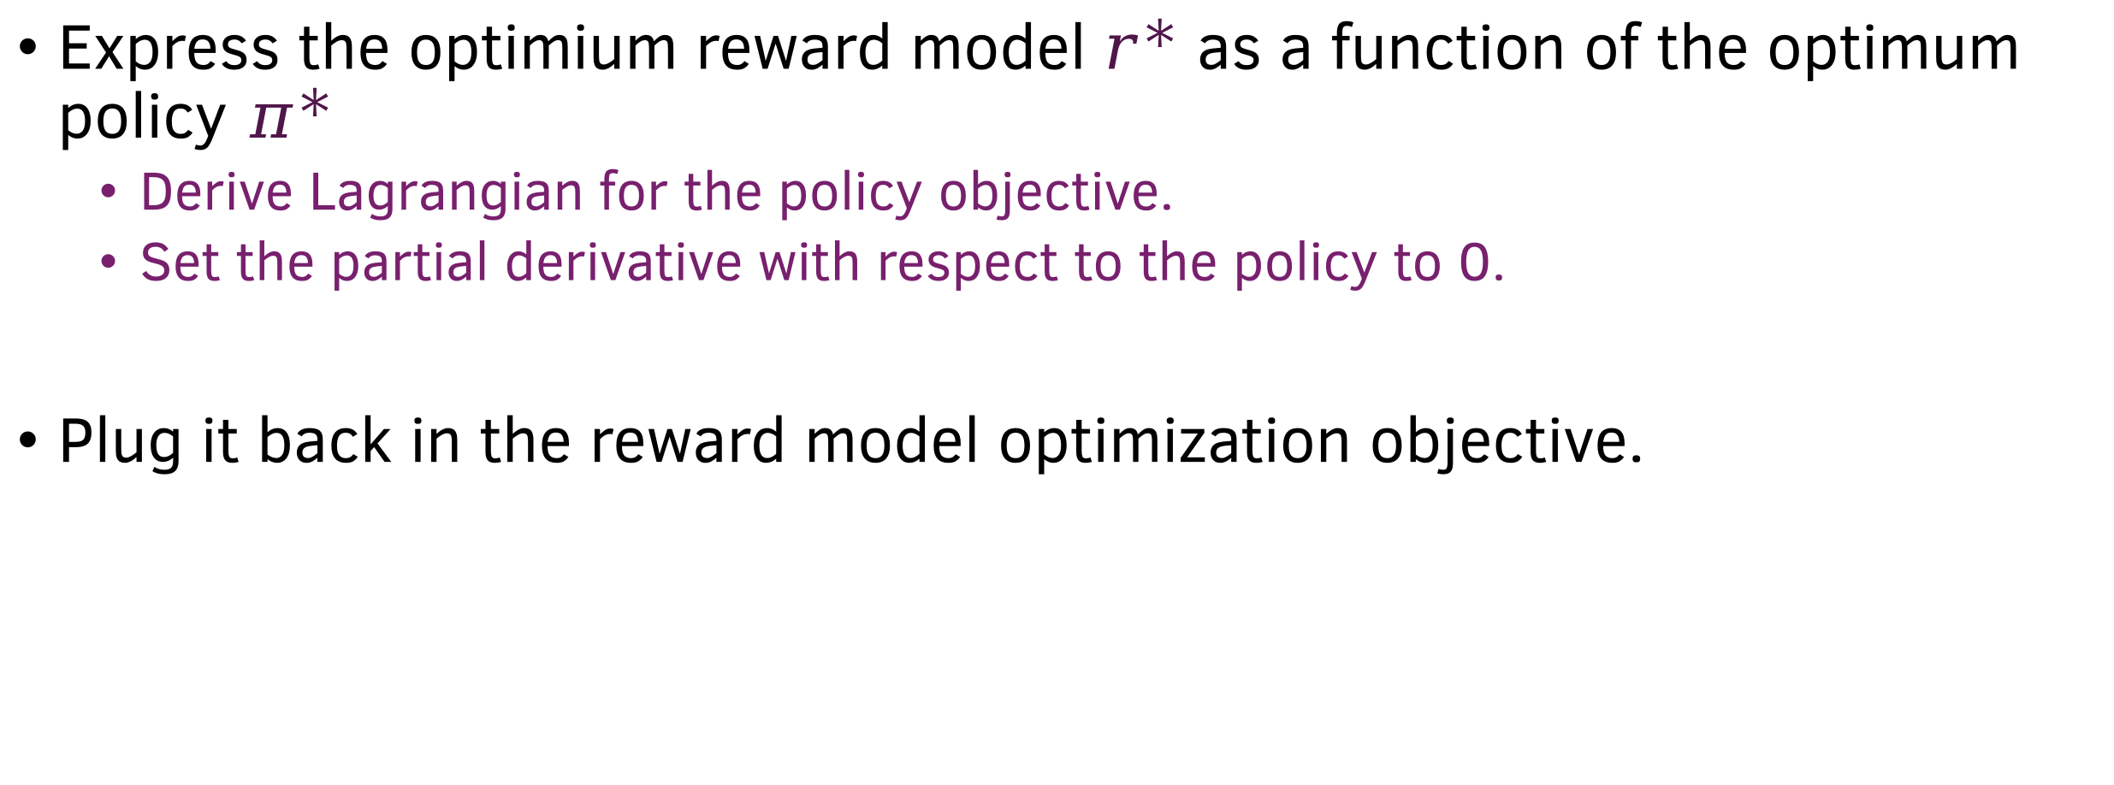
Cutting out the middle man
Express the optimium reward model $r^{∗}$ as a function of the optimum policy $π^{∗}$
  Derive Lagrangian for the policy objective.
  Set the partial derivative with respect to the policy to 0.
Plug it back in the reward model optimization objective.

Slide 8
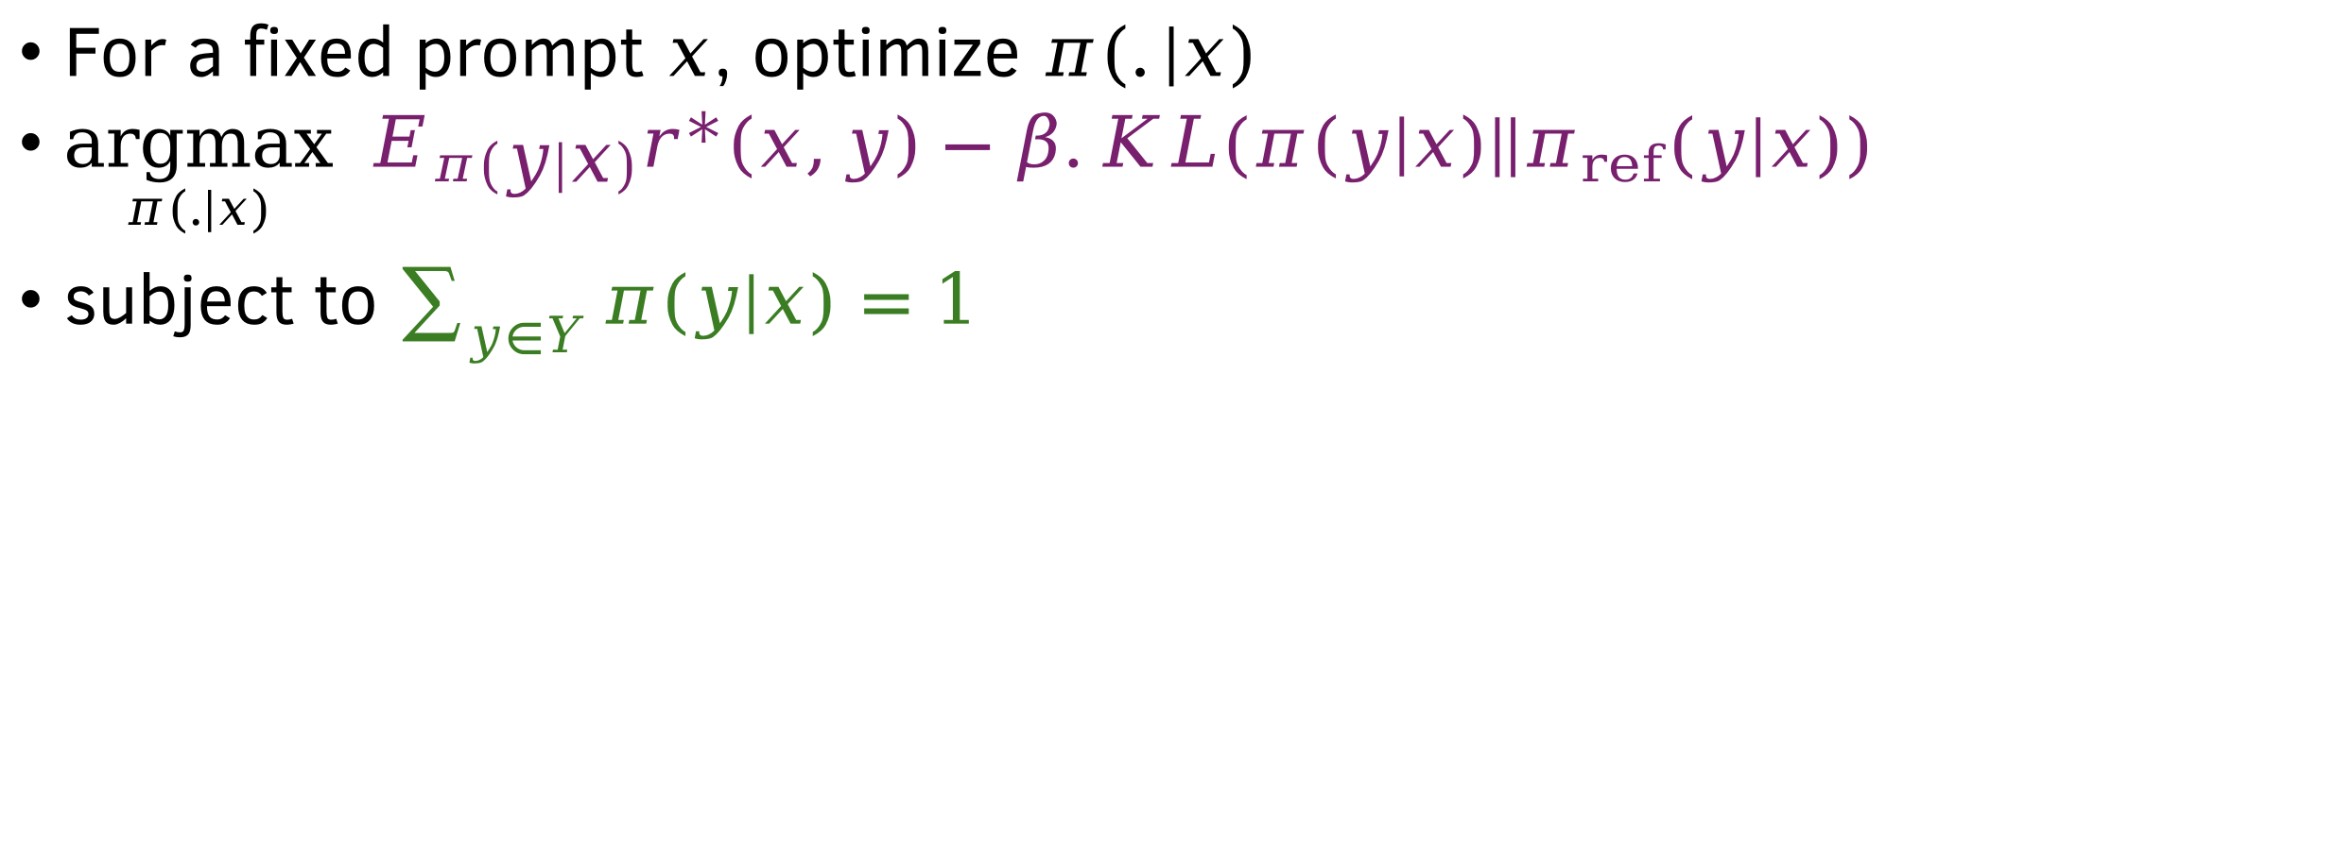
Lagrangian for the policy objective
For a fixed prompt $x$, optimize $π(.|x)$
$\underset{π(.|x)}{argmax}{ E_{π\left(y | x\right)}r^{∗}\left(x,y\right)−β.KL(π\left(y | x\right)||π_{ref}(y|x))}$
subject to $\sum_{y∈Y}{π(y|x)}=1$

Slide 9
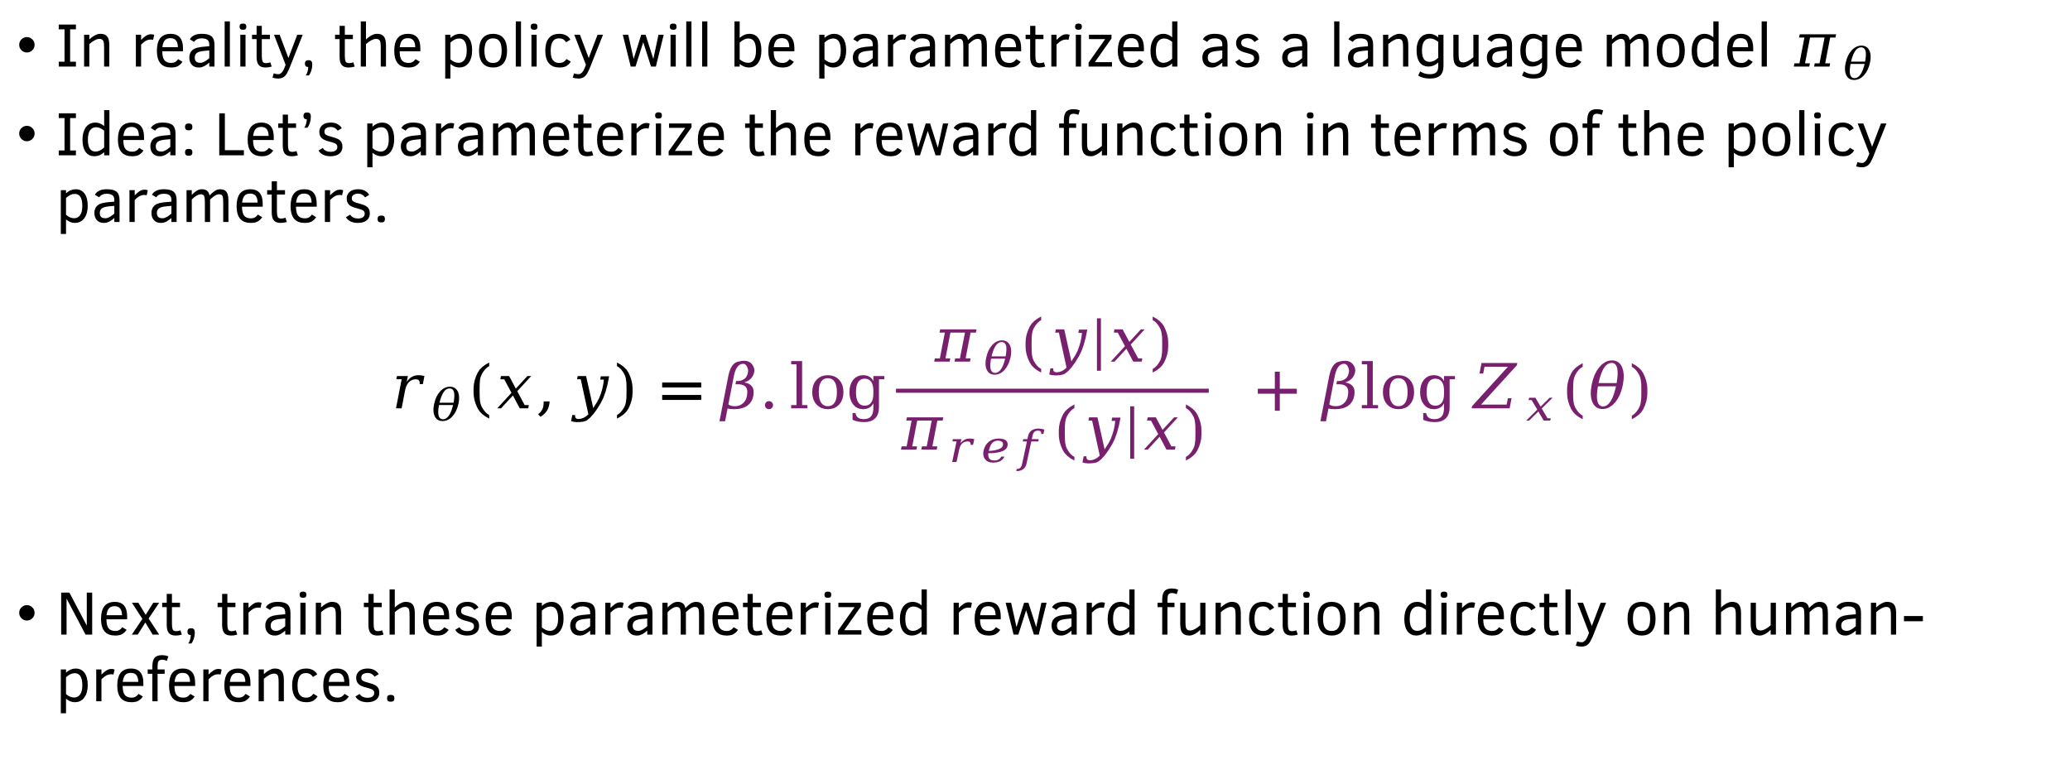

The parametric policy & reward $(π_{θ},r_{θ})$
In reality, the policy will be parametrized as a language model $π_{θ}$
Idea: Let’s parameterize the reward function in terms of the policy parameters.
$$r_{θ}\left(x,y\right)=β.log{\frac{π_{θ}(y|x)}{π_{ref}(y|x)} }+β\log{Z_{x}(θ)}$$
Next, train these parameterized reward function directly on human-preferences.

Slide 10
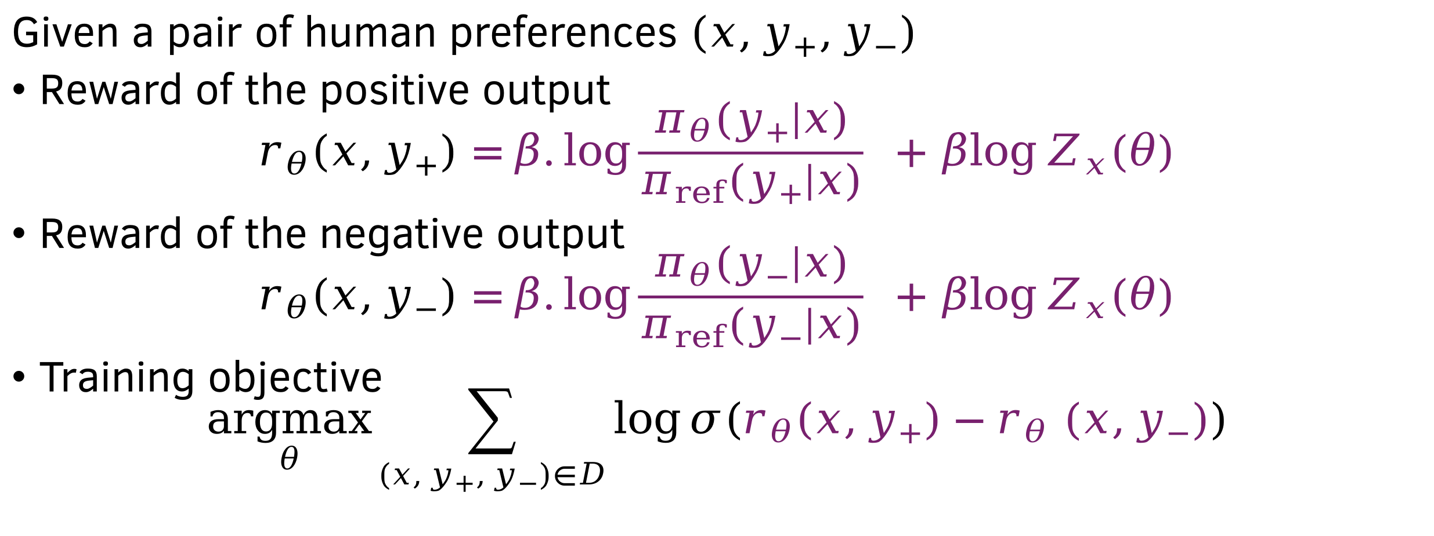
Training the reward function
Given a pair of human preferences $\left(x,y_{+},y_{−}\right)$
Reward of the positive output
$$r_{θ}\left(x,y_{+}\right)=β.log{\frac{π_{θ}(y_{+}|x)}{π_{ref}(y_{+}|x)} }+β\log{Z_{x}(θ)}$$
Reward of the negative output
$$r_{θ}\left(x,y_{−}\right)=β.log{\frac{π_{θ}(y_{−}|x)}{π_{ref}(y_{−}|x)} }+β\log{Z_{x}(θ)}$$
Training objective
$$\underset{θ}{argmax}\sum_{\left(x,y_{+},y_{−}\right)∈D}{\log{σ\left(r_{θ}\left(x,y_{+}\right)−r_{θ} (x,y_{−})\right)}}$$

Slide 11

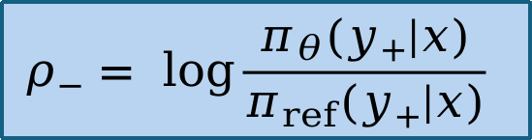
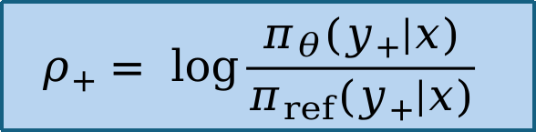
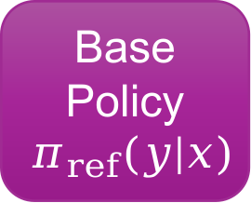
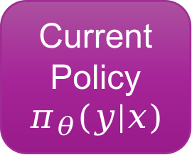


The DPO objective
Current
Policy
$$π_{θ}(y|x)$$
$$ρ_{+}= \log{\frac{π_{θ}(y_{+}|x)}{π_{ref}(y_{+}|x)} }$$
$$(x, y_{+})$$
$$\max{\log{σ(β(ρ_{+}−ρ_{−})) }}$$
$$(x, y_{−})$$
Base
Policy
$$π_{ref}(y|x)$$
$$ρ_{−}= \log{\frac{π_{θ}(y_{+}|x)}{π_{ref}(y_{+}|x)} }$$
Human Preferences

Slide 12
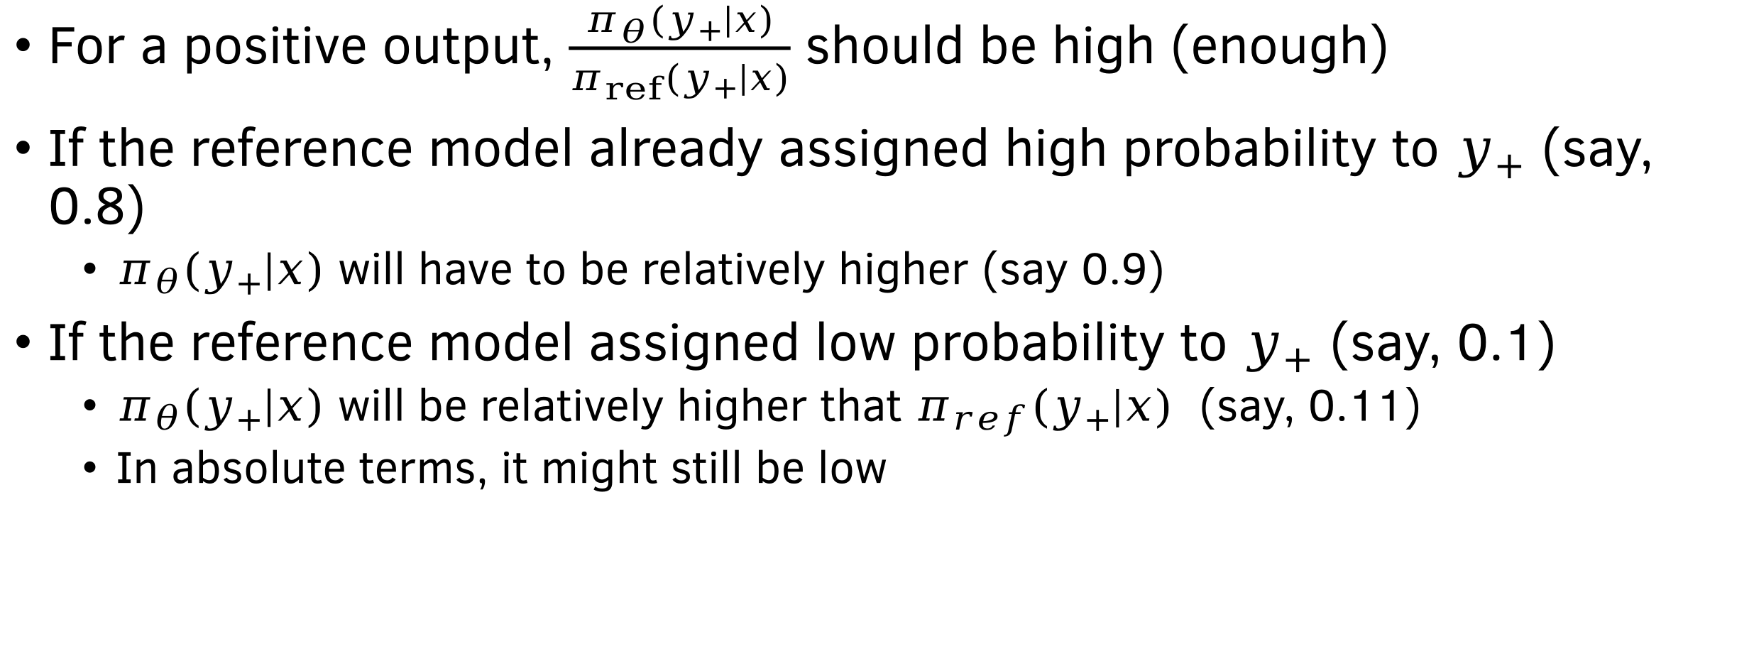
The implicit KL divergence
For a positive output, $\frac{π_{θ}(y_{+}|x)}{π_{ref}(y_{+}|x)}$ should be high (enough)
If the reference model already assigned high probability to $y_{+}$ (say, 0.8)
  $π_{θ}(y_{+}|x)$ will have to be relatively higher (say 0.9)
If the reference model assigned low probability to $y_{+}$ (say, 0.1)
  $π_{θ}\left(y_{+} | x\right)$ will be relatively higher that $π_{ref}(y_{+}|x)$ (say, 0.11)
  In absolute terms, it might still be low

Slide 13
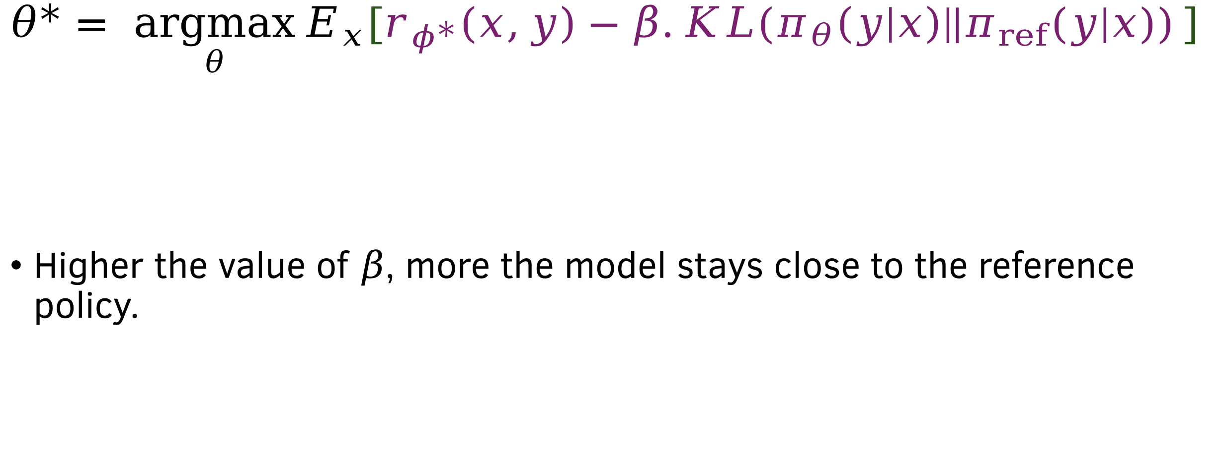

Interpreting $β$ in the RLHF objective
$$θ^{∗}= \underset{θ}{argmax}{E_{x}[r_{φ^{∗}}\left(x,y\right)−β.KL(π_{θ}\left(y | x\right)||π_{ref}(y|x))}]$$
Higher the value of $β$, more the model stays close to the reference policy.

Slide 14
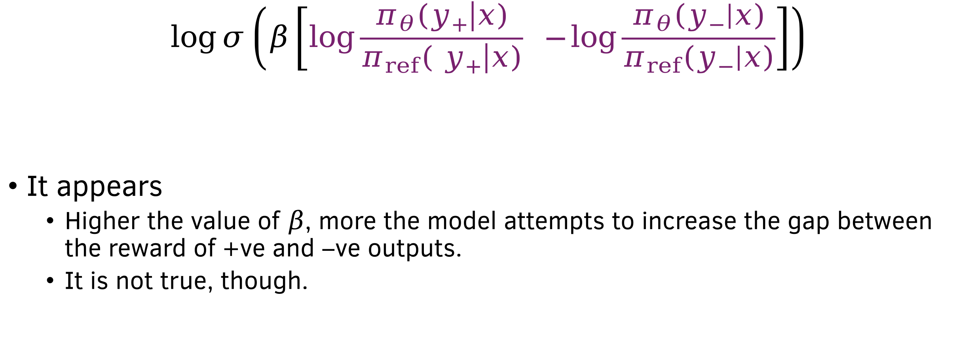

Interpreting $β$ in the DPO objective
$$\log{σ\left(β\left[\log{\frac{π_{θ}\left(y_{+} | x\right)}{π_{ref}\left( y_{+} | x\right)}} −\log{\frac{π_{θ}\left(y_{−} | x\right)}{π_{ref}\left(y_{−} | x\right)}}\right]\right)}$$
It appears
  Higher the value of $β$, more the model attempts to increase the gap between the reward of +ve and –ve outputs.
  It is not true, though.

Slide 15
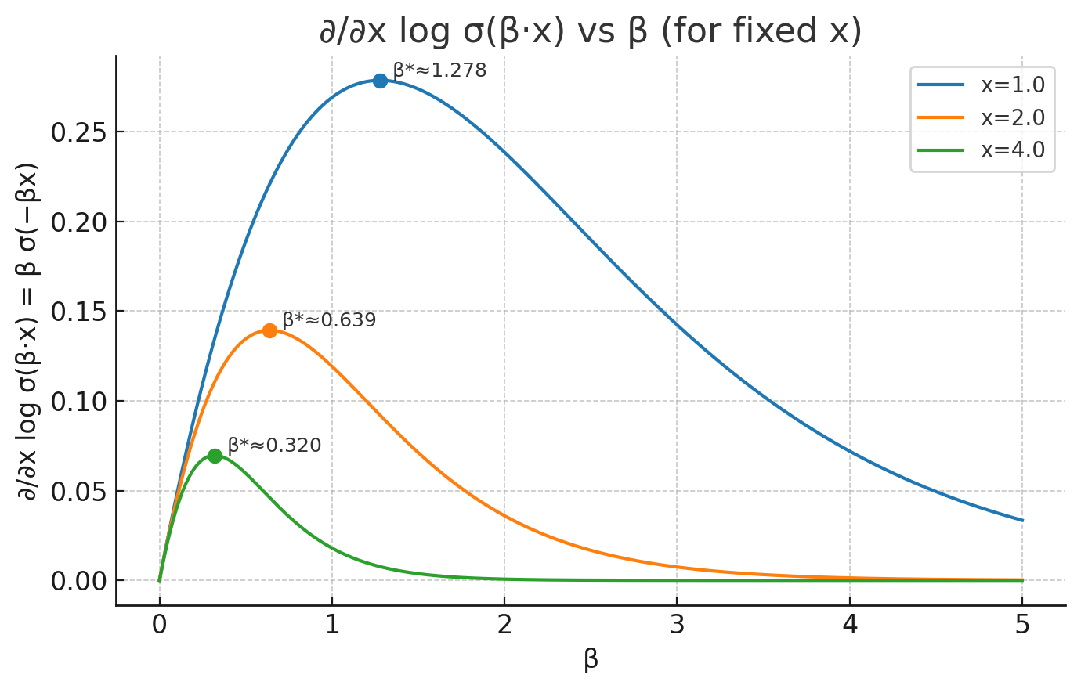
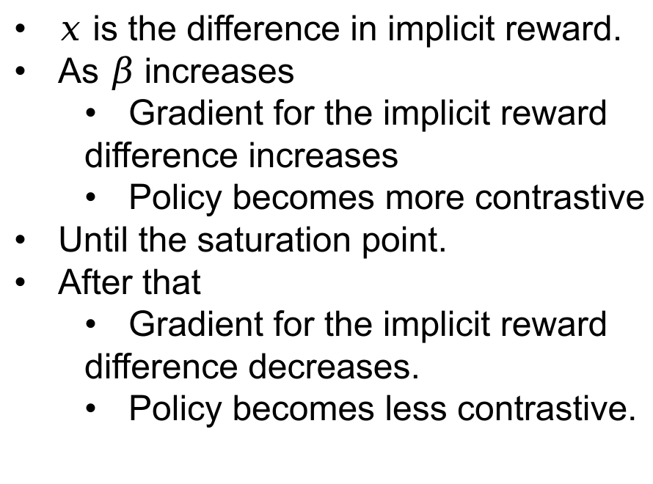
Does higher beta lead to a more contrastive policy?
$x$ is the difference in implicit reward.
As $β$ increases
  Gradient for the implicit reward
  difference increases
  Policy becomes more contrastive
Until the saturation point.
After that
  Gradient for the implicit reward
  difference decreases.
  Policy becomes less contrastive.

Slide 16
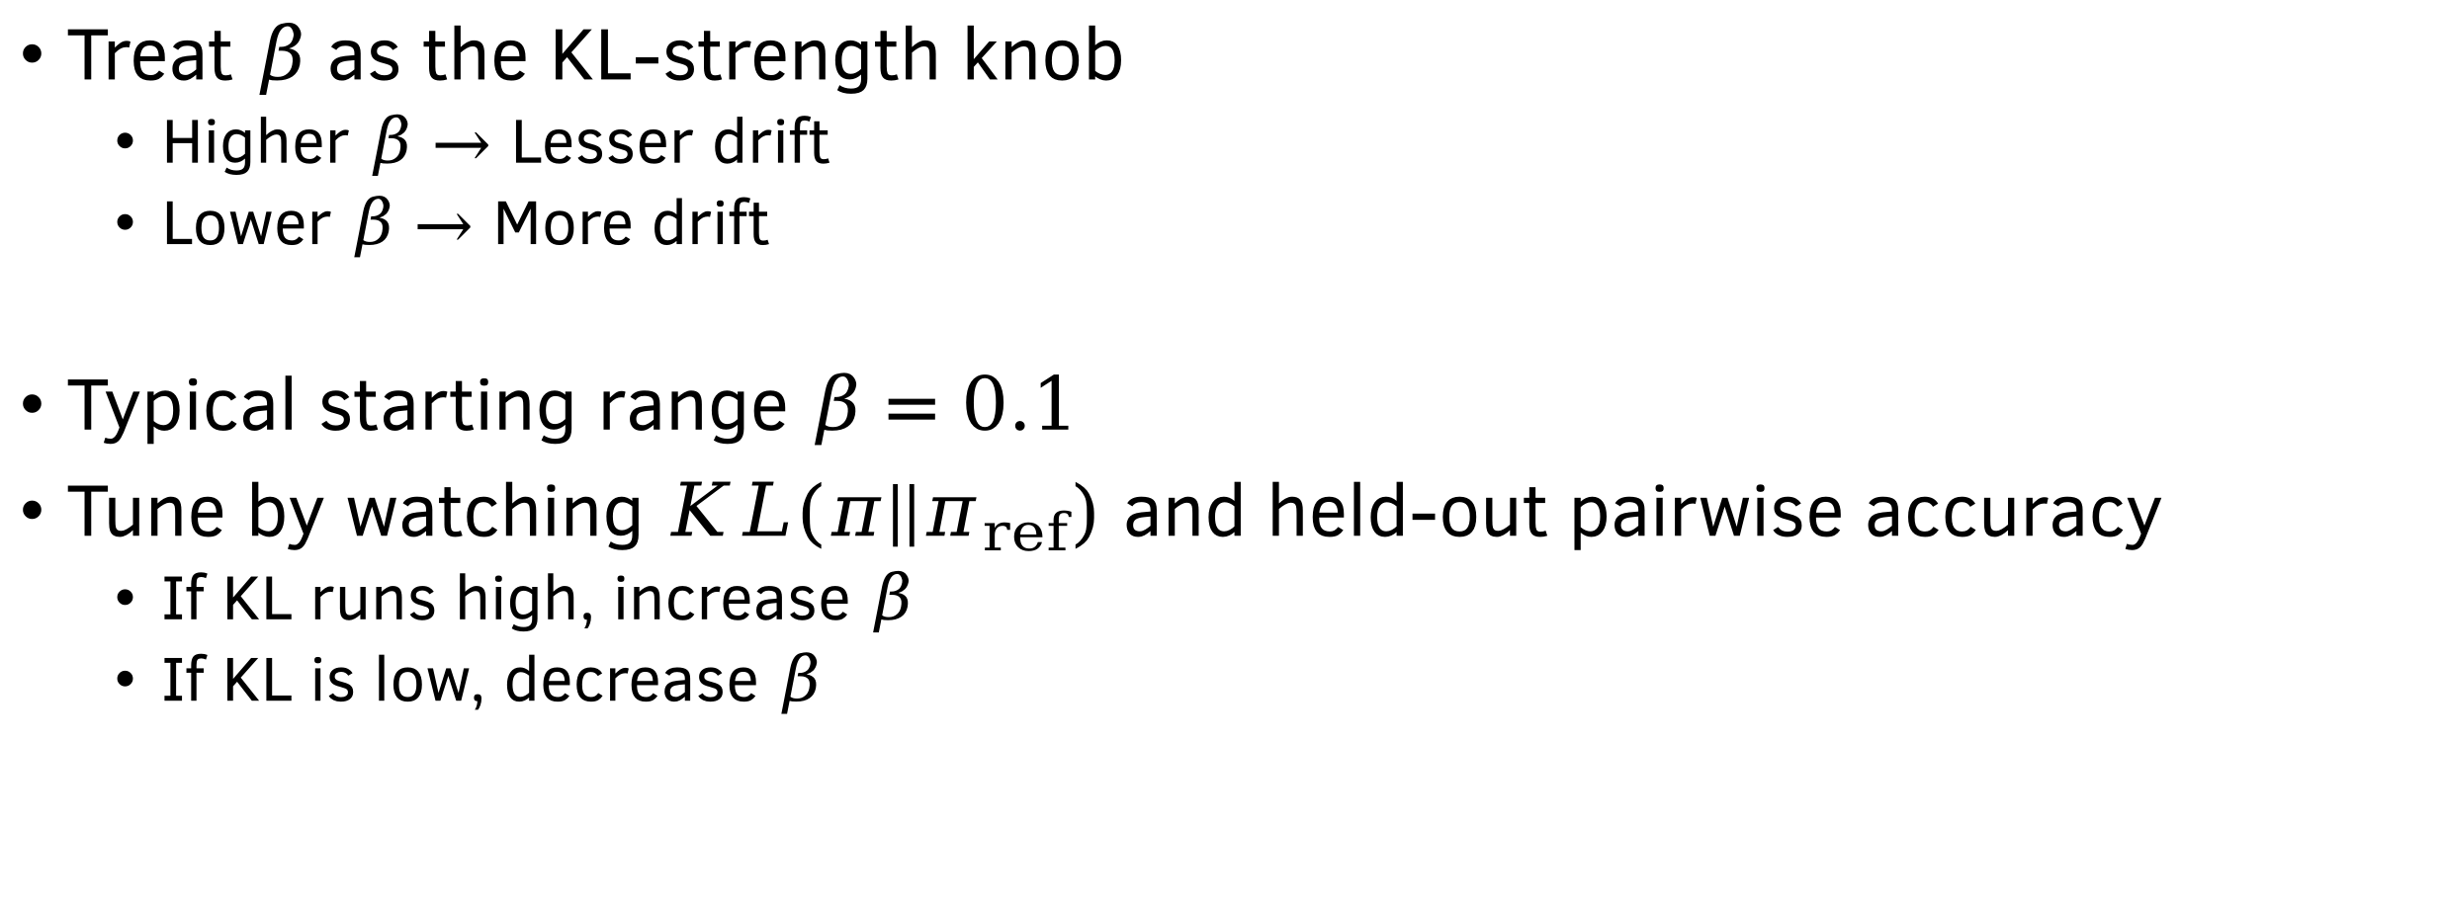
Practical tip
Treat $β$ as the KL-strength knob
  Higher $β→$ Lesser drift
  Lower $β→$ More drift
Typical starting range $β=0.1$
Tune by watching $KL(π||π_{ref})$ and held-out pairwise accuracy
  If KL runs high, increase $β$
  If KL is low, decrease $β$

Slide 17
PPO vs DPO – Reward/Preference hacking
PPO
Problem- Model finds adversarial shortcuts to inflate RM scores
Solution
  Ensembling reward models
  Enforcing diversity in output space.
DPO
Problem – Model captures unimportant differences between the preferences
Solution
  Curate hard, diverse preference pairs – not easy to hack
  Add SFT loss on +ve preference

Slide 18
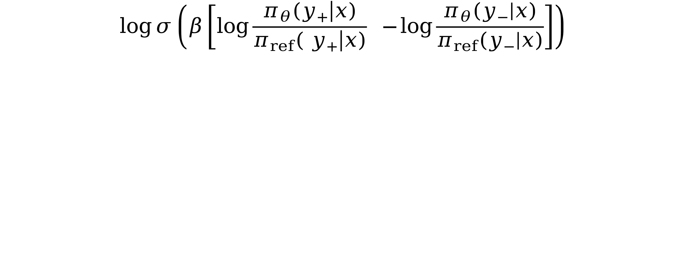
Why is DPO biased?
$$\log{σ\left(β\left[\log{\frac{π_{θ}\left(y_{+} | x\right)}{π_{ref}\left( y_{+} | x\right)}} −\log{\frac{π_{θ}\left(y_{−} | x\right)}{π_{ref}\left(y_{−} | x\right)}}\right]\right)}$$

Slide 19


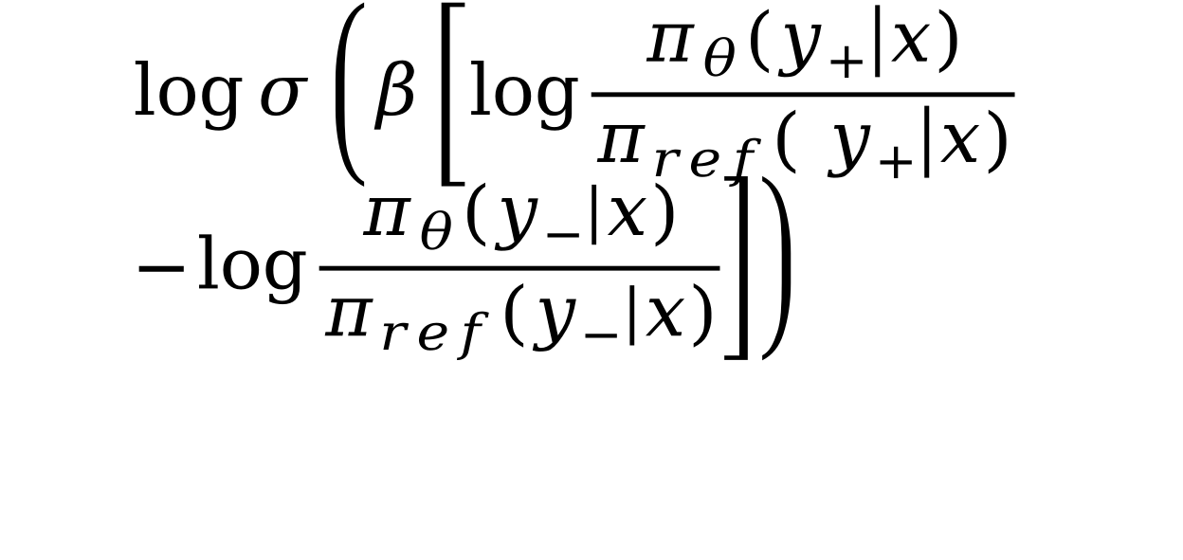
Why is DPO biased?
$$\log{σ\left(β\left[\log{\frac{π_{θ}\left(y_{+} | x\right)}{π_{ref}\left( y_{+} | x\right)}} −\log{\frac{π_{θ}\left(y_{−} | x\right)}{π_{ref}\left(y_{−} | x\right)}}\right]\right)}$$
$$π_{ref}\left(y_{o} | x\right)=0$$
0.5
0.5
Say $y_{0}=(the, the, the)$

Slide 20

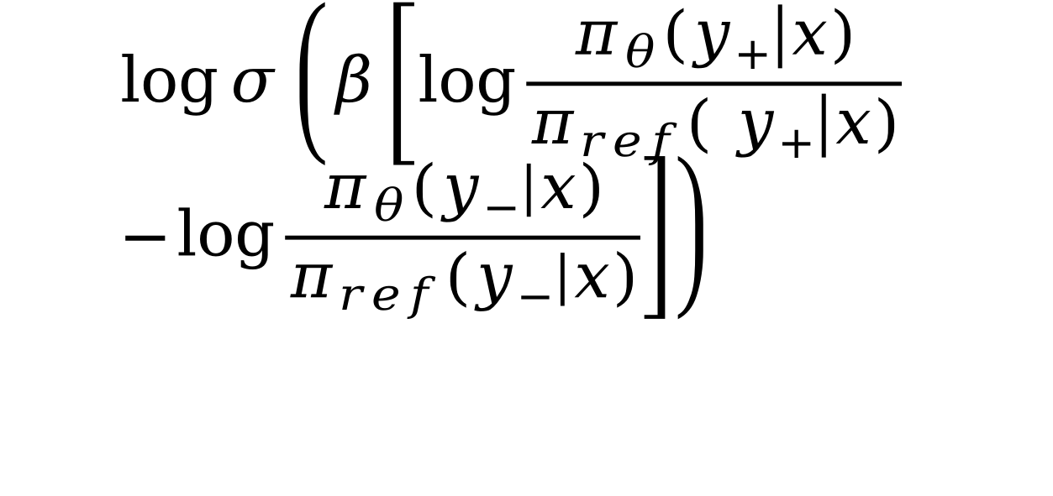
Why is DPO biased?
At the beginning of training
0.5
0.5
$$π_{θ}\left(y_{o} | x\right)=0$$
$$\log{σ\left(β\left[\log{\frac{π_{θ}\left(y_{+} | x\right)}{π_{ref}\left( y_{+} | x\right)}} −\log{\frac{π_{θ}\left(y_{−} | x\right)}{π_{ref}\left(y_{−} | x\right)}}\right]\right)}$$
After few steps of training, either $π_{θ}\left(y_{+} | x\right)$ will increase or $π_{θ}\left(y_{−} | x\right)$will decrease

Slide 21

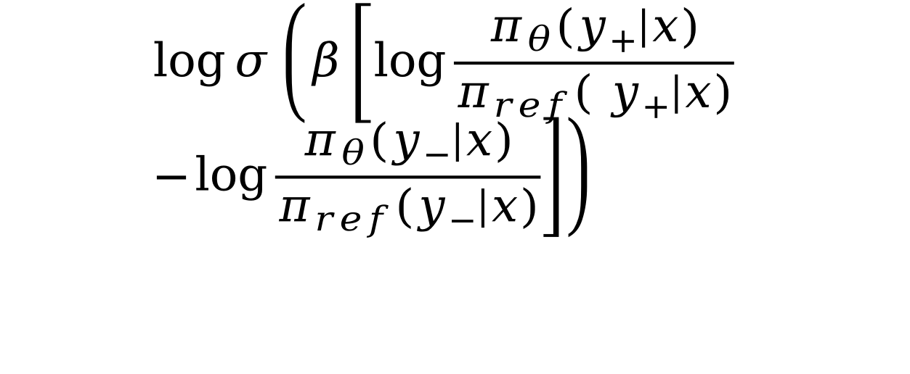
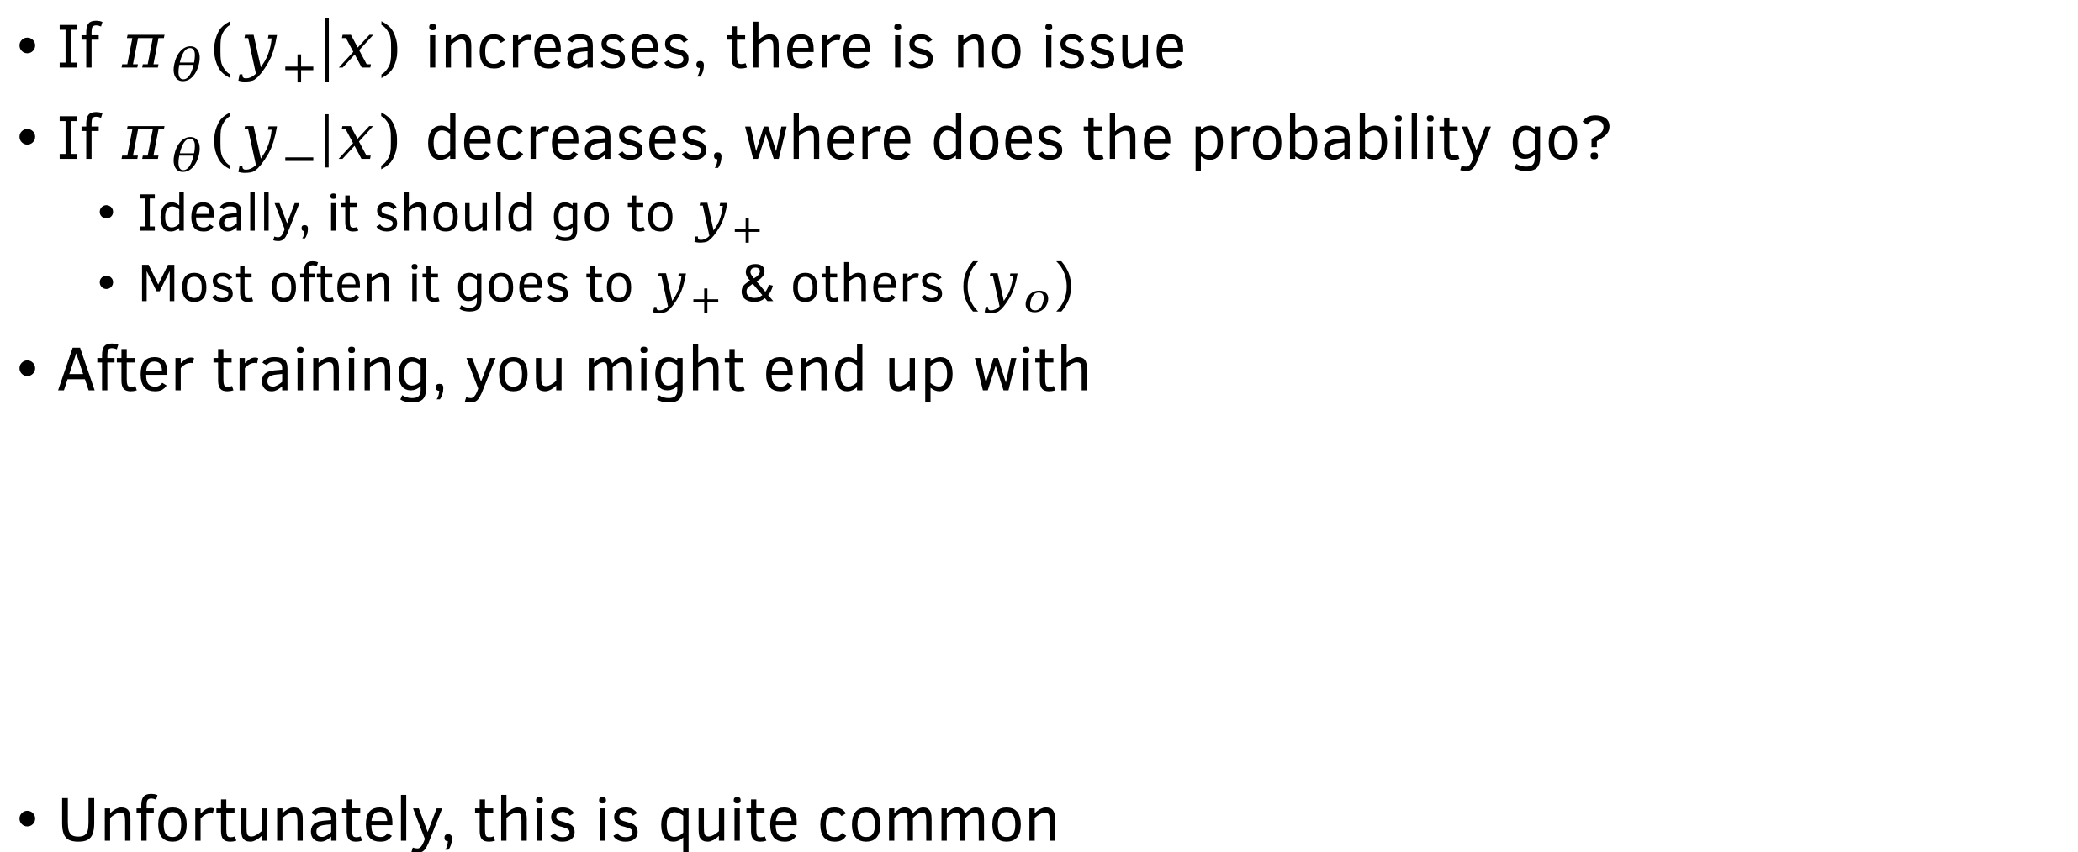
Why is DPO biased?
If $π_{θ}\left(y_{+} | x\right)$increases, there is no issue
If $π_{θ}\left(y_{−} | x\right)$decreases, where does the probability go?
  Ideally, it should go to $y_{+}$
  Most often it goes to $y_{+}$ & others ($y_{o}$)
After training, you might end up with
Unfortunately, this is quite common
0.6
0.1
$$π_{θ}\left(y_{o} | x\right)=0.3$$
$$\log{σ\left(β\left[\log{\frac{π_{θ}\left(y_{+} | x\right)}{π_{ref}\left( y_{+} | x\right)}} −\log{\frac{π_{θ}\left(y_{−} | x\right)}{π_{ref}\left(y_{−} | x\right)}}\right]\right)}$$
Say $y_{0}=(the, the, the)$

Slide 22
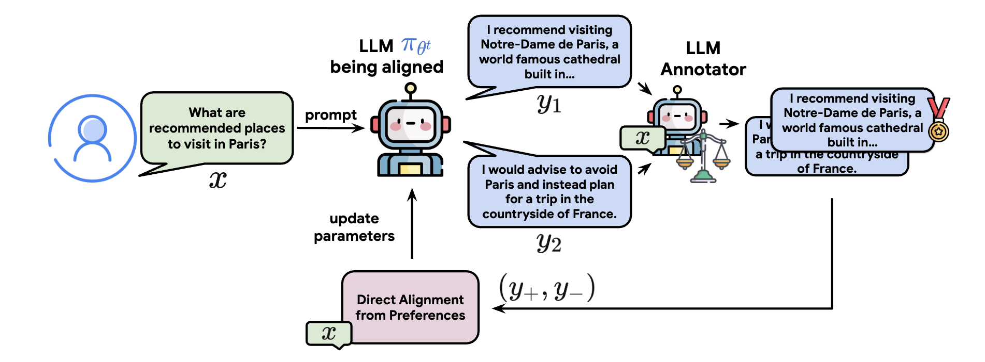
How to deal with out-of-distribution bias in DPO?
If the probability of a certain OOD output increases
  It gets sampled in online DPO
  Gets a low reward
  Its probability decreases
Resampling should be done frequently to prevent OOD bias
Possible Solution: Online DPO
Open Problem: How to deal with out-of-distribution bias in offline DPO?
Credit: Direct Language Model Alignment from Online AI Feedback

Slide 23
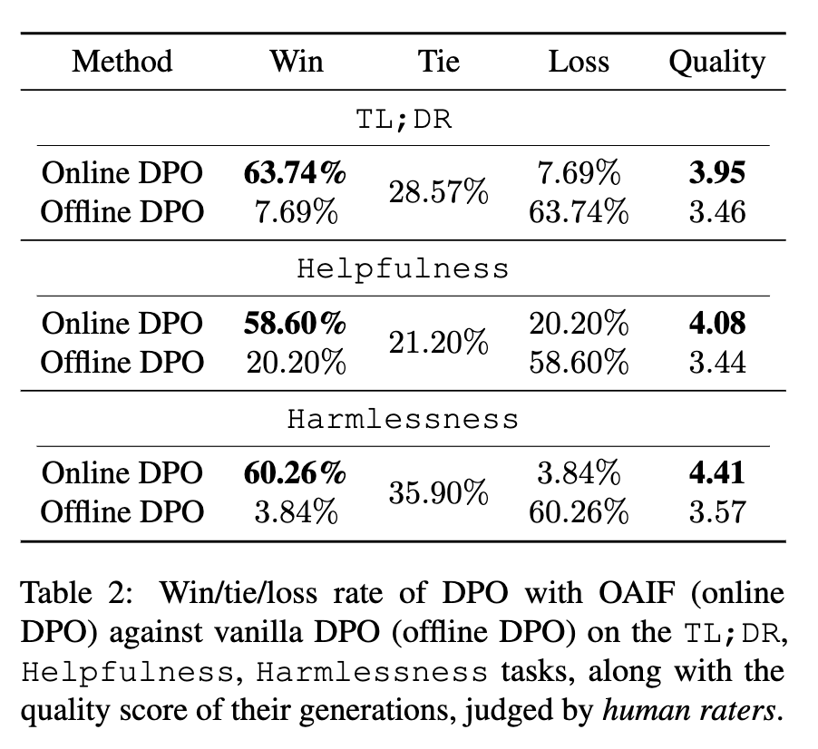
Performance Comparison: Offline vs Online DPO
Credit: Direct Language Model Alignment from Online AI Feedback

Slide 24
Main Takeaways
DPO can learn the policy directly from human/AI preferences
  No reward model or value function needed
Can capture unimportant differences between the preferences
Can be biased towards OOD samples
To prevent bias
  A reward model can be trained
  Outputs can be sampled frequently from the policy and ranked using the reward model

Slide 25
Resources
Direct Preference Optimization: Your Language Model is Secretly a Reward Model
Direct Preference Optimization Explained In-depth - https://www.tylerromero.com/posts/2024-04-dpo
Direct Language Model Alignment from Online AI Feedback
https://huggingface.co/docs/trl/main/en/online_dpo_trainer
DPO from scratch - https://github.com/0xallam/Direct-Preference-Optimization

