Slide 1
Retrieval Augmented
Language Models
CS728
Soumen Chakrabarti
Yatin Nandwani

Slide 2
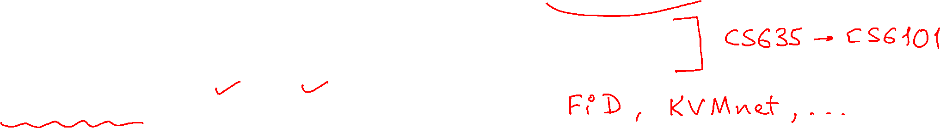
Outline
Motivation
  Drawbacks of Parametric LLMs – hallucination, verification …
  Motivating Retrieval-based LLMs – close book vs open book
Major components of Retrieval-based LLMs – index, retrieve, read …
Retrieval Methods – sparse, dense, reranking, black-box
kNN, RETRO, REALM, RAG – seminal works
Overview of Training Techniques – independent, sequential, joint training ...
Limitations – lost in the middle, still hallucinating, retriever failures ...

Slide 3
Outline
Motivation
  Drawbacks of Parametric LLMs – hallucination, verification …
  Motivating Retrieval-based LLMs – close book vs open book
Major components of Retrieval-based LLMs – index, retrieve, read …
Retrieval Methods – sparse, dense, reranking, black-box
kNN, RETRO, REALM, RAG – seminal works
Overview of Training Techniques – independent, sequential, joint training ...
Limitations – lost in the middle, still hallucinating, retriever failures ...

Slide 4

Parametric LLMs – amazing creative writers!

Slide 5
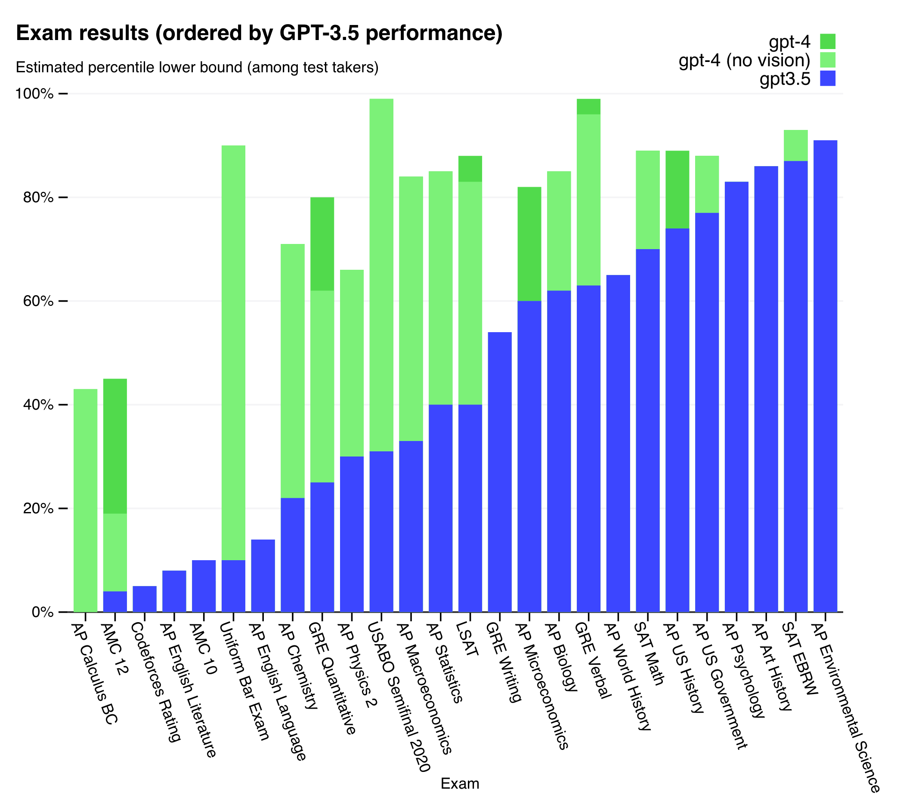
Parametric LLMs: stellar exam performance!
OpenAI – GPT-4 Technical Report
https://arxiv.org/abs/2303.08774
Slide source: https://drive.google.com/file/d/1YUpp7L1SCK6jgdfFObsqHKXrq6HC-TLp/view

Slide 6
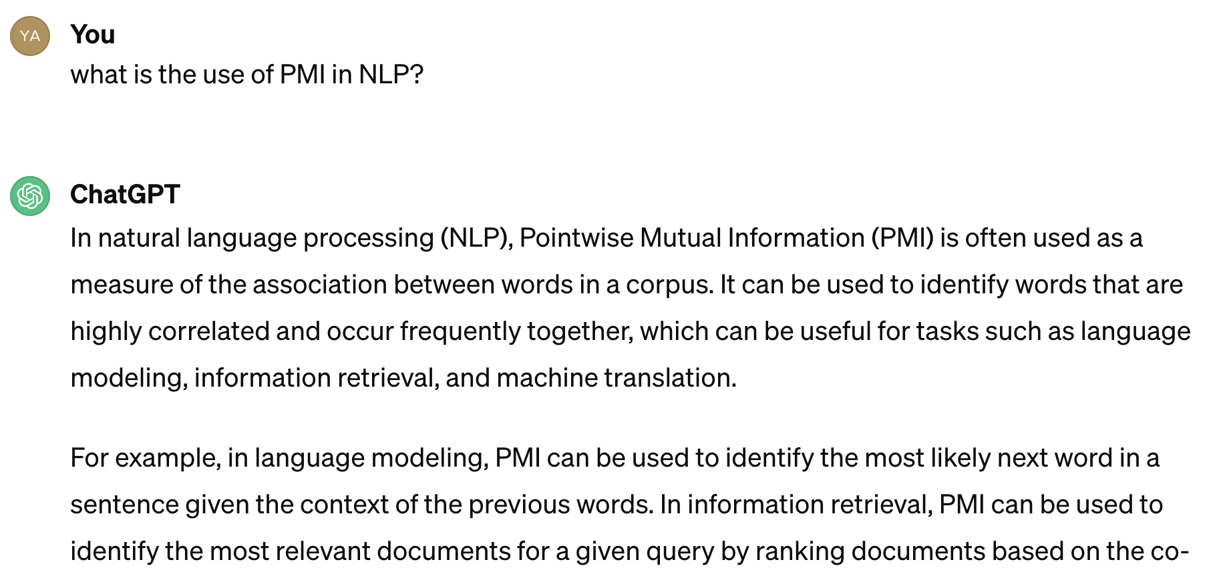
Hallucinations in parametric LLMs

Slide 7
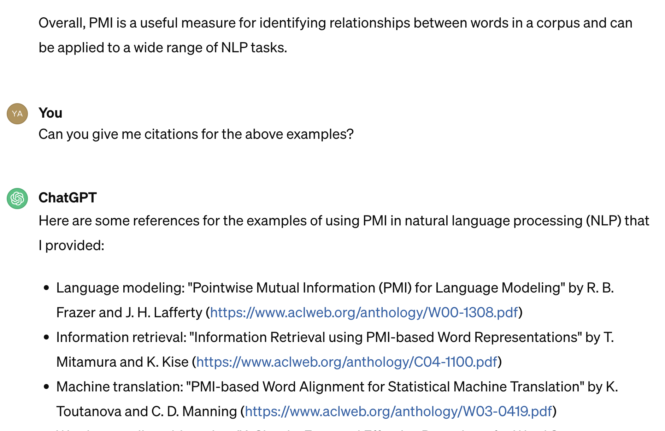
Hallucinations in Parametric LLMs

Slide 8
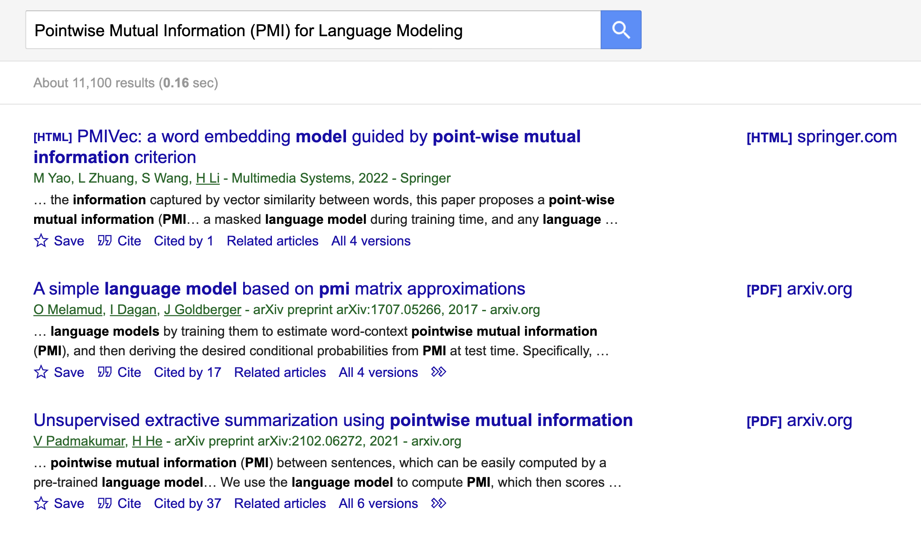
Hallucinations in Parametric LLMs

Slide 9

Hallucinations in parametric LLMs

Slide 10

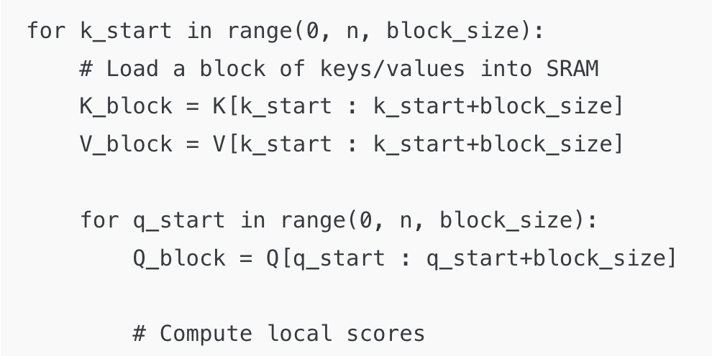
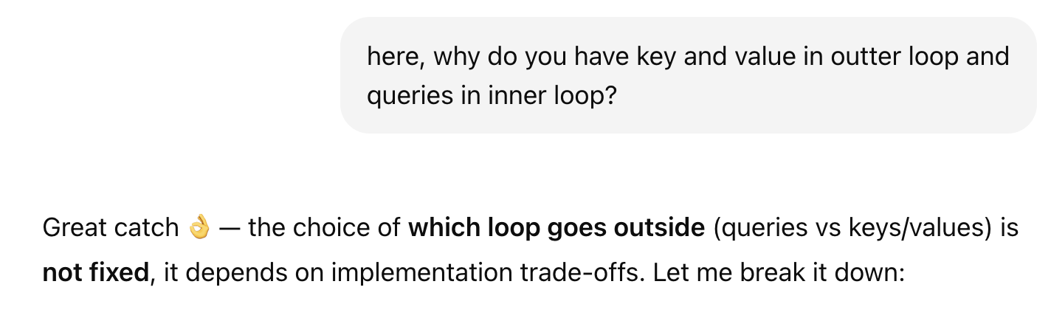
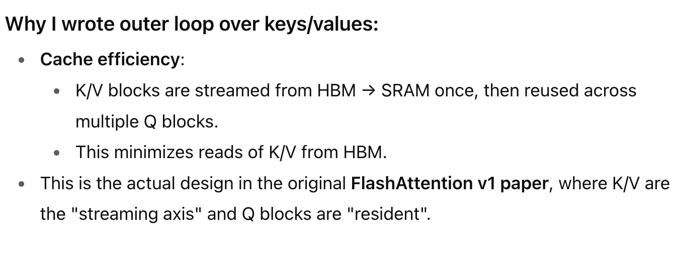
Hallucinations in parametric LLMs

Slide 11
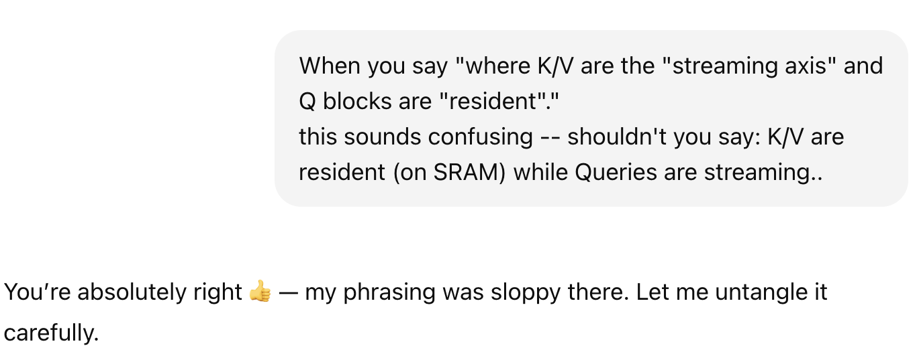
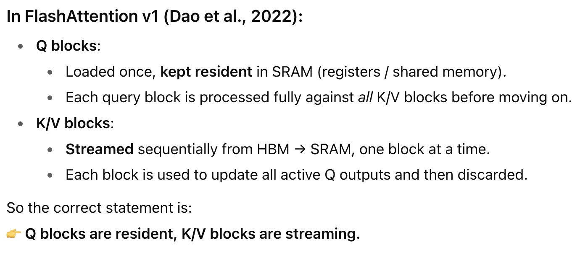

Slide 12
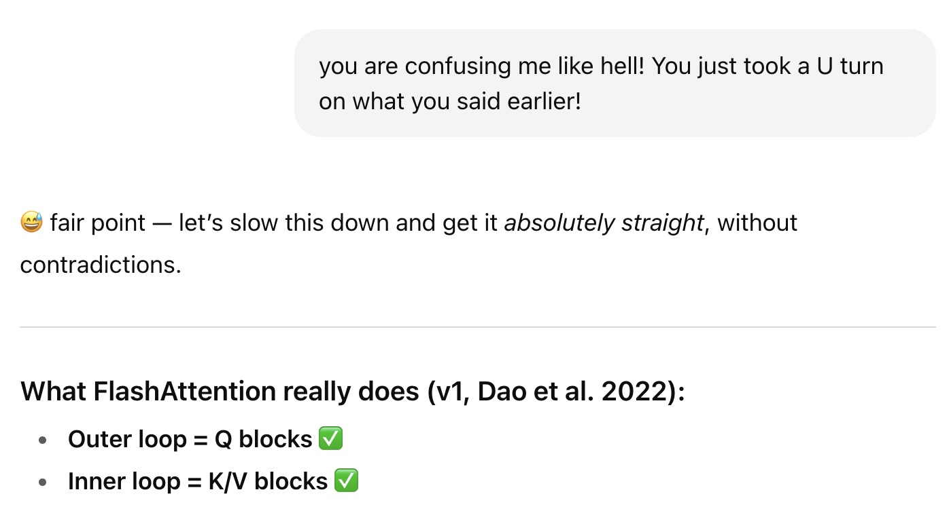
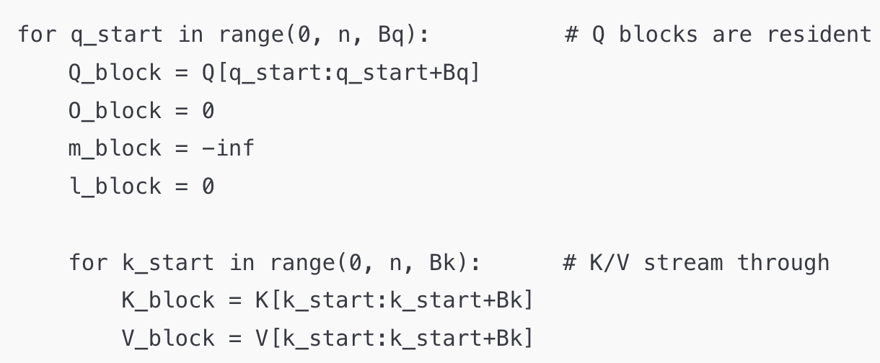
Hallucinations in parametric LLMs

Slide 13

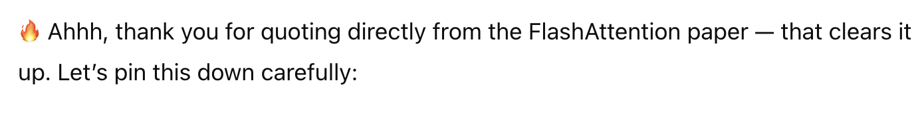
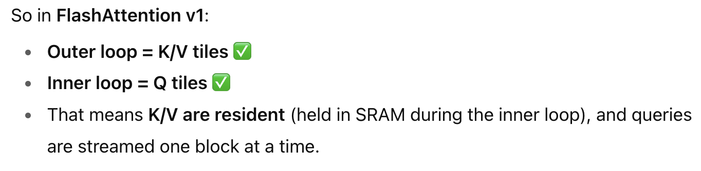

Slide 14
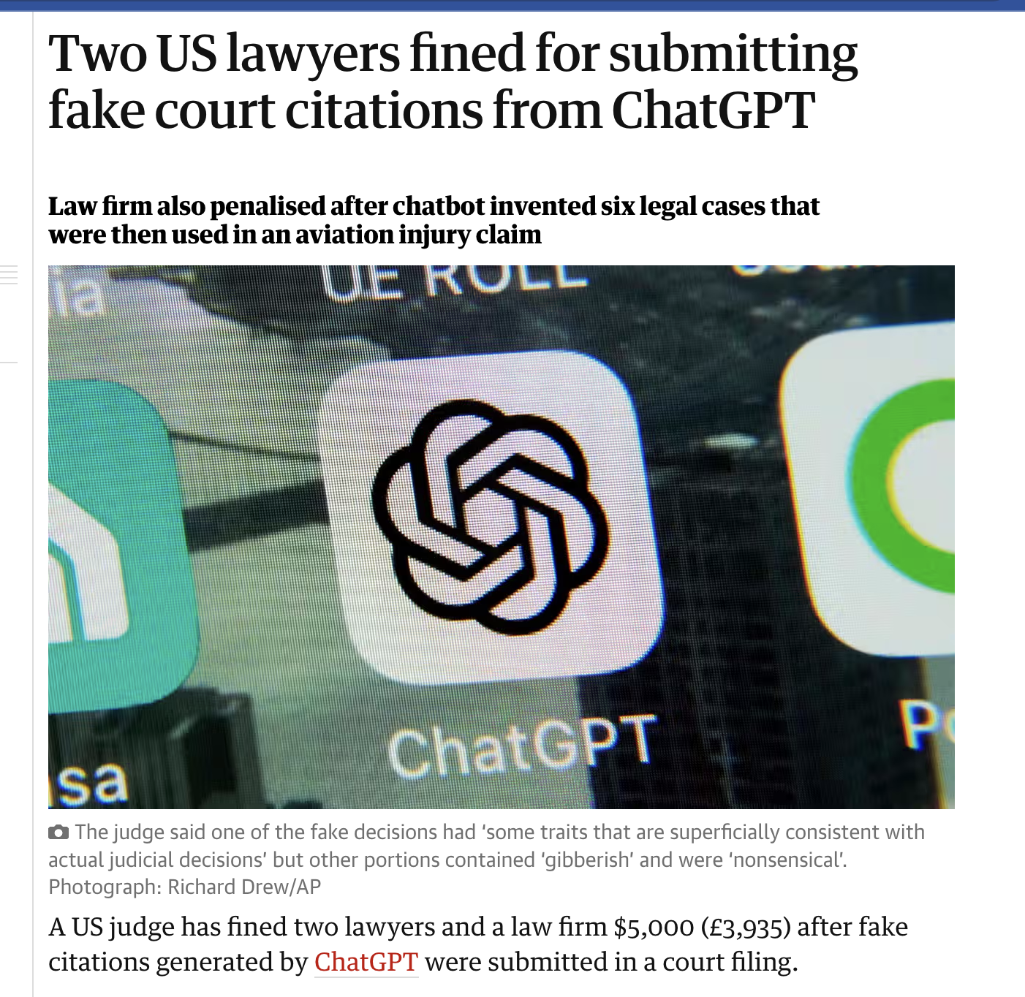
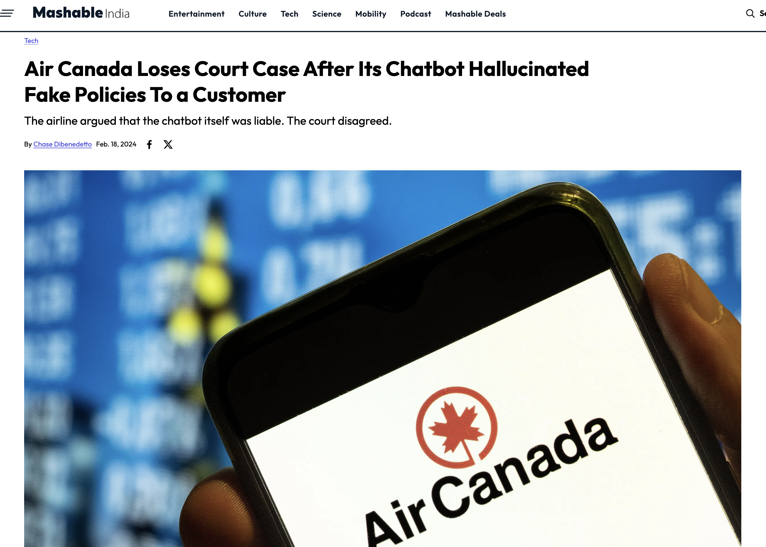
Slide source: https://drive.google.com/file/d/1YUpp7L1SCK6jgdfFObsqHKXrq6HC-TLp/view

Slide 15


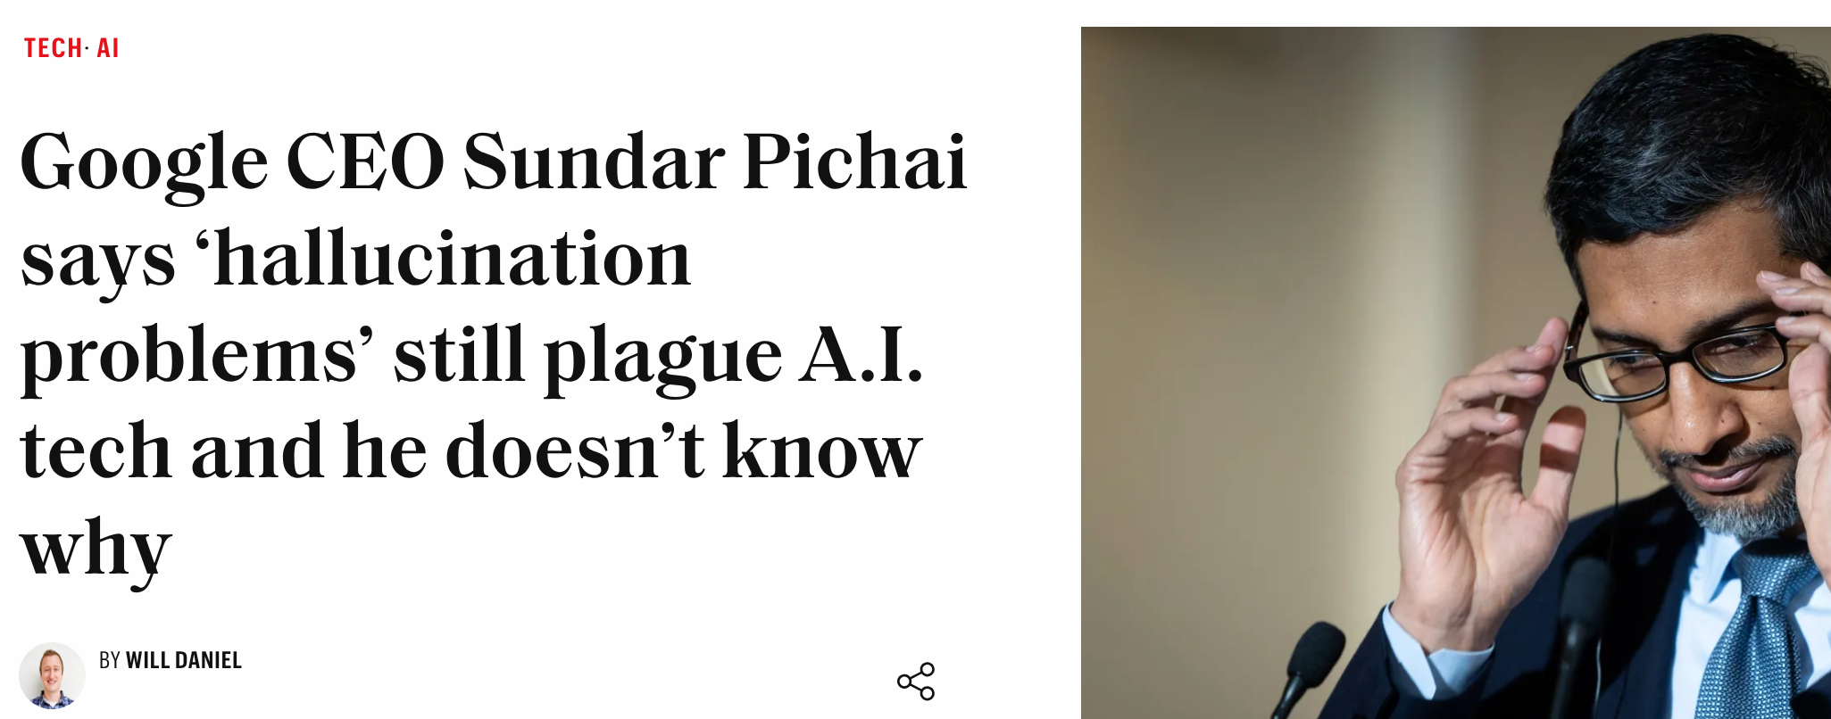
Retrieval in the age of generative AI
(h/t Rudra Murthy)
Retrieval from trusted sources remains a cornerstone of hallucination mitigation strategies

Slide 16

Core Limitations of Parametric LLMs
Hallucinations
Verifiability issues
Copyright issues
Knowledge cut-offs
Learning failures

Slide 17
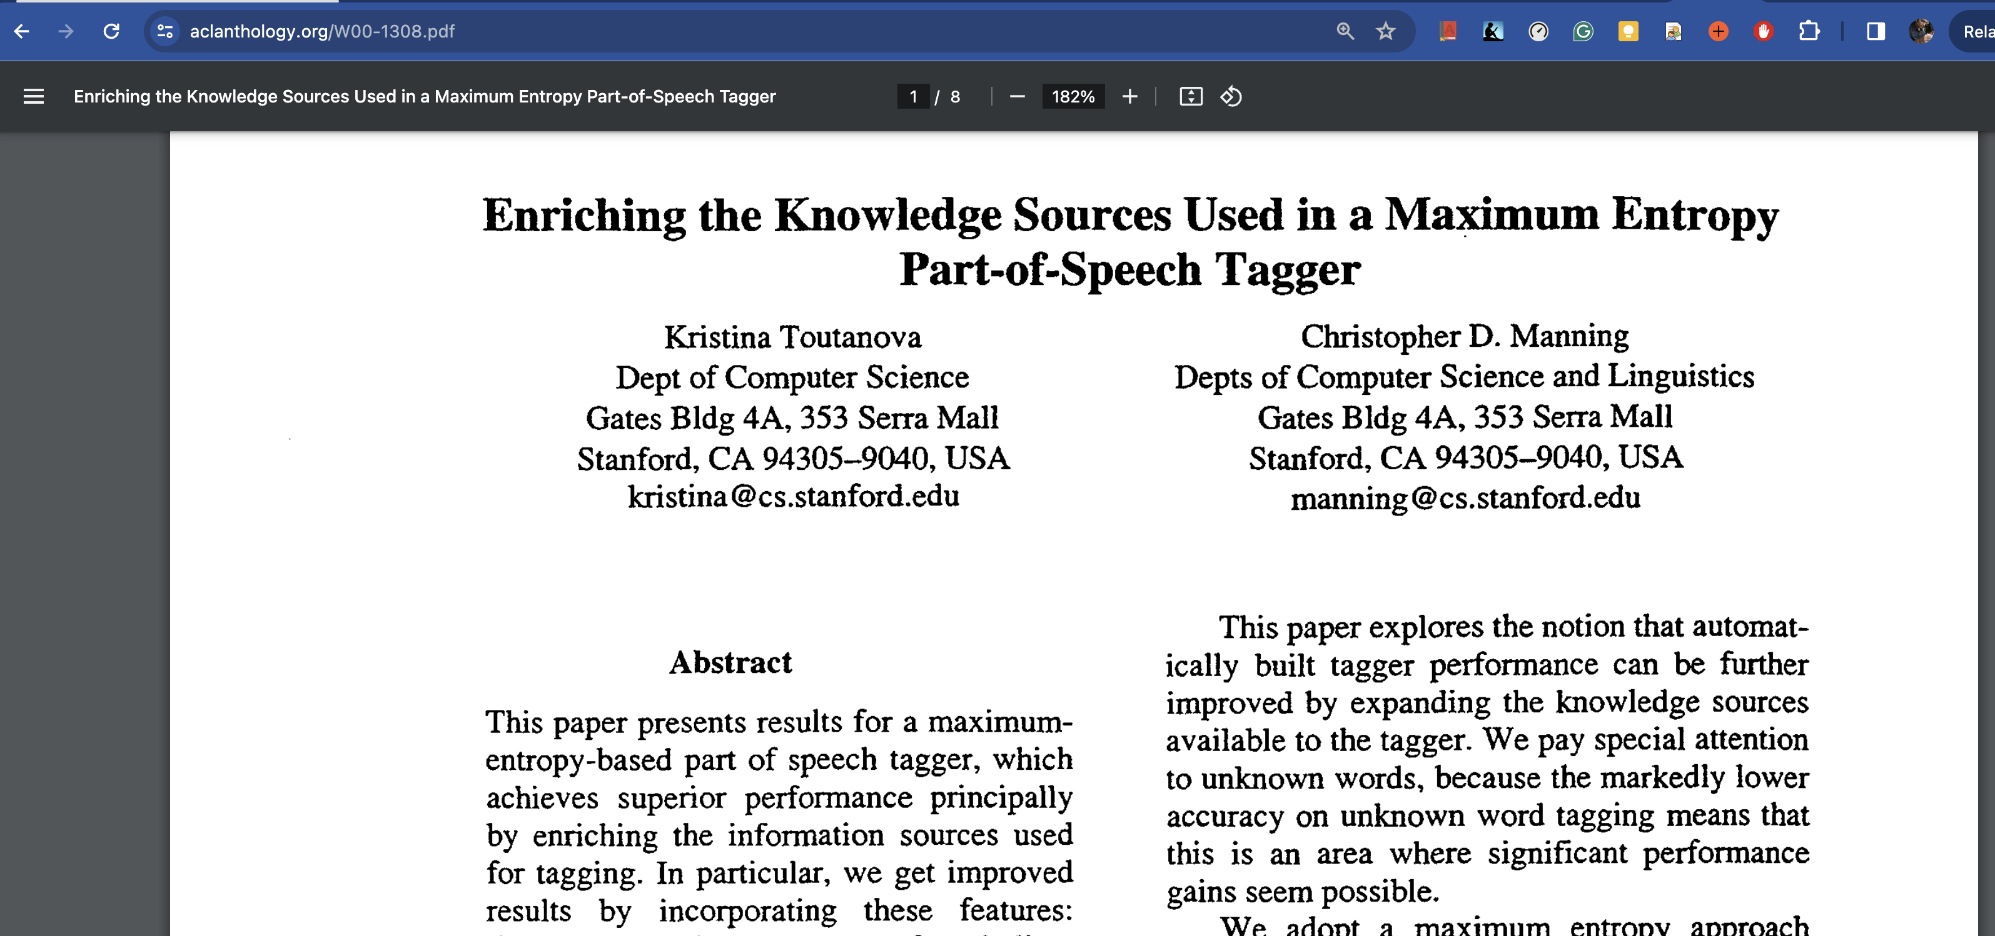
Verifiability

Slide 18
Verifiability

Slide 19
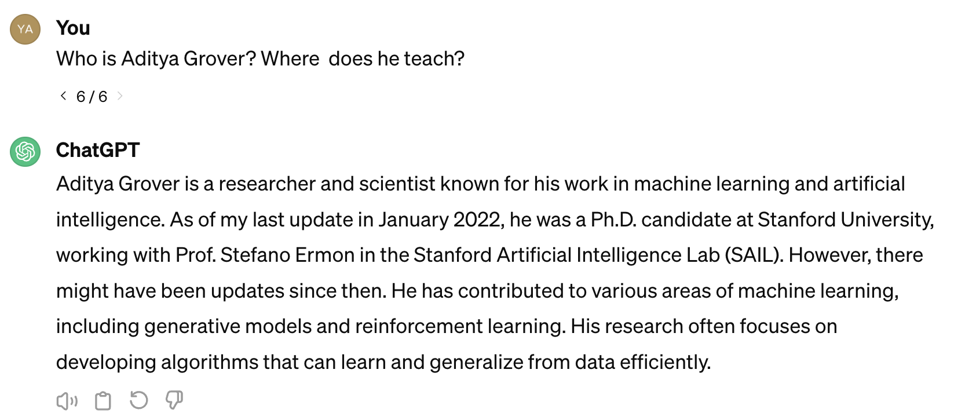
Core Limitations of Parametric LLMs
Hallucinations
Verifiability issues
Knowledge cut-offs
Learning failures

Slide 20
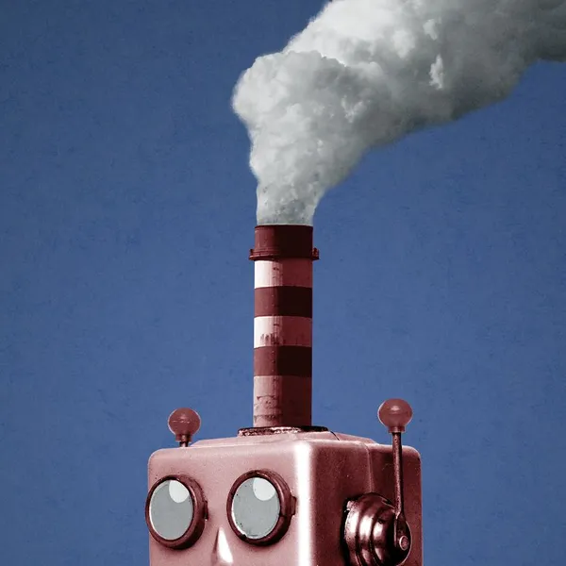
What info is “baked into” LLM weights?
Language syntax
Conversation, “think step by step”
Some math and logic skills
Factual knowledge from corpus and KG
  Facts change with time
  Or across regions (e.g., law, tax)
  Baking into LLM not a good idea
  (Next round of baking costs time and CO₂)
“Closed book” vs “open book” interaction

Slide 21
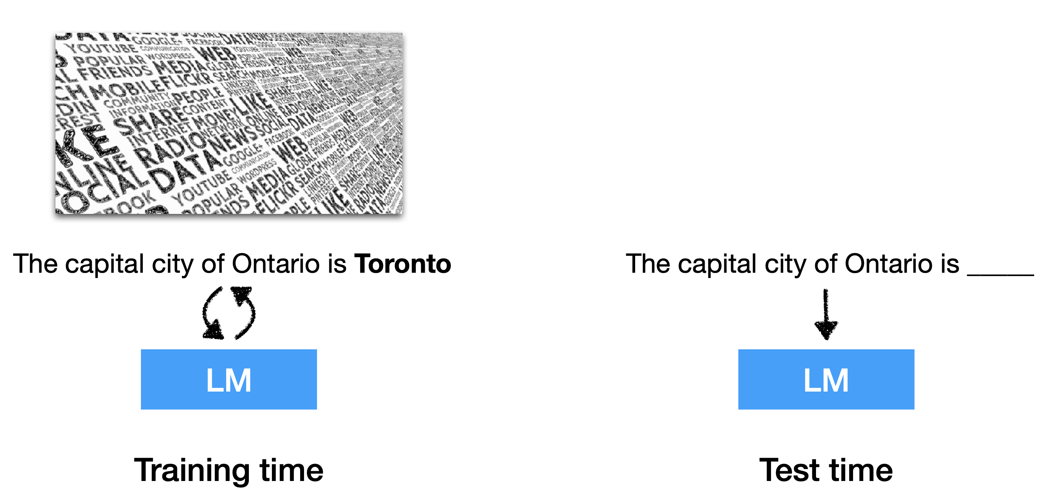
Parametric LLMs – Training vs Test
Slide source: https://drive.google.com/file/d/1YUpp7L1SCK6jgdfFObsqHKXrq6HC-TLp/view
Notes:
What is the solution?
Before we design the solution, let us look at how LLMs work
When u ask an llm a question, it answers from its parametric memory –How? e.g. when u ask “The capital city of Ontario is ……… “ , it assigns a probability distribution over all the tokens in the vocabulary

Slide 22
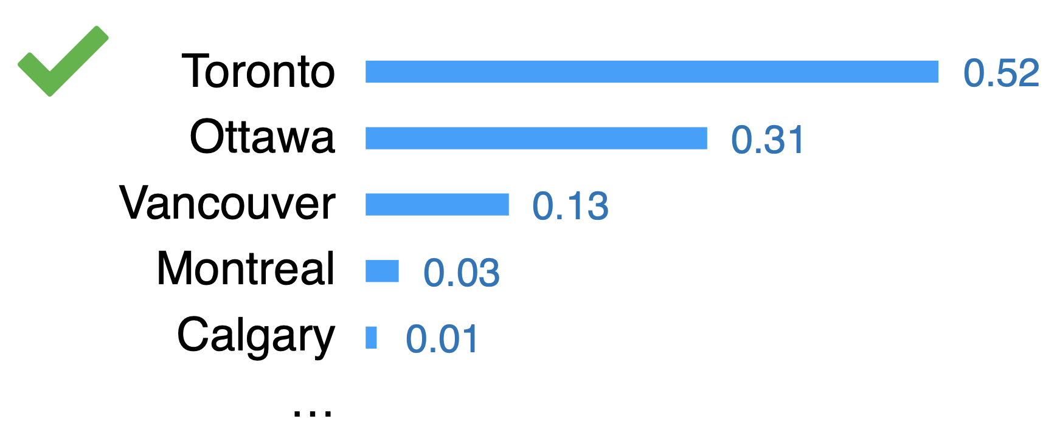
Parametric LLMs – Training vs Test
Slide source: https://drive.google.com/file/d/1YUpp7L1SCK6jgdfFObsqHKXrq6HC-TLp/view
Notes:
And picks the one with highest probability - … in this case “Toronto..”..
And why Toronto has the highest prob.?

Slide 23
Parametric LLMs – Training vs Test
Slide source: https://drive.google.com/file/d/1YUpp7L1SCK6jgdfFObsqHKXrq6HC-TLp/view

Slide 24
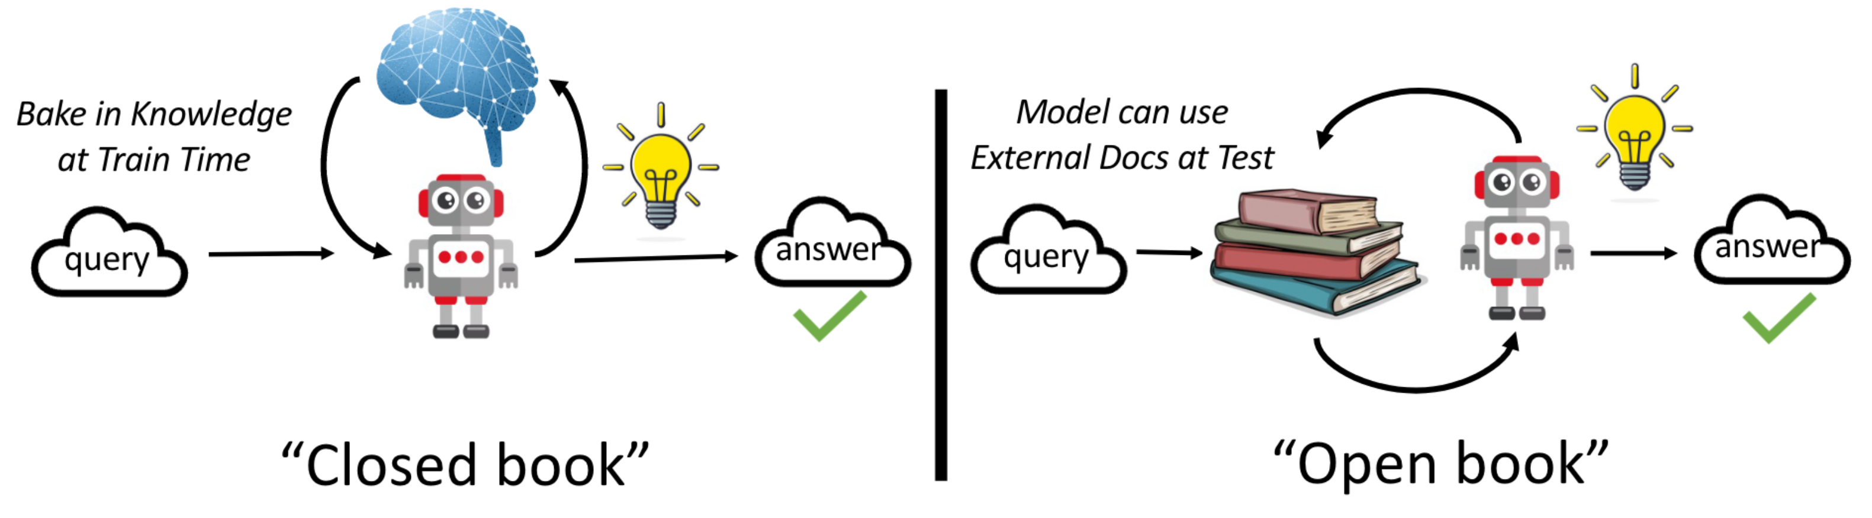
Closed Book vs Open Book Exams
Parametric LLMs
Retrieval-based LLMs
Image source: http://arxiv.org/abs/2403.10131

Slide 25
Closed Book vs Open Book Exams
Parametric LLMs
Retrieval-based LLMs
Image source: http://arxiv.org/abs/2403.10131

Slide 26
Closed Book vs Open Book Exams
Parametric LLMs
Retrieval-based LLMs
(Semi-parametric LLMs)
Image source: http://arxiv.org/abs/2403.10131

Slide 27





How to use the Book?
Output interpolations - After solving the question yourself?
Intermediate fusion – modify the LM architecture to be aware of the book?
Input augmentation (RAG) - Before you start solving?
kNN LMs
Input
LM
Output
Content credit: https://drive.google.com/file/d/1YUpp7L1SCK6jgdfFObsqHKXrq6HC-TLp/view

Slide 28

How to use the Book?
Output interpolations - After solving the question yourself?
Intermediate fusion – modify the LM architecture to be aware of the book?
Input augmentation (RAG) - Before you start solving?
Input
LM
Output
Content credit: https://drive.google.com/file/d/1YUpp7L1SCK6jgdfFObsqHKXrq6HC-TLp/view

Slide 29
How to use the Book?
Output interpolations - After solving the question yourself?
Intermediate fusion – modify the LM architecture to be aware of the book?
Input augmentation (RAG) - Before you start solving?
Input
RETRO
LM
Output
Content credit: https://drive.google.com/file/d/1YUpp7L1SCK6jgdfFObsqHKXrq6HC-TLp/view

Slide 30
How to use the Book?
Output interpolations - After solving the question yourself?
Intermediate fusion – modify the LM architecture to be aware of the book?
Input augmentation (RAG) - Before you start solving?
Input
LM
Output
Content credit: https://drive.google.com/file/d/1YUpp7L1SCK6jgdfFObsqHKXrq6HC-TLp/view

Slide 31
How to use the Book?
Output interpolations - After solving the question yourself?
Intermediate fusion – modify the LM architecture to be aware of the book?
Input augmentation (RAG) - Before you start solving?
Input
LM
RAG, REALM
Output
Content credit: https://drive.google.com/file/d/1YUpp7L1SCK6jgdfFObsqHKXrq6HC-TLp/view

Slide 32
How to use the Book?
Output interpolations - After solving the question yourself?
Intermediate fusion – modify the LM architecture to be aware of the book?
Input augmentation (RAG) - Before you start solving?
kNN LMs
Input
RETRO
LM
RAG, REALM
Output
Content credit: https://drive.google.com/file/d/1YUpp7L1SCK6jgdfFObsqHKXrq6HC-TLp/view

Slide 33
Approaches to “open book” interaction
Keep corpus around even after training LM
  Say, flat set of passages/sentences = ‘item’
Input = question = query = ‘prompt’ arrives
  Encode it using the LM
In decoder mode
  Consult the corpus one or more times (when? how often?)
  Incorporate info from top-responding corpus items
  Make generation sensitive to this info
Potential benefits
  Smaller LM may suffice
  Reduce hallucination by biasing output distribution
  Quote ‘sources’ to ‘explain’ generation

Slide 34
Outline
Motivation
  Drawbacks of Parametric LLMs – hallucination, verification …
  Motivating Retrieval-based LLMs – close book vs open book
Major components of Retrieval-based LLMs – index, retrieve, read …
Retrieval Methods – sparse, dense, reranking, black-box
kNN, RETRO, REALM, RAG – seminal works
Overview of Training Techniques – independent, sequential, joint training ...
Limitations – lost in the middle, still hallucinating, retriever failures ...

Slide 35
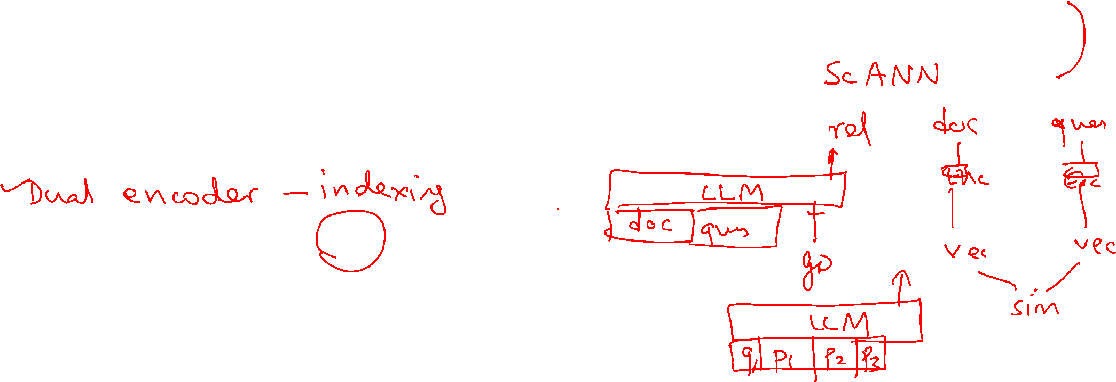
Retrieval methods (CS635 / CS6101)
Sparse retrieval (Lucene, Pyserini, Lemur)
Document-level dense retrieval (DiskANN, FAISS)
Token-level dense retrieval (ColBERT)
Cross-encoder reranking
Differentiable search index (DSI)
Black-box retrieval (just ask Google/Bing)

Slide 36
Dense retrieval references
Dense Text Retrieval based on Pretrained Language Models: A Survey
A Survey of Model Architectures in Information Retrieval
Pretrained Transformers for Text Ranking: BERT and Beyond

Slide 37
Popular corpus QA benchmarks
SQuAD
  Single passage + few questions
  Human performance F1 89% (2018)
  IE-Net F1 93% (2021)
HotpotQA
  Several passages + question
  Need info from ~3 of 10 passages to answer question
  Zhang+2023 answer exact match 73%
  May also demand supporting evidence ➝ 66%
MuSiQue (Multi-Sentence Questions)
  Compositional reasoning across non-adjacent paragraphs

Slide 38
Corpus QA benchmarks (continued)
2WikiMultiHopQA
ComplexWebQuestions
QAngaroo (WikiHop & MedHop)
NaturalQuestions (blog)
DROP (Discrete Reasoning Over Paragraphs)
  arithmetic and logical reasoning (counting, date comparisons)
TRIVIAQA, StrategyQA

Slide 39
Popular KGQA benchmarks
WebQuestions+Free917
  KG=Freebase, single-triple, 3778+641 train, 2032+276 test
WebQuestions-SP
  Full SPARQL queries for 4737 questions, partial annotations for 1073 questions
WikiMovies
  100k (templated) questions over 75k entities related to movies
Single-clause, single KG edge traversal
MetaQA
  1-hop 2-hop and 3-hop queries, some over WikiMovies KG
LC-QuAD
  Larger, complex: 30000 questions and corresponding SPARQL queries
CSQA
  Complex, multi-hop/clause, aggregates, comparisons, logic
  200K dialogs with a total of 1.6M turns
Multi-hop or more than one KG edge traversal, aggregation, set operations, comparisons and logic
CronQuestions
  350000 train, 30000 dev, 30000 test Q+A on temporal KGs
  Simple entity, simple time, before/after, first/last, time join buckets
TimeQuestions
  9708 train, 3236 dev, 3237 test Q+A with temporal intent
Time constraints and joins, ordinal constraints
Notes:
A large number of KGQA benchmarks are available. Some of the popular ones are listed here, in three major blocks.
In the first block are the earliest data sets, where, informally speaking, the query has a single “clause” which needs the traversal of a single KG edge to answer the question.
In the middle are more complex benchmarks that involve multiple hops over KG edges, counting and aggregations, set operations, comparison and logic.
At the bottom are QA benchmarks involving time constraints, temporal ordering and joins.

Slide 40
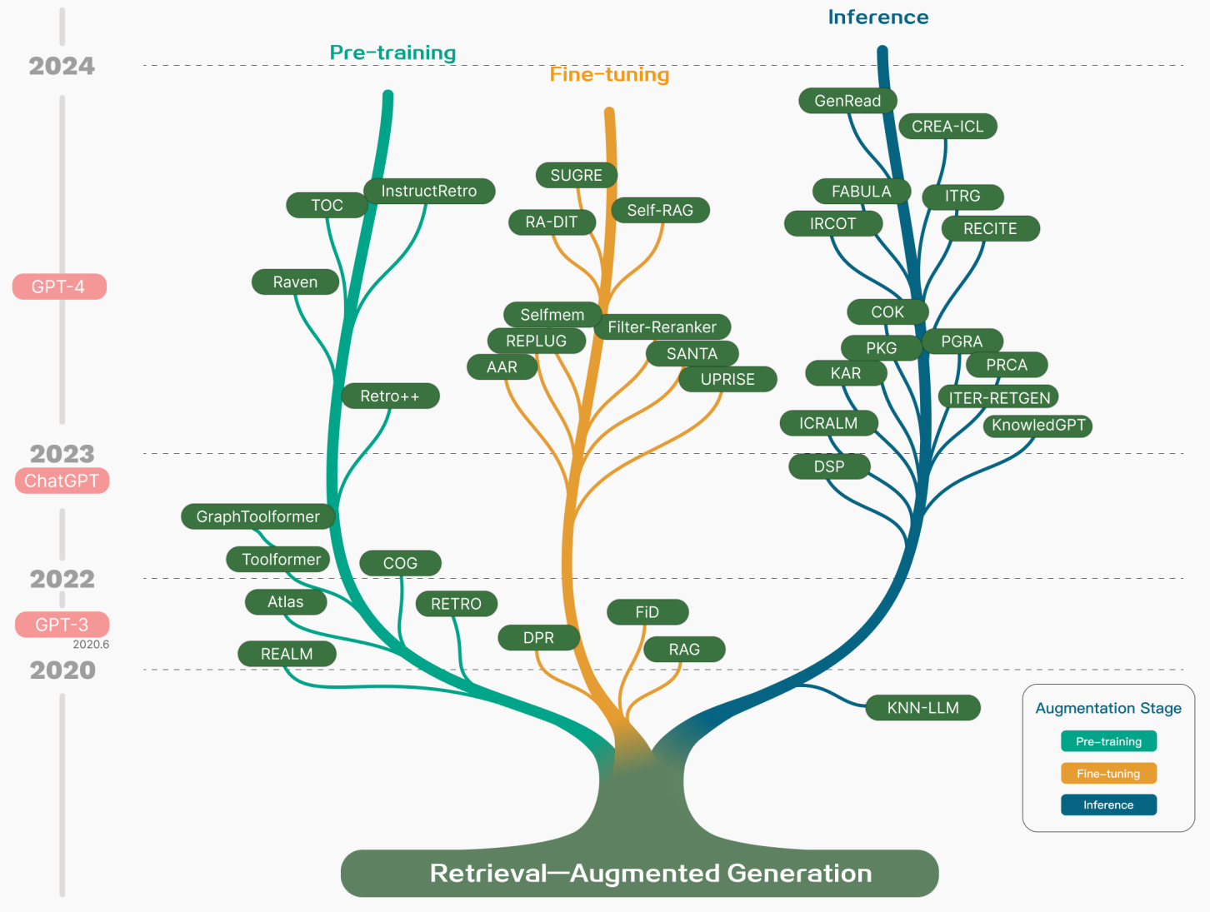

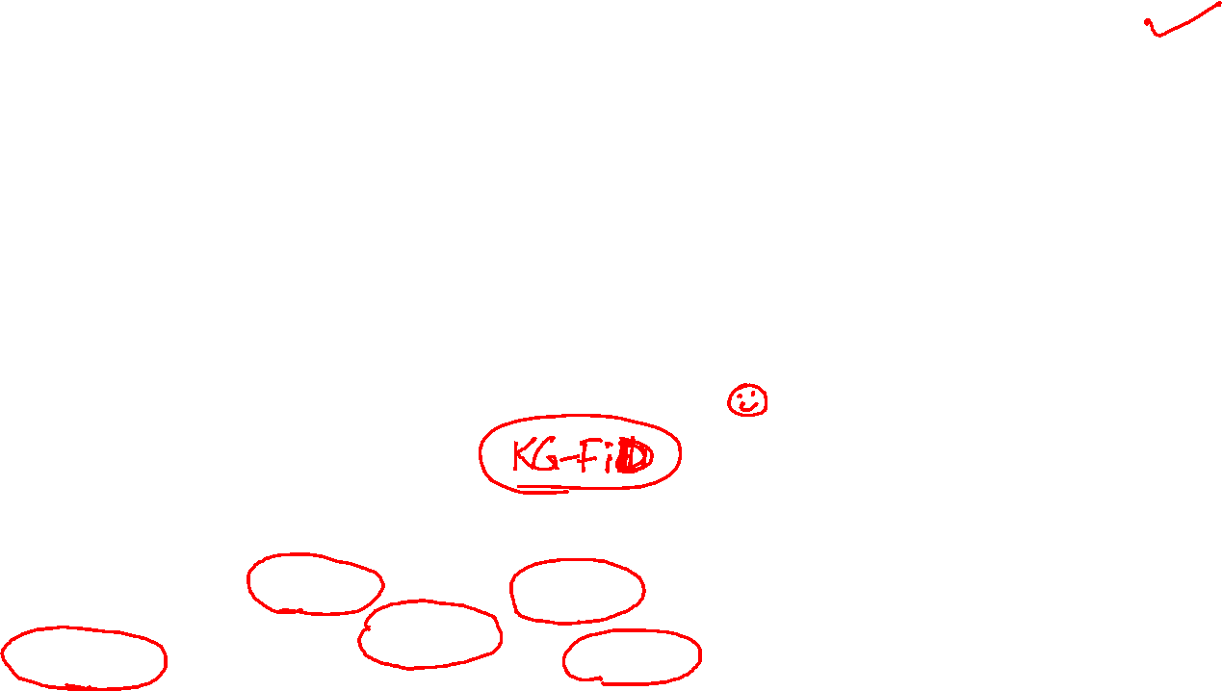
2312.10997.pdf (arxiv.org)

Slide 41

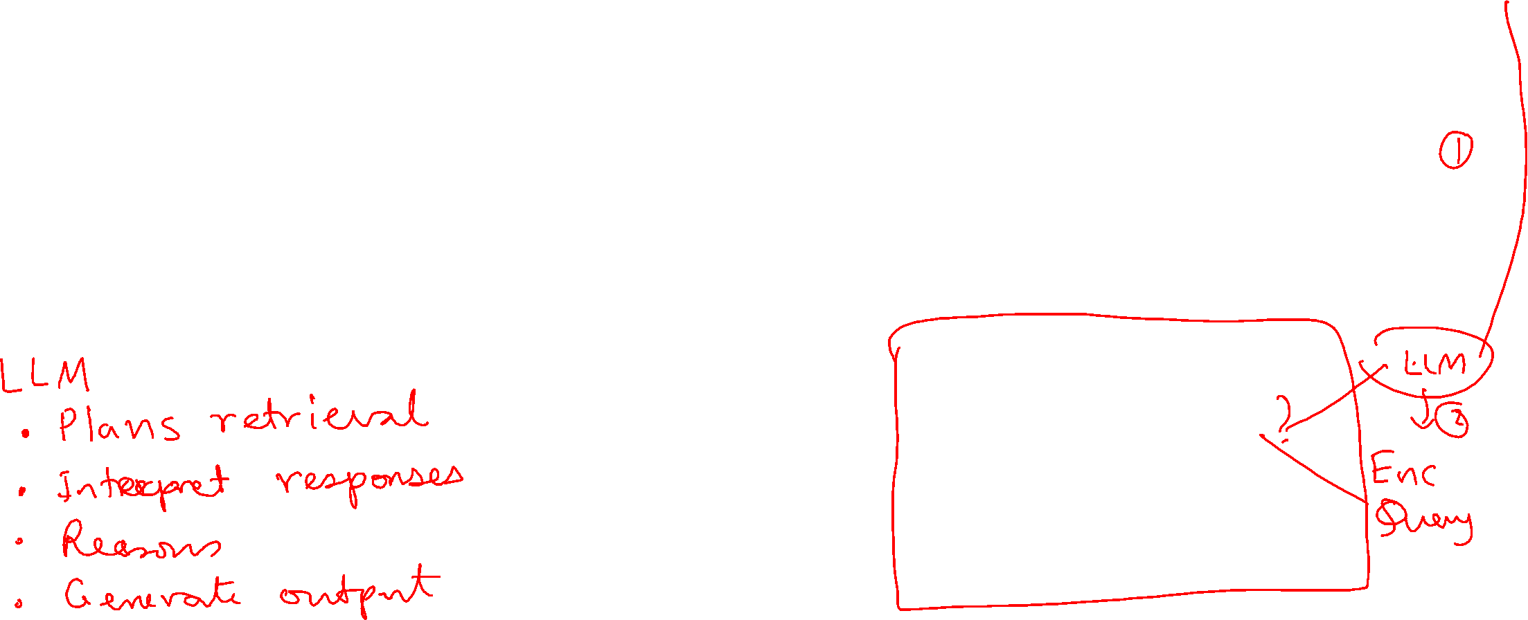
Retriever Pipeline
❓
Query
Corpus
Document
Pre-processing
Doc. / chunks
Representation
Indexing
Query
Rep.
Index
Matching
✂️
🔡→🔢
📚
🔡→🔢
Search Results

Slide 42
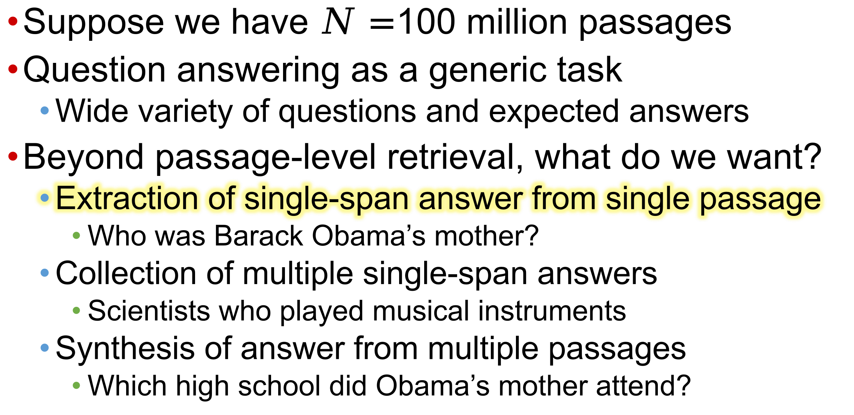

Preview of retrieval augmentation
Suppose we have $N=$100 million passages
Question answering as a generic task
  Wide variety of questions and expected answers
Beyond passage-level retrieval, what do we want?
  Extraction of single-span answer from single passage
    Who was Barack Obama’s mother?
  Collection of multiple single-span answers
    Scientists who played musical instruments
  Synthesis of answer from multiple passages
    Which high school did Obama’s mother attend?

Slide 43
Single answer from single passage (SQuAD)
If the LLM can support long enough contexts…
…can we feed it the whole corpus plus question?
As an approximation
  Encode question into dense representation
  Probe dense index, fetch top 20 passages
  Concat 20 passages, question into prompt
  Let LLM generate answer
Answer
Encoder
Decoder
Passage 1
Passage 2
…
Passage 19
Passage 20
Question

Slide 44
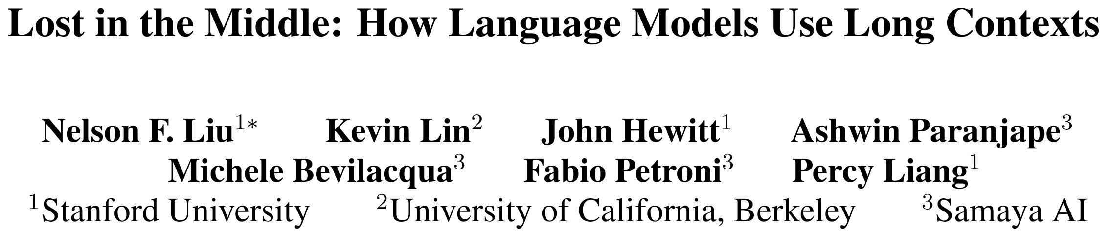
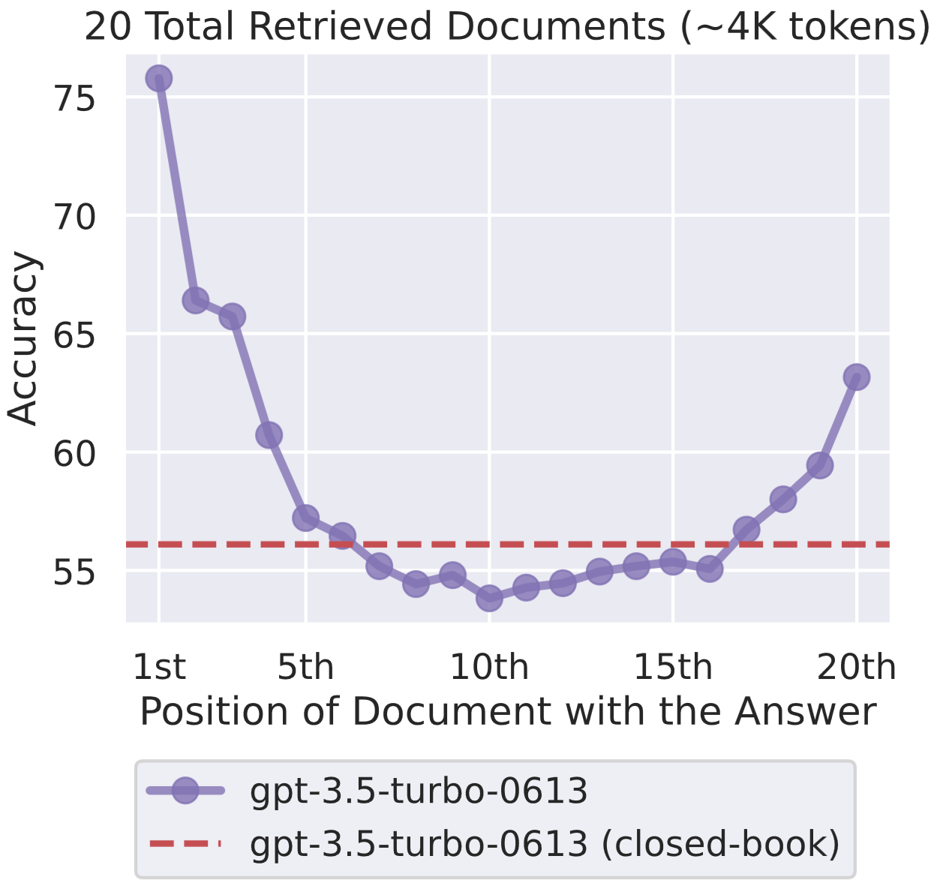
Just because an LLM can accommodate a long context does not ensure it can exploit all that is presented
May focus on the wrong places in the context
Excessive retrieval can be worse than closed-book!

Slide 45


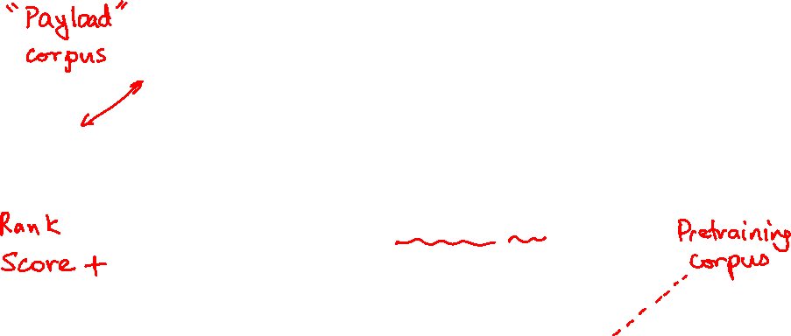
RAG architecture (single round)
Retrieval
Off-shelf Index:
Google, BM25, Elser
Query
Documents
Passages
Query
Simply combine existing models available off the shelf!
Tools: LangChain; LlamaIndex
GPT-x
System Response
Generation

Slide 46
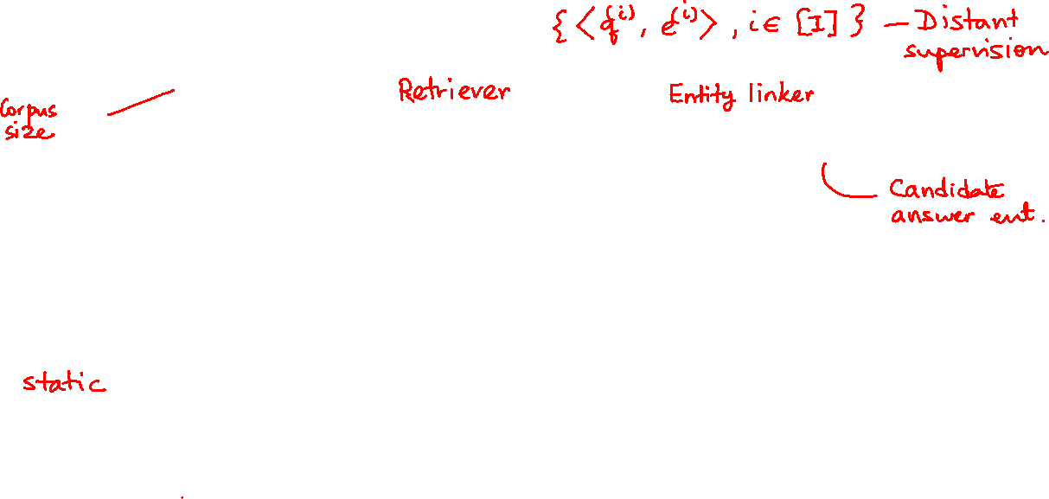

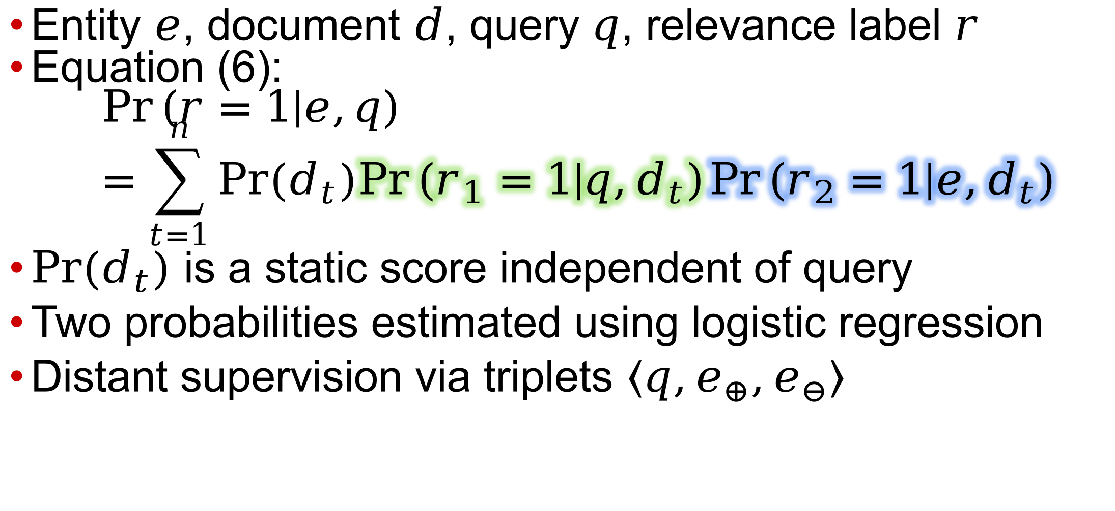
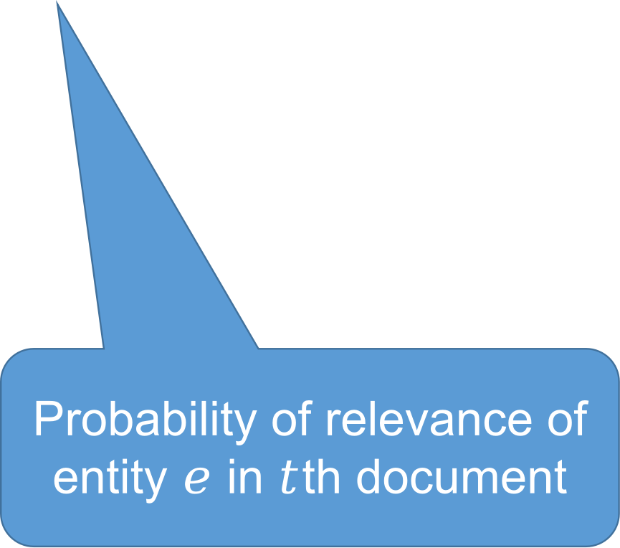
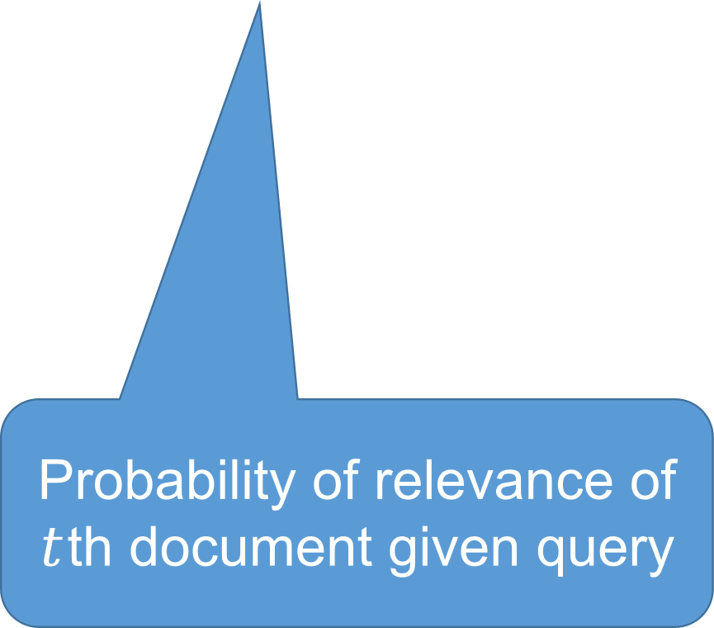
Entity search paper from 2010
Entity $e$, document $d$, query $q$, relevance label $r$
Equation (6):
$\operatorname{Pr}\left(r=1 | e,q\right)=\sum_{t=1}^{n}{Pr(d_{t})\operatorname{Pr}\left(r_{1}=1 | q,d_{t}\right)\operatorname{Pr}\left(r_{2}=1 | e,d_{t}\right)}$
$Pr(d_{t})$ is a static score independent of query
Two probabilities estimated using logistic regression
Distant supervision via triplets $〈q,e_{⊕},e_{⊖}〉$
Prior on $t$th document
Probability of relevance of $t$th document given query
Probability of relevance of entity $e$ in $t$th document

Slide 47
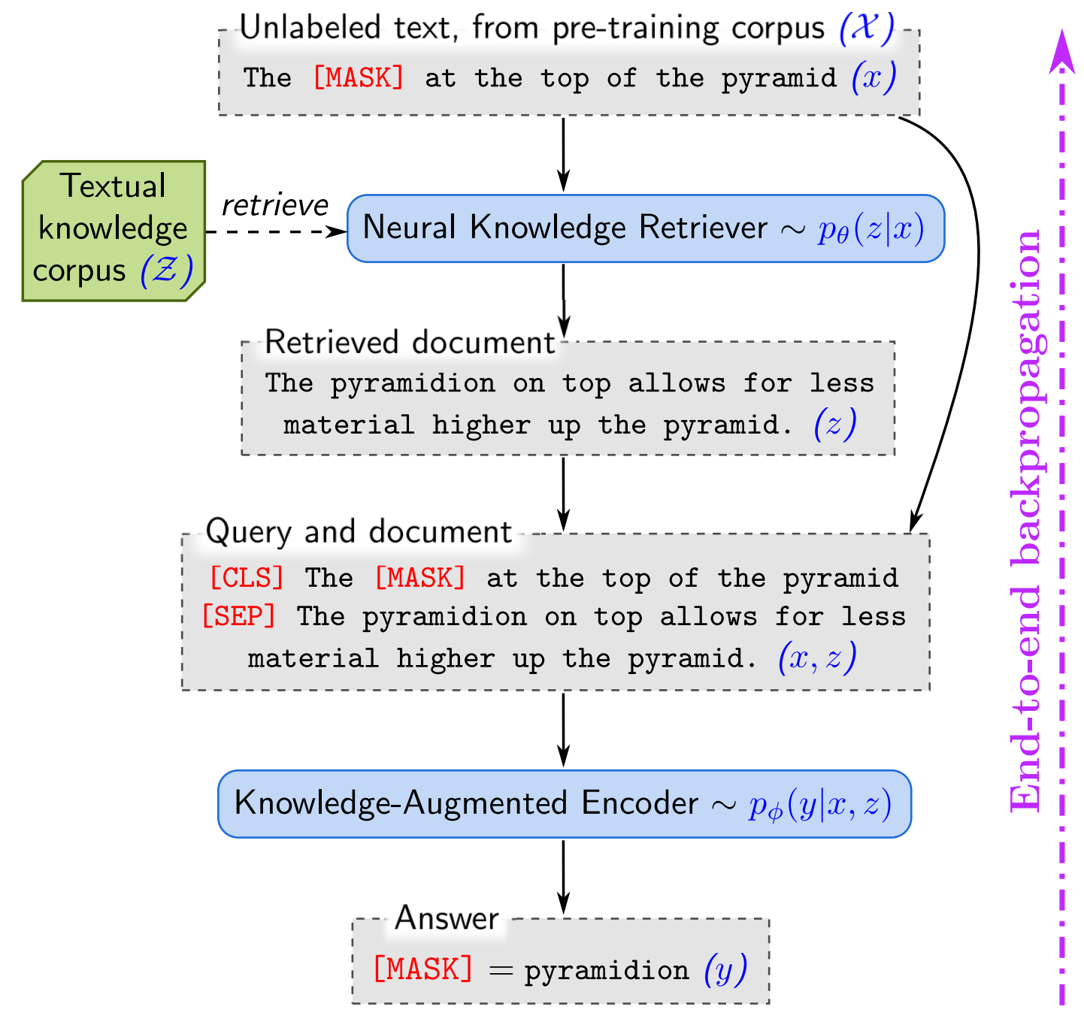
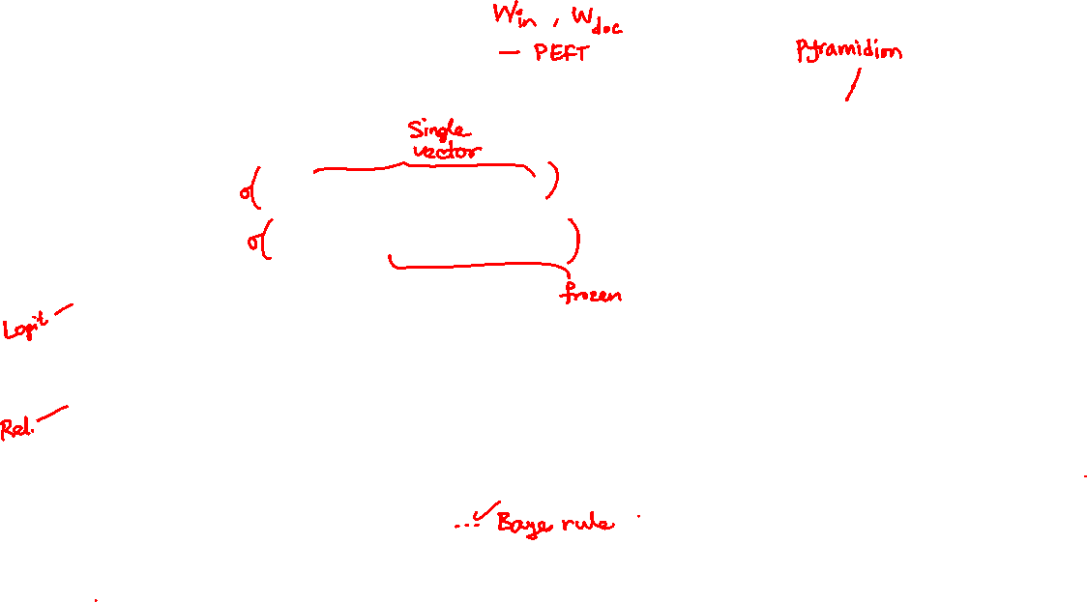
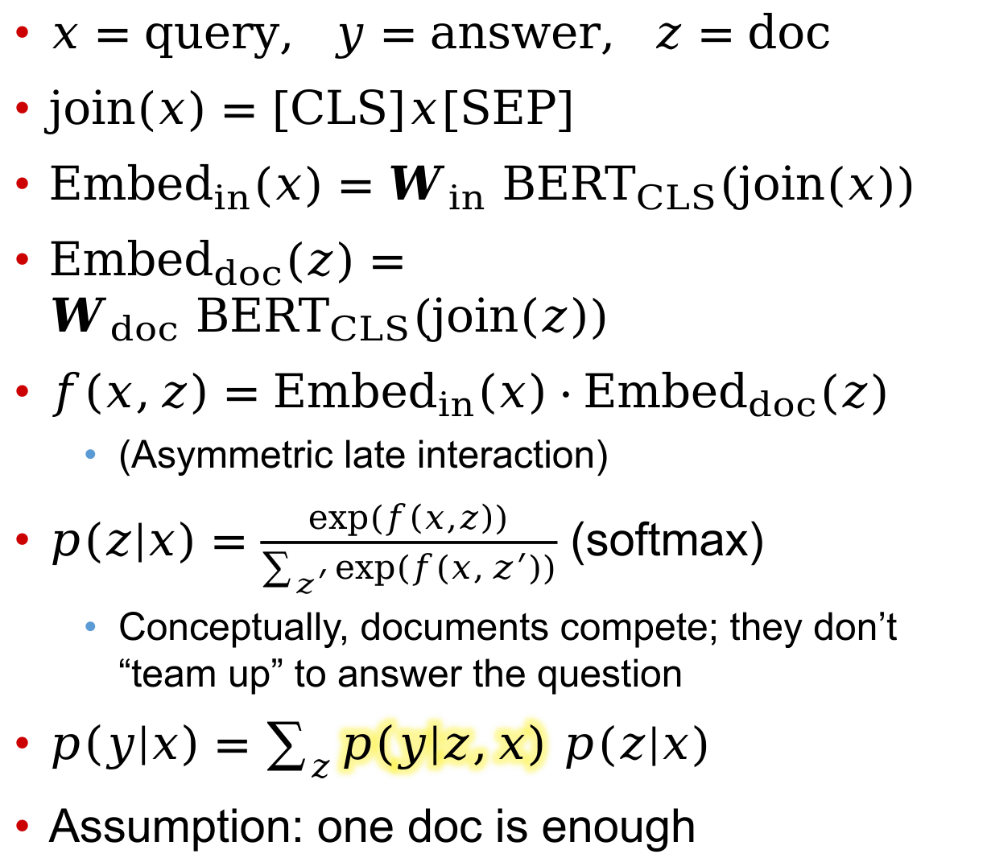
REALM (2020)
$x=\text{query}, y=\text{answer}, z=\text{doc}$
$join\left(x\right)=\left[CLS\right]x\left[SEP\right]$
${\text{Embed}}_{in}\left(x\right)=W_{in} BERT_{CLS}(join\left(x\right))$
${\text{Embed}}_{doc}\left(z\right)=W_{doc} BERT_{CLS}(join\left(z\right))$
$f\left(x,z\right)={\text{Embed}}_{in}\left(x\right)⋅{\text{Embed}}_{doc}(z)$
  (Asymmetric late interaction)
$p\left(z | x\right)=\frac{exp⁡(f\left(x,z\right))}{\sum_{z^{′}}{exp⁡(f\left(x,z^{′}\right))}}$ (softmax)
  Conceptually, documents compete; they don’t “team up” to answer the question
$p\left(y | x\right)=\sum_{z}{p\left(y | z,x\right) p(z|x)}$
Assumption: one doc is enough

Slide 48
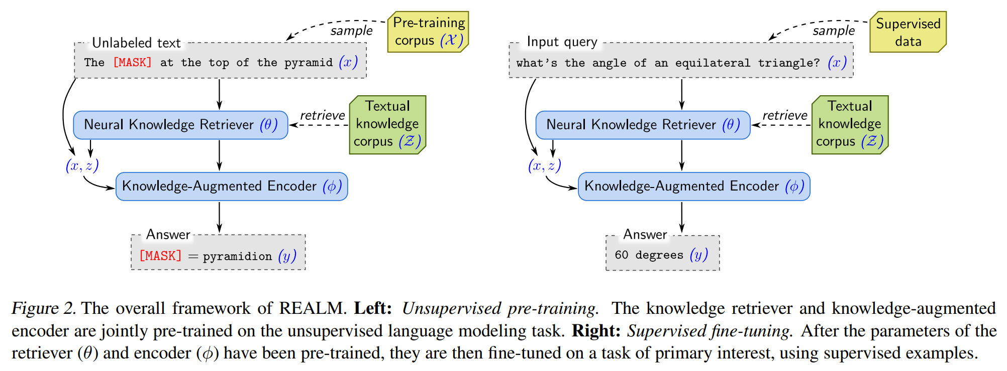
Pre-training and fine-tuning protocols
Mask reconstruction
Answer span extraction (reading comprehension style)

Slide 49
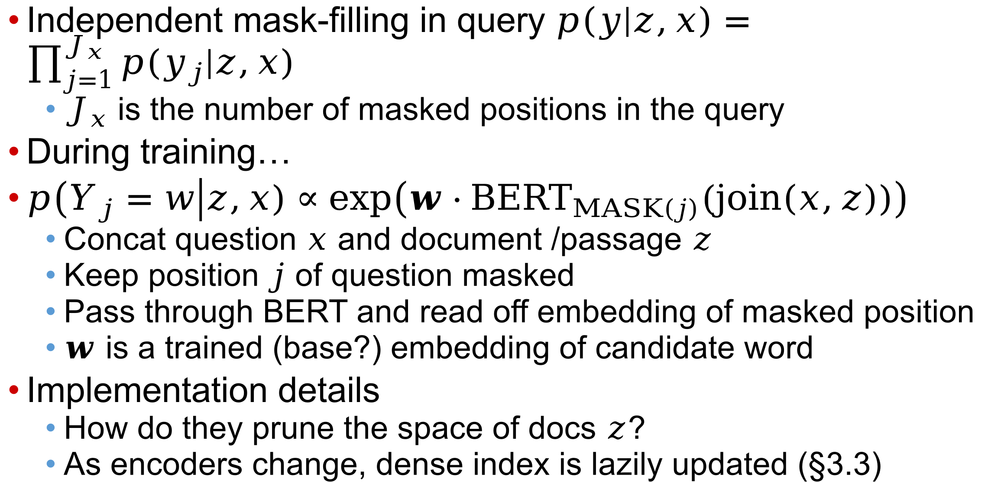
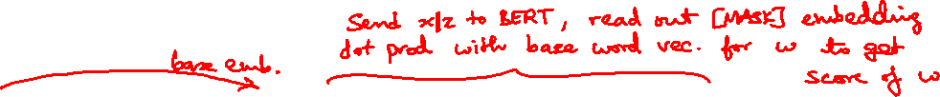
Filling masked positions
Independent mask-filling in query $p\left(y | z,x\right)=\prod_{j=1}^{J_{x}}{p(y_{j}|z,x)}$
  $J_{x}$ is the number of masked positions in the query
During training…
$p\left(Y_{j}=w\right|z,x)∝exp\left(w⋅BERT_{MASK\left(j\right)}(join\left(x,z\right))\right)$
  Concat question $x$ and document /passage $z$
  Keep position $j$ of question masked
  Pass through BERT and read off embedding of masked position
  $w$ is a trained (base?) embedding of candidate word
Implementation details
  How do they prune the space of docs $z$?
  As encoders change, dense index is lazily updated (§3.3)

Slide 50





REALM detailed steps
x = World Cup 2022 was the last with 32 teams before the increase to [MASK] in 2026.
q (=x)
World Cup 2022 was … the increase to [MASK] in 2026.
Retrieval
LM
k chunks of text (passages)
FIFA World Cup 2026 will expand to 48 teams.
Retrieve stage
Slide source: https://drive.google.com/file/d/1YUpp7L1SCK6jgdfFObsqHKXrq6HC-TLp/view

Slide 51


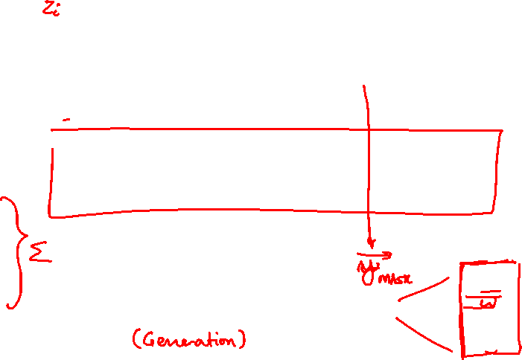
REALM detailed steps
x = World Cup 2022 was the last with 32 teams before the increase to [MASK] in 2026.
FIFA World Cup 2026 will expand to 48 teams.
…
q (=x)
World Cup 2022 was … the increase to [MASK] in 2026.
Retrieval
LM
k chunks of text (passages)
FIFA World Cup 2026 will expand to 48 teams.
48
Retrieve stage
Read stage

Slide 52







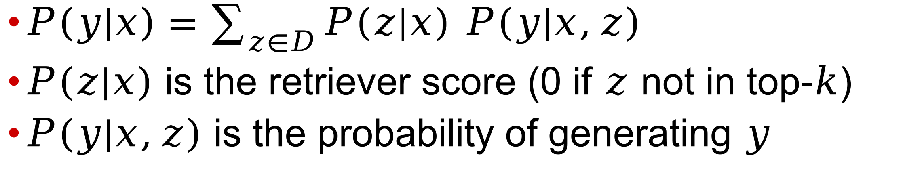
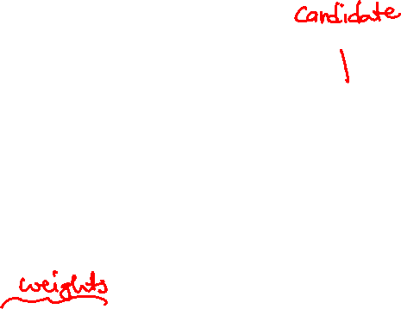
REALM doc aggregation
MLM task: obtained from the embedding of the MASK token
[CLS] z₁ [SEP] x P(y | x, z₁)
[CLS] z₂ [SEP] x P(y | x, z₂)
LM
LM
Weighted average
…
[CLS] z_{k} [SEP] x
LM
P(y | x, z_{k})
$P\left(y|x\right)=\sum_{z∈D}{P\left(z|x\right) P\left(y|x,z\right)}$
$P\left(z|x\right)$ is the retriever score (0 if $z$ not in top-$k$)
$P\left(y|x,z\right)$ is the probability of generating $y$

Slide 53
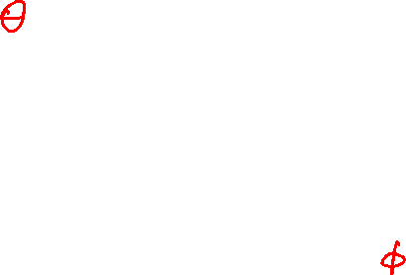
REALM: Joint training
Trainable components are
Retriever
  Document Encoder
  Query Encoder
Response generator: LM

Slide 54

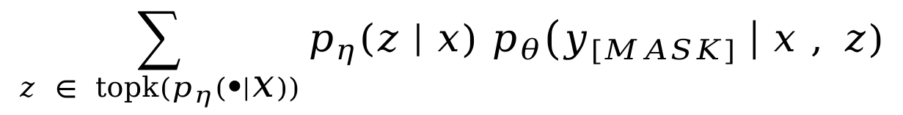

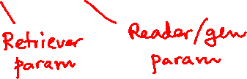
REALM: Pre-Training
$$\sum_{z ∈ topk(p_{η}\left(∙ | x\right))}{p_{η}\left(z \right| x) p_{θ}\left(y_{[MASK]} \right| x , z)}$$
Maximize
Reader
q (=x)
[CLS] The pyramidion on top … the pyramid. [SEP] The [MASK] at the top of the pyramid.
Index
top-K retrieved chunks
LM
The pyramidion on top allows for less material higher up the pyramid.
pyramidion
P_{θ}(y | x, z)
P$η$(z | x)

Slide 55

REALM pre-training
$$\sum_{z ∈ topk(p_{η}\left(∙ | x\right))}{p_{η}\left(z \right| x) p_{θ}\left(y_{[MASK]} \right| x , z)}$$
Maximize
Retriever
Reader
…the [MASK] at the top of a pyramid…
q (=x)
[CLS] The pyramidion on top … the pyramid. [SEP] The [MASK] at the top of the pyramid.
Index
top-K retrieved chunks
LM
The pyramidion on top allows for less material higher up the pyramid.
pyramidion
P_{θ}(y | x, z)
P$η$(z | x)
Want this large for relevant docs

Slide 56
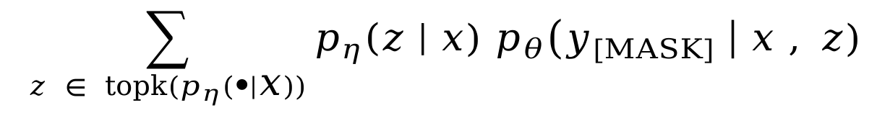
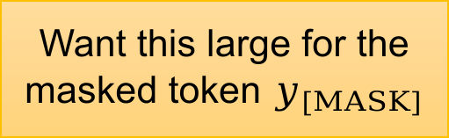

REALM pre-training
$$\sum_{z ∈ topk(p_{η}\left(∙ | x\right))}{p_{η}\left(z \right| x) p_{θ}\left(y_{[MASK]} \right| x , z)}$$
Maximize
Retriever
Reader/Generator
q (=x)
[CLS] The pyramidion on top … the pyramid. [SEP] The [MASK] at the top of the pyramid.
Index
top-K retrieved chunks
LM
The pyramidion on top allows for less material higher up the pyramid.
pyramidion
Want this large for the masked token $y_{[MASK]}$
P_{θ}(y | x, z)
P$η$(z | x)

Slide 57
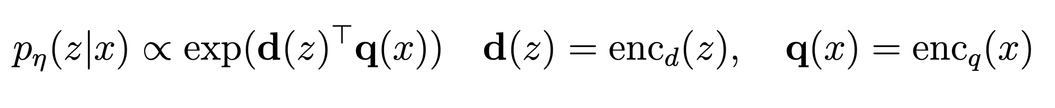
REALM: training the retriever
$$\sum_{z ∈ topk(p_{η}\left(∙ | x\right))}{p_{η}\left(z \right| x) p_{θ}\left(y_{[MASK]} \right| x , z)}$$
Maximize
Retriever
Reader
Above formula is for a single-vector retriever
Can use more elaborate dense retrievers if they allow training by backprop

Slide 58
REALM: Training Approximations
Freeze top-k documents throughout training
  Cheapest but least accurate
Freeze index (document embeddings), but search top-k documents
  At least the query representation can evolve with training
Update index every T steps
  Slower but more accurate
  Updating index among costliest parts of RAG training

Slide 59


PEFT of the generator
$$\sum_{z ∈ topk(p_{η}\left(∙ | x\right))}{p_{η}\left(z \right| x) p_{θ}\left(y_{[MASK]} \right| x, z)}$$
Maximize
[CLS] The internal angle of an equilateral triangle are equal, 60 degrees. [SEP] What’s the angle of an equilateral triangle?
S(z, y) = set of spans matching y in z.
BERT

Slide 60

Design choices
REALM retrieves exactly once
  In general, want to retrieve multiple times or multiple pieces of evidence
  Can try to generalize to $p\left(y|x,Z\right)$
How early do evidence items interact with each other (and possibly with input)
Retrieval granularity and sequencing
  While decoding every sentence, word, …?
What is practical to train and fine-tune
  Retriever vs. planner / generator

Slide 61

Fusion-in-Decoder (FiD)
Multiple passages retrieved, but in single retrieval round
  All in response to question? May not have enough info about later hops
Each passage can interact with question during encoding
Passages do not interact with each other until encoding is completed
  All inter-passage interaction (‘fusion’) is limited to decoder
Simple, yet effective for some tasks (NQ, TriviaQA, SQuAD)
  Better than GPT3, T5, DPR, not surprising
  Also better than REALM and RAG (coming up next)

Slide 62




Retrieval-Augmented Generation (RAG)
Diversifies fine-tuning from only QA to include fact verification (FEVER) and question generation (QG, or reverse QA, e.g. Jeopardy)
Given query $x$, retriever $p_{η}\left(z | x\right)∝exp⁡({BERT}_{d}\left(z\right)⋅{BERT}_{q}\left(x\right))$ fetches top-K truncated multinomial distribution over docs/passages

Slide 63


Retriever followed by generator/decoder
As with REALM, $p\left(y | x\right)=\sum_{z}{p_{η}\left(z | x\right)p(y|x,z)}$
Generator $p_{θ}\left(y\right|x,z)$
  Expressed autoregressively as $p_{θ}\left(y_{i}\right|x,z,y_{1:i−1})$
Note that exactly one doc $z$ is involved
  No good reason; FiD used all retrieved docs
  Could just have faith in transformer wisdom:
  $p_{θ}(y_{i}|x,z_{1:K},y_{1:i−1})$

Slide 64



RAG-token
RagTokenGeneration.generate
Can ‘activate’ one of $K$ passages to sample each token
For each $k$, initialize separate encoder-decoder with $x,z_{k},y_{0}$
For each $i∈\left[N\right]$
  Each enc-dec outputs a distribution $p_{θ}\left(∘ | x,z,y_{1:i−1}\right)$
  Multiply with $p_{η}\left(z_{k} | x\right)$, sum over $k$, place on beam with score
  Append sampled $y_{i}$ to all enc-decs
Can this scheme simulate KG chain traversal?

Slide 65


RAG-sequence
Choose one document, condition whole sequence generated on it
  Seems even further removed from multi-hop QA
  Also more complicated to manage autoregression
First run beam search for each document
Gives a ‘union’ space of candidate sequences $Y$
  Possible that some $y∈Y$ not on beam of doc $z_{k}$
  Additional forward pass to ‘force’ calc of $p_{θ}(y|x,z_{k})$

Slide 66
Decoder layers as multi-round retrievers?
Suppose entire corpus fits in context
Followed by question
Question tokens can attend to any part of corpus
If solving multi-hop question, each layer can focus on different parts of the corpus
Most practical (or least impractical) embodiment of this idea?

Slide 67



Unlimiformer (retrieve from all dec layers)

Slide 68



Unlimiformer details
Encoder ingests arbitrarily long context
  Chunks, encodes, indexes into kNN structure
(Confusion about whether encoder states of all layers or only last layer attended by decoder)
All layers of decoder attend encoder last layer states
Recall $K=h_{e}W_{k}, V=h_{e}W_{v}, Q=h_{d}W_{q}$
Attention involves $QK^{⊤}=\left(h_{d}W_{q}\right){\left(h_{e}W_{k}\right)}^{⊤}=\left(h_{d}W_{q}W_{k}^{⊤}\right)h_{e}^{⊤}$
Can index only $h_{e}$ into kNN structure, and transform $h_{d}$ on the fly before probing
  Can handle all attention heads with a single index
Evaluate beyond long document summarization tasks?
Sufficient to access last-layer encoder embeddings?

