Slide 1
Knowledge Graphs
(Preliminaries)
(CS728)
Soumen Chakrabarti

Slide 2
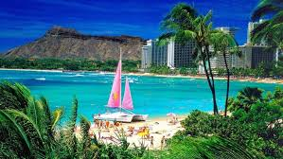

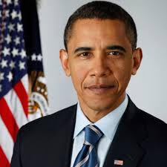
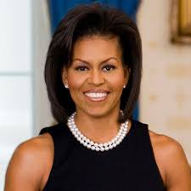
Knowledge base (KB) / graph (KG)
born_in
city_of
Honolulu
Nodes are entities
Edges are relations
USA
Barack Obama
spouse
nationality
A KB triple or ‘fact’ looks like a relation-typed edge
(subject, relation, object)
Michelle Obama
Knowledge base with entities and binary relations
Notes:
For our purposes, a KG has nodes representing entities and edges representing typed relation instances or facts.
Nodes and edge types are known by canonical IDs, but we are showing textual names for clarity.
A binary relation fact has three fields: subject, relation, and object.

Slide 3

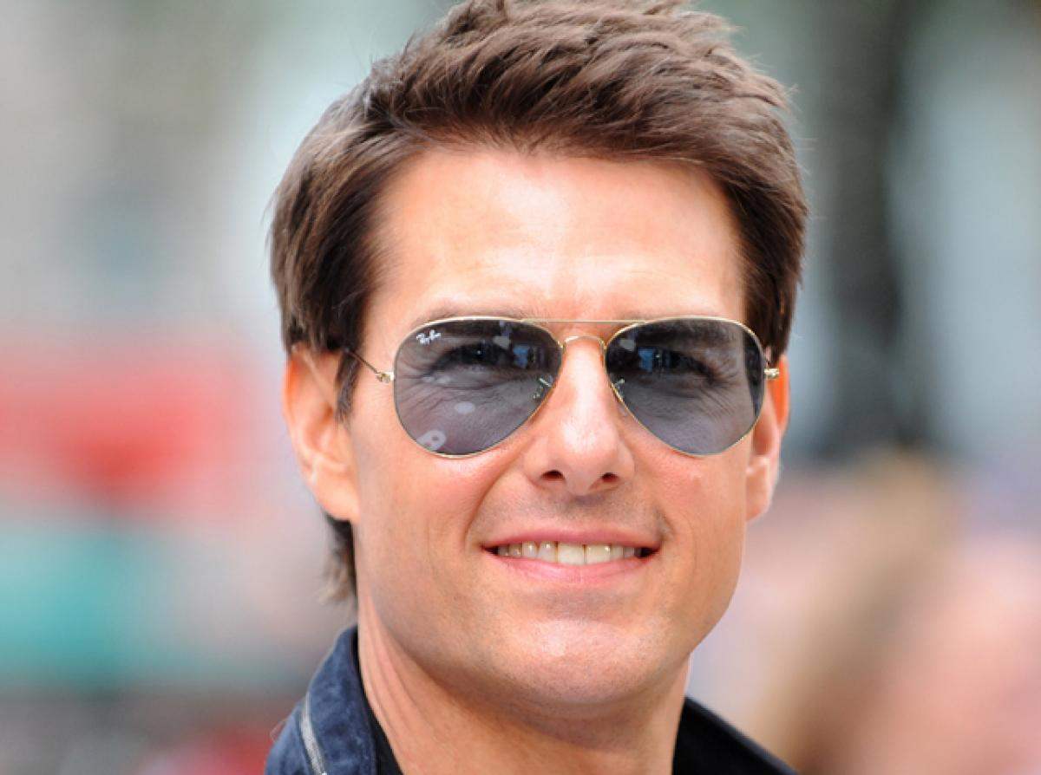
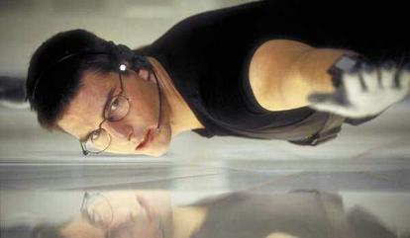
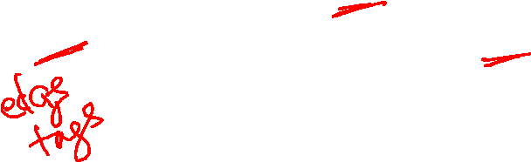
Beyond binary relations
Barack Obama
person
president-of
country
Table=“president-of”
start-year
end-year
person | country | start-year | end-year
B.Obama | USA | 2009 | 2017
J.Chirac | France | 1995 | 2007
… | … | … | …
2009
2017
Mission:
Impossible
Table=“acted-as”
Tom Cruise
Ethan Hunt
actor | role | movie
Tom Hanks | Jim Lovell | Apollo 13
Tom Cruise | Ethan Hunt | Mission…
… | … | …
movie
actor
acted-as
role
Notes:
Sometimes we need to represent relational facts having arity greater than two.
This is done by introducing a “complex value type” or CVT node, connected to each participating entity node.
Thus the ternary relation “acted-as” is represented as a CVT node with three links: the actor, role and the movie.
CVT nodes may include other temporal or quantitative assertions.
For example, the president of a country holds the office for a limited range of time.
Such fact annotations may be very useful in question answering.

Slide 4
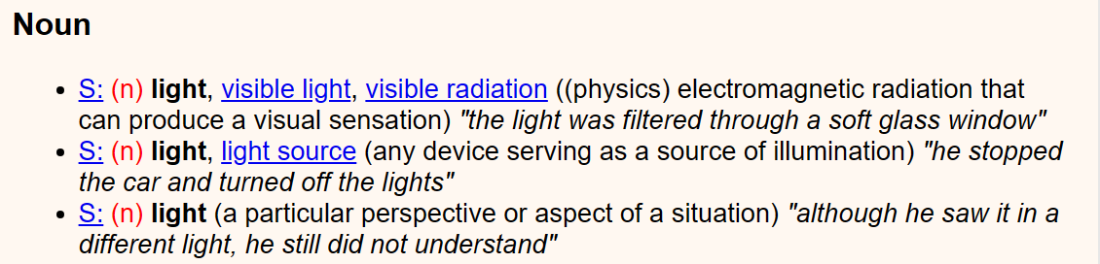
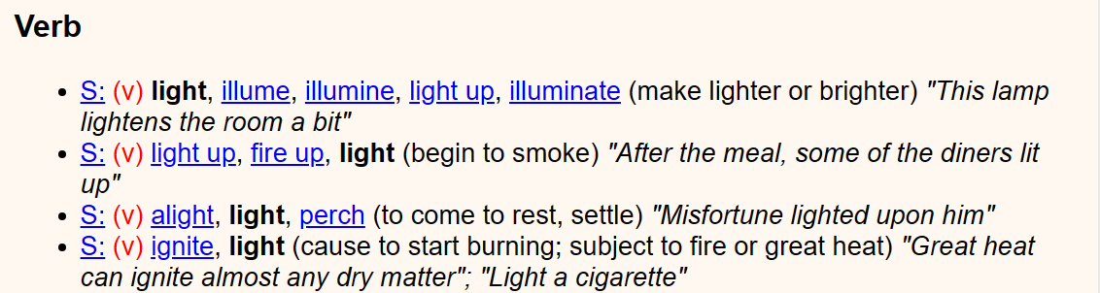
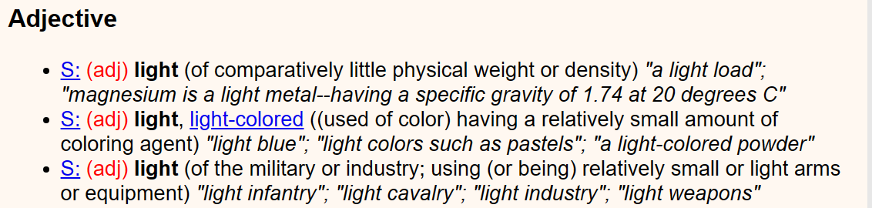
Slices of WordNet (‘light’)
Noun, verb, adjective (+adverb) senses of ‘light’
Multiple senses per POS
Each line represents a synset
Each synset comes with a (gloss) and an “example occurrence”
Synsets are connected by relations

Slide 5
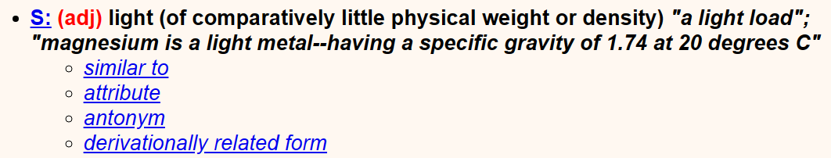
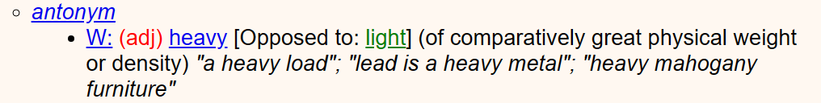
Relations between synsets in WordNet

Slide 6
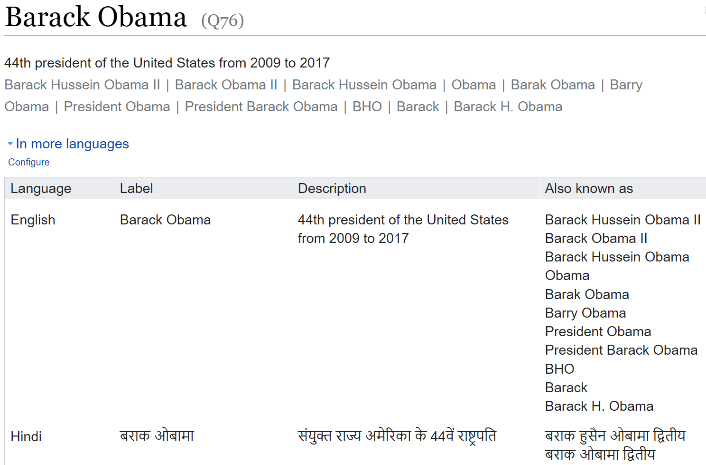
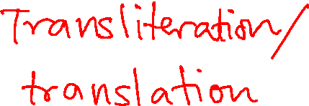
Glimpse of Wikidata: Entities (“topics”)
Name (can be ambiguous)
Unique canonical entity ID
A prominent description
Other English names or “aliases”
Aliases in other languages
Notes:
The wikidata page for Obama has a textual name, but it can be ambiguous and shared with other aliased entities.
But the canonical ID Q76 is unique throughout the KG.
There is a longer description, as well as aliases in many languages.

Slide 7
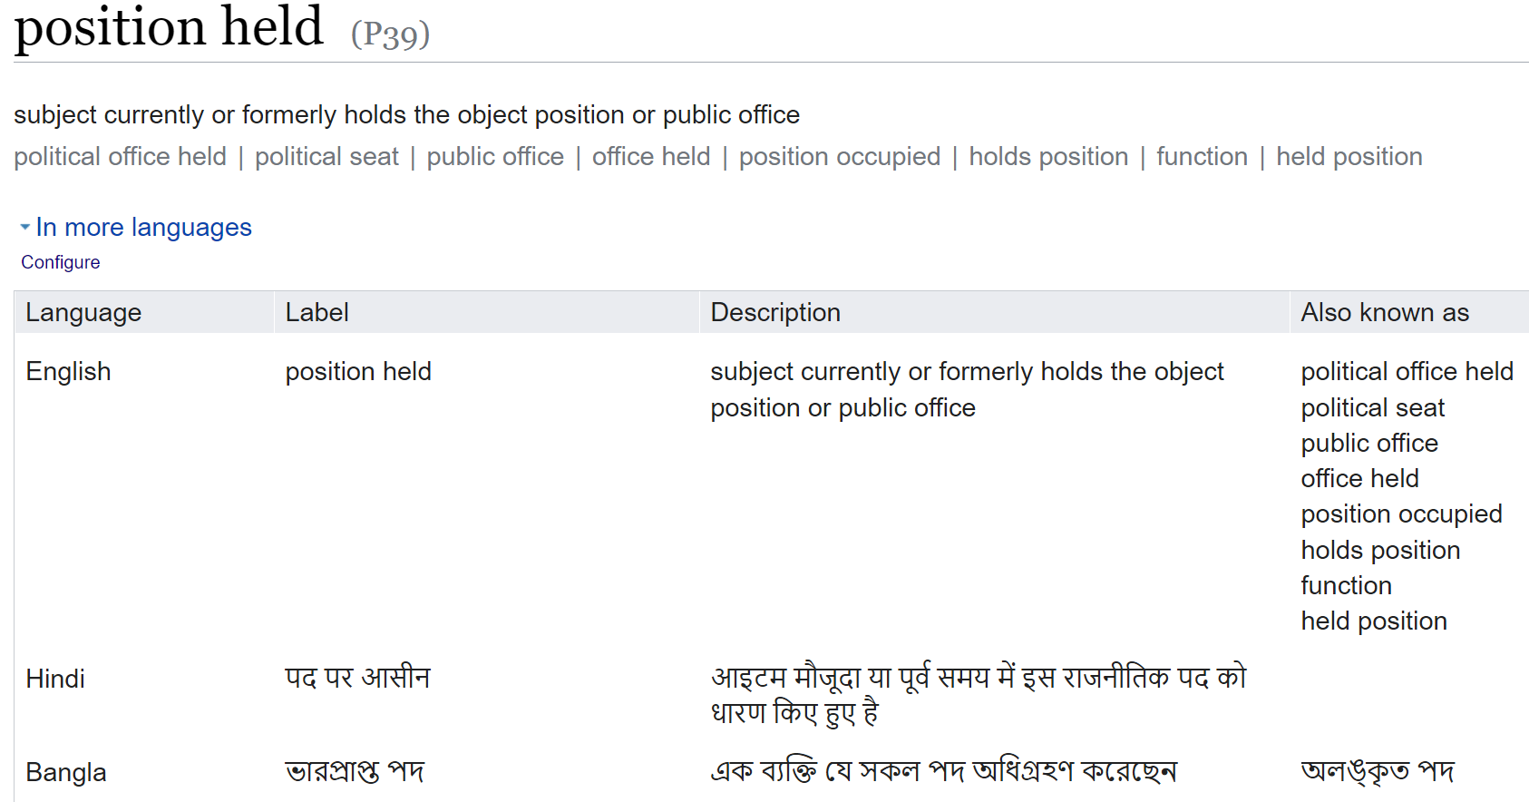
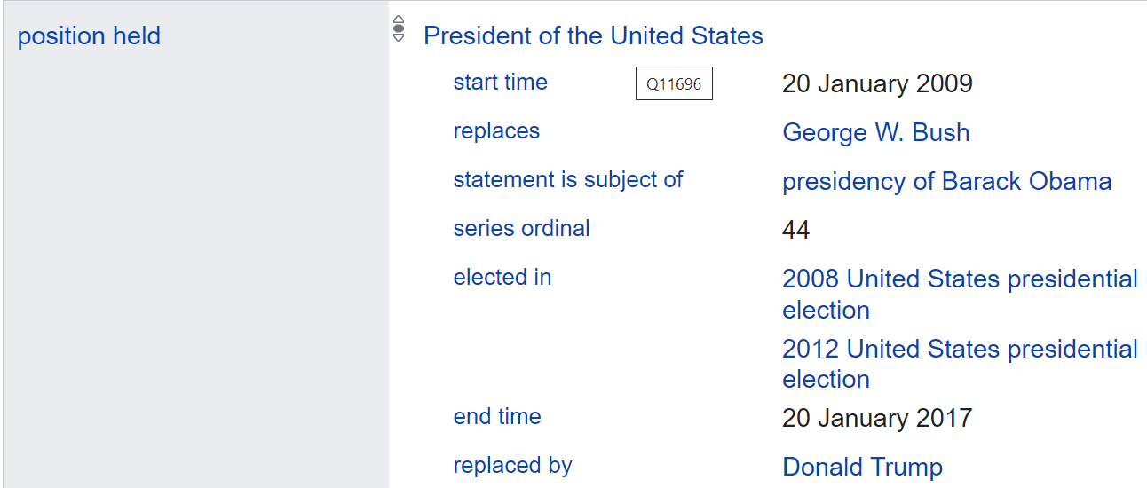
Glimpse of Wikidata: Relations (“statements”)
Unique canonical relation ID
Relation aliases in multiple languages
Notes:
Further down the Wikidata record for Barack Obama, we find that he is involved in a relation of type “position held”.
Clicking on that takes us to the record for that relation type, with canonical ID P39.
We also get textual aliases of the relation in various languages.

Slide 8
Knowledge graphs: Useful but incomplete
Used for question answering, product search, dialog, information extraction
Not possible to
manually cover
all human knowledge
nor stay current
Freebase relations | % INcomplete
/people/person/parents | 98.8
/people/person/places_lives | 96.6
/people/person/place_of_birth | 93.8
/people/person/employment_history | 92.3
/people/person/nationality | 78.5
/people/person/education | 79.2
[Min et al 2013]
Notes:
KGs are usually highly incomplete.
For example, 93.8% of persons from Freebase2 have no place of birth, and 78.5% have no nationality.
Therefore, automatic KG completion is of much interest, and has largely driven research on neural KG representation.
[https://www.aclweb.org/anthology/N13-1095.pdf]

Slide 9
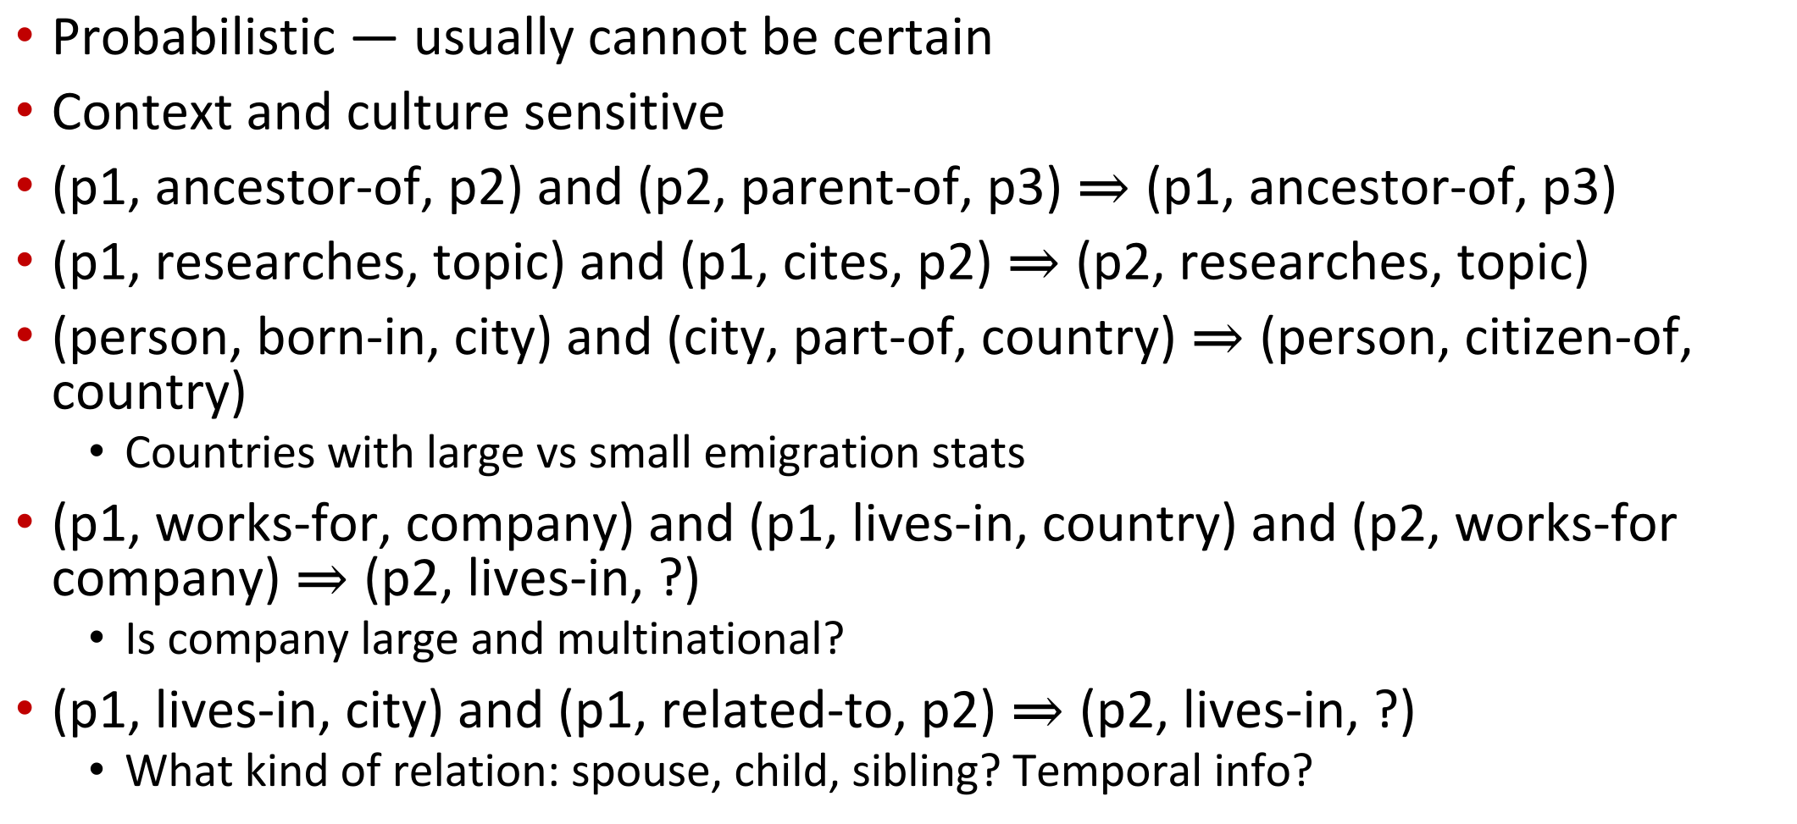
Remedy: KG completion
Probabilistic — usually cannot be certain
Context and culture sensitive
(p1, ancestor-of, p2) and (p2, parent-of, p3) $⇒$ (p1, ancestor-of, p3)
(p1, researches, topic) and (p1, cites, p2) $⇒$ (p2, researches, topic)
(person, born-in, city) and (city, part-of, country) $⇒$ (person, citizen-of, country)
  Countries with large vs small emigration stats
(p1, works-for, company) and (p1, lives-in, country) and (p2, works-for company) $⇒$ (p2, lives-in, ?)
  Is company large and multinational?
(p1, lives-in, city) and (p1, related-to, p2) $⇒$ (p2, lives-in, ?)
  What kind of relation: spouse, child, sibling? Temporal info?

Slide 10
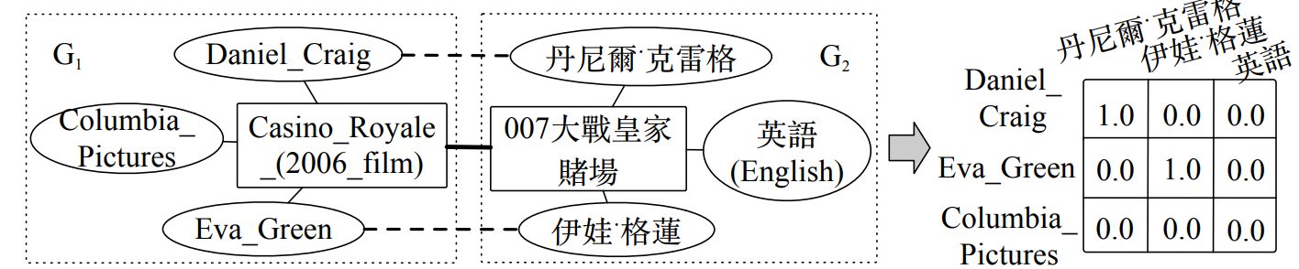
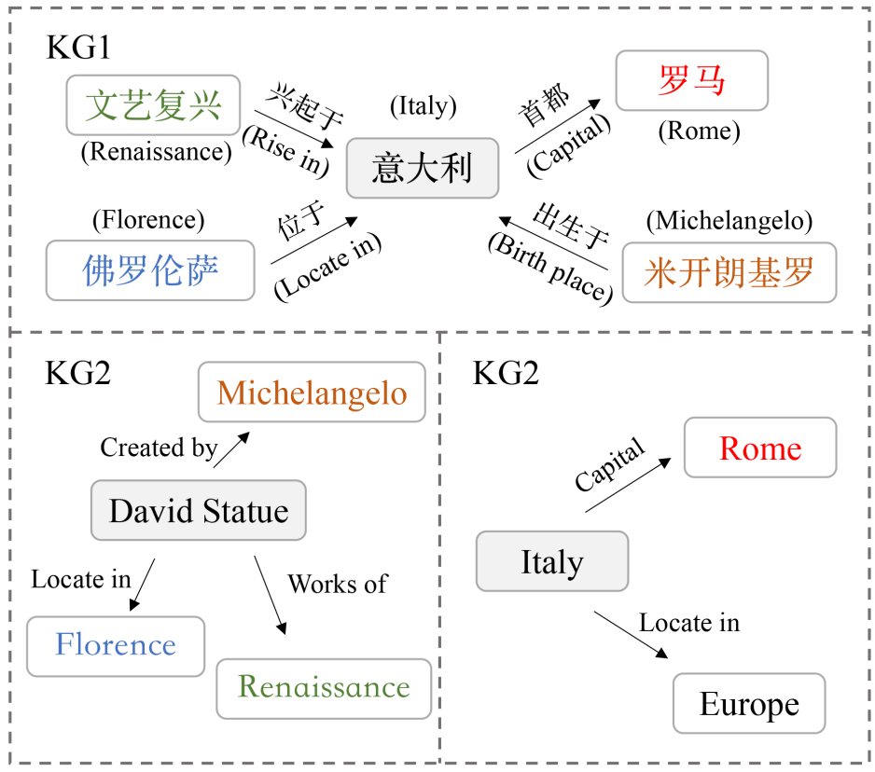
Remedy: KG alignment
Transliteration, translation give some clue for entity alignment
Agreement of neighboring entities is also a strong signal
Neighbors through what relation? May also be important
Synergy between entity and relation alignment, with KG completion
Notes:
Alignment between multiple KGs is also a promising way to improve the completeness of all of them.
KG alignment has progressed through a sequence of ideas.
Entity names and descriptions give vital clues, particularly if we are armed with translation and transliteration tools.
To decide if two entities should be aligned, it helps to know if they have some aligned neighbors.
It may help further to know through what relations these aligned neighbors are connected.
We can also formulate multi-task learning problems to explore the synergy between …

Slide 11
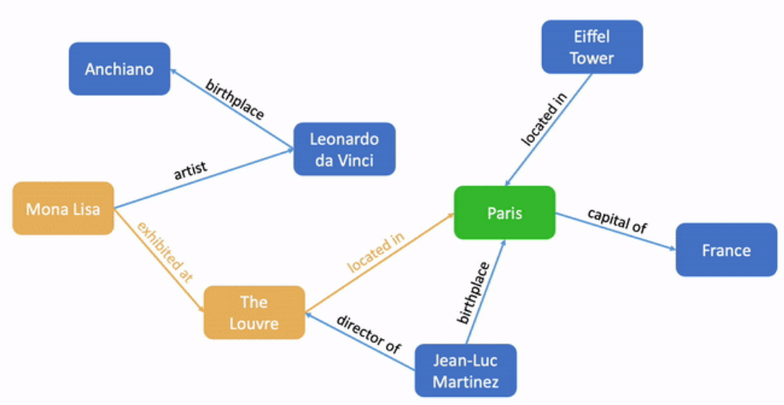
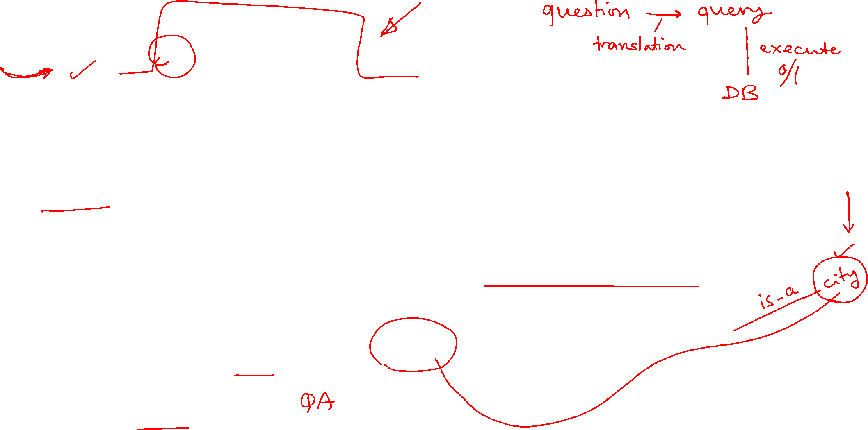
Application: KG-based question answering (KGQA)
What city is the Mona Lisa in?
Disambiguate Mona Lisa (‘the’?)
Infer that exhibited-at followed by located-in implies Mona Lisa is in Paris
Look up or infer that
Paris is a city
Approaches
  Semantic interpretation
  End-to-end trainable
Notes:
Question answering is a prominent application depending on knowledge graphs.
Here we show a KG fragment and an associated query: …

Slide 12
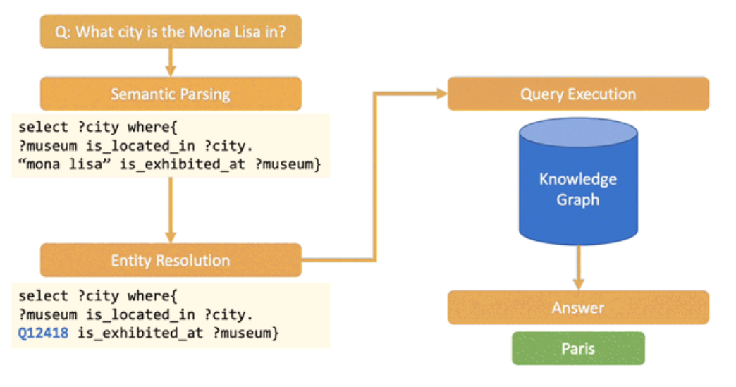
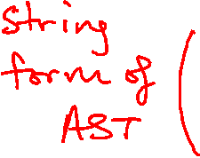
Application: Semantic interpretation
Translate natural language question to structured query cognizant of KG schema
Execute structured query on KG
 Interpretable
 Tricky to
implement
 Not (easily)
end-to-end
trainable
Notes:
In the semantic interpretation approach …

Slide 13
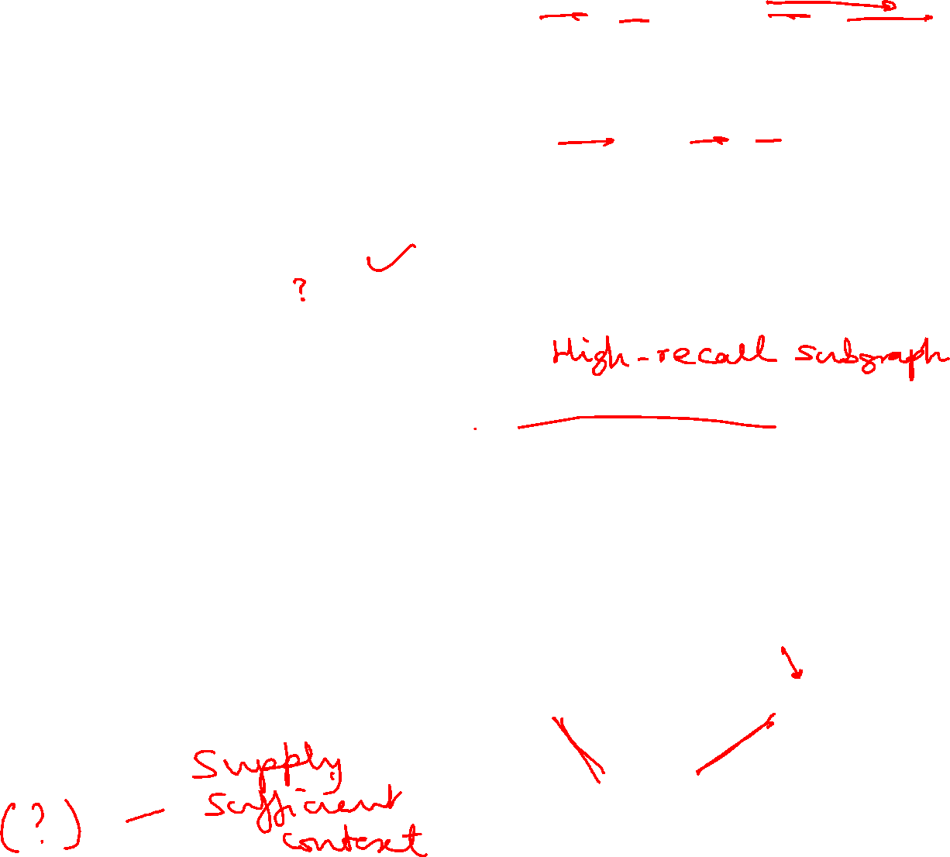
Application: “Differentiable KG”
Find dense query embedding (e.g., using BERT)
Find dense graph embedding (e.g., GCN, graph transformer)
Cross attention layers establish correspondences between query and
graph elements
Answer selection identifies graph element(s) to transcribe to response
End-to-end trainable, no logical form needed
Not easily interpretable
What city is the Mona Lisa in?
Contextual text representation
Answer selection
Cross-attention network
Paris
Graph representation learning
Notes:
The alternative to semantic interpretation is to represent KGs as continuous artifacts and KGQA as a continuous scoring function.

Slide 14
Knowledge Graphs
(Fact Scoring)
CS728
Soumen Chakrabarti

Slide 15
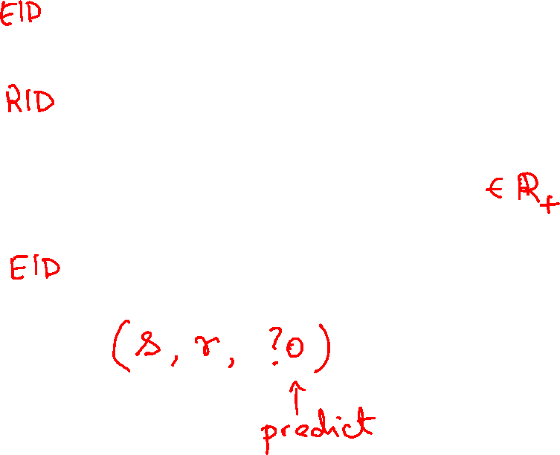
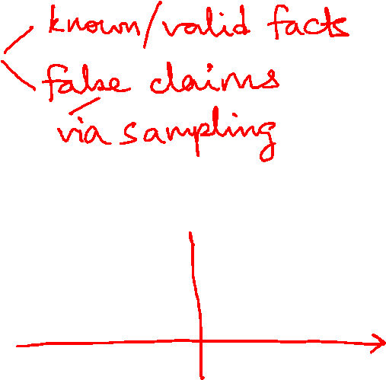
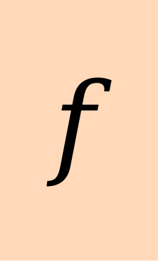
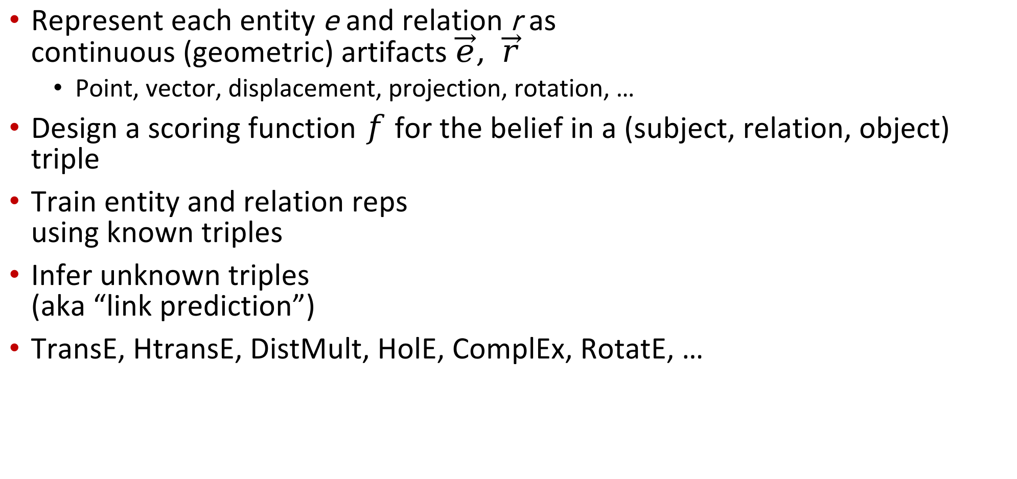
Knowledge graph completion (KGC)
Represent each entity e and relation r as
continuous (geometric) artifacts $\vec{e}, \vec{r}$
  Point, vector, displacement, projection, rotation, …
Design a scoring function $f$ for the belief in a (subject, relation, object) triple
Train entity and relation reps
using known triples
Infer unknown triples
(aka “link prediction”)
TransE, HtransE, DistMult, HolE, ComplEx, RotatE, …
subject
$$f$$
relation
belief
object
Notes:
We mentioned earlier that KGs are very incomplete.
Inferring missing facts is a key driver of neural KG representation.
The task is called knowledge graph or knowledge base completion; KGC or KBC.
It can also be regarded as a generalization of link prediction in social networks.
Each entity and relation may be represented as some artifact in a geometric space.
They may be points, vectors, displacements, hyperplanes, matrices, projections, rotations, etc.
The centerpiece of KGC is the scoring function, shown by this box.
It computes the belief that a specified fact is true.
We can also use it to score a missing argument (say, object) and rank candidate objects.
In principle, a deep network with sufficient capacity should be able to learn f given enough examples.
In practice, almost a decade and thousands of papers later, we don’t really know what the best f should be.

Slide 16
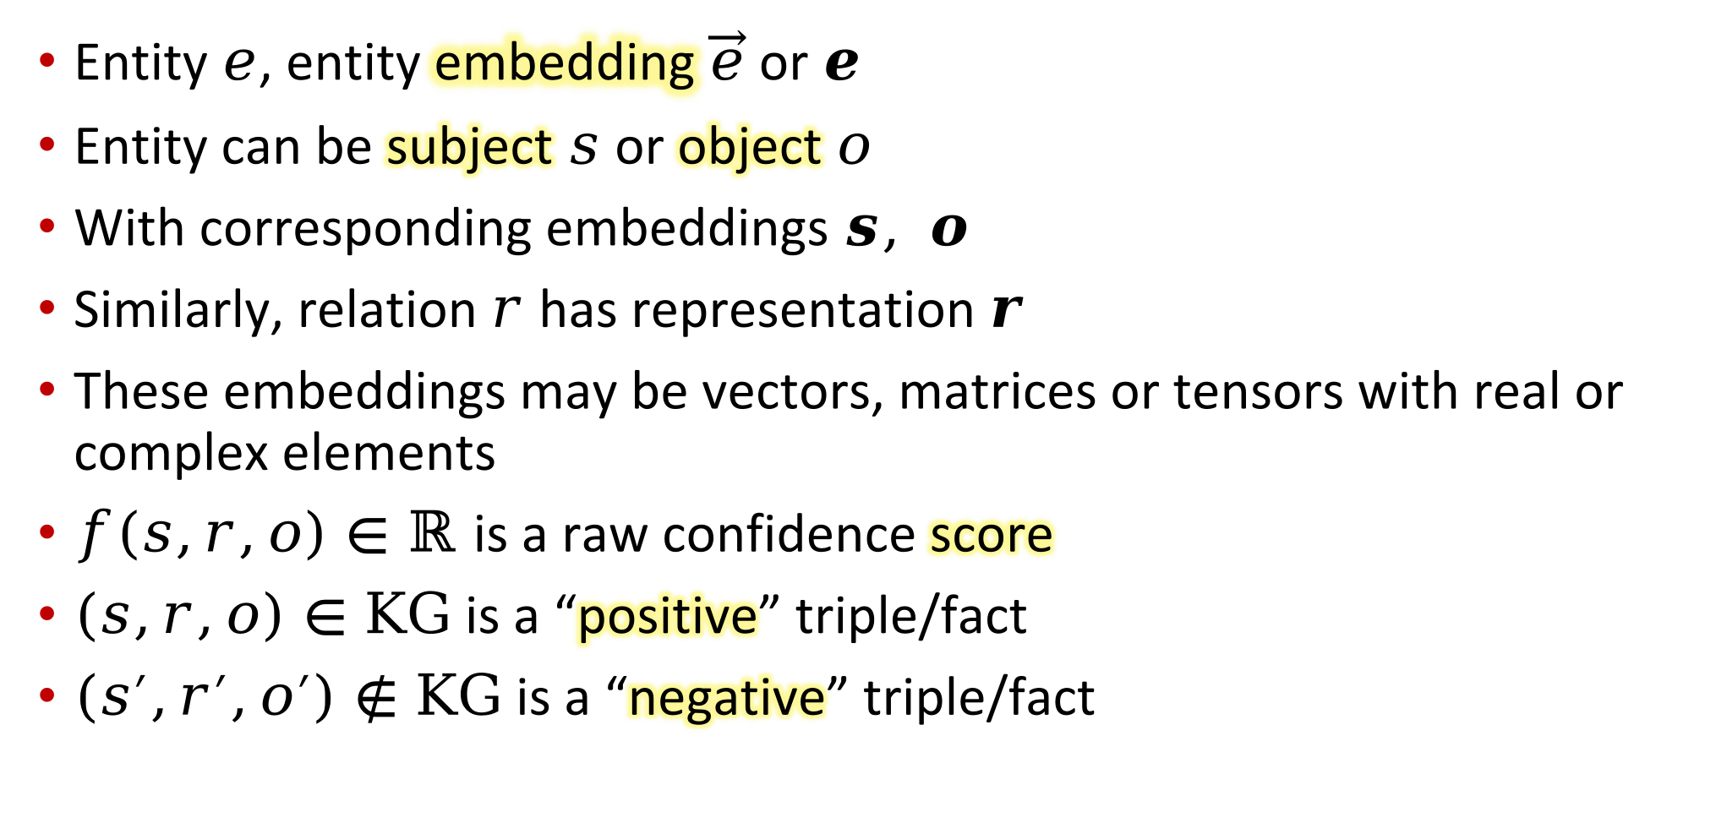
Initial notation
Entity $e$, entity embedding $\vec{e}$ or $e$
Entity can be subject $s$ or object $o$
With corresponding embeddings $s, o$
Similarly, relation $r$ has representation $r$
These embeddings may be vectors, matrices or tensors with real or complex elements
$f\left(s,r,o\right)∈ℝ$ is a raw confidence score
$\left(s,r,o\right)∈KG$ is a “positive” triple/fact
$\left(s^{′},r^{′},o^{′}\right)∉KG$ is a “negative” triple/fact

Slide 17



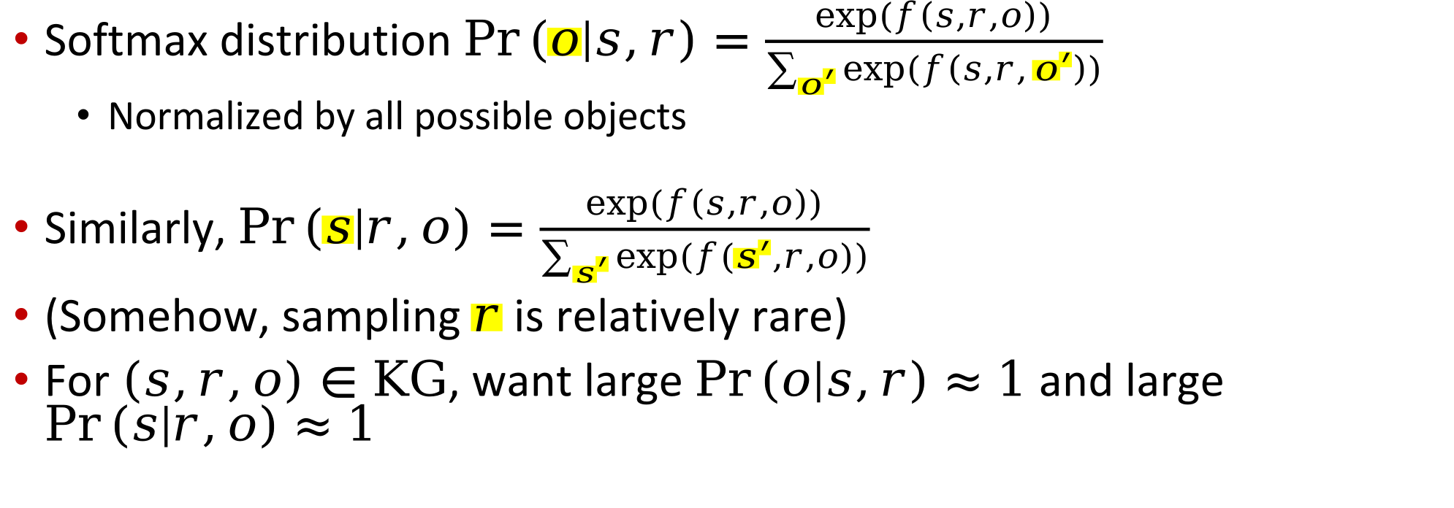
From score to probability
$$r$$
$$s$$
$$?$$
Softmax distribution $\operatorname{Pr}\left(o | s,r\right)=\frac{exp⁡(f\left(s,r,o\right))}{\sum_{o^{′}}{exp⁡(f\left(s,r,o^{′}\right))}}$
  Normalized by all possible objects
Similarly, $\operatorname{Pr}\left(s | r,o\right)=\frac{exp⁡(f\left(s,r,o\right))}{\sum_{s^{′}}{exp⁡(f\left(s^{′},r,o\right))}}$
(Somehow, sampling $r$ is relatively rare)
For $\left(s,r,o\right)∈KG$, want large $\operatorname{Pr}\left(o | s,r\right)≈1$ and large $\operatorname{Pr}\left(s | r,o\right)≈1$
Notes:
The raw score f can be turned into probabilities by a suitable softmax operation.
If s is known and o is unknown, we want to normalize by a sum over all possible objects.
Conversely, if s is unknown, we want to normalize by a sum over all possible subjects..
If (s,r,o) is a true fact, we want …

Slide 18
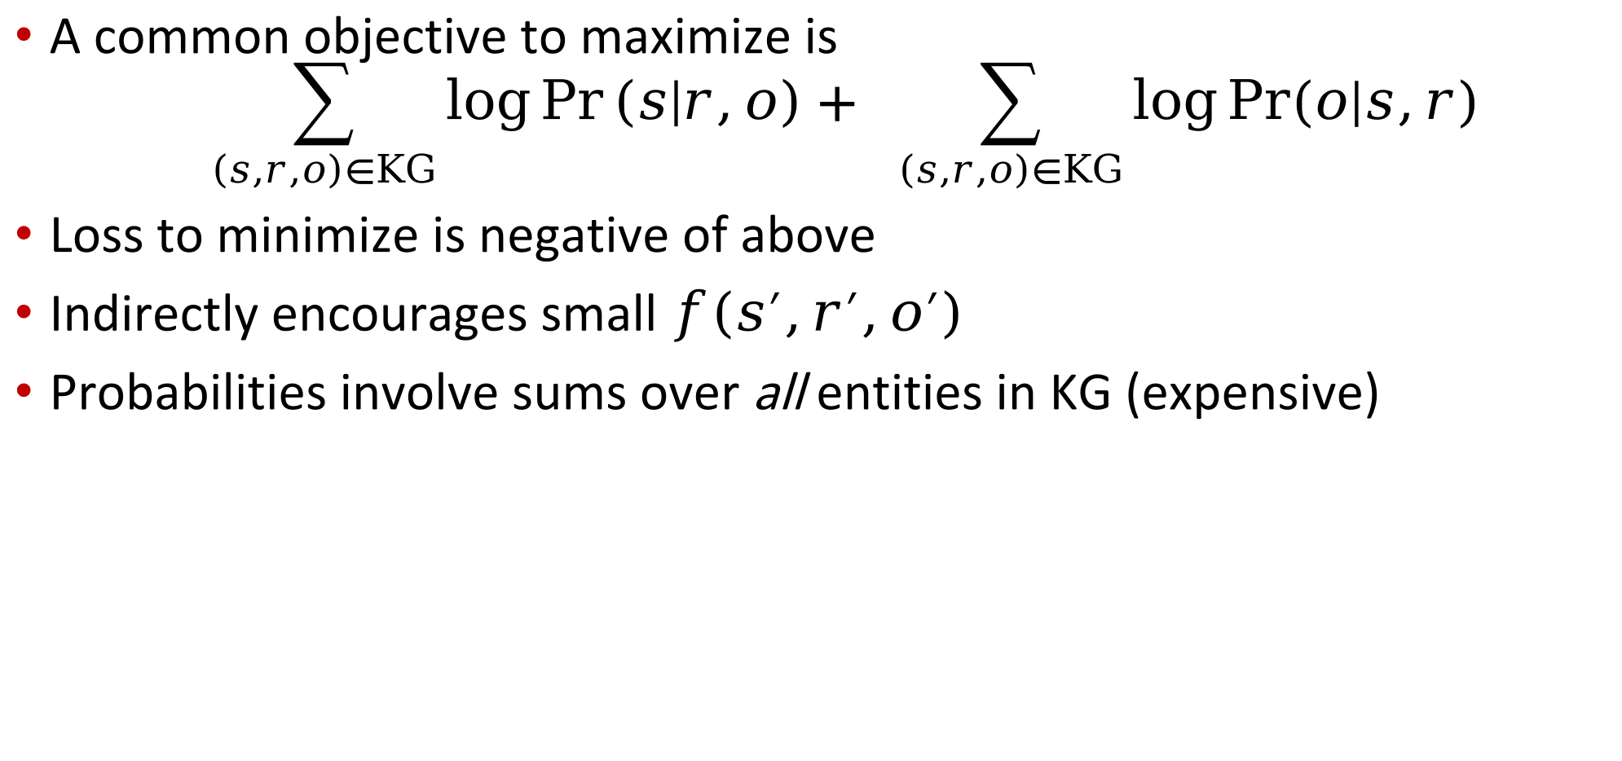
Probability to loss function
A common objective to maximize is
$$\sum_{\left(s,r,o\right)∈KG}{\log{\operatorname{Pr}\left(s | r,o\right)+ \sum_{\left(s,r,o\right)∈KG}{\log{Pr⁡(o|s,r)}}}}$$
Loss to minimize is negative of above
Indirectly encourages small $f\left(s^{′},r^{′},o^{′}\right)$
Probabilities involve sums over all entities in KG (expensive)
Notes:
Next, we can turn these probabilities into a loss to minimize by taking negative log of the probability.
Here the sums are over only true facts in the KG, which is very sparse compared to all possible KG facts.
However, as we have seen, the probabilities involve sums over all entities in the KG.
Therefore, direct evaluation of the log-likelihood loss may become expensive.

Slide 19
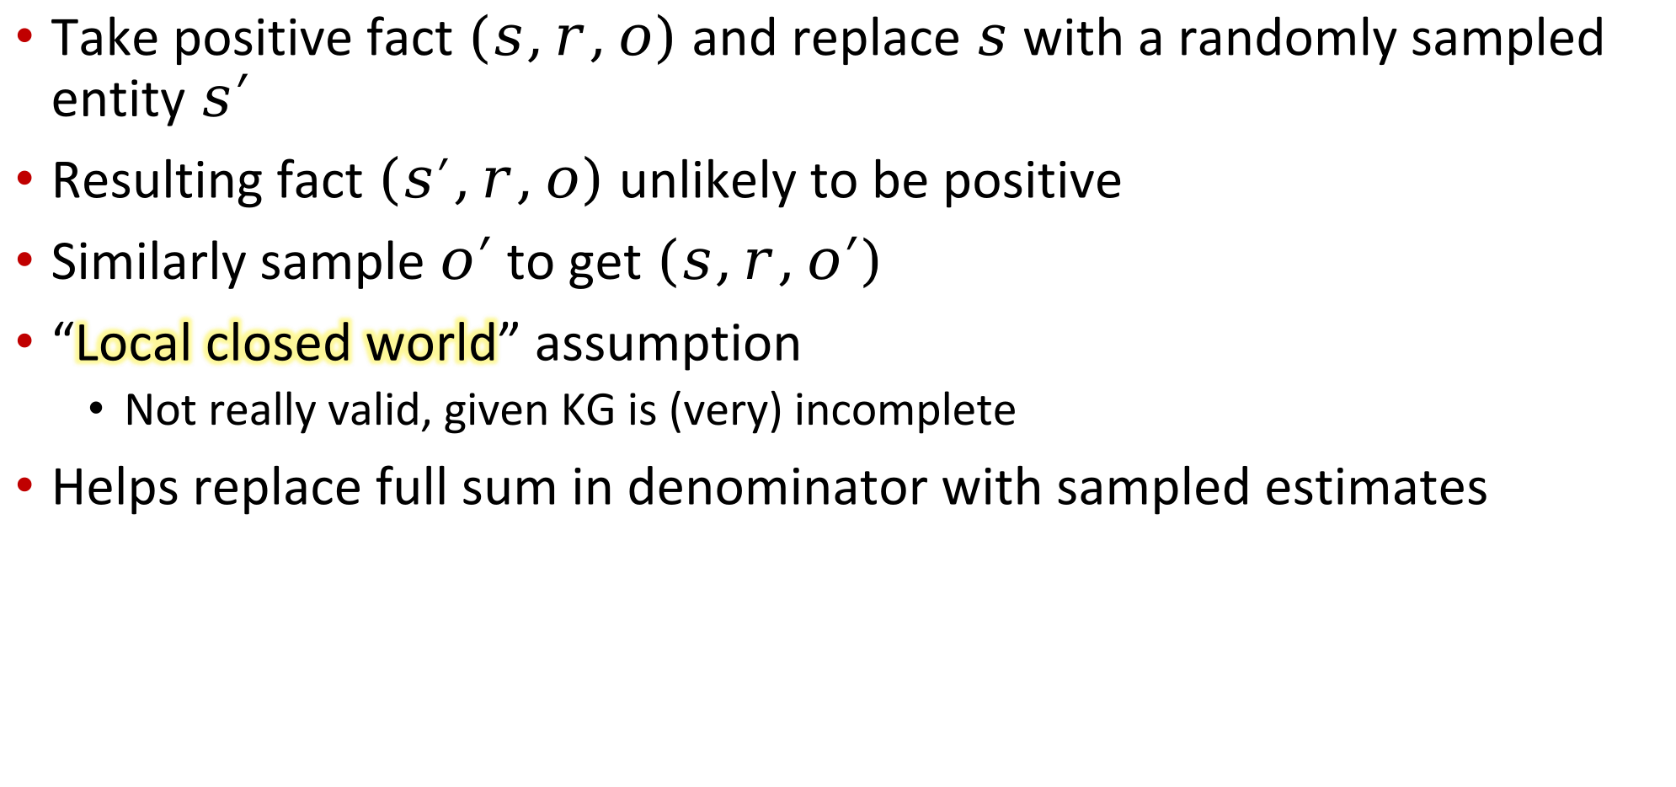
Negative sampling
Take positive fact $(s,r,o)$ and replace $s$ with a randomly sampled entity $s′$
Resulting fact $\left(s^{′},r,o\right)$ unlikely to be positive
Similarly sample $o′$ to get $\left(s,r,o′\right)$
“Local closed world” assumption
  Not really valid, given KG is (very) incomplete
Helps replace full sum in denominator with sampled estimates
Notes:
A popular way out is to replace the full score summation over all candidates with a relatively small number of “presumed” negative samples.
In the kind of batched stochastic gradient descent optimization used in deep learning today, explicitly checking that a sampled fact is negative or false
(or at least not known to be true) may be cumbersome.
Instead, implementers just knock out one of the fields in a fact, and replace with a sample.
The local closed world assumption says the resulting perturbed triple is unlikely to be valid.
By repeated sampling, we can gain back reasonable estimates of the softmax denominator.

Slide 20
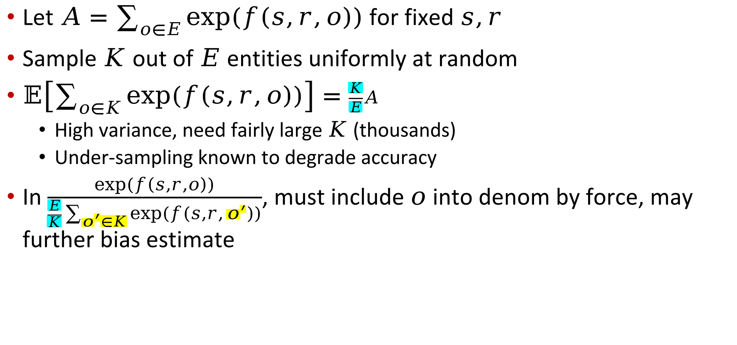
Uniform negative sampling
Let $A=\sum_{o∈E}{exp⁡(f\left(s,r,o\right))}$ for fixed $s,r$
Sample $K$ out of $E$ entities uniformly at random
$𝔼\left[\sum_{o∈K}{exp⁡(f\left(s,r,o\right))}\right]=\frac{K}{E}A$
  High variance, need fairly large $K$ (thousands)
  Under-sampling known to degrade accuracy
In $\frac{exp⁡(f\left(s,r,o\right))}{\frac{E}{K}\sum_{o^{′}∈K}{exp⁡(f\left(s,r,o^{′}\right))}}$, must include $o$ into denom by force, may further bias estimate
Notes:
Consider the sum A over all entities as objects in score function f.
If we uniformly sample K out of E entities, we get an estimate of A multiplied by K over E.
Therefore, we can compensate by multiplying with E over K.
To keep probabilities between 0 and 1, we usually force the gold object to be included into the denominator.
These estimates can be very noisy. Empirically, K in the several thousands works best for popular benchmarks.
In fact, just by increasing K from a few hundred to several thousand, we could make old methods beat some newer ones.

Slide 21
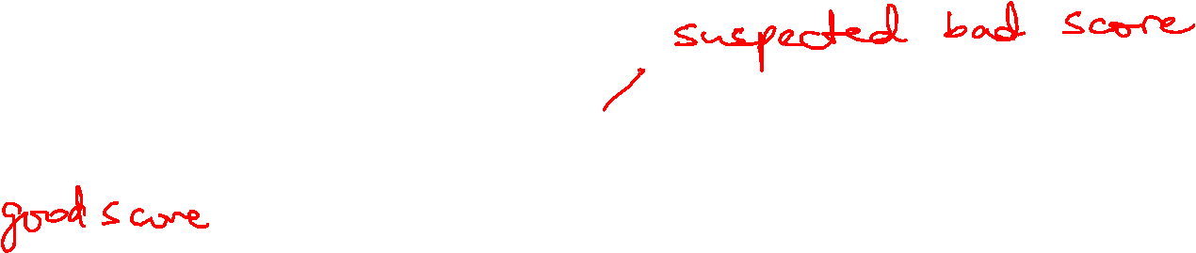
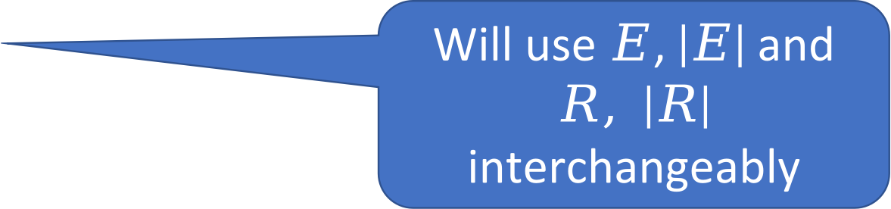
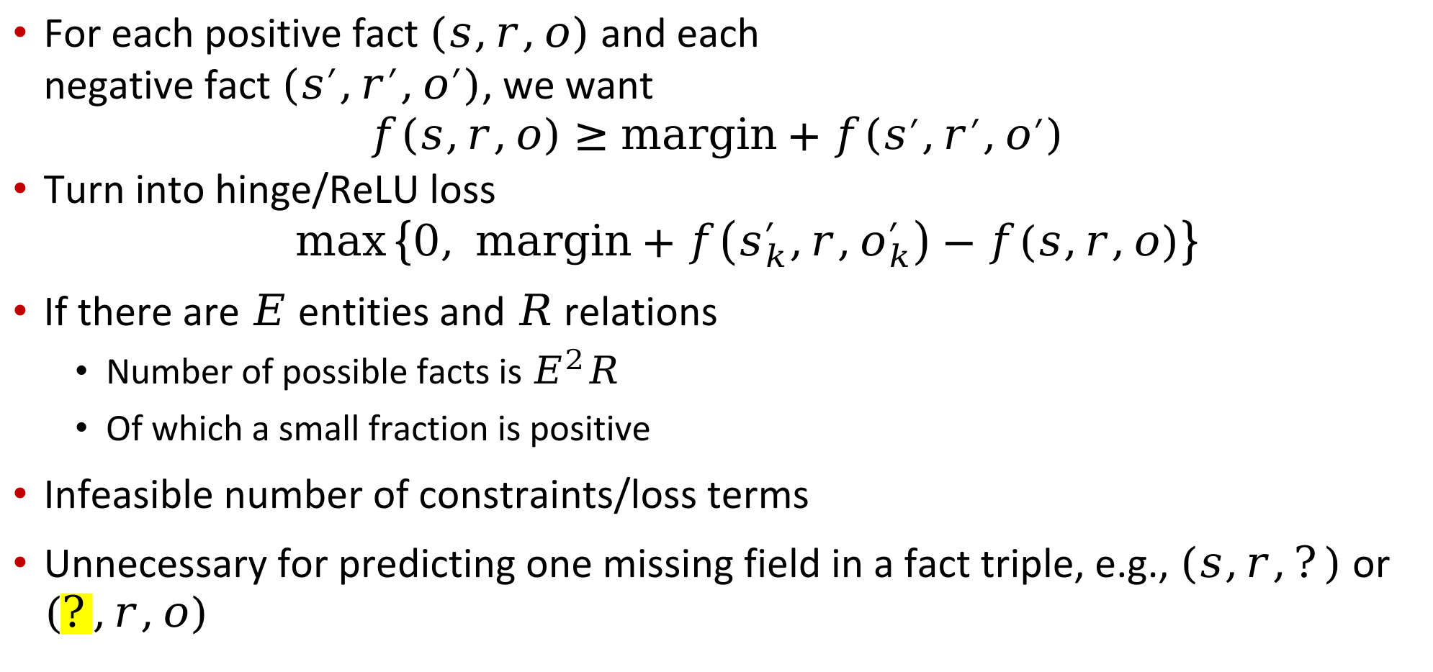
Discriminative training (à la SVM)
For each positive fact $(s,r,o)$ and each
negative fact $\left(s^{′},r^{′},o^{′}\right)$, we want
$$f\left(s,r,o\right)≥margin+f\left(s^{′},r^{′},o^{′}\right)$$
Turn into hinge/ReLU loss
$$\max\left\{0, margin+f\left(s_{k}^{′},r,o_{k}^{′}\right)−f(s,r,o)\right\}$$
If there are $E$ entities and $R$ relations
  Number of possible facts is $E^{2}R$
  Of which a small fraction is positive
Infeasible number of constraints/loss terms
Unnecessary for predicting one missing field in a fact triple, e.g., $(s,r,?)$ or $(?,r,o)$
Will use $E$, $\left|E\right|$ and $R, \left|R\right|$ interchangeably
Notes:
Before moving on to evaluation, let me quickly visit the other style of training: the discriminative loss.
The idea is that the f score of a true fact should be much larger than the score of a false fact.
This can be turned into a hinge or ReLU loss as usual.
Our earlier problem persists: there are too many constraints or loss terms, because there are so many false facts.
Again, the solution is negative sampling.

Slide 22
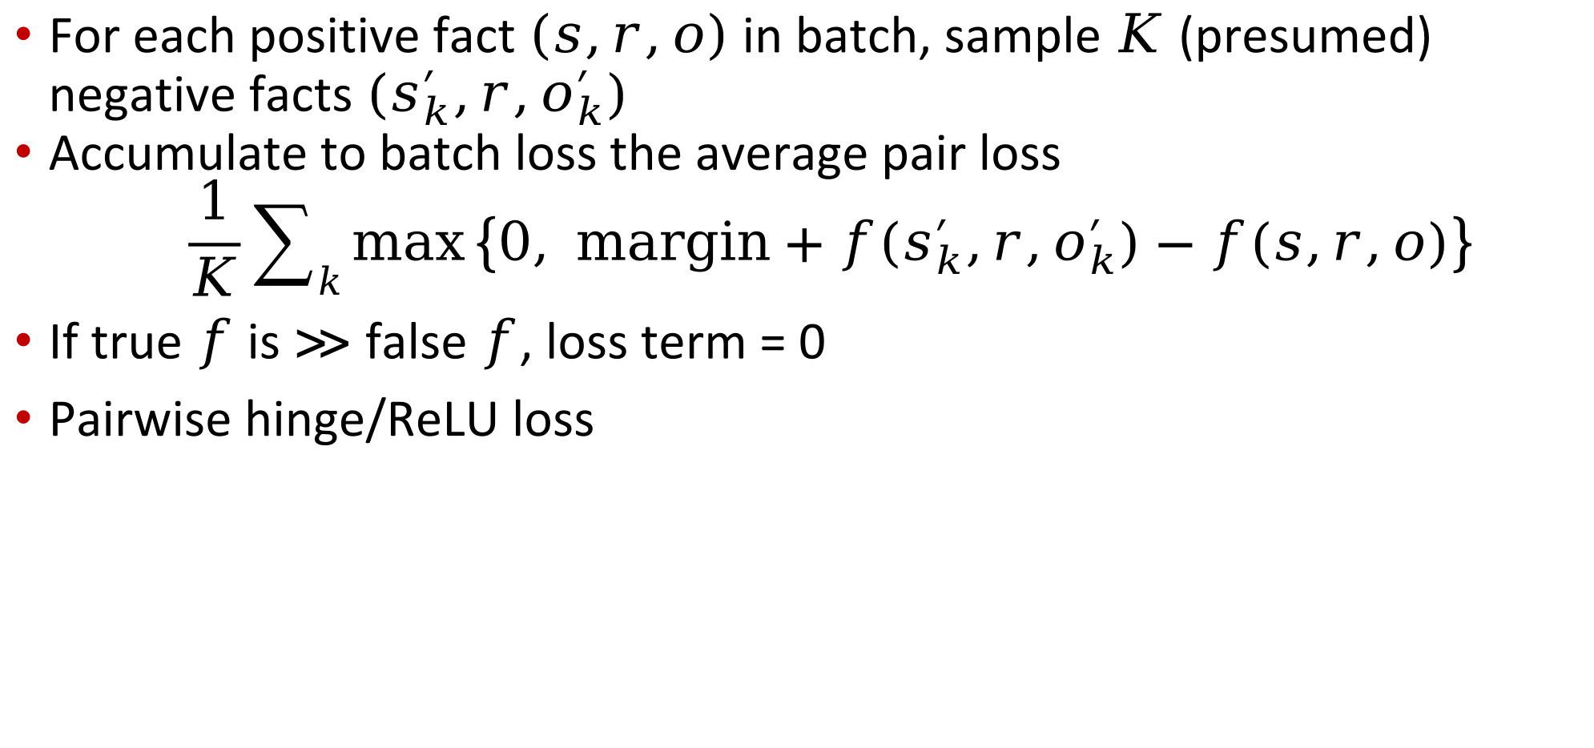
Sampling for discriminative training
For each positive fact $\left(s,r,o\right)$ in batch, sample $K$ (presumed) negative facts $(s_{k}^{′},r,o_{k}^{′})$
Accumulate to batch loss the average pair loss
$$\frac{1}{K}\sum_{k}{\max\left\{0, margin+f\left(s_{k}^{′},r,o_{k}^{′}\right)−f(s,r,o)\right\}}$$
If true $f$ is $≫$ false $f$, loss term = 0
Pairwise hinge/ReLU loss

Slide 23
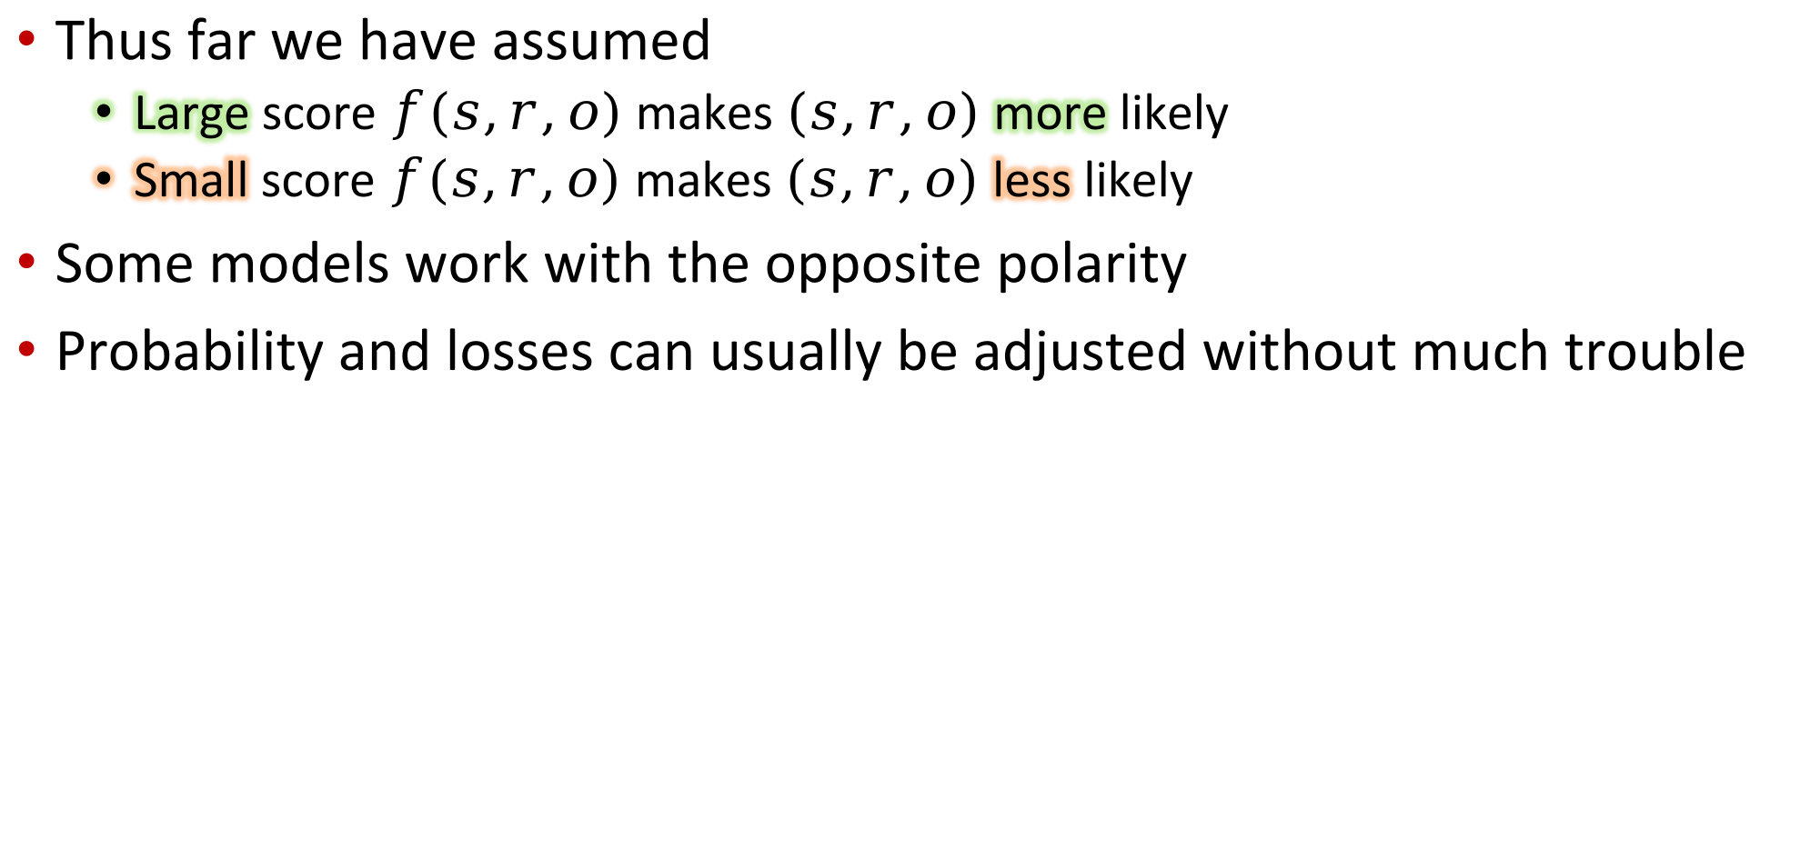
Score polarity
Thus far we have assumed
  Large score $f(s,r,o)$ makes $(s,r,o)$ more likely
  Small score $f(s,r,o)$ makes $(s,r,o)$ less likely
Some models work with the opposite polarity
Probability and losses can usually be adjusted without much trouble
Notes:
Another minor footnote before we move on.

Slide 24
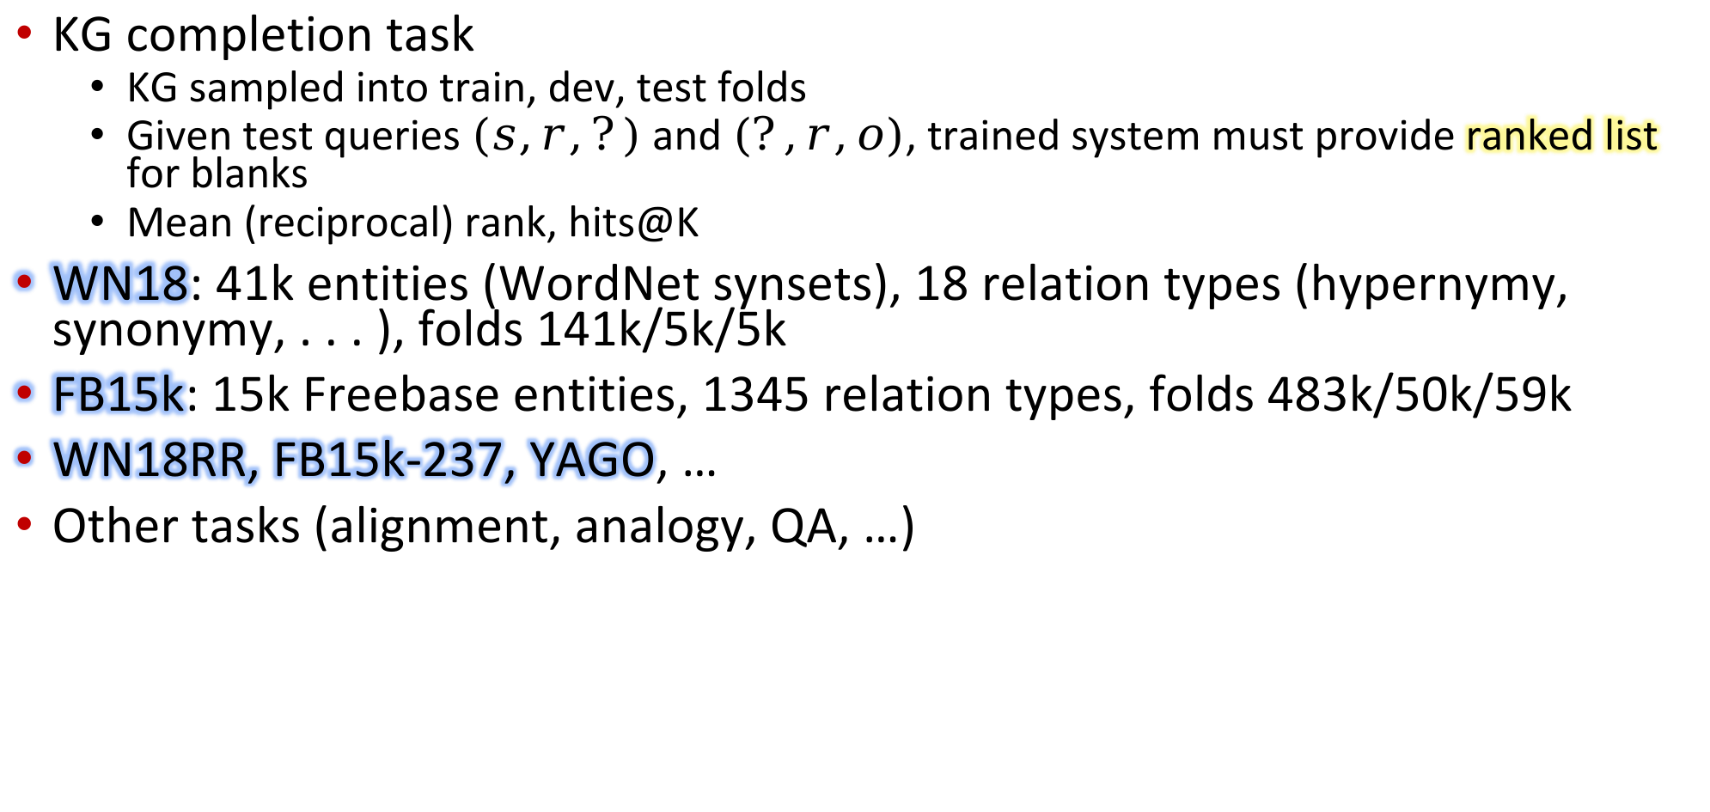
Testing embedding and score quality
KG completion task
  KG sampled into train, dev, test folds
  Given test queries $(s,r,?)$ and $(?,r,o)$, trained system must provide ranked list for blanks
  Mean (reciprocal) rank, hits@K
WN18: 41k entities (WordNet synsets), 18 relation types (hypernymy, synonymy, . . . ), folds 141k/5k/5k
FB15k: 15k Freebase entities, 1345 relation types, folds 483k/50k/59k
WN18RR, FB15k-237, YAGO, …
Other tasks (alignment, analogy, QA, …)
Notes:
The quality of KG embeddings is usually measured as the quality of discovering purposefully withheld facts.

Slide 25
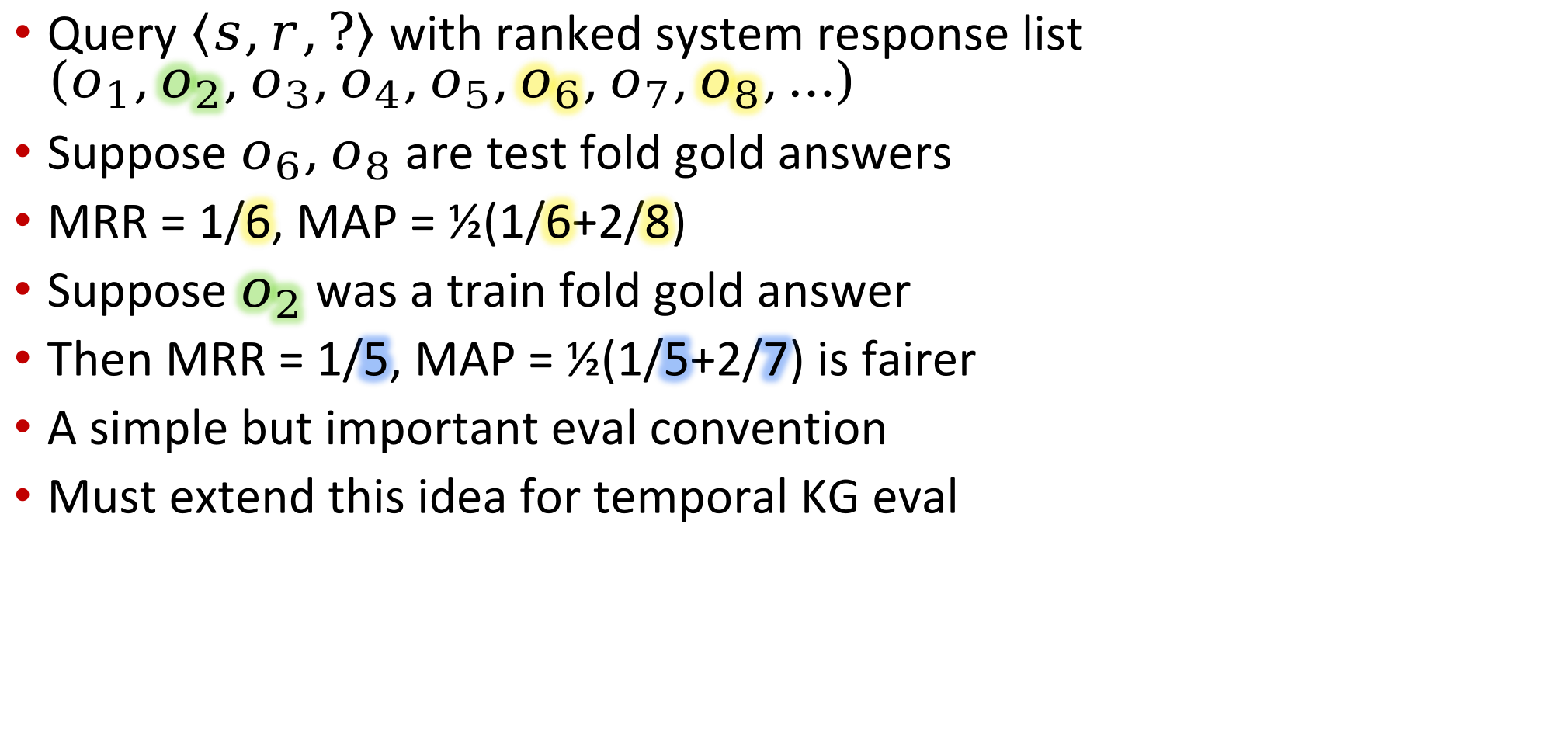
Filtered evaluation
Query $\left\langle s,r,?\right\rangle$ with ranked system response list $\left(o_{1},o_{2},o_{3},o_{4},o_{5},o_{6},o_{7},o_{8},…\right)$
Suppose $o_{6},o_{8}$ are test fold gold answers
MRR = 1/6, MAP = ½(1/6+2/8)
Suppose $o_{2}$ was a train fold gold answer
Then MRR = 1/5, MAP = ½(1/5+2/7) is fairer
A simple but important eval convention
Must extend this idea for temporal KG eval
Notes:
Another important footnote regarding evaluation.

Slide 26
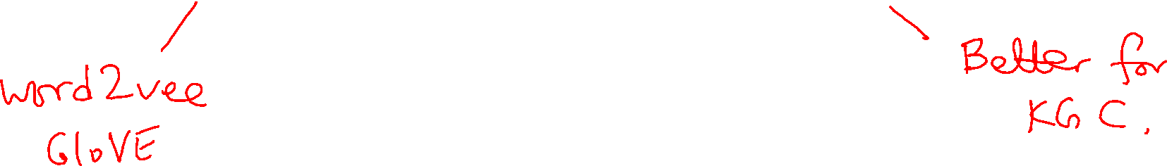
KG Completion:
Translation and Rotation
CS728
Soumen Chakrabarti

Slide 27

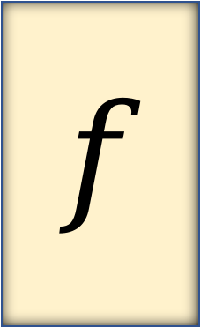
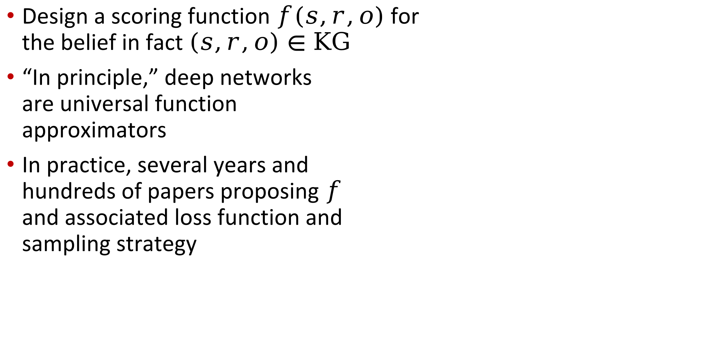
Design of scoring function $f$
Design a scoring function $f(s,r,o)$ for
the belief in fact $\left(s,r,o\right)∈KG$
“In principle,” deep networks
are universal function
approximators
In practice, several years and
hundreds of papers proposing $f$
and associated loss function and
sampling strategy
subject
$$f$$
relation
belief
object
Notes:
Recall that solving KG completion entails the design of
(a) embeddings for entities and relations and
(b) the score function f that discriminates between likely and unlikely facts.
Let us review the earliest efforts at KG representation, inspired from word embeddings.

Slide 28
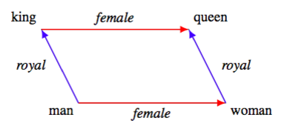
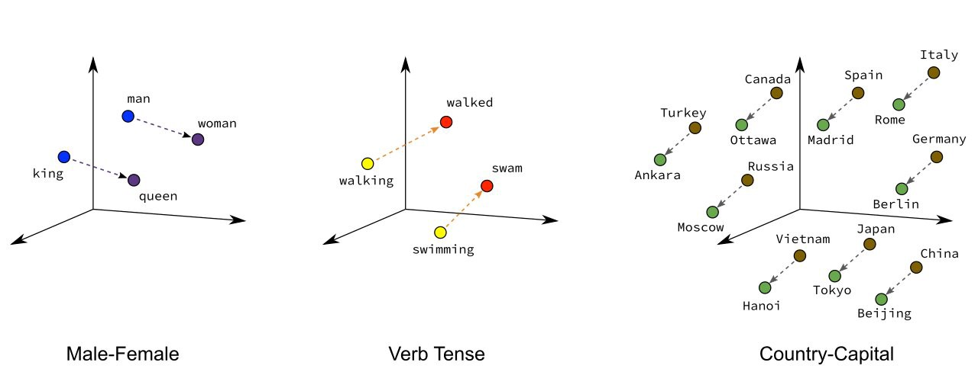
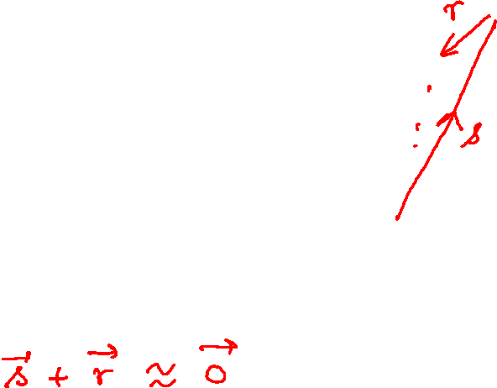
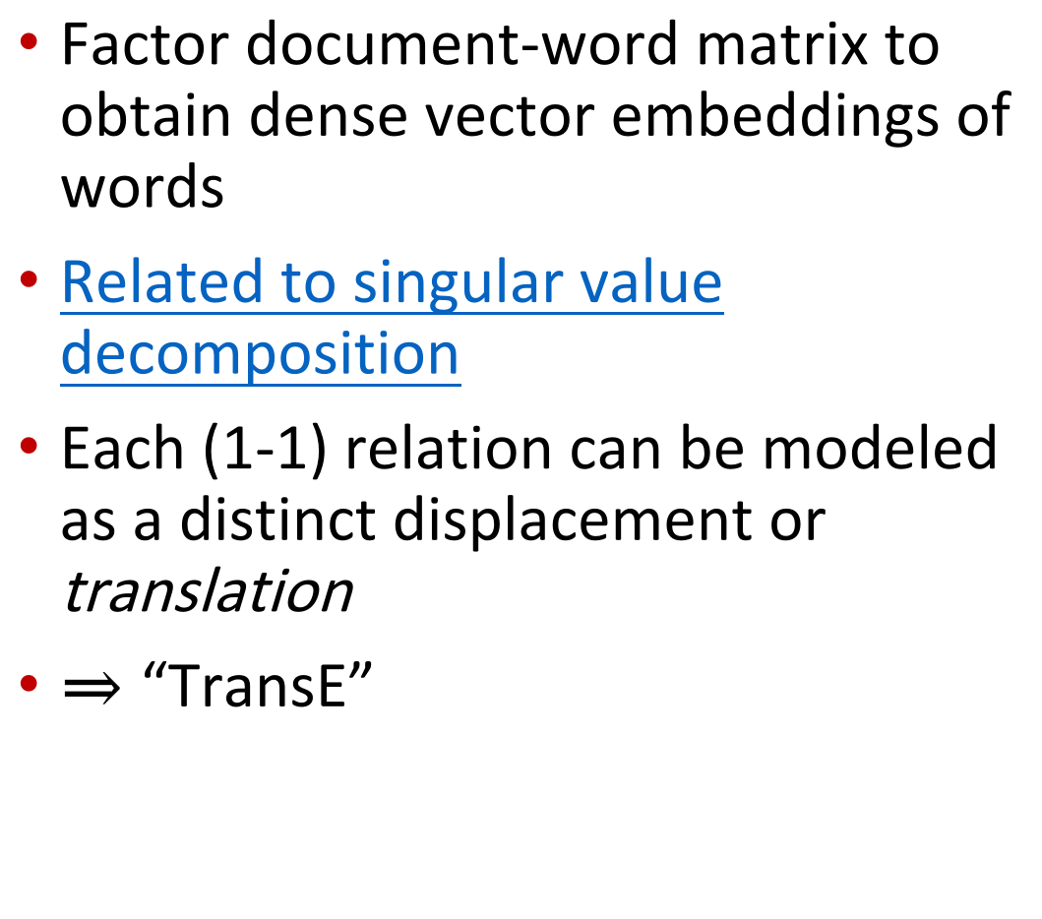
Quick review of word2vec and GloVE
Factor document-word matrix to obtain dense vector embeddings of words
Related to singular value decomposition
Each (1-1) relation can be modeled as a distinct displacement or translation
$⇒$ “TransE”
Notes:
Before we get to early KG representations, we will take a detour into word embeddings.
You are likely all familiar with word2vec and GloVE, word embedding methods that kicked off the field of deep NLP.
Despite some differences in formulation, both effectively find low rank factors of some form of the document-word matrix.
Word2vec is related to singular value decomposition of a transformed document-word matrix.
What made word embeddings really intriguing is the curious property of parallel translations.
Specifically, the vector for king minus the vector for man was approximately similar or parallel to the vector for queen minus the vector for woman.
Therefore, it seems like starting from man and displacing or translating it by a vector corresponding to royalness takes us to king.
Moving away from text, can KG entities be embedded into vectors such that each relation corresponds to a translation?
For example, can we embed countries and capital cities so that the relation “capital-of” is the same translation for all such pairs?
Let’s find out, with the earliest KG embedding scheme, TransE.

Slide 29
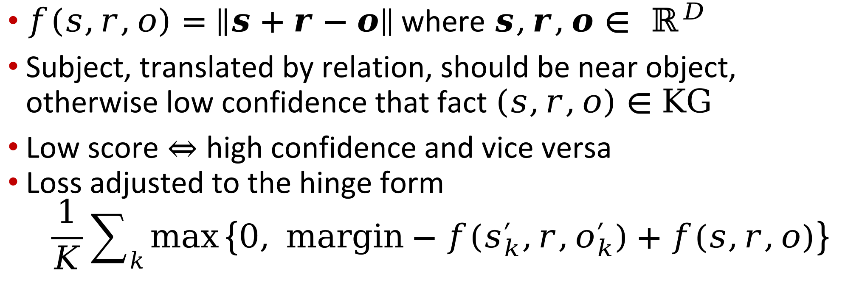
TransE
$f\left(s,r,o\right)=\left\|s+r−o\right\|$ where $s,r,o∈ ℝ^{D}$
Subject, translated by relation, should be near object, otherwise low confidence that fact $\left(s,r,o\right)∈KG$
Low score $⇔$ high confidence and vice versa
Loss adjusted to the hinge form
$$\frac{1}{K}\sum_{k}{\max\left\{0, margin−f\left(s_{k}^{′},r,o_{k}^{′}\right)+f(s,r,o)\right\}}$$
Want large
Want small
Notes:
In TransE, if we translate or displace subject vector s by the relation vector r, we want to land up close to the object vector, if (subject, relation, object) is in the KG.
Conversely, if subject + relation is not close to object, we have low confidence in that fact.
For each positive triple (s,r,o), we sample K negative triples. For each such good-bad pair, we want the bad score to be large and the good score to be small.
We adjust the ReLU or hinge loss accordingly.

Slide 30

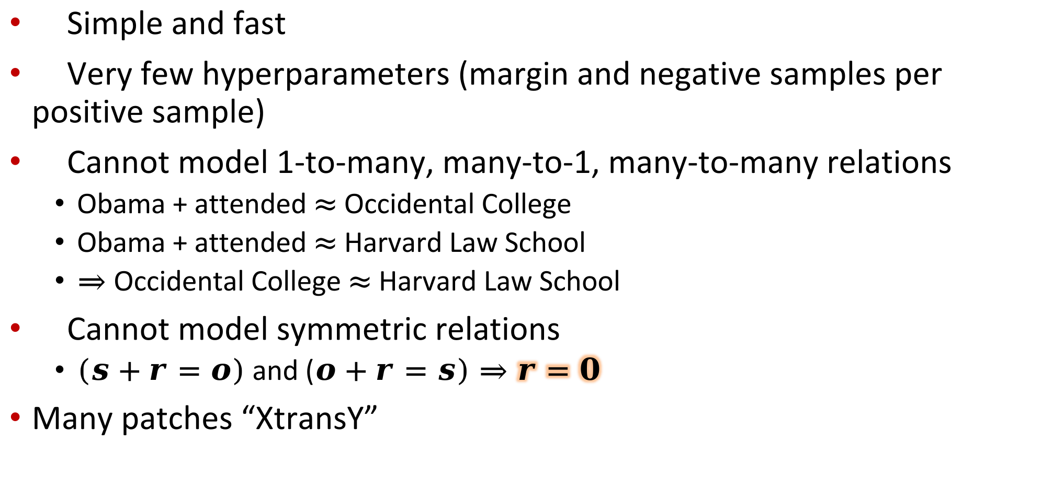
TransE benefits and limitations
Simple and fast
Very few hyperparameters (margin and negative samples per positive sample)
Cannot model 1-to-many, many-to-1, many-to-many relations
  Obama + attended $≈$ Occidental College
  Obama + attended $≈$ Harvard Law School
  $⇒$ Occidental College $≈$ Harvard Law School
Cannot model symmetric relations
  $(s+r=o)$ and ($o+r=s)⇒r=0$
Many patches “XtransY”
Notes:
TransE is simple and fast.
Apart from relation and entity vectors, f itself has no trainable parameters.
The margin and K are the only hyperparameters to tune.
The biggest disadvantage of TransE is that it can only model 1-to-1 relations.
If Obama…
It also cannot model symmetric relations without collapsing the relation vector to all-zeros.
Many patches to TransE have been proposed since. With one exception, we avoid discussing them, because multiplicative models give better performance.

Slide 31
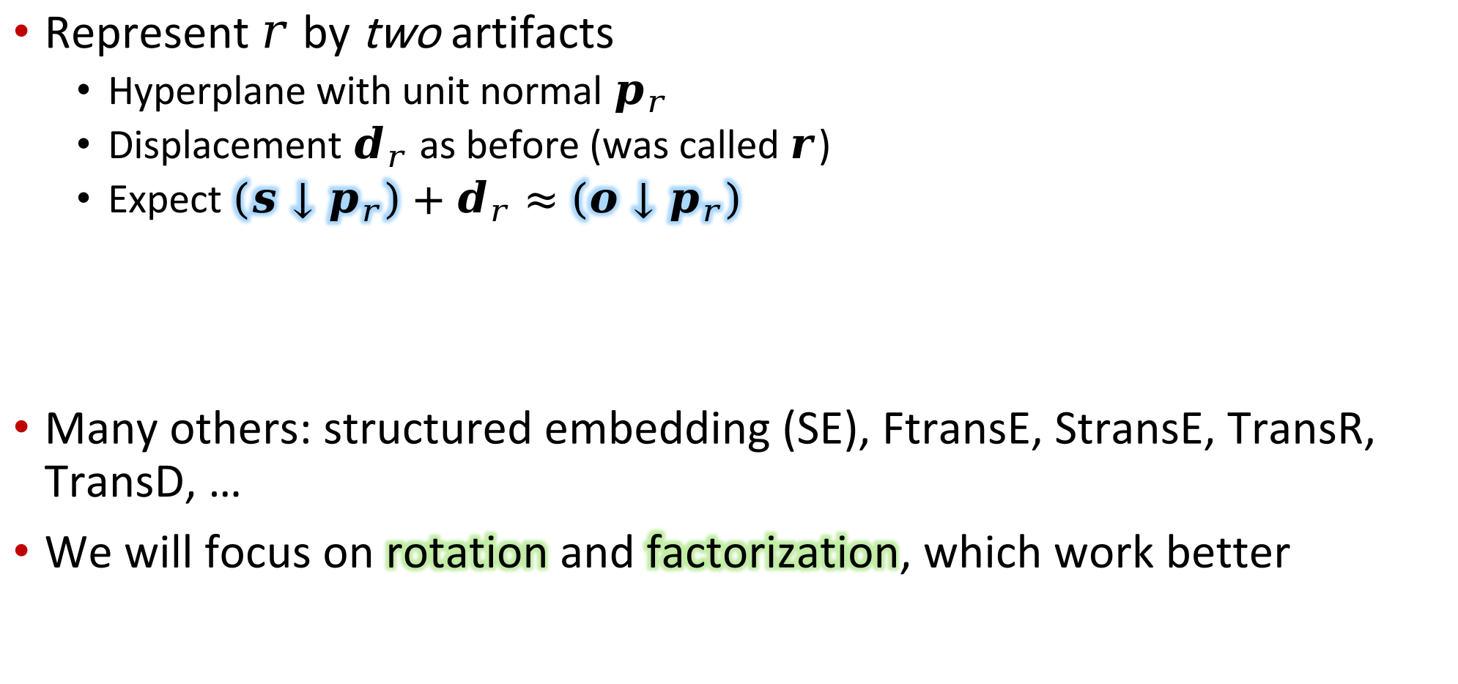
TransH: Early fix to TransE
Represent $r$ by two artifacts
  Hyperplane with unit normal $p_{r}$
  Displacement $d_{r}$ as before (was called $r$)
  Expect $\left(s↓p_{r}\right)+d_{r}≈\left(o↓p_{r}\right)$
Many others: structured embedding (SE), FtransE, StransE, TransR, TransD, …
We will focus on rotation and factorization, which work better
Subject projected to hyperplane
Object projected to hyperplane
Notes:
We will discuss only one fix to TransE, called TransH, whose main goal was to generalize from 1-to-1 relations, because we will revisit this technique when we discuss temporal KGs.
The idea is to associate every relation r with a hyperplane, characterized by its unit normal p_r.
To assess facts involving r, the subject and object vectors are projected to the relation’s hyperplane.
Within the hyperplane, the projections have to displaced with respect to each other by another vector d_r associated with the relation.
While this fixes the 1-to-1 limitation, overall TransH does not perform as well as the methods we discuss next.

Slide 32
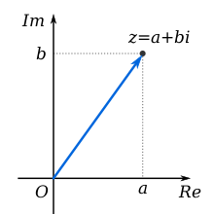



Relation as translation → rotation
Complex number $a+b\sqrt{−1}=a+jb$
Another complex number $r=cos{θ+j\sin{θ}}$
Then $\left(a+jb\right)r$ rotates $(a,b)$ in the complex plane by angle $θ$ anticlockwise
💡 Model relation as rotation instead of translation
  Elegant handling of anti/symmetry, inversion, composition
Add more capacity (multiple complex dims) to handle many-to-many relations
Close to top methods
Notes:
To set up basic notation, a + jb is a complex number with real part a and imaginary part b.
Complex numbers are also written in polar form with some amplitude and angle or phase theta wrt the real axis.
If complex number r has unit amplitude, then multiplying a complex number (a+jb) by r results in rotating the origin-to-(a,b) line through angle theta anticlockwise.
The key idea is to move away from relation as translation to relation as rotation.
To support a large number of entities and relations, rotations are generalized to a vector of unit amplitude complex numbers, which are applied elementwise to similarly wider entity vectors.
The resulting method, RotatE, is quite competitive.
RotatE can handle symmetry and anti-symmetry, inverse relations, and relation composition.
Let us fill in the details, next.

Slide 33

RotatE
Norm of complex number $a+jb$ is written as $\left|a+jb\right|=\sqrt{a^{2}+b^{2}}$
Let $s,o∈ℂ^{D}$ be complex vectors
Norm of complex vector $c$ is written as $\left\|c\right\|=\sqrt{\sum_{d}{{\left|c_{d}\right|}^{2}}}=\sqrt{\sum_{d}{ℜ{\left(c_{d}\right)}^{2}+ℑ{\left(c_{d}\right)}^{2}}}$
Let $r∈ℂ^{D}$ with $\left|r_{d}\right|=1 ∀d$
$f\left(s,r,o\right)={\left\|s⊙r −o\right\|}^{2}$
$$=\sum_{d}{\left[ℜ{\left(s_{d}r_{d}−o_{d}\right)}^{2}+ℑ{\left(s_{d}r_{d}−o_{d}\right)}^{2}\right]}$$
Must ensure during gradient descent
Real part
Imaginary part
Notes:
The norm of a complex number …
Entitles are embedded to vectors of complex numbers.
The norm of a complex vector is defined as the square root of the sum over vector dimensions of the square of the amplitude of the complex vector elements.
Then the score function f is defined as the norm of the complex vector that is the result of subtracting the object vector from the rotated subject vector.
Why are we bothering with all this? Because the resulting formulation has many nice properties.

Slide 34

KG properties supported by RotatE
RotatE can simulate TransE
Relation $r$ is symmetric if
$$\left(s,r,o\right)∈KG⇒\left(o,r,s\right)∈KG ∀s,o$$
  $o=s⊙r$ and $s=o⊙r$ $⇒ r⊙r=1$
  I.e., rotation $r$ is its own inverse $⇒$180° rotation
Relation $r$ is anti-symmetric if
$$\left(s,r,o\right)∈KG⇒\left(o,r,s\right)∉KG ∀s,o$$
  For anti-symmetric relation choose a different angle
Notes:
Although we won’t show it here, RotatE is more general than TransE in the sense that it can simulate TransE through suitable constraints on its embeddings.

Slide 35

RotatE properties, continued
Relations $r$ and $r′$ are inverses of each other if
$$\left(s,r,o\right)∈KG⇒\left(o,r^{′},s\right)∈KG ∀s, o$$
  Inversion modeled by complex conjugate: if $r$ is represented as $\cos{θ+j\sin{θ}}$, then $r^{−1}$ is represented as $\cos{θ−j\sin{θ}}$
Composition of relations is equivalent to adding angles of rotation
  $r_{1}↦\exp\left(jθ_{1}\right), r_{2}↦\exp\left(jθ_{2}\right)⇒$
  $r_{1}∘r_{2}↦exp⁡(j\left(θ_{1}+θ_{2}\right))$
  $\left(e_{0},r_{1},e_{1}\right), (e_{1},r_{2},e_{2})$ means $e_{0}⊙r_{1}⊙r_{2}=e_{2}$
Can RotatE support many-to-many relations?
Notes:
Inversion and composition amount to subtraction and addition of rotation angles, which is modeled directly by complex conjugates.
In the next module, we will study a different family of approaches, based on low-rank factorization of matrices and tensors.
Together with complex embeddings, those give among the best performance on standard benchmarks.

Slide 36




Implementation details
Fact batch
$$s$$ | $$r$$ | $$o$$ | $$y$$
Entity embedding matrix
$$B$$
$$E$$
Relation embedding matrix
$$R$$

Slide 37
Multiplicative/Factoring KG Models
CS728
Soumen Chakrabarti

Slide 38




Latent semantic indexing review
Closely related to word2vec and GloVE
Document-term matrix = low-rank matrix + noise
Recover low-rank matrix via singular value decomposition, retaining top $K$ dims (“topic space”)
Dense $K$-dimensional embeddings of words (and documents)
From factoring 2-axis matrix to 3-axis tensor…
Notes:
First, we shall review Latent Semantic Indexing or LSI from classic Information Retrieval literature.
The goal is to find an approximate low-rank factorization of the document-term matrix A.
Why? Because we suspect not all rows and columns are linearly independent.
For example, in A, the column of car and the column of sedan are expected to be similar.
LSI uses the singular value decomposition procedure on A, which returns three factors:
The left singular vectors U, a diagonal matrix Sigma with singular values, and right singular vectors V.
The factorization is exact to within numerical precision.
However, usually, LSI discards -– effectively zeros out --- all but the K largest singular values, and corresponding columns of U and V, resulting in a rank-K decomposition of A.
It also gives us K-dimensional embeddings of documents and words.
So, as you can see, word embeddings have been around since 1988.
In fact, it turns out these word embeddings are closely related to word2vec word embeddings.
Why revisit LSI?
Because we are going to extend from factoring a 2-axis document-word matrix to factoring a 3-axis KG tensor, next.

Slide 39





KG as a third order (3-axis) tensor
R$elation$
$$r∈R$$
Three axes one each
for subject, relation, object
$E×E×R$ bits
Can represent any KG
$X$ is extremely sparse
Suspected low rank (rows/cols/”fibers” approx. linearly dependent)
$$X$$
Subject
$$s∈E$$
Object
$$o∈E$$
Notes:
Consider a three-axis tensor X to represent a KG.
The axes sizes are E, E, and R.
If (s,r,o) is known to be true, we set the bit at cell [s,o,r] to 1, otherwise 0.
Clearly this can represent any possible KG.
X has very few cells filled with 1s --- it is extremely sparse.
Rows and columns generalize to “fibers” in tensors.
As with the document-word matrix, we expect many fibers to be approximately linearly dependent,
Corresponding to similar entities and relations.
For example, born-in-country and citizen-of-country are strongly correlated,
Philadelphia and Washington DC are similar cities,
Chicken and turkeys are similar animals.
Therefore, we are interested in a low-rank factorization of X.

Slide 40











Factoring the KG tensor
$$M$$
Each relation “plate” represented by $D×D$ matrix $M_{r}$
$$X$$
$$A′$$
Dense $D$-dimensional embedding of each entity
$$A$$
$A$ is the entity embedding matrix, used for both subject and object positions (can also separate roles)
Objective: $\min_{A,M}{\left\|X−M×_{1}A×_{2}A\right\|}_{F}^{2}$
Regularizers: $+{∎\left\|A\right\|}_{F}^{2}+∎{\left\|M\right\|}_{F}^{2}$
Notes:
Recall that the shape of X is E times E times R.
We can look at X as a stack of R plates, each E times E.
The plate for relation r gives the entity pairs related by r.
To factor X, we start with the entity embedding matrix A, where each of E entities gets a D-dimensional embedding vector.
We could consider an A for entities in the subject and a different A for entities in the object position, but let us keep things simple and share a single entity representation as both subject and object.
Now imagine we are invoking something like LSI or SVD on each r plate of X to decompose it into three matrices as before.
Stacking the middle matrices, we get a tensor decomposition into A, a D times D times R 3-axis tensor M, and A-transpose.
In general, this decomposition will not be exact. Our goal will be to minimize the Frobenius error between X and its reconstruction from the factors. We may also want to regularize A and M.

Slide 41

Factoring, continued
Alternating substeps
  Fix $M$ and improve $A$ via gradient descent
  Fix $A$ and improve $M$via gradient descent
Local optimum, slower than SVD
Two popular (further) approximations
  Convert to matrix factorization and apply SVD
  Restrict the relation tensor $M$ to simpler forms
Notes:
Unfortunately, unlike SVD, factoring tensors is neither that efficient nor guaranteed to have a unique loss minimizer.
Usually, the optimization proceeds in alternating substeps: …
The optimization has been further streamlined in two ways, at the cost of weaker expressiveness.
By suitable reshaping, we can convert this 3-axis tensor factorization into a 2-axis matrix factorization.
Or we can strict M to simpler forms that reduce parameters and optimization complexity.

Slide 42

Reshape to matrix factorization
Each row corresponds to a $\left(s,o\right)$ pair
Each column corresponds to a relation $r$
Matrix SVD gives embedding for each entity pair
(subject, object) | Born-in | Capital-of | Citizen-of
(Obama, Honolulu) | ✔
(Honolulu, Hawaii) |  | ✔
(Bangkok, Thailand) |  | ✔
(Einstein, Ulm) | ✔
(Einstein, USA) |  |  | ✔
(Obama, USA) |  |  | ✔
Notes:
In the reshaping approach, each row …
If (s,r,o) is a true fact, row (s,o) and column r is set to 1.
The approximate low-rank property is expected to persist in the reshaped matrix.
We can now run a regular matrix SVD over this, yielding an embedding for each entity pair, rather than singleton entities.

Slide 43



“Universal schema”
Can mix free text and canonical info sources into same table
Unifies open information extraction and closed relation classification
Sparsity and OOV issues
Second option: simplify relation tensor $M$
Notes:
Such reshaped factorization has been used in a variant of the KG called “universal schema”.
In it, rather than harden decisions early that link unstructured text to KG elements,
Structured and unstructured information live in peaceful co-existence.
The left part of the matrix columns shows unstructured relations expressed as “surface patterns” in free text.
The columns to the right show canonical relations in the KG.
Once SVD provides an embedding for each column, these can be compared to canonicalize free text relations.
More important, unstructured and structured information extraction can inform each other.
Despite these attractions, universal schema has some limitations.
The most important one is sparsity. Even if we have encountered two entities separately in training data, but never as a pair, we cannot obtain an embedding for the pair and make predictions about them during evaluation.
Our second option does not find entity pair embeddings. Instead, it simplifies the structure of the middle-tensor M.

Slide 44










Simplify relation tensor $M$
$X\left[s,r,o\right]≈a_{s}^{⊺}M_{r}a_{o}$
If $M_{r}$ is constrained to be diagonal, then we can simplify to
$$X\left[s,r,o\right]≈\sum_{d}{s_{d}r_{d}o_{d}}$$
Shorthand: $\left\langle s,r,o\right\rangle$
Called DistMult
Faster to train than general $M$
Clearly, cannot handle asymmetry and anti-symmetry
$$a_{s}^{⊺}$$
$$M_{r}$$
$$a_{o}$$
$$s$$
$$r$$
$$o$$
Notes:
Recall our tensor factorization scheme.
From the plate for relation r, we can see that X[s,r,o] is approximated by the vector-matrix-vector product a_s transpose M_r a_o …
Called DistMult for “distributed multiplication”.
Obviously, a symmetric score function.
Strangely, DistMult gives reasonable performance on benchmarks that includes asymmetric relations! How is this possible?

Slide 45

Has DistMult been stress-tested?
“The good performances of DistMult on notoriously nonsymmetric datasets such as FB15K or WN18 are surprising. First, let us note that for the symmetricity to become an issue, one would have to evaluate queries $(s, r, ?)$ while also trying to answer correctly to queries of the form $(?, r, s)$ for a non-symmetric predicate $r$. In FB15K, those type of problematic queries make up only 4% of the test set and thus, have a small impact.”
—Lacroix et al.
Notes:
This highlights the critical importance of designing carefully sampled data sets to stress-test all salient aspects of proposed models.

Slide 46

A SimplE extension
To address asymmetry or anti-symmetry, each entity $e$ has two associated vectors $\vec{sub}(e)$ and $\vec{obj}(e)$, depending on its role in a fact
For each relation $r$, introduce inverse relation $r^{−1}$ unless explicitly provided
Corresponding vectors $\vec{rel}(r)$ and $\vec{rel}(r^{−1})$
Define the score as
$$\frac{1}{2}\left(\left\langle \vec{sub}\left(s\right),\vec{rel}\left(r\right),\vec{obj}(o)\right\rangle +\left\langle \vec{sub}\left(o\right),\vec{rel}\left(r^{−1}\right),\vec{obj}(s)\right\rangle \right)$$
Can fully express any KG with a(nti)symmetric rels
Notes:
It is not difficult to fix the symmetry-asymmetry limitation in DistMult.
Each entity is associated with two embeddings …
Also, unless already identified explicitly, for each relation r, …
It should be harmless to introduce a redundant inverse; the redundant copies will just train to very similar embeddings.
If (s,r,o) holds, then so does (o, r-inverse, s).
The overall score of (s,r,o) is the average pooled DistMult scores of the forward and reverse facts.
It is not difficult to show that this model, called SimplE, can express any KG with asymmetric or antisymmetric relations, given embeddings with sufficient width.

Slide 47













ComplEx extension of DistMult
Change embeddings from
$s,r,o∈ℝ^{D}$ to $s,r,o∈ℂ^{D}$
Change $f$ from $\left\langle s,r,o\right\rangle$ to $ℜ\left\langle s,r,o^{⋆}\right\rangle$
Here $o^{⋆}$ is the complex
conjugate of $o$
  ${\left(a+jb\right)}^{⋆}=a−jb$
If a relation is symmetric, set
$ℑ\left(r\right)=0$, reducing to DistMult
If a relation is anti-symmetric, set $ℜ\left(r\right)=0$: ensures
$$ℜ\left\langle s,r,o^{⋆}\right\rangle =−ℜ\left\langle o,r,s^{⋆}\right\rangle$$
Real part of
$$s$$
$$r$$
$$o$$
Real part
$$ℜ$$
$$s$$
$$r$$
$$o$$
$$ℑ$$
$$s$$
$$r$$
$$o$$
Imaginary part
Notes:
Finally we come to ComplEx, among the best KG completion methods to date.
Some improvements may have been achieved by follow-up systems, but ComplEx remains the most effective baseline against which all other proposals must be compared.
ComplEx can be interpreted as an interesting merger of SimplE and DistMult.
Like SimplE, entities get a two-part embedding, except they are not designed specifically for subject and object positions. Instead, entities get complex vector embeddings like in RotatE.
Relations also get complex vector embeddings, except the score function f is different from RotateE, and more similar to DistMult. It is the same three-way inner product, with two important differences:
a) we take elementwise conjugate of the object vector, which makes all the difference about asymmetry handling, and
b) we take the real part from the resuling complex number, so it can be turned into softmax.
We make two important observations.

Slide 48




ComplEx, other notation
Can also write as
$X≈ℜ\sum_{d}{a_{∙,d}{⊗M}_{∙,d,d}{⊗a}_{∙,d}^{⋆}}$
$a_{∙,d}∈ℂ^{E},M_{∙,d,d}∈ℂ^{R}$
Thus $X∈ℝ^{E×R×E}$
Each rhs term is a rank-1 “fiber”
Expresses $X$ as sum of $D$ rank-1 tensors
Thus, this is a rank $≤D$ decomposition of $X$
$$E$$
$$R$$
$$D$$
$$D$$
$$E$$
$$D$$
$$D$$
Fibers
Notes:
X can also be written as the elementwise real part of the sum over embedding dimensions of three fibers: a subject entity fiber, times a relation fiber on the diagonal of the relation tensor, and another conjugated object entity fiber.

Slide 49

Further ComplEx-ity
Like SimplE, use $\vec{sub}(e)$ and $\vec{obj}(e)$ for entities, $\vec{rel}(r)$ and $\vec{rel}(r^{−1})$ for relations and inverses
Except these are complex vectors
Regularize a nuclear p-norm
We call this version Complex-N3
Notes:
Recently, more improvement were proposed to ComplEx, taking it a little closer to SimplE in some ways.
They restored the explicit two-part encoding of entities, as subject and object,
but unlike SimplE, each remains a complex vector.
They introduce inverse relation embeddings as in SimplE, but again these are complex vectors.
They also replace L2 regularization with a different norm, which we do not have time to discuss in detail.
We call the new version Complex-N3.

Slide 50



Sample KG completion performance
ComplEx-V2 uses large/full negative sampling
Almost as good as Complex-N3
Both generally
better than
others
Notes:
ComplEx-N3 improves performance beyond the original version of ComplEx.
We also experimented with SimplE and ComplEx where we sampled many more negative facts than in the original implementations. We called this SimplE-V2 and ComplEx-V2.
On the early versions of benchmarks, SimplE-V2 and ComplEx-V2 became comparable to Complex-N3, but on the more recent benchmark versions, ComplEx-N3 retains an edge.

Slide 51

WN18$→$WN18RR, FB15k$→$FB15k-237
WN18 KG was extracted from WordNet
  18 relations and 40943 entities
  Many test triples $(s,r,o)$ had corresponding $(o,r^{−1},s)$in train fold
  Removing them gave 93003 triples over 40943 entities and 11 relation types
  Harder benchmark, less leakage
FB15k to FB15k-237: similar story
  592213 triples, 14951 entities, 1345 relations $⟶$ 310079 triples, 14505 entities, 237 relations
Notes:
These updates again underscore the importance of designing, inspecting and improving benchmarks that can adequately probe the strengths and weaknesses of competing methods.

Slide 52
Embedding KG Hierarchies
CS728
Soumen Chakrabarti

Slide 53



Hierarchies in KGs
Anti/symmetry … how about transitivity?
(camel, is-a, mammal) and
(mammal, is-a, animal) $⇒$
(camel, is-a, animal)
Popular KG type systems:
FIGER, GFT, DbPedia, TypeNet
None of the KG
embedding methods
discussed thus
far handle
hierarchies
Deserts are home to which animals?
Notes:
Transitive relations are important in KGs with several applications like information extraction and question answering.
If camel and desert co-occur in a text passage, but there is no mention of animal, and the question is “deserts are home to which animals”,
it helps to know that camels are mammals are animals.
FIGER, Google Fine Types, DbPedia, and TypeNet offer curated type hierarchies of increasing size.
None of the KG representations we have studied thus far have any explicit mechanism to support such type hierarchies.

Slide 54


Two views of embedding hierarchies
Embed a hierarchy (DAG) in a space with a distance such that distances on DAG are approximately preserved by distance in the embedding space
  Euclidean $→$ Poincaré balls, hyperbolic embeddings
Encode DAG nodes so that ancestor-descendant queries can be answered efficiently
  Gaussian, order and box embeddings
Should work with incomplete supervision
Should play well with other embeddings
Notes:
So far in our discussion of embeddings, there has been a notion of symmetric distance or similarity between embeddings as points.
One family of approaches to embedding hierarchies hangs on to that notion of distance or neighborhood.
The goal is to assign embedding coordinates to each node in the hierarchy so that graph distances between nodes are preserved in the Euclidean distance between their embeddings --- in other words, we want low distortion.
Another family of embeddings, on which we will spend more time, seeks to efficiently answer ancestor descendant queries, because those are frequently asked in QA and information extraction applications. There may not be any meaningful notion of distance.
Ideally, hierarchy embeddings should allow completion just like earlier KG completion, and should play well with other embeddings like GloVe or BERT.

Slide 55


Low-distortion graph embeddings
Each node $v$ in graph $G=(V,E)$ embedded to $x\left(v\right)∈ℝ^{D}$ by embedding function $x$
Graph distance between $u,v∈V$ is $d_{G}(u,v)$
Distortion of embedding function $x$ is given by
$distor\left(x,G\right)=\frac{\max_{u,v}{\frac{\left\|x\left(u\right)−x(v)\right\|}{d_{G}(u,v)}}}{\min_{u,v}{\frac{\left\|x\left(u\right)−x(v)\right\|}{d_{G}(u,v)}}}$
Distortion of G is $\inf_{x}{distor(x,G)}$
Maximum stretch
Minimum stretch
Lowest distortion achievable by smartest possible embedding $x$
Notes:
Although we will not get into details, let us take a moment to formalize the notion of distortion.

Slide 56

Euclidean distortion facts
With large enough $D$, any graph with $n$ nodes can be embedded in $ℝ^{D}$ with $O(log⁡n)$ distortion
Any connected planar graph can be embedded in $ℝ^{2}$ with $O(n)$ distortion; trees with $O(\sqrt{n})$
With large enough $D$, any tree can be embedded in $ℝ^{D}$ with $O(\log{\log{n)}}$ distortion
Binary trees can be embedded in a line with $O\left(\frac{n}{\log{n}}\right)$ distortion
Binary trees can be embedded in $ℝ^{D}$ with $O\left(\frac{n^{1/D}}{\log{n}}\right)$ distortion
Distortion of $\left(1+ε\right)$ is possible in hyperbolic space
Notes:
With these definitions in place, we quote a few results about distortion which motivates the recent interest in hyperbolic spaces.
…
In contrast to these Euclidean distortions that grow with n, a distortion of 1+eps is possible in hyperbolic space.

Slide 57





Poincaré disk, hyperbolic space
$\operatorname{arcosh}\left(a\right)=\ln\left(a+\sqrt{a^{2}+1}\right)$
Points $x, y$ strictly inside unit circle
Hyperbolic distance
$d_{H}\left(x,y\right)=arcosh\left[1+2\frac{{\left\|x−y\right\|}^{2}}{\left(1−{\left\|x\right\|}^{2}\right)\left(1−{\left\|y\right\|}^{2}\right)}\right]$
As $x,y$ approach perimeter, $d_{H}→∞$
Natural tree embedding
Precision bits not free!
Notes:
The Poincare disk or ball is an example of a hyperbolic space.
First we recall the definition of the arc cosine hyperbolic function, also shown by its graph.
Consider a unit circle …
As either x or y approaches the perimeter, the hyperbolic distance goes to infinity.
Visually, this lets us pack a lot of leaves near the periphery, giving a natural embedding of trees.
Note that the illusion of infinite “free” space at the periphery may be misleading in the face of finite precision arithmetic.

Slide 58

Training hyperbolic embeddings
Given a graph, sample or enumerate
  Neighbors $(x,y)$
  Non-neighbors $(x,y^{′})$ and $(x^{′},y)$
For each pair $(x,y)$ and $(x,y^{′})$, want
$$d_{H}\left(x,y\right)+margin≤d_{H}(x,y^{′})$$
Likewise with $(x^{′},y)$
Turn into a hinge loss
Gradient descent on all node coordinates

Slide 59

WordNet nouns in Poincaré disk
As expected, generic synsets near disk center, specific near periphery
What do applications
(e.g., QA) need?
  “scientists who played musical instruments”
  “mammals living in the desert”
Notes:
We can use distortion to guide the loss while we fit embeddings of the hierarchy nodes in hyperbolic space.
Applying this to the Wordnet noun hierarchy results in an intuitive layout, with general nouns near the center and specific ones near the periphery.
However, we should ask what consumers of KG embeddings need.
For example, in QA, a dominant use case is to search for instances of various types, like scientists, musical instruments or mammals, constrained by other requirements specified in the question.
For such applications, distortion may not be the right thing to worry about. Instead, transitive containment is our primary concern.

Slide 60











Toward order embeddings
Computing Euclidean or hyperbolic distance between items not the only choice
Denote partial order by “$x≺y$” meaning $x$ is a descendant of $y$
In case of a tree, associate
with each item $x$ the in-order
traversal interval $I(x)$
  $I\left(B\right)=\left[2,3\right], I\left(A\right)=\left[1,10\right]$,
  $I\left(D\right)=\left[5,6\right]$
  $I\left(x\right)⊂I\left(y\right)⇔x≺y$
$$↓1$$
A
$$↑10$$
$$↓2$$
B
$$↑3$$
$$↓4$$
C
$$↑9$$
$$↓5$$
D
$$↑6$$
$$↓7$$
E
$$↑8$$
Nodes of a tree can be embedded in one dimension to answer ancestor- descendant queries in constant time.
Notes:
If node x is a descendant of y in the hierarchy, we represent it with the “precedence” operator.
Consider a tree hierarchy.
Suppose we perform an in-order tree traversal, keeping track of the time we enter and leave the subtree rooted at each node.
Each node thus gets a time interval associated with it, and ancestor-descendant queries are trivial to answer:
if the interval of x is contained in the interval of y, then and only then is x a descendant of y.
In other words, nodes of a tree can be embedded …
Perhaps, to embed hierarchies more complicated than trees, we can extend to multiple dimensions?
Let’s look at that possibility next.

Slide 61


Apex of axis-aligned open cones
Item $x$ represented by $u_{x}∈ℝ^{D}$
$u_{x}$ is the apex of an open cone
$x≺y⇔u_{x}≥u_{y}$, elementwise
Design training loss function
  Notation: $ReLU\left(a\right)={\left[a\right]}_{+}=max\left\{0,a\right\}$
  If $x≺y$, $\left\|ReLU\left(u_{y}−u_{x}\right)\right\|$, i.e.
  all $D$ dims must satisfy constraint
  If $x\text{⊀}y$, $ReLU\left[α−\left\|ReLU\left(u_{y}−u_{x}\right)\right\|\right]$
  $α$ is the margin
Does not recognize asymmetry in losses
Actor
People
Politician
Loss
Actor
People
Notes:
Let us first generalize the idea to half-open spaces in higher dimensions.
Node or type x in the hierarchy will be embedded to u_x,
which is the apex of an axis-aligned open cone of all entities that belong to type x.
We unify instance-of and subtype-of relations into the “precedes” operator, which we can also read as “subset-of”.
If x is a subset of y, then we demand that u_x ge u_y, elementwise … i.e., the cone of y must contain x and its cone.
The most general type is the “lowest and leftmost” cone … people, in this example.
Now we must design a loss to train these u vectors, given a hierarchy.

Slide 62

Addressing loss asymmetry
If $x≺y$, then for all dim $d$, want $u_{x}\left[d\right]≥u_{y}\left[d\right]$
  E.g., $ℓ_{+}\left(x,y\right)=\max_{d∈[D]}ReLU\left(u_{y}\left[d\right]−u_{x}[d]\right)$
If $x\text{⊀}y$, then for some d, want $u_{x}\left[d\right]<u_{y}[d]$
  $ℓ_{−}\left(x,y\right)=\min_{d∈[D]}ReLU\left(α−ReLU\left(u_{y}\left[d\right]−u_{x}[d]\right)\right)$
All open cones and their intersections have same measure of volume (unlike in-order intervals)
  … even though Politicians ⊊ People
Hard to model negative correlation
  X is-a fruit ⇒ X is-not-a scientist
Want small
Want large
Notes:
To address the asymmetry in loss, if x is a subset of y, we want, for all dimensions …
Conversely, if x is not a subset of y, we want a violation in at least one dimension.
One limitation with open cones is …
We can fix this partly by containing all cones in a sufficiently large cube universe,
but it is still difficult to model negative correlations, because all cone pairs will generally intersect.

Slide 63

(Hyper)rectangle/box embeddings
Each type/item $x$ characterized by interval $I_{x}\left[d\right]=\left[b_{x,d},h_{x,d}\right]$ for each dimension $d$
Want $I_{x}\left[d\right]⊆I_{y}\left[d\right] ∀d$, iff $x≺y$
Learning to lay out Venn diagrams
Set $↔$ rectangle (in large number of dimensions)
Scientist
Banana
Fruit
Einstein
Physicist
Merkel
Politician
Bush
Notes:
It is more natural to represent hierarchy nodes or types by closed boxes.
In other words, an interval for each dimension.
Defined by base b and height h.
This generalizes one-dimensional intervals for embedding trees.

Slide 64





Hinge loss for boxes
$$b_{y}$$
$$h_{y}$$
If x ≺ y, then, for all dimensions, interval of x must be contained in interval of y
$$b_{x}$$
$$h_{x}$$
$$ℓ_{+}\left(x,y\right)=\max_{d∈[D]}{\max\left\{{\left[b_{y}\left[d\right]−b_{x}[d]\right]}_{+},{\left[h_{x}\left[d\right]−h_{y}[d]\right]}_{+}\right\}}$$
$$ℓ_{−}\left(x,y\right)={\min_{d∈\left[D\right]}\left[α−\max\left\{{\left[b_{x}\left[d\right]−b_{y}\left[d\right]\right]}_{+},{\left[h_{y}\left[d\right]−h_{x}\left[d\right]\right]}_{+}\right\}\right]}_{+}$$
If x ⊀ y, then, for some dimension, interval of x must stray outside the interval of y

Slide 65






Hinge vs. “escaped volume” $x∖y$
For simplicity just one dimension
$\max\left\{{\left[b_{y}−b_{x}\right]}_{+},{\left[h_{x}−h_{y}\right]}_{+}\right\}$
  Grows indefinitely as $x$ moves outside and away from $y$ — gives gradient guidance
$\min\left\{{\left[b_{y}−b_{x}\right]}_{+},h_{x}−b_{x}\right\}$
$$+\min\left\{{\left[h_{x}−h_{y}\right]}_{+},h_{x}−b_{x}\right\}$$
  Volume (=length) of $x$ that lies outside $y$
  At most $h_{x}−b_{x}$, i.e., bounded loss from one instance
  No gradient guidance once $x$ has moved completely outside $y$
$$b_{y}=3$$
$$h_{y}=5$$
$$b_{x}$$
$$h_{x}$$
1
Notes:
The hinge loss, whose expression is repeated here for reference, grows indefinitely as type x moves away from type y, and is not normalized across type pairs.
An alternative is to measure the volume of x that has escaped from inside the region of y.
The benefit is that the maximum loss from a pair (x, y) is bounded.
The disadvantage is that once x has become disjoint from y, the loss becomes flat and offers no gradient guidance.

Slide 66




Smooth boxes
$\tanh\left[\max\left\{{\left[b_{y}\left[d\right]−b_{x}[d]\right]}_{+},{\left[h_{x}\left[d\right]−h_{y}[d]\right]}_{+}\right\}\right]$
May need $h_{x}−b_{x}$ scale factor
Can use differentiable
surrogates of max and min
over dimensions
More principled probabilistic
formulations also exist
Whatever helps the optimizer
fit good $B$ and $H$
Notes:
To retain the best of both worlds, we can retain the hinge expression, but apply a tanh nonlinearity to it.
The result is a gently sloped tub loss surface, as shown.
We can scale this with the length of the interval of x, if that gives a louder voice to larger intervals and behaves better.
If the sharp max and min functions cause trouble, we can replace them with differentiable surrogates.
Thus far, we have designed box losses by the seat of the pants. But more formal and principled probabilistic formulations exist and work well.
In the end, what matters most is that we fit good base and height matrices for all nodes in the hierarchy.

Slide 67


“Leaky” evaluation protocol
T = available partial order, clo(T) transitive closure
  WordNet has |T|=82115, |clo(T)|=838073
Sample positive test/eval fold …4000
Sample positive valid/dev fold …4000
Rest train/learn fold …830k(!)
Plus negative samples L–, D–, E–, typically 1:1
  Local closed world assumption
With 830k of 838k known, what’s left to discover?
Notes:
$E_+ \subset \text{clo}(T)$
$D_+ \subset \text{clo}(T) \setminus E_+$
$L_+ = \text{clo}(T) \setminus (E_+ \cup D_+)$

Slide 68

OE with leaky protocol
TC = transitive closure on L₊ gave 0/1 acc = 88.6%
  Gaussian embedding worse, 86.6%; OE at 90.6%
OE was actually undersold, gains more when training fold shrunk
Still, both TC and OE rewarded for computing transitive closure

Slide 69

Sanitized evaluation protocol
Give no credit for computing transitive closure
Sample $L_{+}∈clo\left(T\right)$
Perturb each $\left(x,y\right)∈L_{+}$ to negative sample $\left(x’,y’\right)$
Discard if $\left(x’,y’\right)∈clo\left(T\right)$
Sample pos dev $\left(x,y\right)∈D_{+}⊂clo\left(T\right)\backslash clo\left(L_{+}\right)$
  Discard $\left(x,y\right)$ from D₊ if x or y is o.o.v. from $L_{+}∪L_{−}$
Sample pos eval $\left(x,y\right)∈E_{+}⊂clo\left(T\right)\backslash \left(clo\left(L_{+}\right)∪clo\left(D_{+}\right)\right)$
Perturb and discard as before
Notes:
$L_+ \subset \text{clo}(T)$
$(x, y) \in L_+$
$(x', y') \in \text{clo}(T)$
$D_+ \subset (\text{clo}(T) \setminus \text{clo}(L_+))$
$E_+ \subset \text{clo}(T) \setminus (\text{clo}(L_+) \cup \text{clo}(D_+))$

Slide 70
Results: leaky and sanitized protocols
 | Leaky protocol |  |  | Sanitized protocol
 | OE | σOE | Rect | OE | σOE | Rect
Acc | 0.922 | 0.921 | 0.926 | 0.574 | 0.742 | 0.767
AP | 1 | 1 | 1 | 0.977 | 0.969 | 0.986
P | 0.994 | 0.915 | 0.973 | 0.987 | 0.925 | 0.983
R | 0.850 | 0.929 | 0.877 | 0.151 | 0.527 | 0.544
F1 | 0.916 | 0.922 | 0.923 | 0.262 | 0.671 | 0.722
Sanitized protocol destroys recall and F1 of OE
Rectangle is better than σOE is (much) better than OE
σOE and rectangle better even with leaky protocol

Slide 71





Precision vs. recall for ranking
Sort (x,y) by increasing containment violation
x ≺ y = “relevant”
x ⊀ y = “irrelevant”
Recall-precision plot,
AUC, MAP, NDCG etc.
Rectangle has higher
precision at lower recall
than OE
gitlab.com/soumen.chakrabarti/rectangle
Notes:
$\max_{d\in[D]} \max\{[b_{y,d}-b_{x,d}]_+, [h_{x,d}- h_{y,d}]_+ \}$

Slide 72

Thinking outside the BoxE
Large KG has diverse relations, some reflexive, some a/anti/symmetric, some transitive, etc.
Can a single general score function cover all these variations? Yes — enter the BoxE
Bonus: supports arbitrary $K$-ary relations $r(e_{1},e_{2},…, {e_{k}, …, e}_{K})$ beyond $r(s,o)$
Key idea: build contextual embedding of $e_{k}$, influenced by all $e_{≠k}$
Notes:
Hierarchies are important parts of KGs, but there are plenty of other coexisting relations that are not hierarchical.

Slide 73


BoxE formulation
Entity $e$ associated with two embeddings
  Center $c_{e}∈ℝ^{D}$, ‘bump’ $b_{e}∈ℝ^{D}$
Every entity ‘bumps’ the center of all other entities participating with it in a relation
  Contextual $e_{k}^{r(e_{1},…,e_{K}) }=c_{e_{k}}−b_{e_{k}}+\sum_{k^{′}∈\left[K\right]}{b_{e_{k^{′}}}}$ or $e_{k}^{r(e_{1},…,e_{K}) }=c_{e_{k}}+\sum_{k^{′}∈\left[K\right],k^{′}≠k}{b_{e_{k^{′}}}}$
Contextual embedding of $k$th argument to relation
Start with context-independent embedding
Add bumps from all other arguments
Notes:
Let us dig into how BoxE works.

Slide 74


BoxE formulation, continued
$K$-ary relation $r$ represented by $K$ boxes $r^{(1)},…, r^{(K)}$
If fact $r(e_{1},e_{2},…, {e_{k}, …, e}_{K})$ holds, then for each $k∈[K]$, we want $e_{k}^{r(e_{1},…,e_{K}) }∈r^{(k)}$
I.e., contextual embedding of $e_{k}$ must fit inside $r^{(k)}$
Notes:
After contextual embeddings of entities, BoxE defines each K-ary relation as K boxes.

Slide 75

BoxE properties
Can represent any KG given enough dimensions
  Nontrivial proof via induction
Type hierarchy: special case with $K=1$ (no bump)
A/Anti/Symmetry, inversion, hierarchy, intersection, mutual exclusion
Elegant; performance good but not quite as good as best ComplEx variations

Slide 76

Unsupervised type embeddings
Symbolic supervision of types tedious and tricky
    Pal/Lassie, Flipper, Air Bud are actors but not people
Type of an entity as noisy shorthand for
    Relations in which entity can participate
    Attributes that entity can have
“Entity (E) model” included a form of arg type checking
  Each entity $e$ embedded to vector $ae$
  Each relation $r$ embedded to two vectors $r_{sub},r_{obj}$
  Fact score $f_{E}\left(s,r,o\right)=a_{s}⋅r_{sub}+a_{o}⋅r_{obj}$
Notes:
In the last part of this module, we shift gears from supervised to unsupervised type embeddings.
Explicit symbolic supervision of types can be tedious and risky.
One taxonomy designer may claim that all actors are people, but another may point out well-known animal actors.
Symbolic names for types are merely a convenience for communication.
In fact, an old KG completion model called the E model included a form of argument type checking in relation embeddings.

Slide 77
Does KGC model types?
When best KG completion methods fail, they often highly rank entities of absurdly incorrect types
OTOH, every column in a relational table constrains acceptable types ⎯ may also help here
Subject s | Relation r | Gold object o | Prediction o1 | Prediction o2
Howard Leslie Shore | Follows-religion | Jewism | Walk Hard (film) | 21 Jump St (film)
Spyglass Entertainment | HQ-located-in | El Lay (location) | The Real World (TV) | Contraband (film)
Les Fradkin | Born-in-location | New York | Federico Fellini | Louie de Palma
Gene Hackman | Studied-topic | Rural Journalism | Loudon Wainwright | Bourne Legacy (film)
Chief Phillips (film) | Released-in-loc | Yankee land (loc) | Akira Isida (person) | Medal of Freedom (award)

Slide 78







Disentangling type check info
Each relation has two type-checking sub-vectors and regular vector
Each entity has a type-checking sub-vector and a “residual” vector
Overall fact score $f^{′}\left(s,r,o\right)=f\left(a_{s},r,a_{o}\right)$
$$TS\left(r_{sub},u_{s}\right) TO(r_{obj},u_{o})$$
TS
Subject type
checker
$$r_{sub}$$
$$r$$
$$r_{obj}$$
$$us$$ | $$as$$
$$f$$
$$f′$$
$$uo$$ | $$ao$$
TO
Object
type checker
Notes:
To remedy this limitation, we further develop the E model idea of relation type-checking.

Slide 79
KB completion results
Model | FB15k |  |  | FB15k237 |  |  | YAGO3-10
↓ | MRR | HITS@1 | HITS@10 | MRR | HITS@1 | HITS@10 | MRR | HITS@1 | HITS@10
DM | 67.47 | 56.52 | 84.86 | 37.21 | 27.43 | 56.12 | 55.31 | 46.80 | 70.76
TypeDM | 75.01 | 66.07 | 87.92 | 38.70 | 29.30 | 57.36 | 58.16 | 51.36 | 70.08
CX | 70.50 | 61.00 | 86.09 | 37.58 | 26.97 | 55.98 | 54.86 | 46.90 | 69.08
TypeCX | 75.44 | 66.32 | 88.51 | 38.93 | 29.57 | 57.50 | 58.65 | 51.62 | 70.42
Balanced number of parameters 3M real, 6M complex
Broadly DM < TypeDM, CX < TypeCX
Are typed variants learning to abstract type info?
Notes:
Adding the type checking gadgets to distmult (written as DM) and complex (written as CX) uniformly improves the performance beyond respective baselines.

Slide 80




Clustering parts of entity embeddings
Per, loc, org, film, sports
    85% of FB15k entities
2d PCA projections
Type not revealed when training TypeDM, TypeCX
DM a_{e} show diffused types
TypeDM a_{e} has no better type info than DM a_{e}
TypeDM u_{e} >> TypeDM a_{e}
TypeCX u_{e} also good
TypeDM u_{e}
TypeDM a_{e}
TypeCX u_{e}
DistMult a_{e}
Notes:
We chose five coarse types (that were not revealed to TypeDM or TypeCX).
We projected various parts of entity embeddings via PCA for visualization, color coding each coarse type.
Embedding a, the residual part, shows colored clouds diffused into each other.
In contrast, the type components u_e show much sharper separation.

Slide 81

Predict embeddings to types
Only 19 dims of type part competes favorably with 180 or even 360 dims
No explicit attempt yet to decorrelate $ae$ and $ue$
Some type info persists in $ae$ in TypeDM, TypeCX
But $u_{e}$ are clearly better symbolic type predictors
Method | Vector/s | Sizes | Type F1
DM | a_{e} | 200 | 81.34
TypeDM | u_{e} | 19 | 81.77
 | a_{e} | 180 | 75.96
 | Both | 199 | 82.57
CX | a_{e} | 200(x2) | 81.58
TypeCX | Re(u_{e}) | 19 | 82.70
 | a_{e} | 180(x2) | 74.75
 | Both | 379 | 84.14
Notes:
As a last experiment, we check if a_e or t_e are good predictors of the symbolic coarse types.

Slide 82
Summary and outlook
Variety of methods to embed KG entities and relations
Early methods used only graph topology
Later methods incorporated text associated with KG
Will next study integrations between KG and LLM
String token sequence as only ‘datatype’ in LLM is a problem
Any use of canonical entity and relation IDs? Desirable?
Some level of discontent remains
May not show up in popular benchmarks

