Slide 1

Graph NNs, Scoring and Retrieval
2024-CS 728
Indradyumna Roy
IIT Bombay

Slide 2
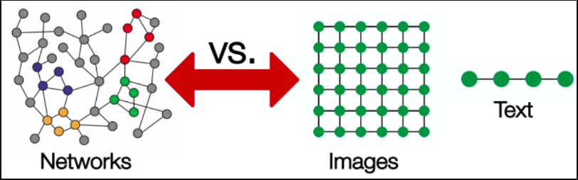
Graph ML Applications
Applications [Jonathan Hui Blog, Sergei Ivanov Blog]
  Images as scene graphs
  molecular graphs - chemical compounds
  User-Item bipartite graphs for recommender systems
  Social Network Graphs
Graphs in NLP [Michael Galkin’s Blogs]
Graph ML in Computer Vision [LINK]
Source [LINK]
Notes:
graphs as a strict generalization of images if you have any image data set you can treat the image as a grid graph where every node corresponds to a pixel and its four or eight immediate neighbors specify the adjacency matrix

Slide 3
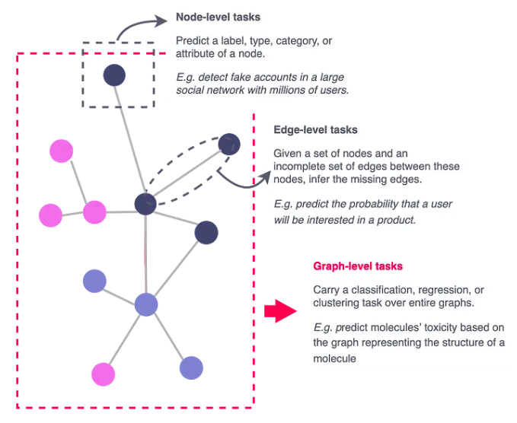
Prediction on Graphs
Graph Classification
  image classification
  predicting toxicity of chemical compounds
Node Classification
  user classification
Link Prediction
  Recommending connections in Social Networks
  Recommending items for purchase in user-item bipartite graphs
Source [LINK]

Slide 4
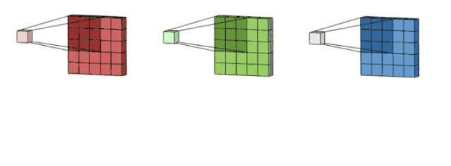
Convolutional Layers
Source [LINK]
Images are grid graphs - regularity makes things easier
Generalize to operate on arbitrary graphs
Small number of parameters shared across all positions
Translational Invariance
Exploit locality
Notes:
so what we actually want is something that sort of generalizes a convolutional layer because
convolutional neural networks leverage the convolution operator to exploit this strong spatial regularity in images and it would be highly appropriate if we could somehow generalize this to operate over arbitrary graphs so just as a quick reminder how convolutions work on images is we're able to exploit the spatial regularity to define a comparably very small matrix of parameters k which is then slid across the different positions in the image and at each step we just take local pairwise position product sums which allows us to specify an output image that detects patterns in the original image and because this is just one operator that's applied everywhere in the same way it's going to capture very important invariances such as translation and variance so an object of interest is interesting no matter where it appears in the image and also it exploits locality so a pixel is far more likely to be related to the pixels right near it rather than pixels in opposite corners so what we really want when we try to define a graph convolution is something that's quite similar something that considers the immediate local neighborhood of a particular node and uses that information to further update the notes features so if i have features in a central vertex b in this case and i have features of its immediate neighbors my graph convolution layer needs to predict the next step features of this node hb prime which is some function of the entire set of neighbors of node b
so we basically need an operator that looks at over sets of neighbors to derive next step features.

Slide 5
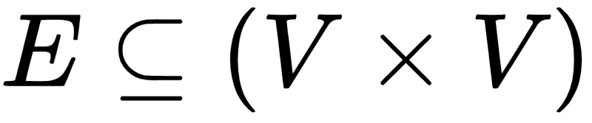
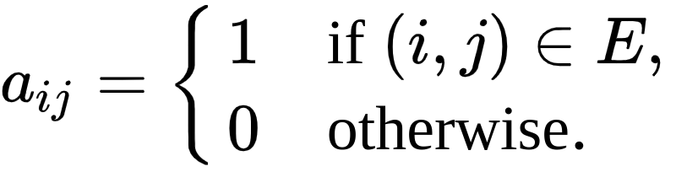
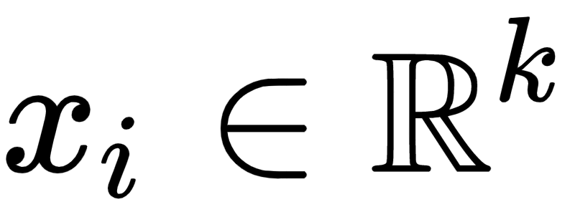
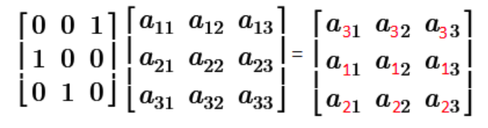
Notation
G= (V,E)
V : Set of nodes
Adjacency matrix A with entries
Node features
Above imposes a node ordering
Permute using permutation matrices P
Source [LINK]
Notes:
the typical way in which we give this data to the machine learning model we typically stack those features together into what we call a node feature matrix so this capital x is a matrix that has a node rows equal to the number of nodes and the i throw this matrix will tell you the features of the ith node
this is the standard way in which you feed node feature data for both set and graph neural networks very act of you doing this is bad because you've specified an ordering of the nodes
set is unordered there should be no ordering in this set whatsoever i'm not assuming any ordering between my nodes so whenever we apply a neural network over this data we need to make sure it doesn't perpetuate this ordering to the output. want the output of any neural network
over this input to not depend on the exact way you chose to stack the features
operations that change the order of the nodes is the permutation

Slide 6
Desideratum (Sets)
Consider Sets (only nodes V, no edges)
Designing functions on sets: f(X)
Permutation Invariance: f(PX) = f(X)
Permutation equivariance: f(PX) = Pf(X)
DeepSets (Zaheer, et al., NeurIPS’17)
Recipe
  Stack equivariant functions inside. Enforced by applying function on set elements in isolation
  Additional invariant function outside if required.
Follow up: Murphy, et al., ICLR’19, Pabbaraju and Jain 2020
Notes:
we're not going to start with graphs we are going to start with sets so graphs with no edges between them
permutation invariance so we want as we said functions neural networks f x that work over these node feature matrices and don't depend on the order of the rows so what does this mean mathematically if i apply a permutation matrix to the input that shouldn't change the outputs
you don't have to use sum right this was the originally proposed model but you can use anything which is what we call permutation invariant aggregator so something that will combine all the rows of this matrix in a way that doesn't depend how you do it and that means you could have used max you could have used average all of those functions have that same property and for that reason we should e thinking about something that will aggregate stuff without caring for the order
now the second important concept we will need is permutation equivariance and why do we need it well in the previous steps we predicted one label for the entire set and by summing all the set elements together right and that's great if your label is on the level of the entire set but what if you need to predict something in the nodes so you need a you need to do segmentation or something like this right so every node now is associated with a label well in this case the summing is actually a pretty bad operation because it destroys everything about the individual nodes right you might be able to recover it depending on the setting but it still puts a lot of pressure right so we actually don't want something that will give us in this case we actually don't want something that will give us a single vector we want something that will give us an output for every single node and what does this mean well when i permute the input i should now actually expect a different answer but i should expect an answer that's different in a very predictable way which allows me to still identify which row corresponds to
which node
cool result - no matter what well behave set function you give me, we must be able to express it using this deepset formulation

Slide 7
Desideratum (Graphs)
Functions no node features X,edge information A
Permutation Invariance: f(PX, PAP^T) = f(X,A)
Permutation equivariance: f(PX, PAP^T) = Pf(X,A)
Like sets, apply operators on nodes in isolation to ensure equivariance
Each node now influenced by its local neighborhood
  Neighborhood entails multiset of features
  Influence must be permutation invariant
Graph level function (optional) ensures invariance

Slide 8
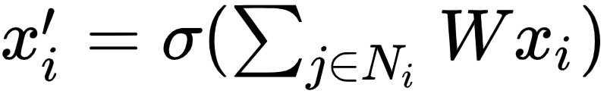
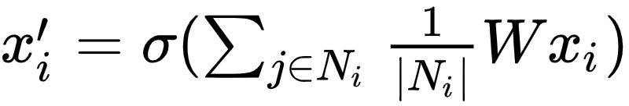
Defining a graph convolution layer
X’ = σ (AXW)
  Initial node feature matrix X
  Adjacency matrix A
  Learnable weights W
  nonlinearlity σ
Ensure central node is always factored in during update
  A’ = A + I
Node-wise update rule:
Normalize appropriately
  X’ = σ (D^-1 A’XW)
  D is degree matrix (diagonal)
Mean pooling update rule:
Notes:
update node features to be mindful of the entire graph. Assume undirected unweighted.
multiplying your node feature matrix h by the adjacency matrix this effectively recombines the information in the neighborhood into just one vector
giving some layered processing of the features so besides multiplying by the adjacency matrix we will also multiply by some learnable linear transformation w
if it's not explicitly enforced this update rule may discard the central node and therefore your predictions for a particular vertex would drop the context about that vertex itself so you can make a very simple correction here by adding the identity matrix to your adjacency matrix and this enforces that node i is always connected to itself
nodewise update is the sum over all the neighbors of the features of that neighbor multiplied by the linear transformation w and finally you can apply a non-linearity this is called sum pooling , pooling all of your neighbors with the summation aggregation function
might come with a few problems because multiplying by the adjacency matrix may increase the scale of the output features
normalize the adjacency matrix by multiplying by the inverse of the degree matrix where the degree matrix tells you the overall degree of each vertex along the main diagonal
node wise it is mean pooling original sum pulling rule and further dividing by the degree of the receiver node

Slide 9
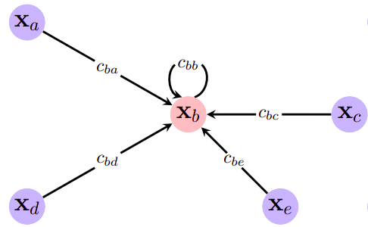
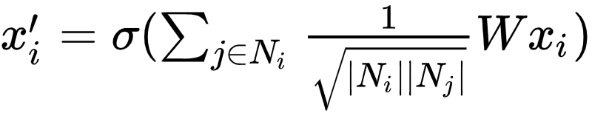
GCN (Kipf and Welling, ICLR’17)
Symmetric Normalization
  X’ = σ (D^-½ A’ D^½ XW)
Node wise update rule:
Edge features not explicitly modeled
Thomas Kipf’s Blog
Homophily v/s Heterophily
Transductive: training algo sees all nodes during training. Propagate labels from training nodes to rest of the graph.
Inductive: Generalize to unseen test graphs
Source: [LINK, page 82]
Notes:
one very popular approach performs this idea of symmetric normalization where instead you multiply by the inverse square root of the degree matrix from both sides
cannot model complex features to the edges

Slide 10
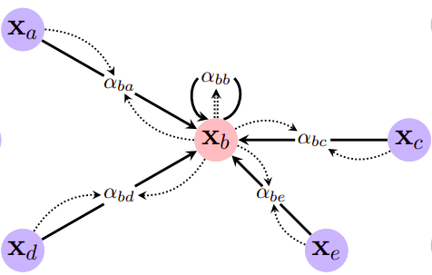
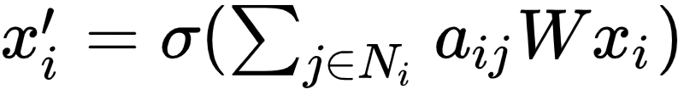
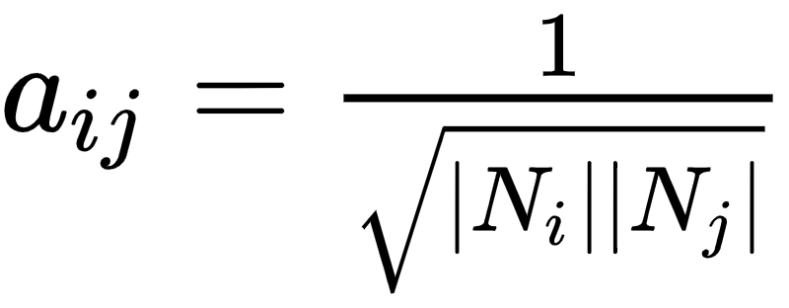

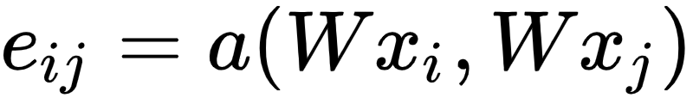
GAT (Velickovic et al., ICLR’18)
General node update rule
GCNs define
GAT uses attention to compute importance of neighbors
Source: [LINK, page 82]
Notes:
this coefficient alpha i j which said how much are nodejs features important for node i what the gcn did when they defined the 1 over square root of neighborhood i neighborhood j was they defined this coefficient explicitly so they explicitly said based on the graph structure this is exactly how much node j is important to node i but there are many possible factors other than graph structure that influence the importance of a neighbor to another vertex so it might be quite useful if we can compute this coefficient in a slightly different way and in the graph attention network model
for a particular edge take the features of the sender the receiver and the edge features and we pipe them through this attention function a which gives us coefficients along pairs of nodes i j which we can then normalize using a soft max function across the neighborhood

Slide 11
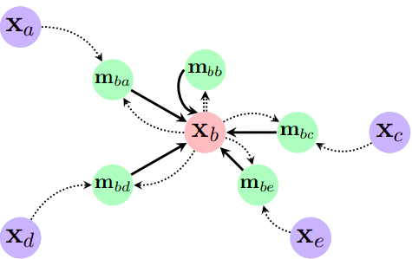

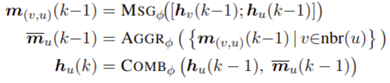
MPNN (Gilmer et al., ICLR’17)
Most general and powerful framework
May have scalability issues
Source: [LINK, page 82]
Notes:
we can compute messages that is arbitrary vectors that get sent across edges of the graph and you can condition these messages using any edge features that you might have and then we can think of the aggregation function as just aggregating all the messages sent to it
takes into account the features of the sender vertex i the features of the receiver vertex j and any edge features you might have along that path
the message passing network is the most potent craft neural network layer at least in terms of layers that look at only first order neighbors however it requires us to store and manipulate these edge messages which can get costly both from memory and representation point of view like it could overfit if the data is sparse and it could end up using a lot of memory if the graphs are big so in practice these mpn models are often only applied to small graphs or graph data sets where it is assumed that there's some pretty complex manipulation going on over the edges

Slide 12
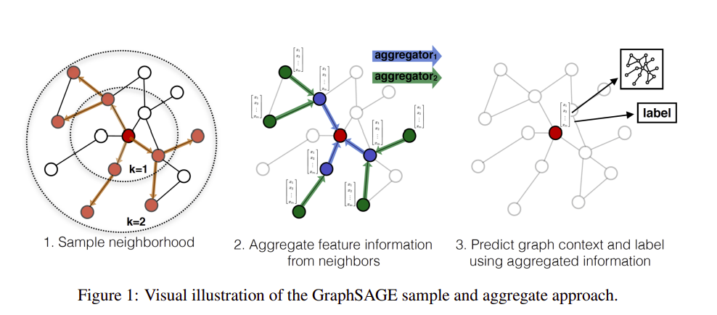
GraphSAGE (Hamilton et al., NeurIPS’17)
Notes:
there's been quite some research on how you might be able to run these graph neural networks on very large graphs and one of the first approaches graph sage showed that you can basically sub-sample some neighbors and sub-sample some neighbors neighbors and only run your graph neural network over this reduced graph of sub-sample neighbors and if you let this model train for long enough you will end up with performance that is quite competitive to having the whole graph in there in the first place.

Slide 13
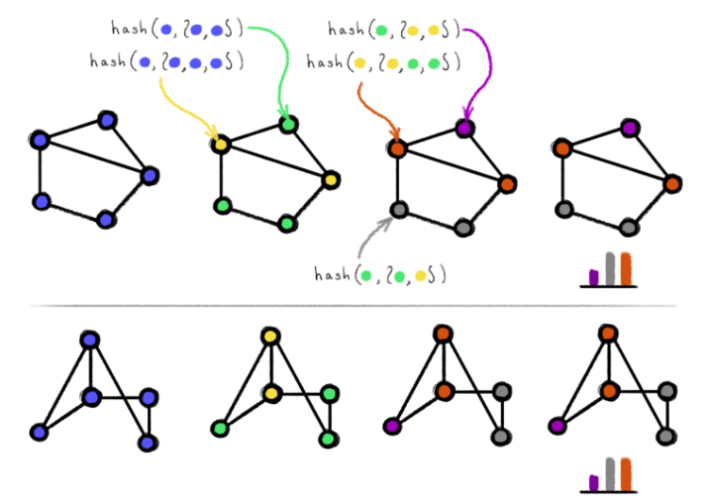
Representational Power of GNNs
Graph Isomorphism test
  Define GNNs’ power by the graphs they can distinguish
Weisfeiler-Lehman test (1-WL)
  (approximately) decide graph isomorphism
  Propagate random hashes of sums along edges
  Iterate until hashes do not change
  If histograms are same, then graphs are possibly isomorphic
Michael Bronstein’s Blog
Notes:
It is important because many interesting tasks on a graph such as various combinatorial optimization tasks are np complete and what we've discussed till now is still polynomial time so very evident that there exists some problems that GNNs cannot solve
one canonical example that people like to use in graph representation learning to measure this power of GNNs is the task of deciding graph isomorphism
In the context of gnns we ask ourselves can this gnn distinguish two non-isomorphic graphs
if you cannot give them different embeddings any task that has to discriminate them is hopeless
Can we even tell 2 graphs apart ? ?
we will talk about the expressive power of graph neural networks and we will discuss this in the context of weisfeiler lehman tests
at the start every node has the same color . compute random hashes in every node you pass them along the edges and you sum them up and you iterate until these hashes stop changing . if their histograms are the same you say they're possibly isomorphic otherwise you stop and say they're not isomorphic
basically tracking all the possible neighborhoods and assign different colors to different situations a
this feels a lot like a graph neural network right because you're passing neighborhood information along the edges of the graph and using that to update your representations so

Slide 14
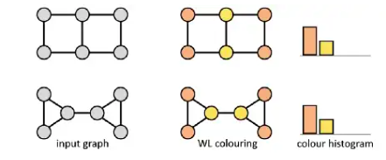
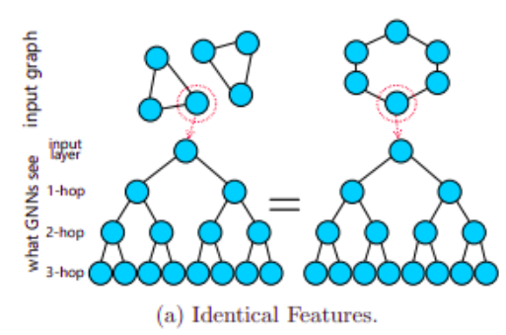
1-WL failure cases
Determine Isomorphism over graphs with discrete features
Source [LINK]
Notes:
however, it does fail in some painfully simple scenarios

Slide 15
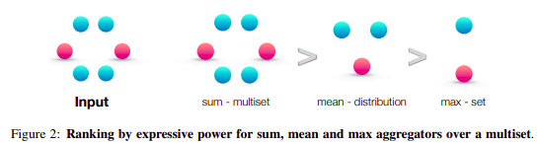
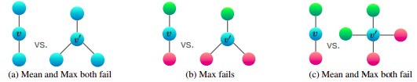
How Powerful are GNNs ?
GNNs are no more powerful than 1-WL
Permutation invariant aggregator must be injective for maximal power
Over discrete features, sum is optimal way to capture diversity of neighborhood
Notes:
when our features are discrete you can prove that a gnn can never be more powerful than this test if you want a gnn that performs exactly as powerful as one wise father test you need to be
careful on the hyper parameters of the model specifically if you want to get maximal power you need to have an injective permutation invariant aggregator one example of this in the discrete feature case is sum so if i have a neighborhood like this of blue and red neighbors summing them up like their one hot features will capture the multiplicities of every single one of them so i've captured the whole neighborhood the moment i take the average i'm already just capturing the distribution like what's the ratio of blues to reds and if i take something like max that's even worse i'm reducing all the multiplicities in this set so i hope this gives you kind of a visual representation of how in this case summation captures more information about the neighborhood than the other ones okay and in fact the way in which you prove this is very similar to the proof you do to show that deep sets are universal the main difference is that now inputs are no longer set they're multi-sets so a feature can repeat itself so you must be careful about which aggregator to use okay
in real world scenarios features might be continuous and maybe this situation doesn't happen that often

Slide 16
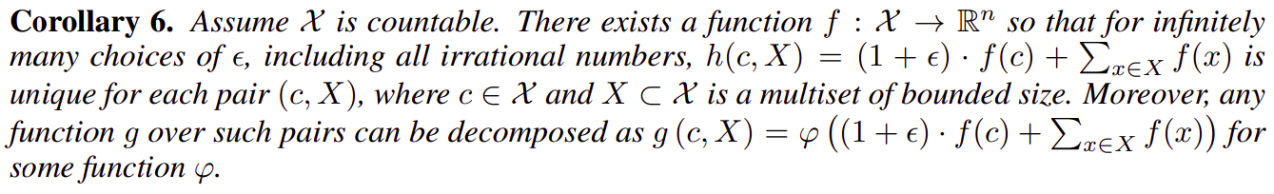

GIN (Xu et al., ICLR’19)
MLP must be some sort of an universal approximator
epsilon required to distinguish the central node apart from the rest
Notes:
the authors of the paper that showed this built then a model called the graph
isomorphism network kind of to align with that algorithm. it's like a simple GNN that follows this principle that you should use the sum aggregation and it's as simple as possible but satisfies this constraint of being as powerful as 1WL.
it tells apart the central node from all the other nodes specifically it has to add this epsilon to make it theoretically distinguishable in the original paper epsilon is an irrational number because all of these guys are countable features and this one wouldn't have to be somehow non-countable to tell it apart in reality computers cannot represent the rational numbers so this epsilon is just a learnable weight

Slide 17
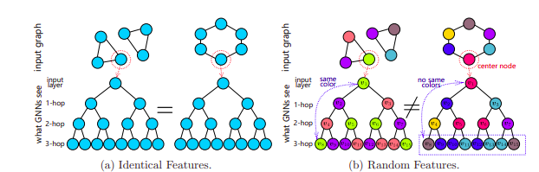
Beyond 1-WL (Sato et al., SDM’21)
Notes:
there's a random number in every single node well now a node can see itself a certain number of
hubs away and therefore you know you've closed a certain kind of a cycle right

Slide 18
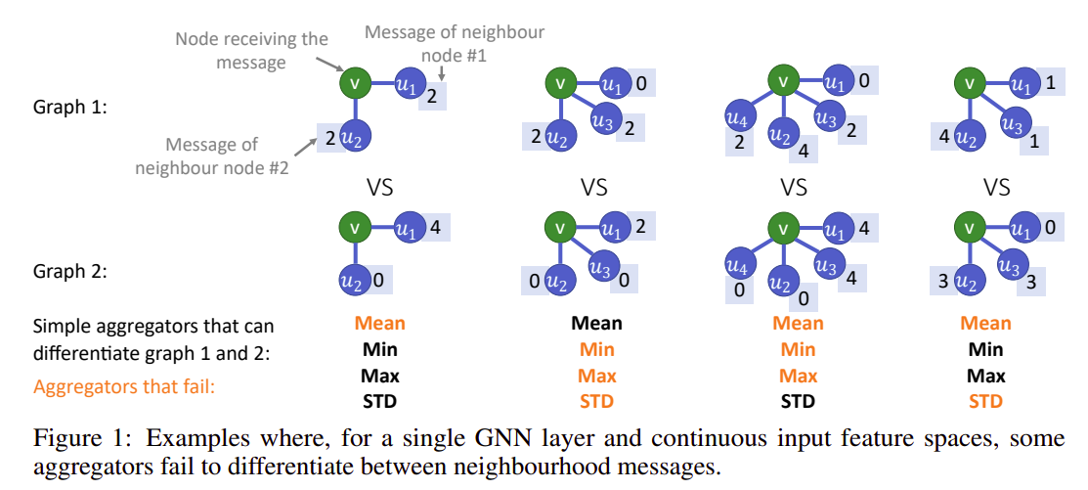
PNA (Corso et al., NeurIPS’20)
Notes:
Going beyond discrete features. GIN injectivity of sum doesn’t hold.
COuple of interesting proofs
what if the features are not discrete it's very common in the real world that the features might be continuous
Evidently it turns out that when you put continuous features in the nodes all of those previous proofs that you should use the sum aggregation fall apart and here's a few concrete examples

Slide 19
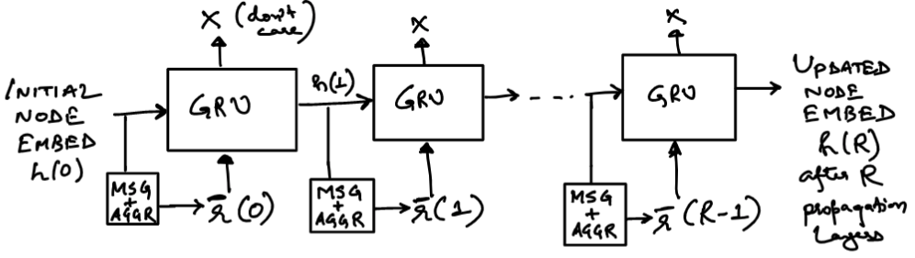
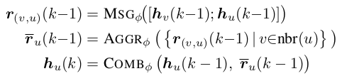
GMN Node Encoder
Proposed in : [GGSNN, GMN]

Slide 20
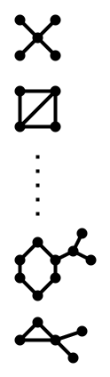
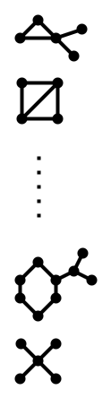


Setup: TOP-K Graph Retrieval
Top K
similar graphs
Graph Similarity scoring and ranking model
Query
Graph
Database of
Corpus Graphs
Corpus graphs ranked based on similarity scores

Slide 21
Graph Similarity Scoring
Application dependent choice of similarity scoring function
  Graph Edit Distance (GED)
  Maximum Common Subgraph MCS)
  Subgraph Isomorphism
All similarity scores rely on finding an optimal matching between the query and corpus graphs
Leverage recent advances in GRL for representation and scoring
  Message Passing Graph Neural Networks (GNNs)

Slide 22
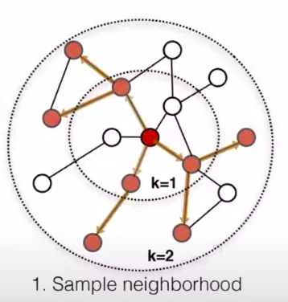
Framework for Message Passing GNNs
Two considerations
  Individual node features
  Graph Topology
Message passing framework factors in topology
Each additional stack of a GC layer increases the topological radius of influence by one additional hop
Figure from [GraphSage]

Slide 23
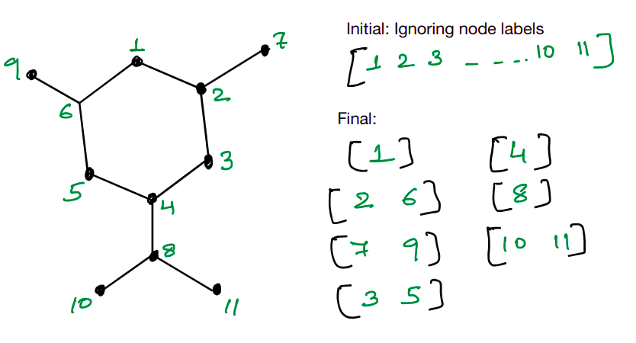
Goal: Injective mapping
Injective mapping between node neighborhood and embedding

Slide 24
Whole Graph Representation
Option 1:
Treat the graph as a set of node embedding vectors
GNN
GNNs compress node neighborhood topological information
Node embedding
space
Graph Embedding Vector
Option 2: Obtain coarse graph level vector
Symmetric Aggregator

Slide 25
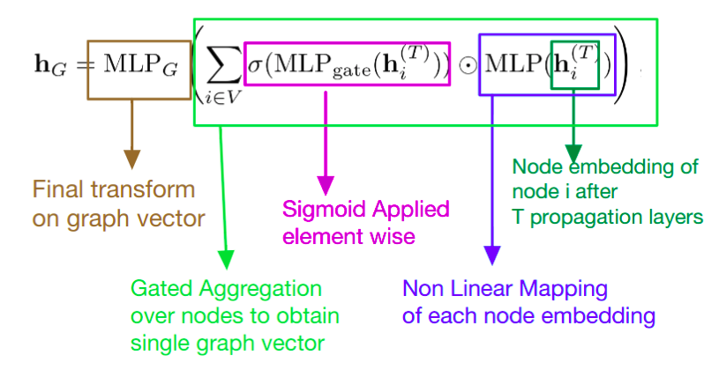
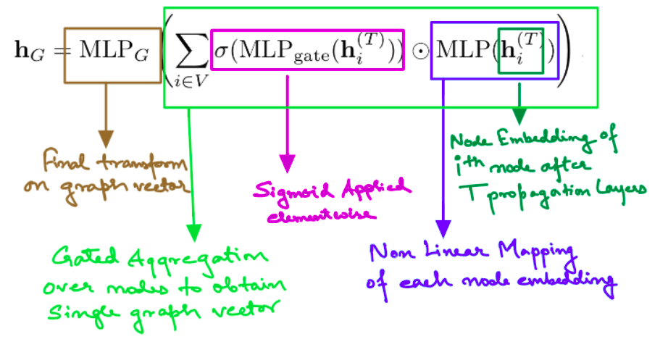
GMN Aggregator:
Gatednode embedding aggregator
Proposed in : [GGSNN, GMN]

Slide 26
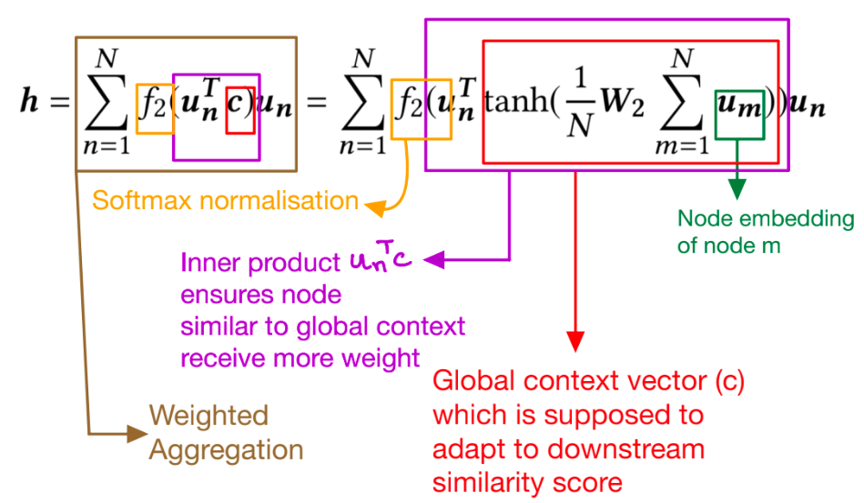
SimGNN Attention based Aggregator
Attention based node embedding aggregator
Proposed in : [SimGNN]

Slide 27
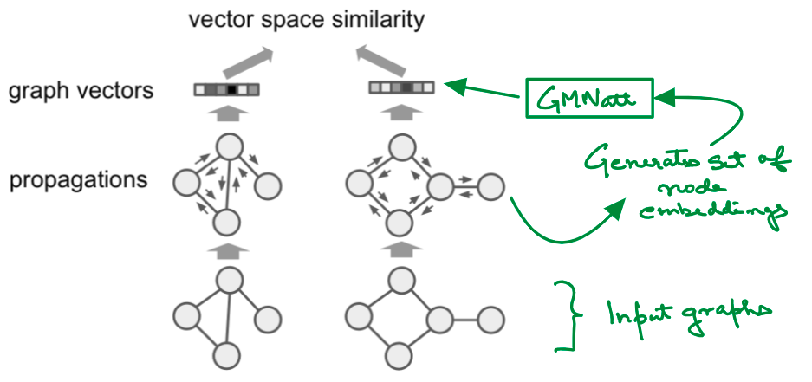
GMNembed: Graph Embedding Network
Vector similarity can be based on euclidean distance or cosine similarity
Figure from : [GMN]

Slide 28
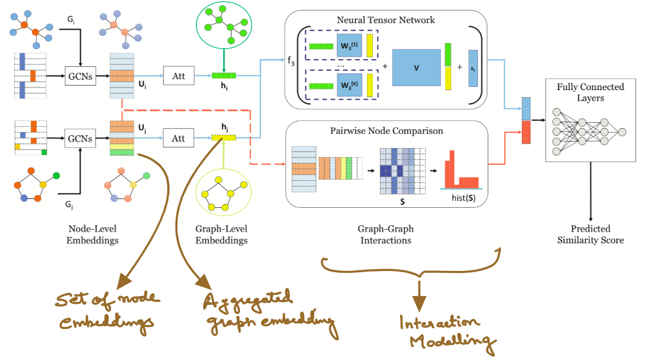
SimGNN
Figure from : [SimGNN]

Slide 29
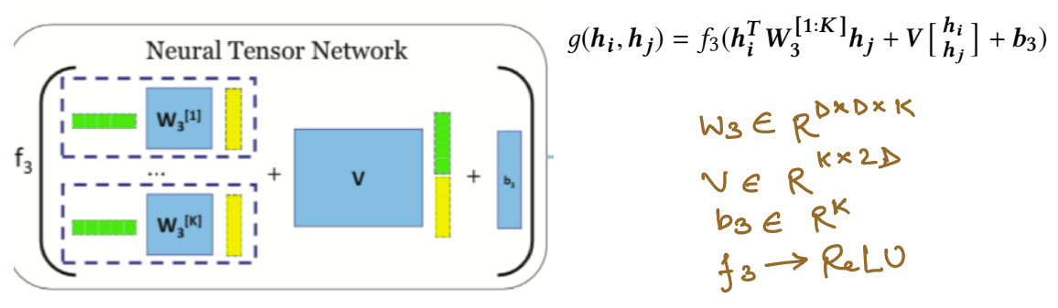
SimGNN : Neural Tensor Network (NTN)
Figure from : [SimGNN]

Slide 30
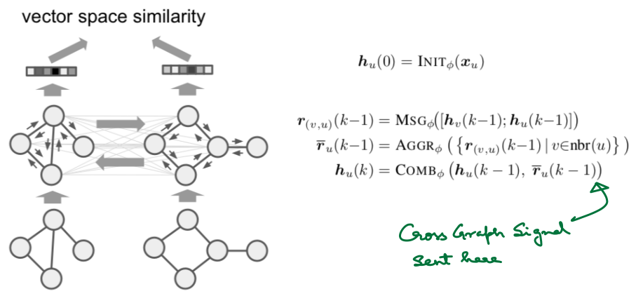
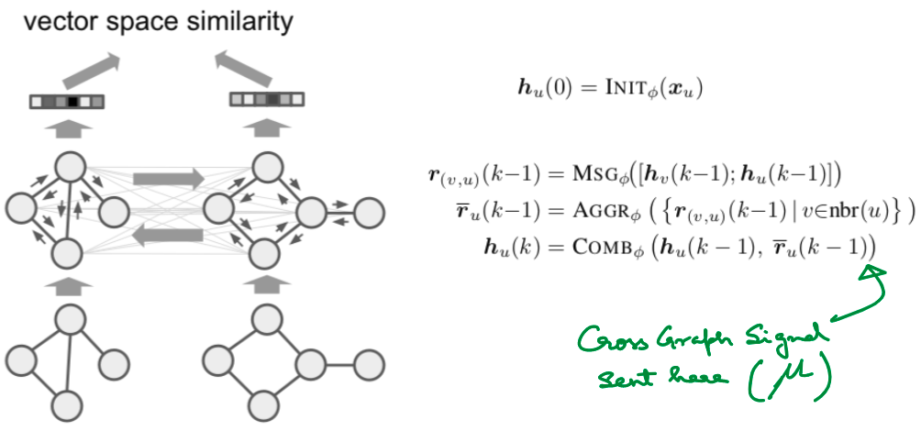
Early Interaction Modelling (GMNmatch):
Figure from : [GMN]
Trade-Off: Greater accuracy and interpretability, at the cost of scalability

Slide 31
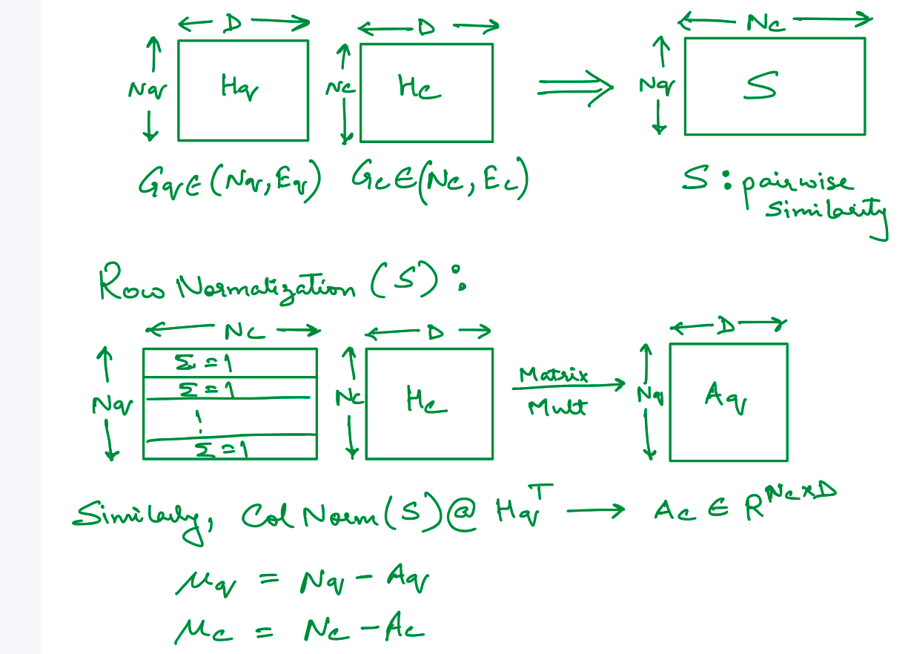
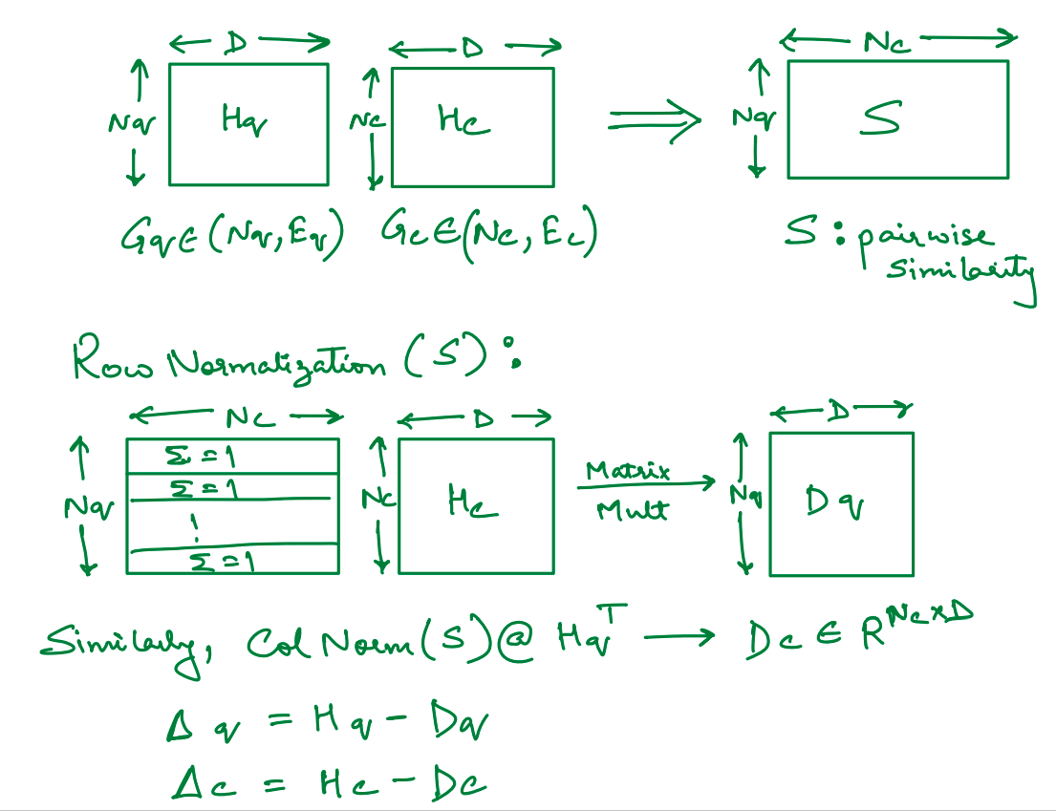
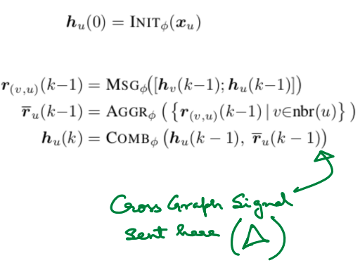
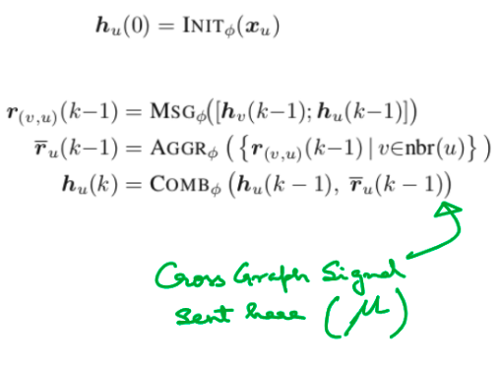
GMN Early Interaction modelling:
Allows for non injective mapping between nodes

Slide 32
Desideratum and Trade-Offs
  Accuracy - Retrieval should return relevant corpus graphs
  Scalability - Should scale to large corpora
  Interpretability - Should justify high relevance judgements
Interaction | Accuracy | Scalability | Interpretability
Zero (GMNembed) | Low | High | Low
Early (GMNmatch) | High | Low | High
Late (SimGNN) | Medium | Medium | Medium
Notes:
Choice of interaction modelling
Choice of interaction modelling

Slide 33


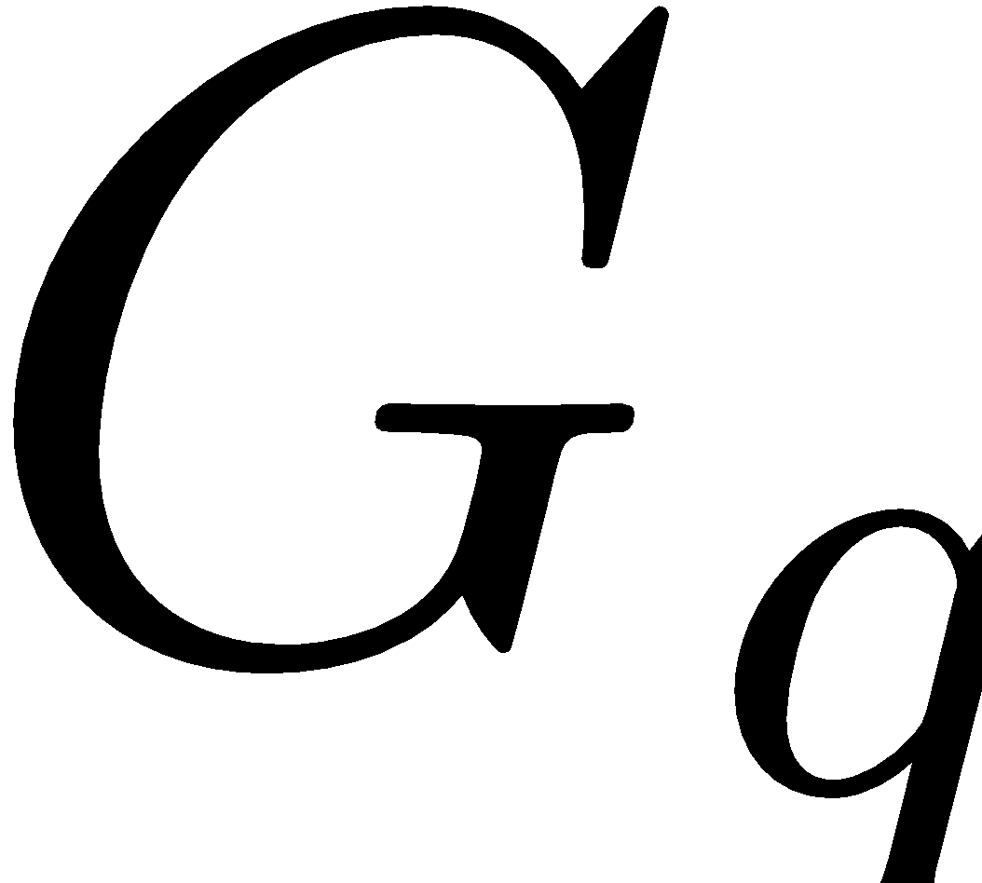
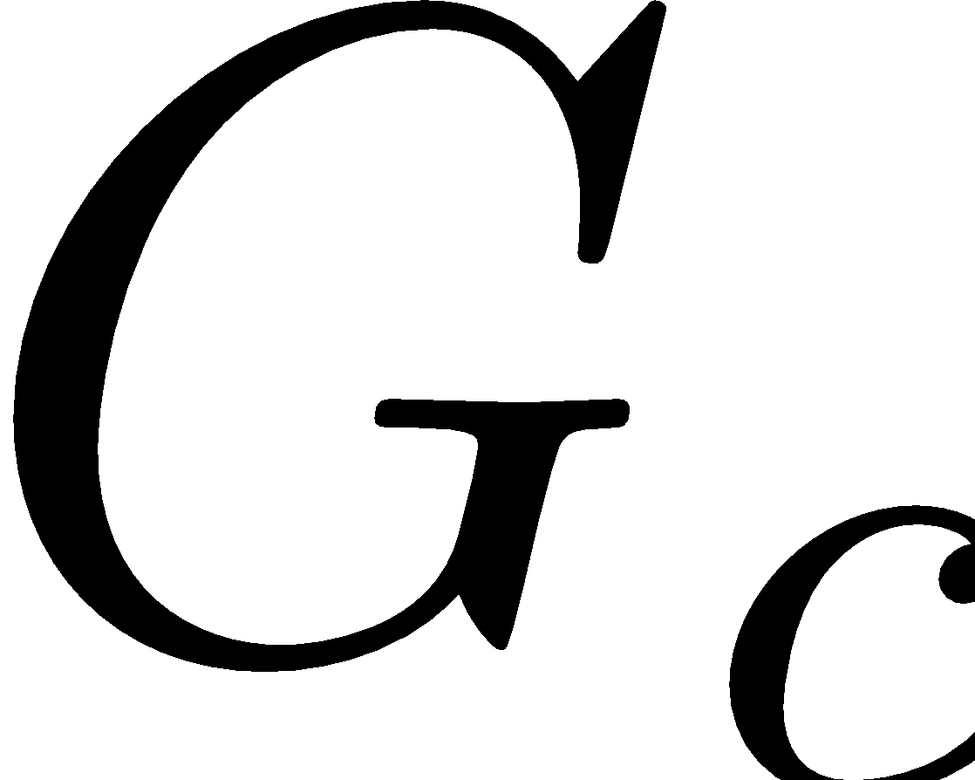
Graph Matching Challenge
Finding an optimal alignment of nodes, which is structurally consistent wrt edges
Quadratic Assignment Problem (QAP)
NP-Hard
1
2
3
4
A
1 | 0 | 0 | 0
0 | 0 | 0 | 1
0 | 1 | 0 | 0
1
2
B
Consistent!
A
C
1
2
3
4
B
C
4
3
A
1 | 0 | 0 | 0
0 | 0 | 1 | 0
0 | 0 | 0 | 1
B
Inconsistent!
C

Slide 34




Deep Graph Matching
GNN
Linear Assignment Program (LAP)
GNN
P
GNNs compress node neighborhood topological information
Node embedding
space
QAP on graph adjacency matrices
Intractable!
LAP on node embedding matrices
Tractable!

Slide 35
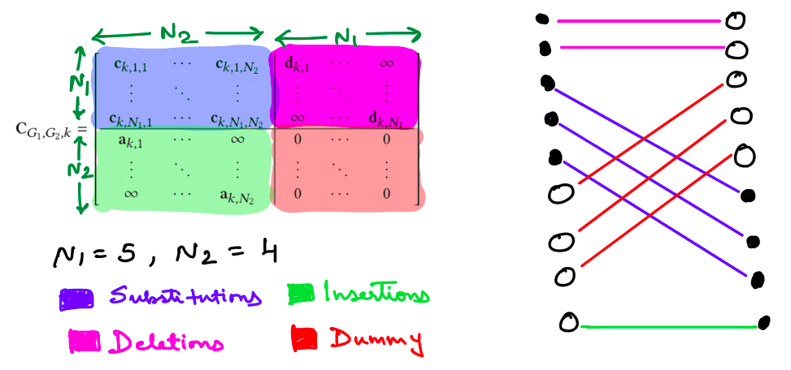
Handling Unequal Sized Sets:
In many applications, we want an injective mapping (optimal matching)
Option 1 : Pad appropriately
Option 2 : (For GED)
Image from :
[GOTSim]

Slide 36
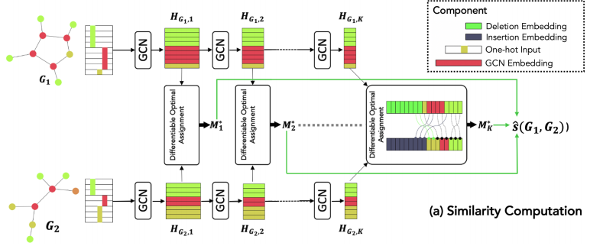
GOTSim
Combinatorial Solver used to obtain optimal assignment cost.
Image from : [GOTSim]

Slide 37
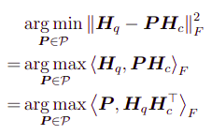
Objective for Matching

Slide 38
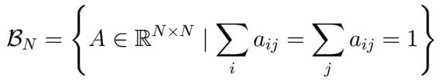
Objective for Matching
Non differentiable and requires considering n! solutions
Relax permutations. Consider instead the set of doubly stochastic matrices (Birkhoff Polytope)
This defines the convex hull of N*N permutation matrices

Slide 39

Sinkhorn Iterations for (soft) Matching
Non differentiable and requires considering n! solutions
Relax permutations. Consider instead the set of doubly stochastic matrices (Birkhoff Polytope)
This defines the convex hull of N*N permutation matrices
Iterative Sinkhorn Normalization
Theorem 1 of [Mena et al.]
Notes:
Cost matrix itself is estimated by NN so not completely reliable.
So we are fine with an approx solution if it is much faster, and is differentiable and backpropagable.
One sensible way to approximate a discrete category by con tinuous values is by using a temperature-dependent softmax function, component-wise defined as softmaxτ (x)i =
exp(xi/τ )/
P
j=1 exp(xj/τ ). For positive values of τ , softmaxτ (x)i
is a point in the probability simplex. Also, in the limit τ → 0, softmaxτ (x)i converges to a vertex of the simplex, a one-hot
vector corresponding to the largest xi
Cuturi’13 brought attention to it in the context of OT.
Add some amt of negative entropy as a regularizer, - adding p log(p) term to original linear objective, gives mized objective. Optimal value no longer lies on a corner of th epolytope.

Slide 40













IsoNet(Roy et al. AAAI’22):
Neural Alignment using Sinkhorn Network
Gumbel
Sinkhorn
Network
Edge
embedding
space
IsoNet,
Differentiable alignment module allows for end-to-end training
Human interpretable explanations during inference:
facilitated by neural alignment

Slide 41


IsoNet(Roy et al. AAAI’22):
Neural Alignment using Sinkhorn Network
Gumbel
Sinkhorn
Network
Node
embedding
space

Slide 42
IsoNet(Roy et al. AAAI’22): :
Training from binary relevance labels
IsoNet
Differentiable alignment module allows for end-to-end training
Human interpretable explanations during inference:
facilitated by neural alignment
Can be trained using binary relevance labels

Slide 43

IsoNet Interpretability Analysis (Qualitative)

Slide 44


Interpretability Analysis (MCES and MCCS)
Maximum Common Edge Subgraph (MCES)
Maximum Common Connected Subgraph (MCCS)
MCSNet, Roy et al., NeurIPS’22

