Slide 1


GIT
Presented by:
KAUSHIK
JUHITHA
SHIVA
VARSHA

Slide 2

What is GIT?
GIT is a distributed version control system to manage source code history which is used for:
1. Tracking code changes
2. Tracking who made changes
3. Coding collaborations
GIT is developed by Linus Torvalds in 2005 for development of Linux Kernel.

Slide 3
VCS
Version control systems are a category of software tools that helps in recording changes made to files by keeping a track of modifications done to the code.
The types of VCS are:
Local Version Control Systems
Centralized Version Control Systems
Distributed Version Control Systems

Slide 4
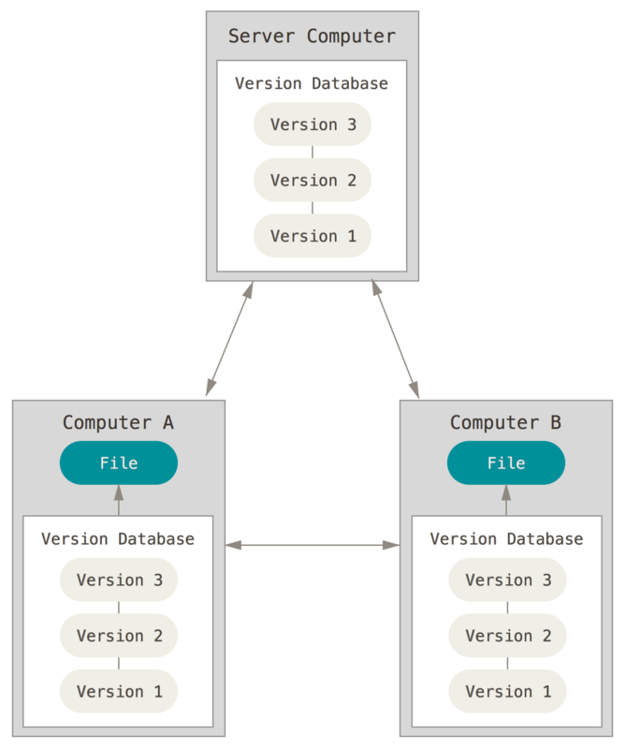
Distributed version control system

Slide 5
Why GIT?
Workability speed
Distributed VCS
Open source and free to use
Data security
Data safety

Slide 6
GIT vs GITHUB
It is a software | It is a service
It is a command-line tool | It is a graphical user Interface
It is focused on version control and code sharing | It is focused on centralized source code hosting
It has no user management feature | It has user management feature

Slide 7
GIT Commands
git init : create a new local repository
git clone : create a working copy in the local repository
git add : add one or more files to staging
git commit : commit changes to head
git push : send changes to the master branch to your remote repository
git status : list the files you have changed that you still need to add or commit
git pull : fetch and merge changes on the remote server to your working directory
git log : access the history of commits

Slide 8
FORK | CLONE
Forking is done on the GitHub Account | Cloning is done using Git
Forking a repository creates a copy of the original repository on our GitHub account | Cloning a repository creates a copy of the original repository on our local machine
Changes made to the forked repository can be merged with the original repository via a pull request | Changes made to the cloned repository cannot be merged with the original repository unless you are the collaborator or the owner of the repository
Forking is just containing a separate copy of the repository and there is no command involved | Cloning is done through the command ‘git clone‘ and it is a process of receiving all the code files to the local machine

Slide 9
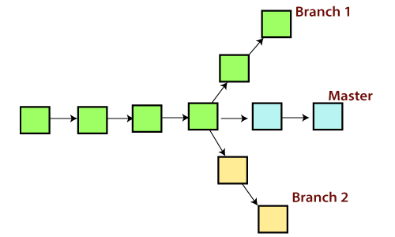
Branching

Slide 10
A branch is a version of the repository that diverges from the main working project. A Git project can have more than one branch. These branches are a pointer to a snapshot of your changes.
Operations on Branches
git branch <branch name> : create a new branch
git branch : gives the list of branches
git branch –d <branch name> : delete a branch
git checkout <branch name> : switch between branches
git merge <branch name> : merge another branch with currently active branch

Slide 11
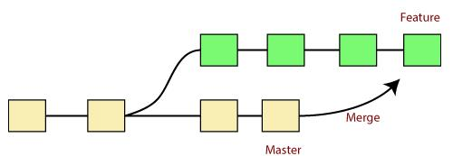

Merge and Merge Conflicts

Slide 12

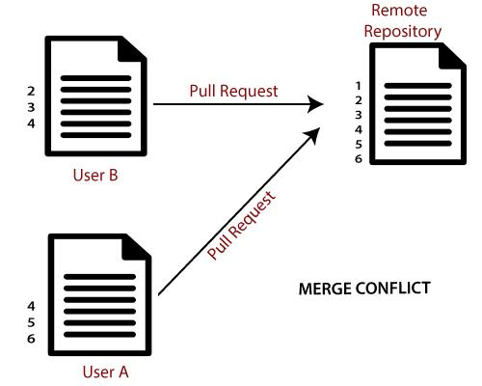
Merging is a procedure to connect the branches and it joins two or more development history together.
Git merge is used to combine two branches.
When two branches are trying to merge, and both are edited at the same time and in the same file, git won't be able to identify which version is to take for changes.
While merging, we encounter three options :-
Accept incoming changes
Accept current changes
Accept both changes

Slide 13
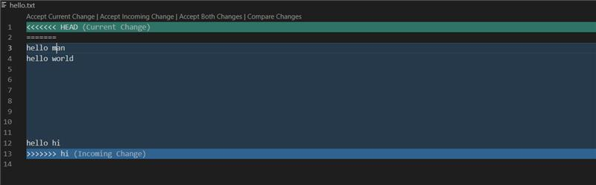
Merging Procedure

Slide 14


