Slide 1
North East England Housing Report
A detailed analysis of the North East housing market from 2020 - 2025

Slide 2
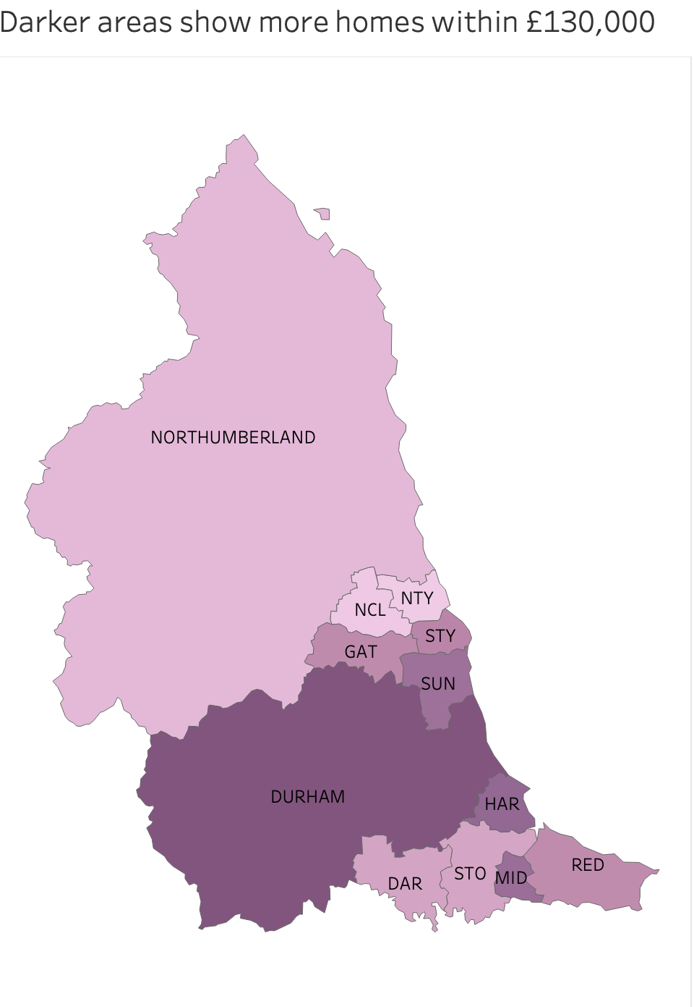
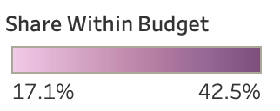
Where can a first-time buyer afford a home within their budget across the North East
County Durham consistently ranks as the most affordable area, compared to North Tyneside which is the most expensive in 2025, with Newcastle and Northumberland as close contenders.

Slide 3
A £130,000 budget covered 30% of North East homes sold in 2025, down from 41% in 2020
The hardest hit area was Redcar and Cleveland down to 30% from 47%, with semi-detached homes being the type that fell the most down to 21% from 41%
However, pay for lower paid full-time workers rose faster than typical home price increases across 11 of the 12 areas. Meaning these homes now take fewer years of a full-time salary to pay off.

Slide 4
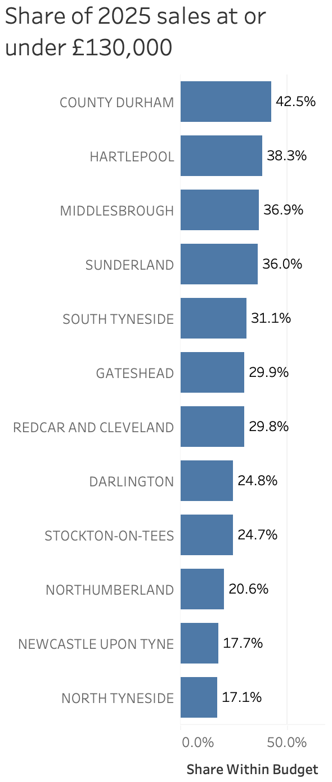
A £130,000 budget goes furthest in County Durham and least north of the Tyne
County Durham ranks the highest for 2025 at 42.5% of homes sold and Hartlepool second at 38.3%. This contrasts with the districts north of the Tyne which are the areas where a budget of this amount would cover the least ranging from 20.6% down to 17.1%.

Slide 5
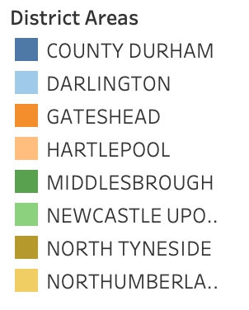
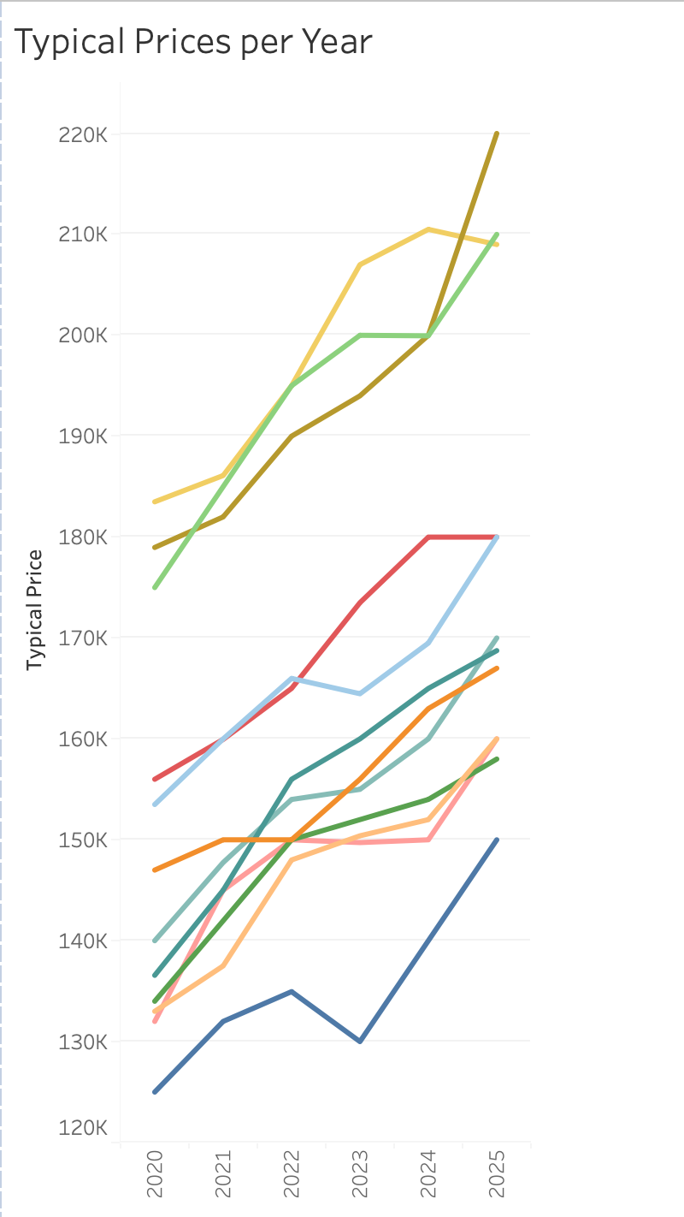
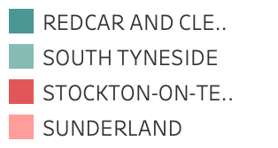
Typical prices rose in every North East area between 2020 and 2025
Every region has seen an increase in its typical prices over the five-year period from 2020 to 2025. In pounds North Tyneside has grown the most with an increase of over £40k in prices. Every area has seen growth whilst there has also been massive wage growth for the lowest full-time workers in society associated with the minimum wage increases of the past five years.

Slide 6
A first-time buyer can see where a budget goes furthest, but the data has limits
A first-time buyer can use this data to decide on a district level scale, where they get the most for their money across the North East.
This does come with significant limitations however, firstly it ignores mortgage rates, which are the most significant monthly costs associated with home ownership. It also ignores regional wage differentials as well as other localised costs and the budget of £130,000 is an assumption.
Contains HM Land Registry data © Crown copyright and database right 2026, licensed under the Open Government Licence v3.0. Source: Office for National Statistics, licensed under the Open Government Licence v3.0.

