Slide 1


Team Project 02
Proposal Presentation
Team5 (Global Team)
Dennis Goretzki, Lee Juhwan, Yu Seoyeon, Cha Seungjoon

Slide 2
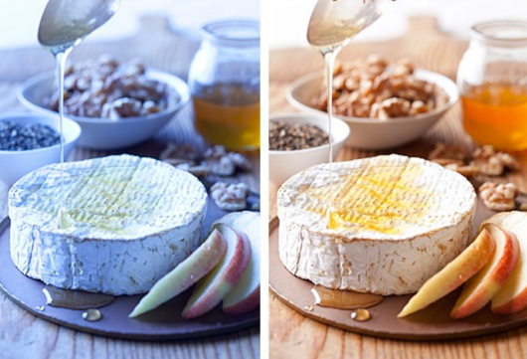
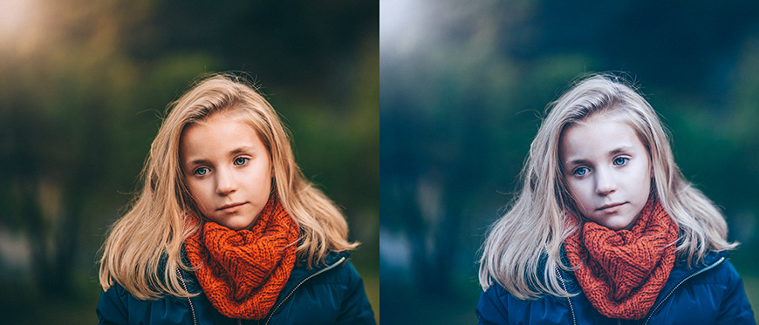
Motivation
Bad lighting, incorrect white balance, camera setting
➡️ Color imbalance

Slide 3
Program Objective
1. Detect Color imbalance
2. Correct white balance
3. Provide color temperature presets
Automatically adjust color balance
for more natural, visually pleasing results

Slide 4
Program Structure
Input Image
Extract Color Stats
Gamma & Saturation Correction
Visualization & Evaluation
Output Image
White Balance Correction
Color Temperature Adjustment

Slide 5
Team Roles & Development Plan
Member | Role | Key Tasks
A | Research & Theory | Gray-World, Gamma math
B | Core Implementation | Color space, algorithms
C | Evaluation & Visualization | Histograms, comparisons
D | Integration & Docs | Coding, Report
Research
Implement Color Conversion
Impement Gamma and Presets
Integration and Testing

Slide 6
Expected Results
Automatic Image Processing system that enhances color harmony
Balanced RGB values
Visually natural output
Quantative metrics (mean shift, variance)

Slide 7
Thank You
Team5 (Global Team)
Dennis Goretzki, Lee Juhwan, Yu Seoyeon, Cha Seungjoon

