Slide 1

LugTrack
Team 12
Jui Hemanth Prajwal Yinyin Vinayaka

Slide 2
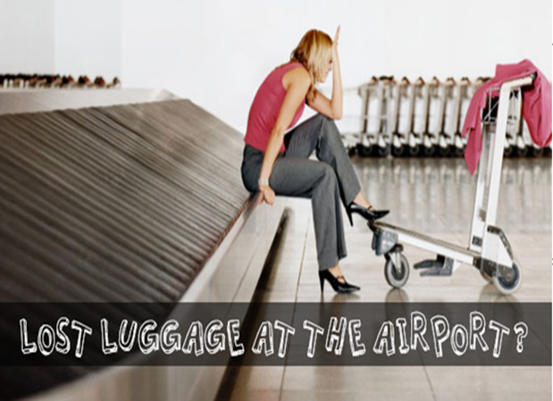
Need and Customer Segments
Due to increase in the passengers traveling by airplane, cases of luggage being misplaced/lost has increase by 3 times.
It takes minimum of 3-4 Working days to get back your belongings with NO Guarantee !!!
Need for an app that provides accurate live location of your luggage.
Notes:
I Miss Jui Ashinkar along with my group is here to present our project Lug track.
To be honest our project idea was derived from most of our team member’s personal experience.
Losing luggage is never a pleasant experience it is always a hassle which include dealing with lot of paperwork, losing out precious time, also there is no guarantee of your luggage. With the recent statistics it is evident that there is a need for an app that tracks the live location of your luggage and provides you the comfort that your luggage is travelling with you on the same flight. Our focus segment will be Passengers right from Solo Travellers to Group Tours, daily travellers to first time travellers etc. we will also tie up with the Commercial airlines that will support the app to provide guarantee of their passengers on their luggage.

Slide 3
Proposed Solution- LugTrack
Existing Solution
Our Solution
Lugloc
Waldo
LugTrack
Exclusive Features
Provides Update on Live Location of your Luggage
Easy to use
Notification on boarding
Available on iOS/Android
GSM Module
Push Notification
Bluetooth
Push Notification
RFID Technology
Push Notification +SMS Notification
Notes:
We propose LugTrack, as a service that will help you to know the status of your Bags.
It will use RFID technology to track and provide you an update via a mgs or an email to give you a confirmation on your luggage status. This Solution is easy compare to the existing one and more accurate. I would now like Hemanth (with an H) to take over

Slide 4
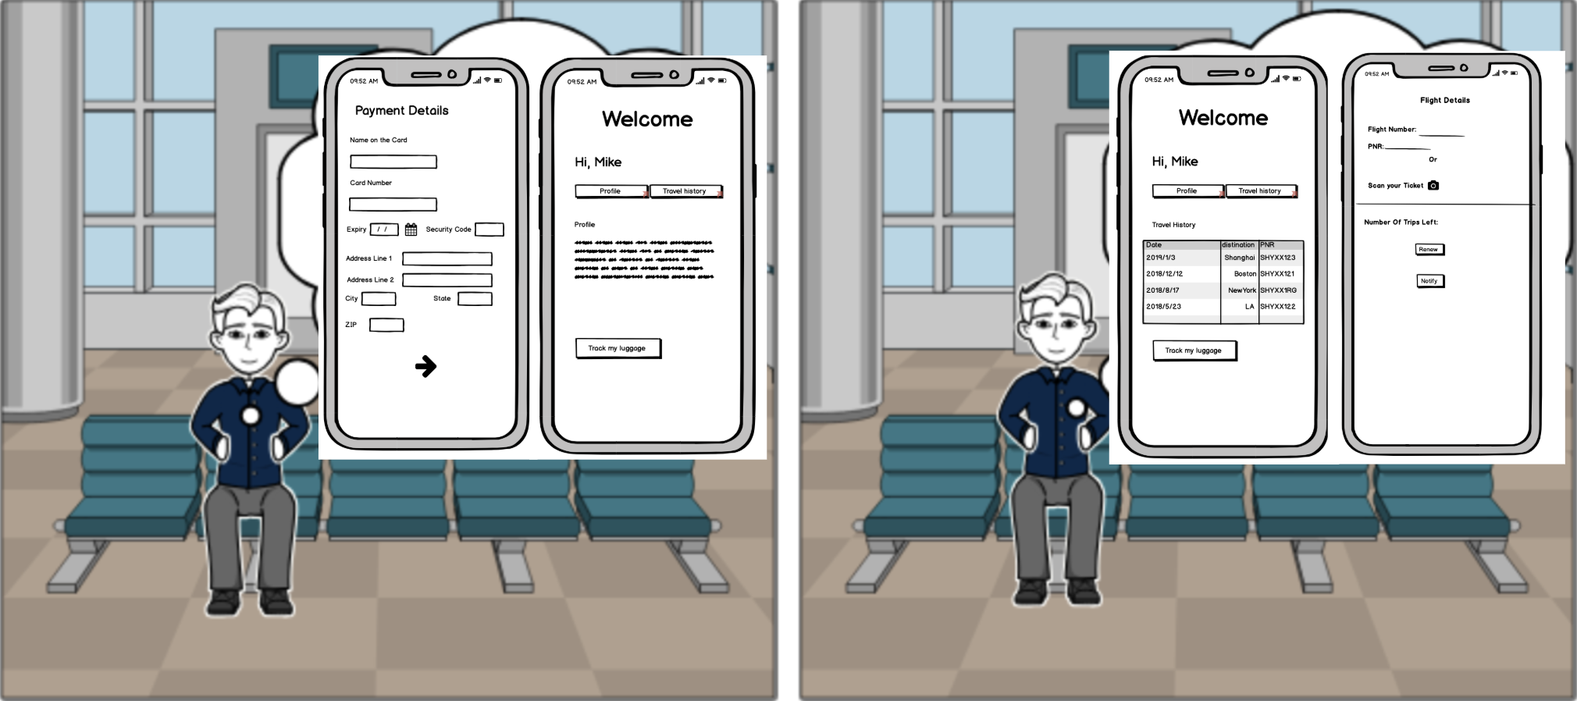
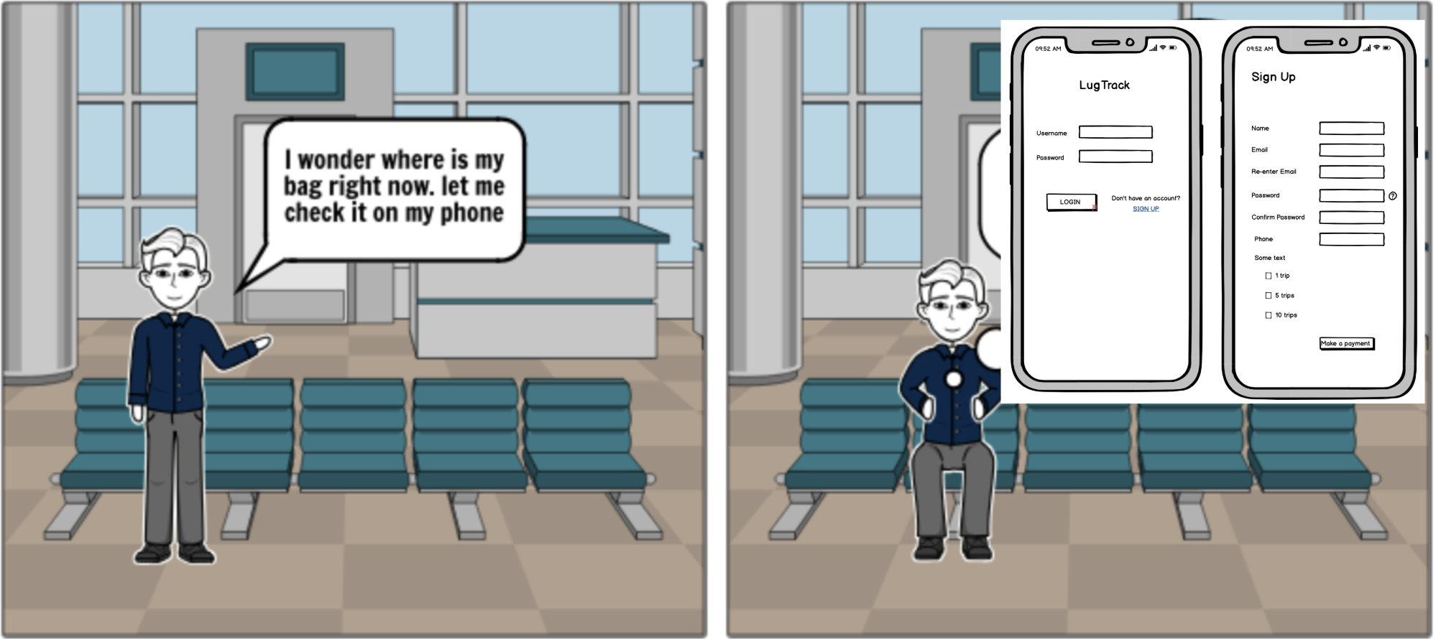
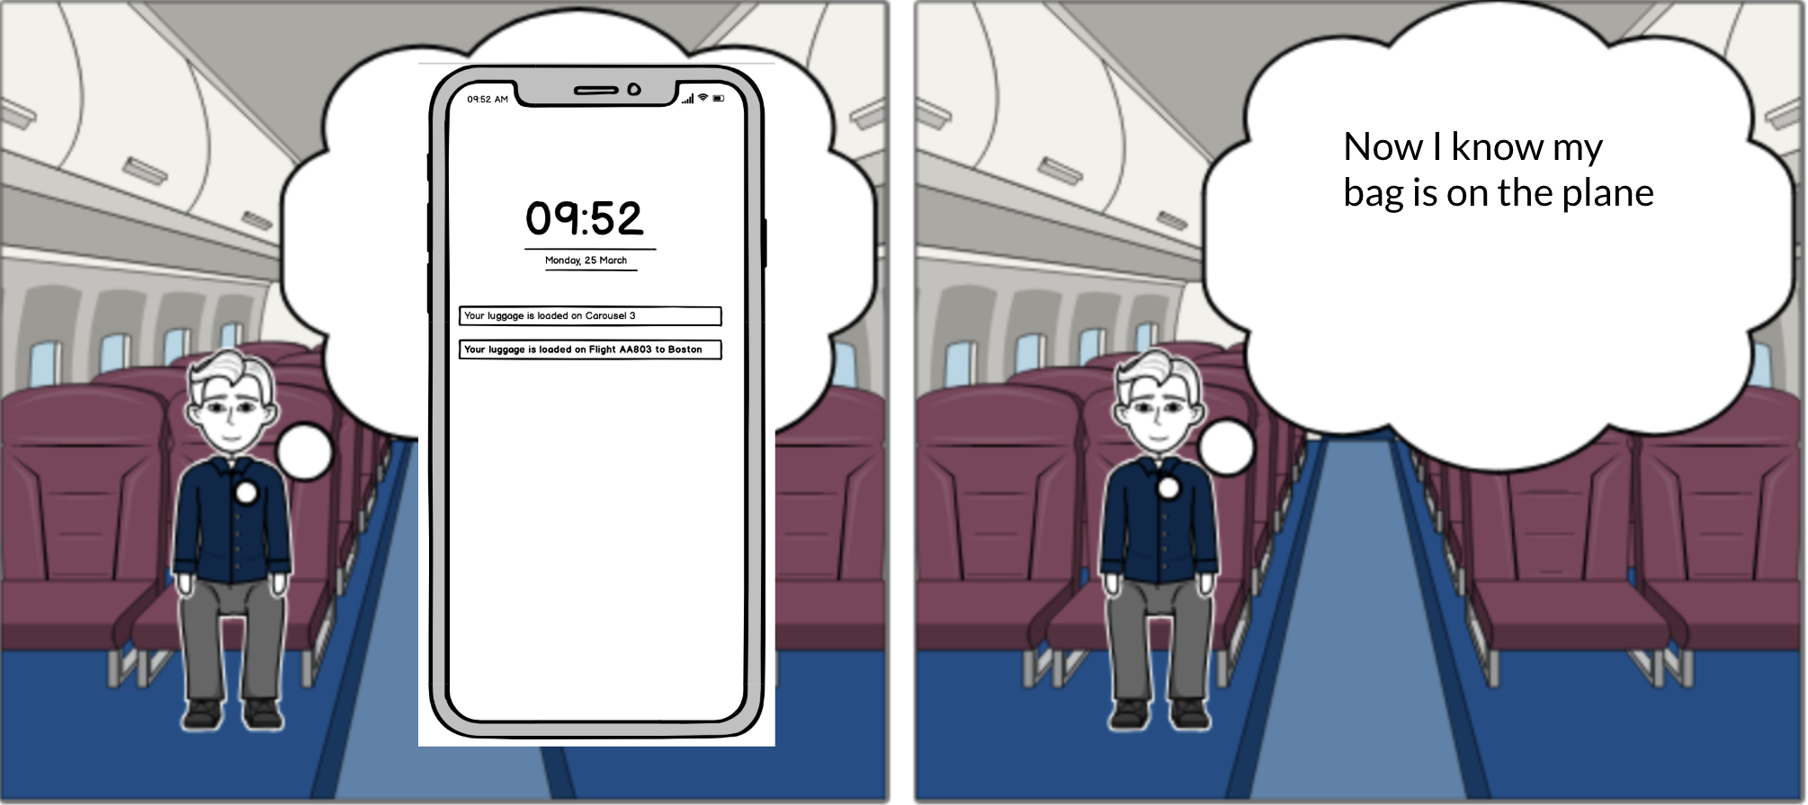
Storyboard

Slide 5
Product Roadmap for Q1-Q4
Themes
Q1
Q2
Q3
Q4
Launch
Marketing
Software Development
Customer Satisfaction
Product Launch with free trials
Maximum possible awareness at launch
Achieve app with zero bugs
Link to help/
documentation
Limit free trials and incentivise referrals
Secure marketing funding
Develop more attractive UI
Set up customer helpdesk
Implement popular requests
Approach different marketing platforms
Implement feature enhancements
Train customer care executives
Launch app for airport officials
Collaborations/
Company tie-ups
App and website integration
Achieve 100% customer satisfaction
Notes:
Launch :

Slide 6
Product Features
01
Live Location Updates
Push Notification
Text Messages
Emails
02
Network and Hardware Features
Bluetooth, GSM and WiFi
iOS /Android
Carousel Track
03
Proximity Alert
Easy Add-on Luggage
Live Chatting
Cloud
In-App Features
04
Modes
Airplane Mode
Sleep Mode
Alarms
Notes:
Hello everyone, I am Prajwal and I will be covering Product Features and the features that will make the cut during Launch.
First and foremost, we are introducing this innovative product which integrates every single feature available in the market at a much cheaper rate
We are focused and dedicated to provide Accurate Live Location of your luggage via Texts, in app notification with GPS and Emails while keeping in mind the compatibility with the lowest configuration of Android or iOS devices
We are providing the Ultimate combination of GSM-Bluetooth and WiFi model to enhance the Network Usage in times of emergency.
The proximity Alert feature will be one of the important aspects of our product as it uses RFID unique Identifier to locate your luggage in case of mishandling.
Along with that we are providing an In-App Chat Box which will be our door to satisfied customer service
What better than a smart device that knows when to shut off and when to raise an alarm, boom!
Our Auto Airplane Mode and Sleep Mode will help you save a lot of battery when traveling continuously and will raise an alarm if you lose the luggage in a pile

Slide 7
Features of MVP for launch
80%
70%
65%
Location Updates
Network Usage
and Hardware
In-App Features and Modes
GPS Tracker
Push Notification
Text Messages
RFID Tracking
Bluetooth Model
GPS-GSM Model
iOS/Android
Proximity Alert
Easy Add-on
Airplane Mode
Sleep Mode
Notes:
While our Design Team working very hard to provide these features right away our MVP will have around 80% of the features with Location Updates with Text Messages and RFID Notifications.
Our Network Model will make a 30% cut will have the GPS-GSM model compatible with the iOS 10+ versions and Android above Oreo
Proximity Alerts, Add-on Luggage with Airplane Mode and Sleep Mode makes the 65% of the promised features at the time of the launch excluding the Alarms and Live Chatbots to be introduced in the later stage of the roadmap
Thank you, Hemanth will be taking over now

Slide 8
Key Metrics
Customer Base
Activity Tracking
Feedback
Active Users
Referred Users
Targeting Potential Customers
Hover
Ad-Promotion
Clicks
Customer Experience
Customer Feedback
Feature Requests
Marketing
Awareness Events / Emails
Hoardings
Offers and Incentives
Targeted Ads
Social Media Interest Tracking
Promotional offers
Email Ads
Survey after each use
Ratings
Loyalty Programs
Incentivised Survey
Notes:
This is Hemanth, Now, for the key metrics for our app, we have three main measures.
We want to actively monitor our customer base and ensure that there is a steady and healthy expansion. This can be achieved by identifying our potential customers and targeting them with ads and nearby events to invoke interest. We can track the number of referrals, incentivized sign-ups, voluntary registrations. Analytics on these numbers will give us a clear picture of our market and customer growth.
Online User Activity Tracking such as recording hovers over the ad or clicking on the link to our app can help us understand a customer’s interest and further enable us to draw them to our service. Targeted ads can be sent to these users once they have been identified as potential subscribers.
Conducting regular surveys can give us direct customer feedback. Users can give a rating at the end of each successful tracking to express their happiness with the service. Customer requirements and feedback information can also be collected to gain insights. Pushing offers to loyal customers can further increase their usage and hence, the probability of recommending it to someone. Paid surveys can also be done from time to time to get additional feedback

Slide 9
Operational Needs
01
Software Development Team
Develop application for iOS and Android
Add regular enhancements and update bug fixes
Add features and improve customer experience
02
Manufacturing Facility
Manufacturing Equipment
Supply Chain
Shipping
03
R&D / Engineering Team
Design based on size and requirement
Continuous testing and improvements
Develop new tracking methods
04
Customer Helpdesk
Chat-bot
24/7 Customer Support
Help / Documentation
05
Marketing Team
Target Potential Customers
Multiple Platforms
Collaboration / Awareness Programs
Notes:
As a service provider these are some of our most important operational needs.
For the mobile application, we would need a software development team who are able to deliver the fully functional application without any bugs for product launch. They would also need to provide timely feature enhancements and updates.
For manufacturing the tracking devices, We have identified a leading company in Taiwan for chip manufacturing, assembly and shipping of the device.
Continuous research and innovation by the R&D / Engineering team will further enable us to create better tracking devices. Making the devices smaller and cheaper would make them more accessible to the consumers and increase our customer base.
Online payments, internet transactions, incorrect information etc. might be certain areas where a person might need assistance. Providing customer support by having chat-bots and a helpdesk to answer frequently asked questions will improve customer satisfaction.
The marketing team has to come up with various strategies across various marketing platforms to increase their reach and cast a wider net. Collaborating with companies in this industry will allow us to tap into their user base.
Over to you vinayaka

Slide 10
Projected Costs
Application development costs: $735,000
Hardware costs: $62,750
Office space costs: $120,000
Total costs for MVP: $918,000
Notes:
Thank you Hemanth! Hope you are excited for our product! I know I am!!
Now I am going to talk about the projected costs and the risks/ caveats of our project.
-Over the span of a year. For our project MVP, we will be needing an application development team, hardware required to run the project and an office space.
Market changes/ inflation is not considered due to the fact that our service is independant.
Cost for the development team is estimated to be $735,000.
Hardware cost is going to be around $63,000.
Office space will cost $120,000.
In total it will cost $918,000.

Slide 11
Addressing Risks
01
Legal/Patent Risks
02
Technology risks
03
Adoption risks
04
Piracy risks
Notes:
Now let us talk about the risks involved.
As RFID, GSM and a
mobile/web application forms the base of our product! legal/patent risks are minimal.
-There is the risk of technology failing due to various unforeseen technical circumstances! To address these issues a customer support team will be available 24/7.
-Like any other business venture, we are running the risk of our product not being adopted by the market. To work around this, there will be a running a demo of our product, showcasing its key features!
-Piracy is also an issue as our product uses its user-based subscription service! To mitigate this, we are going to make sure our application is up to date.
We are the LugTack team! We look forward to serving you! Hope you love and enjoy our service!!
Thank you!

