Slide 1
KA Chatbot some results
Phongsathorn Chuisrikaeo

Slide 2
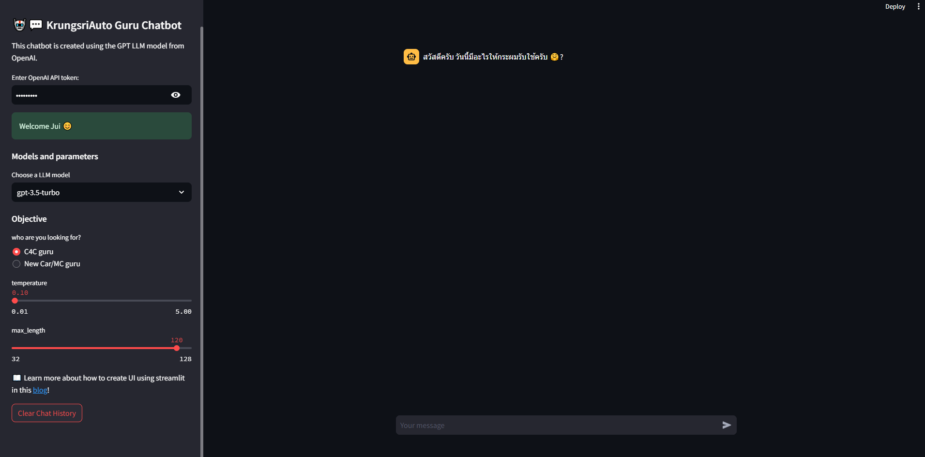
Chatbot UI
Start the app by inserting your Openai Api key on the sidebar.

Slide 3
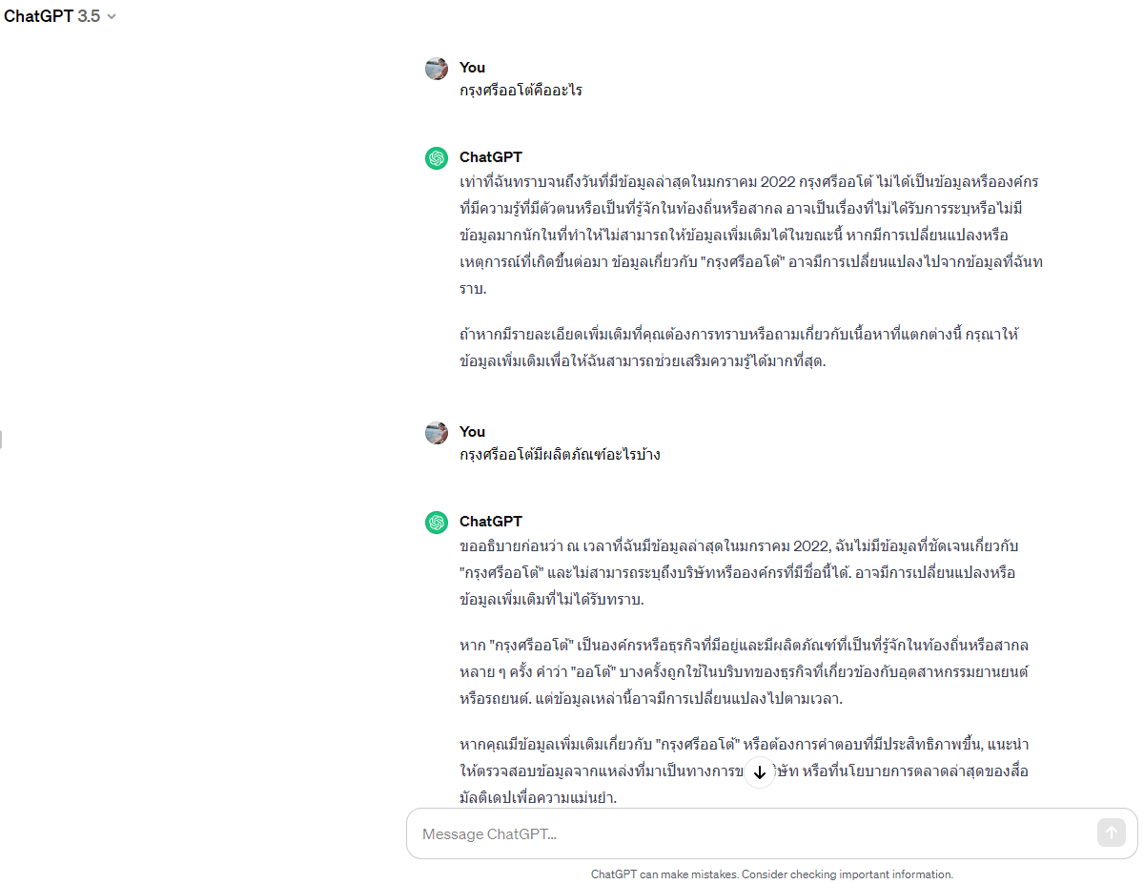
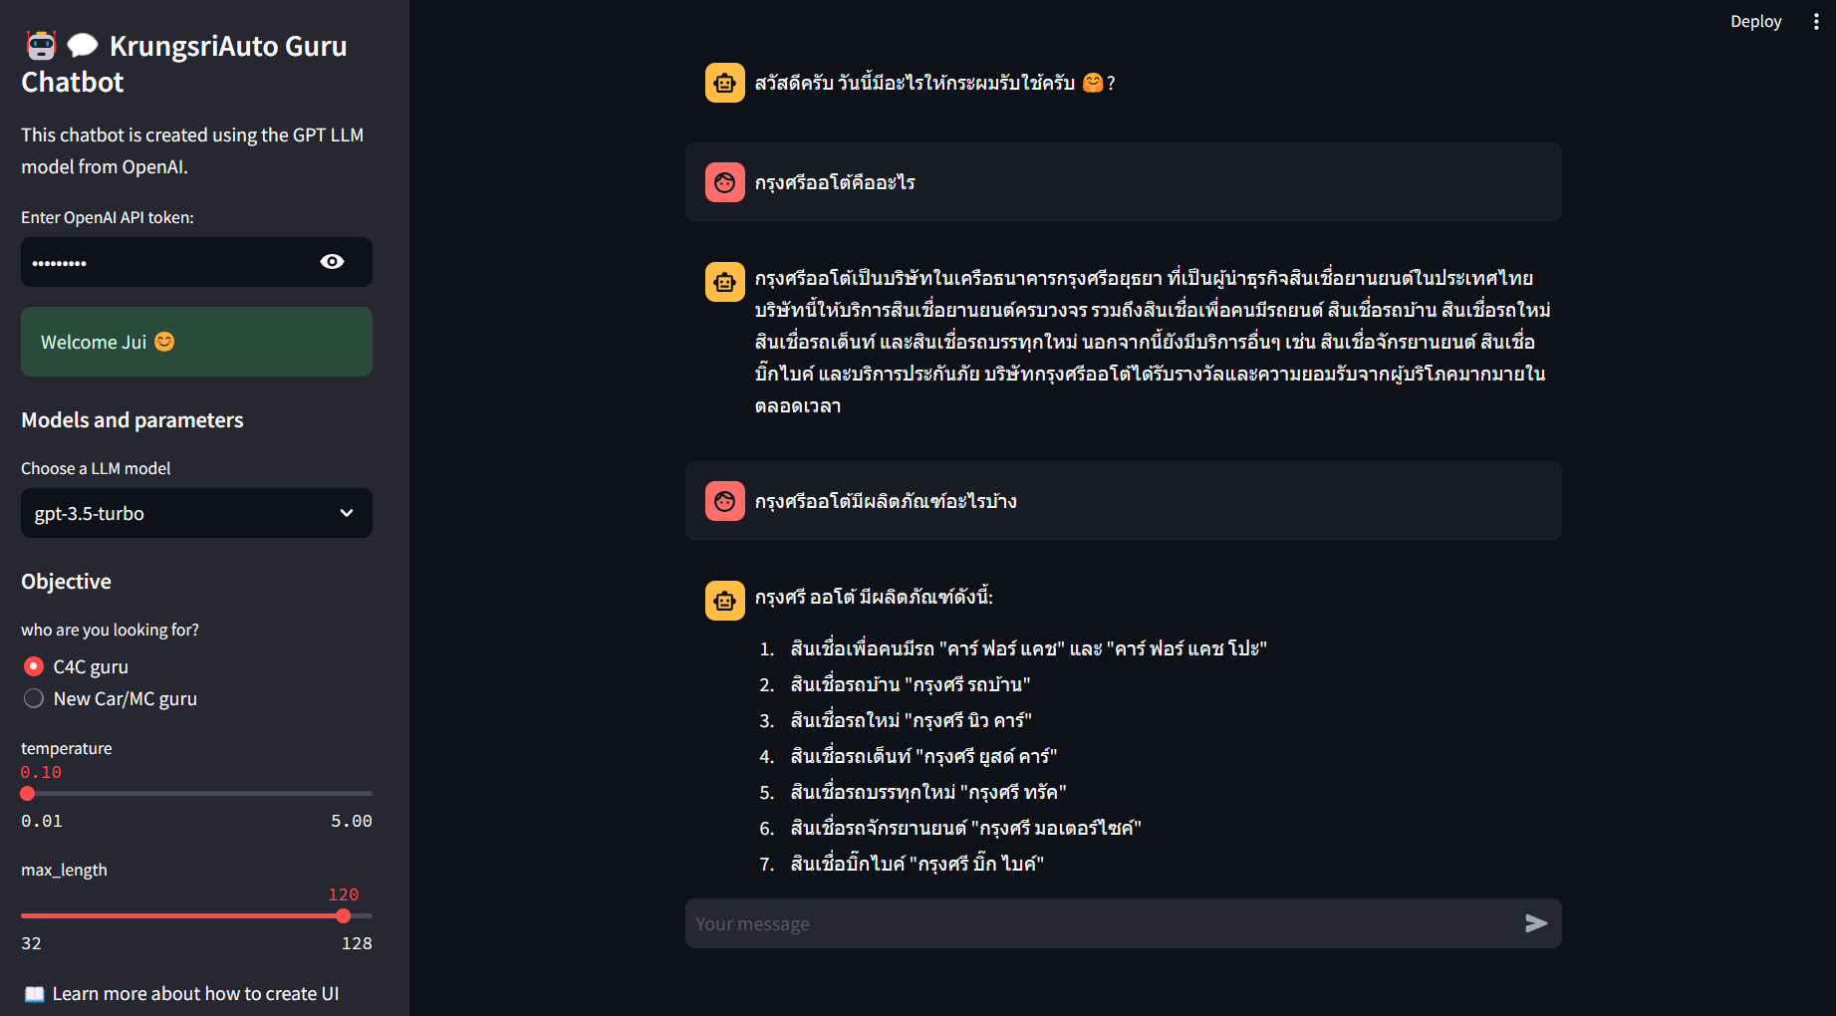
To some extent, the KA Chatbot can answer some specific product-related questions (as shown in result.pptx) better than the general well-known free chatgpt-3.5.

Slide 4
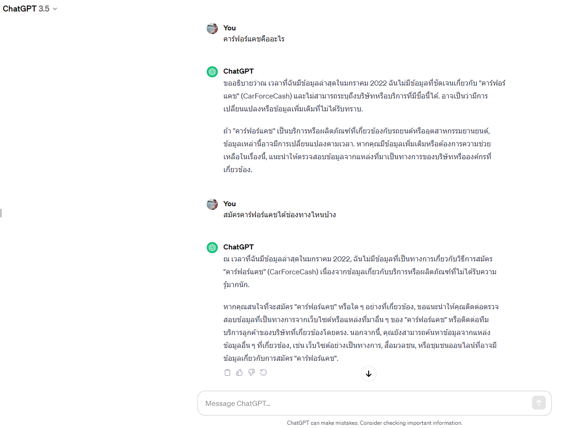
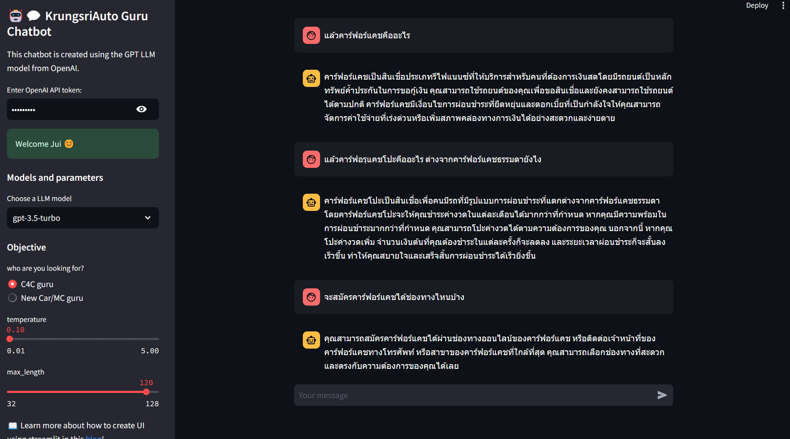
To some extent, the KA Chatbot can answer some specific product-related questions (as shown in result.pptx) better than the general well-known free chatgpt-3.5.

Slide 5
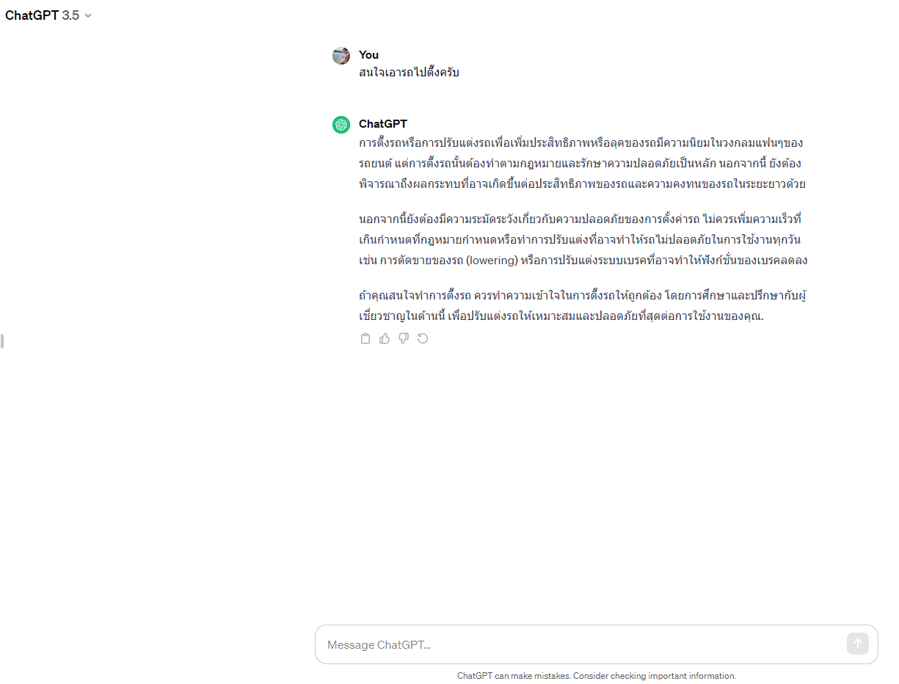
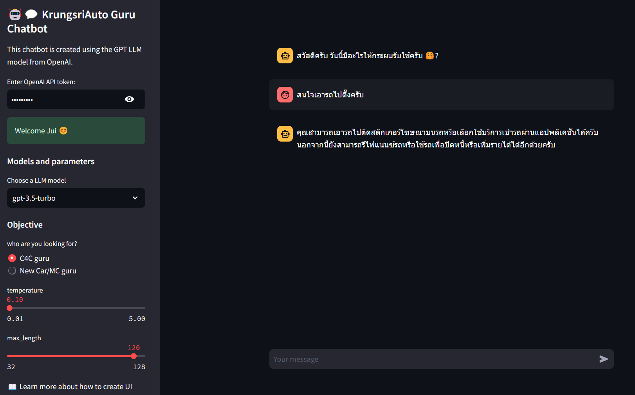
To some extent, the KA Chatbot doesn’t work so well. E.g. in the picture I said สนใจเอารถไปตึ๊งครับ
= I want to refinance my car, but model doesn’t understand “ตึ๊ง” which basically, means “refinance”.
The general well-known free chatgpt-3.5 seems to have the same problem.

