Slide 1
GitHub

Slide 2
Why am I learning GitHub?
GitHub is a skill that you will either learn now or when you get into the workforce
Just a little background my name is Jacob Johnson and I am helping Mr. Teston and Mr. Kroll design these courses
I graduated the same semester as Mr. Teston and we both have gone through applying for jobs
Many DevOps jobs state that they use GitHub so it is good to learn
Even more importantly many jobs you may apply for will ask you to upload your resume and sometime as an optional step you can link your portfolio, maybe a website you’ve created, or they ask for your GitHub link

Slide 3
Think of GitHub as a public portfolio of your code
Our goal is for everyone here to get jobs quickly out of college and knowing GitHub and having your own portfolio of code will greatly increase your odds
These classes are going to be build around code you make and we are going to have you guys add to your code as you progress throughout your time here to simulate how an actual DevOps job might behave
Any code you make should be stored in your account so that as we add on to certain scripts you never have to start over

Slide 4
What is source code?
Think of source code as files in folders
Code you make needs to be saved just like this PowerPoint
Source code is the files saved with your code (A file of code)
Source Code- A text listing of commands to be compiled or assembled into an executable computer program

Slide 5
What is Version Control?
When creating code for a business typically you are working with a group
If you work on the same files it will override each others changes
Having version control allows you to track what you worked on, what other people in your team worked on, so you do not clash/override other peoples changes
Version Control- Allows teams to work together and collaborate in a more efficient manner

Slide 6
What is Git?
Git- Git is a free and open source distributed version control system
It allows teams to work together in a more efficient manner locally
Git can be installed on your computer and you use it for distributed version control via the command line
Git can be synced locally which is great… except what if you need to collaborate with people in different rooms, cities, states, or even countries?

Slide 7
What is GitHub?
GitHub- A code hosting platform for version control and collaboration which allows you and others to work on projects from anywhere
GitHub is the GUI version of Git with a few other differences
GitHub is a website where your account can be viewed by everyone
In the real world you may be tasked with a simple coding project. Instead of wasting time working on it you can search GitHub for similar or even exact scripts to solve your problems

Slide 8
Key Vocabulary
Repository
Branches
Commits
Pull Request
Fork
Collaborators
Contributors

Slide 9
Repository
A repository is the most basic element of GitHub. Imagine them as a project’s folder. A repository contains all of the project files (including documentation), and stores each file’s revision history. Repositories can have multiple collaborators and can be public or private. They can only be private if you pay a small monthly fee.
Repositories can contain just about any type of file you would need to describe your project. Folders, files, images, videos, spreadsheets, and data sets.
Because it is open source you are able to search through other peoples repositories in search for specific code you need for a project.
Best practice is to include a README.md file with each repository. A README.md is a file with information about your project that appears automatically when someone enters your repository.

Slide 10
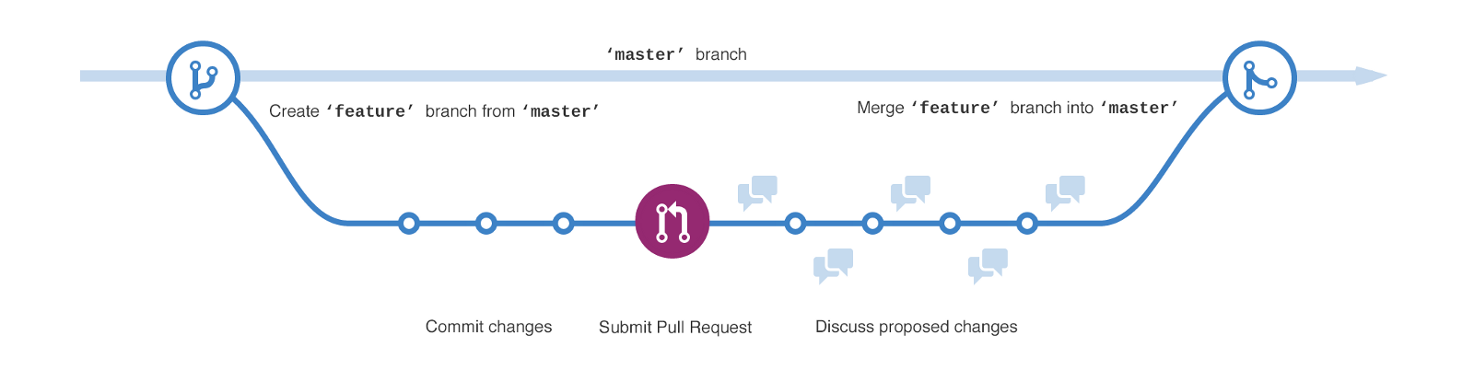
Branches
Branching is a way to get a parallel version of a repository. This secondary branch is contained within the repository. You can use a secondary branch to work freely on your code without disrupting the “live” version. After you have solved a problem you can merge that secondary branch into the master branch to publish your changes.
After you create a repository it comes with a default branch. This is referred to as the master branch. Often you use that default branch as your production branch.
Reasons to use branches include developing features, fixing bugs in your code, or safely experimenting with new ideas.

Slide 11
Commits
A commit is like editing a file or set of files in a branch. The main difference is in GitHub every time you make a change to a file it creates a point-int-time snapshot before the file is edited over. This allows you to go back to any point in time of that file.
Commits usually contain a commit message which is a brief description of what changes were made to the file.
When you make a commit to a file you have the option to commit to the current branch the file is in or make a brand new branch containing the changes you made and doing this will automatically open up a pull request.

Slide 12
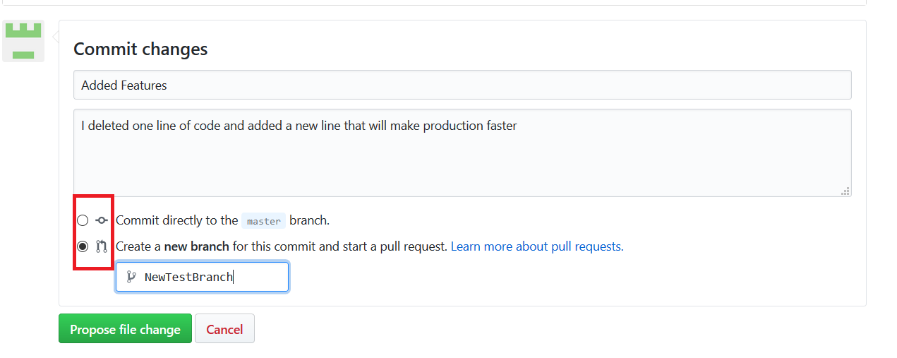
Commits Continued
When making a commit you have 2 options as shown below.
You can commit directly to the branch you are currently in, or you can create a new branch opening up a pull request.
Even if someone makes the mistake of committing directly to the master branch wrongly, no worries as GitHub implements the concept of versioning.
Before every new change an old snapshot is saved so you can go back to any point in your history whenever you want.

Slide 13
Pull Requests
Pull requests are proposed changes to a repository and submitted by a user and accepted or rejected by a repository’s collaborators.
The open source nature of GitHub allows any account to create a pull request.
If you have a group of people you need to work on a project with at work you can add different GitHub accounts to a repository and they are then referred to as collaborators. Collaborators have read and write access to a repository and has been invited to contribute by the repository owner.
A contributor is someone who has contributed to a project by having a pull request merged, but they do not have collaborator access.

Slide 14
Pull Requests Continued
A pull request is used to merge 2 branches together. Usually this is used to merge successfully tested code into your production environment, done by merging the test branch into the master branch.
Pull requests have their own discussion forum allowing you to explain why this change might be a good or bad idea.
They also show something called a diff.
Diffs are the differences in changes between 2 commits. It shows what was added, highlighted in green, and what was deleted highlighted in red.
If everyone approves of it, you can choose to merge the test branch into the master branch.

Slide 15
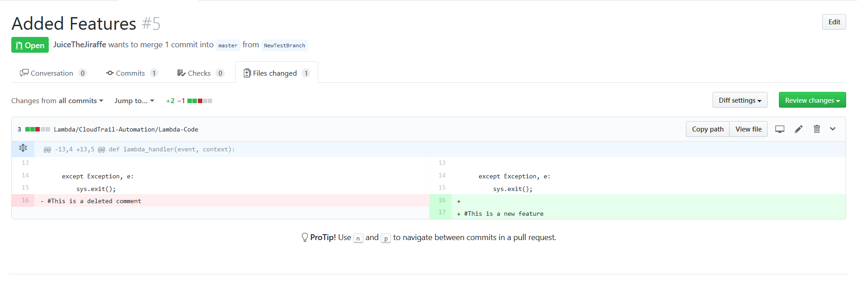
Diff Example

Slide 16
Forks
What if you found code that was super relevant for what you are doing.
Well you have the ability to fork repositories.
Forking essentials gives you your own personal copy of another user’s repository that lives on your account. They allows you to freely make changes to a project without affecting the original. Forks remain attached to the original, allowing you to submit a pull request to the original repository to update with your changes. You can also keep your fork up to date by pulling in updates from the original.

