Slide 1
CAMPAIGN REPORT
20260916T110927Z-local-32gb
profile local-32gb · workload kv-mixed · native-kv-mixed · platform-native — not a ranking
generated 2026-09-16 12:48 UTC
Numbers from result.json · charts from monitoring-report.html
20260916T110927Z-local-32gb
1 / 26

Slide 2
CONTENTS
Agenda
1. How to read a number — T1 / T2 / T3, confirmed vs offered
2. Probe-and-sweep — ladder, hold at 0.9×knee, in-flight cap
3. Load path — Gateway gRPC / Arma gRPC / ZMQ
4. Headline results and why some rows are excluded
5. Workload semantics — kv-mixed reads, JSON-wrap, state DB
6. Per-platform deep dive, then takeaways
20260916T110927Z-local-32gb
2 / 26

Slide 3
SEMANTICS
How to read a number
Headline throughput and latency always use T3. NeuChain T2 is a local send, not submit latency.
Stamp | Meaning | Who sets it
T1 | Immediately before Submit | Load generator
T2 | Platform acknowledged receipt (async ack) | Adapter Submit / AckTime
T3 | Committed in a block, or read path returns | Adapter WaitForFinality
Headline TPS = confirmed commits per second from T3 timestamps, never T1.
Offered TPS = submitted / wall-clock — the load actually presented.
End-to-end latency = T3 − scheduled send (coordinated-omission safe).
NeuChain T2 is “bytes left the client socket.” Never quote it as submit latency.
A hold with every sweep step held is a lower bound on the knee, not the knee.
20260916T110927Z-local-32gb
3 / 26

Slide 4
METHODOLOGY
Probe-and-sweep
Probe at 10 TPS × 30 s — floor latency, no load on the platform.
Sweep a shared ladder (same steps on every platform). A step holds only if fail ≤ 2%, confirmed ≥ 95% of offered, and send-gap p99 ≤ 50 ms.
After 2 consecutive failed steps, higher rungs are skipped. That is abort, not a shorter config.
Hold 5 min at 0.9 × the highest step that actually held — not 90% of the top of the YAML.
In-flight cap ≈ max(target_tps × 8, 1024). If the platform stops finalizing, excess txs fail as “not sent: already in flight.”
Same seed, key space, warmup/cooldown, and sequential isolation. Native and normalized never share a ranking table.
20260916T110927Z-local-32gb
4 / 26

Slide 5
LOAD PATH
What hits the wire
One logical Transaction. Each adapter turns it into the platform’s real API.
 | fabric-cft / bft | drunix | fabricx | neuchain
Client API | Gateway gRPC | Gateway gRPC (LP) | Arma + deliver gRPC | ZMQ PUB/REQ
Contract | kvstore chaincode | same kvstore | adapter RW-set (ns 0) | YCSB protobuf
T2 | orderer/gateway accept | LP/orderer accept | first router SUCCESS | local send return
T3 | peer block events | Committing Peer events | deliver :4001 | tip/block poll
NeuChain T2 is not a platform acknowledgement. Compare NeuChain on confirmed TPS and e2e (T3) only.
Fabric-X T2 is a real ack: first SUCCESS from the four Arma routers, before ordering and commit.
20260916T110927Z-local-32gb
5 / 26

Slide 6
LOAD PATH
Fabric family — Gateway gRPC + chaincode
Tx
adapter
Gateway
:7051
kvstore CC
Orderer
VSCC / MVCC
T3
fabric-cft
fabric-bft
drunix
Raft ×1 orderer
LevelDB · 5 containers
Endorse → order → commit
SmartBFT ×4 orderers
Same Put path as CFT
Thinner per-container RAM
Lite Peer → CP :7061
Yugabyte · JSON-wrap
~13 containers on this profile
kv-read / kv-mixed reads on this family are Gateway Evaluate on one peer — no orderer, no commit.
That is not the same path as a NeuChain read, which is a committed transaction.
20260916T110927Z-local-32gb
6 / 26

Slide 7
LOAD PATH
Fabric-X (Arma gRPC) and NeuChain (ZMQ)
fabricx — no chaincode
neuchain — EV, no ordering
TxWrite
sign ns 0
4 Arma
routers
YCSB +
RSA-1024
ZMQ PUB
:5001
T2 local
send
T2 first
SUCCESS
committer
+ Postgres
deliver
:4001 T3
EV nodes
poll tip
:7003
T3
Broadcast the same envelope to all four routers (avoids ~10 s FirstStrike).
Reads are QueryService GetRows — not ordered.
T2 is a real platform ack.
T2 is not comparable — it is the local send return, not a platform ack.
Never quote NeuChain submit latency.
Reads are committed transactions, unlike Fabric Evaluate.
20260916T110927Z-local-32gb
7 / 26

Slide 8
RESULTS
Headline results
platform-native — not a ranking
1800
13500
8996.5
fabric-bft
fabricx
neuchain
p50 44.5 ms
p50 180.1 ms
p50 134.0 ms
Platform | Status | Hold TPS | p50 ms | p99 ms | Fail | Knee
fabric-cft | excluded | — | — | — | — | 5000
fabric-bft | hold | 1800 | 44.5 | 434.7 | 0.00% | 2000
drunix | excluded | — | — | — | — | 1000
fabricx | lower bound | 13500 | 180.1 | 732.2 | 0.00% | ≥ 15000
neuchain | lower bound | 8996.5 | 134.0 | 248.1 | 0.04% | ≥ 10000
Amber rows are excluded (OOM / no headline). Blue-grey rows did not saturate — quote as a lower bound, not a knee. Not sorted by TPS.
20260916T110927Z-local-32gb
8 / 26

Slide 9
RESULTS
Why rows are excluded — or not a knee
fabric-cft · EXCLUDED · OOM: peer0.org1.example.com, dev-peer0.org1.example.com-kvstore_1.0-e88284a33ff88069…; no headline
drunix · EXCLUDED · OOM: dev-peer0.org1.example.com-kvstore_1.0-e88284a33ff8806958375f99312782794164d62a…; no headline
fabricx · LOWER BOUND · never saturated — 15000 TPS is a lower bound, not a knee
neuchain · LOWER BOUND · never saturated — 10000 TPS is a lower bound, not a knee
OOM is a resource-split failure, not evidence the platform “cannot do TPS.” A lower bound means extend the ladder; do not publish it as saturation.
20260916T110927Z-local-32gb
9 / 26

Slide 10
WORKLOAD
Read / write semantics
kv-mixed at 50% reads: headline TPS blends two paths and is not a write ceiling.
Fabric / Drunix / Fabric-X reads are Evaluate / QueryService — not ordered, not committed.
NeuChain reads are committed transactions. Do not compare mixed-read TPS across those families as if the work were equal.
Drunix write values are JSON-wrapped client-side so Yugabyte JSONB does not panic; on-wire size differs.
state_db is what actually ran; state_db_requested is the contract. They differ on Drunix (Yugabyte) and Fabric-X (Postgres).
Native and normalized numbers never share a ranking table. Native kv-mixed is not ranked against native kv-write.
fabric-cft: leveldb (requested leveldb, parity held) · fabric-bft: leveldb (requested leveldb, parity held) · drunix: yugabyte (requested yugabyte, parity held) · fabricx: postgres (requested postgres, parity held) · neuchain: leveldb (requested leveldb, parity held)
20260916T110927Z-local-32gb
10 / 26

Slide 11
FABRIC-CFT
fabric-cft
2.5.16 · platform-native
—
container-failed
5000
excluded
no headline
campaign status
detected saturation
not a measurement
Topology · batch · crypto
chaincode×2 · orderer×1 · peer×2 · 5 containers · 18 CPU / 20 GB
batch msgcount=500 timeout=500ms preferred=4 MB
crypto sig=ECDSA-P256 hash=SHA-256 per_tx_endorse_verify=true
state DB leveldb (requested leveldb)
workload kv-mixed generators 2 seed 1
OOM: peer0.org1.example.com, dev-peer0.org1.example.com-kvstore_1.0-e88284a33ff88069…; no headline
20260916T110927Z-local-32gb
11 / 26

Slide 12
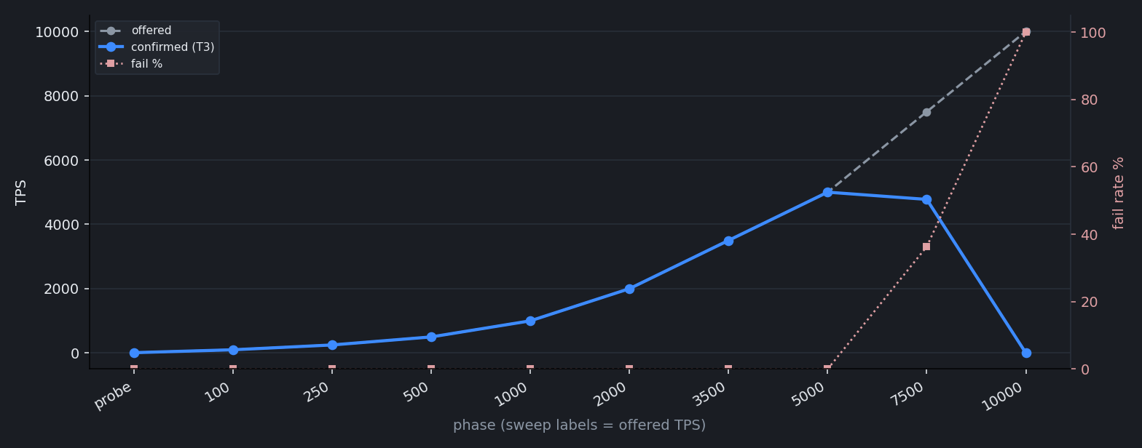
FABRIC-CFT
Sweep ladder
Offered vs confirmed (T3) vs fail rate. Full phase table lives in summary.txt, not here.
20260916T110927Z-local-32gb
12 / 26

Slide 13
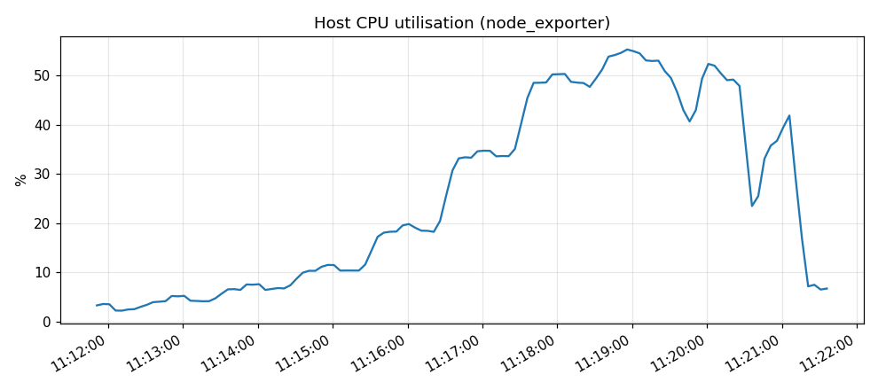
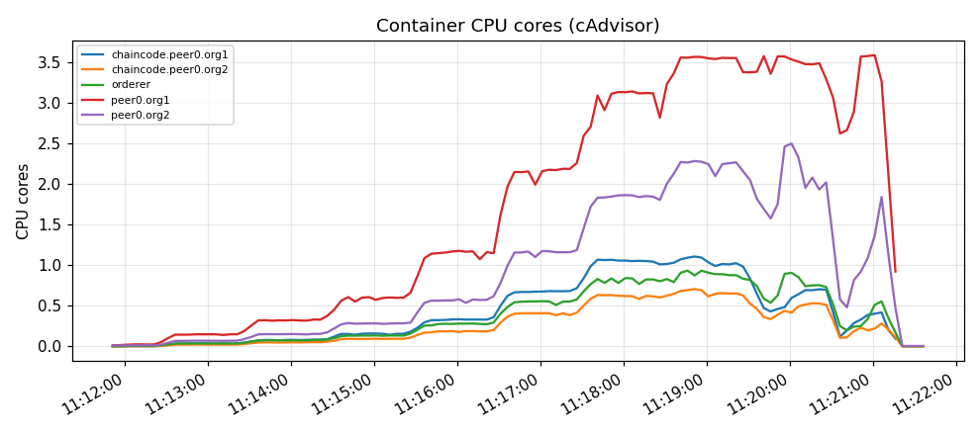
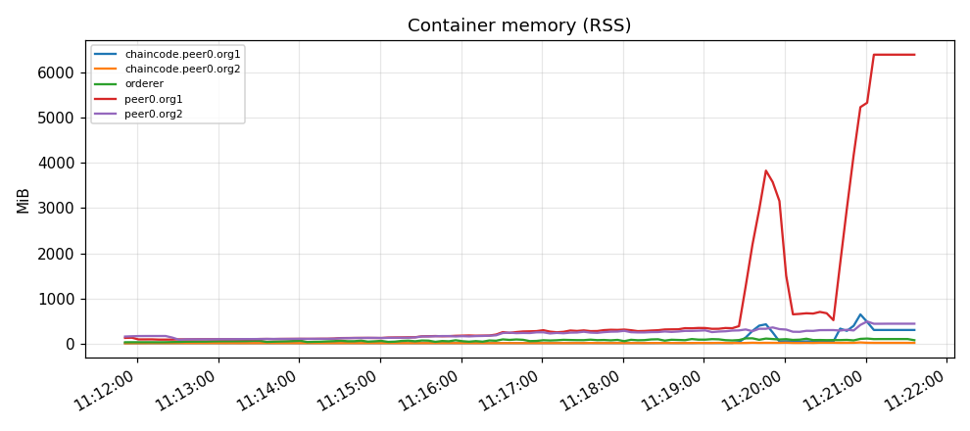
FABRIC-CFT
Host and container resources
PNG charts already embedded in monitoring-report.html. Empty placeholders skipped.
Host CPU utilisation (node_exporter)
Container CPU cores (cAdvisor)
Container memory (RSS)
20260916T110927Z-local-32gb
13 / 26

Slide 14
FABRIC-BFT
fabric-bft
3.1.5 · platform-native
1800
44.5
434.7
0.00%
confirmed TPS (T3)
e2e p50 ms
e2e p99 ms
fail rate
Topology · batch · crypto
chaincode×2 · orderer×4 · peer×2 · 8 containers · 18 CPU / 20 GB
batch msgcount=250 timeout=1s preferred=4 MB
crypto sig=ECDSA-P256 hash=SHA-256 per_tx_endorse_verify=true
state DB leveldb (requested leveldb)
workload kv-mixed generators 2 seed 1
kv-mixed native: Fabric/Drunix/Fabric-X reads are Evaluate/QueryService (not ordered); NeuChain reads are committed transactions. Headline TPS blends two paths.
20260916T110927Z-local-32gb
14 / 26

Slide 15
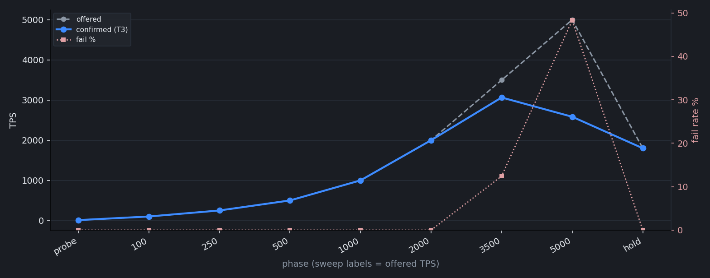
FABRIC-BFT
Sweep ladder
Offered vs confirmed (T3) vs fail rate. Full phase table lives in summary.txt, not here.
20260916T110927Z-local-32gb
15 / 26

Slide 16
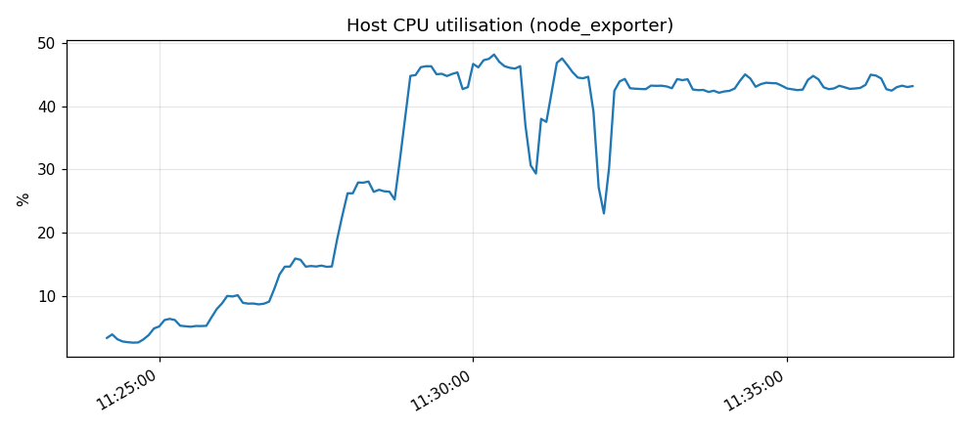
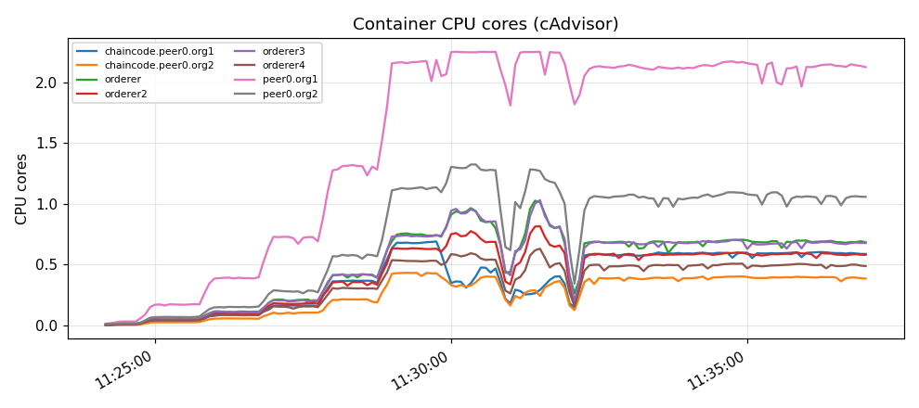
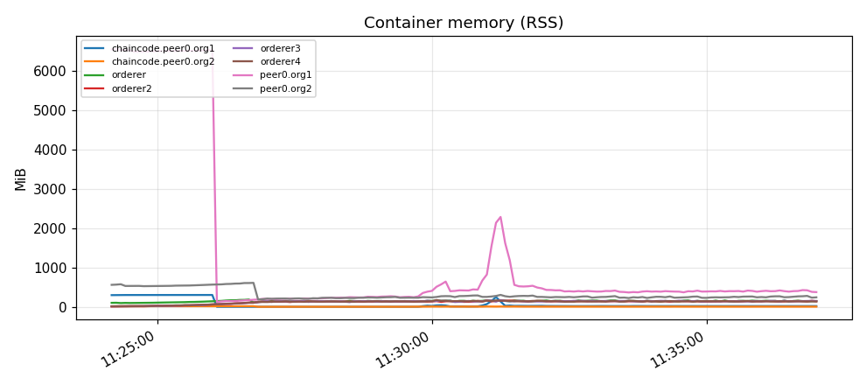
FABRIC-BFT
Host and container resources
PNG charts already embedded in monitoring-report.html. Empty placeholders skipped.
Host CPU utilisation (node_exporter)
Container CPU cores (cAdvisor)
Container memory (RSS)
20260916T110927Z-local-32gb
16 / 26

Slide 17
DRUNIX
drunix
drunix-ddc0eae77815 · platform-native
—
container-failed
1000
excluded
no headline
campaign status
detected saturation
not a measurement
Topology · batch · crypto
chaincode×2 · committing_peer×2 · keydb×2 · lite_peer×2 · orderer×1 · validation_service×2 · yugabyte×2 · 13 containers · 18 CPU / 20 GB
batch msgcount=500 timeout=500ms preferred=4 MB
crypto sig=ECDSA-P256 hash=SHA-256 per_tx_endorse_verify=true
state DB yugabyte (requested yugabyte)
workload kv-mixed generators 2 seed 1
OOM: dev-peer0.org1.example.com-kvstore_1.0-e88284a33ff8806958375f99312782794164d62a…; no headline
20260916T110927Z-local-32gb
17 / 26

Slide 18
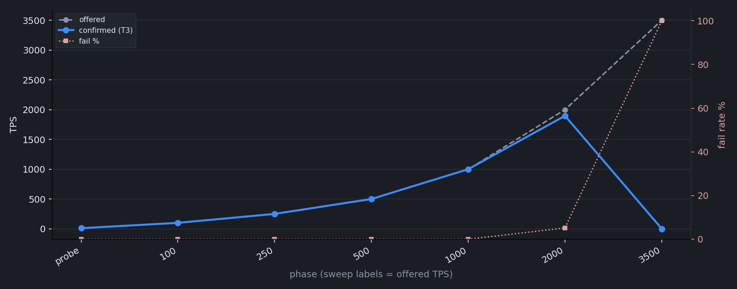
DRUNIX
Sweep ladder
Offered vs confirmed (T3) vs fail rate. Full phase table lives in summary.txt, not here.
20260916T110927Z-local-32gb
18 / 26

Slide 19
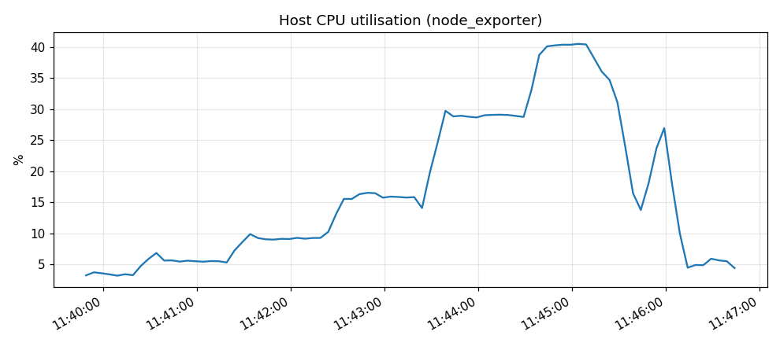
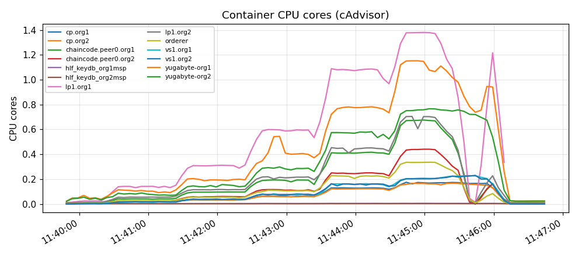
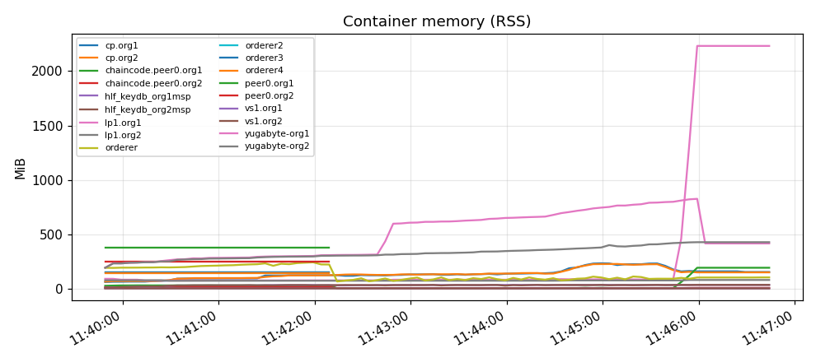
DRUNIX
Host and container resources
PNG charts already embedded in monitoring-report.html. Empty placeholders skipped.
Host CPU utilisation (node_exporter)
Container CPU cores (cAdvisor)
Container memory (RSS)
20260916T110927Z-local-32gb
19 / 26

Slide 20
FABRICX
fabricx
fabricx-committer-v1.0.5-orderer-v1.0.6 · platform-native
13500
180.1
732.2
0.00%
confirmed TPS (T3)
e2e p50 ms
e2e p99 ms
fail rate
Topology · batch · crypto
arma×1 · committer×1 · pipeline×1 · postgres×1 · 4 containers · 18 CPU / 20 GB
batch msgcount=500 timeout=500ms preferred=4 MB
crypto sig=ECDSA-P256 hash=SHA-256 per_tx_endorse_verify=true
state DB postgres (requested postgres)
workload kv-mixed generators 3 seed 1
every sweep step held: the platform did not saturate within the ladder, so 15000 TPS is a lower bound on its knee, not the knee
20260916T110927Z-local-32gb
20 / 26

Slide 21
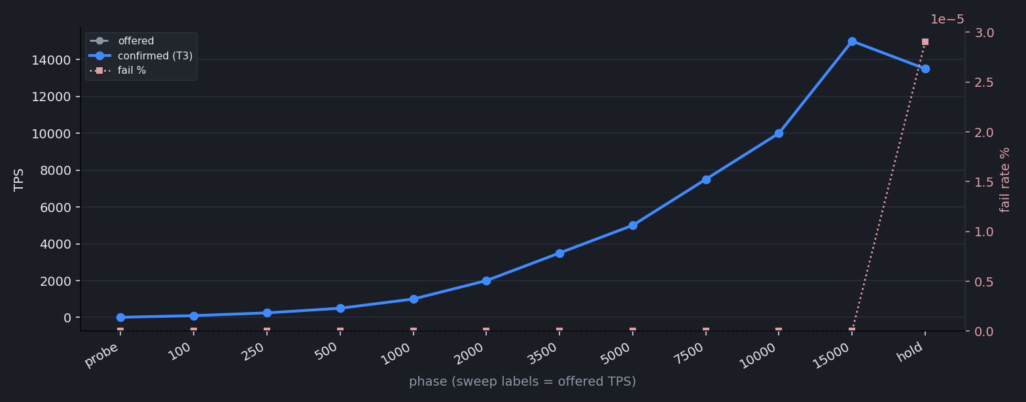
FABRICX
Sweep ladder
Offered vs confirmed (T3) vs fail rate. Full phase table lives in summary.txt, not here.
20260916T110927Z-local-32gb
21 / 26

Slide 22
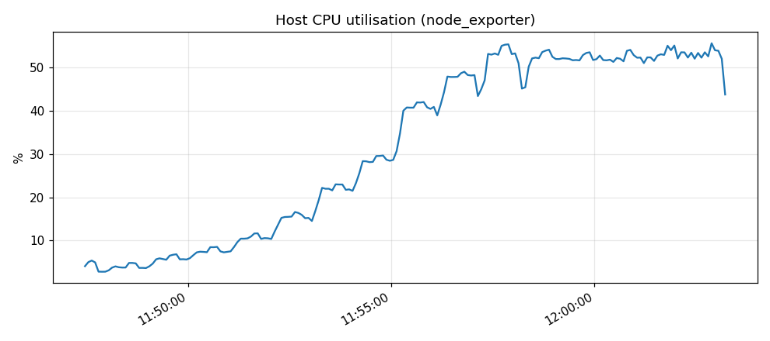
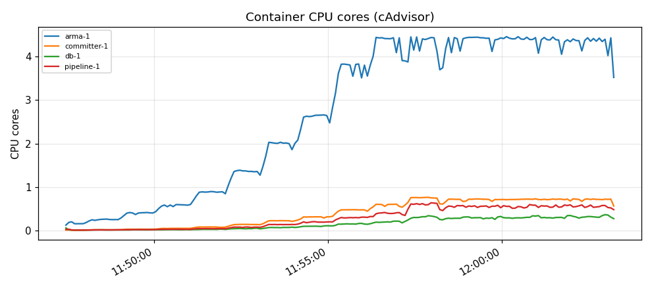
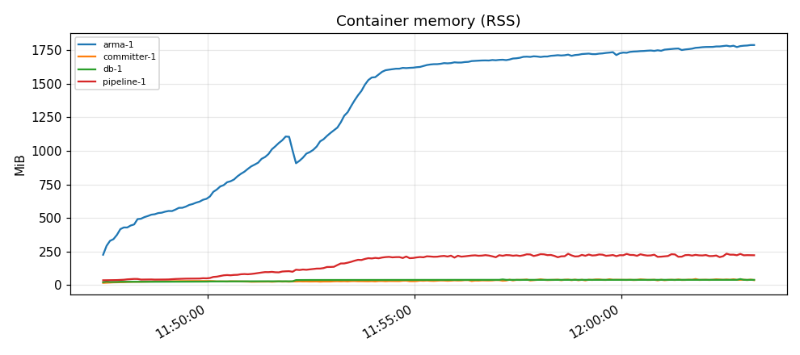
FABRICX
Host and container resources
PNG charts already embedded in monitoring-report.html. Empty placeholders skipped.
Host CPU utilisation (node_exporter)
Container CPU cores (cAdvisor)
Container memory (RSS)
20260916T110927Z-local-32gb
22 / 26

Slide 23
NEUCHAIN
neuchain
neuchain-ev-patched · platform-native
8996.5
134.0
248.1
0.04%
confirmed TPS (T3)
e2e p50 ms
e2e p99 ms
fail rate
Topology · batch · crypto
block_server×4 · epoch_server×4 · 4 containers · 18 CPU / 20 GB
batch n/a
crypto sig=RSA-1024-PKCS1v15 hash=SHA-256 per_tx_endorse_verify=false
state DB leveldb (requested leveldb)
workload kv-mixed generators 3 seed 1
every sweep step held: the platform did not saturate within the ladder, so 10000 TPS is a lower bound on its knee, not the knee
T2 is local send — submit/commit split is not shown and is not comparable.
20260916T110927Z-local-32gb
23 / 26

Slide 24
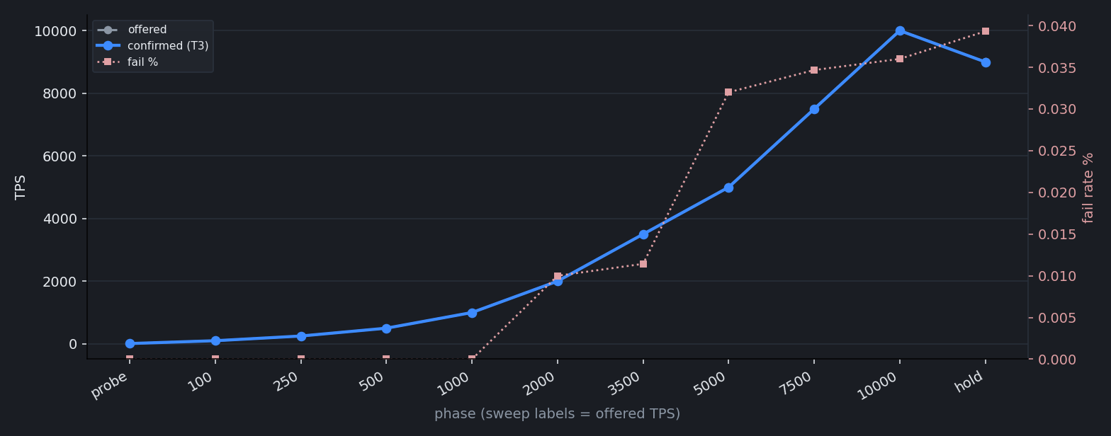
NEUCHAIN
Sweep ladder
Offered vs confirmed (T3) vs fail rate. Full phase table lives in summary.txt, not here.
20260916T110927Z-local-32gb
24 / 26

Slide 25
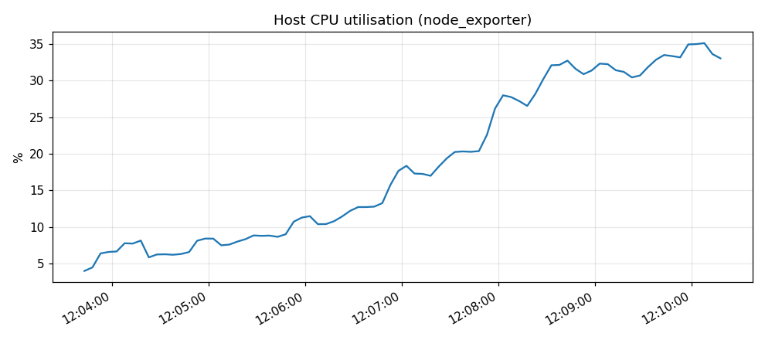
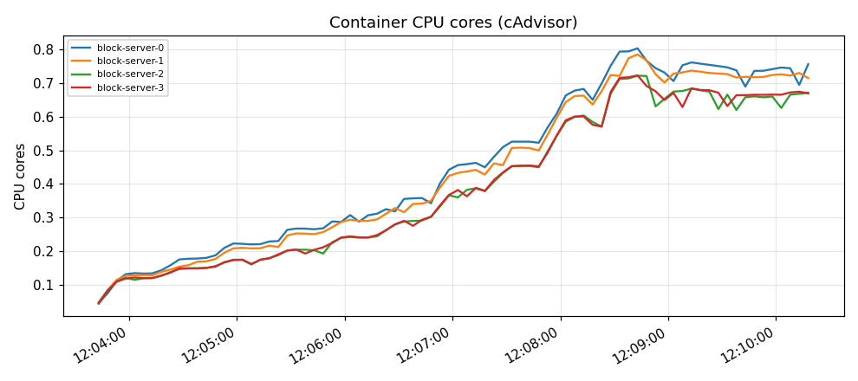
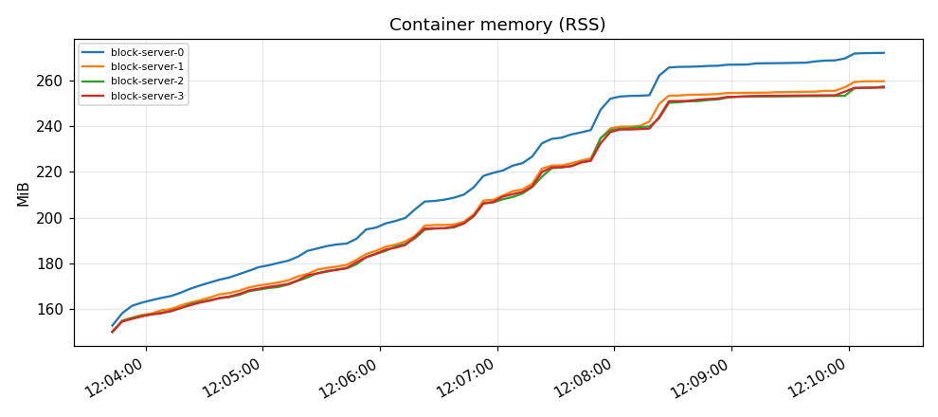
NEUCHAIN
Host and container resources
PNG charts already embedded in monitoring-report.html. Empty placeholders skipped.
Host CPU utilisation (node_exporter)
Container CPU cores (cAdvisor)
Container memory (RSS)
20260916T110927Z-local-32gb
25 / 26

Slide 26
CLOSE
Takeaways
This campaign is platform-native kv-mixed. These numbers are not a ranking, and they are not comparable to normalized kv-write or to native write ceilings.
Real hold (a knee was found): fabric-bft 1800.
Lower bound, not a knee — extend the ladder before quoting saturation: fabricx 13500 (ladder ≥ 15000); neuchain 8996.5 (ladder ≥ 10000).
Excluded (OOM / no headline): fabric-cft, drunix. Rerun on a profile that leaves more RAM per container; do not read this as a TPS ceiling.
NeuChain T2 is never submit latency. kv-mixed headline TPS blends Evaluate/QueryService reads with committed NeuChain reads.
20260916T110927Z-local-32gb
26 / 26

