Slide 1
Entegris Pump Interface
Scott Lindauer

Slide 2
Problem Statement
Entegris pump software enables several functions such as alarm monitoring, SVID parameters, and dispense profiling.
However, many functions are only accessible by accessing 1 pump at a time. Fab25 has over 200 Entegris pumps installed so making comparisons between pumps is impossible.
Dispense profile traces are only stored for the last dispense so diagnosing issues with previous dispenses is difficult.

Slide 3
Scope of project
Create a dashboard interface that shows the current status of each pump.
Dashboard will display some of the SVID parameters such as Dispense Confirmation of the last dispense and of previous dispenses.
Create a parameter table for comparison across the entire fleet of pumps.
Interface to access and display multiple dispense profiles.
When a new “reference” profile is created upload this file for future reference and stored in database.

Slide 4
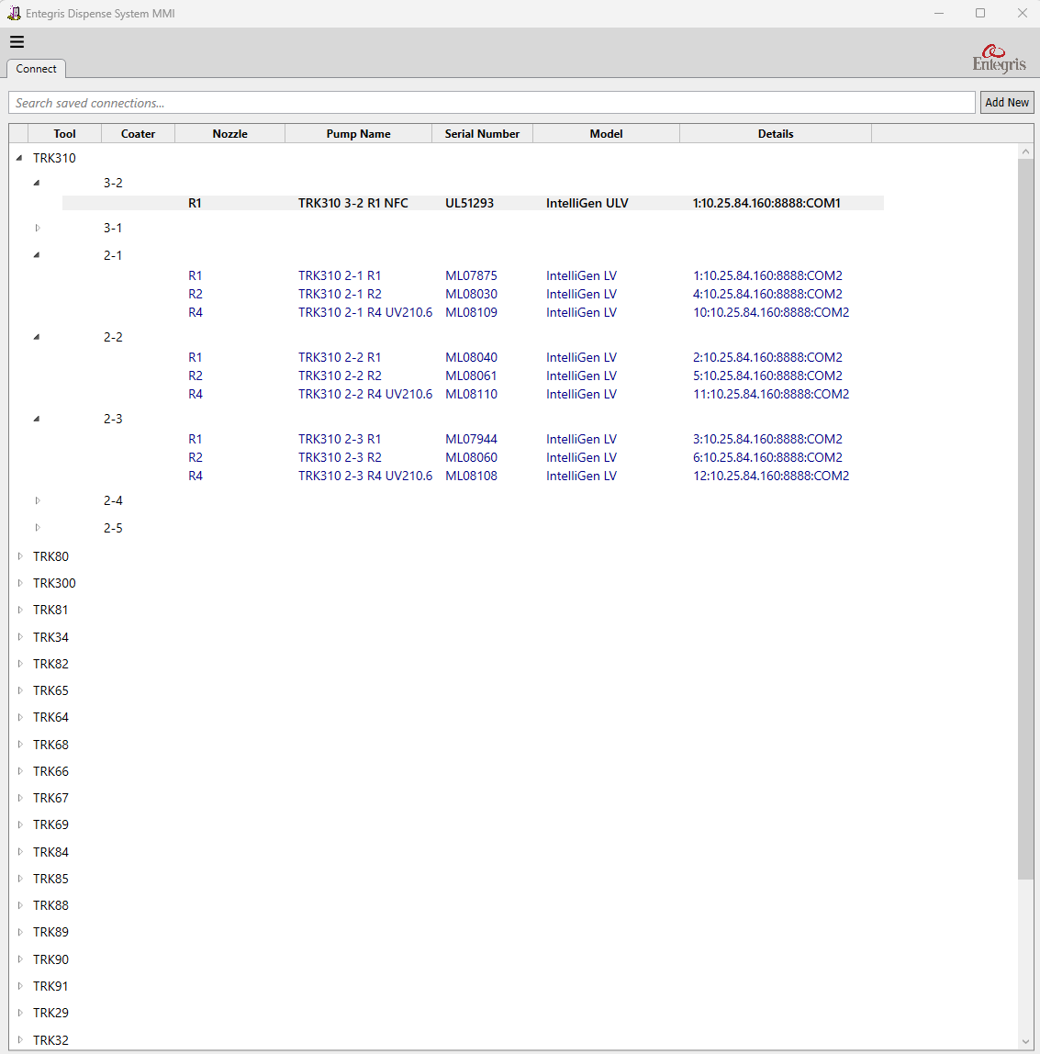
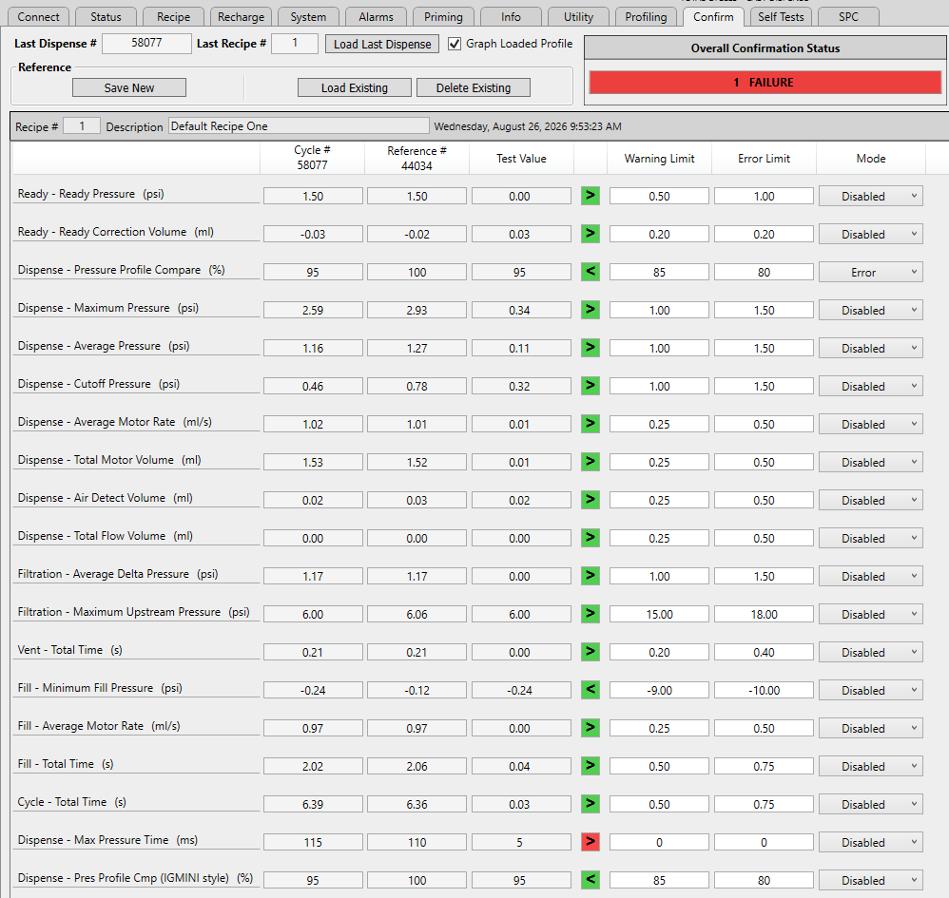
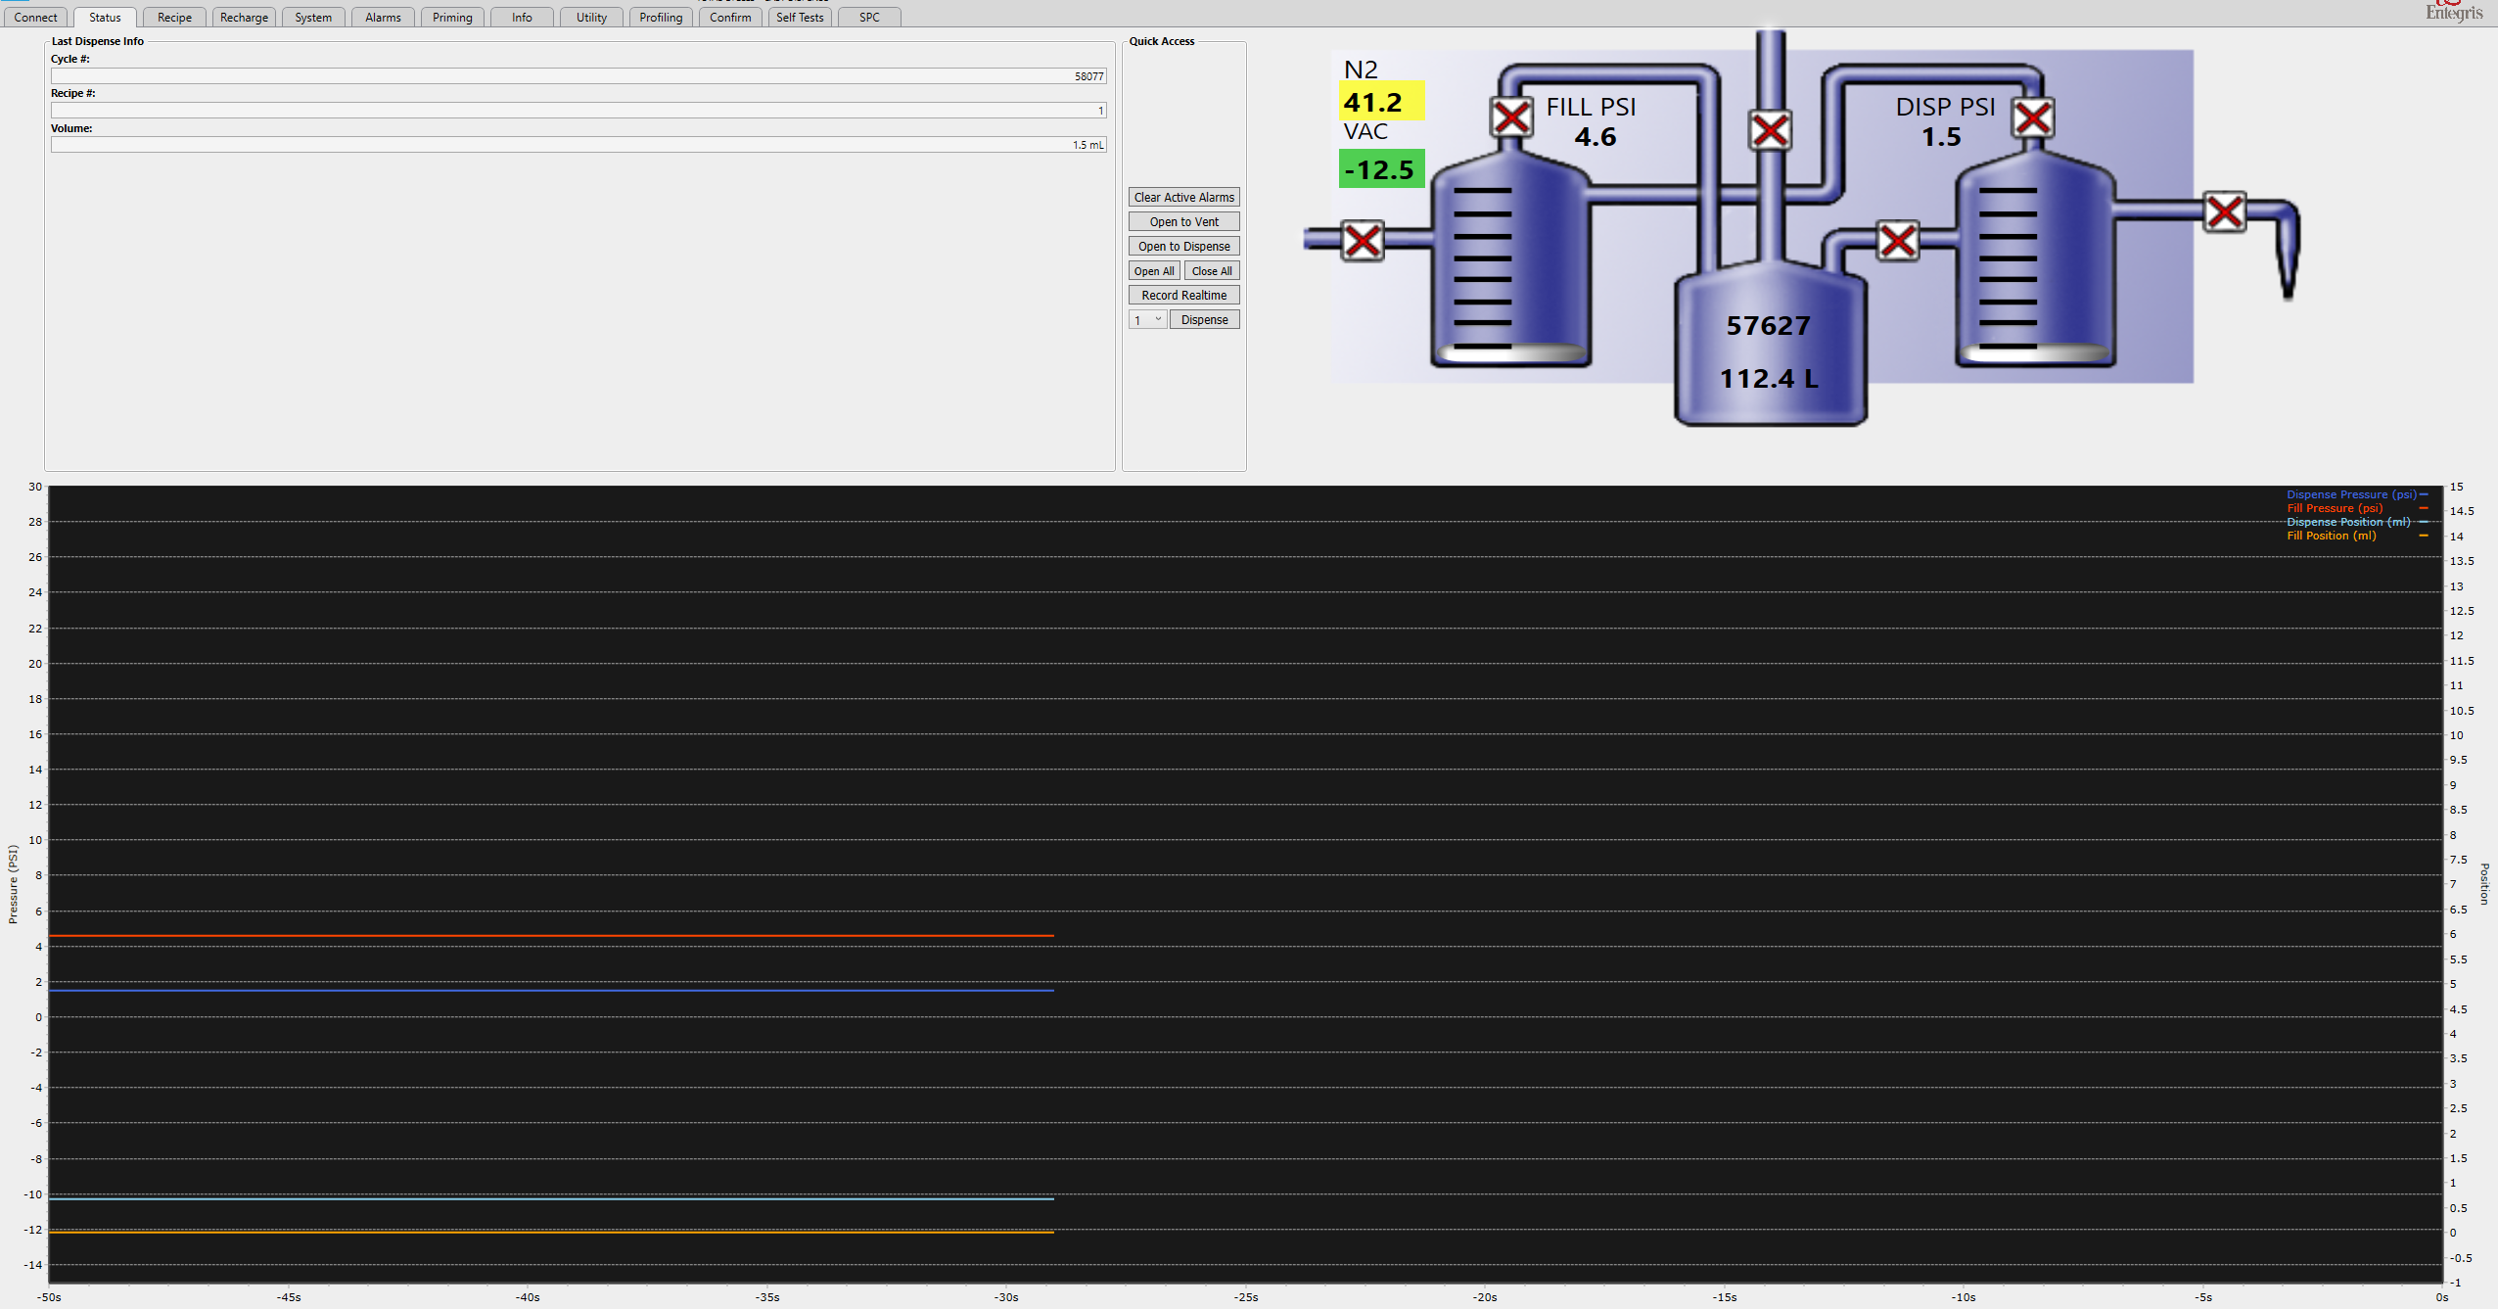
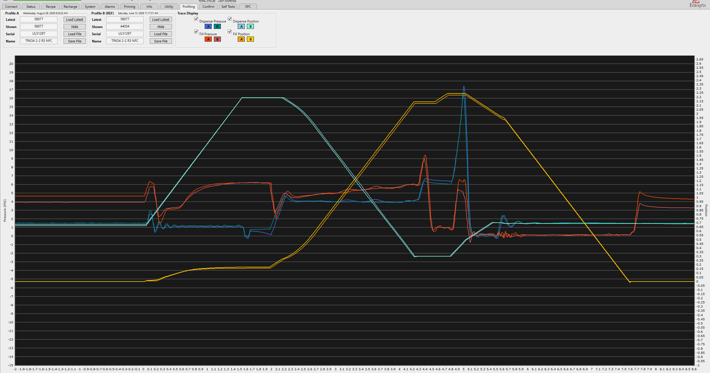
Screen shots of Entegris software

