Slide 1
Understanding GPT Models
An Overview by Juilee Patil

Slide 2
What is GPT?
Generative Pre-trained Transformer
Transformer architecture
Processes entire sentences or paragraphs at once

Slide 3
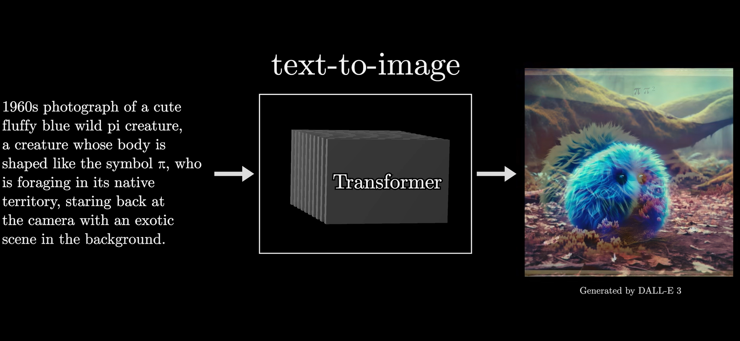
How do GPT models work?

Slide 4
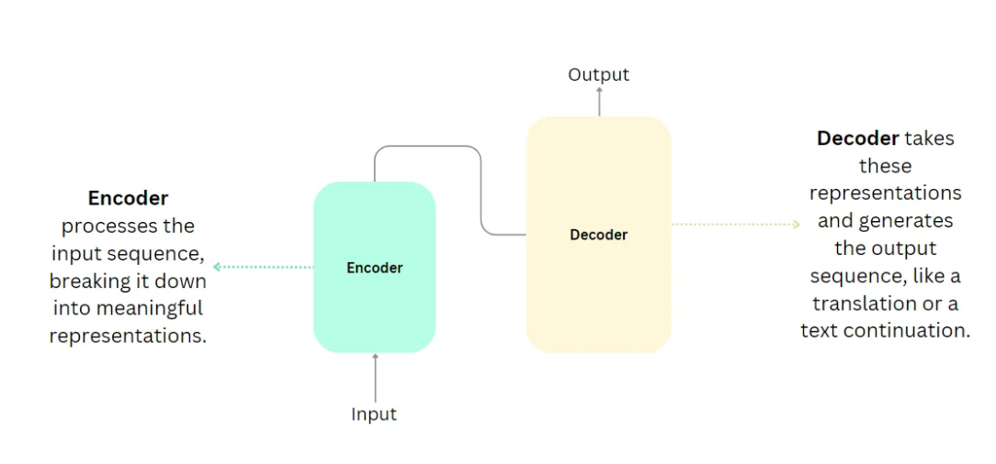
Transformer Architecture
Encoder and decoder components
Focus on decoder in GPT models

Slide 5
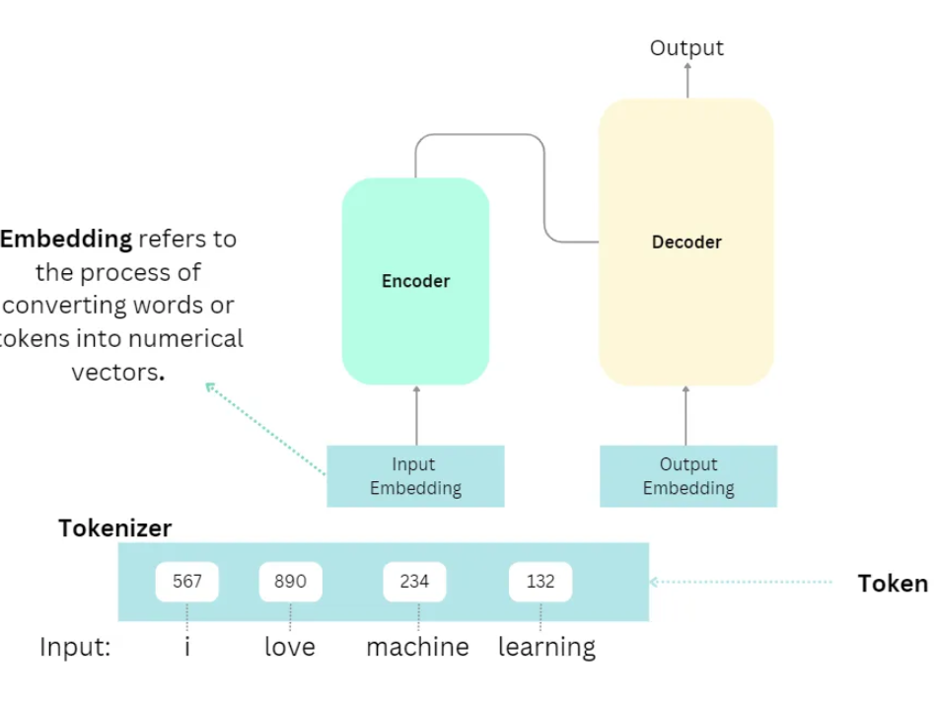

Slide 6
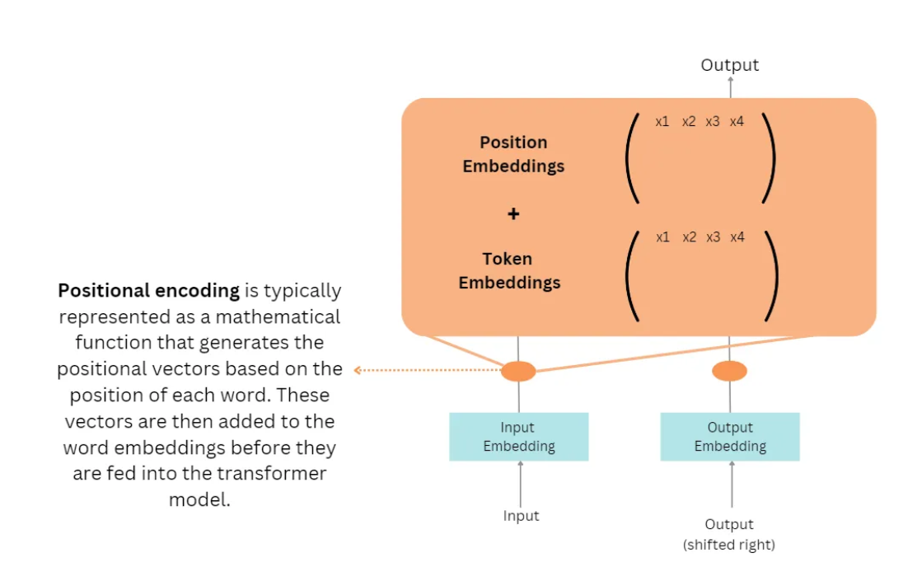
Positional encoding

Slide 7
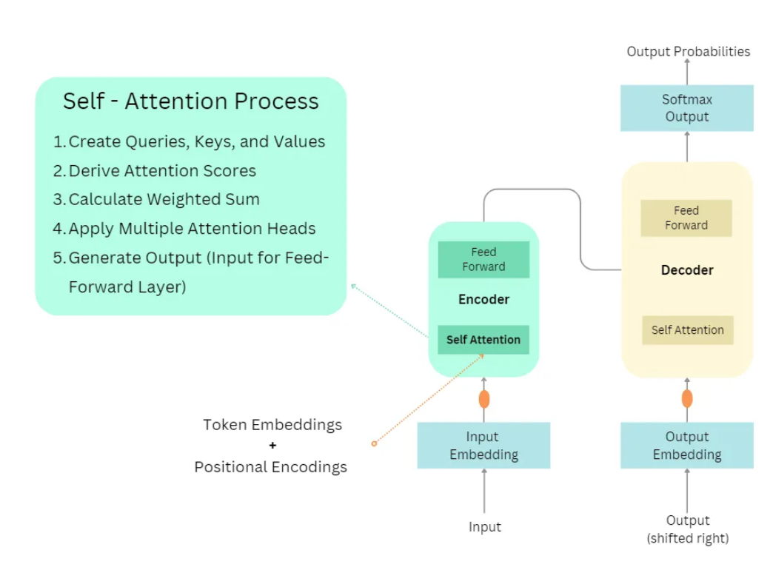
Self-Attention Mechanism

Slide 8
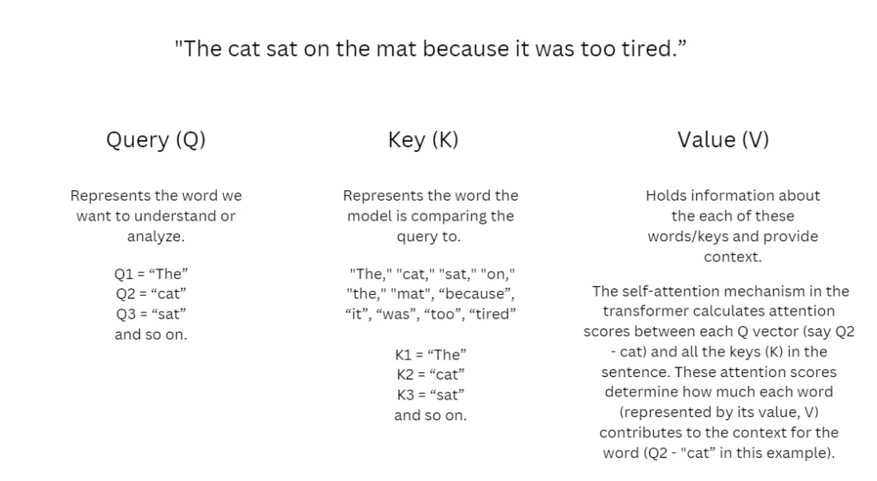
Self-Attention Mechanism

Slide 9
Feed Forward Layer
Linear Transformation
Activation Function
Second Linear Transformation
Residual Connection and Layer Normalization
Generate Output (Input for Decoder)

Slide 10
Decoder
The Decoder in the Transformer architecture processes its input through self-attention, cross-attention with the Encoder’s output, and position-wise Feed-Forward networks, repeatedly for each stacked block, culminating in a final output sequence after the softmax operation.

Slide 11
Applications of GPT
Text generation
Chatbots and virtual assistants
Translation and summarization
Creative content generation

Slide 12
Real-World Examples
OpenAI’s GPT-3
Advanced chatbots
Essay writing and coding
Customer service and content creation

Slide 13
Limitations and Challenges
Computational resource requirements
Potential for biased or nonsensical text
Need for responsible deployment

Slide 14
Thank you!

