Slide 1
Driver Monitoring System using Computer Vision
Juili Gulhane
712595012

Slide 2
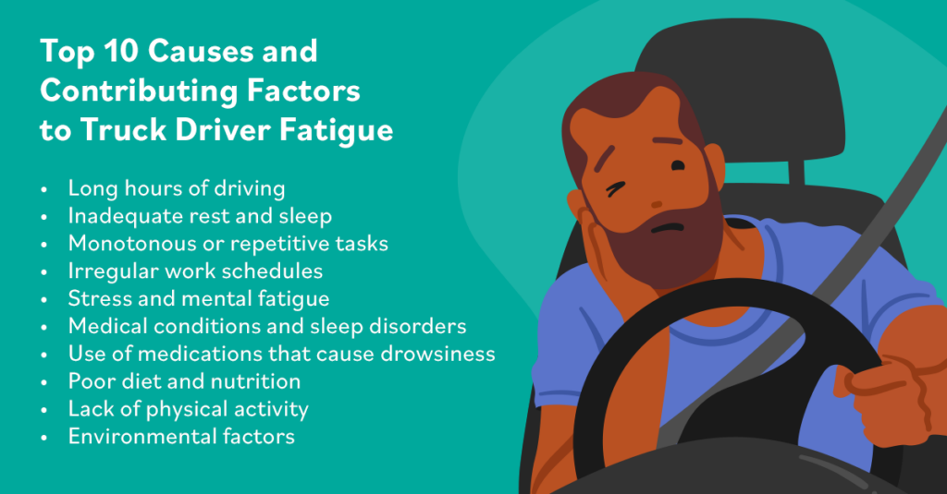
Problem Statement
Drowsiness causes accidents
Real-time detection needed

Slide 3
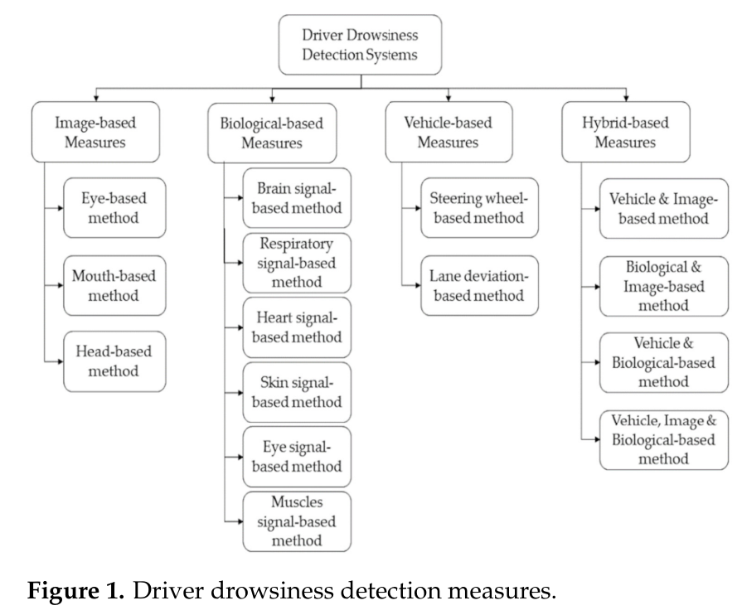

Slide 4
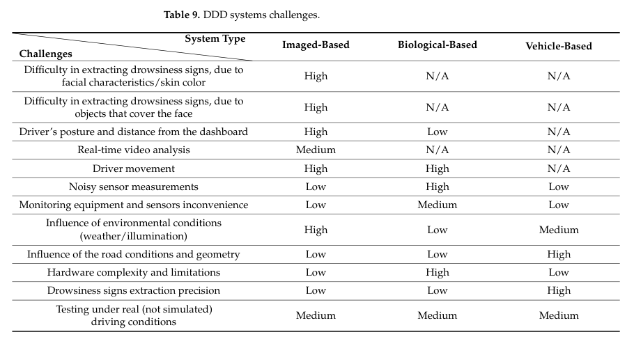

Slide 5
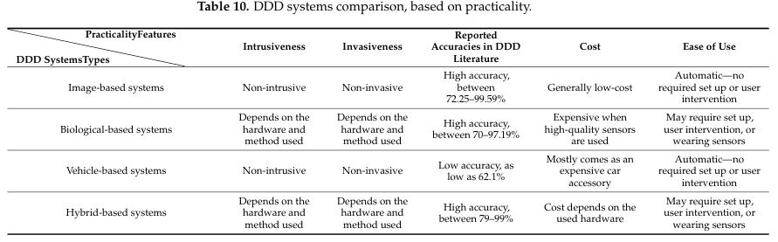

Slide 6
Proposed System
Video
Face Detection
Landmark
EAR/ MAR
Decision
Alert
Features Used:
Reliability Enhancement:
Eye Aspect Ratio (EAR)
Mouth Aspect Ratio (MAR)
Head Pose
Multi-Feature Fusion
Temporal Smoothing

Slide 7
Dataset Used
NTHU-DDD / Kaggle
Different scenarios:
Day/night
Glasses
Yawning
The dataset has the following properties : • RGB images • 2 classes (Drowsy & Non-Drowsy) • Size of image : 227 x 227 • More than 41,790 images in total
https://www.kaggle.com/datasets/ismailnasri20/driver-drowsiness-dataset-ddd

Slide 8
Algorithm- MATLAB
Computer Vision Toolbox

Slide 9
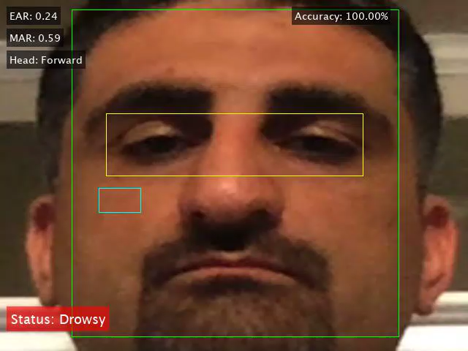
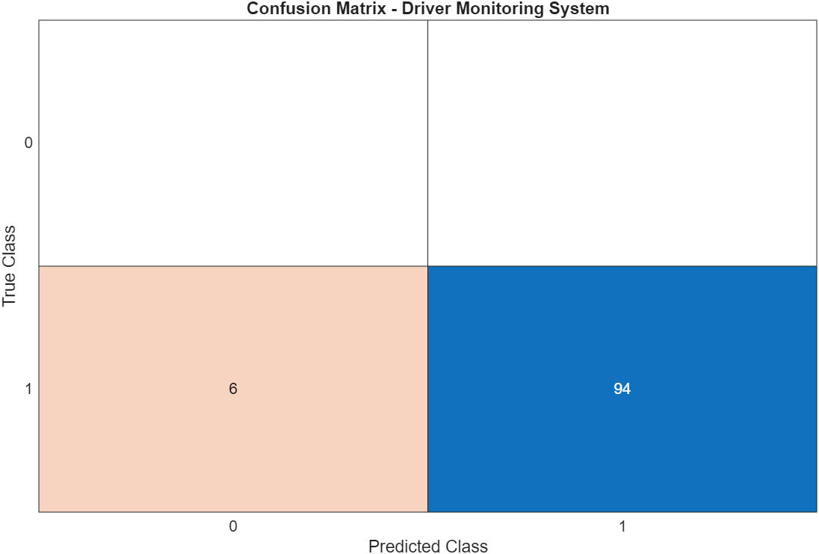
Results
Notes:
True Positives (TP) = 94 → Drowsy correctly detected ✅
False Negatives (FN) = 6 → Drowsy but predicted as Non-Drowsy ❌
True Negatives (TN) = 0 → Non-drowsy correctly detected ❌
False Positives (FP) = 0 → Non-drowsy wrongly detected ❌

Slide 10
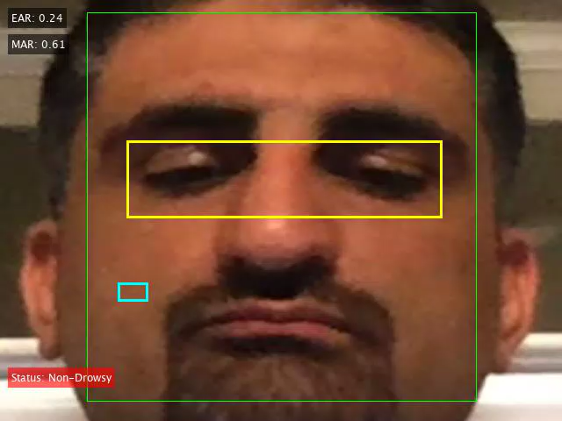
Results
Notes:
The system achieves 91.8% accuracy with high recall (~96%), ensuring most drowsy instances are correctly detected. False negatives are minimal, which is critical for safety applications.
(How well you catch drowsy)Recall = TP / (TP + FN) = 59 / (59 + 2) ≈ 96.7%
Precision (How accurate when saying Drowsy?)
Precision = TP / (TP + FP) = 59 / (59 + 8) ≈ 88%

Slide 11
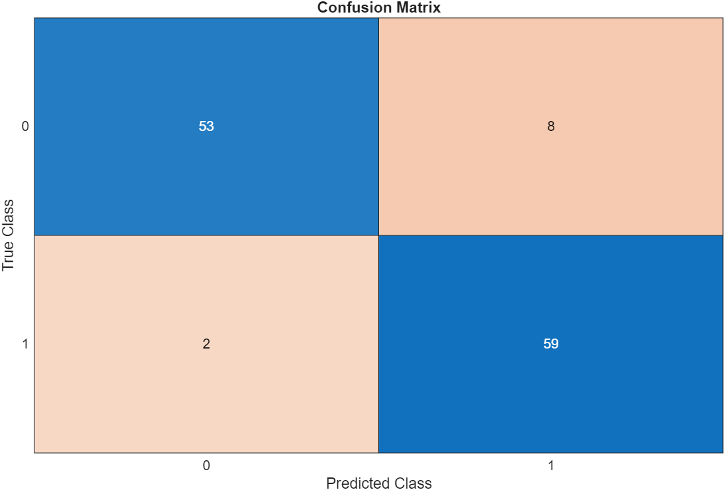
Validation
Notes:
ensuring most drowsy instances are correctly detected. False negatives are minimal, which is critical for safety applications.

Slide 12
Validation parameters
Accuracy: 91.8%
How well you catch drowsy
Recall = TP / (TP + FN) = 59 / (59 + 2) ≈ 96.7%
How accurate when saying Drowsy?
Precision = TP / (TP + FP) = 59 / (59 + 8) ≈ 88%

Slide 13
Limitations
Future Work
MATLAB’s 'Mouth' detector is:
Old Haar cascade Very sensitive to:
lighting
face angle
occlusion
Sensor Fusion
Real-car integration
AI Models

Slide 14
References:
Nasri, I., Karrouchi, M., Snoussi, H., Kassmi, K., Messaoudi, A. (2022). Detection and Prediction of Driver Drowsiness for the Prevention of Road Accidents Using Deep Neural Networks Techniques. In: Bennani, S., Lakhrissi, Y., Khaissidi, G., Mansouri, A., Khamlichi, Y. (eds) WITS 2020. Lecture Notes in Electrical Engineering, vol 745. Springer, Singapore. https://doi.org/10.1007/978-981-33-6893-4_6
Albadawi, Y.; Takruri, M,Awad, M., A Review of Recent Developments in Driver Drowsiness Detection Systems. Sensors 2022, 22, 2069. https://doi.org/10.3390/s22052069

Slide 15
Thank you

