Slide 1

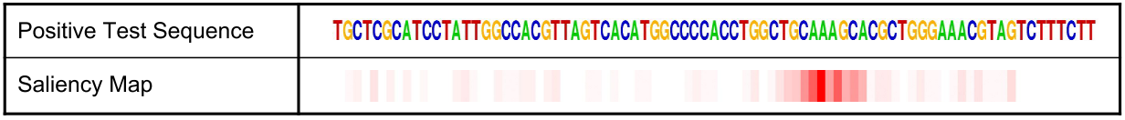
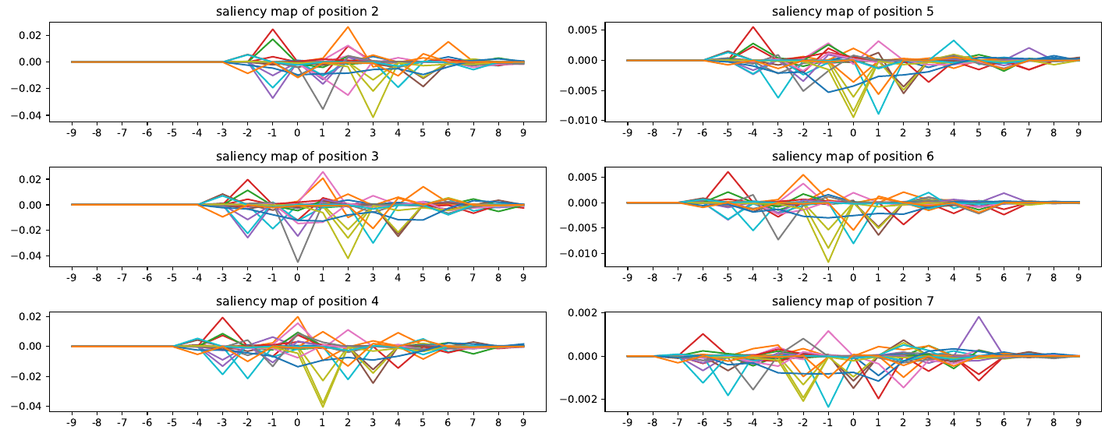
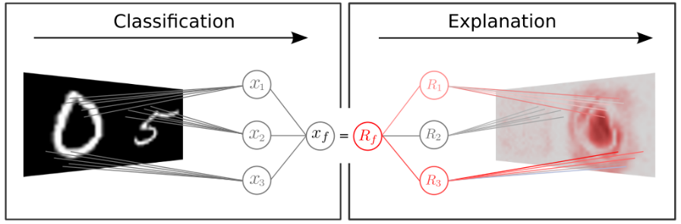
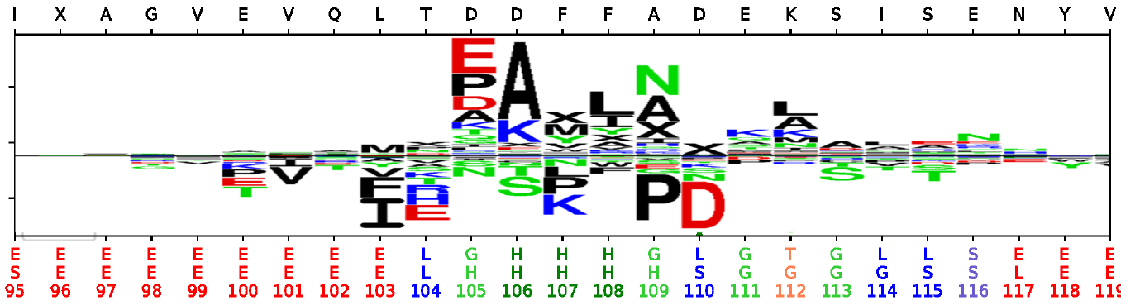
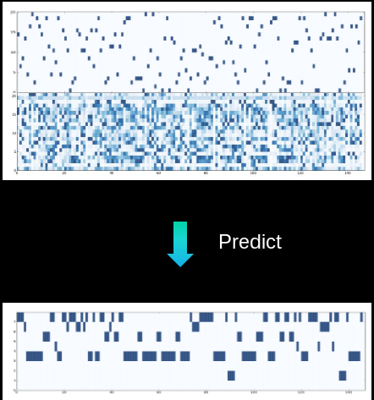
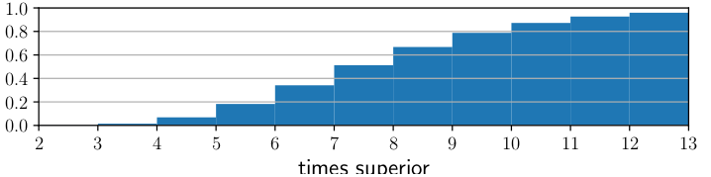
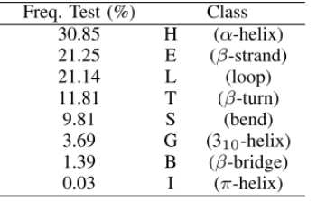
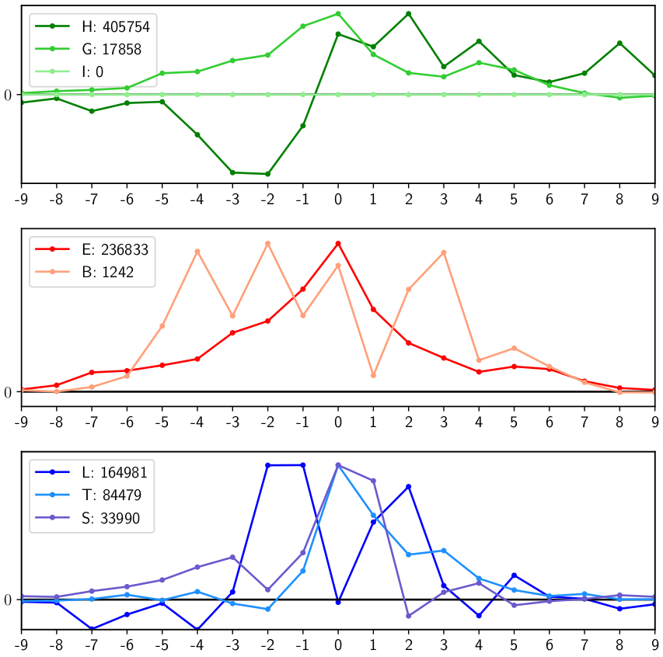
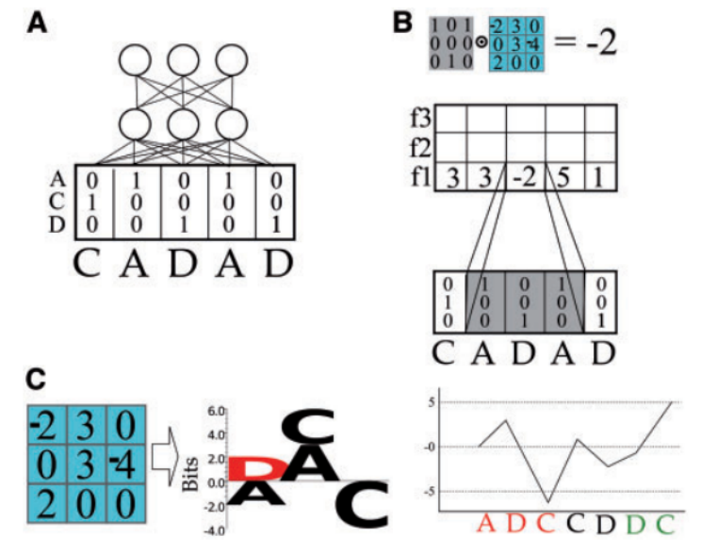
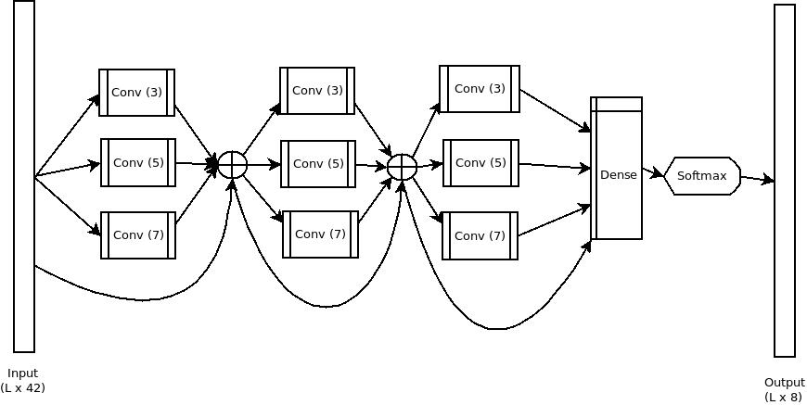
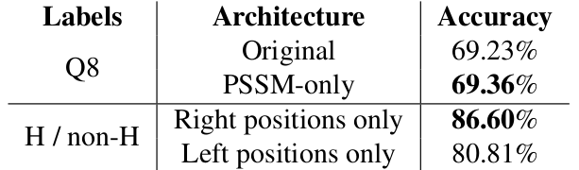
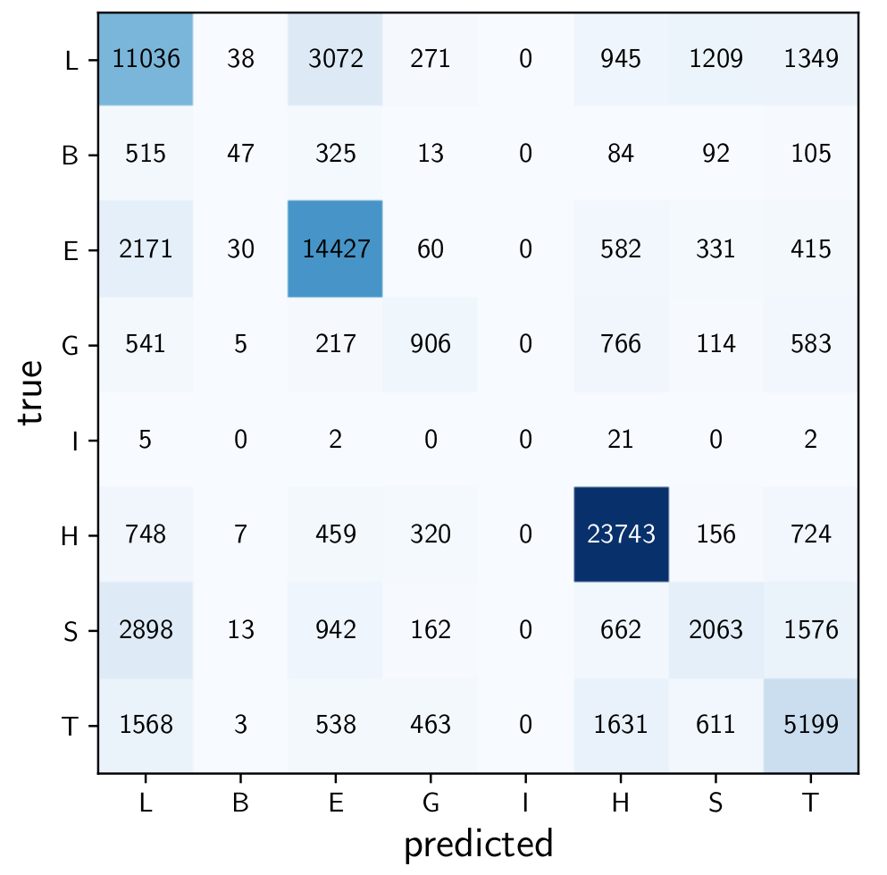
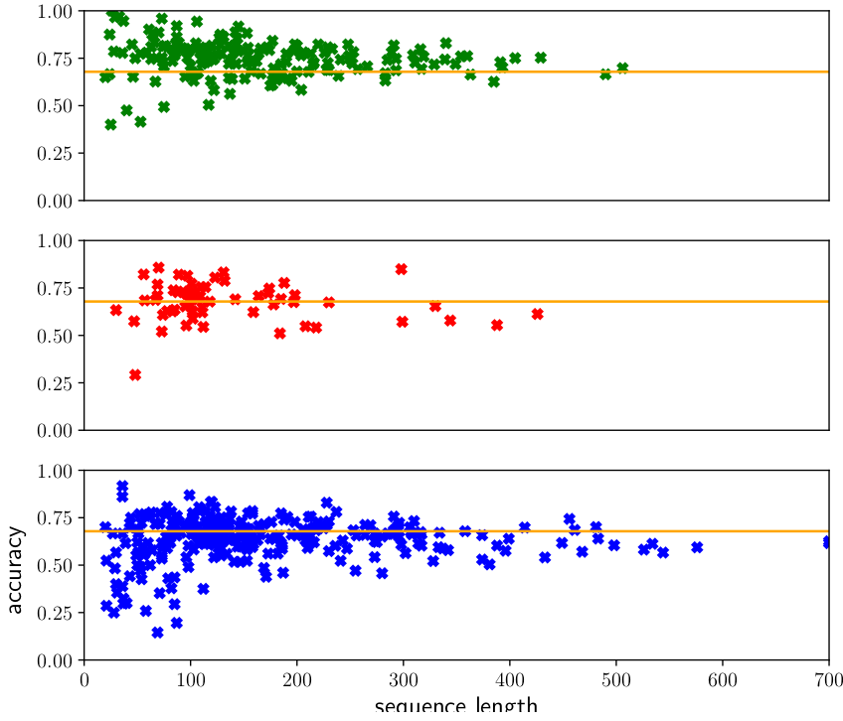
Saliency Map on Cnns for Protein Secondary Structure Prediction
School of Electronics and Computer Science
Guillermo Romero Moreno, Mahesan Niranjan, Adam Prugel-Bennett
What else can we get from our machines?
Machine Learning researchers sometimes fall into a race for accuracy, trying different models and methods without putting excessive attention on the reasons for the successes. Moreover, deep learning architectures are difficult to interpret and typically act as black boxes.
Interpretability techniques should be used more often for understanding the underlying processes, spot the key drivers of improvements in accuracy, and detect spurious rules learned by the models
Main interpretability techniques (from computer vision field):
- Saliency maps (influence from inputs for classification output)
- Feature visualisation (generate synthetic input from the learned model)
Extracting saliency maps from many-to-many classification
Previous work (on TFBS)[1]: 1 saliency map per sequence
Our work: 1 saliency map per position, 8x42x19 (8 classes, 42 inputs, 19 window size). 1.3M positions.
Methods of aggregation: per-sequence, per-class
The protein secondary-structure prediction (SPPS) problem
        Inputs: 21 aminoacids (one-hot)
        + 21 values PSSM (evolutionary)
        Outuput: 8 classes
        (one-hot)
State-of-the-art architectures: 1D CNNs
        Accuracy on test set: 67.7%
Results
Relevance of inputs: PSSM values over one-hot amino acids
        Cumulative histogram with relative strength of PSSM scores as compared to amino-acid saliency scores
Spatial relevance of surrounding positions per class
        H class predicted more from one side. Periodicity
        Modified networks:
        - With PSSM only
        - With right positions only (predicting H)
Future work
  Implement more advanced saliency map techniques
  Extend to bigger state-of-the-art models
  Perform clustering on the saliency maps
References
[1] J. Lanchantin, R. Singh, B. Wang, and Y. Qi, Deep Motif Dashboard: Visualizing and Understanding Genomic Sequences Using Deep Neural Networks, 2016.
Saliency map image:
SPPS input image:
Sequence CNN image:
Author contact details
Email: grm1g17@soton.ac.uk
ECS department, University of Southampton

