Slide 1


Sabre Insurance
Cluster Analysis
Rachel Dyer, Jui-Ting and Koonkarn Arthasarnprasit

Slide 2

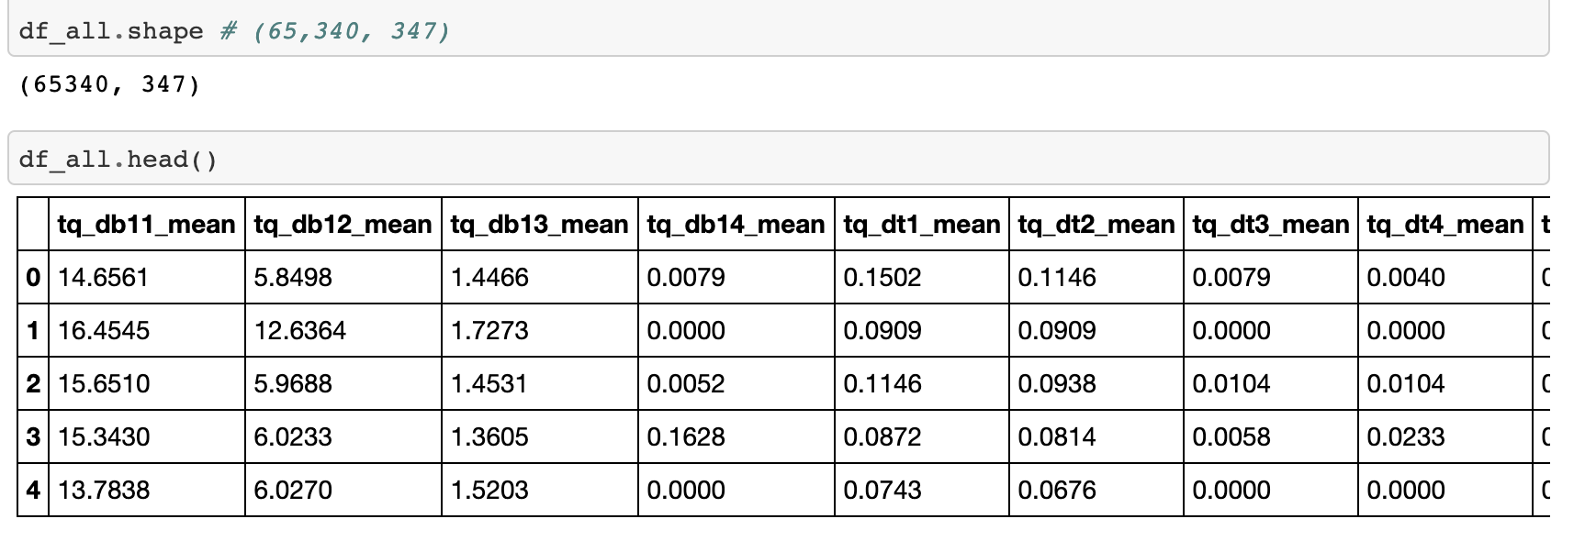
Vehicle type is High Cardinality Categorical Variables in supervised learning task.
One method is to gather further information about the hccv. ➡️ (65430, 347)
Using unsupervised learning to find a lower dimension representation of the data which can be used directly in the original supervised task.
➡️ Clustering
Data
Description

Slide 3
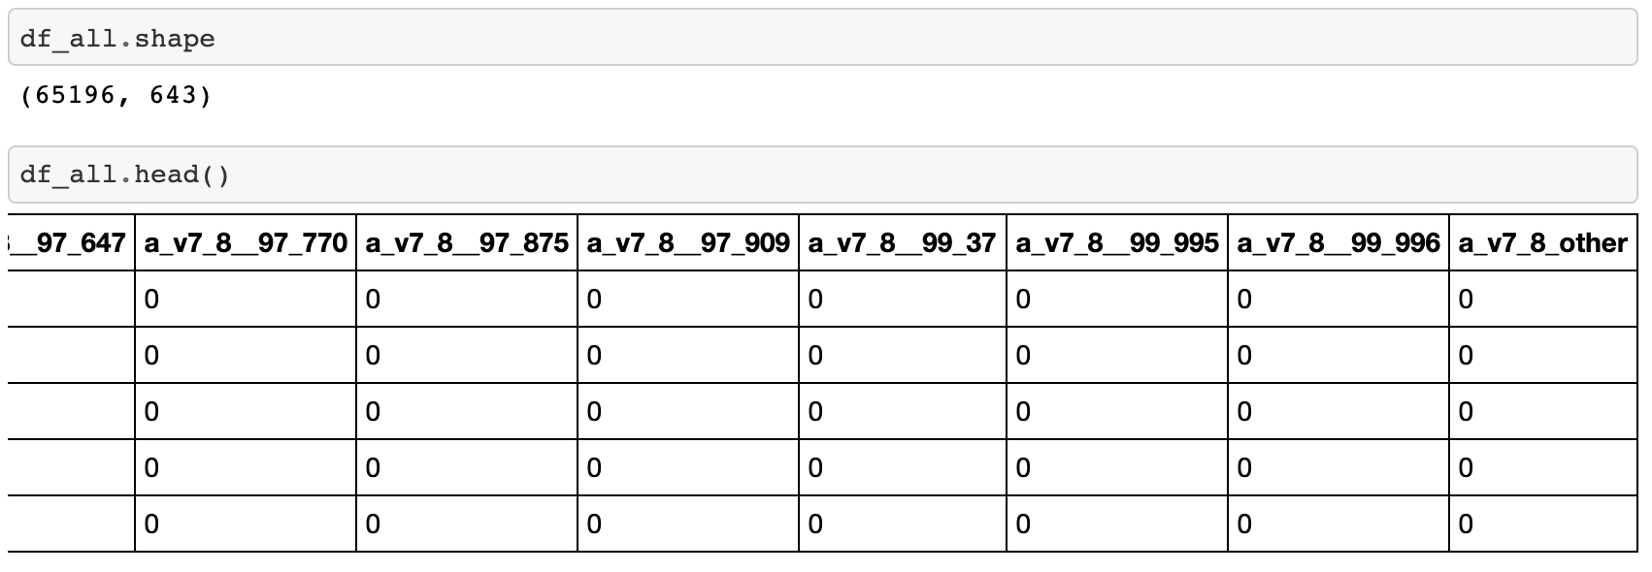
Omit duplicate, error variables and all 0 columns.
Deal with missing values.
➡️ Histogram variables replaced with 0.
➡️ Numerical variables replaced with mean.
One hot encoding categorical variables.
Deal with a_v7, a_v8 (a_v8 is a lower hierarchy under a_v7).
Concatenate a_v7 and a_v8, creating new variable a_v7_8.
Data
Cleaning

Slide 4
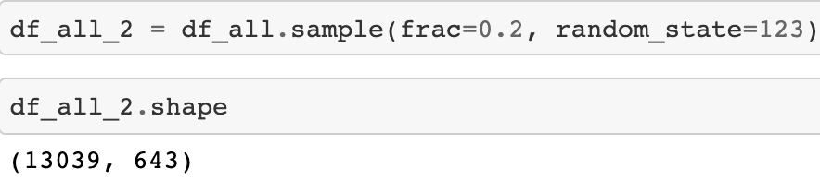
Distance Matrix Computation
Random sample 20% of data.
Scaling data：
➡️ Normalise numerical variables.
➡️ Histogram variables divided by 100.
➡️ Categorical variables not scaled.
Exclude ID and target variables.
Distance metrics components：
➡️ City block for numerical variables.
➡️ Hamming for categorical variables.
➡️ Jensen-Shannon for histogram variables.
Add equal weights.

Slide 5
Cluster Algorithm Comparison
HAC
HDBSCAN
K-Medoids
Main reason: precomputed square distance matrix can be used.
Advantages & Disadvantages :
➡️ HAC & HDBSCAN can produce a hierarchy of clusters. ↔️ K-medoids clusters are flat.
➡️ HAC & K-medoids can decide the number of clusters. ↔️ HDBSCAN can not do this.
➡️ HDBSCAN detects outliers in the dataset . ↔️ HAC & K-medoids do not do this.
It’s difficult to identify which algorithm is best.

Slide 6
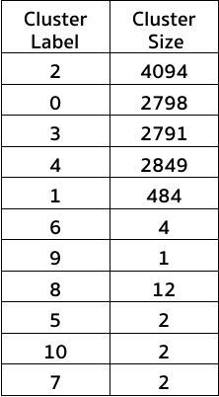
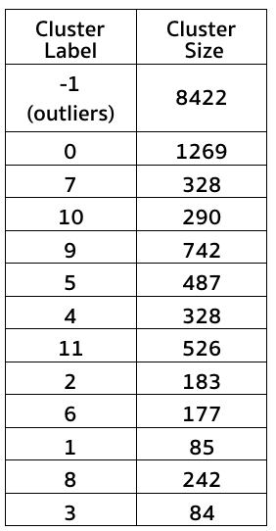
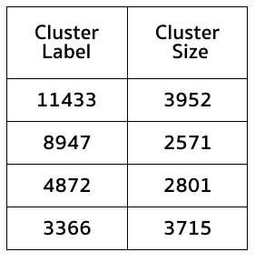

Cluster Size Comparison
HAC
HDBSCAN
K-Medoids

Slide 7
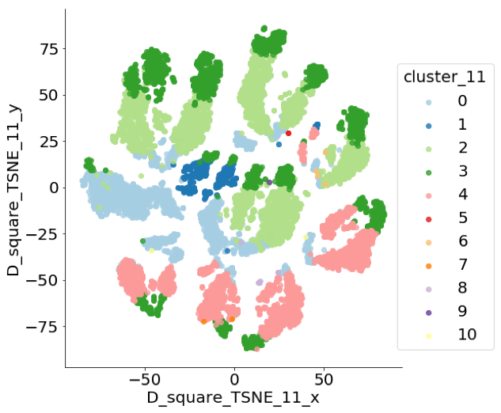
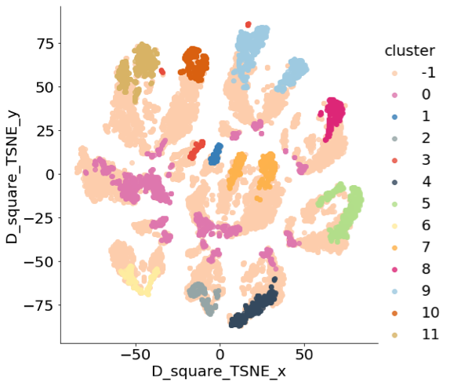
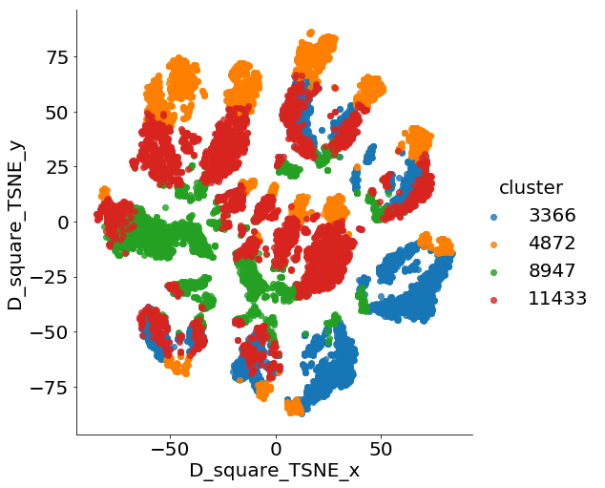
t-SNE Plot Comparison
HAC
HDBSCAN
K-Medoids

Slide 8
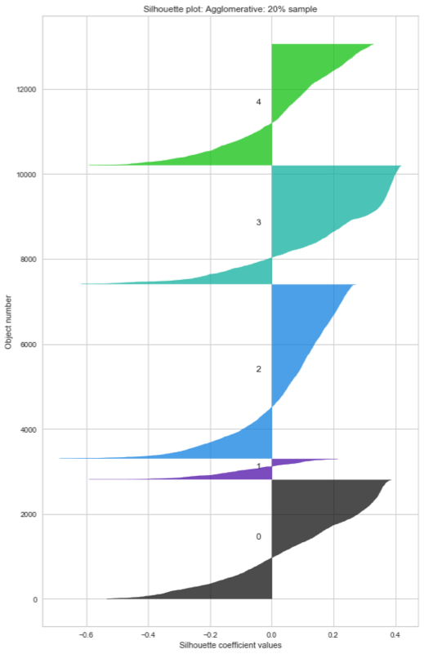
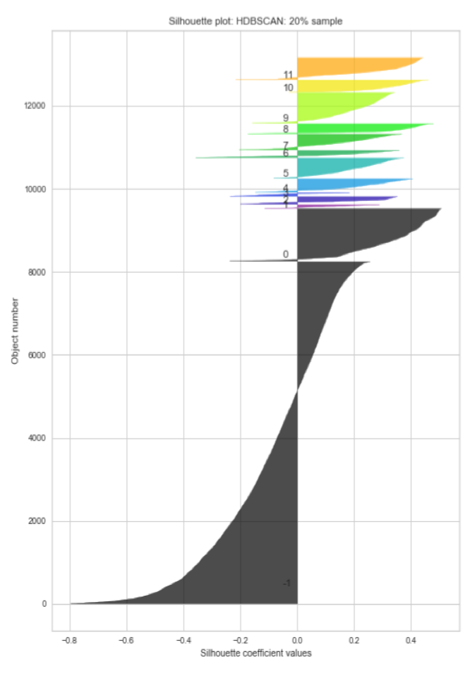
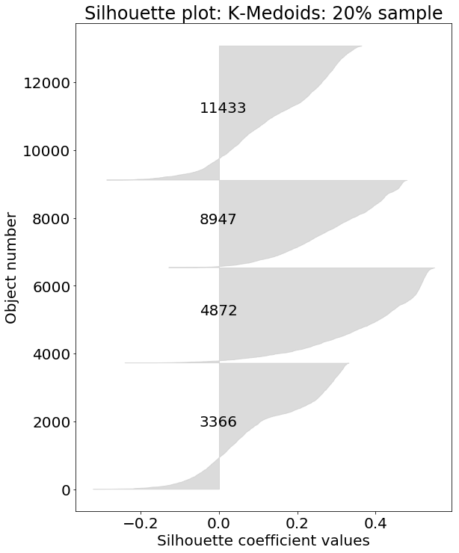
Silhouette Score Comparison
HAC
HDBSCAN
K-Medoids

Slide 9
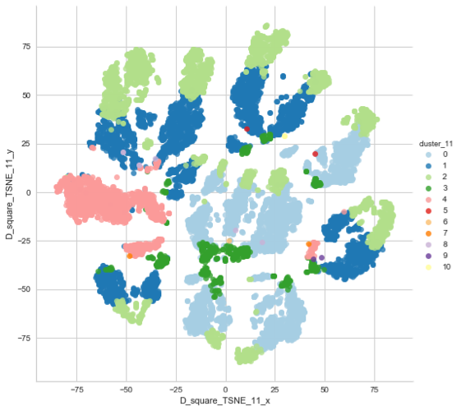

HAC Limitations & Further Work
Excluding
variables
Varying cluster sizes.
Different percentage of data produces different results.
Including different variables produces different results.
➡️ With/without target variables.
➡️ With/without a_v7, a_v8 & tq_v3.
Use different algorithms.
➡️ HAC with greater selection of linkage.
➡️ Hierarchical Divisive Clustering.
➡️ Limitations of HAC on large data sets.
Including
variables

Slide 10
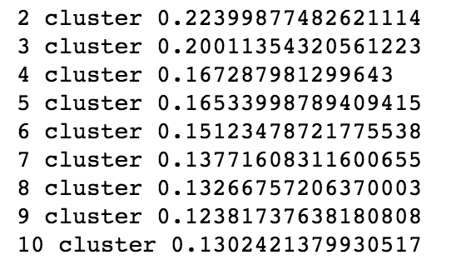
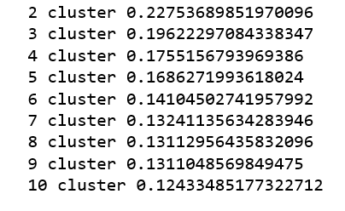
k-medoids Limitations & Further Work
20%
K- Medoids compute the compactness but not relationship.
The algorithm select medoid randomly and every time it is rerun the optimal number changes.
Use Elbow curve and Gap statistic to verify optimal number
of clusters in comparison to Silhouette score.
Calculate medoids manually and use the algorithm to find nearest points.
K-Medoids is not the best when dealing with large dataset.
Use PAM and CLARA to complement the existing K-medoids.
40%

Slide 11
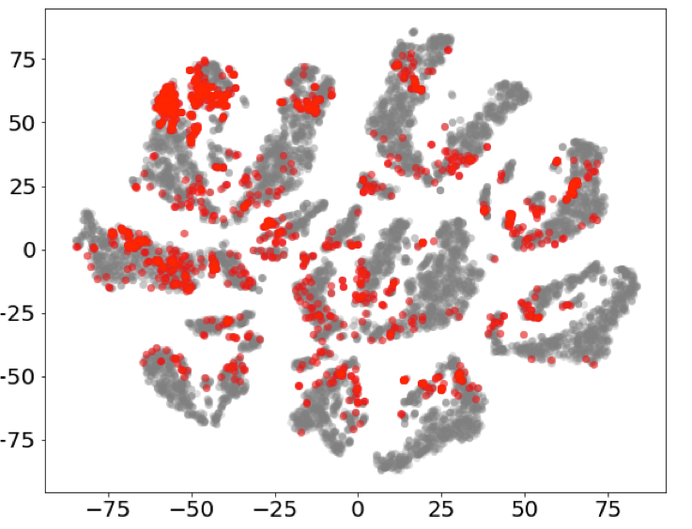
HDBSCAN Limitations
Not easy to determine the best values for parameters.
More than half of the data objects are deemed as outliers.
The dimensionality of data affect the performance.
The distribution of outliers

Slide 12
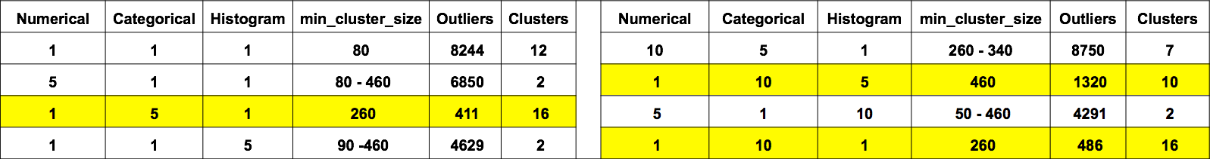
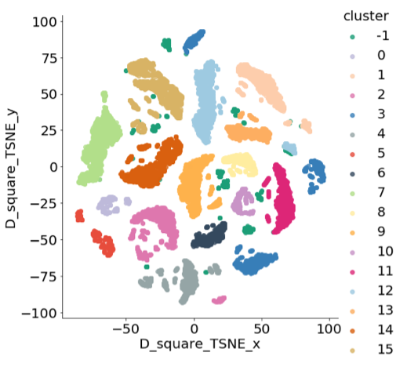
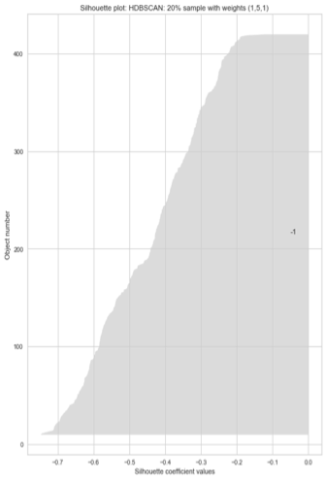
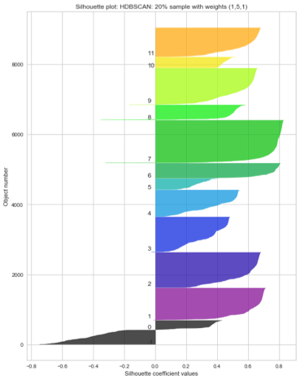
HDBSCAN Further Work
Experiment parameter with adding more different weights
⭐️ Numerical : 1, Categorical : 5, Histogram : 1 ⭐️
The distribution of clusters Outliers Sil scores Clusters Sil scores

Slide 13
General Limitations & Further Work
Dataset is too large.
➡️ Use greater percentage of data.
Lack of unsupervised learning and Confidential nature of data.
Other methods to evaluate cluster results.
➡️ Davies-Bouldin Index / Dunn index.
➡️ Define quality measure.
➡️ Inspect centroids.
Other methods to find lower dimensional representation of the data.
➡️ Feature agglomeration.
➡️ Neural network encoders.

Slide 14

💡Alan : It is always the way with these thing, that our first step of analysis lead to more question, but that’s how we make progress...
Thank Sabre Insurance and Alan
for the opportunity!

