Slide 1
Multi-Class Intrusion Detection using Machine Learning: A Comparative and Explainable Approach
Hrushikesh Ramilla | Avadh Khandelwal | Himavarshith Reddy

Slide 2
Problem Statement
Intrusion Detection Systems classify malicious network traffic before damage spreads.
UNSW-NB15 is highly imbalanced, multiclass, and noisy, which makes minority-class detection difficult.
Goal: build a reproducible, explainable IDS pipeline and a usable GUI for demo and SaaS-style inference.

Slide 3
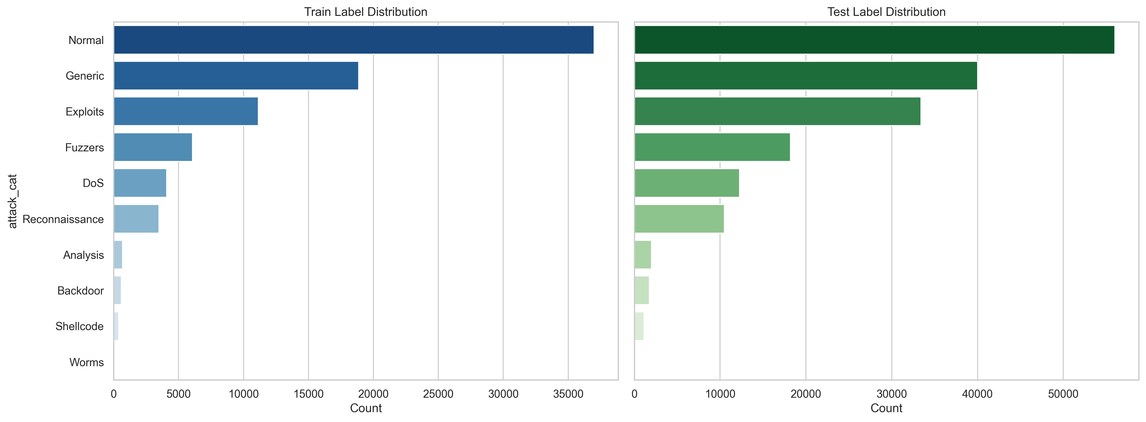
Dataset Overview
Predefined training rows: 82,332
Predefined testing rows: 175,341
After leakage-safe cleaning, duplicates were removed and the multiclass target remained attack_cat.
Class distribution remains heavily skewed toward normal and exploits traffic.

Slide 4
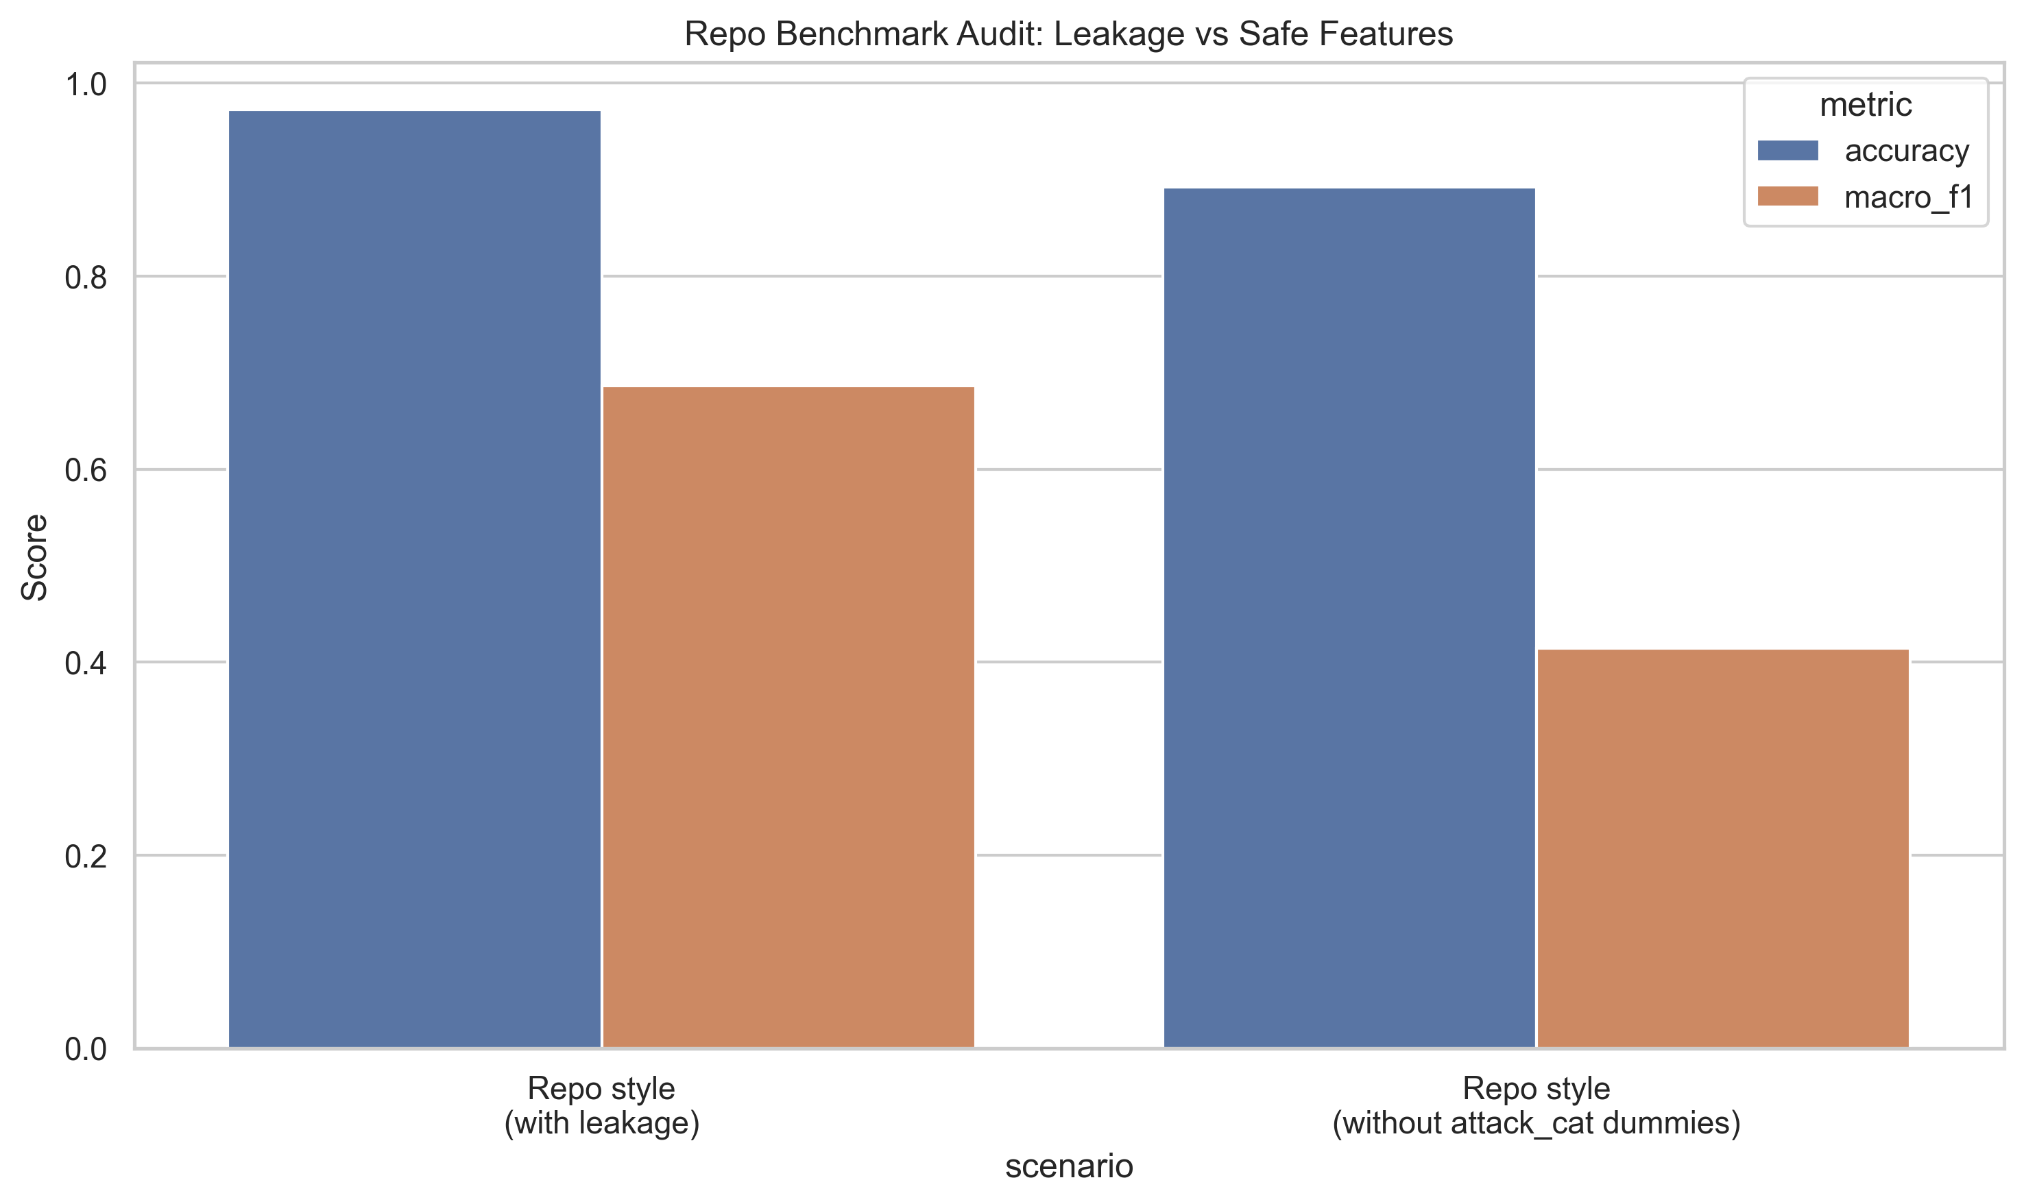
Initial Problems
ID leakage inflated apparent performance and hid true generalization gaps.
Duplicate removal originally ran before dropping ID, so duplicates were effectively invisible.
Feature-selection and imbalance handling were too weak for minority classes like fuzzers and worms.

Slide 5
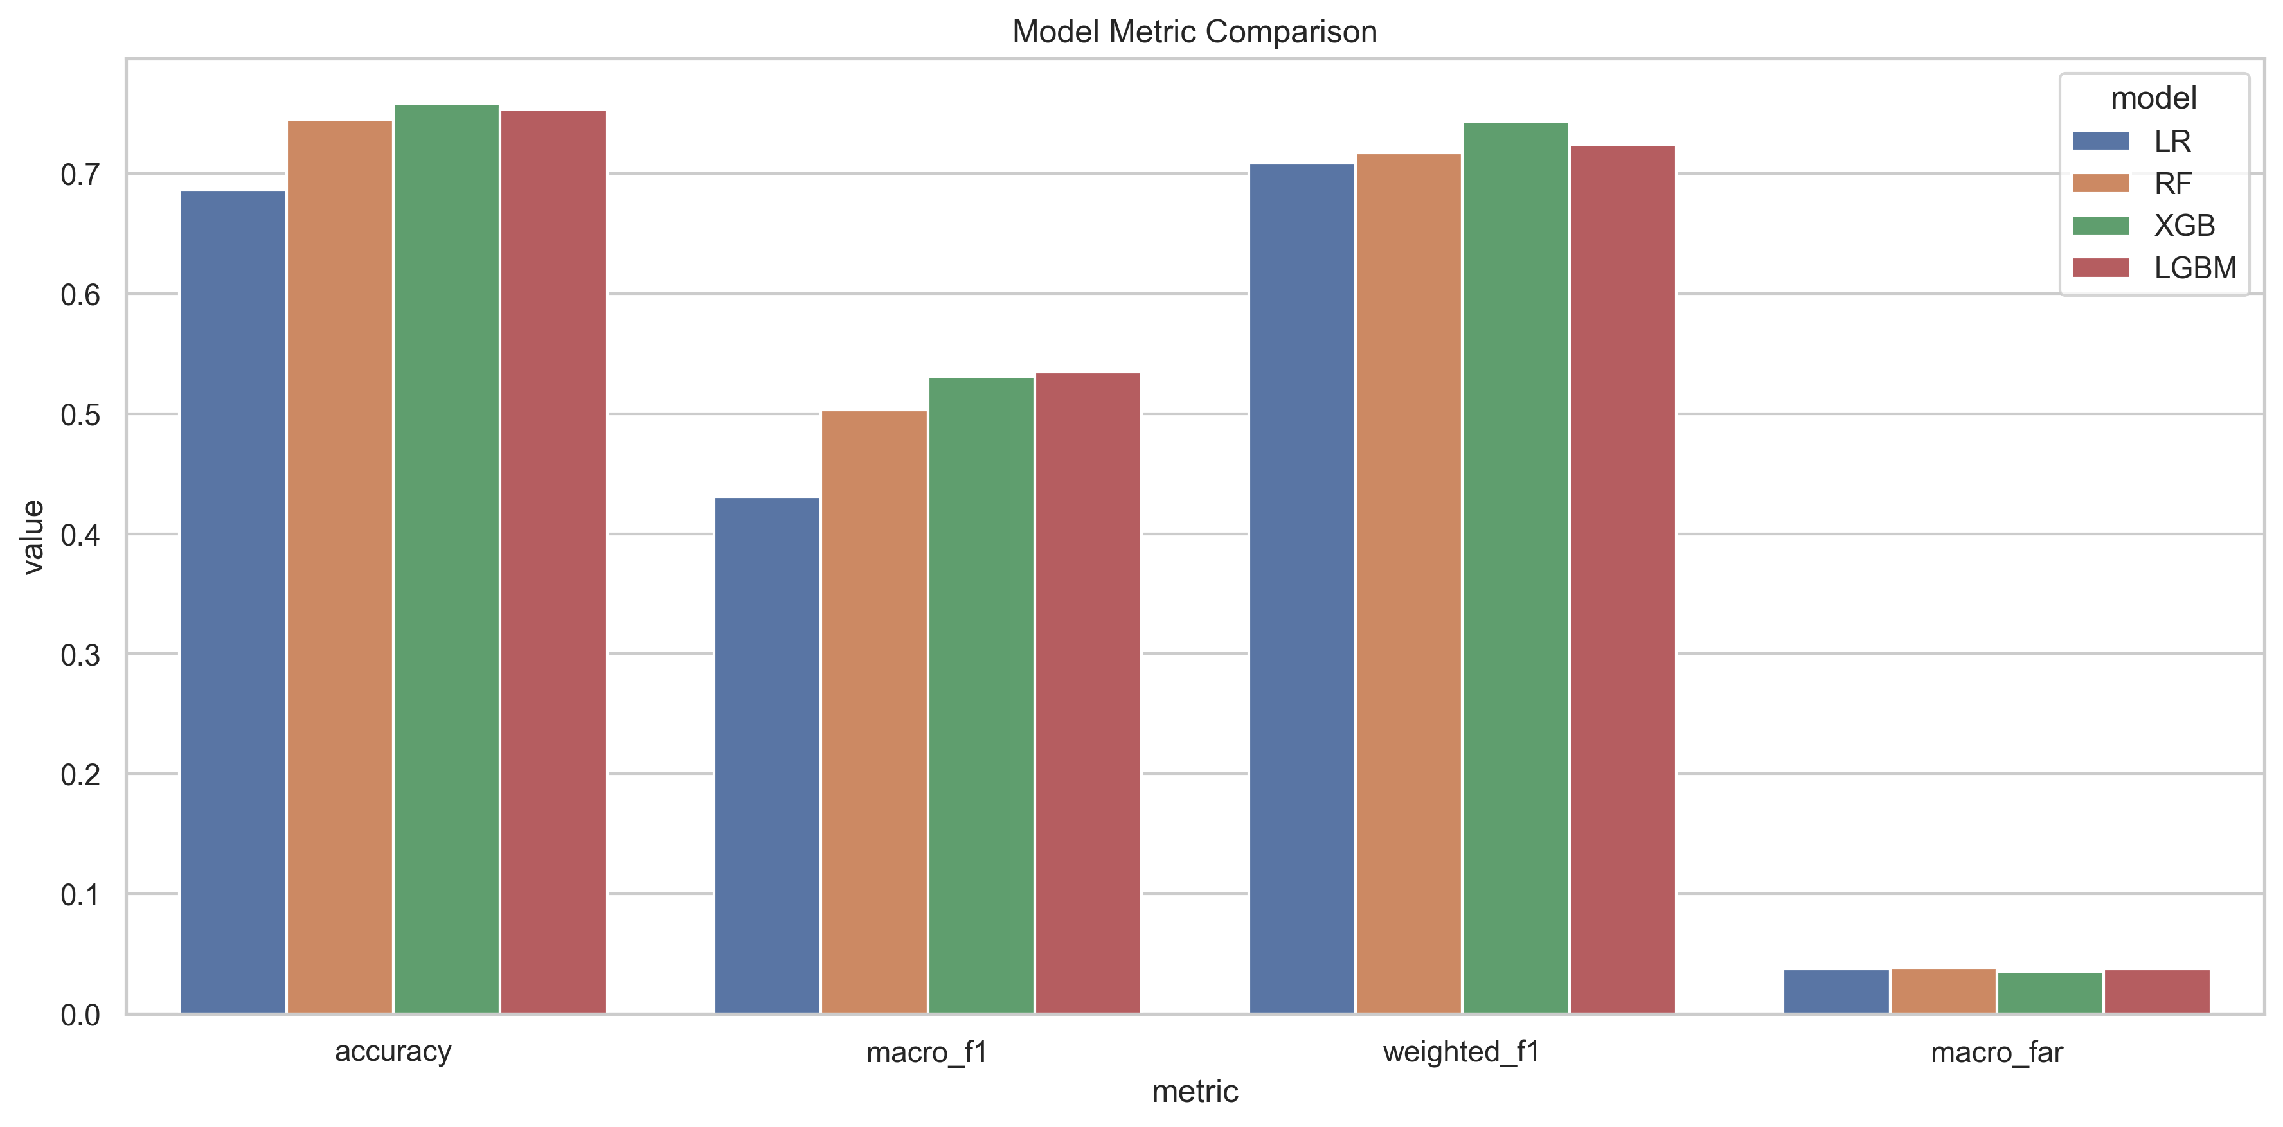
Baseline Performance
Stage | Accuracy | Macro F1 | Weighted F1
Leakage-safe baseline | 71.71% | 0.4341 | 0.6982
Phase 1 established the first reliable, leakage-free baseline after removing ID leakage and fixing duplicate handling.
LGBM became the best baseline model under the unchanged ranking rule.

Slide 6
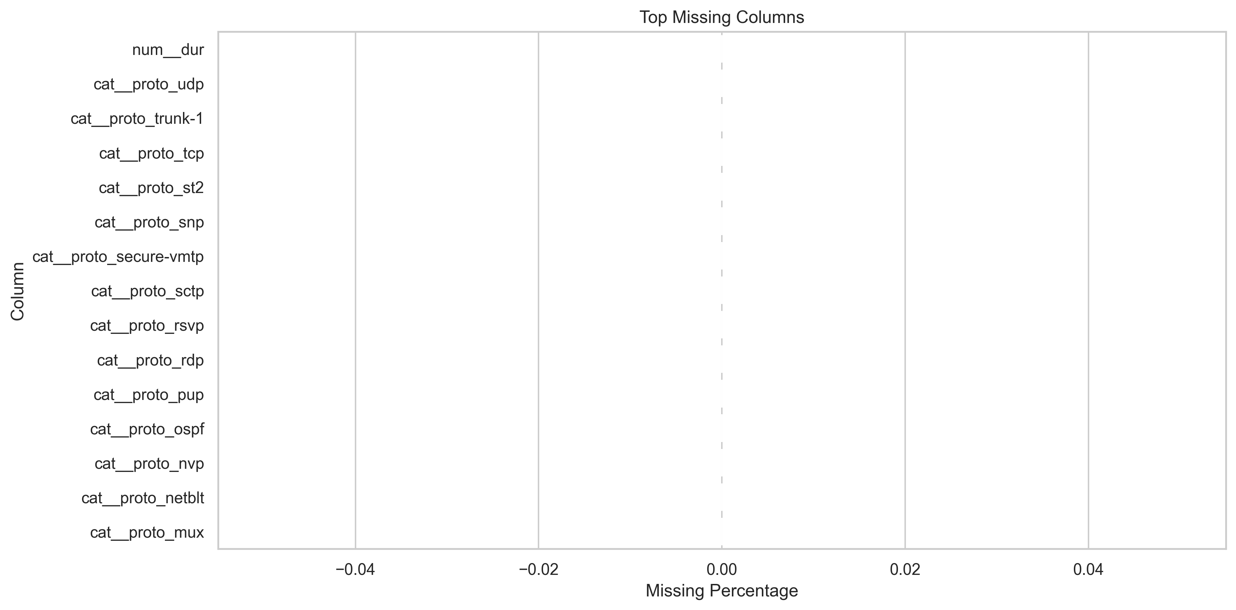
Phase 1 Fixes
Fix | Why It Mattered
Drop ID before features | Removed leakage and reduced overfitting.
Correct duplicate order | Exposed 26,387 train and 67,601 test duplicates.
Restore feature cap | Re-enabled controlled selection for stable training.
These fixes rebuilt trust in the evaluation pipeline.
They also changed the effective class distribution materially, especially for normal and generic traffic.

Slide 7
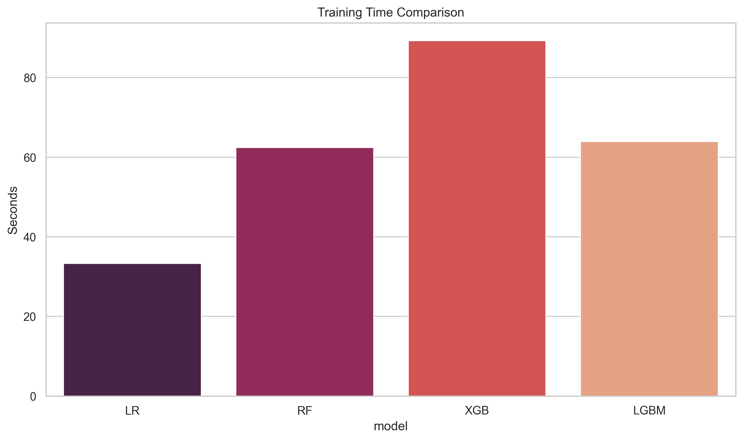
Phase 2 Improvements
Model | Accuracy | Macro F1 | Weighted F1
LGBM (offline) | 73.74% | 0.5248 | 0.7010
LGBM (production calibrated) | 73.49% | 0.4992 | 0.6890
Feature cap increased to 50, class weights were applied, SMOTE was added on training-only paths, and the final model was calibrated.
Macro F1 improved materially, but fuzzers still underperformed in production.

Slide 8
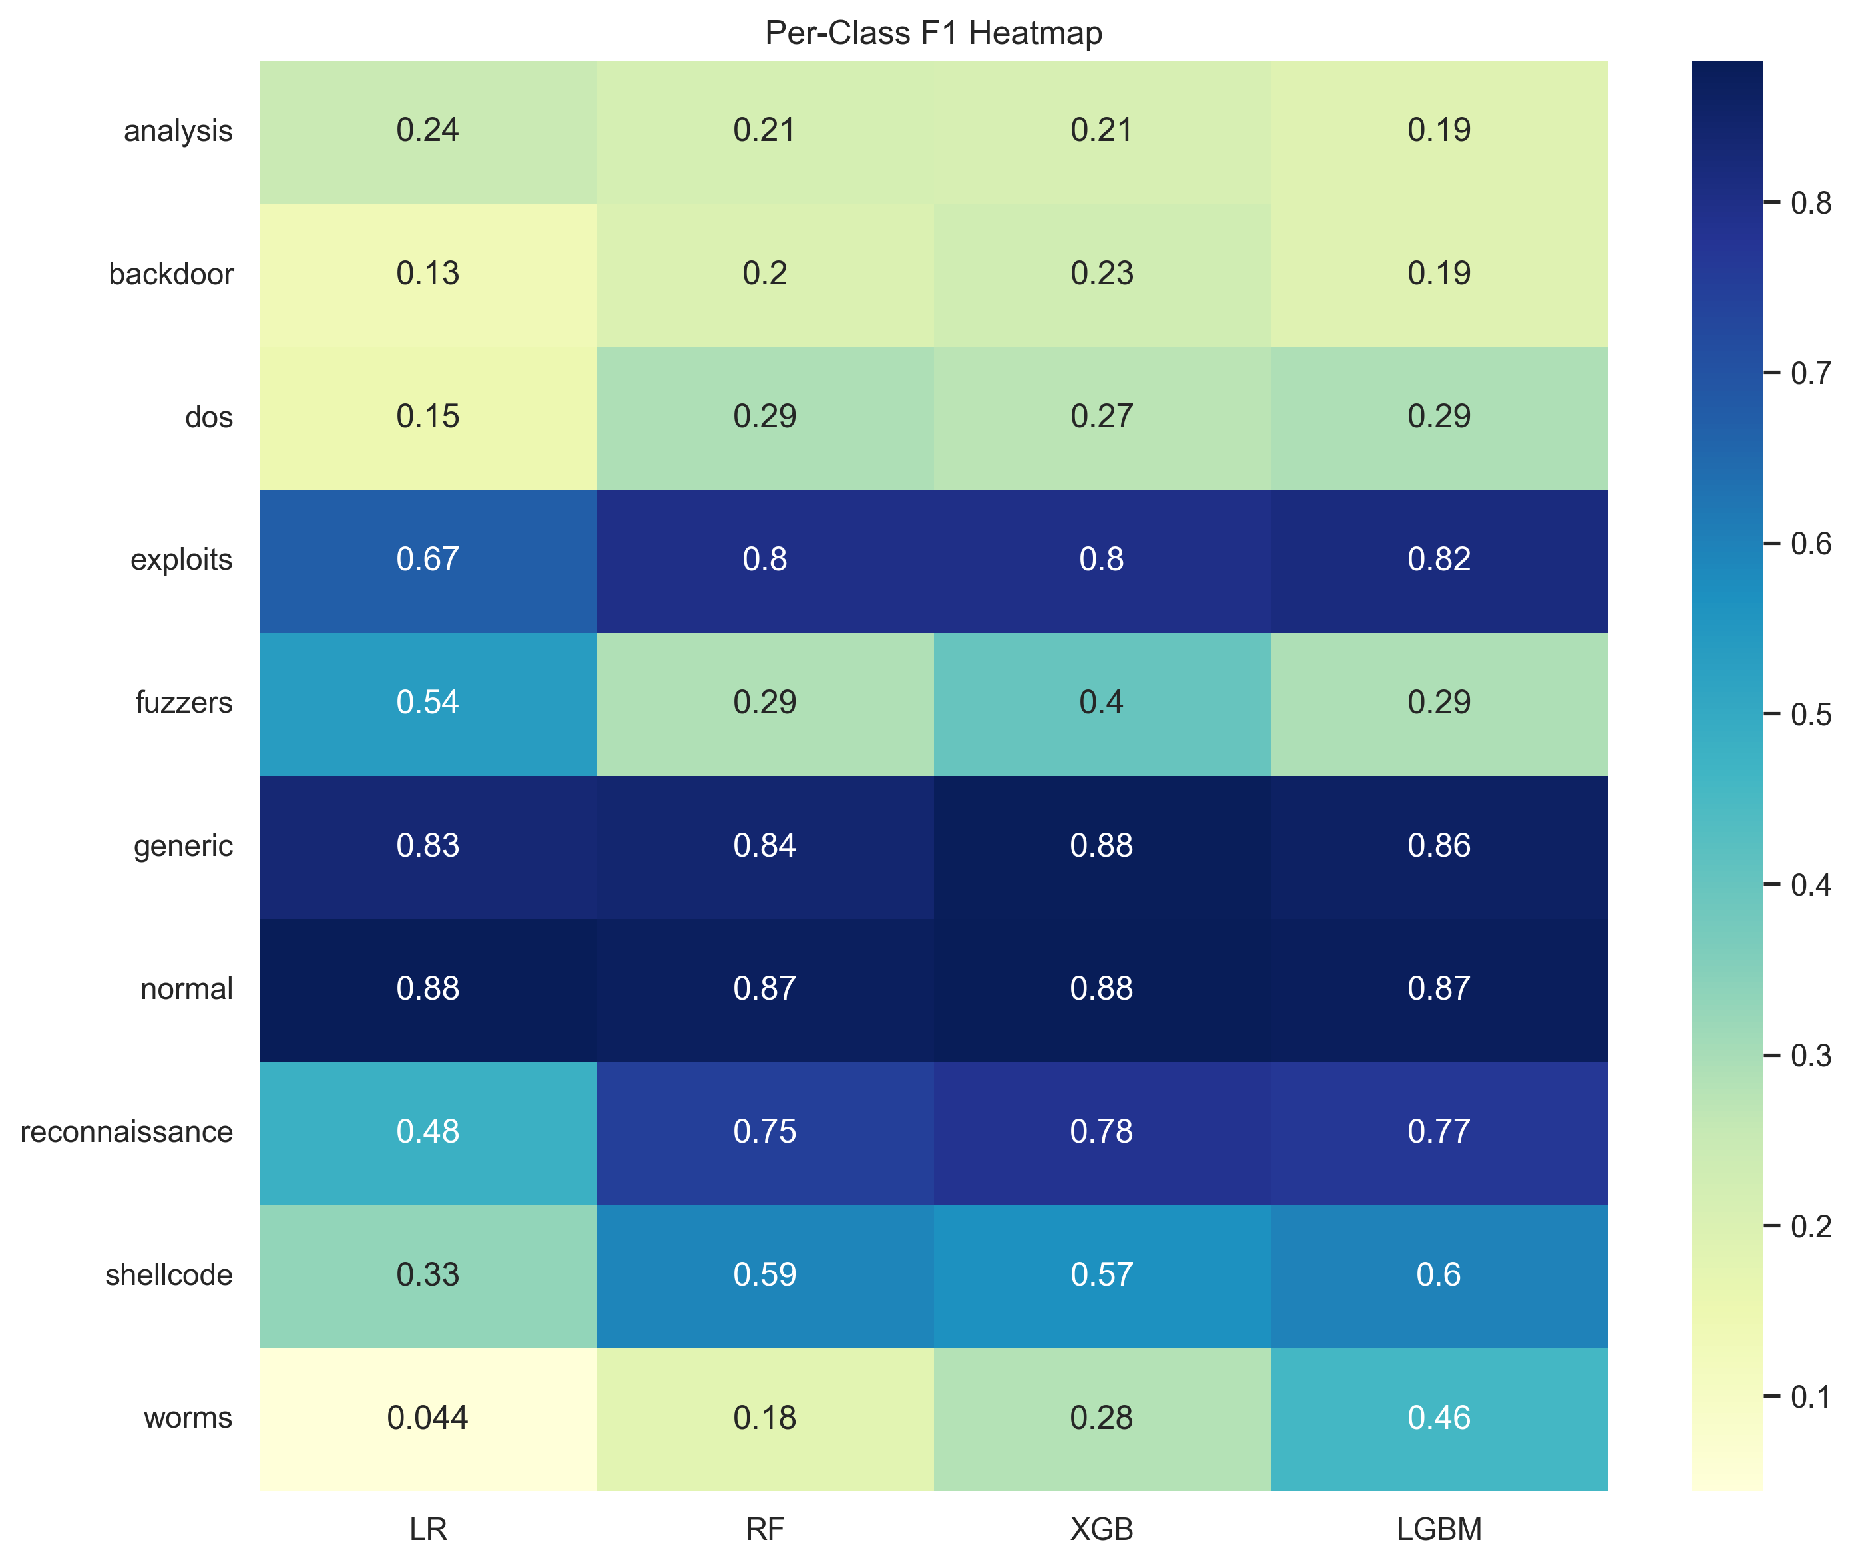
Phase 3 Improvements
Model | Accuracy | Macro F1 | Weighted F1
LGBM (offline) | 75.34% | 0.5346 | 0.7244
LGBM (production thresholded) | 74.73% | 0.5269 | 0.7125
Added interaction features, raised feature cap to 75, reduced SMOTE aggressiveness, and tuned minority thresholds.
Tuned thresholds: fuzzers=0.30, backdoor=0.15, analysis=0.20, worms=0.15.

Slide 9
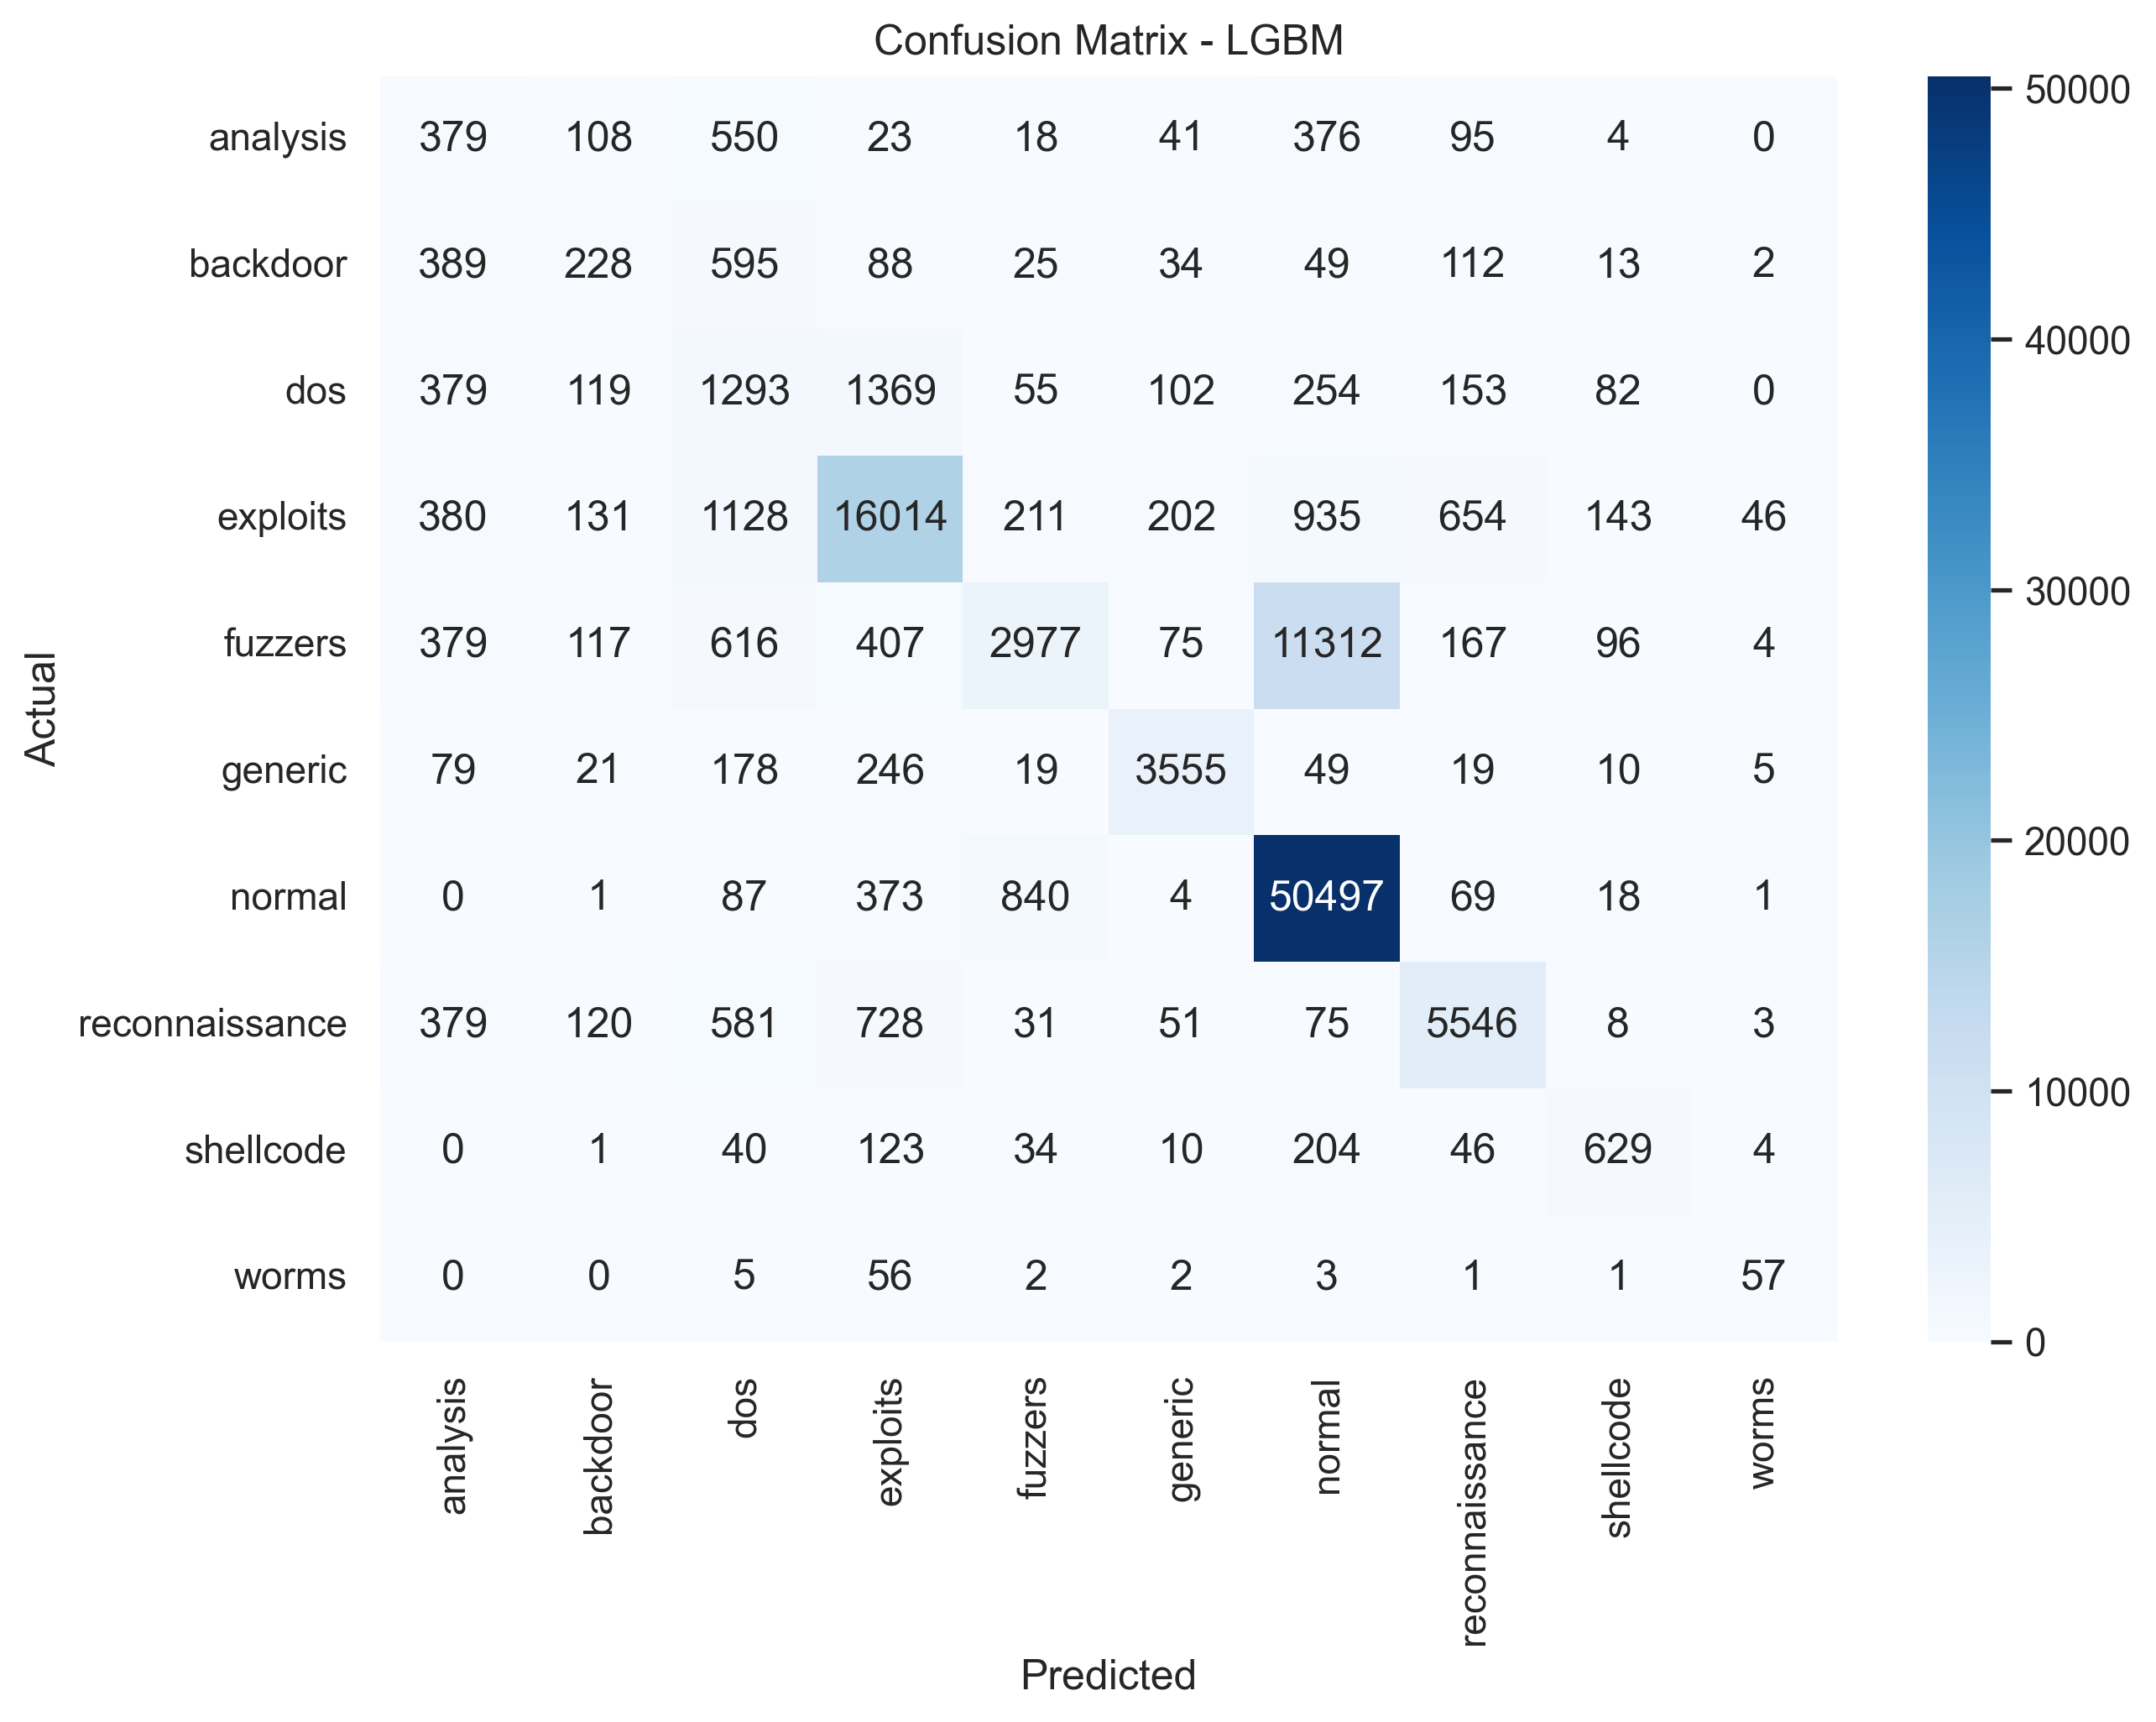
Final Results
Metric | Value
Accuracy | 74.73%
Macro F1 | 0.5269
Weighted F1 | 0.7125
Final Model | LGBM
Fuzzers F1 | 0.2552
Fuzzers Recall | 0.1557
The current deployable model is a calibrated and thresholded LGBM.
Performance improved materially across phases, but the 0.60+ Macro F1 target was not reached.

Slide 10
Model Architecture
Raw UNSW Features
Cleaning + ID Removal
Interaction Features
Encoding + Selection
SMOTE + Class Weights
LGBM
Calibration + Thresholds
Prediction + SHAP
Production path: cleaned inputs -> selected 75-feature space -> calibrated + thresholded LGBM -> multiclass prediction -> SHAP explanation

Slide 11
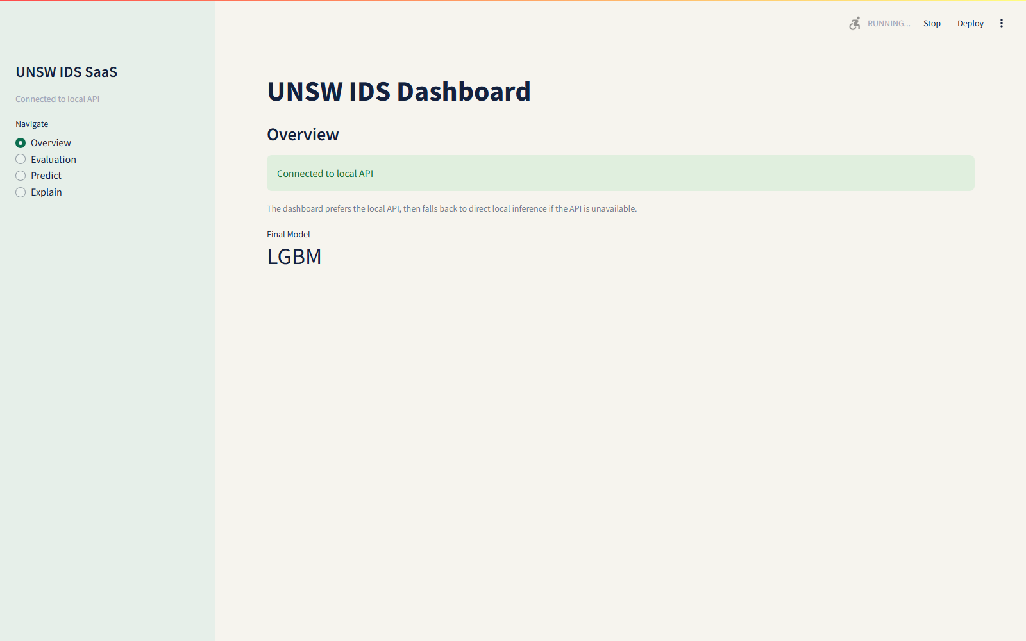
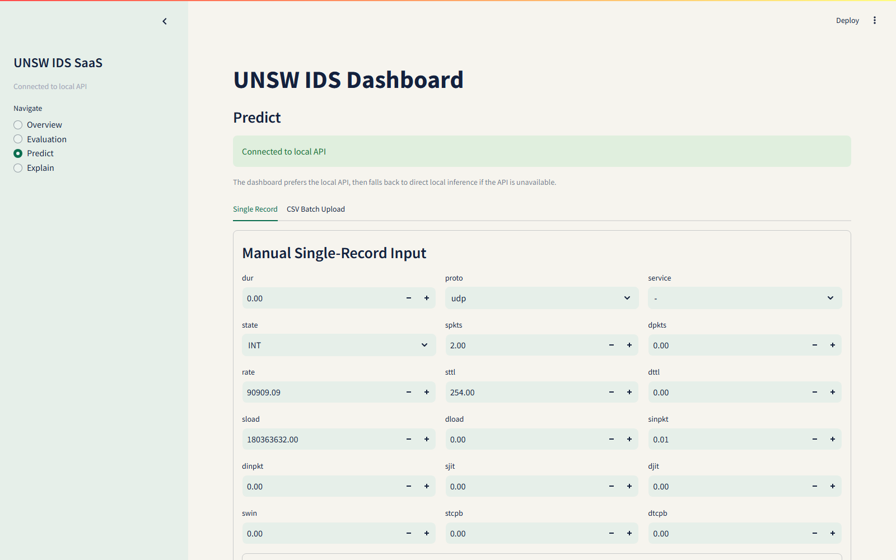
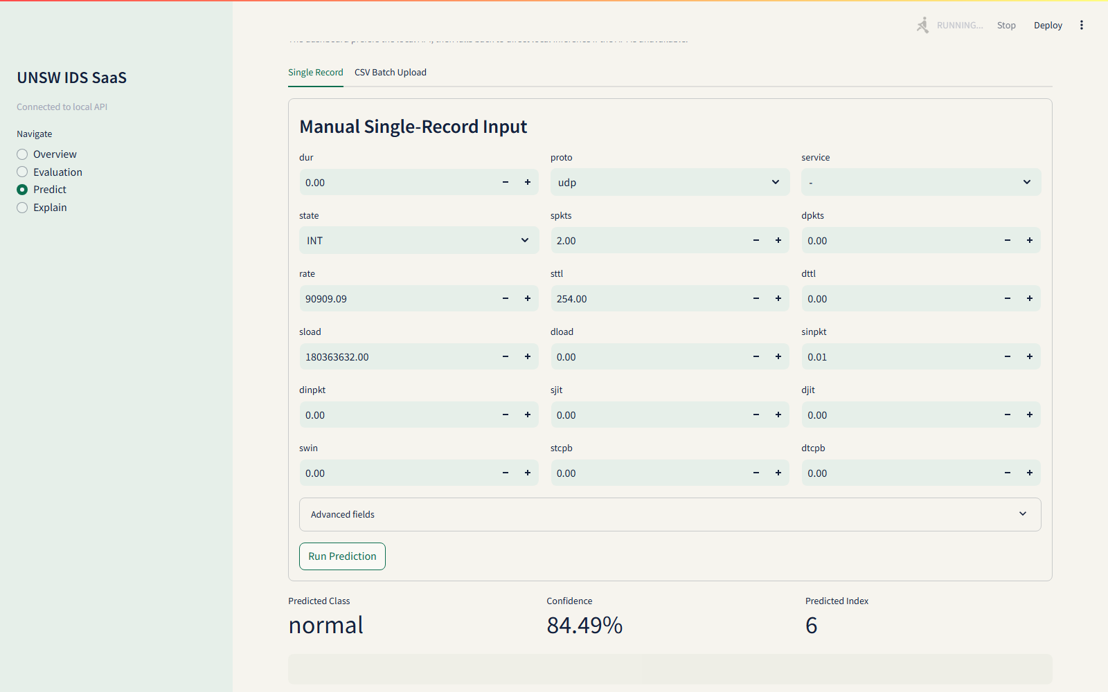
GUI Demo
Dashboard validation passed: overview=True, prediction=True, CSV with id=True.
The GUI prefers the API when available and falls back to direct local inference when needed.
Prediction flow supports manual single-record scoring, CSV batch upload, and SHAP-backed explanation views.

Slide 12
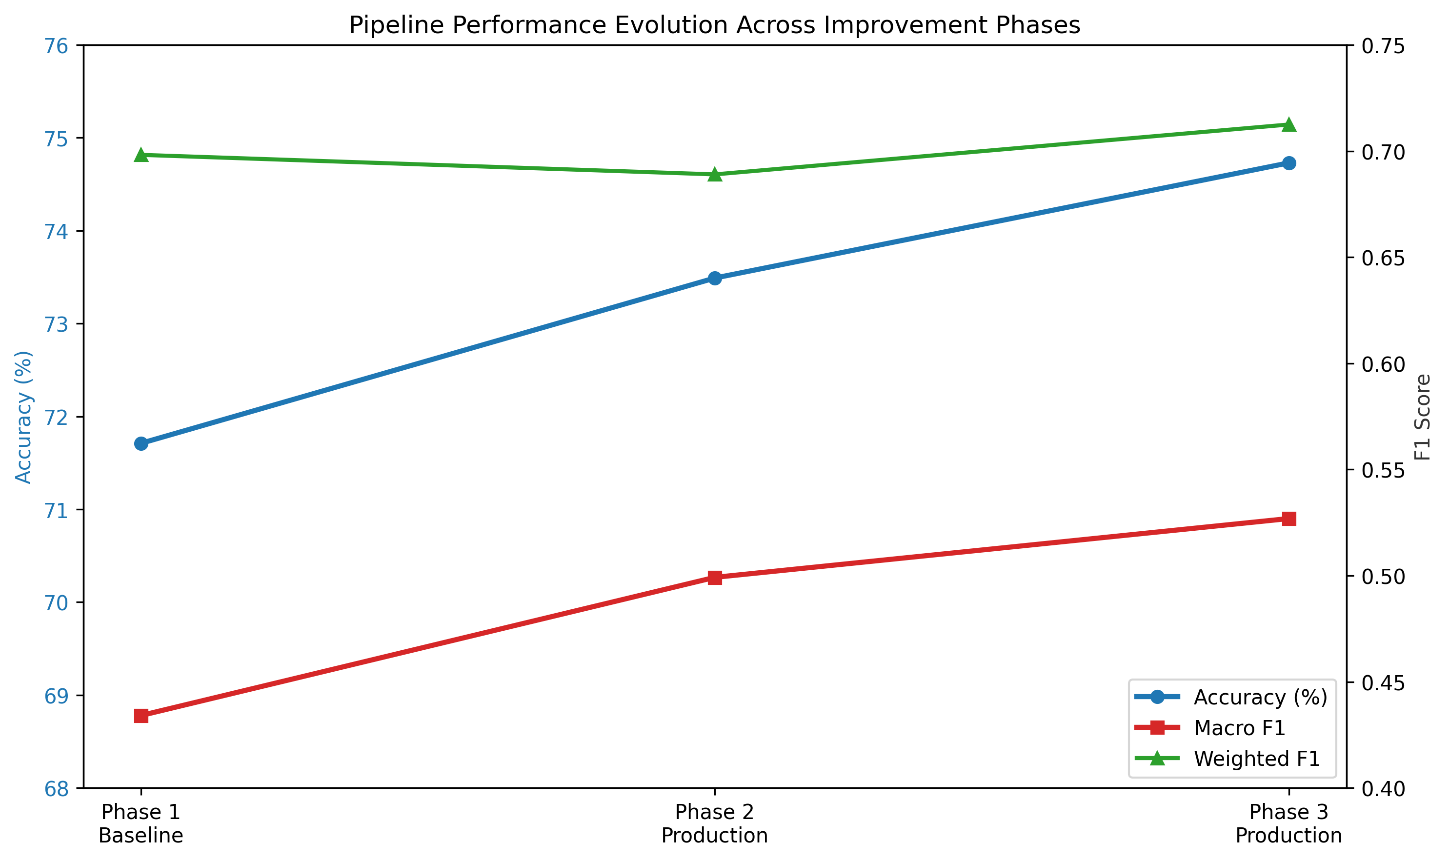
Key Insights
Leakage removal mattered more than raw model complexity.
Controlled SMOTE plus threshold tuning improved minority-class recovery without destabilizing the pipeline.
Fuzzers remains the most difficult class because of overlap with benign behavior and limited discriminative signal.

Slide 13
Limitations
Production Macro F1 is 0.5269, so the 0.60+ target was not achieved.
Fuzzers recall remains low even after threshold tuning and interaction features.
The dataset still reflects strong class overlap and heavy skew toward normal traffic.

Slide 14
Future Work
Train a dedicated binary detector alongside the multiclass model for layered defense.
Explore cost-sensitive boosting and richer temporal or flow-aggregation features.
Add threshold search per deployment scenario and automated periodic model refresh.

