Slide 2
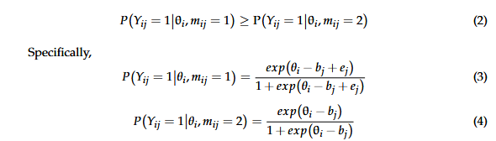
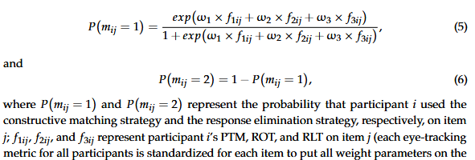
Theoretical Labels
Data-Driven
Classification
Multi-Strategy Eye-Tracking Model (MEM)
Recursive Feature Elimination
Random Forest
Seven features, including RA, RT, and five eye-tracking metrics (i.e., PTM, LFT, RLT, NOT, and ROT), were analyzed.

Slide 3
Theoretical Labels
Data-Driven
Classification
Multi-Strategy Eye-Tracking Model (MEM)
Recursive Feature Elimination
Random Forest
Seven features, including RA, RT, and five eye-tracking metrics (i.e., PTM, LFT, RLT, NOT, and ROT), were analyzed.
Constructive matching
Response elimination

Slide 4
Theoretical Labels
Data-Driven
Classification
Multi-Strategy Eye-Tracking Model (MEM)
Recursive Feature Elimination
Random Forest
Seven features, including RA, RT, and five eye-tracking metrics (i.e., PTM, LFT, RLT, NOT, and ROT), were analyzed.
Constructive matching
Response elimination
Data-Driven and Theoretical Model Comparison
Classification accuracy > 0.9 with only PTM and RLT; stable with top 3 features. K-means clustering based on PTM, RLT, LFT showed high alignment (82%) with MEM strategy labels.

Slide 5
Theoretical Labels
Data-Driven
Classification
Multi-Strategy Eye-Tracking Model (MEM)
Recursive Feature Elimination
Random Forest
Seven features, including RA, RT, and five eye-tracking metrics (i.e., PTM, LFT, RLT, NOT, and ROT), were analyzed.
Constructive matching
Response elimination
Data-Driven and Theoretical Model Comparison
Classification accuracy > 0.9 with only PTM and RLT; stable with top 3 features. K-means clustering based on PTM, RLT, LFT showed high alignment (82%) with MEM strategy labels.

Slide 6
Theoretical Labels
Data-Driven
Classification
Multi-Strategy Eye-Tracking Model (MEM)
Recursive Feature Elimination
Random Forest
1
Seven features, including RA, RT, and five eye-tracking metrics (i.e., PTM, LFT, RLT, NOT, and ROT), were analyzed.
Multimodal Joint-Hierarchical Cognitive Diagnosis Modeling (MJ-DINA)
3
RA, RT, FX
Constructive matching
Response elimination
Impulsive focuser
Impulsive scanner
Reflective focuser
Reflective scanner
2
Plan 1

Slide 7
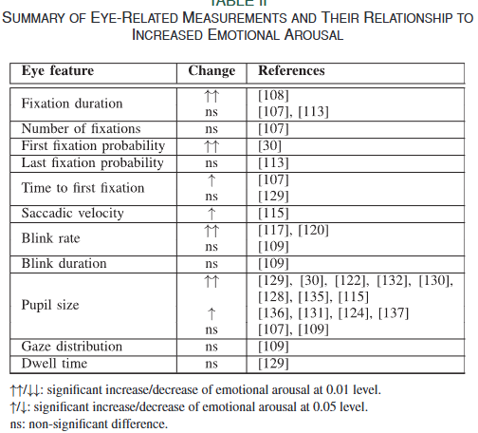
Theoretical Labels
Data-Driven
Classification
Multi-Strategy Eye-Tracking Model (MEM)
Recursive Feature Elimination
Random Forest
Seven features, including RA, RT, and five eye-tracking metrics (i.e., PTM, LFT, RLT, NOT, and ROT), were analyzed.
3
Other Theoretical Model
2
Fixation duration, number of fixations, Saccadic velocity, blink rate, blink duration, pupil size, gaze distribution, dwell time
Strategy
Attention
Emotional Arousal and Stress
Workload
1
Plan 2
Constructive matching
Response elimination

Slide 8
Theoretical Labels
Data-Driven
Classification
Multi-Strategy Eye-Tracking Model (MEM)
Recursive Feature Elimination
Random Forest
Seven features, including RA, RT, and five eye-tracking metrics (i.e., PTM, LFT, RLT, NOT, and ROT), were analyzed.
Constructive matching strategy
Response elimination strategy
Plan 3
Only replace data.

Slide 9
Model | MEM Multi-Strategy Eye-Tracking Model | MJ-DINA Multimodal Joint-Hierarchical Cognitive Diagnosis Modeling
Strategy Classification | Constructive matching strategy Response elimination strategy | Impulsive focuser Impulsive scanner Reflective focuser Reflective scanner
Included Metrics | PTM, ROT, and RLT | NA.

Slide 10






Slide 11
MJ-LLTM
Man, Kaiwen, and Joni M. Lakin. 2024. “An Exploratory Study Using Innovative Graphical Network Analysis to Model Eye Movements in Spatial Reasoning Problem Solving.” Journal of Educational Measurement 61 (4): 710–39.
Liu, Y., He, K., Man, K., & Zhan, P. (2025). Exploring Critical Eye-Tracking Metrics for Identifying Cognitive Strategies in Raven’s Advanced Progressive Matrices: A Data-Driven Perspective. Journal of Intelligence, 13(2), 14.

