Slide 1
Olympic dataset analytics
GitHub repository:
https://github.com/Jujie-YANG/durhack_2022

Slide 2
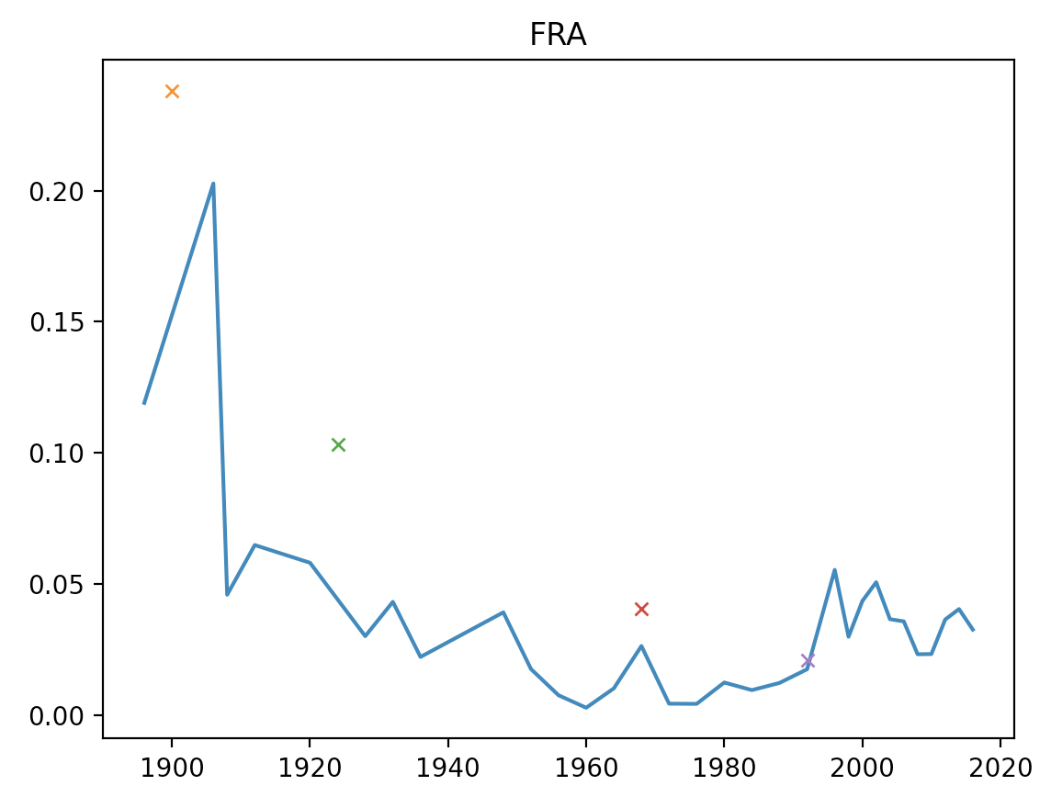
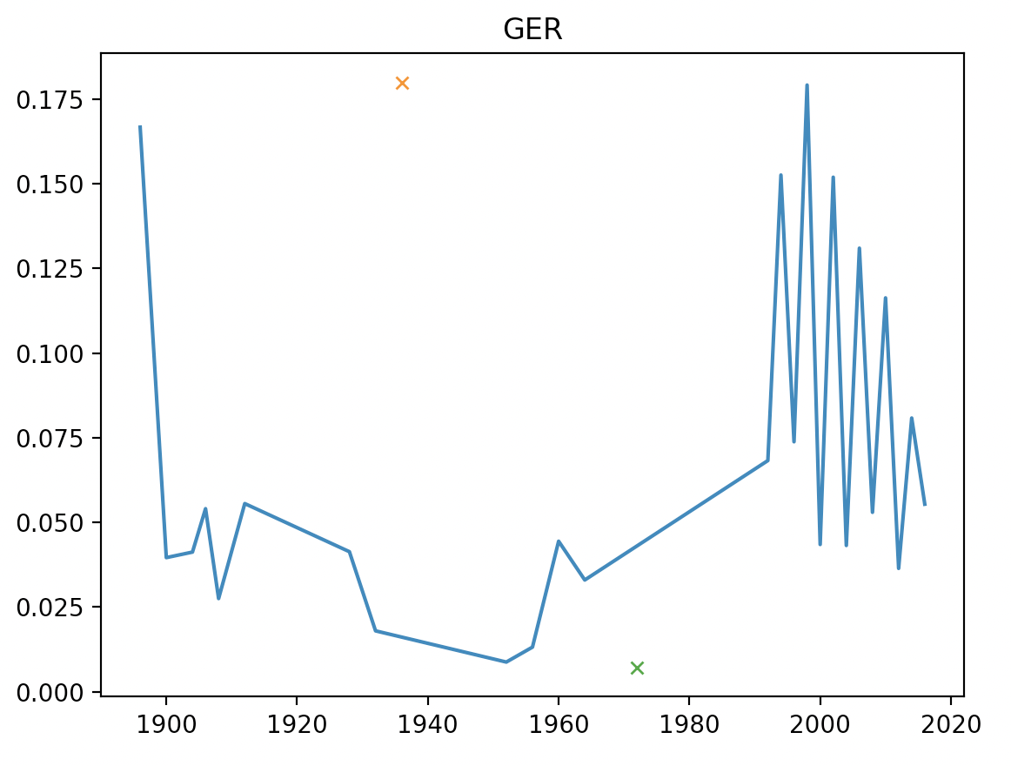
Analyse how being host country affects proportion of medals won
Python code: hostPerformance.py
Takes CSV file and outputs graphs comparing number of medals won when host (crosses) and general trend line
e.g.
France:
Germany:

Slide 3
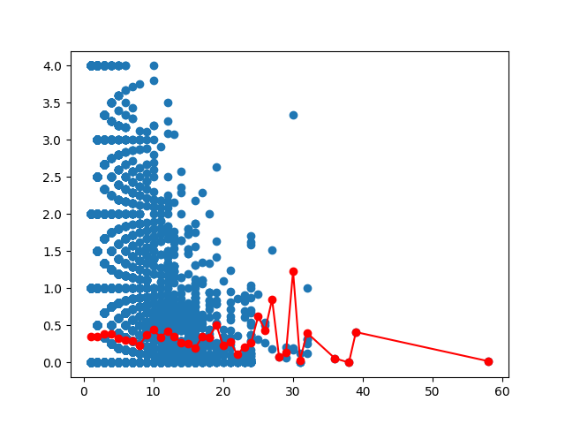
Analyses trends of athlete performance over several games
Output processed by Python, mathplotlib to form graph showing variation in performance
Model: score of 4 for Gold, 2 for Silver and 1 for Bronze
Language interoperation achieved by JSON intermediate

Slide 4
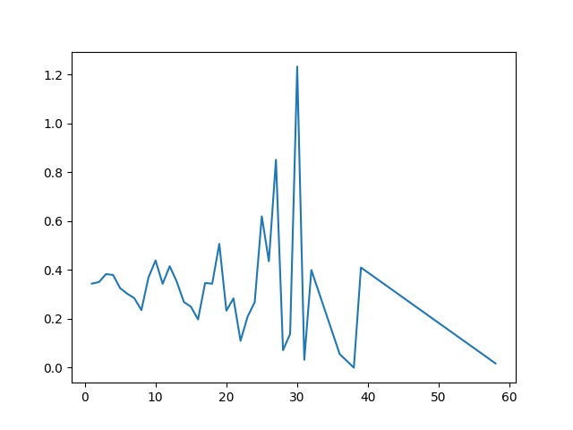
Analysis of countries performance relative to number of athletes sent
Compares performance against number of athletes sent.

Slide 5
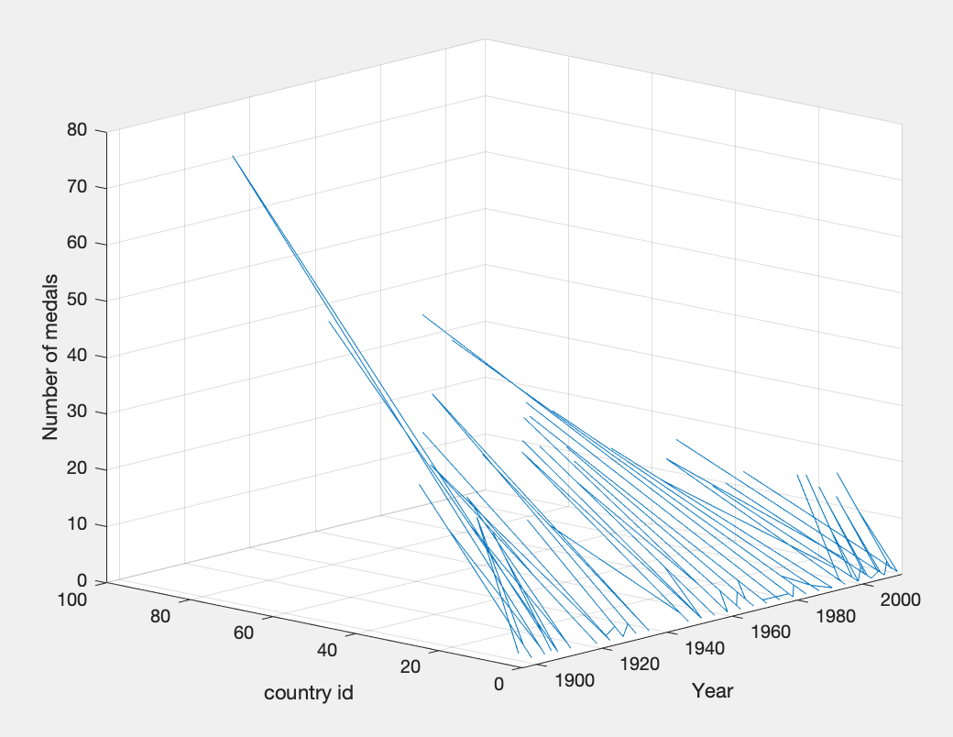
Matlab graphing of each competitors number of medals for each game
Matlabgraph.m

Slide 6
End Q&A

