Slide 1
OMRON HeartGuide
Functions of device
Creepy aspect
Comparison with another technology

Slide 2
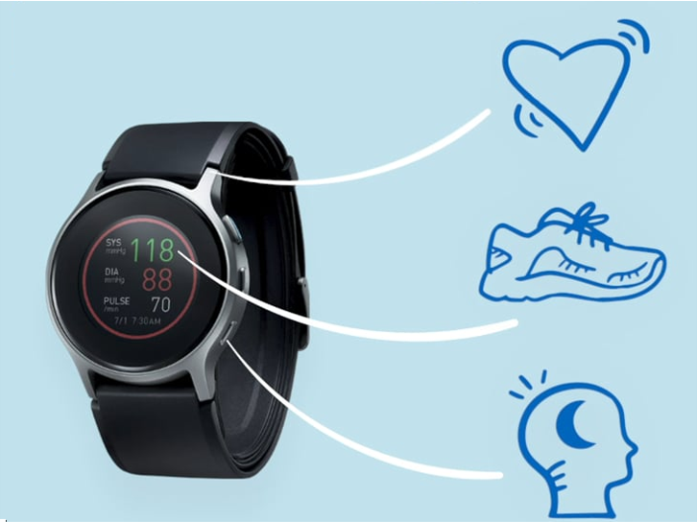
OMRON HeartGuide
Notes:
Quality of our night,
Our training
Blood pressure => medical instrument / tool => usefull even more for elderly

Slide 3
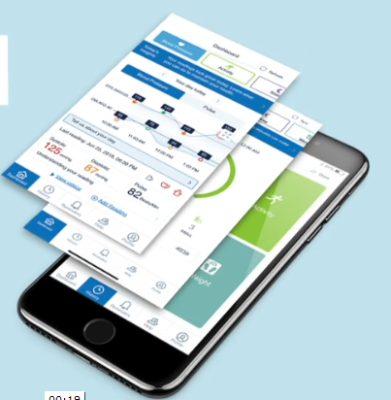
Dangerous point
Notes:
Saving into our phones
Data can be used by Omron
Or kept into our phone, so maybe Samsung can have an accès too

Slide 4
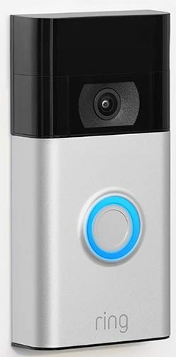
Amazon Ring
Same data creepy point
Notes:
Does the company has still an accès to data after the sell ?

