Slide 1

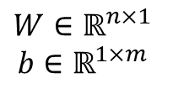
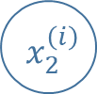


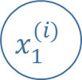

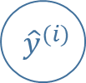

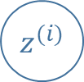


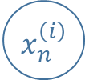


$$x_{1}^{(i)}$$
$$w_{1}$$
$${ x}_{2}^{\left(i\right)}$$
$$b$$
$$w_{2}$$
$$z^{(i)}$$
$$σ( )$$
$${ \hat{y}}^{(i)}$$
$$w_{m}$$
$${ x}_{n}^{\left(i\right)}$$
$$n=12288$$
$$X∈{\left[0, 1\right]}^{n×m}$$
$$W∈ℝ^{n×1}$$
$$b∈ℝ^{1×m}$$
$$Z∈ℝ^{1×m}$$
$$\hat{Y}∈{\left[0, 1\right]}^{1×m}$$

Slide 2
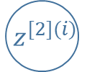


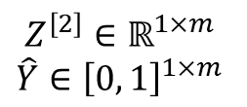
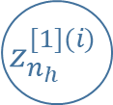
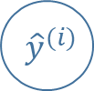

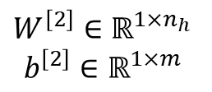
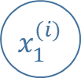


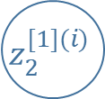
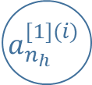
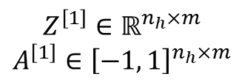
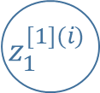


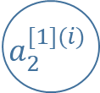

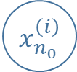
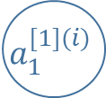

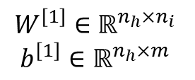
$$W^{[1]}$$
$$b^{[1]}$$
$$W^{[2]}$$
$$x_{1}^{(i)}$$
$$z_{1}^{[1](i)}$$
$$tanh( )$$
$$a_{1}^{[1](i)}$$
$$x_{2}^{\left(i\right)}$$
$$z_{2}^{[1](i)}$$
$$tanh( )$$
$$a_{2}^{[1](i)}$$
$$b^{[2]}$$
$$z^{[2](i)}$$
$$σ( )$$
$${ \hat{y}}^{(i)}$$
$${ x}_{n_{0}}^{\left(i\right)}$$
$$z_{n_{h}}^{[1](i)}$$
$$tanh( )$$
$$a_{n_{h}}^{[1](i)}$$
$$n_{h}∈\left\{1, 2, 3, 4, 5, 10, 15, 20, 30, 50, 100\right\}$$
$$X∈{\left[0, 1\right]}^{n_{0}×m}$$
$$W^{\left[1\right]}∈ℝ^{n_{h}×n_{i}}$$
$$b^{\left[1\right]}∈ℝ^{n_{h}×m}$$
$$Z^{\left[1\right]}∈ℝ^{n_{h}×m}$$
$$A^{\left[1\right]}∈{\left[−1, 1\right]}^{n_{h}×m}$$
$$W^{\left[2\right]}∈ℝ^{1×n_{h}}$$
$$b^{\left[2\right]}∈ℝ^{1×m}$$
$$Z^{\left[2\right]}∈ℝ^{1×m}$$
$$\hat{Y}∈{\left[0, 1\right]}^{1×m}$$

Slide 3



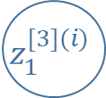




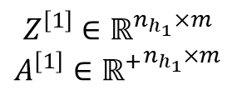
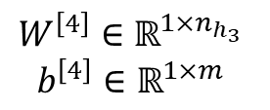
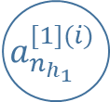


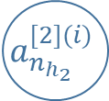



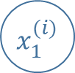


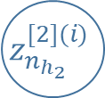
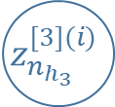
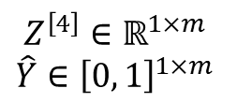
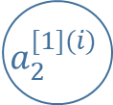



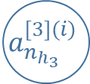
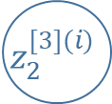

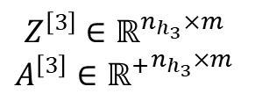
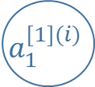

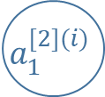
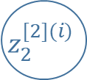

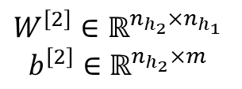
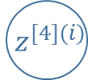
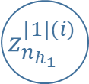


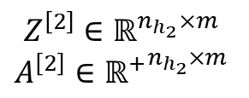
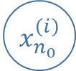





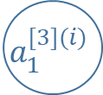

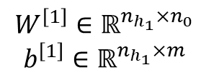

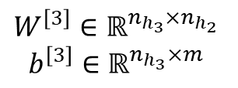
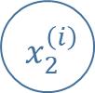
$$W^{[1]}$$
$$b^{[1]}$$
$$W^{[2]}$$
$$b^{[2]}$$
$$W^{[3]}$$
$$b^{[3]}$$
$$W^{[4]}$$
$$x_{1}^{(i)}$$
$$z_{1}^{[1](i)}$$
$$ReLU( )$$
$$a_{1}^{[1](i)}$$
$$z_{1}^{[2](i)}$$
$$ReLU( )$$
$$a_{1}^{[2](i)}$$
$$z_{1}^{[3](i)}$$
$$ReLU( )$$
$$a_{1}^{[3](i)}$$
$$x_{2}^{\left(i\right)}$$
$$z_{2}^{[1](i)}$$
$$ReLU( )$$
$$a_{2}^{[1](i)}$$
$$z_{2}^{[2](i)}$$
$$ReLU( )$$
$$a_{2}^{[2](i)}$$
$$z_{2}^{[3](i)}$$
$$ReLU( )$$
$$a_{2}^{[3](i)}$$
$$b^{[4]}$$
$$z^{[4](i)}$$
$$σ( )$$
$${ \hat{y}}^{(i)}$$
$${ x}_{n_{0}}^{\left(i\right)}$$
$$z_{n_{h_{1}}}^{[1](i)}$$
$$ReLU( )$$
$$a_{n_{h_{1}}}^{[1](i)}$$
$$z_{n_{h_{2}}}^{[2](i)}$$
$$ReLU( )$$
$$a_{n_{h_{2}}}^{[2](i)}$$
$$z_{n_{h_{3}}}^{[3](i)}$$
$$ReLU( )$$
$$a_{n_{h_{3}}}^{[3](i)}$$
$$n_{0}=12288$$
$$n_{h_{1}}=20$$
$$n_{h_{2}}=7$$
$$n_{h_{3}}=5$$
$$X∈{\left[0, 1\right]}^{n_{0}×m}$$
$$W^{\left[1\right]}∈ℝ^{n_{h_{1}}×n_{0}}$$
$$b^{\left[1\right]}∈ℝ^{n_{h_{1}}×m}$$
$$Z^{\left[1\right]}∈ℝ^{n_{h_{1}}×m}$$
$$A^{\left[1\right]}∈{ℝ^{+}}^{n_{h_{1}}×m}$$
$$W^{\left[2\right]}∈ℝ^{n_{h_{2}}×n_{h_{1}}}$$
$$b^{\left[2\right]}∈ℝ^{n_{h_{2}}×m}$$
$$Z^{\left[2\right]}∈ℝ^{n_{h_{2}}×m}$$
$$A^{\left[2\right]}∈{ℝ^{+}}^{n_{h_{2}}×m}$$
$$W^{\left[3\right]}∈ℝ^{n_{h_{3}}×n_{h_{2}}}$$
$$b^{\left[3\right]}∈ℝ^{n_{h_{3}}×m}$$
$$Z^{\left[3\right]}∈ℝ^{n_{h_{3}}×m}$$
$$A^{\left[3\right]}∈{ℝ^{+}}^{n_{h_{3}}×m}$$
$$W^{\left[4\right]}∈ℝ^{1×n_{h_{3}}}$$
$$b^{\left[4\right]}∈ℝ^{1×m}$$
$$Z^{\left[4\right]}∈ℝ^{1×m}$$
$$\hat{Y}∈{\left[0, 1\right]}^{1×m}$$

Slide 4
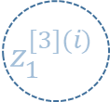

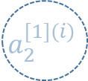
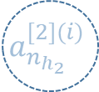

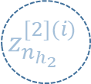

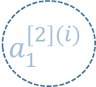




$$W^{[1]}$$
$$b^{[1]}$$
$$W^{[2]}$$
$$b^{[2]}$$
$$W^{[3]}$$
$$b^{[3]}$$
$$W^{[4]}$$
$$x_{1}^{(i)}$$
$$z_{1}^{[1](i)}$$
$$ReLU( )$$
$$a_{1}^{[1](i)}$$
$$z_{1}^{[2](i)}$$
$$ReLU( )$$
$$a_{1}^{[2](i)}$$
$$z_{1}^{[3](i)}$$
$$ReLU( )$$
$$a_{1}^{[3](i)}$$
$$x_{2}^{\left(i\right)}$$
$$z_{2}^{[1](i)}$$
$$ReLU( )$$
$$a_{2}^{[1](i)}$$
$$z_{2}^{[2](i)}$$
$$ReLU( )$$
$$a_{2}^{[2](i)}$$
$$z_{2}^{[3](i)}$$
$$ReLU( )$$
$$a_{2}^{[3](i)}$$
$$b^{[4]}$$
$$z^{[4](i)}$$
$$σ( )$$
$${ \hat{y}}^{(i)}$$
$${ x}_{n_{0}}^{\left(i\right)}$$
$$z_{n_{h_{1}}}^{[1](i)}$$
$$ReLU( )$$
$$a_{n_{h_{1}}}^{[1](i)}$$
$$z_{n_{h_{2}}}^{[2](i)}$$
$$ReLU( )$$
$$a_{n_{h_{2}}}^{[2](i)}$$
$$z_{n_{h_{3}}}^{[3](i)}$$
$$ReLU( )$$
$$a_{n_{h_{3}}}^{[3](i)}$$
$$n_{0}=12288$$
$$n_{h_{1}}=20$$
$$n_{h_{2}}=7$$
$$n_{h_{3}}=5$$
$$X∈{\left[0, 1\right]}^{n_{0}×m}$$
$$W^{\left[1\right]}∈ℝ^{n_{h_{1}}×n_{0}}$$
$$b^{\left[1\right]}∈ℝ^{n_{h_{1}}×m}$$
$$Z^{\left[1\right]}∈ℝ^{n_{h_{1}}×m}$$
$$A^{\left[1\right]}∈{ℝ^{+}}^{n_{h_{1}}×m}$$
$$W^{\left[2\right]}∈ℝ^{n_{h_{2}}×n_{h_{1}}}$$
$$b^{\left[2\right]}∈ℝ^{n_{h_{2}}×m}$$
$$Z^{\left[2\right]}∈ℝ^{n_{h_{2}}×m}$$
$$A^{\left[2\right]}∈{ℝ^{+}}^{n_{h_{2}}×m}$$
$$W^{\left[3\right]}∈ℝ^{n_{h_{3}}×n_{h_{2}}}$$
$$b^{\left[3\right]}∈ℝ^{n_{h_{3}}×m}$$
$$Z^{\left[3\right]}∈ℝ^{n_{h_{3}}×m}$$
$$A^{\left[3\right]}∈{ℝ^{+}}^{n_{h_{3}}×m}$$
$$W^{\left[4\right]}∈ℝ^{1×n_{h_{3}}}$$
$$b^{\left[4\right]}∈ℝ^{1×m}$$
$$Z^{\left[4\right]}∈ℝ^{1×m}$$
$$\hat{Y}∈{\left[0, 1\right]}^{1×m}$$

Slide 5



Layer 1
Compute: $Z^{[1]}$ and $A^{[1]}$
Layer 2
Compute: $Z^{[2]}$ and $A^{[2]}$
Layer L
Compute: $Z^{[L]}$ and $A^{[L]}$
Prediction

Slide 6








Layer 1
Compute: $Z^{[1]}$ and $A^{[1]}$
Save: $Z^{[1]}$
Layer 2
Compute: $Z^{[2]}$ and $A^{[2]}$
Save: $Z^{[2]}$
Layer L
Compute: $Z^{[L]}$ and $A^{[L]}$
Save: $Z^{[L]}$
Update the parameters
Using: $\frac{∂ℒ}{∂W^{[l]}}$, $\frac{∂ℒ}{∂b^{[l]}}$
Cost
Compute: $ℒ\left(A^{[L]}, Y\right)$
Compute: $\frac{∂ℒ}{∂A^{[L]}}$
Layer 1
Using: $Z^{[1]}$, $\frac{∂ℒ}{∂A^{[1]}}$
Compute: $\frac{∂ℒ}{∂W^{[1]}}$, $\frac{∂ℒ}{∂b^{[1]}}$
Save: $\frac{∂ℒ}{∂W^{[1]}}$, $\frac{∂ℒ}{∂b^{[1]}}$
Layer 2
Using: $Z^{[2]}$, $\frac{∂ℒ}{∂A^{[2]}}$
Compute: $\frac{∂ℒ}{∂Z^{[2]}}$, $\frac{∂ℒ}{∂A^{[1]}}$, $\frac{∂ℒ}{∂W^{[2]}}$, $\frac{∂ℒ}{∂b^{[2]}}$
Save: $\frac{∂ℒ}{∂W^{[2]}}$, $\frac{∂ℒ}{∂b^{[2]}}$
Layer L
Using: $Z^{[L]}$, $\frac{∂ℒ}{∂A^{[L]}}$
Compute: $\frac{∂ℒ}{∂Z^{[L]}}$, $\frac{∂ℒ}{∂A^{[L−1]}}$, $\frac{∂ℒ}{∂W^{[L]}}$, $\frac{∂ℒ}{∂b^{[L]}}$
Save: $\frac{∂ℒ}{∂W^{[L]}}$, $\frac{∂ℒ}{∂b^{[L]}}$

