Slide 1

IntelliPark
Justus Beck, Julius Hege, Daniel Schlichting

Slide 2
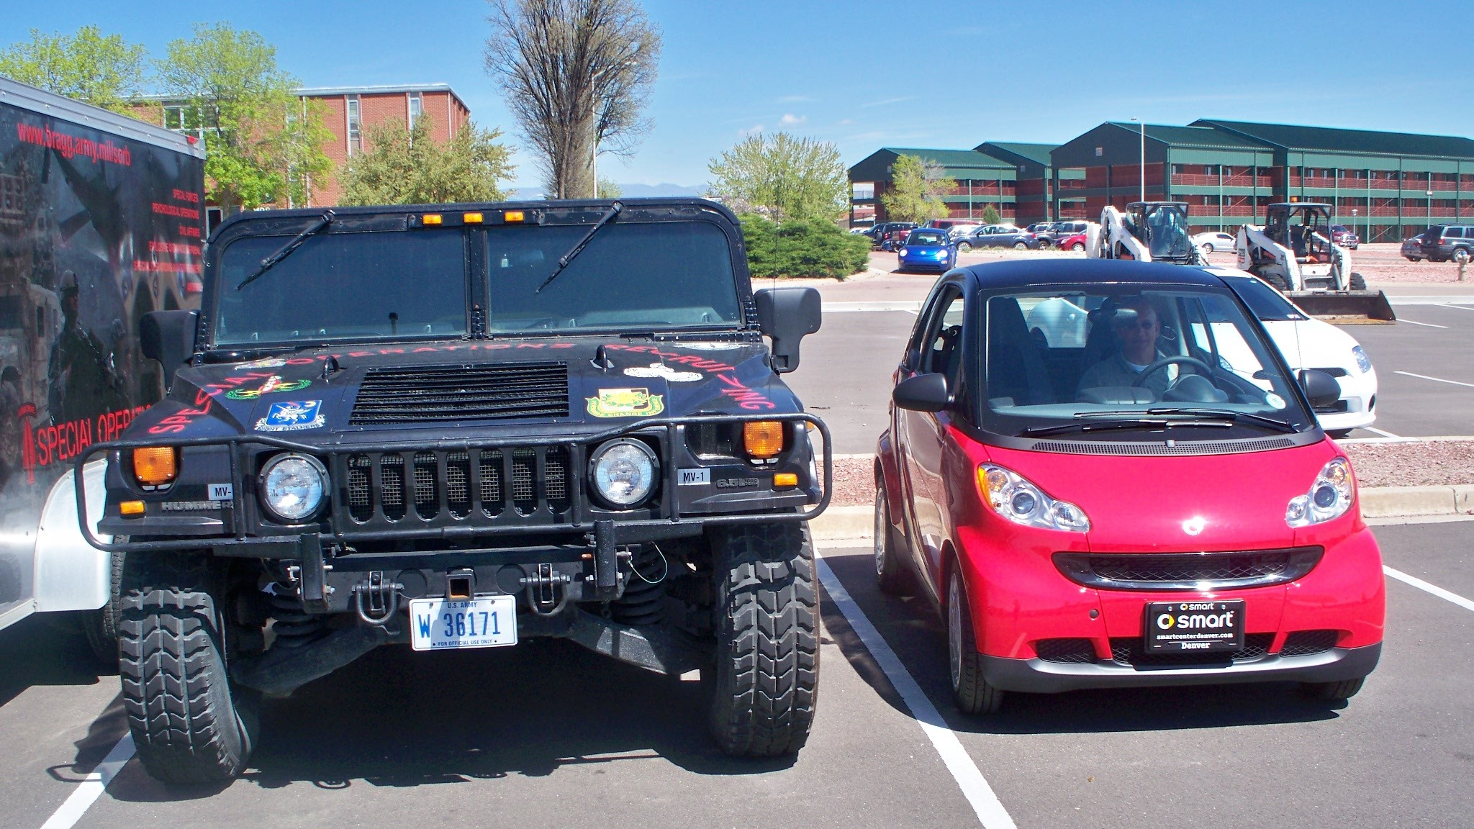

Slide 3
