Slide 1

IntelliPark
Hackaburg 2023
Justus Beck, Julius Hege, Daniel Schlichting

Slide 2
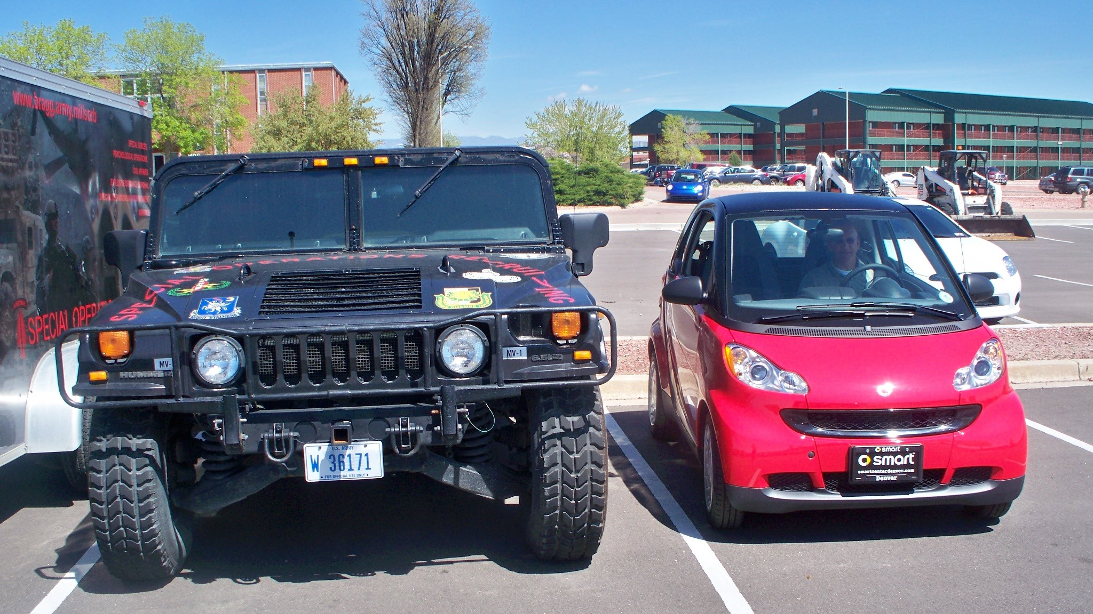

Slide 3
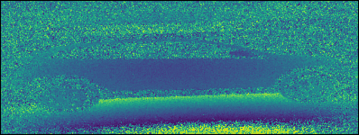

Slide 4
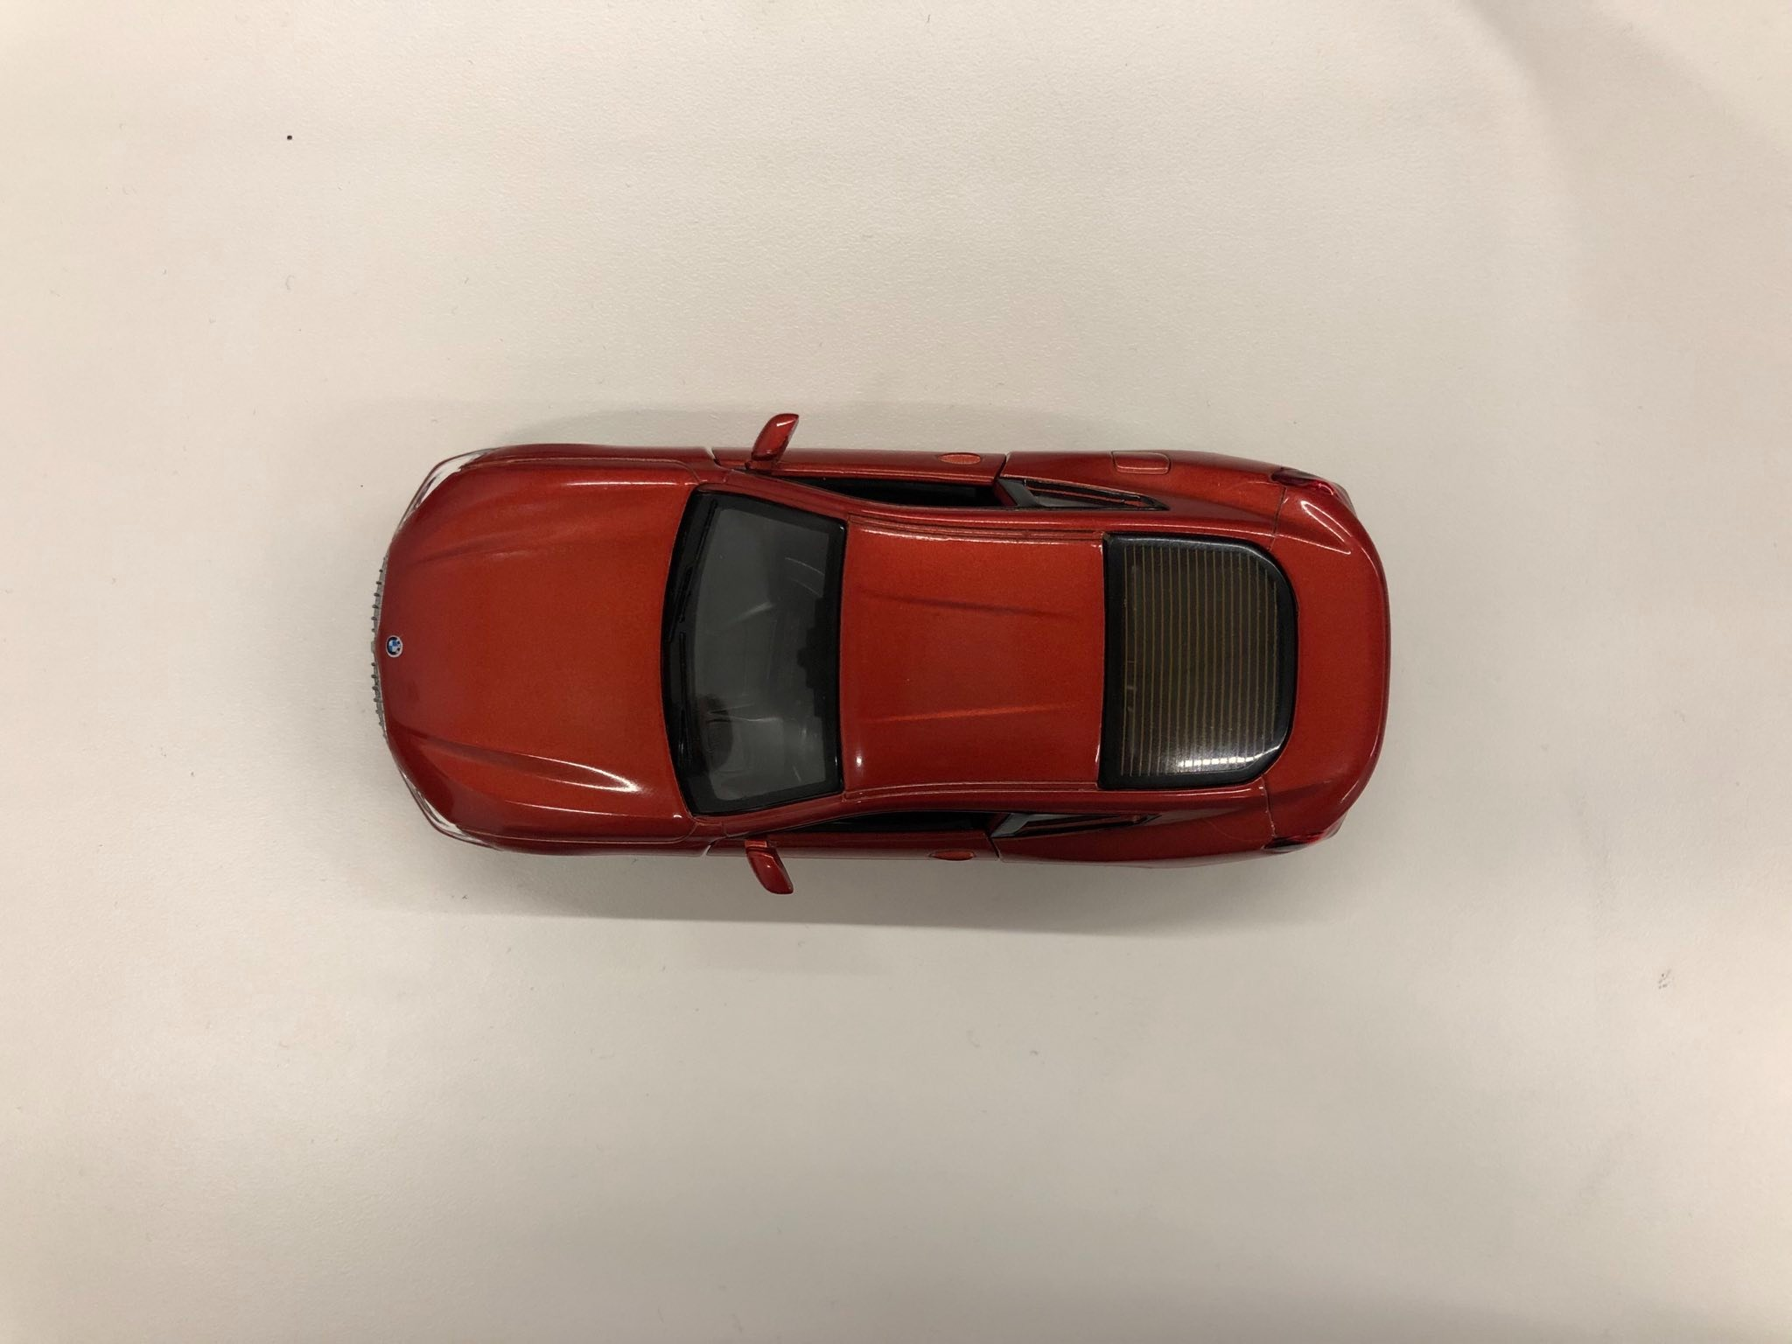

Slide 5
