Slide 1
Evaluation of parallelism techniques on embedded multi-core platforms
Lucas Jenß
Mentor: Prof. Dr. B. Schwarz

Slide 2
Outline
Development Platform
Parallelism Techniques
Pipeline Pattern
Single Instruction – Multiple Data (SIMD)
Google Go for parallelism

Slide 3
The Platform
Xilinx Zynq w/ ARM Cortex-A9

Slide 4
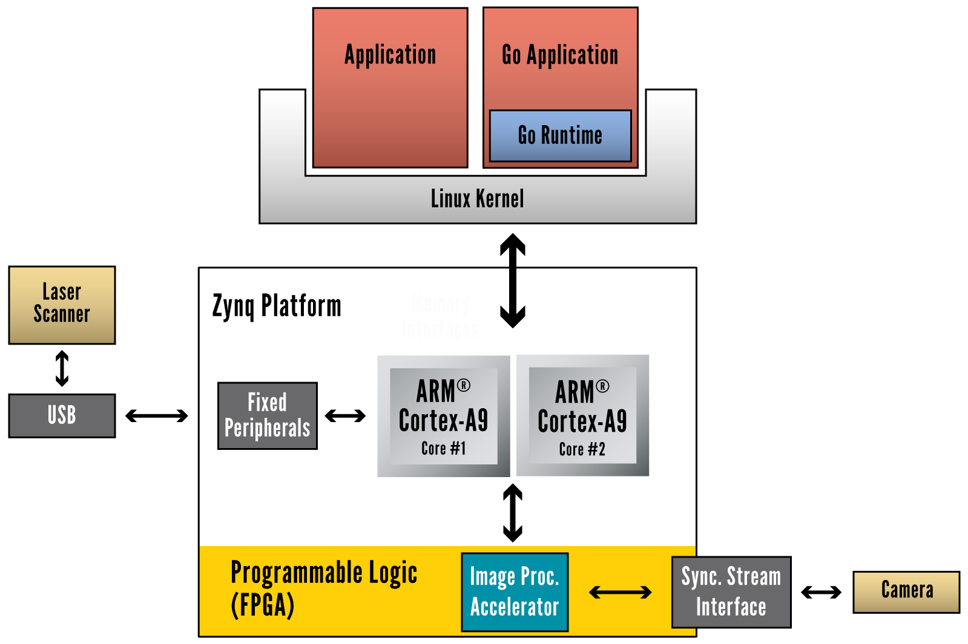
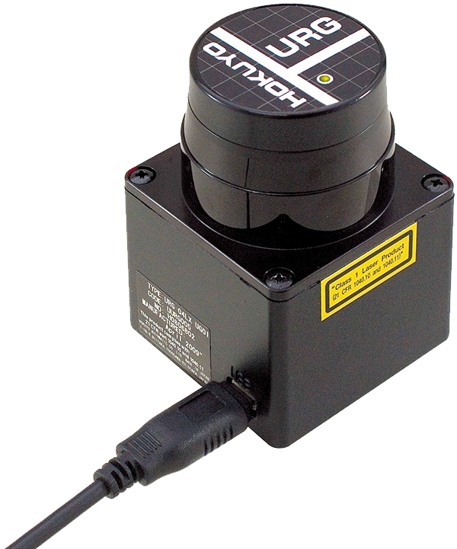
Obstacle Detection
Using Laser scanner
Data rate: ~34KB/s
10Hz scanning freq.
240° in 0.36° steps
Currently implemented with Java on Android OS

Slide 5
Lane Guiding Control
Lane Guiding Control using high FPS camera (60 FPS, 752x40px)
Data rate: ~20MB/s
Implemented using C and FPGA modules, on Linux

Slide 7
Current state: mix of different technologies
Java on Android, C/FPGA on Linux
Goals:
technological unification of the platform
parallelization of tasks to improve performance

Slide 8
Parallelism Techniques
Pipeline pattern

Slide 9
Pipeline Pattern
Analogy: Assembly line (e.g. for a Car)

Slide 10
Pipeline Pattern
Car #1

Slide 11
Pipeline Pattern
Car #2
Car #1

Slide 12
Pipeline Pattern
Car #3
Car #2
Car #1

Slide 13
Pipeline Pattern
All workers
are busy at all times
work on different tasks on different cars
yet all tasks are directly related
Car #3
Car #2
Car #1

Slide 14
Single Instruction – Multiple Data
Using the ARM NEON engine

Slide 15
Single Instruction - Multiple Data
Exploits data-level parallelism
Operations repeatedly applied to independent data

Slide 16
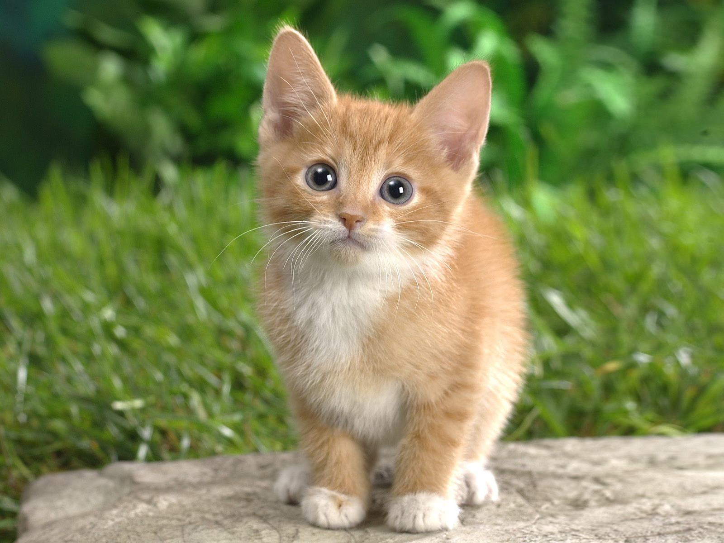
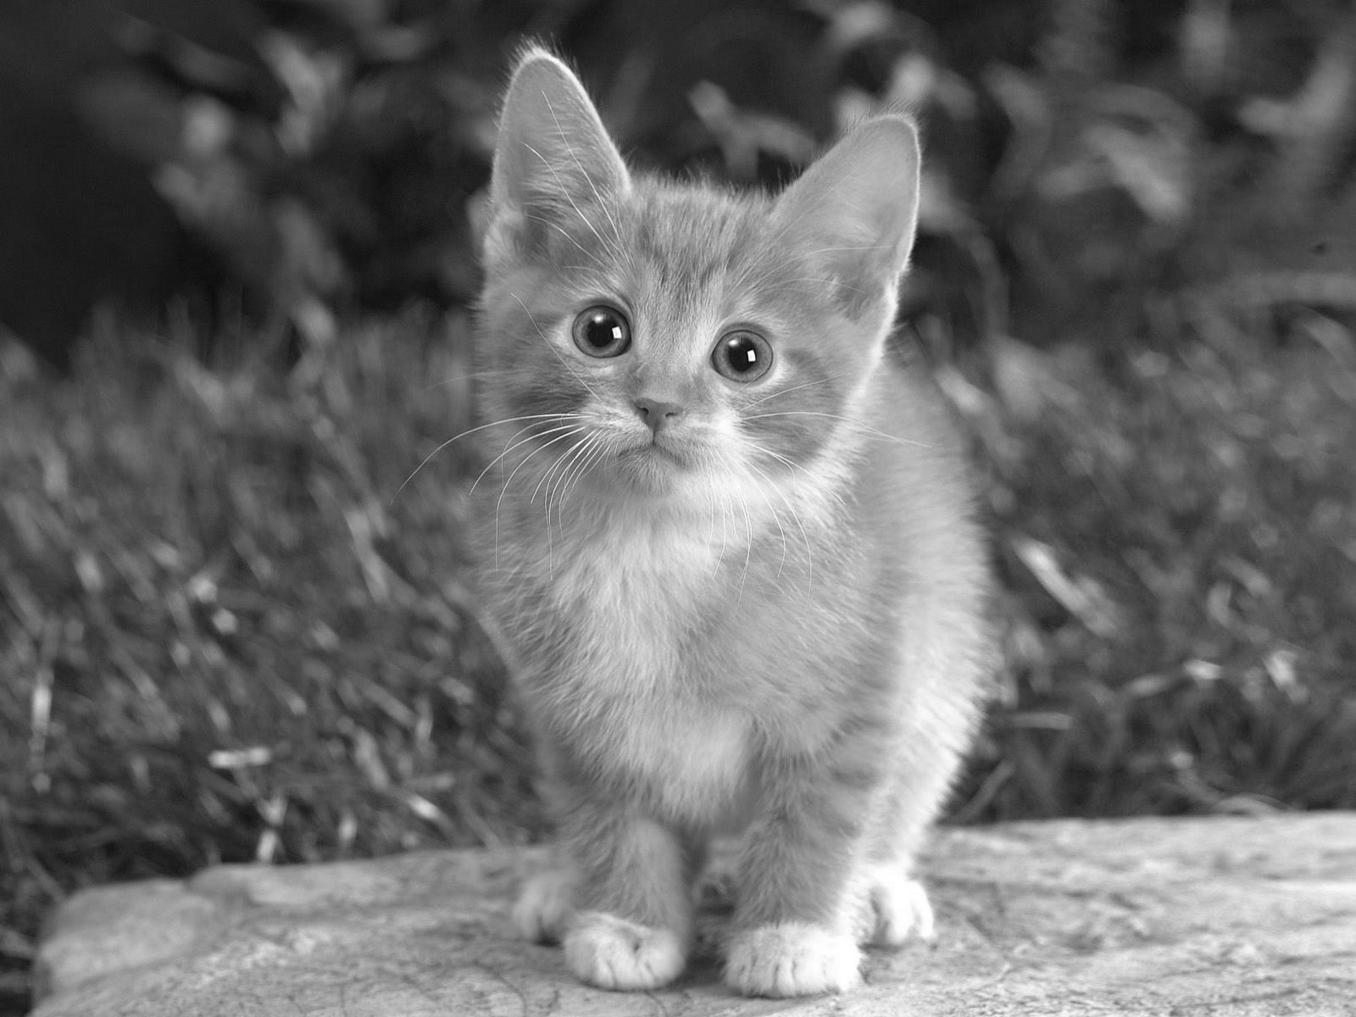
Single Instruction - Multiple Data
Exploits data-level parallelism
Operations repeatedly applied to independent data

Slide 17
Single Instruction – Single data Converting an image to gray scale
Notes:
TODO:
Show each step

Slide 18
Single Instruction – Single data Converting an image to gray scale
void rgb2grey(uint8_t *dest, uint8_t *src, int pixels) { for(int i=0; i < pixels; i++) { uint8_t r = *src++; uint8_t g = *src++; uint8_t b = *src++; uint16_t y = r * (int)(0.2126*256) + g * (int)(0.7152*256) + b * (int)(0.0722*256); *dest++ = (y >> 8); } }
Notes:
TODO:
Multiply
Write back

Slide 19
Single Instruction – Single data Converting an image to gray scale
void rgb2grey(uint8_t *dest, uint8_t *src, int pixels) { for(int i=0; i < pixels; i++) { uint8_t r = *src++; uint8_t g = *src++; uint8_t b = *src++; uint16_t y = r * (int)(0.2126*256) + g * (int)(0.7152*256) + b * (int)(0.0722*256); *dest++ = (y >> 8); } }
Notes:
TODO:
Multiply
Write back

Slide 20
Single Instruction – Single data Converting an image to gray scale
void rgb2grey(uint8_t *dest, uint8_t *src, int pixels) { for(int i=0; i < pixels; i++) { uint8_t r = *src++; uint8_t g = *src++; uint8_t b = *src++; uint16_t y = r * (int)(0.2126*256) + g * (int)(0.7152*256) + b * (int)(0.0722*256); *dest++ = (y >> 8); } }
Notes:
TODO:
Multiply
Write back

Slide 21
Single Instruction – Single data Converting an image to gray scale
void rgb2grey(uint8_t *dest, uint8_t *src, int pixels) { for(int i=0; i < pixels; i++) { uint8_t r = *src++; uint8_t g = *src++; uint8_t b = *src++; uint16_t y = r * (int)(0.2126*256) + g * (int)(0.7152*256) + b * (int)(0.0722*256); *dest++ = (y >> 8); } }
Notes:
TODO:
Multiply
Write back

Slide 22
Single Instruction – Multiple data Converting an image to gray scale
ARM NEON uses special registers
Separate from CPU registers
“Q” and “D”, 128-bit and 64-bit wide
Multiple elements per register
e.g. 8 * 8 bit in “D” register

Slide 23
Single Instruction – Multiple data Converting an image to gray scale
Steps to use SIMD:
Load data into NEON registers
Apply operations
Write data back to memory

Slide 24
Single Instruction – Multiple data Load data into NEON registers

Slide 25
Single Instruction – Multiple data Apply operations
multiply
multiply, accumulate

Slide 26
Single Instruction – Multiple data Converting to gray scale
for(int i=0; i < pixels; i += FACTOR) { uint8x8x3_t rgb = vld3_u8(src); uint16x8_t acc; acc = vmull_u8(rgb.val[0], rcoeff); acc = vmlal_u8(acc, rgb.val[1], gcoeff); acc = vmlal_u8(acc, rgb.val[2], bcoeff); uint8x8_t result = vshrn_n_u16(acc, 8); vst1_u8(dest, result); src += FACTOR; dest += FACTOR; }

Slide 27
Single Instruction – Multiple data Converting to gray scale
for(int i=0; i < pixels; i += FACTOR) { uint8x8x3_t rgb = vld3_u8(src); uint16x8_t acc; acc = vmull_u8(rgb.val[0], rcoeff); acc = vmlal_u8(acc, rgb.val[1], gcoeff); acc = vmlal_u8(acc, rgb.val[2], bcoeff); uint8x8_t result = vshrn_n_u16(acc, 8); vst1_u8(dest, result); src += FACTOR; dest += FACTOR; }
Load (3 Interleaved)

Slide 28
Single Instruction – Multiple data Converting to gray scale
for(int i=0; i < pixels; i += FACTOR) { uint8x8x3_t rgb = vld3_u8(src); uint16x8_t acc; acc = vmull_u8(rgb.val[0], rcoeff); acc = vmlal_u8(acc, rgb.val[1], gcoeff); acc = vmlal_u8(acc, rgb.val[2], bcoeff); uint8x8_t result = vshrn_n_u16(acc, 8); vst1_u8(dest, result); src += FACTOR; dest += FACTOR; }
uint8x8x3_t
Type
# of Elements
# of Registers

Slide 29
Single Instruction – Multiple data Converting to gray scale
for(int i=0; i < pixels; i += FACTOR) { uint8x8x3_t rgb = vld3_u8(src); uint16x8_t acc; acc = vmull_u8(rgb.val[0], rcoeff); acc = vmlal_u8(acc, rgb.val[1], gcoeff); acc = vmlal_u8(acc, rgb.val[2], bcoeff); uint8x8_t result = vshrn_n_u16(acc, 8); vst1_u8(dest, result); src += FACTOR; dest += FACTOR; }
Loads 8bit * 8 * 3 = 192 bit = 24 byte!

Slide 30
Single Instruction – Multiple data Converting to grayscale
for(int i=0; i < pixels; i += FACTOR) { uint8x8x3_t rgb = vld3_u8(src); uint16x8_t acc; acc = vmull_u8(rgb.val[0], rcoeff); acc = vmlal_u8(acc, rgb.val[1], gcoeff); acc = vmlal_u8(acc, rgb.val[2], bcoeff); uint8x8_t result = vshrn_n_u16(acc, 8); vst1_u8(dest, result); src += FACTOR; dest += FACTOR; }
Apply
operations

Slide 31
Single Instruction – Multiple data Converting to grayscale
for(int i=0; i < pixels; i += FACTOR) { uint8x8x3_t rgb = vld3_u8(src); uint16x8_t acc; acc = vmull_u8(rgb.val[0], rcoeff); acc = vmlal_u8(acc, rgb.val[1], gcoeff); acc = vmlal_u8(acc, rgb.val[2], bcoeff); uint8x8_t result = vshrn_n_u16(acc, 8); vst1_u8(dest, result); src += FACTOR; dest += FACTOR; }
Write back to memory

Slide 32
Single Instruction – Multiple data Converting to grayscale
Native C-Version
16 Instructions / Pixel
SIMD Version:
15 Instructions / 8 Pixels
~2 Instructions / Pixel

Slide 33
Google Go
TODO

Slide 34
Evaluation
TODO

Slide 35
The End
Any questions?

