Slide 1

MASTER’S THESIS DEFENSE
Data-Aware Process Simulation
in a Physically Constrained Setting
A Container Terminal Truck Operations Case Study
Jule Grigat
MSc Big Data Management and Analytics · 2025-2026
Supervisor: Prof. Massimiliano de Leoni
Co-supervisors: Marcel Petersen · Prof. Esteban Zimányi
20 min
Notes:
Open with the claim: the thesis tests how far automatic data-aware simulation transfers into a physical logistics setting. Do not promise a validated digital twin.
[Sources]
- Final submitted thesis, title page and abstract.
[/Sources]

Slide 2
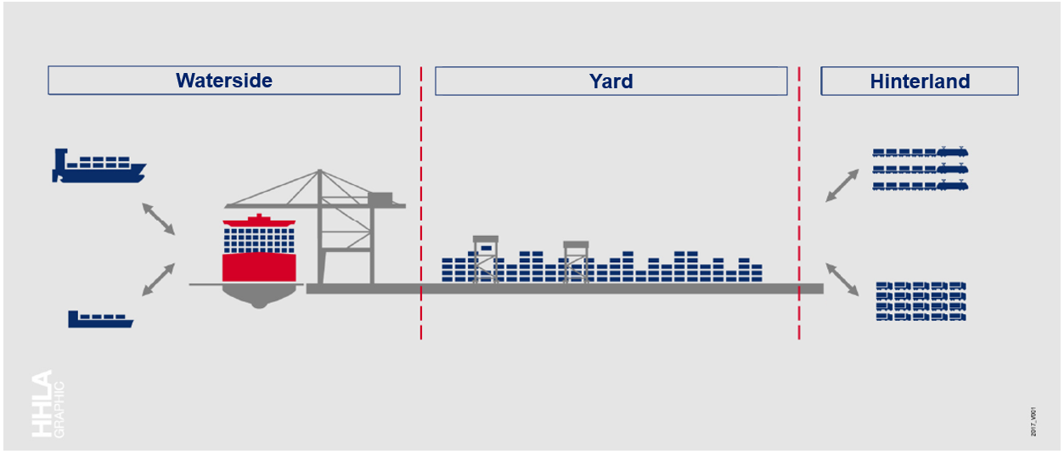
The decision is physical; the data are event-based
1
Sequential visits
One truck cannot perform two yard activities at once.
2
Shared resources
Blocks, handling equipment, calendars and traffic interact.
Operational question
3
Spatial propagation
At what admitted truck rate does modelled delay rise, and what happens when a block is unavailable?
Location and movement determine whether an intervention propagates to delay.
Jule Grigat · Master’s Thesis Defense
02
Notes:
Link the use case to management decisions: gate staffing and truck-slot availability influence admitted arrivals, while construction or mechanical failure can remove a block. The data record events, not the full physical state that propagates those decisions.
[Sources]
- Final thesis, Sections 1.1-1.3, 2.1 and 4.1.
- Terminal overview image inherited from the source defense deck.
[/Sources]

Slide 3
The question is not ‘can it run?’ but ‘what can we trust?’
How far can an event-log-discovered CTB simulator be trusted for history, process structure and operational interventions?
RQ1
RQ2
RQ3-RQ4
Historical fidelity
Physical structure
Intervention adequacy
Does the simulator reproduce a later, untouched operating period?
Does the Petri net satisfy the expert-validated truck-visit contract?
Do added state and parameter changes contain the mechanism required by the question?
Historical fit, physical admissibility and intervention response are separate claims.
Jule Grigat · Master’s Thesis Defense
03
Notes:
Explain the layered audit. Historical fidelity is necessary, but a model can fit the past and still be unable to propagate a demand or resource intervention. That distinction organizes the whole defense.
[Sources]
- Final thesis, Sections 1.3-1.4 and Chapter 6.
[/Sources]

Slide 4
A 64/16/20 split separates selection from final testing
64
16
80
20
Discovery
Validation
Rediscovery
Final test
→
→
→
57,254 cases
four configurations
parameters learned
14,314 cases
pre-specified rule
selects reference
71,568 cases
selected configuration
refitted once
17,892 cases
10 seeds (42-51)
untouched period
Selection uses validation only. The final 20% test remains untouched until one historical-fidelity evaluation.
Jule Grigat · Master’s Thesis Defense
04
Notes:
The outer 80/20 temporal hold-out follows the original design. The first 80% is split chronologically again into 64% discovery and 16% validation. The selected historical configuration is then rediscovered on the full 80% development period and evaluated once on the untouched test.
[Sources]
- Final thesis, Sections 4.3 and 5.1.
[/Sources]

Slide 5
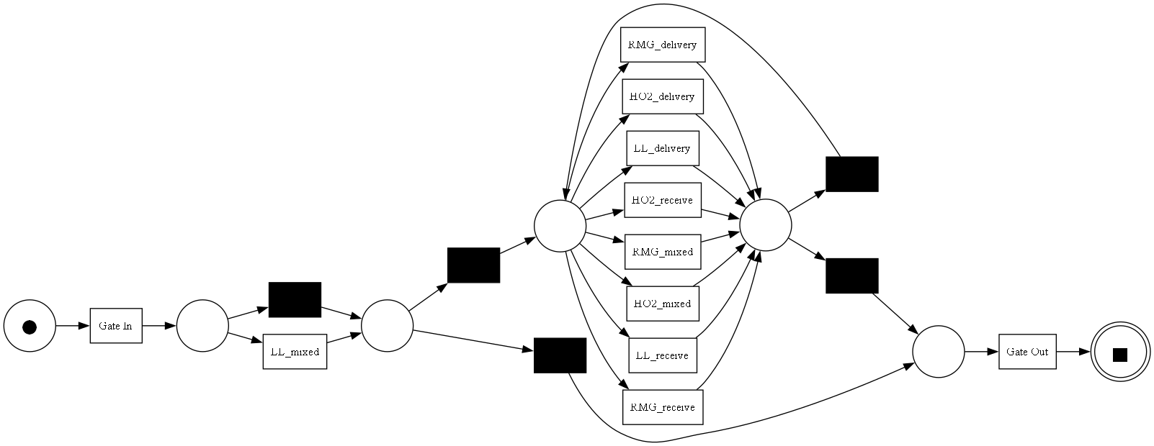
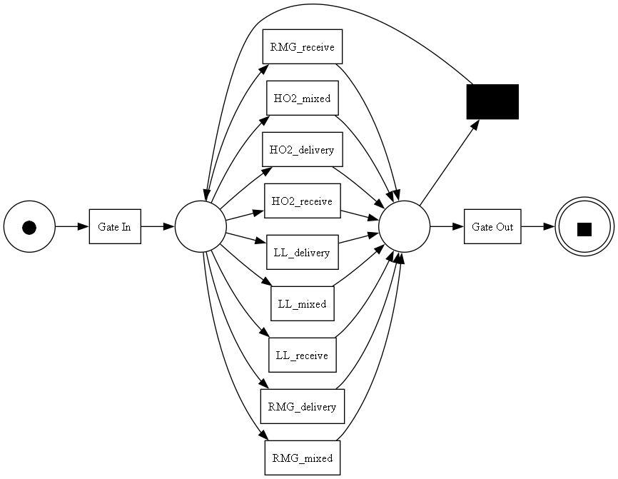
Expert repair makes the process model admissible
1.0000
final-test fitness
0.7641
final-test precision
0.9488
final-test generalisation
Every visit: Gate In, at least one sequential yard activity, Gate Out
Jule Grigat · Master’s Thesis Defense
05
Notes:
The raw 64% Inductive-Miner tree contains three parallel cuts and a gate-only bypass. Experts confirmed that one truck is sequential, every visit has Gate In and Gate Out, at least one yard activity, and arbitrary yard orders and repetitions. The transparent repair is fixed before validation and shared by all four configurations.
[Sources]
- Final thesis, Sections 4.4 and 5.2, Table 5.2 and Figure 4.3.
- Local figure: figures/discovery/petri_net_inductive.png.
[/Sources]

Slide 6
A 2 × 2 design isolates two workload-information sources
00
10
01
11
visit-only
static-only
native-only
both
static proxies: off
native state: off
factorial reference
static proxies: on
native state: off
manual workload
static proxies: off
native state: on
dynamic workload
static proxies: on
native state: on
combined state
Same repaired Petri net, depth 3, split, runner and seeds. Four complementary errors are compared on validation.
Jule Grigat · Master’s Thesis Defense
06
Notes:
The design separates manual demand and utilisation proxies from ProSiT's native workload and queue state. Visit and process attributes remain active in every cell. This is a controlled feature-source experiment, not ad-hoc model shopping.
[Sources]
- Final thesis, Sections 4.5 and 4.5.2.
[/Sources]

Slide 7
Added workload state does not improve validation fidelity
Metric
Range across four cells
9.149-9.253
What the validation shows
Turnaround EMD
1
No resolved gain
Weighted service EMD
1.715-1.773
Every paired 95% interval includes zero.
2
Added state is used
Activity-rate L1
0.1285-0.1305
Trees retain static splits and one queue-length split.
3-gram NGD
0.04857-0.04915
3
Historical reference
The pre-specified rule selects parsimonious visit-only.
Jule Grigat · Master’s Thesis Defense
07
Notes:
The four cells are very close. Static-only is slightly worse on all four criteria. Both has the lowest weighted service EMD, but not the other measures. All paired seed intervals include zero, so no added-state model passes the pre-specified replacement rule. This is not an equivalence proof.
[Sources]
- Final thesis, Section 5.3.2 and Table 5.5.
[/Sources]

Slide 8
Historical fidelity is local, not end-to-end
The rediscovered visit-only reference gives three different fidelity answers on the untouched test.
0.0724 min
2.341 min
6.159 min
Inter-arrival EMD
Weighted yard-service EMD
Turnaround EMD
Arrival spacing is reproduced closely.
Common yard activities are reproduced moderately.
The complete visit remains systematically biased.
Interpretation
Close arrivals and service components do not guarantee accurate full turnaround.
Jule Grigat · Master’s Thesis Defense
08
Notes:
This is the central RQ1 result. Arrival spacing is very close and weighted service error is moderate, but case-turnaround EMD is much larger. Distances already compare real and simulated distributions, so they do not have a separate real value.
[Sources]
- Final thesis, Section 5.3.1 and Table 5.3.
[/Sources]

Slide 9
The historical model still underestimates complete visits
-5.930 min
mean turnaround difference
-14.92% versus the final test
-13.100 min
P90 turnaround difference
-18.45% at the 90th percentile
Narrow Monte-Carlo intervals rule out run noise; they do not validate the model.
Jule Grigat · Master’s Thesis Defense
09
Notes:
The real mean is 39.742 minutes and the simulated mean is 33.812. P90 is 71 versus 57.9. The stable deficit is present across the distribution, not only in a few extreme cases. About 41% of the mean deficit coincides with a later-period slowdown; the remainder is already present relative to development-period conditions.
[Sources]
- Final thesis, Sections 5.3.1 and 5.4, Table 5.3 and Figure 5.1.
[/Sources]

Slide 10
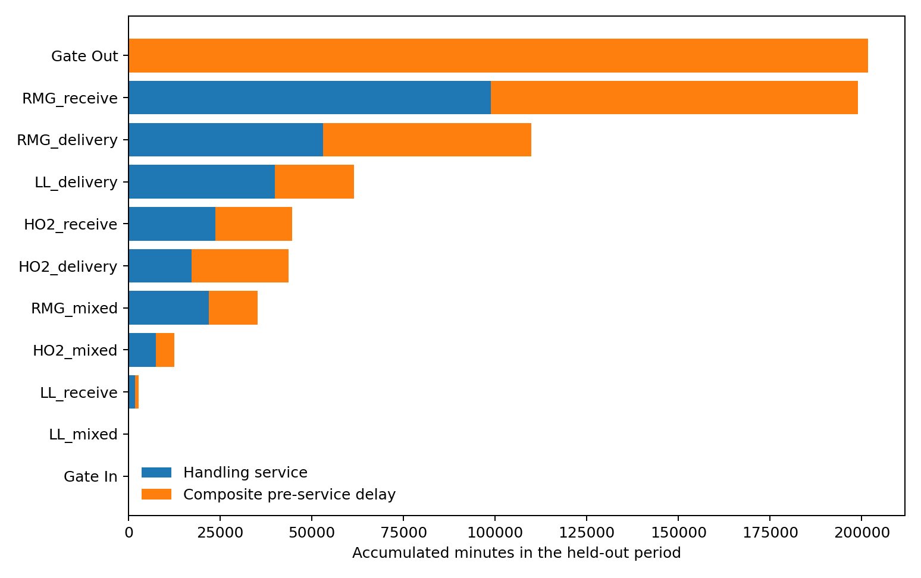
Most observed turnaround lies outside recorded handling
39.742 min
real mean turnaround
14.755 min
recorded handling
24.987 min
composite pre-service
Gate Out is the largest gap; RMG receive contributes 27.99% of total time burden.
Jule Grigat · Master’s Thesis Defense
10
Notes:
The log has start and complete timestamps but no physical enablement or queue-entry timestamp. In the sequential net, ProSiT enables the next activity at the previous completion. Start minus enabled is therefore a composite pre-service delay that can contain movement, traffic, dispatching and waiting. The plot identifies where time accumulates, not a causal queue.
[Sources]
- Final thesis, Sections 5.3.2, 5.8 and 5.9, Figure 5.2.
- Local figure: figures/results_bottleneck_time_burden.png.
[/Sources]

Slide 11
Historical fidelity and intervention adequacy assign different roles
Historical reference: visit-only
Demand mechanism probe: native-only
✓
same repaired Petri net
—
native workload + queue state
✓
selected on 16% validation
—
same cap-three resources
≠
✓
rediscovered on 80%
role
—
tests arrival-to-delay pathway
✓
reported once on final test
—
not a validated CTB forecast
A model can reproduce history yet be structurally unable to respond to an intervention.
Jule Grigat · Master’s Thesis Defense
11
Notes:
Visit-only is the historical-fidelity reference because no added state improves the validation criteria. It is workload-blind and therefore also a negative control for demand. Native-only is used only as the minimal tested bundle with an endogenous state pathway. It is a mechanism probe, not a second globally selected best model.
[Sources]
- Final thesis, Sections 4.5.3, 5.10 and 5.10.6.
[/Sources]

Slide 12
T22 closes in the model, but only as a resource-pool test
-0.70
0.00
+0.70
Intervention check
Mean turnaround
-0.030 [-0.168, +0.107]
T22: 0
eligible assignments after closure
P90 turnaround
+0.100 [-0.428, +0.628]
What the experiment means
Mean RMG pre-service
-0.093 [-0.146, -0.040]
Work is reassigned within one interchangeable pool. Container location, relocation and added travel are absent.
Only RMG pre-service excludes zero.
Jule Grigat · Master’s Thesis Defense
12
Notes:
T22 is removed from every eligible RMG pool and its calendar is closed. The intervention executes exactly, but the remaining labels are interchangeable. The model cannot represent where the container is, relocation work or added travel. The result is therefore a resource-configurability test, not a forecast of a physical block closure.
[Sources]
- Final thesis, Section 5.10.1 and Table 5.11.
[/Sources]

Slide 13
+20% working-time demand remains below the model response region
-0.40
0.00
+0.40
Intervention check
Mean turnaround
-0.087 [-0.281, +0.106]
+20.0%
configured intensity; +15.910% per elapsed hour
Mean RMG service
+0.049 [-0.041, +0.140]
Diagnostic result
Mean RMG pre-service
-0.062 [-0.139, +0.014]
Arrivals update native state, but the change does not reach a resolved handling or turnaround response.
All primary paired intervals include zero.
Jule Grigat · Master’s Thesis Defense
13
Notes:
The configured working-time intensity rises exactly 20%, while the elapsed-hour rate rises 15.910% because closed periods remain fixed. Mean turnaround and RMG pre-service do not change significantly. This does not show that the terminal can absorb 20% more demand; it only shows that this intervention remains below the fitted model's response region.
[Sources]
- Final thesis, Sections 5.10.2 and 5.10.4, Table 5.12.
[/Sources]

Slide 14
Native workload responds only at much higher demand
2.37-2.83x
first resolved response interval
+1.815 min
turnaround at 2.825x realised rate
+2.318 min
RMG pre-service at 2.825x
Visit-only remains invariant. The response is a fitted-model transition, not a CTB capacity threshold.
Jule Grigat · Master’s Thesis Defense
14
Notes:
The same six-level ladder is run for visit-only and native-only with matched seeds. Native-only first shows a resolved end-to-end response between realised rate ratios 2.367 and 2.825. A retained T13 queue-length split at 6.5 routes more cases into a high-delay leaf. This is an inspectable statistical pathway, not a causal queueing law or a physical CTB threshold.
[Sources]
- Final thesis, Section 5.10.5 and Table 5.14.
- Local figure: figures/results_demand_saturation_ladder.png.
[/Sources]

Slide 15
The contribution is a layered audit of where automation stops
1
Control flow
2
Historical fidelity
3
Intervention validity
The repaired sequential Petri net fits the final test. Raw discovery alone is not physically admissible.
Arrivals and service partly transfer, while mean turnaround remains 5.930 minutes too short.
Demand needs endogenous state. T22 needs spatial state. Neither response is yet a physical forecast.
Data-aware simulation is an auditable diagnostic.
Decision-valid logistics simulation needs intervention-specific state and validation.
Questions
Jule Grigat · Master’s Thesis Defense
15
Notes:
Close with the scientific contribution: a reproducible method that separates control-flow conformance, historical stochastic fidelity, expert physical constraints and intervention adequacy. The thesis does not claim a decision-valid digital twin. It shows how to determine what an automatically generated simulator can and cannot support.
[Sources]
- Final thesis, Chapter 6.
[/Sources]

Slide 16
APPENDIX
Research questions and final answers
RQ1
Historical fidelity
Partial: arrivals and yard service transfer better than complete turnaround.
RQ2
Process structure
Expert-repaired net: fitness 1.0, precision 0.7641, sequential case contract satisfied.
RQ3
State sources
No added state gives a resolved multi-perspective validation improvement.
RQ4
What-if decision support
Interventions execute, but physical counterfactual validity is not established.
Jule Grigat · Master’s Thesis Defense
16
Notes:
Use this appendix as a direct one-slide answer if the committee asks for the four RQs together.
[Sources]
- Final thesis, Chapter 6.
[/Sources]

Slide 17
APPENDIX
What exactly is represented - and excluded?
89,460
275,408
2 months
retained one-RMG truck visits
activity events
continuous CTB data
Case semantics
Scope and timestamp boundary
Gate In
→
1+ yard activities
→
Gate Out
1,693 multi-RMG visits (6,820 events) are excluded. No physical enablement, queue-entry or movement timestamp is observed.
A case is one truck visit. ITS schedule order is authoritative; start and complete are observed.
Jule Grigat · Master’s Thesis Defense
17
Notes:
The case representation is intentionally one truck visit with one RMG target context. Multi-RMG visits are excluded because the case-level state cannot attach multiple changing blocks to one visit. This is a clear scope boundary, not a cleaning accident.
[Sources]
- Final thesis, Sections 3.2-3.6 and Chapter 6.
[/Sources]

Slide 18
APPENDIX
Why 64/16/20 and ten seeds?
1
64% discovery
2
16% validation
57,254 early cases discover four configurations without future-period leakage.
14,314 later cases apply the pre-specified historical-fidelity selection rule.
3
80% rediscovery
4
20% final test + 10 seeds
The selected visit-only reference is refitted on 71,568 development cases.
17,892 untouched cases; seeds 42-51 quantify conditional Monte-Carlo variation.
Matched-seed scenario intervals exclude discovery, period and structural uncertainty.
Jule Grigat · Master’s Thesis Defense
18
Notes:
The 64/16 split is the chronological 80/20 subdivision of the original 80% development period. It is not claimed as a universal optimum. It preserves the untouched outer test while providing a separate selection period.
[Sources]
- Final thesis, Sections 4.3 and 4.6.
[/Sources]

Slide 19
APPENDIX
How to interpret the validation metrics
EMD / Wasserstein
Average distributional shift in the metric’s units; lower is better.
KS statistic
Maximum CDF separation; lower is better, but it has no time unit.
Fitness
Can the model replay observed traces? High fitness does not imply precise timing.
Precision
How much extra behaviour does the model allow? Lower precision can reflect deliberate generalisation.
Activity-rate L1
Absolute mismatch in yard-activity incidence per case; lower is better.
3-gram NGD
Frequency distance between real and simulated local three-activity sequences; lower is better.
Jule Grigat · Master’s Thesis Defense
19
Notes:
EMD, L1 and NGD are already distances between real and simulated logs. Three-grams are long enough to include local predecessor-current-successor context while remaining supported in a process with few activities and many variants.
[Sources]
- Final thesis, Sections 2.7.2 and 4.6.
[/Sources]

Slide 20
APPENDIX
Control-flow evidence: fitness is not the whole argument
1.0000
0.7641
0.9488
held-out fitness
held-out precision
held-out generalisation
Why precision below one is acceptable
Why expert repair is necessary
Experts allow arbitrary sequential yard combinations and repetitions. The domain forbids truck concurrency, not unseen orderings.
The raw 64% tree has three parallel cuts and a gate-only bypass. Both are removed transparently before validation and parameter discovery.
Jule Grigat · Master’s Thesis Defense
20
Notes:
Fitness alone is insufficient. Precision reflects the deliberately broad sequential loop. The repair is justified by the expert contract and fixed before all configuration comparisons.
[Sources]
- Final thesis, Sections 4.4, 5.2 and 5.2.1, Table 5.2.
[/Sources]

Slide 21
APPENDIX
Full validation screening: visit / static / native / both
Metric
Values: v | s | n | b
Interpretation
Turnaround EMD (min)
9.149 | 9.163 | 9.253 | 9.173
lower is better
Weighted service EMD (min)
1.735 | 1.760 | 1.773 | 1.715
lower is better
Activity-rate L1
0.1285 | 0.1305 | 0.1291 | 0.1305
lower is better
3-gram NGD
0.04857 | 0.04915 | 0.04863 | 0.04884
lower is better
Paired comparison
all paired 95% intervals include zero
no resolved gain
Retained rules
static variables and queue_length retained
state is used locally
Historical reference
visit-only
pre-specified selection
Inferential scope
not tested as equivalence
small differences remain unresolved
Selection rule: replace visit-only only for resolved improvement without resolved deterioration elsewhere.
Jule Grigat · Master’s Thesis Defense
21
Notes:
Read values left to right as visit-only, static-only, native-only and both. The first four rows are the primary validation criteria. The remaining rows record the inferential and interpretive result.
[Sources]
- Final thesis, Section 5.3.2 and Table 5.5.
[/Sources]

Slide 22
APPENDIX
Scenario details: paired changes and intervals
A · T22 resource-pool reallocation
B · +20% working-time demand
Mean turnaround
-0.030 [-0.168, +0.107]
Working arrival rate
+20.000% (configured)
P90 turnaround
+0.100 [-0.428, +0.628]
Elapsed-hour arrivals
+15.910% elapsed-hour rate
Mean RMG service
+0.006 [-0.053, +0.066]
Mean turnaround
-0.087 [-0.281, +0.106]
Mean RMG pre-service
-0.093 [-0.146, -0.040]
Mean RMG service
+0.049 [-0.041, +0.140]
Delivery pre-service
-0.128 [-0.265, +0.009]
Mean RMG pre-service
-0.062 [-0.139, +0.014]
T22 assignments
eligible assignments after scenario: 0
Delivery pre-service
-0.099 [-0.234, +0.037]
Intervals show matched-seed variation conditional on the frozen native-only bundle.
Jule Grigat · Master’s Thesis Defense
22
Notes:
This appendix gives the exact paired scenario values. Pre-service is model-derived start minus structural enablement, not measured physical queueing.
[Sources]
- Final thesis, Tables 5.11 and 5.12.
[/Sources]

Slide 23
APPENDIX
Demand-saturation ladder: native-only response
Realised rate ratio
Turnaround Δ [95% CI]
RMG pre-service Δ [95% CI]
1.000
reference
reference
1.159
-0.087 [-0.281, +0.106]
-0.062 [-0.139, +0.014]
1.378
+0.045 [-0.102, +0.191]
-0.073 [-0.116, -0.029]
2.367
+0.082 [-0.101, +0.266]
+0.026 [-0.155, +0.207]
2.825
+1.815 [+0.858, +2.772]
+2.318 [+1.132, +3.504]
3.504
+4.069 [+3.743, +4.396]
+5.221 [+4.878, +5.563]
Mechanism
T13 queue_length <= 6.5
7.167 vs 52.404 min leaves
Interpretation
internal fitted response
not a physical threshold
Visit-only is the workload-blind negative control and remains effectively invariant.
Jule Grigat · Master’s Thesis Defense
23
Notes:
The first resolved end-to-end response is between realised ratios 2.367 and 2.825. The T13 split explains the internal non-linearity. The fixed-case-count design also changes calendar exposure and horizon effects, so the transition region is not a pure resource-saturation estimate.
[Sources]
- Final thesis, Section 5.10.5 and Table 5.14.
[/Sources]

Slide 24
The handover separates inspection from exact execution
ProSiT JSON
PORTABLE
1
Human-inspectable rules, distributions, capacities and calendars through the official interface.
Frozen pickle bundle
AUTHORITY
2
Exact post-calibration SimulatorParameters object used for the reported numerical runs.
Click-run notebooks
REPEAT
3
Local and Colab notebooks load the Petri net and bundles, run seeds and compare thesis KPIs.
Jule Grigat · Master’s Thesis Defense
24
Notes:
JSON is kept for portable inspection through ProSiT's official serializer. The frozen pickle is the authoritative numerical snapshot because it preserves the exact post-calibration in-memory state. A round-trip audit documents the difference for the CTB bundles.
[Sources]
- Final thesis, Appendix A.2.
[/Sources]

Slide 25
APPENDIX
Threats to validity—and the path forward
Current boundary
Required extension
One terminal and one two-month period
Repeat discovery across seasons and terminals
1
1
No observed queue, readiness or movement timestamps
Add trajectory, queue-entry and physical readiness events
2
2
One-RMG case scope excludes multi-block visits
Use object-centric state and a hybrid physical simulator
3
3
Mechanism audit and stress response are exploratory
Validate candidate policies prospectively against operations
4
4
Jule Grigat · Master’s Thesis Defense
25
Notes:
The next research step is not another arbitrary feature combination. It is richer observability and representation: object-centric multi-container state, movement and queues, then external and prospective intervention validation.
[Sources]
- Final thesis, Section 5.11 and Section 6.1.
[/Sources]

Slide 26
APPENDIX
Likely examiner questions: concise answers
Why not a random split?
It would mix the later-period shift into training and test, overstating transfer.
Why use two model roles?
Visit-only is the selected historical reference; native-only is the minimal demand-pathway probe.
Does near-perfect fitness prove validity?
No. It proves replay capability; timing and physical mechanisms require separate tests.
Is the demand transition a CTB capacity threshold?
No. It is a fitted-model response under compressed arrivals and fixed case count.
Can the T22 result guide a real block closure?
No. The model reallocates labels without container location, relocation or added travel.
What is the main contribution?
A layered, reproducible audit separating historical fit, physical admissibility and intervention adequacy.
Jule Grigat · Master’s Thesis Defense
26
Notes:
Answer directly, then support with one result or limitation. The safest recurring distinction is between a model-internal response and a physically validated terminal effect.
[Sources]
- Final thesis, Chapters 5 and 6.
[/Sources]

