Slide 1


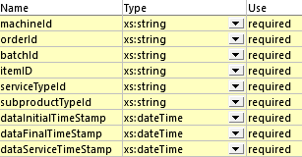




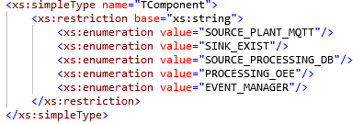

Component List Meta-Model

Slide 2
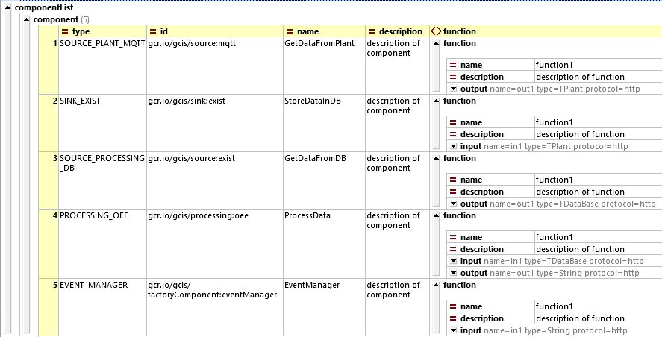
Listado de los componentes de nuestra Fábrica

Slide 3
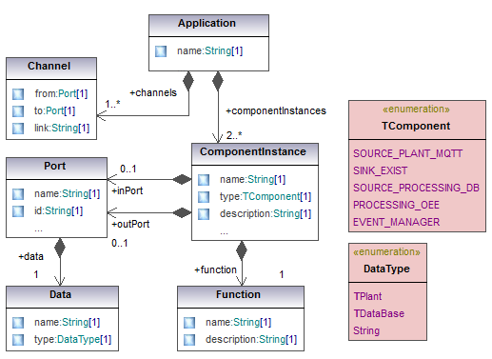
Application UML MM

Slide 4

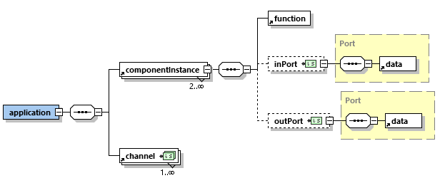




Application XML Schema

Slide 5

Application 1: Data acquisition

Slide 6

Application 2: Data processing

