Slide 1
codedeck
Stack the odds in your favor.

Slide 2
Team Members
John Desrosiers
Julie Ching
Philip Ma
Teddy Hidalgo

Slide 3
Project Description
Interested in learning code? Overwhelmed by the amount of information to learn? We got a tool for you! Blending the old with new, an interactive educational flash card. Try us out and let us know!

Slide 4
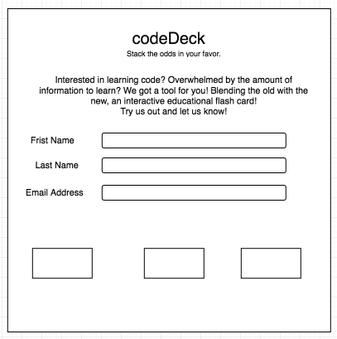
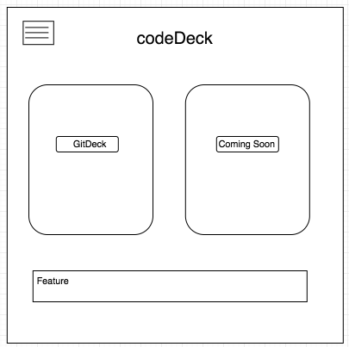
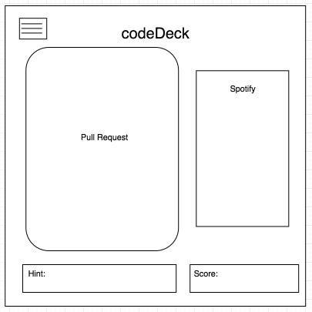
Sketch of Final Product

Slide 5
APIs to be Used
Spotify
Quizlet
Stormpath/Google sign-in/Firebase

Slide 6
Rough Breakdown of Tasks
UI/UX
HTML (Philip)
CSS (Julie)
FE Dev (JS/AJAX)
Quizlet (John)
Spotify (Teddy)
Authentication (Julie/Teddy)
QA
Julie
Project Management
Julie

