Slide 1
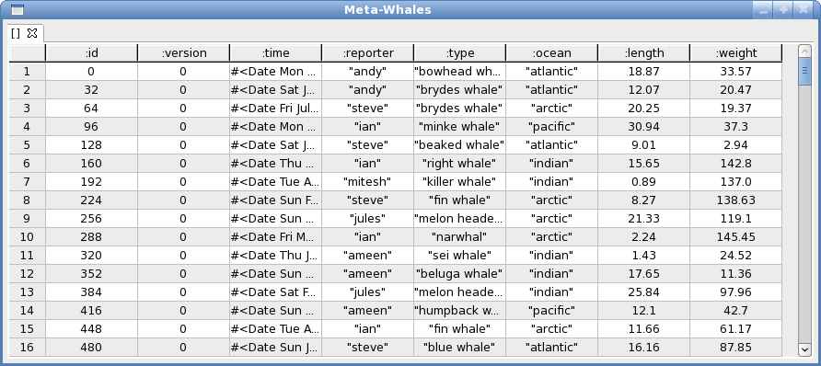
all whales
(? (dfrom "Whales"))

Slide 2
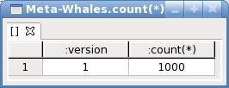
count all whales
(? (dcount)(dfrom "Whales"))

Slide 3
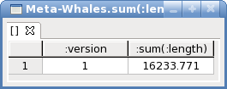
sum length of all whales
(? (dsum :length)(dfrom "Whales"))

Slide 4
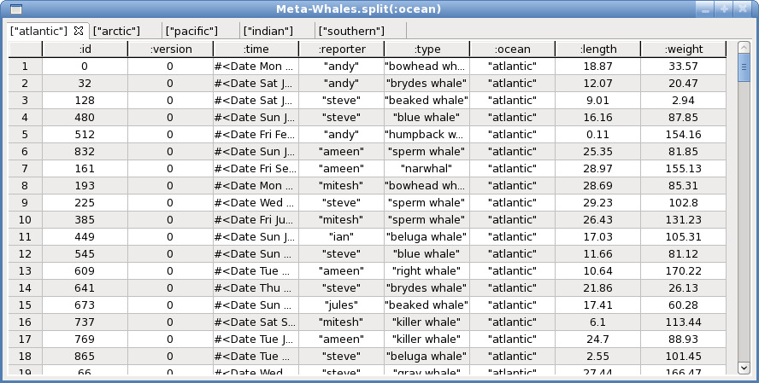
split by ocean
(? (dsplit :ocean)(dfrom "Whales"))

Slide 5
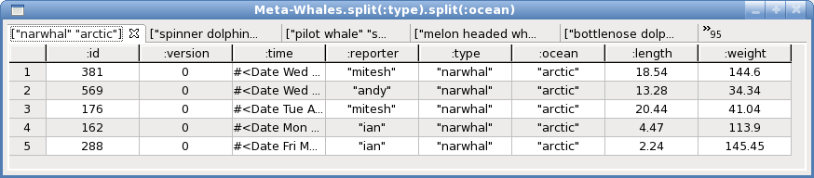
flat split by type then ocean
(? (dsplit :ocean)(dsplit :type)(dfrom "Whales"))

Slide 6
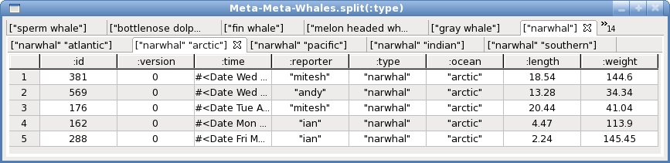
nested split by type then ocean
(? (dsplit :type list [(dsplit :ocean)])(dfrom "Whales"))

Slide 7

sum weights per ocean
(? (dsum :weight)(dsplit :ocean)(dfrom "Whales"))

Slide 8
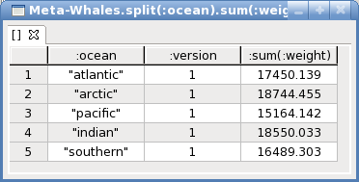
summarise weights per ocean
(? (dunion)(dsum :weight)(dsplit :ocean)(dfrom "Whales"))

Slide 9
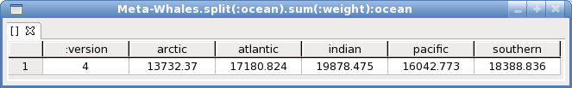
pivot weights per ocean summary
(?
(dpivot :ocean
["arctic" "atlantic" "indian" "pacific" "southern"]
(keyword "sum(:weight)"))
(dsum :weight)
(dsplit :ocean)
(dfrom "Whales"))

Slide 10
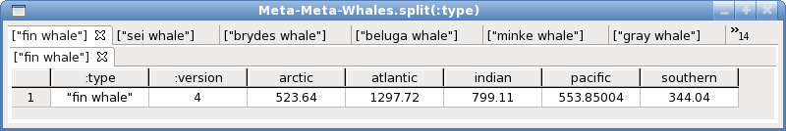
for each type - pivot weights per ocean summary
(?
(dsplit
:type
list
[(dpivot :ocean ["arctic" "atlantic" "indian" "pacific" "southern"] (keyword "sum(:weight)"))
(dsum :weight)
(dsplit :ocean)])
(dfrom "Whales"))

