Slide 1
Developing via Testing & Debugging
You know, those error messages can be pretty handy…
Terri J. Brandt
Slides adapted from Dan Starr and Paul Ivanov.

Slide 2
Verify that it works!
“Hey, it works!”
Who said that?
Can we create a system where a programmer can tell the user how to verify that the code works for them?
“You know, those error messages are pretty handy!”

Slide 3


Errors, Exceptions,
and Traceback, oh my!

Slide 4
Errors, Exceptions,
and Traceback, oh my!
Syntax Errors:
Caught by Python parser, prior to execution
arrow marks the last parsed command / syntax, which gave an error
In [1]: while True print 'Hello world'
File "<ipython-input-1-f4b9dbd125c8>", line 1
while True print 'Hello world'
^
SyntaxError: invalid syntax
Exceptions:
Caught during runtime
In [2]: (1/0)
---------------------------------------------------------------------------
ZeroDivisionError Traceback (most recent call last)
<ipython-input-1-de3693740b15> in <module>()
----> 1 (1/0)
ZeroDivisionError: integer division or modulo by zero

Slide 5
Errors, Exceptions, and Traceback, oh my!
Traceback module provides utilities to render python Traceback objects.
Allows a program to:
Catch an exception within a try/except statement
Print the traceback, and
Continue running
File: tryexcept1.py
import traceback
def example1():
try:
raise SyntaxError, "example"
except:
traceback.print_exc()
print "...still running..."
In [1]: import tryexcept1
In [2]: tryexcept1.example()
---------------------------------------------------------------------------
AttributeError Traceback (most recent call last)
<ipython-input-2-e4dc9ead3b7a> in <module>()
----> 1 tryexcept1.example()
AttributeError: 'module' object has no attribute 'example’

Slide 6
Errors, Exceptions, and Traceback, oh my!
Traceback module provides utilities to render python Traceback objects.
Access Traceback’s elements (filename, line number, function name, text):
File: tryexcept1.py
def example2():
""" Access the (filename, etc) of each Traceback stack element.
"""
try:
raise SyntaxError
except:
stack_list = traceback.extract_stack()
for (filename, linenum, functionname, text) in stack_list:
print "%s:%d %s()" % (filename, linenum, functionname)
print "...still running..."

Slide 7
Errors, Exceptions, and Traceback, oh my!
try:
raise SyntaxError
except:
stack_list = traceback.extract_stack()
for (filename, linenum, functionname, text) in stack_list:
print "%s:%d %s()" % (filename, linenum, functionname)
print "...still running..."
In [3]: tryexcept1.example2()
/opt/local/bin/ipython:7 <module>()
/opt/local/Library/Frameworks/Python.framework/Versions/2.7/lib/python2.7/site-packages/IPython/frontend/terminal/ipapp.py:389 launch_new_instance()
/opt/local/Library/Frameworks/Python.framework/Versions/2.7/lib/python2.7/site-packages/IPython/frontend/terminal/ipapp.py:363 start()
/opt/local/Library/Frameworks/Python.framework/Versions/2.7/lib/python2.7/site-packages/IPython/frontend/terminal/interactiveshell.py:467 mainloop()
/opt/local/Library/Frameworks/Python.framework/Versions/2.7/lib/python2.7/site-packages/IPython/frontend/terminal/interactiveshell.py:586 interact()
/opt/local/Library/Frameworks/Python.framework/Versions/2.7/lib/python2.7/site-packages/IPython/core/interactiveshell.py:2617 run_cell()
/opt/local/Library/Frameworks/Python.framework/Versions/2.7/lib/python2.7/site-packages/IPython/core/interactiveshell.py:2696 run_ast_nodes()
/opt/local/Library/Frameworks/Python.framework/Versions/2.7/lib/python2.7/site-packages/IPython/core/interactiveshell.py:2746 run_code()
<ipython-input-3-5564eee6dc6a>:1 <module>()
tryexcept1.py:16 example2()
...still running…

Slide 8
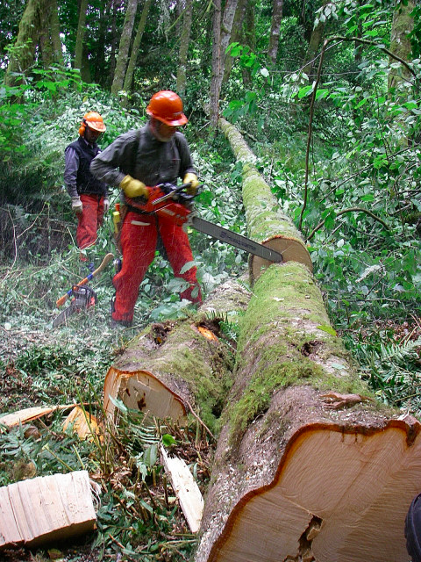

Plus logging!
Fancier debug w print statements piped to log file.
Chop code up into segments with log statements…
…and then record in .log file for later comprehension.

Slide 9
Plus logging!
Logging is useful when:
Recording non-fatal errors
e.g.: Tracebacks caught with try/except statements
Varying error/warning severity levels are needed
Generating high volumes of diagnostic output
Recording errors separately from standard I/O print statements
File: loggin1.py
import logging
LOG_FILENAME = 'loggin1.log'
logging.basicConfig(filename=LOG_FILENAME,level=logging.WARNING)
def make_logs():
logging.debug('This is a debug message')
logging.warning('This is a warning message')
logging.error('This is an error message')
Log Levels:
NOTSET = 0
DEBUG = 10
INFO = 20
WARN = 30
WARNING = 30
ERROR = 40
CRITICAL = 50
FATAL = 50
In [1]: import loggin1
In [2]: loggin1.make_logs()
$ cat loggin1.log
WARNING:root:This is a warning message
ERROR:root:This is an error message

Slide 10
Plus logging!
File: loggin2.py
Using time-stamps and formatting:
Log Levels:
NOTSET = 0
DEBUG = 10
INFO = 20
WARN = 30
WARNING = 30
ERROR = 40
CRITICAL = 50
FATAL = 50
import logging
logger = logging.getLogger("some_identifier")
logger.setLevel(logging.INFO)
ch = logging.StreamHandler()
ch.stream = open("loggin2.log", 'w')
formatter = logging.Formatter("%(asctime)s - %(name)s - %(levelname)s - %(message)s")
ch.setFormatter(formatter)
logger.addHandler(ch)
def make_logs():
logger.info("This is an info message")
logger.debug("This is a debug message")
logger.warning("This is a warning message")
logger.error("This is an error message")

Slide 11
Plus logging!
import logging
logger = logging.getLogger("some_identifier")
logger.setLevel(logging.INFO)
ch = logging.StreamHandler()
ch.stream = open("loggin2.log", 'w')
formatter = logging.Formatter("%(asctime)s - %(name)s - %(levelname)s - %(message)s")
ch.setFormatter(formatter)
logger.addHandler(ch)
def make_logs():
logger.info("This is an info message")
logger.debug("This is a debug message")
logger.warning("This is a warning message")
logger.error("This is an error message")
In [1]: import loggin2
In [2]: loggin2.make_logs()
$ cat loggin2.log
2013-06-14 00:28:23,193 - some_identifier - INFO - This is an info message
2013-06-14 00:28:23,193 - some_identifier - WARNING - This is a warning message
2013-06-14 00:28:23,194 - some_identifier - ERROR - This is an error message

Slide 12

Assert
Use assert for error catching statements.
Assert statements can be disabled with:
optimize flags: python -O or
system environment variable: PYTHONOPTIMIZE
File: my_assertions.py
def do_string_stuff(val):
assert type(val) == type("")
print ">" + val + "< length:", len(val)
In [1]: import my_assertions
In [2]: my_assertions.do_string_stuff('cats')
>cats< length: 4
In [3]: my_assertions.do_string_stuff(3.14)
---------------------------------------------------------------------------
AssertionError Traceback (most recent call last)
<ipython-input-3-a5be41a03ad1> in <module>()
----> 1 my_assertions.do_string_stuff(3.14)
12_Testing/my_assertions.pyc in do_string_stuff(val)
1 def do_string_stuff(val):
----> 2 assert type(val) == type("")
3 print ">" + val + "< length:", len(val)
4
5 def do_string_stuff_better(val):
AssertionError

Slide 13

Assert
Use assert for error statements.
^more informative!
File: my_assertions.py
def do_string_stuff_better(val):
val_type = type(val)
assert val_type == type(""), "Given a %s" % (str(val_type))
print ">" + val + "< length:", len(val)
In [4]: my_assertions.do_string_stuff_better(3.14)
---------------------------------------------------------------------------
AssertionError Traceback (most recent call last)
<ipython-input-4-9bc23bc081fe> in <module>()
----> 1 my_assertions.do_string_stuff_better(3.14)
/Users/tjbrand1/TerrisStuff/pythonLearning/bootcamp/python-bootcamp/Lectures/12_Testing/12_Testing/my_assertions.pyc in do_string_stuff_better(val)
5 def do_string_stuff_better(val):
6 val_type = type(val)
----> 7 assert val_type == type(""), "Given a %s" % (str(val_type))
8 print ">" + val + "< length:", len(val)
9
AssertionError: Given a <type 'float'>
here
Is the
problem!

Slide 14
Python Testing Tools & Packages
A test tool searches directories for modules and files which either:
have filenames which are identified for testing use
(generally by using a “Test” or “test” substring)
or files which contain classes and functions which match a substring identifier or regular expression
Unit testing software evaluates the identified files’ and modules’ testing functions and assert statements.
A tool such as “nose” summarizes which tests passed or failed.
Several tools and frameworks interface with other projects to provide additional diagnostic tools such as:
a debugger (pdb)
coverage: how much of the source code is used when executed
Several older testing tools are still used (often in other tools):
unittest, pyUnit
Modern testing tools:
nose, py.test
Focus on the “nose” tool due to its breadth and popularity.

Slide 15
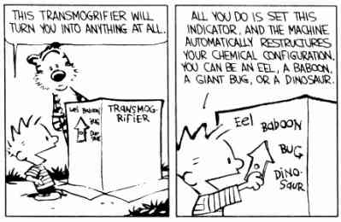
A simple nose testing example:
Transmogrify! thing1 into thing2…
File: example1/nose_example1.py
class Transmogrifier:
""" An important class
"""
def transmogrify(self, person):
""" Transmogrify someone
"""
transmog = {'calvin':'tiger',
'hobbes':'chicken'}
new_person = transmog[person]
return new_person
def test_transmogrify():
TM = Transmogrifier()
for p in ['Calvin', 'Hobbes']:
assert TM.transmogrify(p) != None

Slide 16
Nose:
Examines all files (except executables) for functions named with “test” or “Test”, matching REGEXP: ((?:^|[\b_\.-])[Tt]est).
File: example1/nose_example1.py
class Transmogrifier:
""" An important class
"""
def transmogrify(self, person):
""" Transmogrify someone
"""
transmog = {'calvin':'tiger',
'hobbes':'chicken'}
new_person = transmog[person]
return new_person
def test_transmogrify():
TM = Transmogrifier()
for p in ['Calvin', 'Hobbes']:
assert TM.transmogrify(p) != None
Finds:
test_transmogrify()
Test_transmogrify()
Testtransmogrify()
Transmogrify_test()
Does not find:
transmogrifyTest()
sometest()

Slide 17
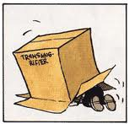
Nose:
?
File: example1/nose_example1.py
class Transmogrifier:
""" An important class
"""
def transmogrify(self, person):
""" Transmogrify someone
"""
transmog = {'calvin':'tiger',
'hobbes':'chicken'}
new_person = transmog[person]
return new_person
def test_transmogrify():
TM = Transmogrifier()
for p in ['Calvin', 'Hobbes']:
assert TM.transmogrify(p) != None
$ cd example1/
$ nosetests-2.7 --all-modules
E
================================================
ERROR: nose_example1.test_transmogrify
----------------------------------------------------------------------
Traceback (most recent call last):
File "/opt/…/lib/…/nose/case.py", line 197, in runTest
self.test(*self.arg)
File "/Users/…/nose_example1.py", line 19, in test_transmogrify
assert TM.transmogrify(p) != None
File "/Users/…/nose_example1.py", line 12, in transmogrify
new_person = transmog[person]
KeyError: 'Calvin’
----------------------------------------------------------------------
Ran 1 test in 0.012s
FAILED (errors=1)

Slide 18
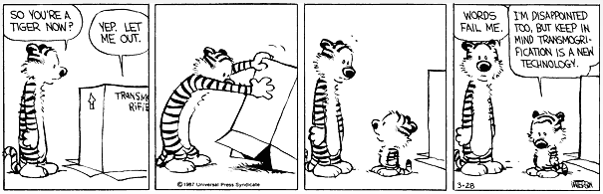
Nose:
?
File: example1/nose_example1.py
class Transmogrifier:
""" An important class
"""
def transmogrify(self, person):
""" Transmogrify someone
"""
transmog = {'calvin':'tiger',
'hobbes':'chicken'}
new_person = transmog[person.lower()]
return new_person
def test_transmogrify():
TM = Transmogrifier()
for p in ['Calvin', 'Hobbes']:
assert TM.transmogrify(p) != None
$ nosetests-2.7 nose_example1_fixed1.py
.
---------------------------------------------------------------
Ran 1 test in 0.001s
OK

Slide 19
Says who?
Doctests:
The doctest module:
scans through all docstrings in a module
executes any line starting with a ‘>>>’
compares the actual output with the docstring expectation
File: doctests_example.py
def multiply(a, b):
"""
'multiply' multiplies two numbers and returns the result.
>>> multiply(0.5, 1.5)
0.75
>>> multiply(-1, 1)
-1
"""
return a*b
$ nosetests-2.7 --with-doctest --doctest-tests doctests_example.py
.
-----------------------------------------------------------------
Ran 1 test in 0.006s
OK

Slide 20
Says who?
Doctests:
$ nosetests-2.7 --with-doctest --doctest-tests doctests_example.py
F
==============================================
FAIL: Doctest: doctests_example.multiply
----------------------------------------------------------------------
Traceback (most recent call last):
File "/opt/…/doctest.py", line 2201, in runTest
raise self.failureException(self.format_failure(new.getvalue()))
AssertionError: Failed doctest test for doctests_example.multiply
File "/Users/…/doctests_example.py", line 1, in multiply
----------------------------------------------------------------------
File "/Users/…/doctests_example.py", line 5, in doctests_example.multiply
Failed example:
multiply(0.5, 1.5)
Expected:
0.75
Got:
1.75
----------------------------------------------------------------------
File "/Users/…/doctests_example.py", line 7, in doctests_example.multiply
Failed example:
multiply(-1, 1)
Expected:
-1
Got:
0
----------------------------------------------------------------------
Ran 1 test in 0.013s
FAILED (failures=1)
File: doctests_example.py
def multiply(a, b):
"""
'multiply' multiplies two numbers and returns the result.
>>> multiply(0.5, 1.5)
0.75
>>> multiply(-1, 1)
-1
"""
return a*b + 1

Slide 21
Nose + doctest = ?
?
File: nose_example1_fixed2.py
class Transmogrifier:
""" An important class
>>> 3 * 3
9 """
def transmogrify(self, person):
""" Transmogrify someone
>>> 4*4
16 """
transmog = {'calvin':'tiger',
'hobbes':'chicken'}
new_person = transmog[person.lower()]
return new_person
def test_transmogrify():
TM = Transmogrifier()
for p in ['Calvin', 'Hobbes']:
assert TM.transmogrify(p) != None
def main():
TM = Transmogrifier()
for p in ['calvin', 'Hobbes']:
print p, '-> ZAP! ->', TM.transmogrify(p)
$ nosetests-2.7 nose_example1_fixed2.py --with-doctest --doctest-tests -vv
nose.config: INFO: Ignoring files matching ['^\\.', '^_', '^setup\\.py$']
nose_example1_fixed2.test_transmogrify ... ok
Doctest: nose_example1_fixed2.Transmogrifier ... ok
Doctest: nose_example1_fixed2.Transmogrifier.transmogrify ... ok
---------------------------------------------------------------
Ran 3 test in 0.012s
OK

Slide 22
Test-Driven Development
Know when you’re done!
Write requirements
Make tests for the requirements
Code class/methods
Test if code satisfies requirements
Iterate!
Requirements:
Animal('owl').move == 'fly’
Animal('cat').move == 'walk’
Animal('fish').move == 'swim’
Animal('owl').speak == 'hoot'
Animal('cat').speak == 'meow'
Animal('fish').speak == ’’

Slide 23
Test-Driven Development
Know when you’re done!
Write requirements
Make tests for the requirements
Code class/methods
Test if code satisfies requirements
Iterate!
Requirements:
Animal('owl').move == 'fly’
Animal('cat').move == 'walk’
Animal('fish').move == 'swim’
Animal('owl').speak == 'hoot'
Animal('cat').speak == 'meow'
Animal('fish').speak == ’’
File: animals/animals_0.py
"""
Test Driven Development using animals and Nose testing.
"""
def test_moves():
assert Animal('owl').move() == 'fly'
assert Animal('cat').move() == 'walk'
assert Animal('fish').move() == 'swim'
def test_speaks():
assert Animal('owl').speak() == 'hoot'
assert Animal('cat').speak() == 'meow'
assert Animal('fish').speak() == ''

Slide 24
Test-Driven Development
Know when you’re done!
Write requirements
Make tests for the requirements
Code class/methods
Test if code satisfies requirements
Iterate!
Requirements:
Animal('owl').move == 'fly’
Animal('cat').move == 'walk’
Animal('fish').move == 'swim’
Animal('owl').speak == 'hoot'
Animal('cat').speak == 'meow'
Animal('fish').speak == ’’
$ nosetests-2.7 animals_0.py
EE
===========================================
ERROR: animals_0.test_moves
----------------------------------------------------------------------
Traceback (most recent call last):
File "/opt/…/nose/case.py", line 197, in runTest
self.test(*self.arg)
File "/Users/…/animals_0.py", line 6, in test_moves
assert Animal('owl').move() == 'fly'
NameError: global name 'Animal' is not defined
===========================================
ERROR: animals_0.test_speaks
----------------------------------------------------------------------
Traceback (most recent call last):
File "/opt/…/nose/case.py", line 197, in runTest
self.test(*self.arg)
File "/Users/…/animals_0.py", line 11, in test_speaks
assert Animal('owl').speak() == 'hoot'
NameError: global name 'Animal' is not defined
----------------------------------------------------------------------
Ran 2 tests in 0.007s
FAILED (errors=2)
File: animals/animals_0.py
"""
Test Driven Development using animals and Nose testing.
"""
def test_moves():
assert Animal('owl').move() == 'fly'
assert Animal('cat').move() == 'walk'
assert Animal('fish').move() == 'swim'
def test_speaks():
assert Animal('owl').speak() == 'hoot'
assert Animal('cat').speak() == 'meow'
assert Animal('fish').speak() == ''

Slide 25
Test-Driven Development
File: animals/animals_1.py
"""
Test Driven Development using animals and Nose testing.
"""
class Animal:
""" This is an animal.
"""
animal_defs = {'owl':{'move':'fly',
'speak':'hoot'},
'cat':{'move':'walk',
'speak':'meow'},
'fish':{'move':'swim',
'speak':''}}
def __init__(self, name):
self.name = name
def move(self):
return self.animal_defs[self.name]['move']
def speak(self):
return self.animal_defs[self.name]['speak']
…
$ nosetests-2.7 animals_1.py -vv
animals_1.test_moves ... ok
animals_1.test_speaks ... ok
-------------------------------------------------------
Ran 2 tests in 0.001s
OK

Slide 26
Test-Driven Development
File: animals/animals_2.py
…
def test_dothings_list():
""" Test that the animal does the same number of things as the number of hour-times given.
"""
times = []
for i in xrange(5):
times.append(random() * 24.)
for a in ['owl', 'cat', 'fish']:
assert len(Animal(a).dothings(times)) ==\
len(times)
def test_dothings_with_beyond_times():
for a in ['owl', 'cat', 'fish']:
assert Animal(a).dothings([-1]) == ['']
assert Animal(a).dothings([25]) == ['']
def test_nocturnal_sleep():
""" Test that an owl is awake at night.
"""
night_hours = [0.1, 3.3, 23.9]
noct_behaves = Animal('owl').dothings(night_hours)
for behave in noct_behaves:
assert behave != 'sleep'
Additional requirements:
Include method which takes list of times (hours = 0 & 24) and returns list of what the animal is (randomly) doing.
Beyond hours 0 to 24: move() = “”
An owl’s move()=‘sleep’ during daytime

Slide 27
Test-Driven Development
$ nosetests-2.7 animals_2.py -vv
animals_2.test_moves ... ok
animals_2.test_speaks ... ok
Test that the animal does the same number of things as the number of hour-times given. ... ERROR
animals_2.test_dothings_with_beyond_times ... ERROR
Test that an owl is awake at night. ... ERROR
==========================================
ERROR: Test that the animal does the same number of things as the number of hour-times given.
-------------------------------------------------------------------
Traceback (most recent call last):
… line 42, in test_dothings_list
assert len(Animal(a).dothings(times)) ==\
AttributeError: Animal instance has no attribute 'dothings’
==========================================
ERROR: animals_2.test_dothings_with_beyond_times
-------------------------------------------------------------------
Traceback (most recent call last):
… line 47, in test_dothings_with_beyond_times
assert Animal(a).dothings([-1]) == ['']
AttributeError: Animal instance has no attribute 'dothings’
==========================================
ERROR: Test that an owl is awake at night.
-------------------------------------------------------------------
Traceback (most recent call last):
… line 54, in test_nocturnal_sleep
noct_behaves = Animal('owl').dothings(night_hours)
AttributeError: Animal instance has no attribute 'dothings’
----------------------------------------------------------------------
Ran 5 tests in 0.003s
FAILED (errors=3)
File: animals/animals_2.py
…
def test_dothings_list():
""" Test that the animal does the same number of things as the number of hour-times given.
"""
times = []
for i in xrange(5):
times.append(random() * 24.)
for a in ['owl', 'cat', 'fish']:
assert len(Animal(a).dothings(times)) ==\
len(times)
def test_dothings_with_beyond_times():
for a in ['owl', 'cat', 'fish']:
assert Animal(a).dothings([-1]) == ['']
assert Animal(a).dothings([25]) == ['']
def test_nocturnal_sleep():
""" Test that an owl is awake at night.
"""
night_hours = [0.1, 3.3, 23.9]
noct_behaves = Animal('owl').dothings(night_hours)
for behave in noct_behaves:
assert behave != 'sleep'
Additional requirements:
Include method which takes list of times (hours = 0 & 24) and returns list of what the animal is (randomly) doing.
Beyond hours 0 to 24: move() = “”
An owl’s move()=‘sleep’ during daytime

Slide 28
Test-Driven Development
File: animals/animals_2.py
…
def dothings(self, times):
""" A method which takes a list
of times (hours between 0 and 24) and
returns a list of what the animal is
(randomly) doing.
- Beyond hours 0 to 24: the animal does: ""
"""
out_behaves = []
for t in times:
if (t < 0) or (t > 24):
out_behaves.append('')
elif ((self.name == 'owl') and
(t > 6.0) and (t < 20.00)):
out_behaves.append('sleep')
else:
out_behaves.append( \
self.animal_defs[self.name]['move'])
return out_behaves
Additional requirements:
Include method which takes list of times (hours = 0 & 24) and returns list of what the animal is (randomly) doing.
Beyond hours 0 to 24: move() = “”
An owl’s move()=‘sleep’ during daytime

Slide 29
Test-Driven Development
File: animals/animals_3.py
…
def dothings(self, times):
""" A method which takes a list
of times (hours between 0 and 24) and
returns a list of what the animal is
(randomly) doing.
- Beyond hours 0 to 24: the animal does: ""
"""
out_behaves = []
for t in times:
if (t < 0) or (t > 24):
out_behaves.append('')
elif ((self.name == 'owl') and
(t > 6.0) and (t < 20.00)):
out_behaves.append('sleep')
else:
out_behaves.append( \
self.animal_defs[self.name]['move'])
return out_behaves
Additional requirements:
Include method which takes list of times (hours = 0 & 24) and returns list of what the animal is (randomly) doing.
Beyond hours 0 to 24: move() = “”
An owl’s move()=‘sleep’ during daytime
$ nosetests-2.7 -vv animals_3.py
animals_3.test_moves ... ok
animals_3.test_speaks ... ok
Test that the animal does the same number of things as the number of hour-times given. ... ok
animals_3.test_dothings_with_beyond_times ... ok
Test that an owl is awake at night. ... ok
--------------------------------------------------------------------
Ran 5 tests in 0.002s
OK

Slide 30
Test-Driven Development
File: animals/animals_3.py
…
c = Animal('cat')
o = Animal('owl')
f = Animal('fish')
times = []
for i in xrange(10):
times.append(random() * 24.)
times.sort()
c_do = c.dothings(times)
o_do = o.dothings(times)
f_do = f.dothings(times)
for i in xrange(len(times)):
print "time=%3.3f cat=%s owl=%s fish=%s" % ( \
times[i], c_do[i], o_do[i], f_do[i])
Run Animal.dothings() 10 times!
$ python animals_3.py
time=1.225 cat=walk owl=fly fish=swim
time=1.560 cat=walk owl=fly fish=swim
time=5.154 cat=walk owl=fly fish=swim
time=9.270 cat=walk owl=sleep fish=swim
time=10.647 cat=walk owl=sleep fish=swim
time=10.908 cat=walk owl=sleep fish=swim
time=17.164 cat=walk owl=sleep fish=swim
time=17.728 cat=walk owl=sleep fish=swim
time=19.281 cat=walk owl=sleep fish=swim
time=23.760 cat=walk owl=fly fish=swim

Slide 31
PDB: Python Debugger
Even with using testing, logging, asserts, some bugs require a more hands-on approach.
PDB:
Allows interactive access to variables
Understands python commands
Has additional debugging commands
Many ways to use PDB:
Interactively run a program, line by line
Invoke PDB at a specific line
Invoke PDB on a variable condition
Invoke PDB on a Python Traceback
…

Slide 32
PDB: Invoke Passively
Automatically invoke pdb after a Traceback error in an executed program:
... <your module code> ...
def invoke_pdb(type, value, tb):
import traceback, pdb
traceback.print_exception(type, value, tb)
print
pdb.pm()
... <your module code> ...
if __name__ == '__main__':
sys.excepthook = invoke_pdb
... <the rest of your module code> ...
Automatically invoking pdb at a certain line in an executed program:
gives access to variables prior to a Traceback
allows stepping through subsequent code
... <your module code> ...
import pdb;
pdb.set_trace()
... <your module code> ...

Slide 33
PDB: Invoke Interactively
Executing pdb.py from shell:
BootCamp> python /usr/lib/python2.5/pdb.py nose_example1.py
> /home/training/src/bootdemo/example1/nose_example1.py(2)<module>()
-> """
(Pdb)
Where is my pdb.py?
>>> import pdb
>>> help(pdb)
...
FILE
/usr/lib/python2.5/pdb.py
...
>>> print pdb.__file__
‘/usr/lib/python2.5/pdb.py’
Using pdb.run():
>>> import nose_example1
>>> import pdb
>>> pdb.run('nose_example1.main()')
> <string>(1)<module>()
(Pdb)
Using pdb.run():
>>> nose_example1.main()
calvin -> ZAP! -> tiger
Hobbes -> ZAP! ->
Traceback (most recent call last):
File "<stdin>", line 1, in <module>
File "nose_example1.py", line 25, in main
print p, '-> ZAP! ->', TM.transmorgify(p)
File "nose_example1.py", line 12, in transmorgify
new_person = transmorg[person]
KeyError: 'Hobbes'
>>> import pdb
>>> pdb.pm()
> /home/…/bootdemo/example1/nose_example1.py(12)transmorgify()
-> new_person = transmorg[person]
(Pdb)

Slide 34
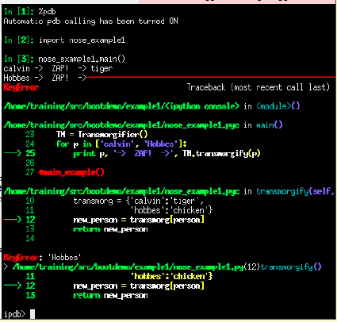
PDB: Invoke Interactively
within iPython:

Slide 35
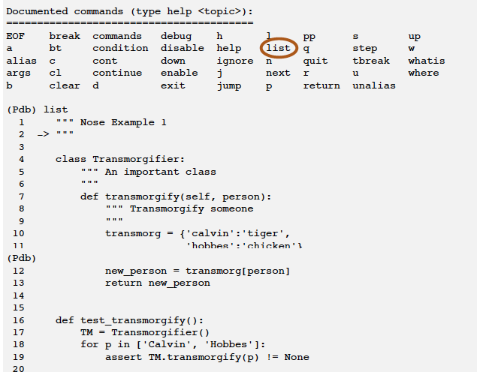
PDB: Basic Commands

Slide 36
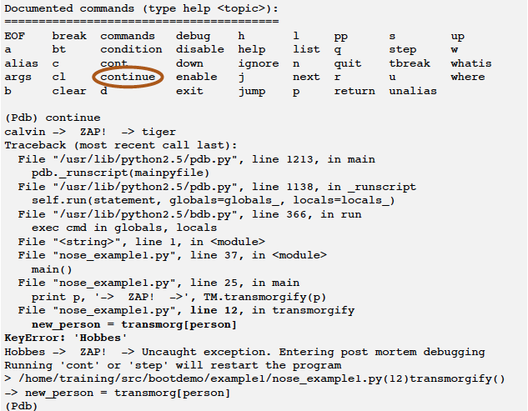
PDB: Basic Commands

Slide 37
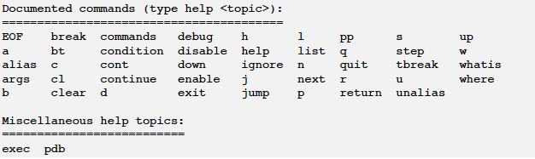
PDB: (Pdb) help

Slide 38
Nose + doctest + pdb = ?
File: nose_example1_fixed2.py
class Transmogrifier:
""" An important class
>>> 3 * 3
9 """
def transmogrify(self, person):
""" Transmogrify someone
>>> 4*4
16 """
transmog = {'calvin':'tiger',
'hobbes':'chicken'}
new_person = transmog[person.lower()]
return new_person
def test_transmogrify():
TM = Transmogrifier()
for p in ['Calvin', 'Hobbes']:
assert TM.transmogrify(p) != None
def main():
TM = Transmogrifier()
for p in ['calvin', 'Hobbes']:
print p, '-> ZAP! ->', TM.transmogrify(p)
Allow pdb to be used to look at variables via nose failure of a test.
$ nosetests-2.7 --all-modules --pdb
> /Users/…nose_example1.py(12)transmogrify()
-> new_person = transmog[person]
(Pdb) print person
Calvin

Slide 39
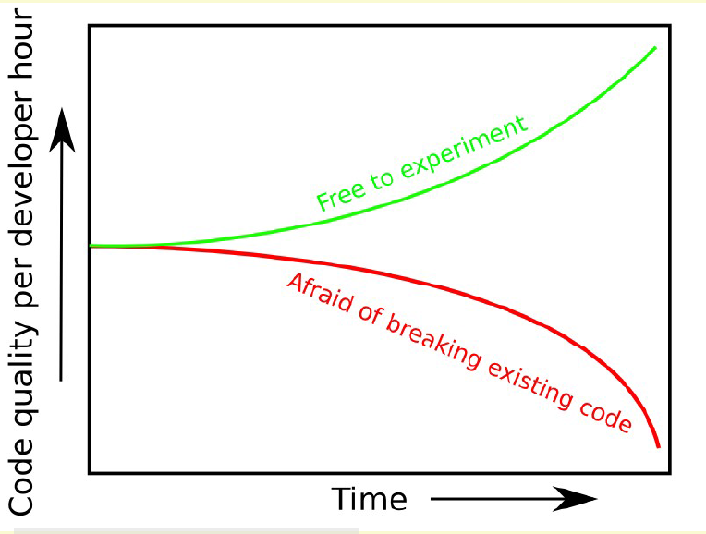
Use version control…
…so this isn’t you!

Slide 40
Breakout
Develop a new animal!
Give the animals more functionality!
Run tests for numpy, scipy, and python
(and report to the code developers!)
http://www.youtube.com/watch?v=kZKex0Y-EXY&feature=youtu.be

