Slide 1
FLAPPY SOUND
Jules VAUTIER
Sensor Classe - Tianjin University - 2017

Slide 2

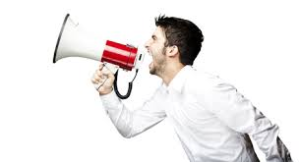
Making a game playable with voice using sound sensor and arduino

Slide 3


Technology
Arduino Zero
Python and pygame library

Slide 4
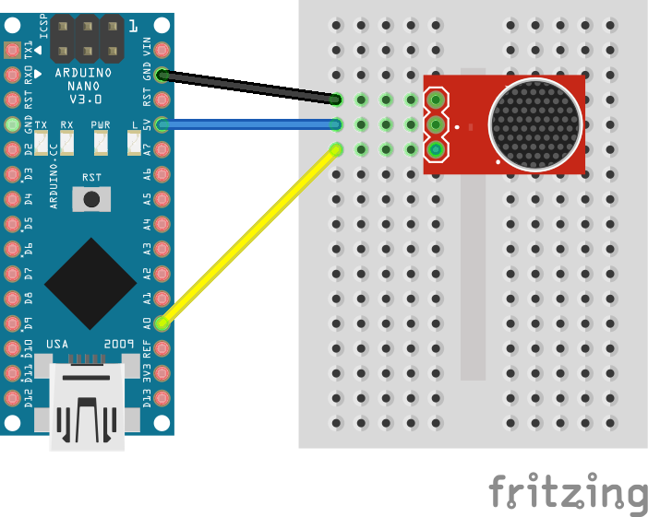
ARDUINO MONTAGE

Slide 5
The game
Fork of existing game
https://github.com/sourabhv/FlapPyBird
Modification of the game to be playable with voice and communicate with Arduino
Modification of the gameplay to become easier to play with voice

Slide 6
Thanks for your attention.
LET’ S PLAY !!

