Slide 1
Projection Pushing Revisited
C. Lambrechts 0733885
K. Triantos 0852612
J.J.H.M Wulms 0747580

Slide 2
Main Idea
Most database queries can be expressed as
Select-Project-Join queries
Order of Select, Project and Join operations
Drastic impact on query processing time
Project-Join order
linear bound on size of intermediate results

Slide 3
Techniques
Straightforward
Projection Pushing
Join Reordering
Bucket Elimination

Slide 4
3-COLOR Problem
Take a graph G, with n vertices,
V = {x₁, x₂, … , x_{n}}
We must color the vertices of a graph in such a way so that NO two adjacent vertices have the same color.

Slide 5
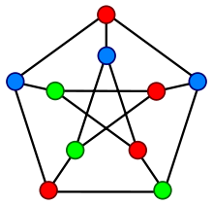
3-COLOR Graph

Slide 6
Setup Simulation
Translate graph instances(G) of 3-COLOR
into project-join queries
Query returns a nonempty result
iff G is 3-colorable

Slide 7
Naïve approach
SELECT [..]
FROM [..]
WHERE [..] AND [..]
Problem!!
The PostreSQL Planner found these queries exceedingly difficult to compile.
Compile_time > Execution_time

Slide 8
Straightforward
SELECT [..]
FROM [..] JOIN [..] … JOIN [..]
ON [..] ON [..] … ON [..]
Advantage
We create the order that the database engine evaluates the query
decreases the compile time dramatically

Slide 9
Project Pushing
SELECT [..]
FROM [..] JOIN [..] … JOIN(Subquery)
ON [..] ON [..] … ON [..]
Early Projection
Reduce intermediate results
Reduce execution time

Slide 10
Join Reordering
Early Projection processes relations linear
Find Permutation to
minimize live variables in intermediate relations
For each step:
Find the atom with the maximum variables

Slide 11
Bucket Elimination
Find MCS order of the vertices
Create bucket for each vertex
Bucket stores:
Edges that bucket’s vertex is inside
Subqueries for bucket’s vertex
Build the SQL query

Slide 12
Bucket Elimination
Step 3 : Build the SQL query
Process Buckets in descending mode
SELECT all live vertices of the bucket
FROM all edjes and subqueries
JOINing them ON conditions
Move Bucket’s query and delete the Bucket

Slide 13
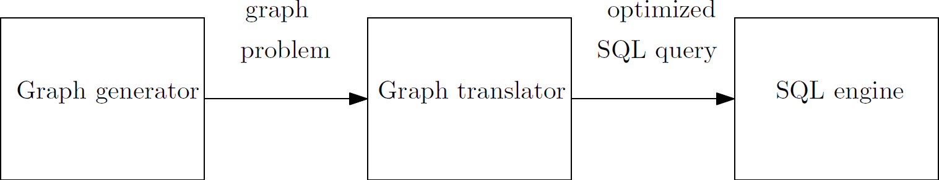
Setup Experiment
Java
Table generator
Graph generator
Graph translator / Query generator
PostgreSQL engine

Slide 14
Experiment
Generate boolean queries
Measure execution time
Scale order with a fixed density (3.0 & 6.0)
Scale density with a fixed order (20)
Still to do:
Different graphs types (Augmented, Ladder, Circular)
More runs

Slide 15
First Results

Slide 16
First Results

Slide 17
First Results

Slide 18
First Results

Slide 19
First Results

Slide 20
First Results

Slide 21
Provisional Conclusion
Almost no difference between approaches
Almost no difference with the paper
Better optimazitions done by the engine
Faster machine
Need to do more runs with higher order and density
Experiment Bucket Elimination and graph types

Slide 22
Questions?

