Slide 1

Course Code: 400
Course Title : Project/Thesis
Comparative Analysis of CLIP-Based and
Vision-Language Models for Medical Visual
Question Answering with Explainability-Driven
Hallucination Assessment
Supervised by
Tanvir Azhar
Assistant Professor, East Delta University
Presented by
Julfikar Rahaman Asif · ID: 222004812

Slide 2
OVERVIEW
02 / 29
Presentation Outline
01 Title
08 Dataset
15 Explainability Analysis
22 XAI — Qwen2.5-VL
02 Outline
09 Challenges
16 Taxonomy
23 XAI — LLaVA-Med
03 Background
10 Class Imbalance
17 Quantitative Results
24 Discussion
04 Problem & Objectives
11 Models Overview
18 Benchmark (Val)
25 Conclusion
05 Scope
12 Methodology Flow
19 Hallucination Results
26 Future Work
06 Literature Table
13 Fine-Tuning
20 XAI — BiomedCLIP
27 References
07 Research Gap
14 Evaluation
21 XAI — PubMedCLIP

Slide 3
INTRODUCTION
03 / 29
Background & Motivation
Medical VQA
The Trust Gap
Given a radiology image and a natural-language question, produce a clinical answer. Potential uses: second reader, training aid, support where specialists are scarce.
Clinical use needs answers a clinician can trust are derived from the image — not from dataset bias or language priors.
Two families compared
CLIP-based classifiers (BiomedCLIP, PubMedCLIP) — closed vocabulary, fused image–text MLP.
Generative LVLMs (Qwen2.5-VL-7B, LLaVA-Med v1.5) — free-form answers, ~40× more parameters, more prone to fluent but ungrounded outputs.

Slide 4
INTRODUCTION
04 / 29
Problem Statement & Objectives
Accuracy and BLEU alone cannot tell a genuinely image-grounded answer from a correct-looking guess.
1
Fine-tune four architectures on VQA-Med 2021 with LoRA / QLoRA
2
Unified metrics: exact-match, BiomedBERT semantic match, BLEU-1–4
3
Explainability: occlusion (classifiers) + attention grounding (LVLMs)
4
Three-way taxonomy: Grounded Correct · Ungrounded Correct · Hallucinated Wrong
5
Test whether scale correlates with accuracy or visual groundedness

Slide 5
INTRODUCTION
05 / 29
Scope of the Study
Dataset
Question type
VQA-Med 2021 — 4,500 train / 500 validation triplets (MedPix radiology).
Closed-form / short-answer only. No open-ended report generation.
Models
Eval split
Four architectures: two CLIP classifiers + two generative LVLMs.
All metrics on official validation (n=500). Official test labels unavailable.

Slide 6
06 / 29
Literature Review
Study / Ref. | Year | Model family | Dataset / focus | Explainability / hallucination evaluation
Nguyen et al.[19] | 2019 | Meta-learning Med-VQA | VQA-RAD / VQA-Med | Illustrative attention only
Eslami et al.[8] | 2023 | PubMedCLIP classifier | ROCO / VQA-Med | None
Zhang et al.[7] | 2023 | BiomedCLIP contrastive VLM | PMC-15M biomedical image-text | None
Li et al.[9] | 2023 | LLaVA-Med generative LVLM | Biomedical instruction data | Limited / non-systematic
Qwen Team[10] | 2025 | Qwen2.5-VL generative LVLM | General + medical benchmarks | Limited / non-systematic
Lameesa et al.[25] | 2026 | ViT-family + RoBERTa , BERT | VQA-Med 2021 | BLEU-focused; no grounding

Slide 7
07 / 29
Research Gap
Metrics only
Benchmarks report exact-match / BLEU; they do not assess whether the answer came from the image.
XAI / Hallucinations
Prior work either skips XAI and hallucination analysis, or treats them only illustratively — not under a systematic, comparable protocol across model families.
This thesis
Applies both techniques and a systematic hallucination taxonomy across closed classifiers and open generative models on the same Med-VQA benchmark.

Slide 8
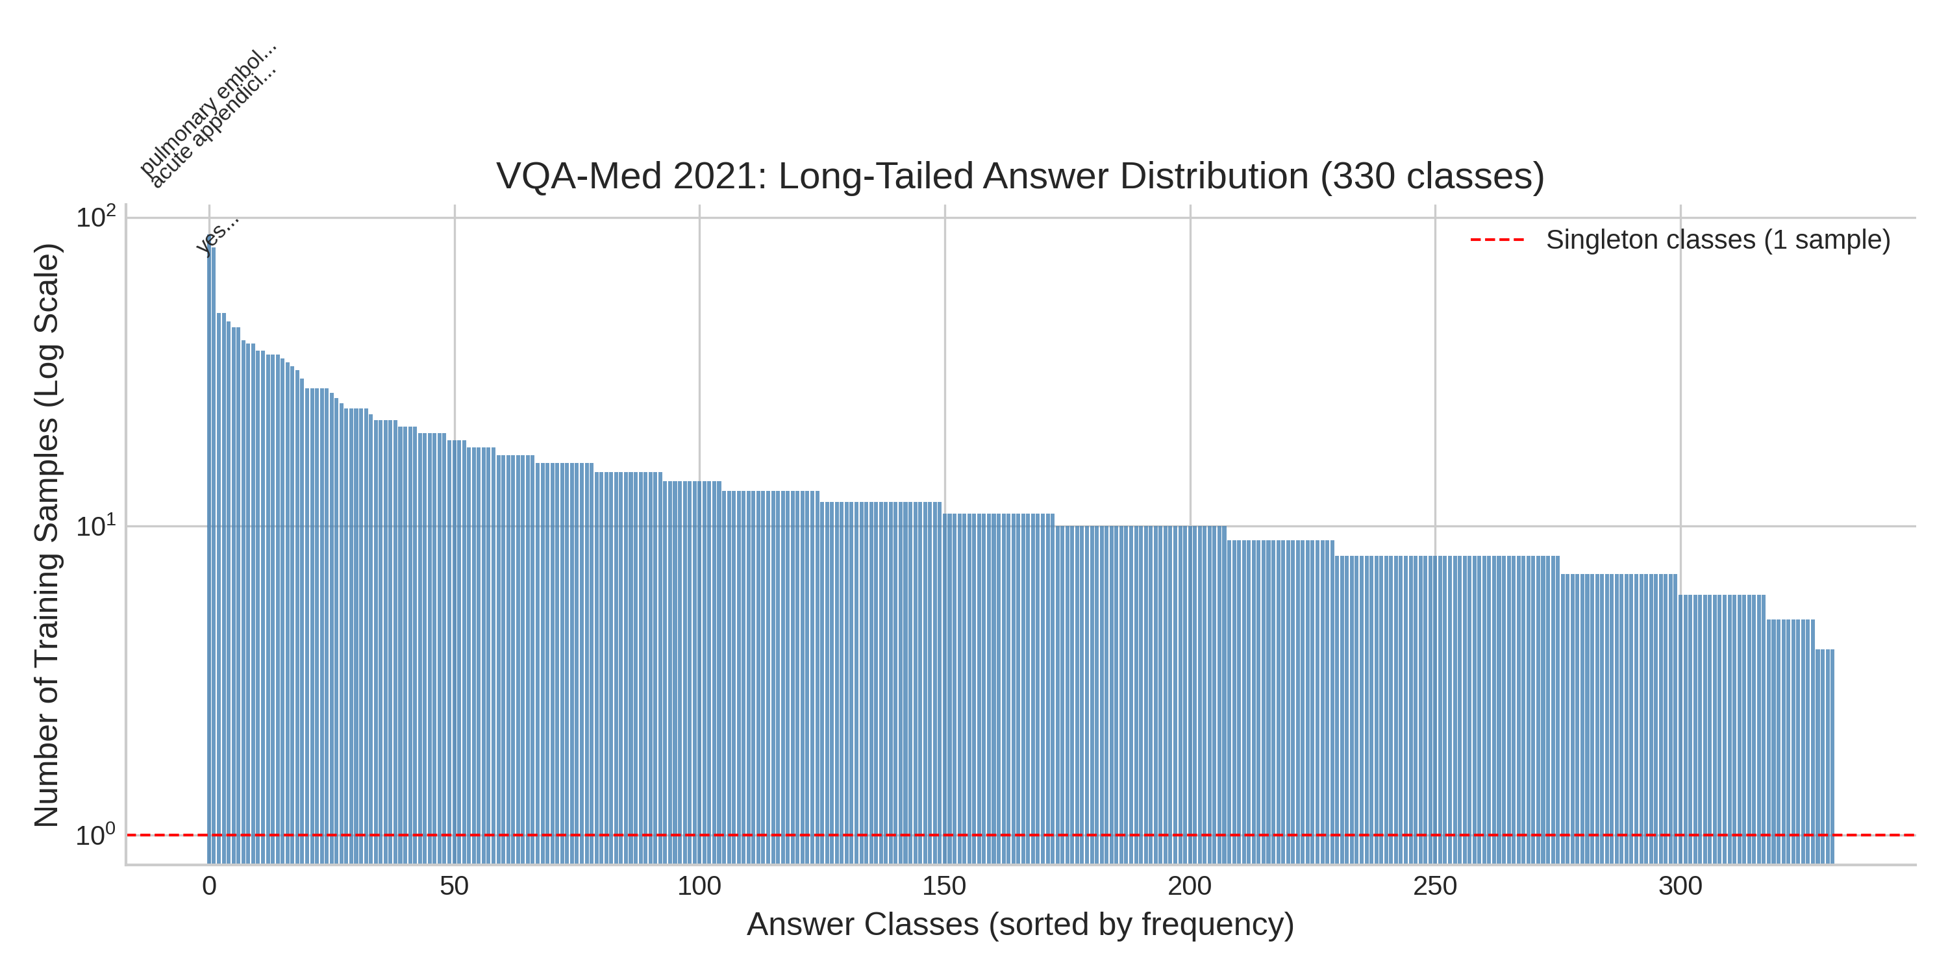
METHODOLOGY
08 / 29
Dataset: VQA-Med 2021
4,500
500
330
Multi
Training triplets
Validation triplets
Answer classes
Imaging
Modalities
Figure: long-tailed answer distribution (thesis Fig. 3.2)

Slide 9
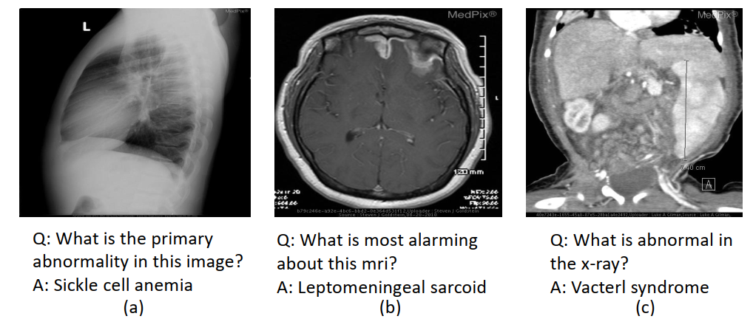
METHODOLOGY
09 / 29
Three examples from the dataset of ImageCLEF 2021 VQA-Med.

Slide 10
METHODOLOGY
10 / 29
Dataset Challenges
Small scale
Only 4,500 training triplets.
Long-tailed answers
Many classes have 1–few examples.
Open-ended phrasing
Multiple clinically valid answers.
Visual ambiguity
Adjacent differentials look similar.
Image artifacts
Overlays, calipers, on-screen text.

Slide 11
METHODOLOGY
11 / 29
Class Imbalance
Effect on CLIP Classifiers
Effect on Generative LVLMs
The fixed-vocabulary MLP head must learn a separate output unit for every one of 330 classes — including rare ones with only a handful of training examples.
Rare diagnostic terms are correspondingly rare in the fine-tuning data used to adapt the language decoder, limiting its ability to generate them.

Slide 12
METHODOLOGY
12 / 29
Four Models Under Evaluation
BiomedCLIP + MLP
PubMedCLIP + MLP
PubMedBERT + ViT · 330-class MLP
LoRA · 4.4M trainable / ~200M
CLIP ViT-B/32 (ROCO) · same MLP
LoRA · 3.71M trainable / ~155M
Qwen2.5-VL-7B
LLaVA-Med v1.5
Native-res vision + LLM
QLoRA 4-bit · 95M / 8.39B
CLIP + Mistral-7B
QLoRA 4-bit · ~95M / 7.5B

Slide 13
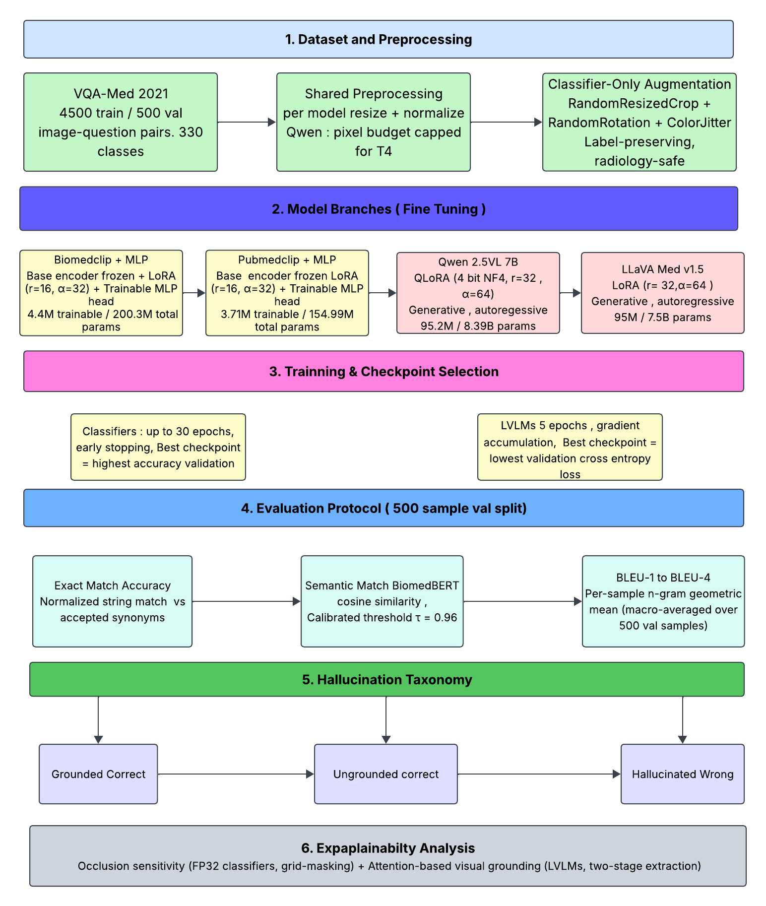
METHODOLOGY
13 / 29
Overall Experimental Workflow

Slide 14
Fine-Tuning Strategy
14 / 29
Hyperparameter | BiomedCLIP | PubMedCLIP | Qwen2.5-VL | LLaVA-Med
LoRA rank | 16 | 16 | 32 | 32
LoRA alpha | 32 | 32 | 64 | 64
Learning rate | 1e-4 | 1e-4 | 2e-4 | 2e-4
Batch size | 32 | 32 | 1×16 accum. | 1×16 accum.
Epochs | 30 | 30 | 5 | 5
Precision | fp32 | fp32 | 4-bit NF4 | 4-bit NF4
Trainable | 4.4M / 200M | 3.71M / 155M | 95.2M / 8.4B | 95M / 7.5B

Slide 15
METHODOLOGY
15 / 29
Evaluation Protocol
Exact-match
Normalized string match against GT synonyms.
Semantic-match
BiomedBERT cosine ≥ 0.96 (calibrated).
BLEU-1–4
Multi-level n-gram precision (Lameesa et al.).
Occlusion sensitivity
Classifiers: max confidence drop ≥ 0.10.
Attention focus
LVLMs: entropy-based image-patch concentration.

Slide 16
METHODOLOGY
16 / 29
Explainability Analysis
Occlusion Sensitivity (Classifiers)
Attention-Based Grounding (LVLMs)
A 32 *32 gray patch is slid across the image (stride 16), recomputing the predicted class probability each time; the maximum confidence drop is the grounding signal, thresholded at 0.10.
After normal generation, a teacher-forced eager attention pass extracts a late-layer, entropy-based focus score over image patches thresholded (0.15).

Slide 17
METHODOLOGY
17 / 29
Hallucination Taxonomy
Grounded Correct
Semantic match AND grounding signal above threshold.
Ungrounded Correct
Semantic match BUT grounding signal below threshold.
Hallucinated Wrong
Not a semantic match — regardless of attention.

Slide 18
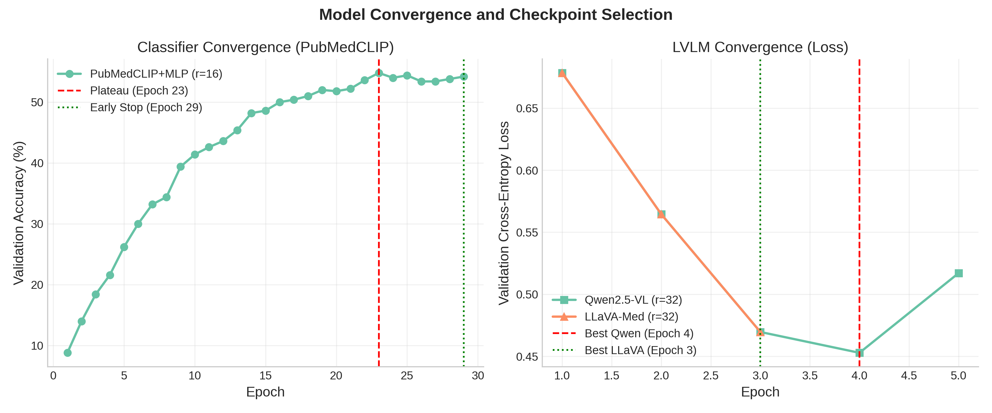
RESULTS
18 / 29

Slide 19
RESULTS
19 / 29
Benchmark Comparison on VQA-Med 2021
Validation-to-validation comparison with Lameesa et al. Architectures differ (ViT/DeiT+BERT vs CLIP+MLP / LVLMs); same VQA-Med 2021 validation setting.
Study / Model | Evaluation splits | Accuracy | Architecture
Lameesa et al. — DeiT + RoBERTa | Validation | 54.87% | ViT-family + RoBERTa
Lameesa et al. — DeiT + BERT | Validation | 54.27% | ViT-family + BERT
Ours — PubMedCLIP + MLP | Validation (500) | 57.20% | CLIP + fused MLP
Ours — BiomedCLIP + MLP | Validation (500) | 43.80% | CLIP + fused MLP
Ours — LLaVA-Med v1.5 | Validation (500) | 43.20% | Generative LVLM
Ours — Qwen2.5-VL-7B | Validation (500) | 41.80% | Generative LVLM
PubMedCLIP+MLP (57.20%) exceeds Lameesa et al.’s best (54.87%). Treat as context, not a strict ranking.

Slide 20
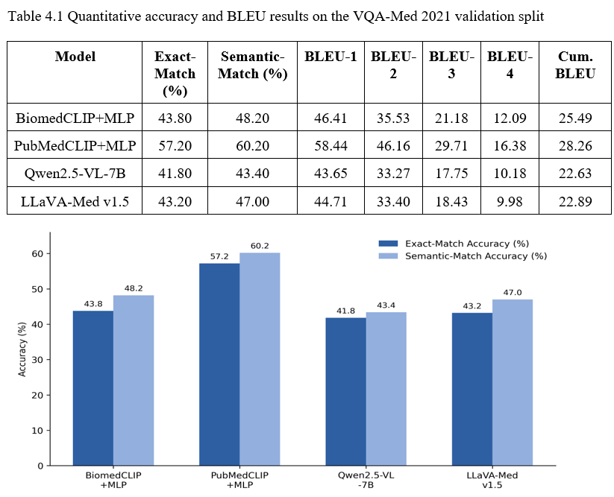
20 / 29
Result Analysis

Slide 21
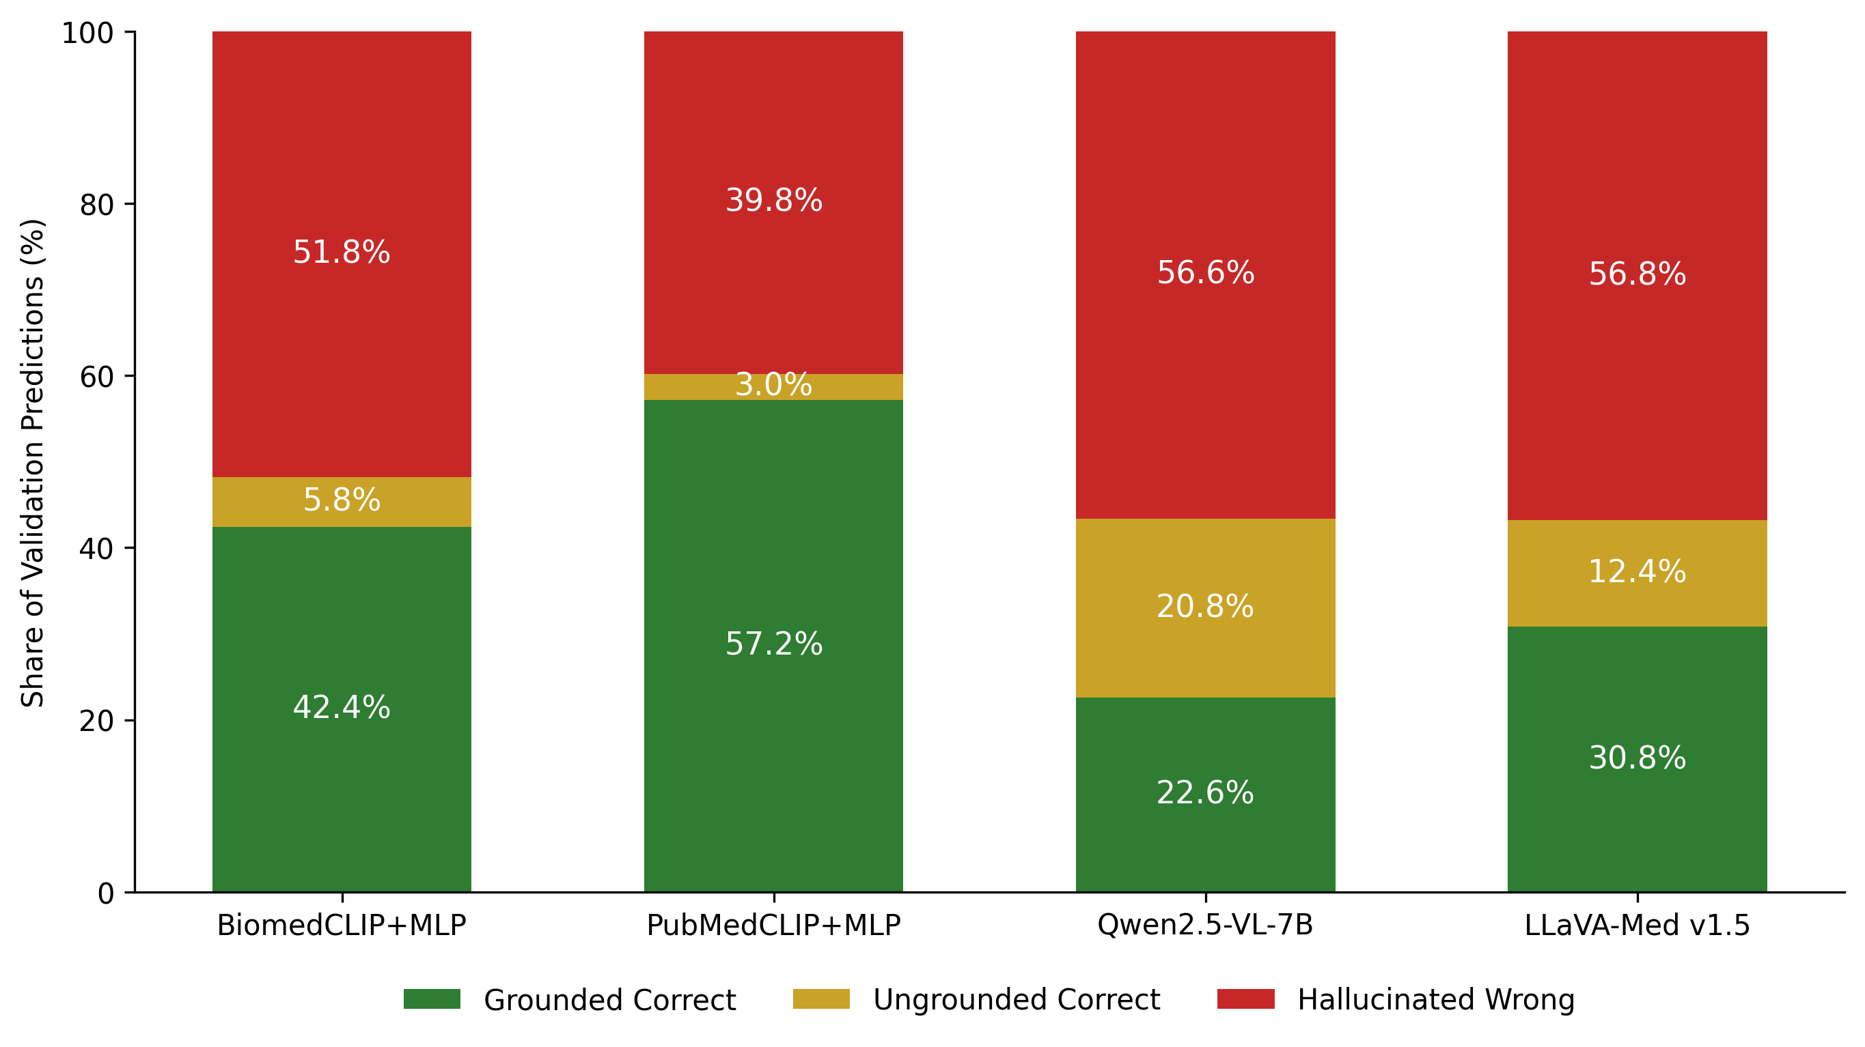
Hallucination Taxonomy Validation (n = 500)
21 / 29
Model | Grounded Correct | Ungrounded Correct | Hallucinated Wrong
PubMedCLIP+MLP | 57.2% | 3.0% | 39.8%
BiomedCLIP+MLP | 42.4% | 5.8% | 51.8%
LLaVA-Med v1.5 | 30.8% | 12.4% | 56.8%
Qwen2.5-VL-7B | 22.6% | 20.8% | 56.6%

Slide 22
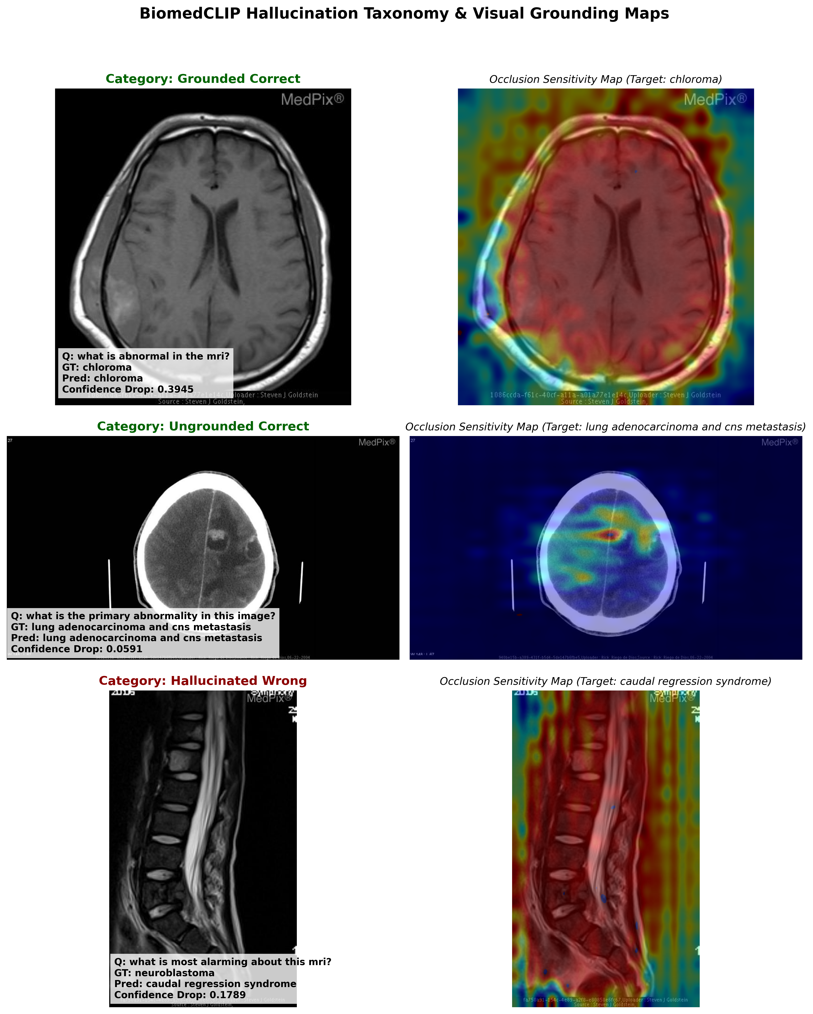
Qualitative Example — BiomedCLIP+MLP
22 / 29

Slide 23
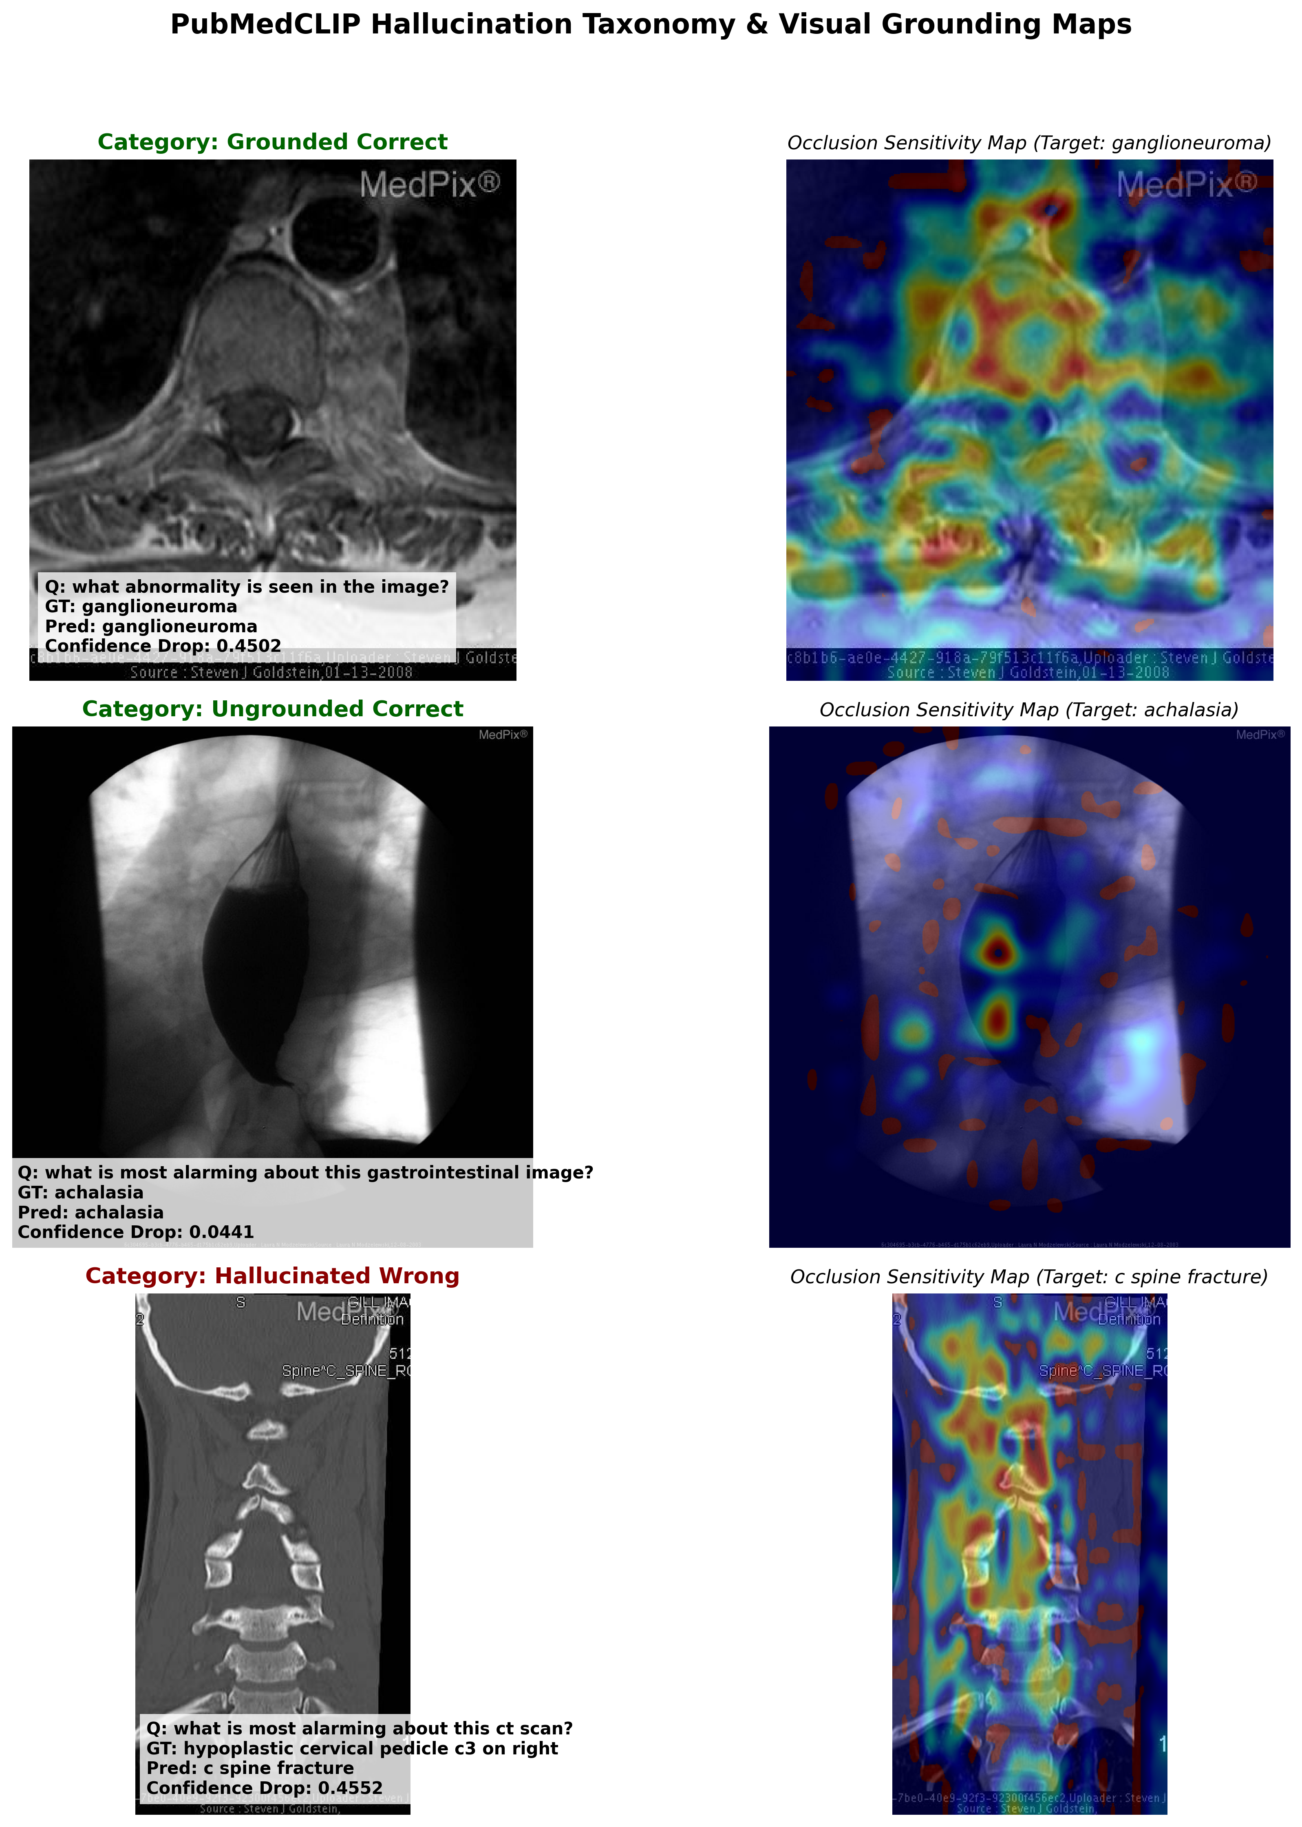
Qualitative Example — PubMedCLIP+MLP
23 / 29

Slide 24
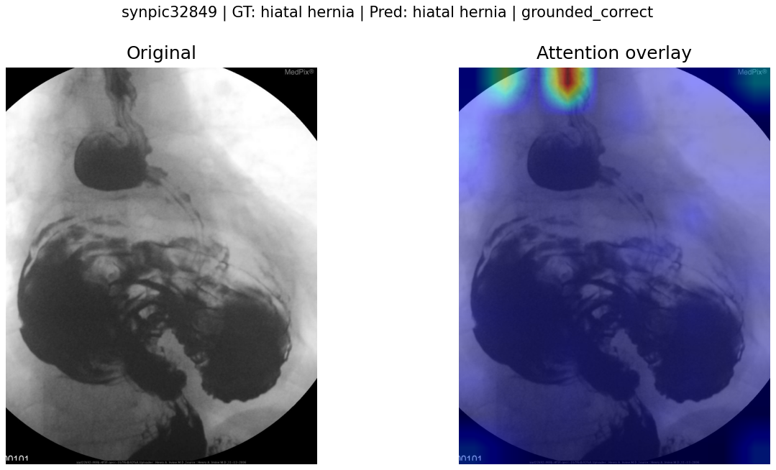
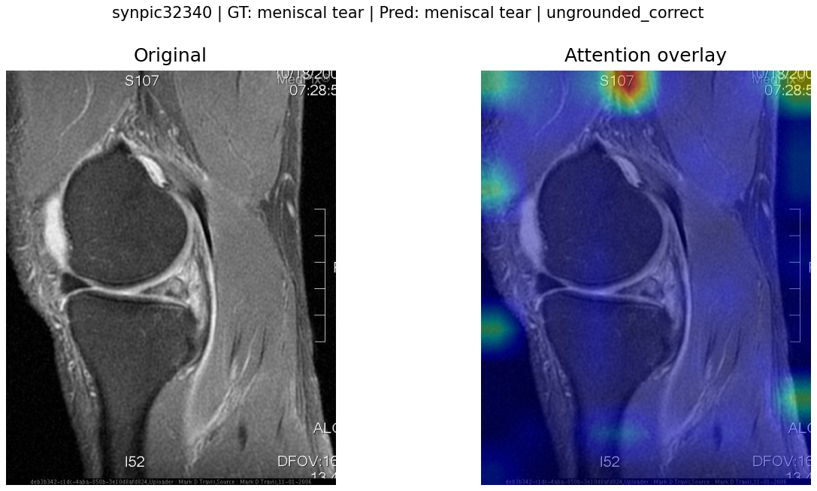
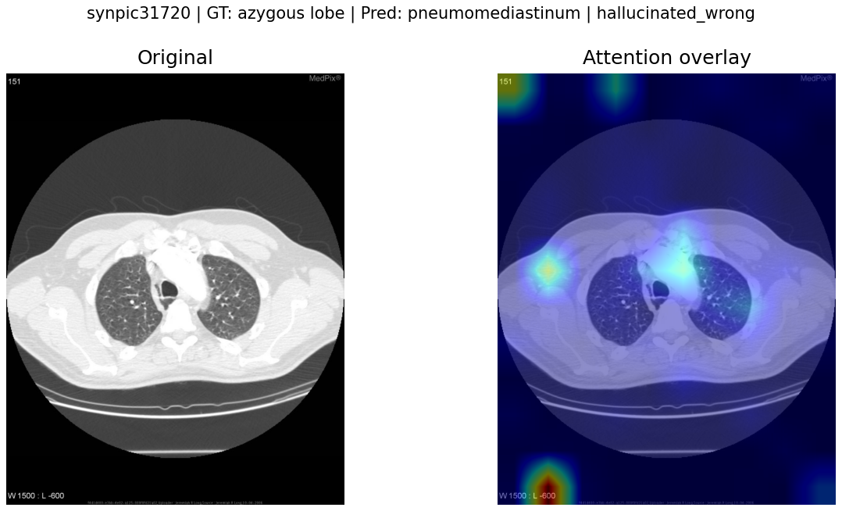
Qualitative Examples — Qwen2.5-VL-7B
24 / 29

Slide 25
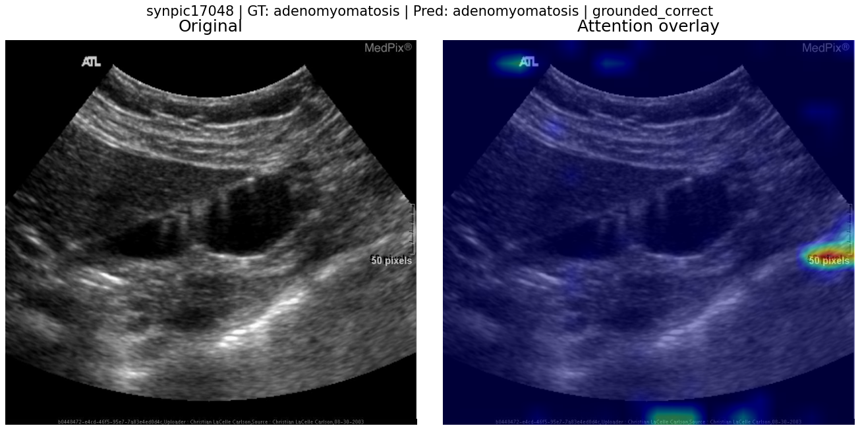
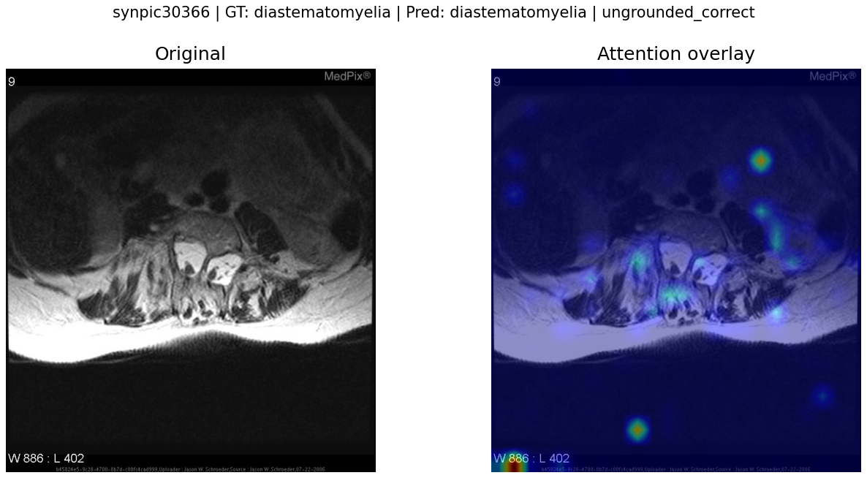
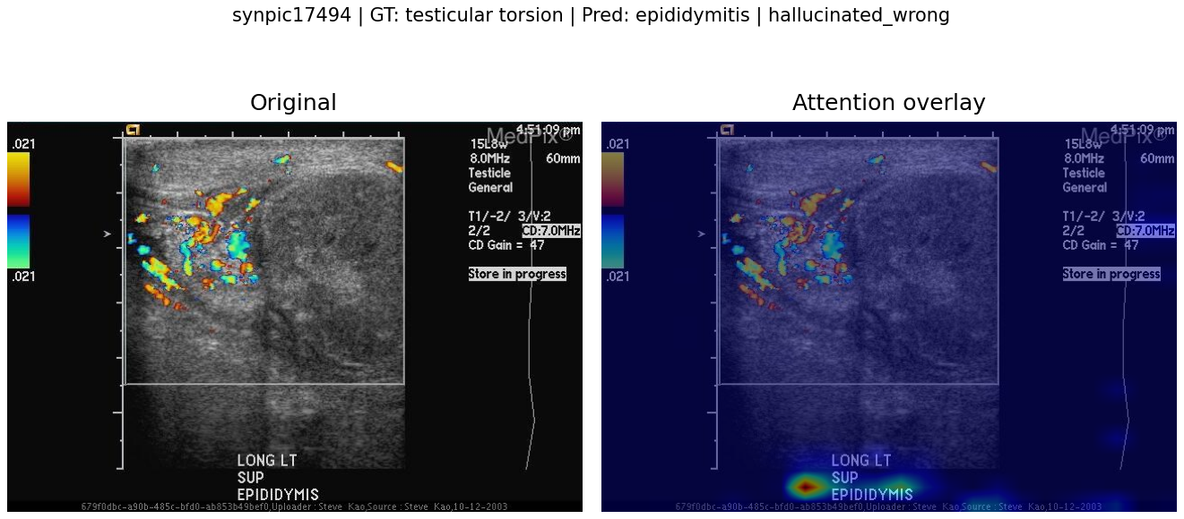
Qualitative Examples — LLaVA-Med v1.5
25 / 29

Slide 26
DISCUSSION
26 / 29
Contributions
01 Unified explainability pipeline
Applied paradigm-appropriate grounding techniques occlusion sensitivity for classifiers, attention-based
focus scoring for LVLMs Integrated under a single conceptual framework in this study.
02 Three-way hallucination taxonomy
Applied a Grounded Correct / Ungrounded Correct / Hallucinated Wrong classification
consistently across both model families on the same benchmark.
03 Unified comparison
Four architectures BiomedCLIP+MLP, PubMedCLIP+MLP, Qwen2.5-VL-7B, LLaVA-Med v1.5 fine-tuned with
LoRA/QLoRA and evaluated on the same VQA-Med 2021 validation split (n = 500) under exact-match,
BiomedBERT semantic-match, and BLEU-1–4.

Slide 27
CONCLUSION
27 / 29
Conclusion
Accuracy alone is incomplete. On the VQA-Med 2021 validation split, a smaller, domain-adapted, constrained-vocabulary classifier was both more accurate and more visually grounded than much larger generative VLMs.
57.2%
39.8%
~40×
Best exact-match (val)
PubMedCLIP+MLP
Lowest hallucination
same model
Parameter gap still
lost to classifier
Limitation: validation-only evaluation; official test labels unavailable. Validation can overestimate true generalization.

Slide 28
CONCLUSION
28 / 29
Future Work
01
Cross-dataset validation
Evaluate the same four architectures on VQA-RAD and SLAKE to test whether the observed ranking holds across datasets with different answer vocabularies and question distributions.
02
Hybrid classifier + generative verification
Use a fine-tuned classifier's grounded prediction as a retrieval-augmented prompt or verification signal for a generative model's free-text answer.

Slide 29
29/ 29
References
[1] Antol et al., “VQA: Visual Question Answering,” ICCV, 2015.
[6] Radford et al., “Learning Transferable Visual Models…,” ICML, 2021.
[7] Zhang et al., “BiomedCLIP…,” arXiv:2303.00915, 2023.
[8] Eslami et al., “PubMedCLIP…,” Findings of ACL: EACL, 2023.
[9] Li et al., “LLaVA-Med…,” NeurIPS, 2023.
[10] Qwen Team, “Qwen2.5-VL Technical Report,” arXiv:2502.13923, 2025.
[13] Ben Abacha et al., “Overview of VQA-Med… ImageCLEF 2021,” CLEF, 2021.
[17] Zeiler & Fergus, “Visualizing and Understanding CNNs,” ECCV, 2014.
[19] Hu et al., “LoRA…,” ICLR, 2022. [20] Dettmers et al., “QLoRA…,” NeurIPS, 2023.
[25] Lameesa et al., “A linguistic lens into vision-language models…,” DIGITAL HEALTH, 2026.
[26] Gong et al., “SYSU-HCP at VQA-Med 2021…,” CLEF WN, 2021.
[27] Eslami et al., “TeamS… BBN-Orchestra…,” CLEF WN, 2021.
[31] Xiao et al., “Yunnan University at VQA-Med 2021…,” CLEF WN, 2021.

Slide 30
Thank You

