Slide 1
Implementation of an Open-source Tool for Aeroelastic Simulations of Horizontal Axis Wind Turbines
Master thesis presentation

Slide 2
Index:
Objectives
Structural module
Aerodynamic module
Implementation
Validation
Questions

Slide 3
Objectives:
Implement a simple open-source aeroelastic tool, (HarPy), for the simulation of horizontal axis wind turbines under steady and turbulent wind inflow conditions in the time domain.
Complete enough to achieve reasonably accurate results.
Simple enough to allow a straightforward connection between the basic concepts, problem physics, model assumptions, key equations, the algorithm and the implemented code.
The code must be open-source and free so the use of the code would not be a barrier to the use, customisation and expandability of the code.

Slide 4
Wind turbine reference kinematics:
Structural module
The complete turbine dynamics is obtained using 1 inertial and 4 moving reference of frames.

Slide 5
Wind turbine reference kinematics:
Structural module
The complete turbine dynamics is obtained using 1 inertial and 4 moving reference of frames.
Reference frames
I₀ : Inertial
I₁ : Tower-top
I₂ : Shaft bearing
I₃ : Shaft tip
I₄ : Blade root
Transformation matrices:

Slide 6
Blade kinematics:
Structural module
The turbine blades displacement is described using a linear combination of its mode shapes.
edgewise
flapwise
Stiff radially

Slide 7
Nacelle and shaft kinematics:
Structural module
The tower top and shaft tip displacements are modelled using linear and angular stiffness.

Slide 8
Wind turbine reference kinematics:
Structural module
The position and absolute velocity of the blades sections are then obtained.

Slide 9
Energy equations:
Structural module
To derive the equations of motion using the Lagrange method is necessary to derive the kinetic and potential energy of the wind turbine and the work done by non-conservative forces.

Slide 10
Lagrangian mechanics:
Structural module
In Lagrangian mechanics, the equations of motion of a system are derived by solving the Lagrange equations.
The Lagrange method often offer a more straightforward and convenient method to implement on symbolic computational tools.

Slide 11


Symbolic implementation:
Structural module
The symbolic derivation was carried out in Python using the symbolic manipulation package Sympy.
A code generator was adapted to translate the symbolic equations into numerical code and generate the structural module code automatically.
numpy.trapz(self.m*self.phi_x[0,:]**2,self.z)

Slide 12
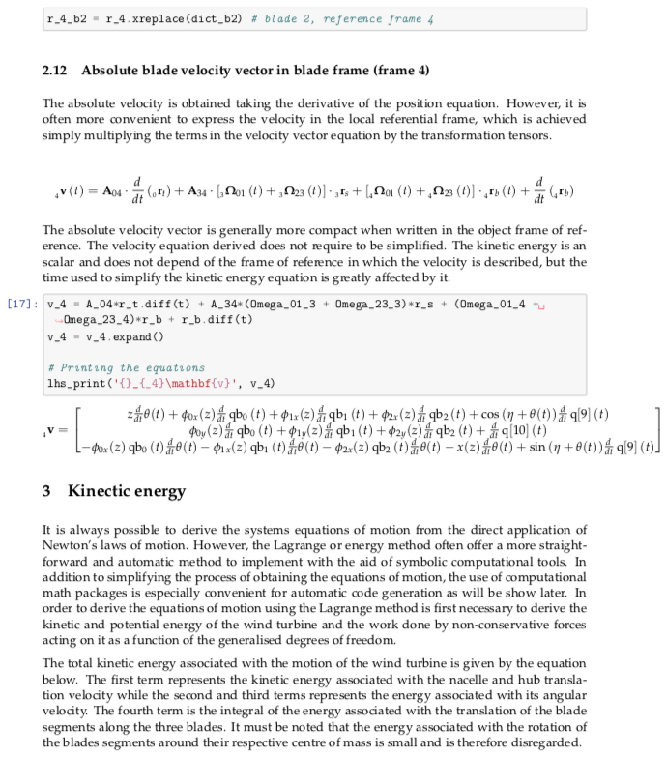

Symbolic derivation:
Structural module

Slide 13
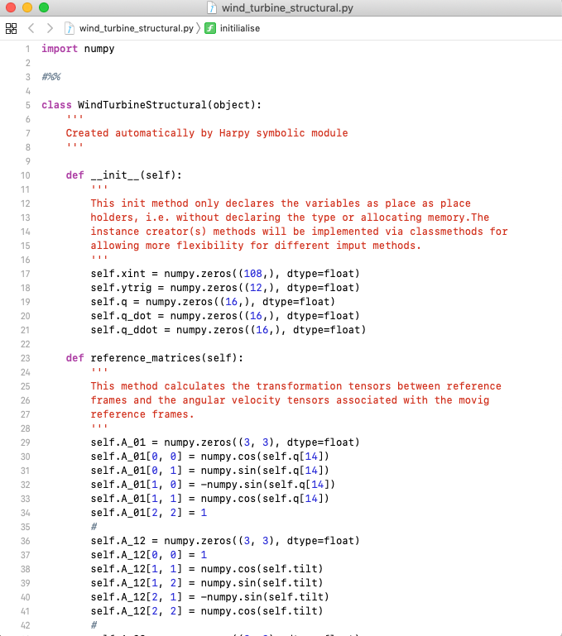
Numerical code output:
Structural module

Slide 14
Aerodynamic module:
The wind turbine aerodynamics is modelled using the unsteady Blade Element Momentum theory under yaw.

Slide 15
Dynamic inflow:
Aerodynamic module
The wind velocity induced by the rotor on flow is calculated using the two filters dynamic inflow model proposed by Stig Øye .

Slide 16
Yaw / Tilt correction:
Aerodynamic module
The wake skew angle effect on the induced wind velocity is calculated using the model proposed by Glauert as referenced in [18] and [35].

Slide 17
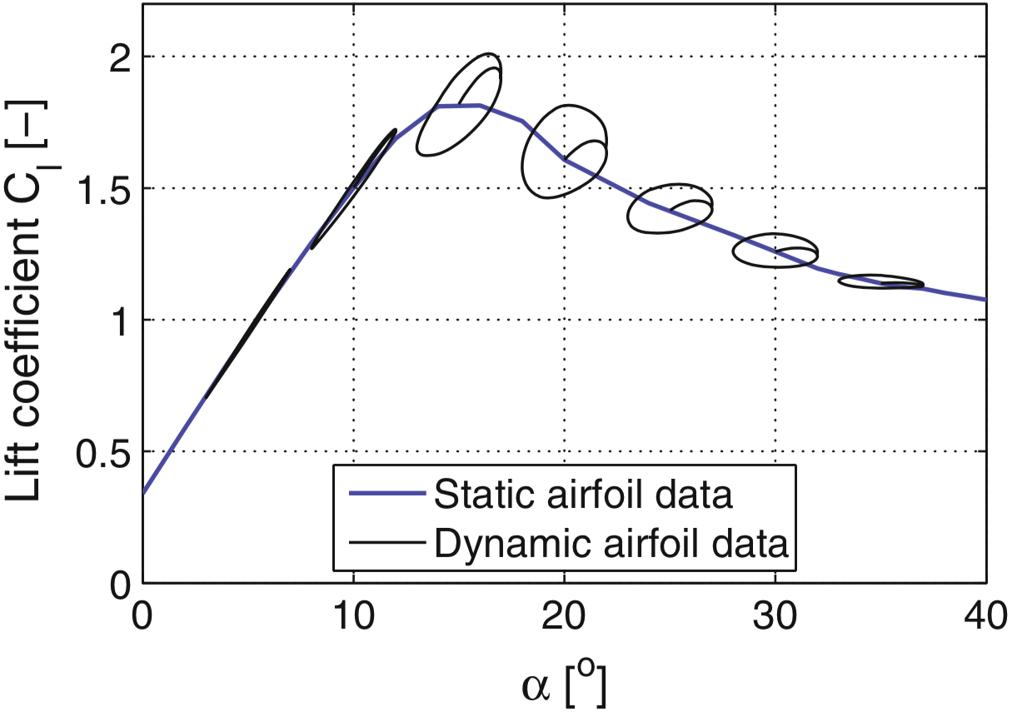
Dynamic stall model:
Aerodynamic module
The dynamic stall is modelled using the separation factor f_{s} between the inviscid and the fully separated lift coefficients proposed by Stig Øye.

Slide 18
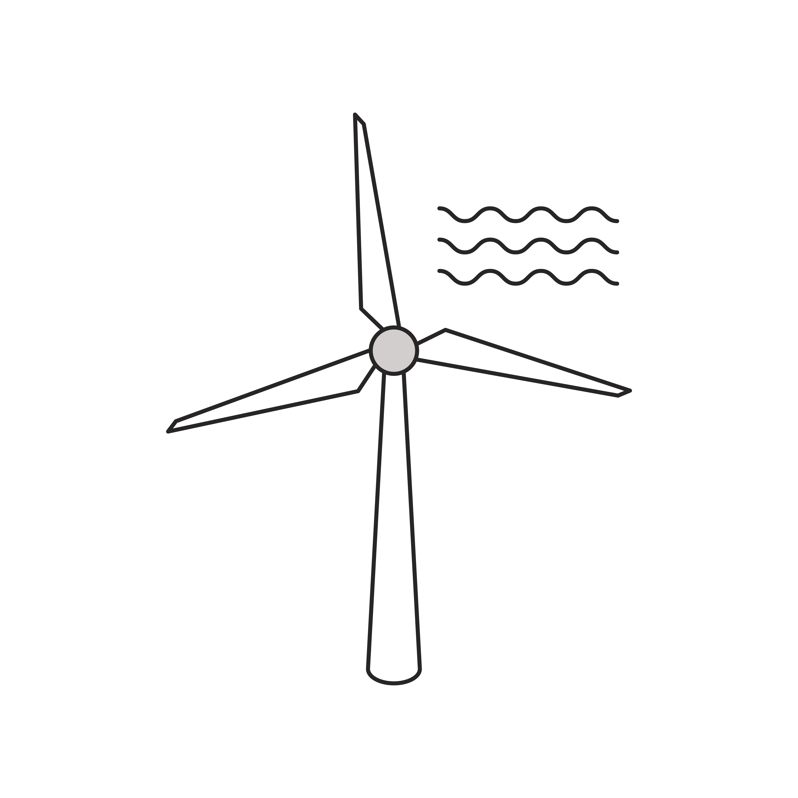
Numeric tool:
Implementation
The software code is implemented in Python using the object-oriented concept, organising the attributes and functions into classes of objects.
Model Script
Wind Turbine
Wind turbine structural
Create objects
Create differential equation
Time integration
Wind Box
Simulation object
Controllers

Slide 19
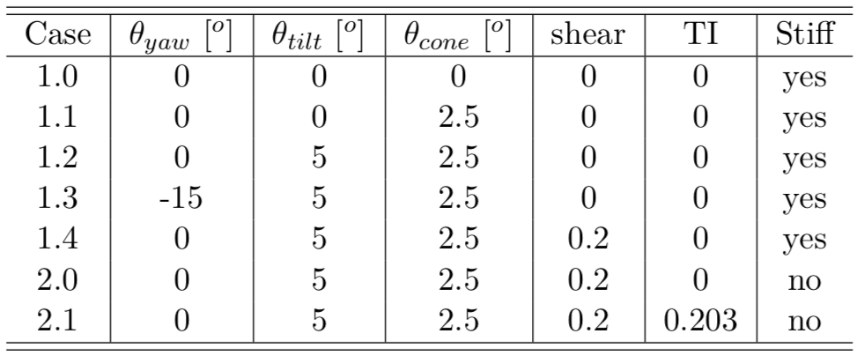
Study cases:
Validation
In order to evaluate the implementation, the results given by the project aeroelastic code under different load scenarios were compared with DTU’s aeroelastic code HAWC2.

Slide 20


Case 1.0:
Validation

Slide 21


Case 1.1:
Validation

Slide 22


Case 1.2:
Validation

Slide 23

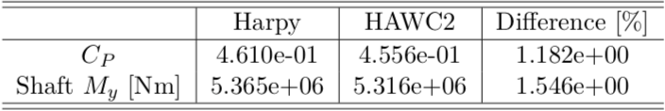
Case 1.3:
Validation

Slide 24


Case 1.4:
Validation

Slide 25


Case 2.0:
Validation

Slide 26


Case 2.1:
Validation

Slide 27
Questions
Discussion

