Slide 1
Analysis of user interaction with YANDEX.ZEN article cards.
Research author: Yulia Bulycheva
Period under analysis
Date: September 24, 2019
Time: 18:00 – 19:00

Slide 2
research objective
The goal is to create a dashboard that will contain the information necessary for analyzing user interactions with article cards on Yandex.Zen. The dashboard should answer the following questions:
1. How many user interactions with cards occur in the system, broken down by card topics?
2. How many cards are generated by sources with different topics?
3. What is the relationship between the topics of the cards and the topics of the sources?

Slide 3
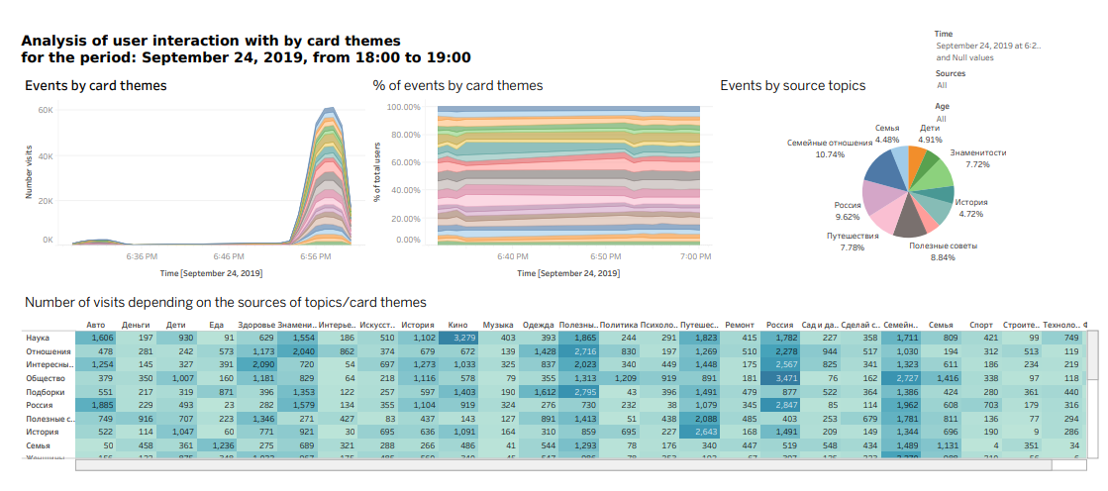

Slide 4
Conclusions
The data on user interactions with article cards on Yandex.Dzen for September 24, 2019, from 18:00 to 19:00 were provided for analysis. During this period, the most popular cards were on the following topics (top 5):
Science (21,736 visits);
Relationships (20,666 visits);
Interesting Facts (19,942 visits);
Society (19,640 visits);
Collections (17,772 visits).
Additionally, sources were generated with the following topics (top 5):
Family Relationships (33,309 visits);
Russia (29,831 visits);
Useful Tips (27,412 visits);
Travel (24,124 visits);
Celebrities (23,945 visits).

Slide 5
The peak of user visits during the analyzed time period occurs in the time interval from 18:56 to 18:58, which is most likely due to the fact that, at this time, the average user has finished work, has more time for relaxation, including reading entertaining content. Therefore, the most popular cards during this time interval are:
- Money;
- Children;
- Women's psychology;
- Women;
- Health.
Judging by the card topics, the primary users during this period are women, divided by age groups, with the largest group covering the age range from 18 to 25 years, and a significant decrease in visit intensity is observed in the group from 26 to 30 years.
The presented data set shows that users are interested not only in specific topics but also in their sources (top 5):
- 'Stories' card - source 'Travel' (4,587 visits);
- 'Society' card - source 'Russia' (3,471 visits);
- 'Science' card - source 'Movies' (3,279 visits);
- 'Russia' card - source 'Russia' (2,847 visits);
- 'Society' card - source 'Family relationships' (2,727 visits).

