Slide 1
A computational model for bacterial resistance
By Julia Eggenschwiler and Jaelle Häfliger

Slide 2
Table of contents
Hypothesis and predictions
Method
Results and conclusion
Biological applications

Slide 3
Hypothesis and predictions
Hypothesis:
Predictions:
Strong mutations won’t persist, because the costs of the trade off are too high. Therefore, the individuals with the weak mutations will take over the population.
Thus, the population will be rescued if there are enough individuals with weak mutations at the beginning.
How do 2 mutations, which can alternate between beneficial and deleterious versions of the same strength, influence the probability of rescue and how does their frequency in the population change?

Slide 4
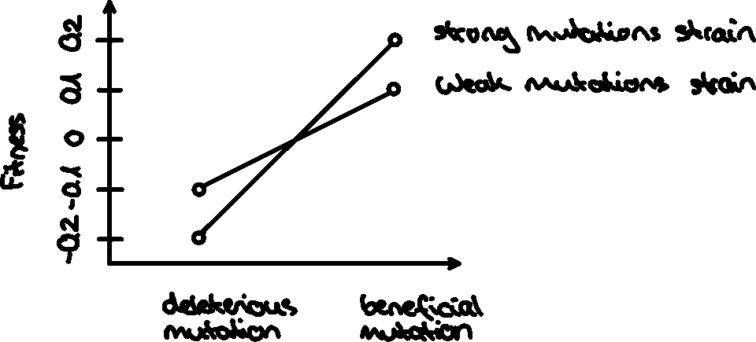
Explanation of the different mutants

Slide 5
Parameters and variables-Deviations from base-model
N_end_wd, N_end_wb, N_end_sd, N_end_sb
Init_wd, init_wb, init_sd, init_sb
decay_rate_wm
Decay_rate_sm
S_wm: selective strength of weak mutation
S_sm: selective strengthof strong mutation
m_rate_wm, m_rate_sm

Slide 6
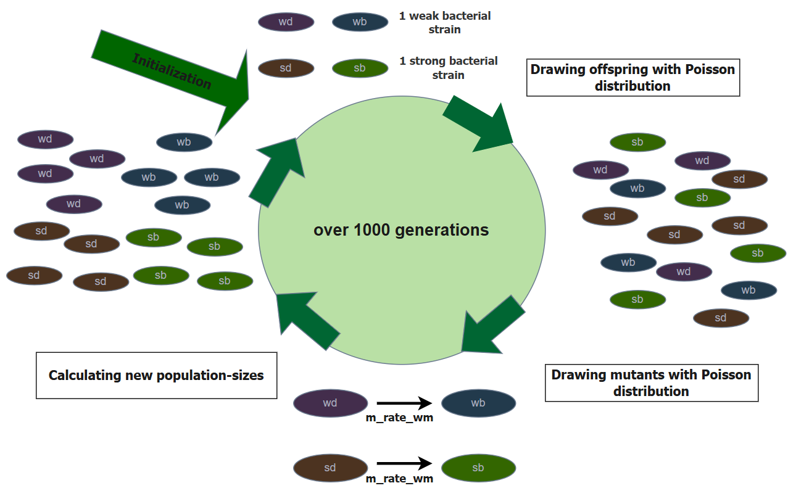
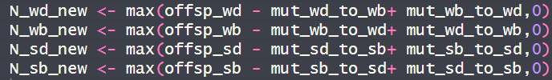

Slide 7
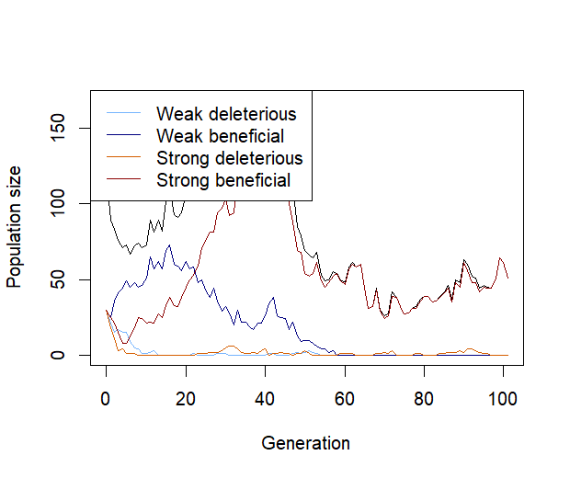
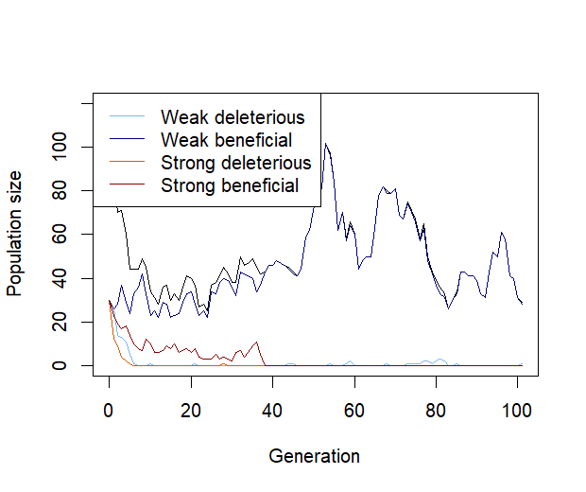
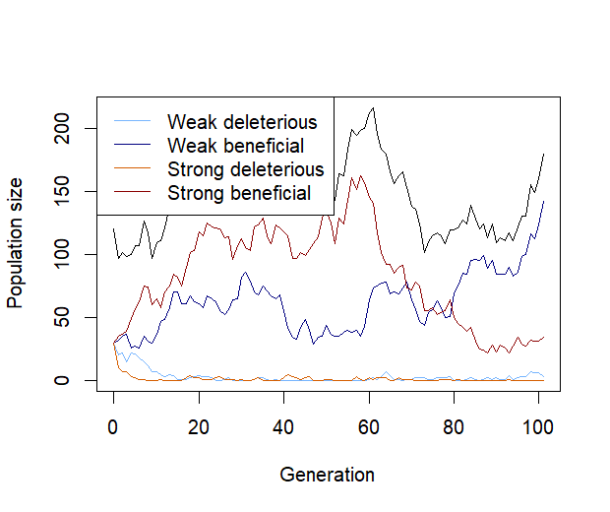
Plot showing one population over multiple generations
Initial populations for all four mutants: N = 30

Slide 8
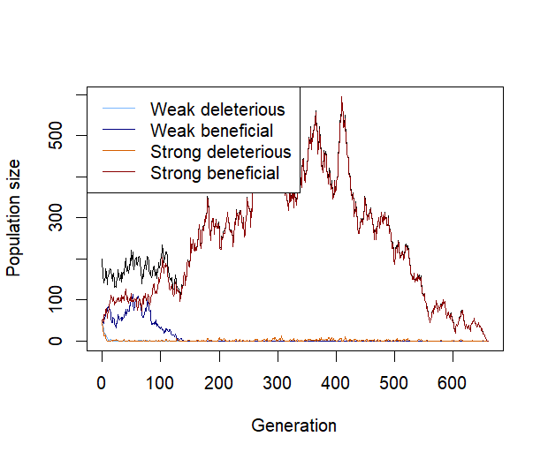
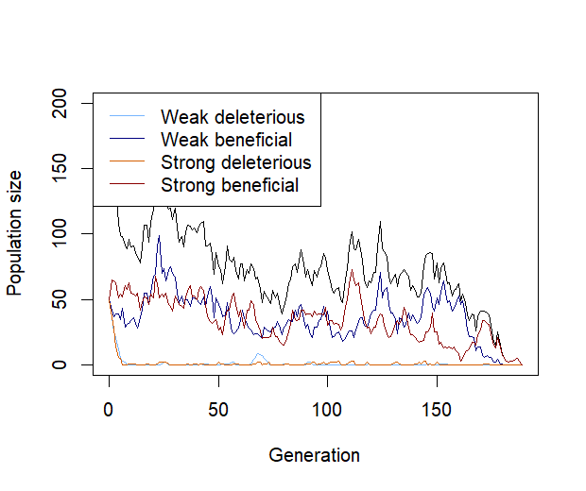
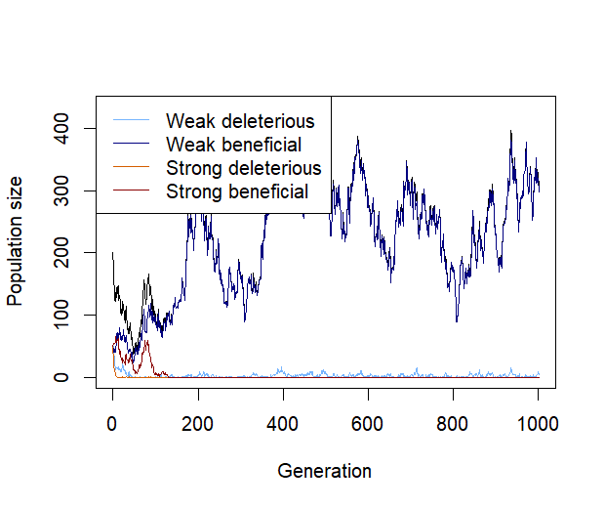
Plot showing one population over multiple generations
Initial populations for all four mutants: N = 50

Slide 9
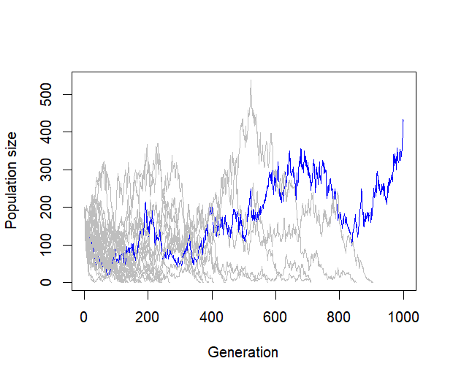
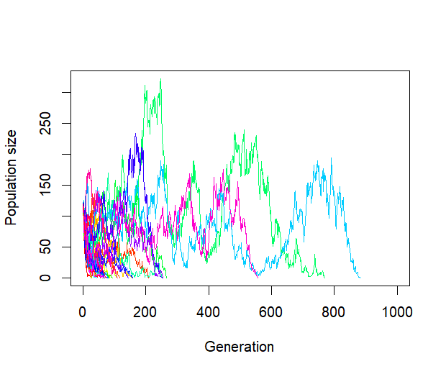
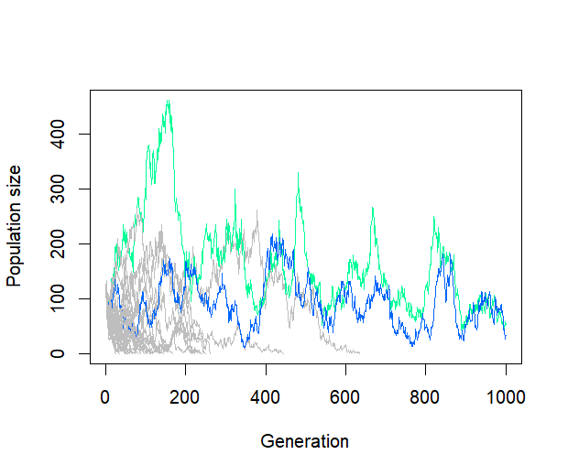
Plot showing multiple populations over a thousand generations
Initial populations for all four mutants: N = 30

Slide 10
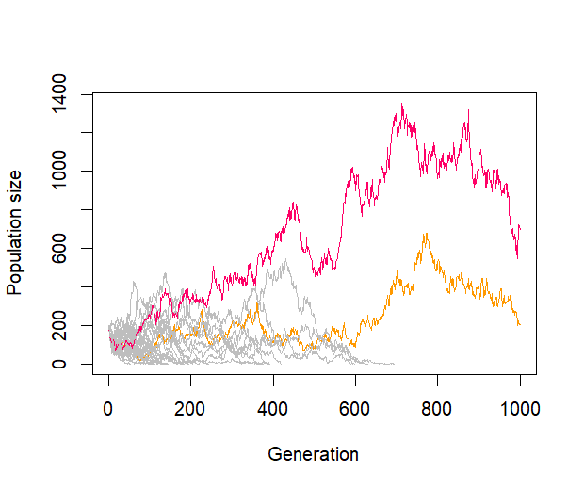
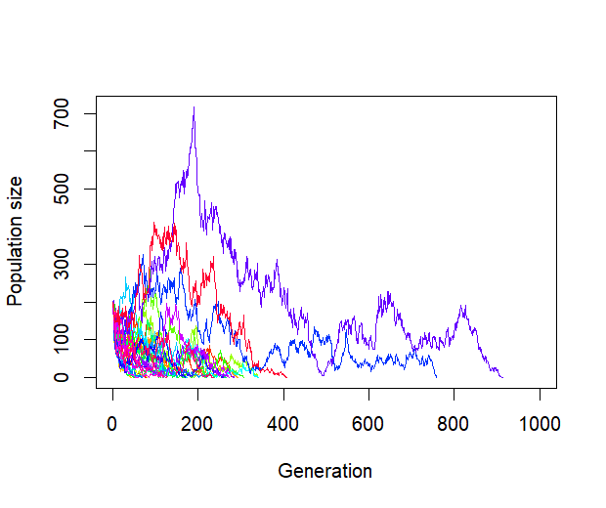
Plot showing multiple populations over a thousand generations
Initial populations for all four mutants: N = 50

Slide 11
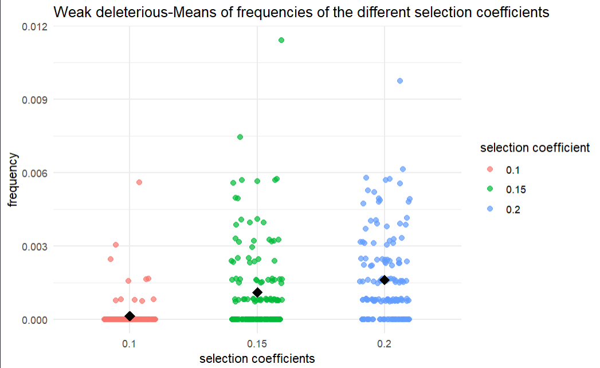
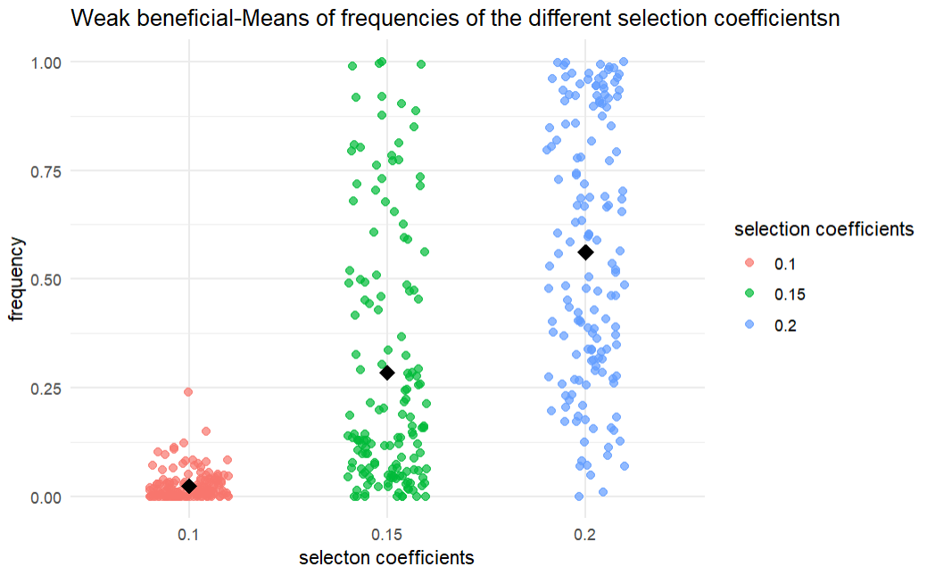
init_wd <- 30init_wb <- 30init_sd <- 30init_sb <- 30m_rate_wm <- 0.001m_rate_sm <- 0.005decay_rate_wm <- 0.1decay_rate_sm <- 0.2s_wm <- 0.2s_sm <- 0.3max_gen <- 1000,no_replicates <- 50

Slide 12
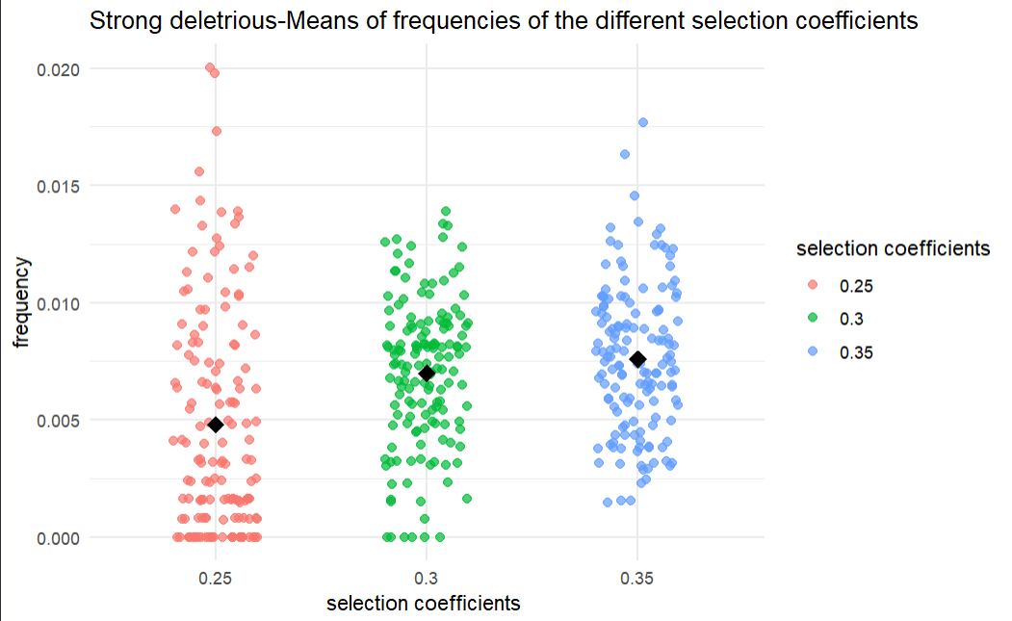
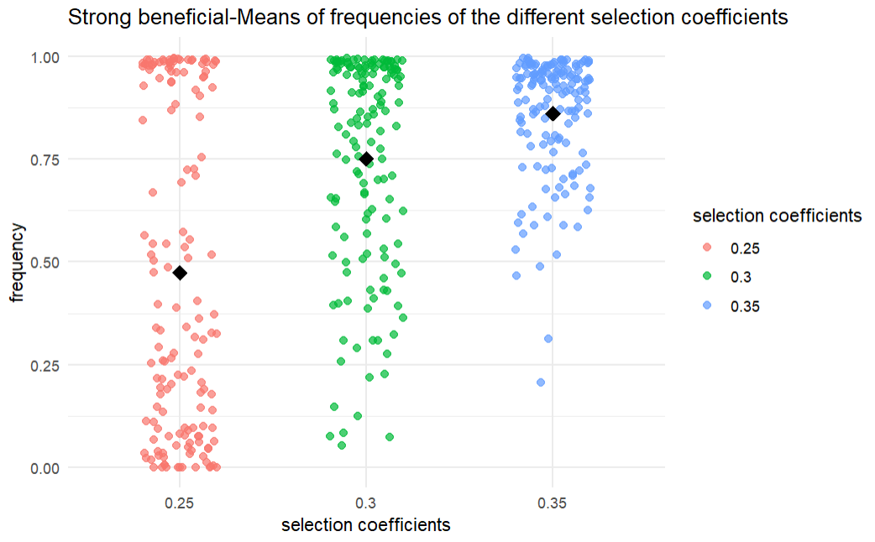
init_wd <- 30init_wb <- 30init_sd <- 30init_sb <- 30m_rate_wm <- 0.001m_rate_sm <- 0.005decay_rate_wm <- 0.1decay_rate_sm <- 0.2s_wm <- 0.2s_sm <- 0.3max_gen <- 1000,no_replicates <- 50

Slide 13
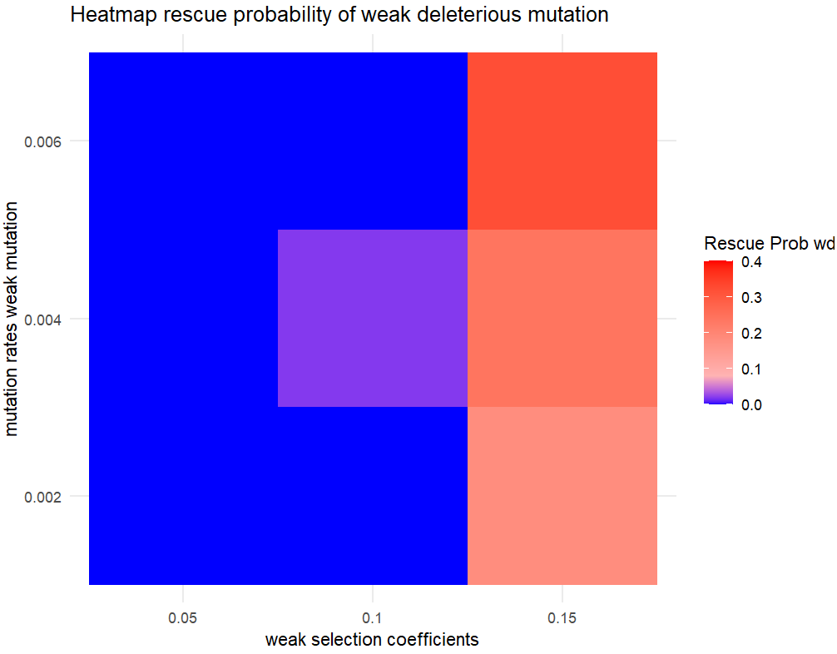
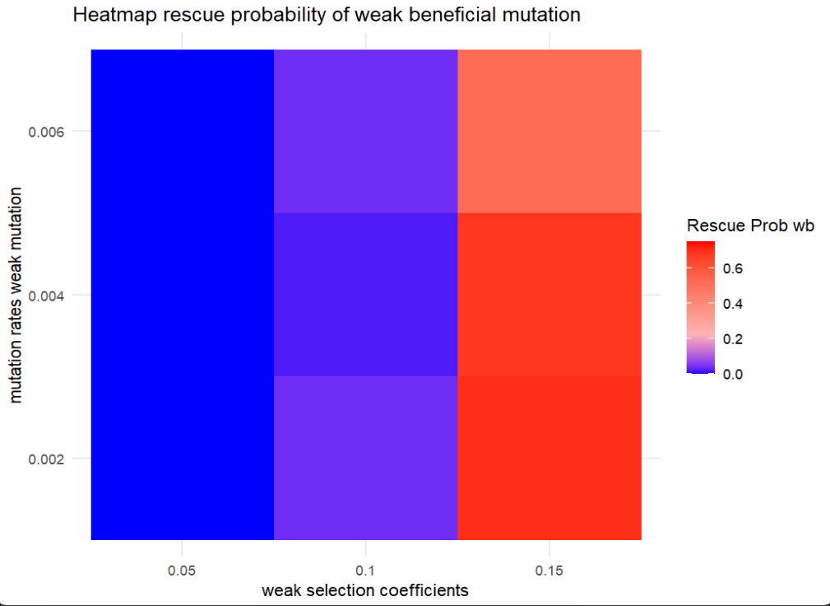
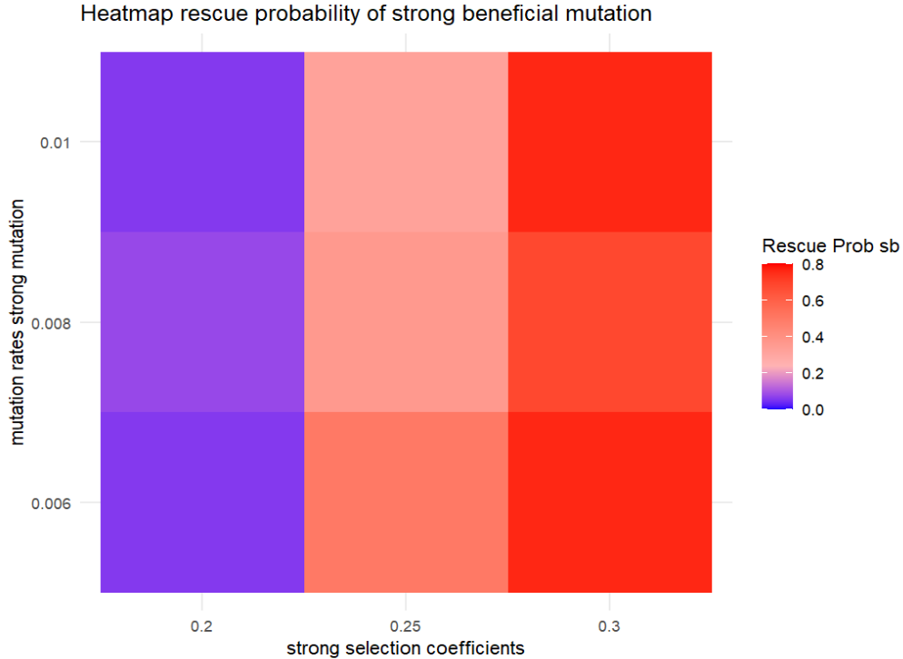
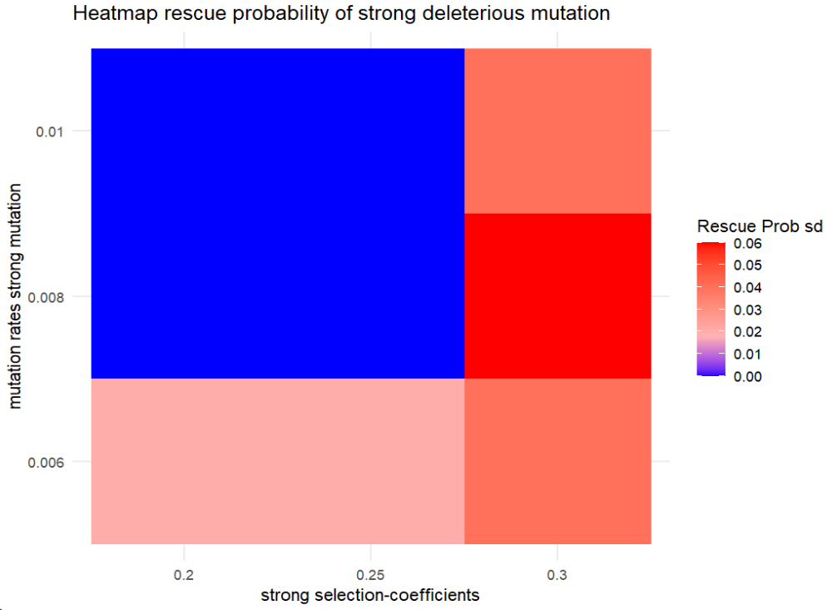
Initial population size for all four mutants: N=50

Slide 14
Biological-applications-Anti microbial resistance
Sophie Maisnier-Patin, Dan I Andersson, Adaptation to the deleterious effects of antimicrobial drug resistance mutations by compensatory evolution, Research in Microbiology, Volume 155, Issue 5, 2004, Pages 360-369, ISSN 0923-2508, (https://www.sciencedirect.com/science/article/pii/S0923250804000683)
Similarities:
Resistance to antimicrobial drugs comes with fitness costs
Mutations as a way to mask effect of deleterious effects→important for adaptation/evolution
Haploid, asexuall populations
Limitations:
Models still are different: no use of exactly 2 deleterious mutations which mutate, including back mutations
Can not really confirm or disprove our results that the strong mutation does better

