Slide 1
A computational model for bacterial resistance
By Julia Eggenschwiler and Jaelle Häfliger

Slide 2
Table of contents
Question and predictions
Method
Results and conclusion

Slide 3
Question and predictions
Question:
Predictions:
Strong deleterious mutations won’t persist, because the costs of the trade off are too high. Therefore, the individuals with the weak and strong beneficial mutations will take over the population.
Thus, the population will be rescued if there are enough individuals with weak and strong beneficial mutations at the beginning.
How do 2 mutations, which can alternate between beneficial and deleterious versions of the same strength, influence the probability of rescue and how does their frequency in the population change?
Notes:
Weak better, Why important? Model for antibiotic resistance in bacteria => situation where exposed to a antibiotic over longer time, also appliable for lab strains

Slide 4
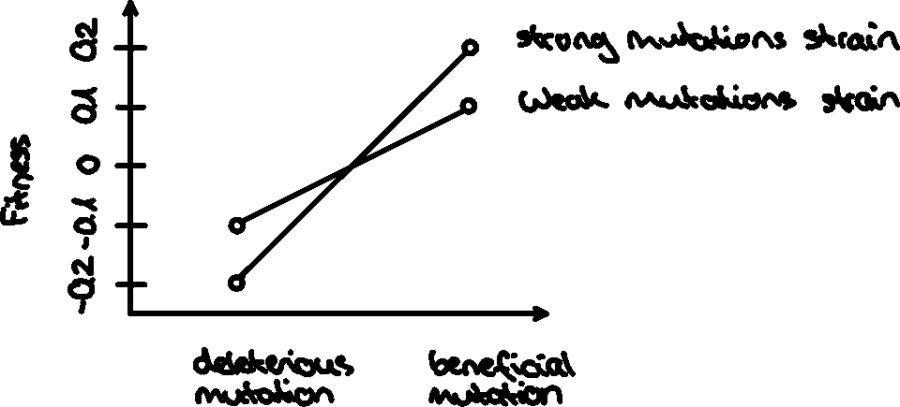
Explanation of the different mutants
Notes:
S get varied in one plot

Slide 5
Parameters and variables-Deviations from base-model
Parameter/Variable | Description | Manipulation
init_wd, init_wb, init_sd, init_sb | initial population sizes of the 4 mutants | always set at the same values for all 4 mutants
decay_rate_wm | decay rate of the weak mutation | fixed
decay_rate_sm | decay rate of the strong mutation | fixed
s_wm | selection-coefficient of weak mutation | varied
s_sm | selection-coefficient of strong mutation | varied
m_rate_wm | mutation rate of the weak mutation | varied
m_rate_sm | mutation rate of the strong mutation | varied
rescue_prob | rescue-probabilities of the 4 mutants | calculated

Slide 6
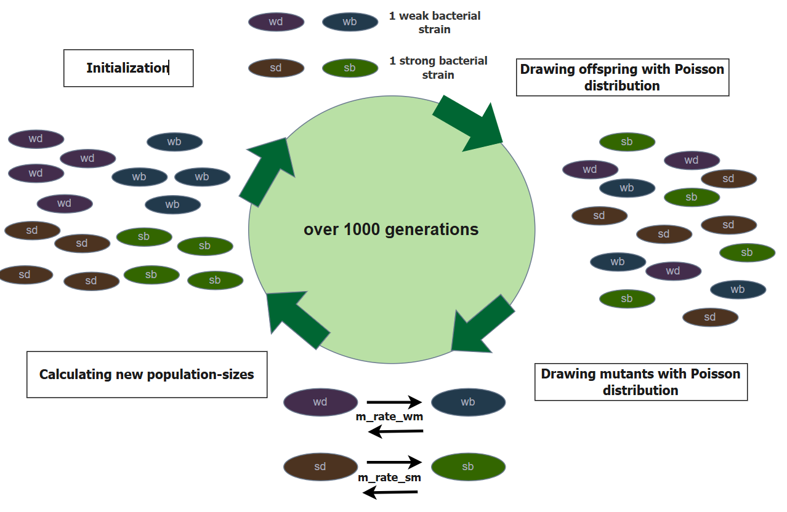
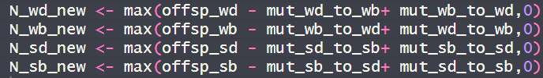
Notes:
Limitation: 1 value for selection coefficient, decay rate and mutation rate, in reality much more compex, also not only 2 mutations exist in individuals, selection coefficient might be too high, although for bacteria they seem fine

Slide 7
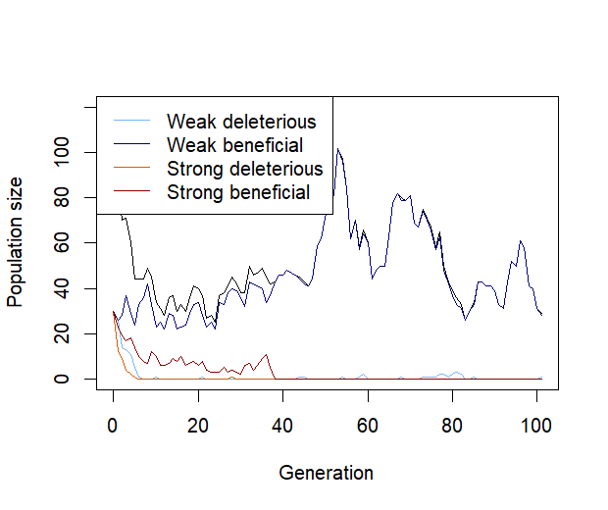
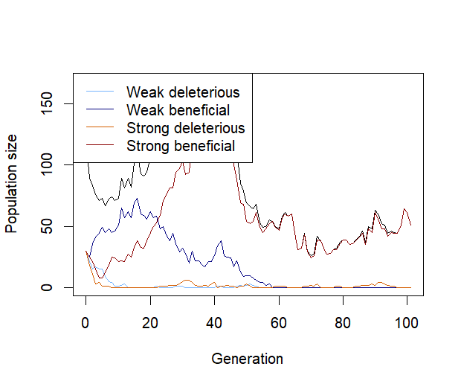
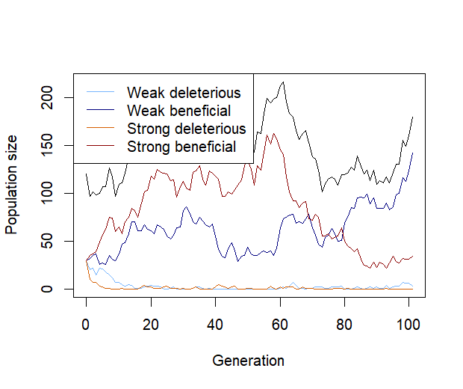
Plot showing one population over multiple generations
Initial populations for all four mutants: N = 30,
m_rate_wm <- 0.003, m_rate_sm <- 0.005, decay_rate_wm <- 0.1, decay_rate_sm <- 0.2, s_wm <- 0.1, s_sm <- 0.2, max_gen <- 1000,
replicates <- 30

Slide 8
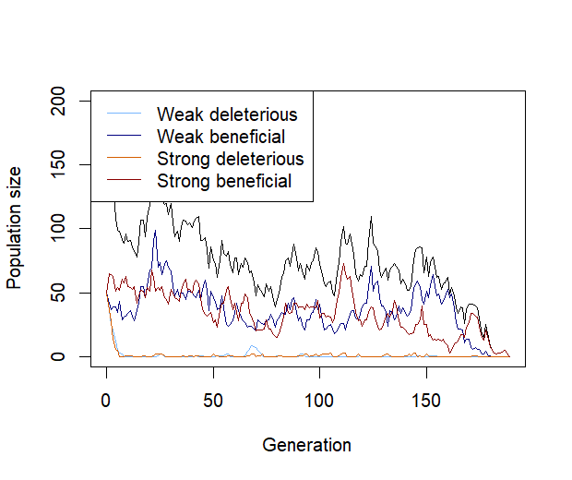
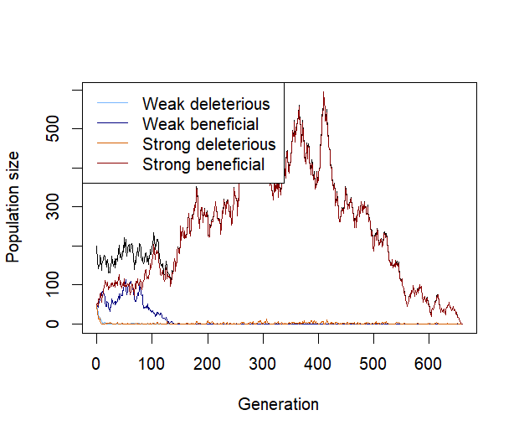
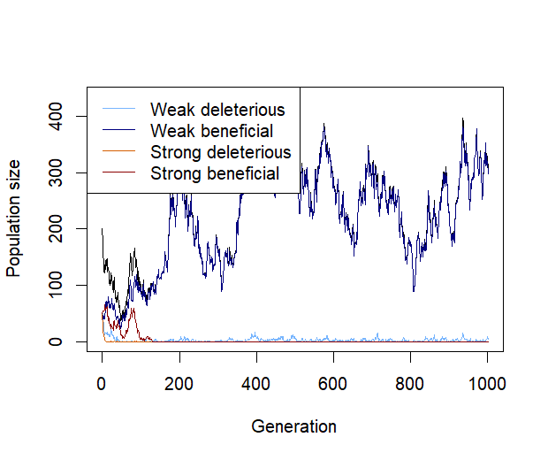
Plot showing one population over multiple generations
Initial populations for all four mutants: N = 50,
m_rate_wm <- 0.002, m_rate_sm <- 0.003, decay_rate_wm <- 0.1, decay_rate_sm <- 0.2,
s_wm <- 0.1, s_sm <- 0.2, max_gen <- 1000, replicates <- 30

Slide 9
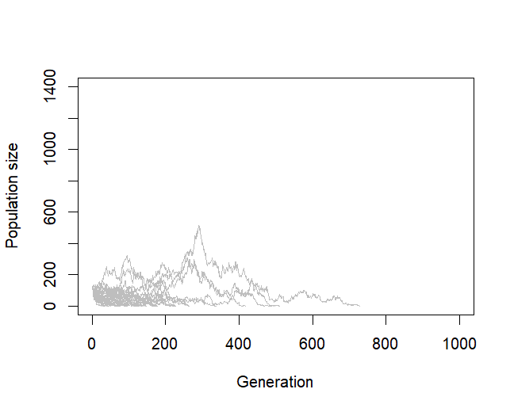
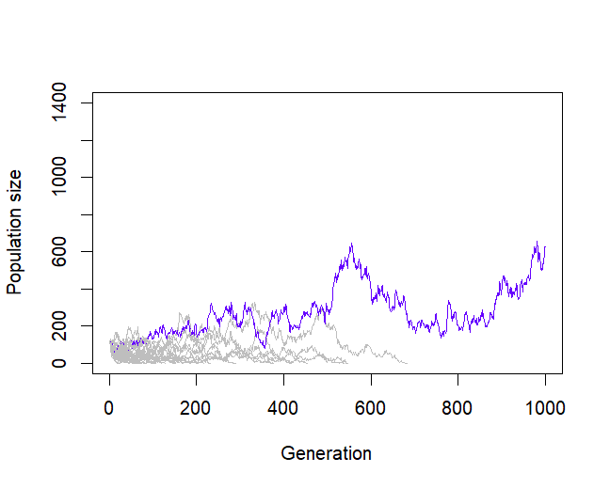
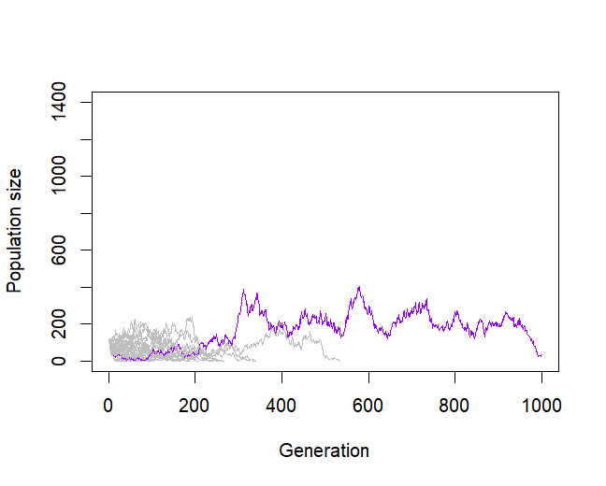
Plot showing multiple populations over a thousand generations
Initial populations for all four mutants: N = 30
m_rate_wm <- 0.003, m_rate_sm <- 0.005, decay_rate_wm <- 0.1, decay_rate_sm <- 0.2, s_wm <- 0.1, s_sm <- 0.2, max_gen <- 1000,
replicates <- 30

Slide 10
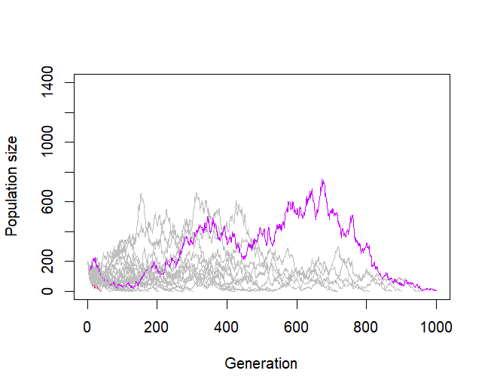
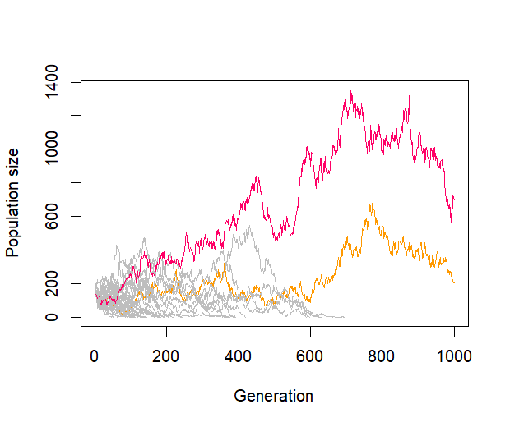
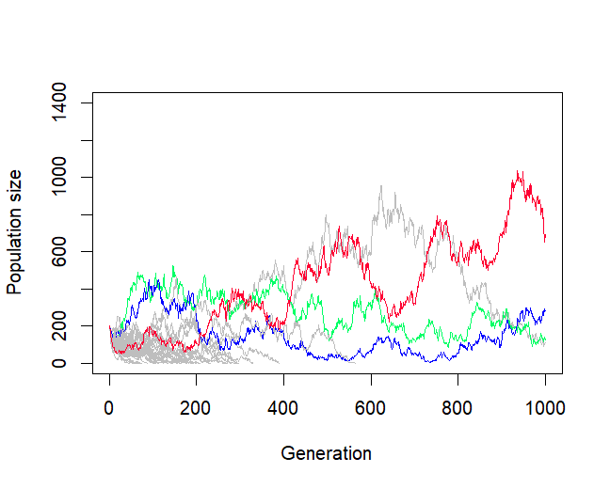
Plot showing multiple populations over a thousand generations
Initial populations for all four mutants: N = 50
m_rate_wm <- 0.002, m_rate_sm <- 0.003, decay_rate_wm <- 0.1, decay_rate_sm <- 0.2,
s_wm <- 0.1, s_sm <- 0.2, max_gen <- 1000, replicates <- 30

Slide 11
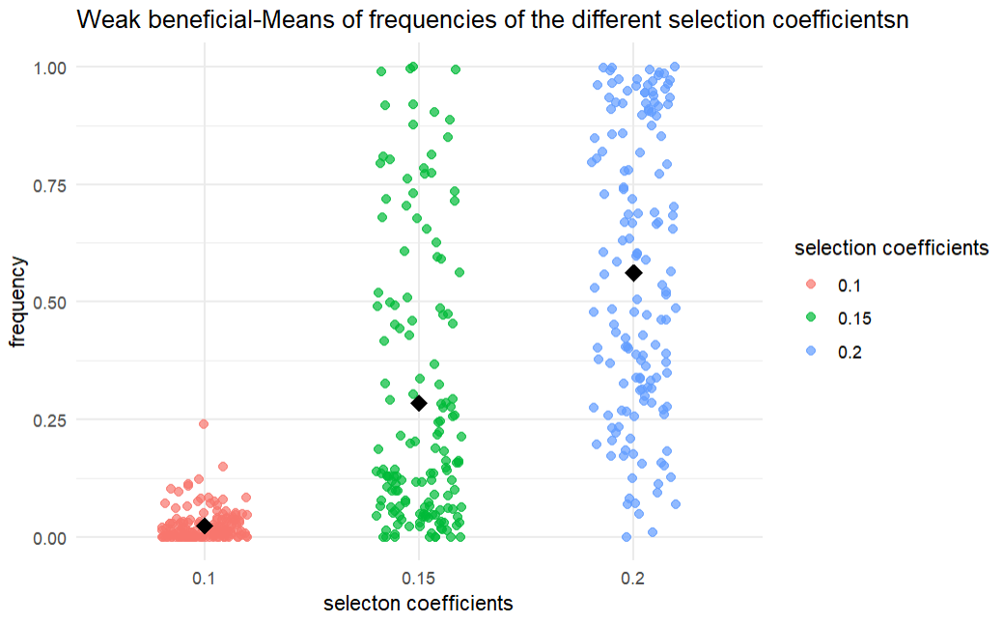
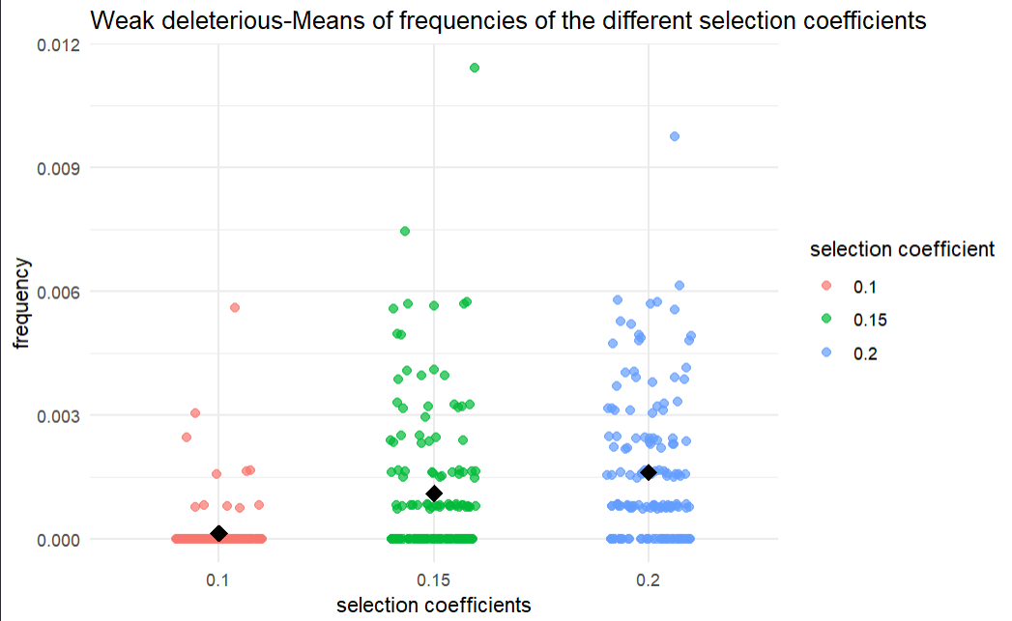
Scatterplots showing the frequency of each mutation depending on different selection coefficients

Slide 12
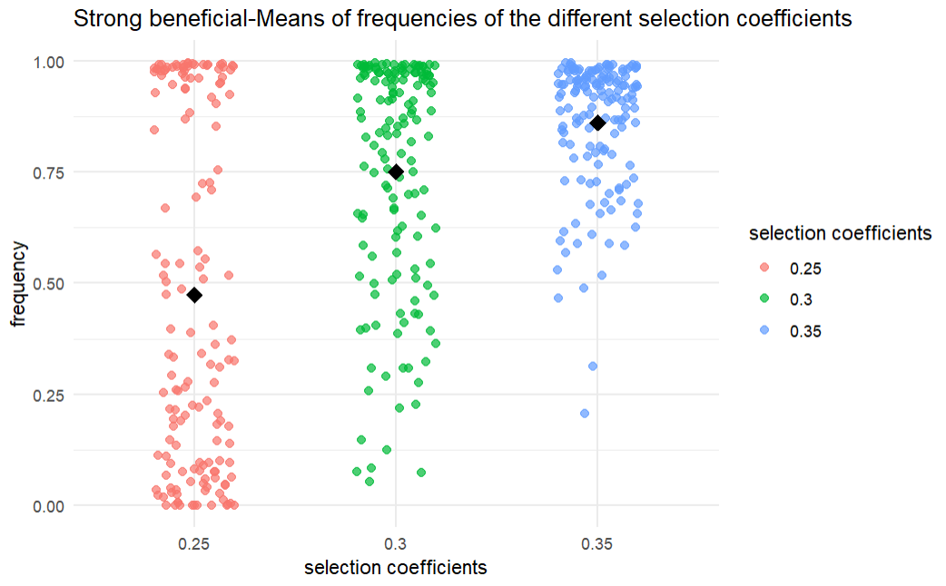
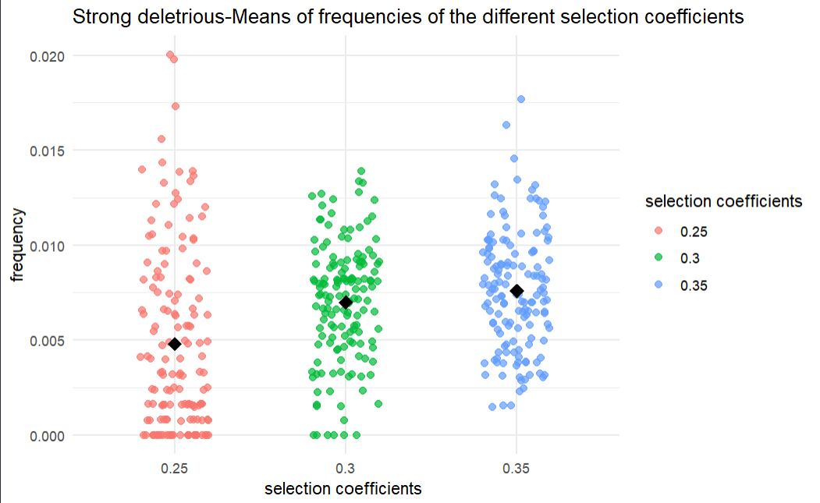
Scatterplots showing the frequency of each mutation depending on different selection coefficients

Slide 13
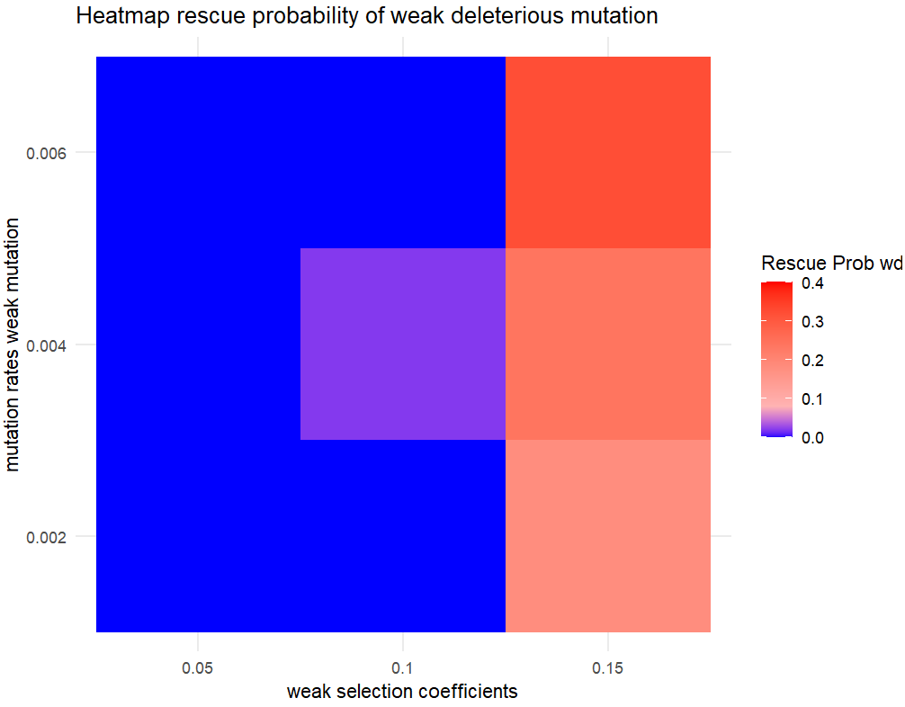
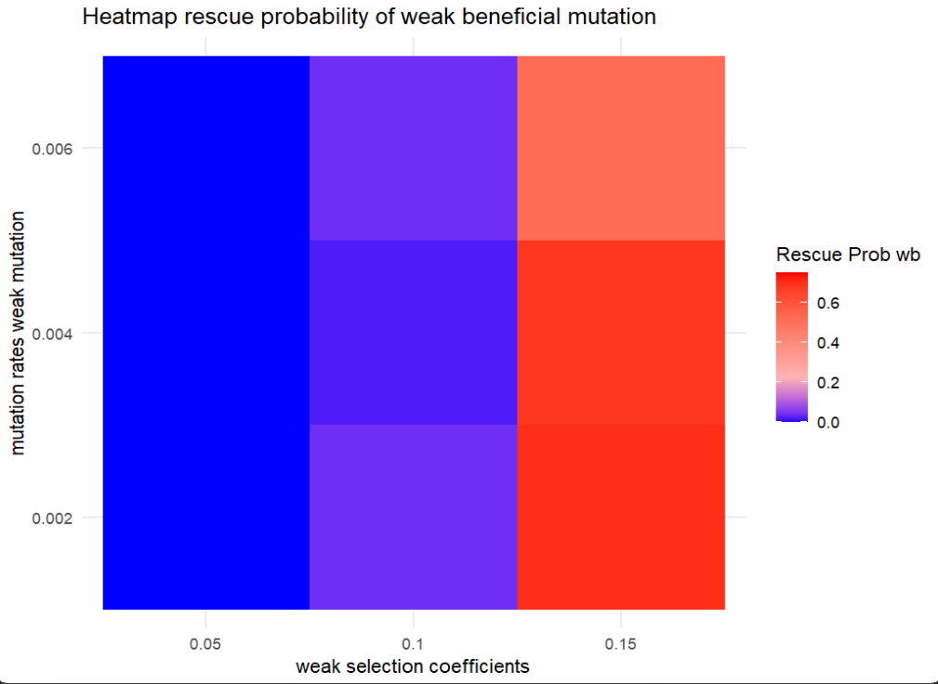
Initial population size for all four mutants: N=50

Slide 14
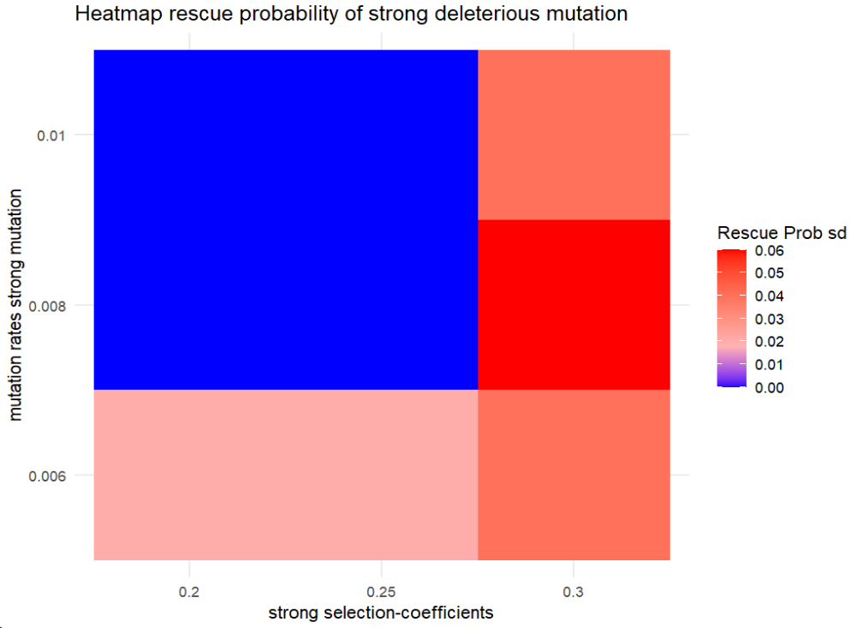
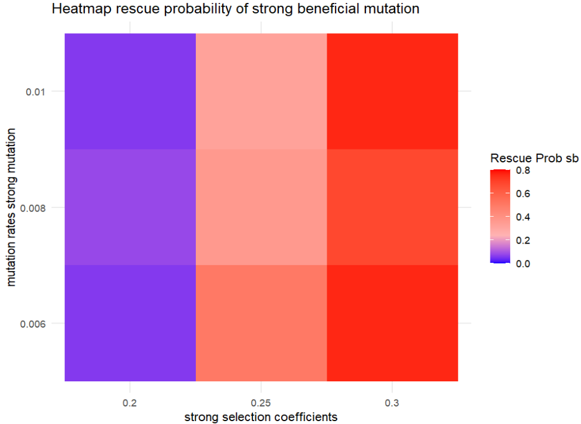

Slide 15

Thank you for your attention!

Slide 16
Biological-applications-Anti microbial resistance
Similarities:
Resistance to antimicrobial drugs comes with fitness costs
Mutations as a way to mask effect of deleterious effects→important for adaptation/evolution
Haploid, asexuall populations
Limitations:
Models still are different: no use of exactly 2 deleterious mutations which mutate, including back mutations
Can not really confirm or disprove our results that the strong mutation does better
Sophie Maisnier-Patin, Dan I Andersson, Adaptation to the deleterious effects of antimicrobial drug resistance mutations by compensatory evolution, Research in Microbiology, Volume 155, Issue 5, 2004, Pages 360-369, ISSN 0923-2508, (https://www.sciencedirect.com/science/article/pii/S0923250804000683)

