Slide 1
A computational model for bacterial resistance
By Julia Eggenschwiler and Jaelle Häfliger

Slide 2
Table of contents
Hypothesis and predictions
Method
Results and conclusion
Biological applications

Slide 3
Hypothesis and predictions
Hypothesis:
Predictions:
Strong deleterious mutation won’t persist, because the costs of the trade off are too high. Therefore, the individuals with the weak and strong beneficial mutations will take over the population.
Thus, the population will be rescued if there are enough individuals with weak mutations or strong beneficial at the beginning.
How do 2 mutations, which can alternate between beneficial and deleterious versions of the same strength, influence the probability of rescue and how does their frequency in the population change?
Notes:
Why is this question important?: bacterial resistance against antibiotics which is growing problem =>need to know to prevent, lab

Slide 4
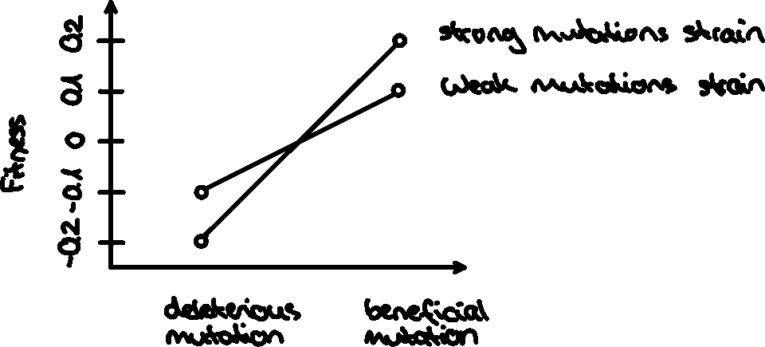
Explanation of the different mutants
Notes:
Limitations: 1 value for selection coefficient, decay rate and mutation rate, in reality much more compex, also not only 2 mutations exist in individuals, selection coefficient might be too high, although for bacteria they seem fine (0.05-0.5 under antibiotics)

Slide 5
Parameters and variables-Deviations from base-model
Parameter/Variable | Description | Manipulated
init_wd, init_wb, init_sd, init_sb | initial population sizes of the 4 mutants | always set at the same values for all 4 mutants
decay_rate_wm | decay rate of the weak mutation | fixed
decay_rate_sm | decay rate of the strong mutation | fixed
s_wm | selection-coefficient of weak mutation | varied
s_sm | melection-coefficient of strong mutation | varied
m_rate_wm | mutation rate of the weak mutation | varied
m_rate_sm | mutation rate of the strong mutation | varied
rescue_prob | rescue-probabilities of the 4 mutants | calculated

Slide 6
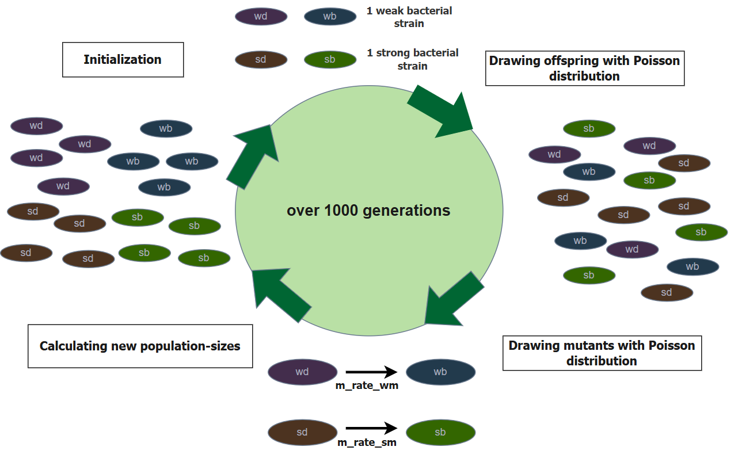
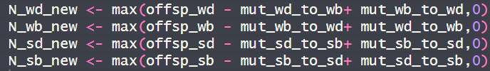

Slide 7
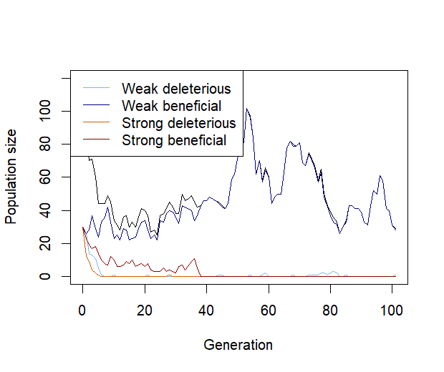
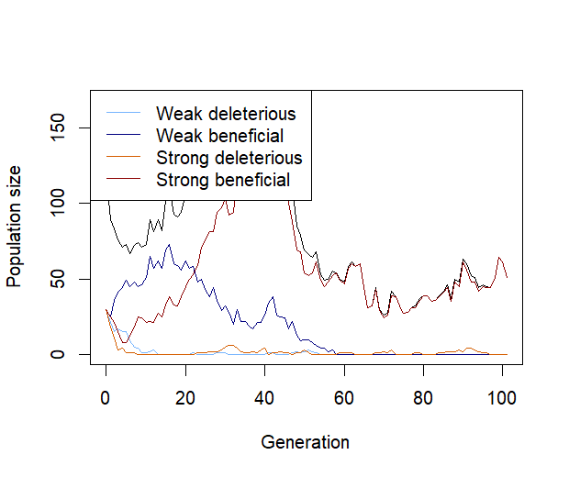
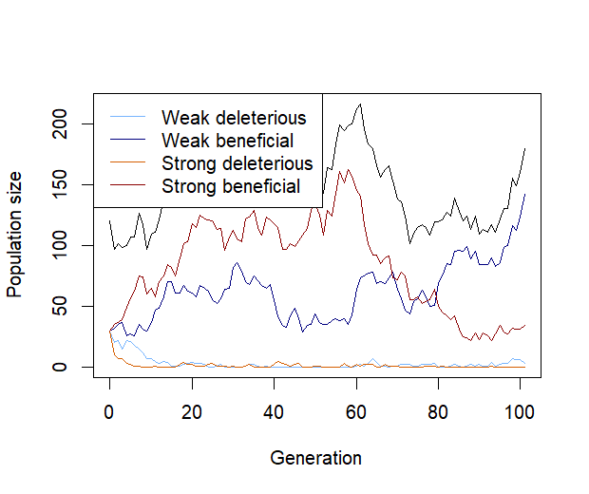
Plot showing one population over multiple generations
Initial populations for all four mutants: N = 30,
m_rate_wm <- 0.003, m_rate_sm <- 0.005, decay_rate_wm <- 0.1, decay_rate_sm <- 0.2, s_wm <- 0.1, s_sm <- 0.2, max_gen <- 1000

Slide 8
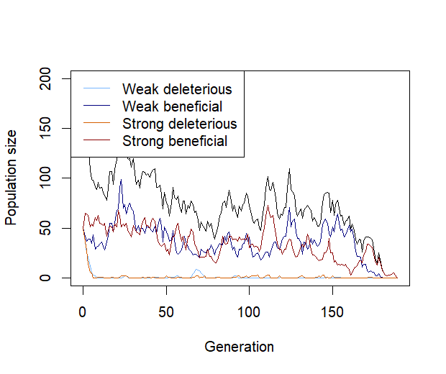
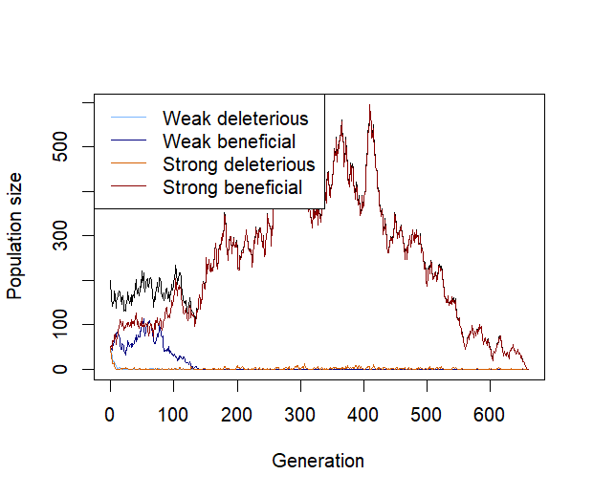
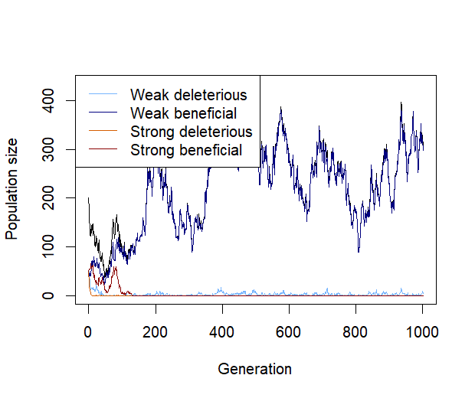
Plot showing one population over multiple generations
Initial populations for all four mutants: N = 50,
m_rate_wm <- 0.002, m_rate_sm <- 0.003, decay_rate_wm <- 0.1, decay_rate_sm <- 0.2, s_wm <- 0.1, s_sm <- 0.2, max_gen <- 1000
replicates <- 30

Slide 9
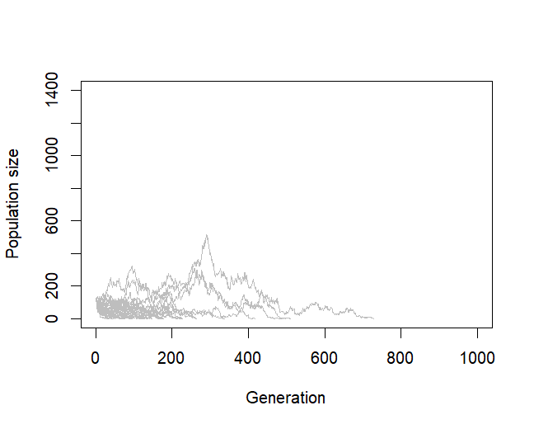
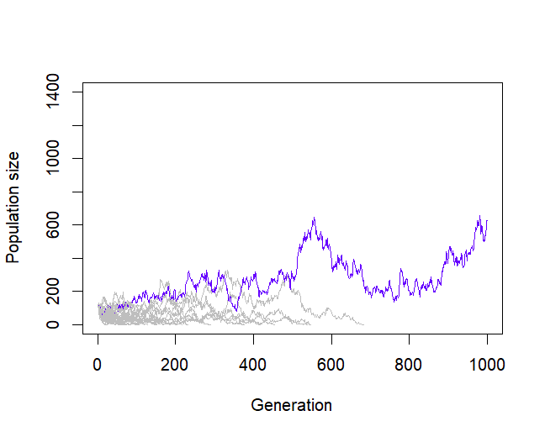
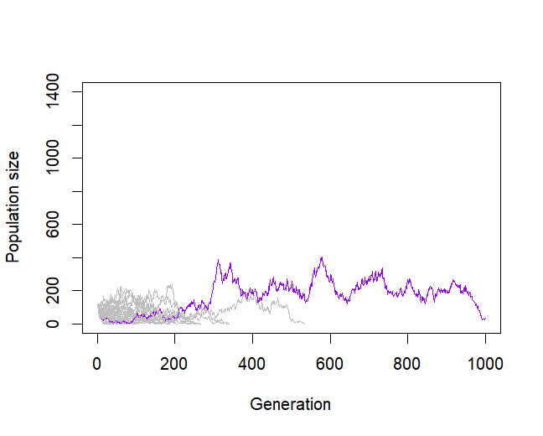
Plot showing multiple populations over a thousand generations
Initial populations for all four mutants: N = 30
m_rate_wm <- 0.003, m_rate_sm <- 0.005, decay_rate_wm <- 0.1, decay_rate_sm <- 0.2, s_wm <- 0.1, s_sm <- 0.2, max_gen <- 1000,
replicates <- 30

Slide 10
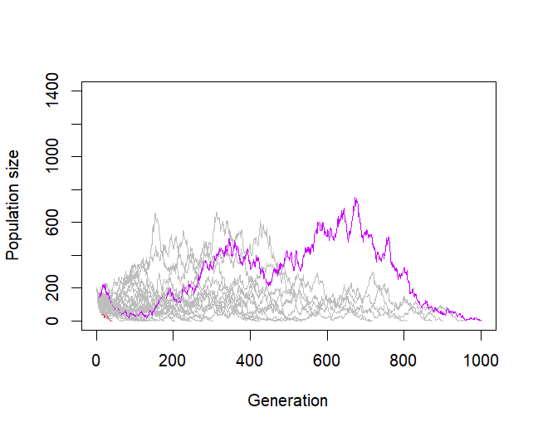
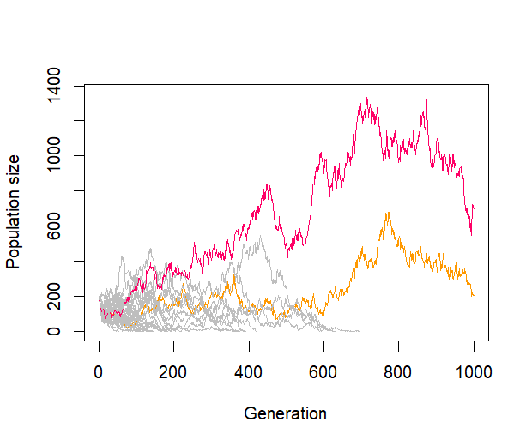
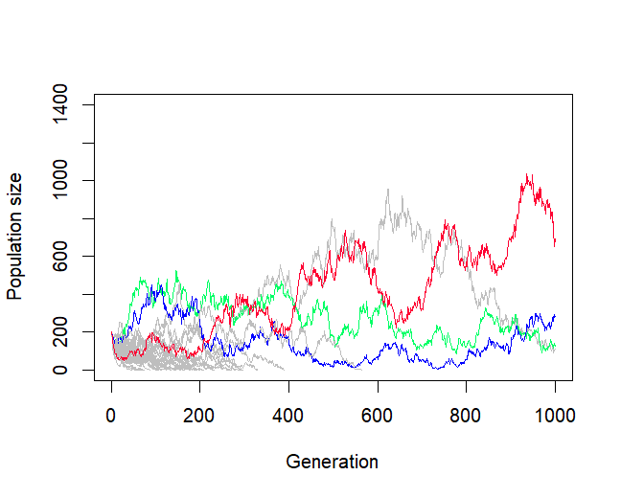
Plot showing multiple populations over a thousand generations
Initial populations for all four mutants: N = 50
m_rate_wm <- 0.002, m_rate_sm <- 0.003, decay_rate_wm <- 0.1, decay_rate_sm <- 0.2,
s_wm <- 0.1, s_sm <- 0.2, max_gen <- 1000, replicates <- 30

Slide 11
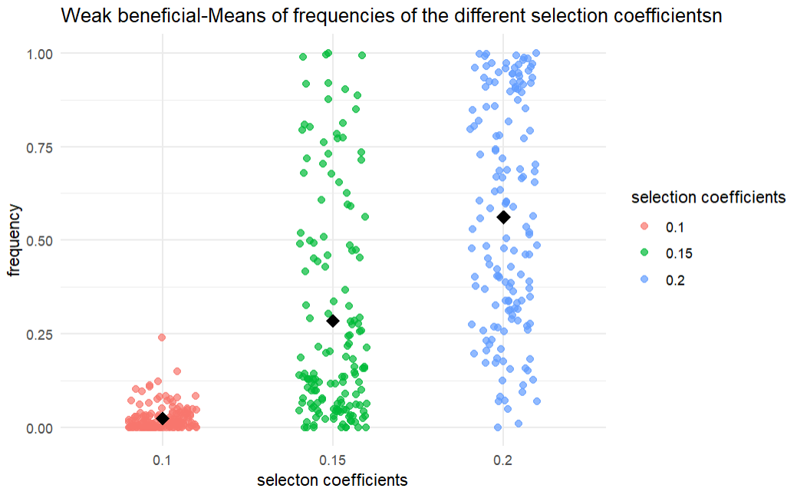
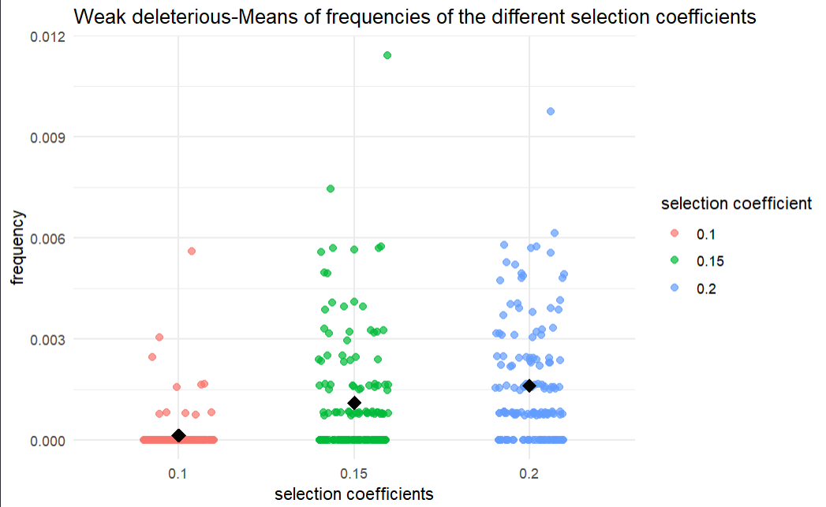
Scatterplots showing the frequency of each mutation depending on different selection coefficients

Slide 12
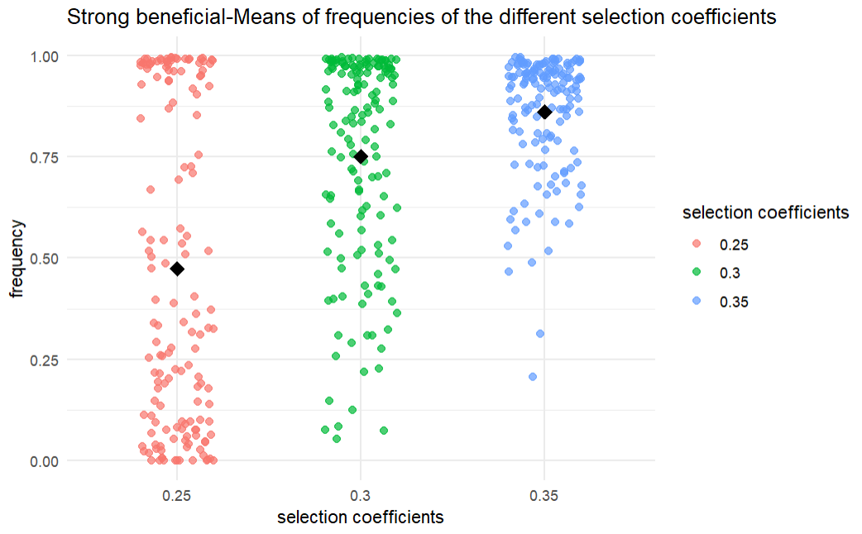
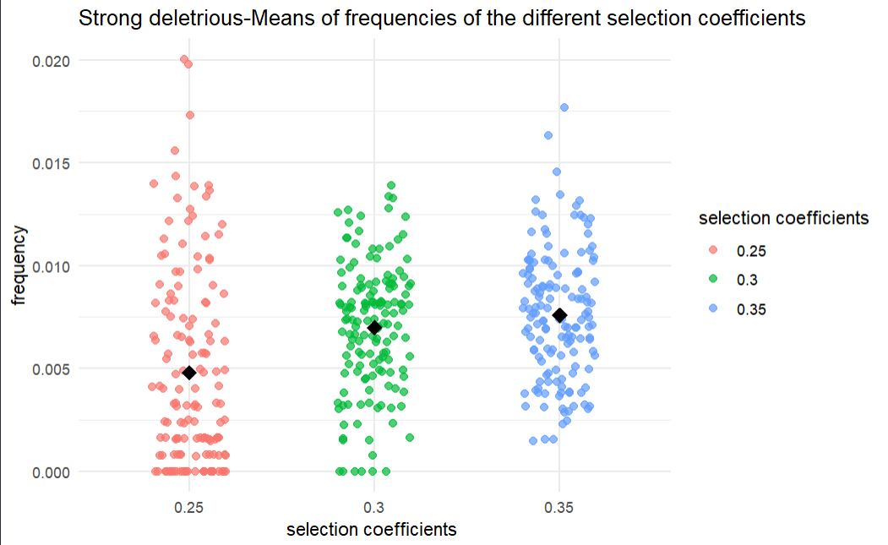
Scatterplots showing the frequency of each mutation depending on different selection coefficients

Slide 13
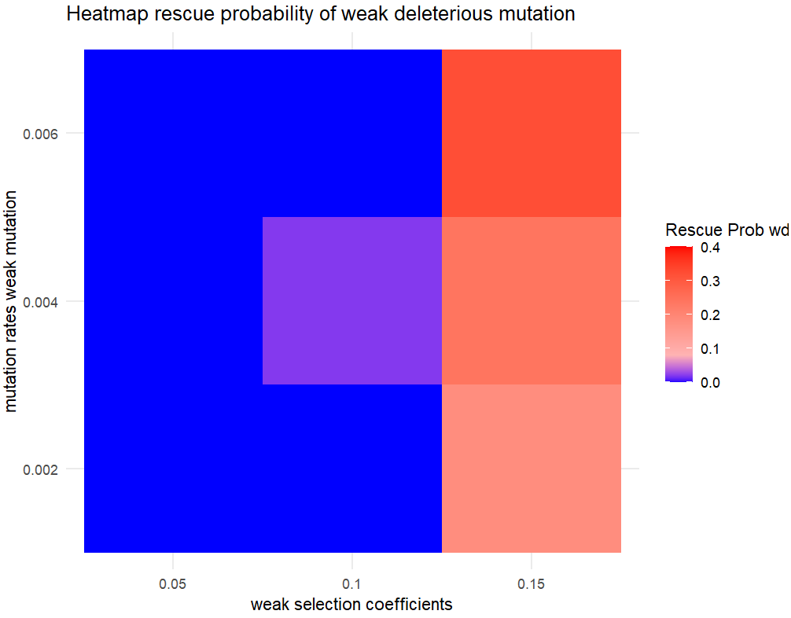
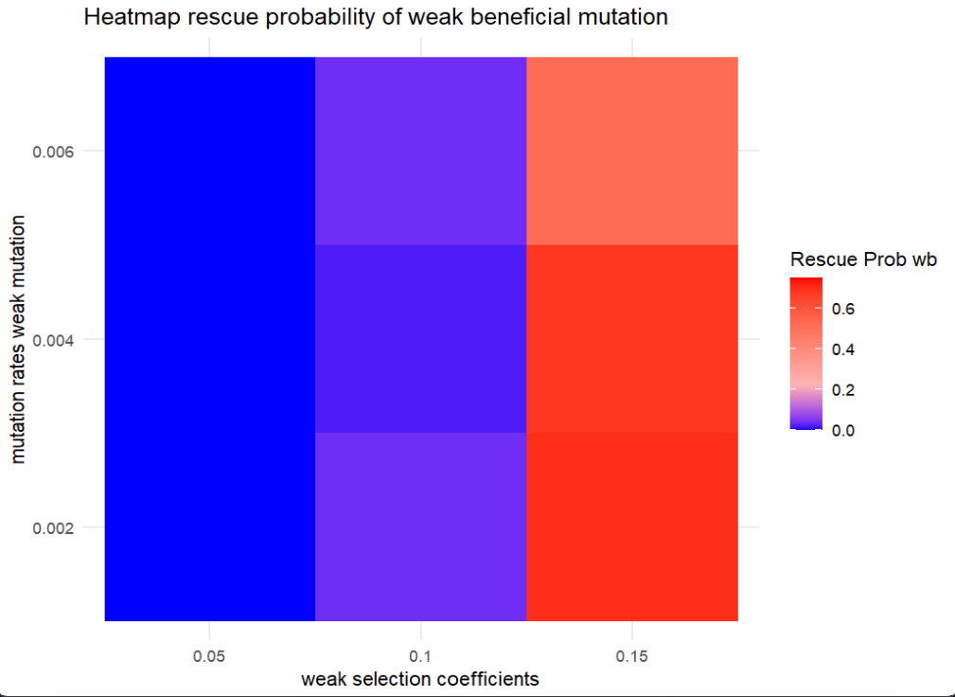
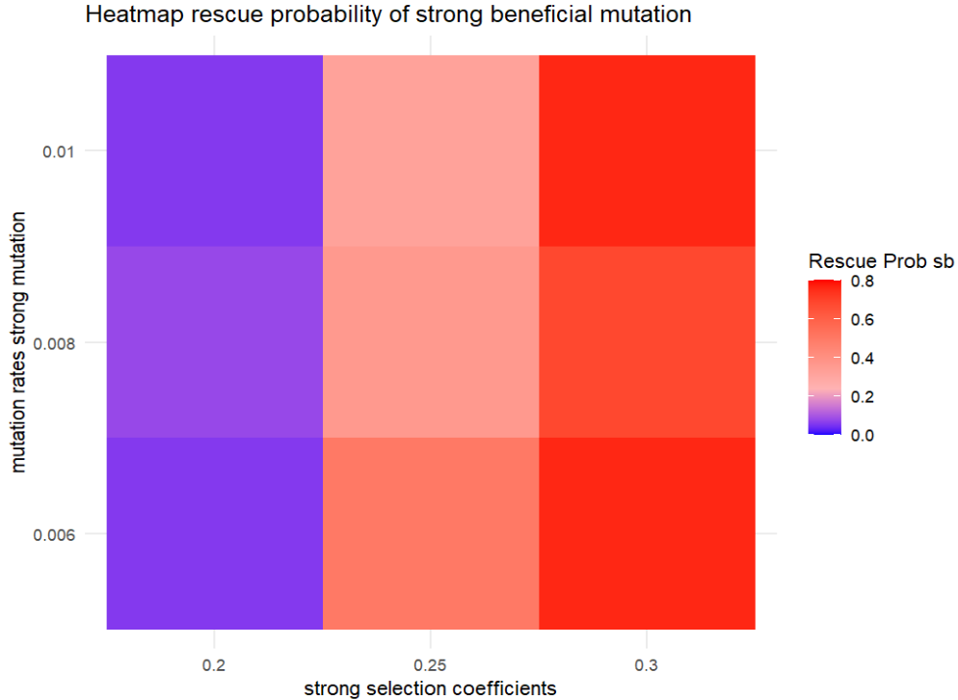
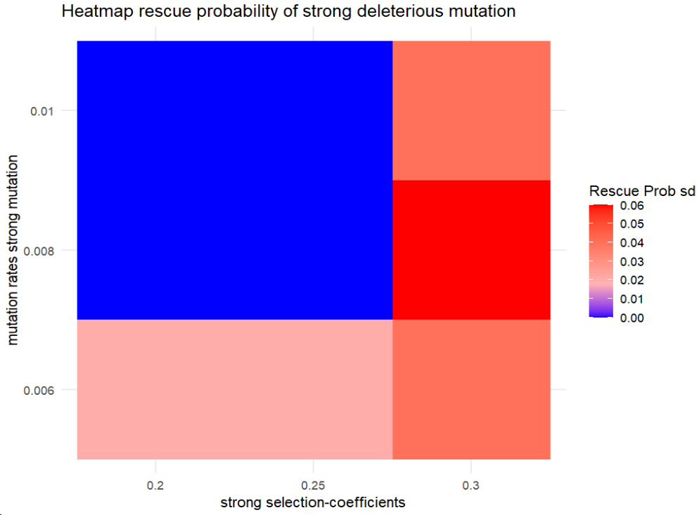
Initial population size for all four mutants: N=50

Slide 14
Biological-applications-Anti microbial resistance
Similarities:
Resistance to antimicrobial drugs comes with fitness costs
Mutations as a way to mask effect of deleterious effects→important for adaptation/evolution
Haploid, asexual populations
Limitations:
Models still are different: no use of exactly 2 deleterious mutations which mutate, including back mutations
Can not really confirm or disprove our results that the strong mutation does better
Sophie Maisnier-Patin, Dan I Andersson, Adaptation to the deleterious effects of antimicrobial drug resistance mutations by compensatory evolution, Research in Microbiology, Volume 155, Issue 5, 2004, Pages 360-369, ISSN 0923-2508, (https://www.sciencedirect.com/science/article/pii/S0923250804000683)

