Slide 1
HCI
TechWatch
# G2 Thomas.E , Julia,
Markus, Martin.W
Remote controlled robotics with haptic feedback

Slide 2

Notes:
https://www.youtube.com/watch?v=p1HmgP9l4VY

Slide 3
Video Summary
„The intent here is to have a diver diving virtually, creating a robot that can be the physical representation of the human”
reflect the contact forces; sense of touch as a new dimension
„physically extract the human from a dangerous area“
„The human can provide the expertise, the cognitive abilities, to the robot. And the two bring together this amazing synergy“

Slide 4





Advantages
Intuitive:
Touch is the earliest sense
developed in human embryology
Close to reality
For tasks that require utmost precision

Slide 5
Advantages
Intuitive:
Touch is the earliest sense
developed in human embryology
Close to reality
For tasks that require utmost precision

Slide 6
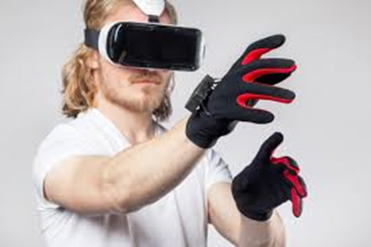
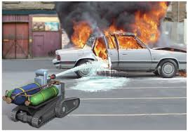
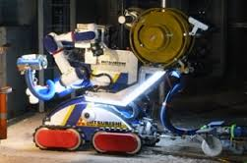
Examples
Dangerous Areas
VR Gloves
How
When
Notes:
Wie geht sowas
Wo Roboter überhaupt eingesetzt:
-> Wo Gefahr für Menschen
Oder: Dort wo PRÄZISION notwendig.
>> Beispiel für Präzision +
wo es wirklich wichtig ist, dass
Der Steuernde das spürt, was der Roboter spürt
0:49

Slide 7
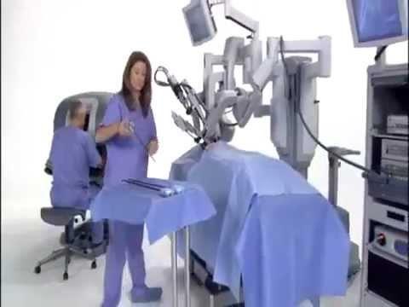
Notes:
https://www.youtube.com/watch?v=VJ_3GJNz4fg

Slide 8
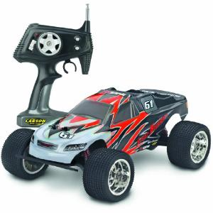
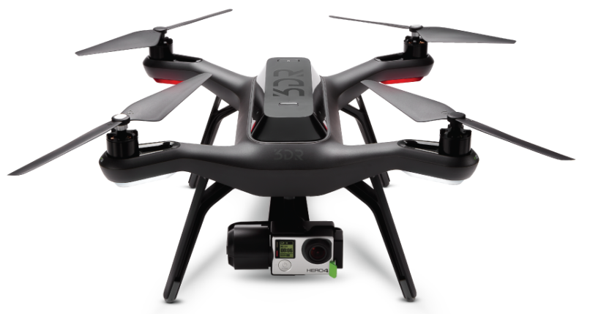
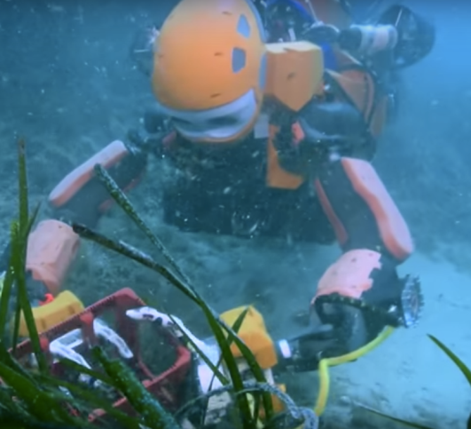
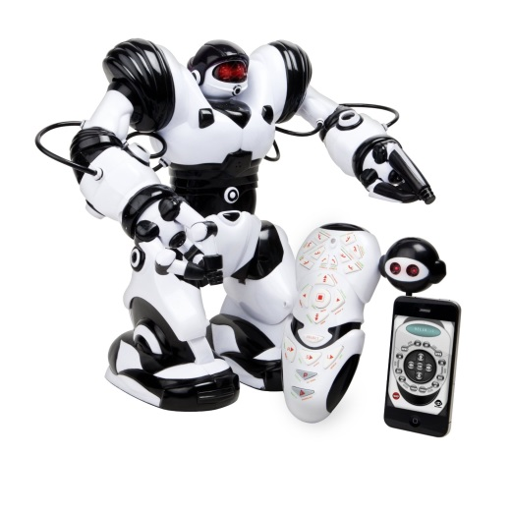
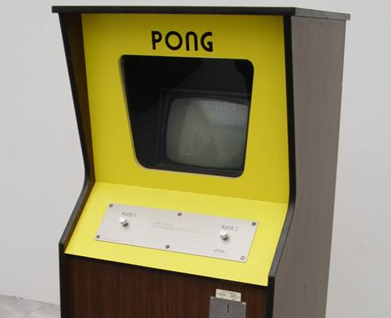
History
vs
Notes:
The question is, if this technology is something new, or if there is a technological shift in remote controlled robots: we argue yes, as especially haptics enable us to use our most useful tools to physically interact – our hands – in different, more intuitive and better ways with robots/other physical representations

Slide 9
HCI
TechWatch
# G2 Thomas.E , Julia,
Markus, Martin.W
Remote controlled robotics with haptic feedback

