Slide 1
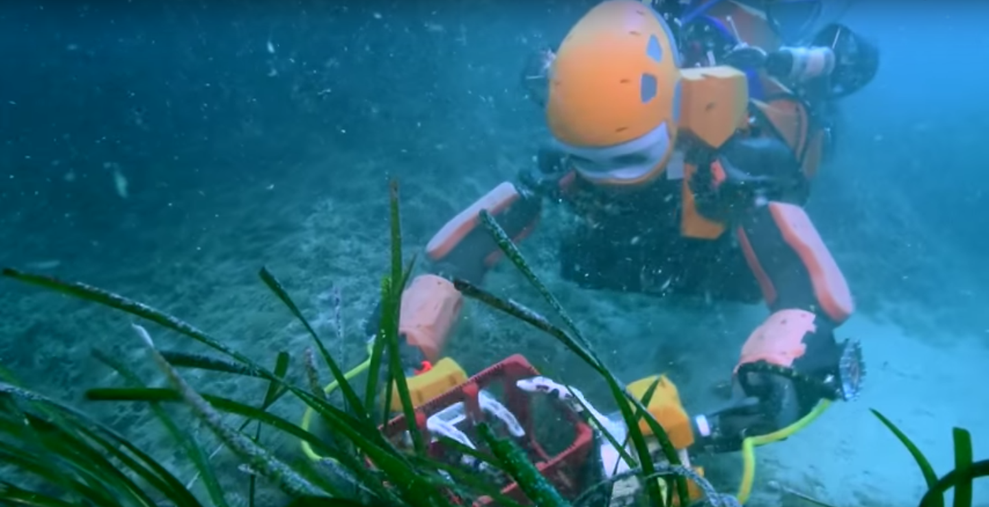
Video

Slide 2
Video Summary
„The intent here is to have a diver diving virtually, creating a robot that can be the physical representation of the human”
reflect the contact forces; sense of touch as a new dimension
„physically extract the human from a dangerous area“
„The human can provide the expertise, the cognitive abilities, to the robot. And the two bring together this amazing synergy“

Slide 3
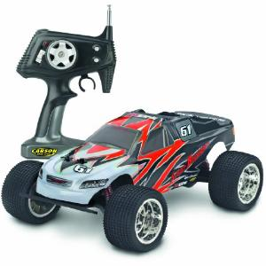
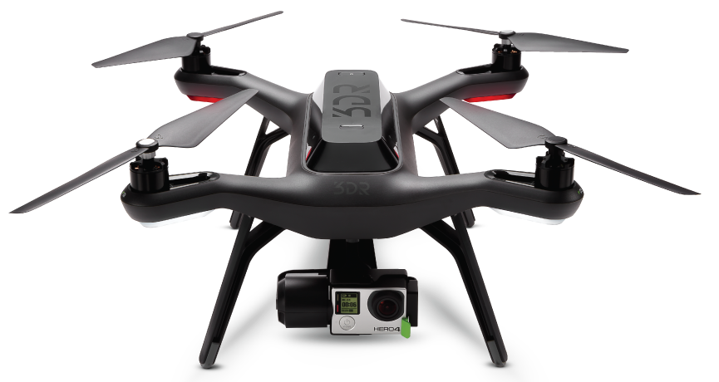
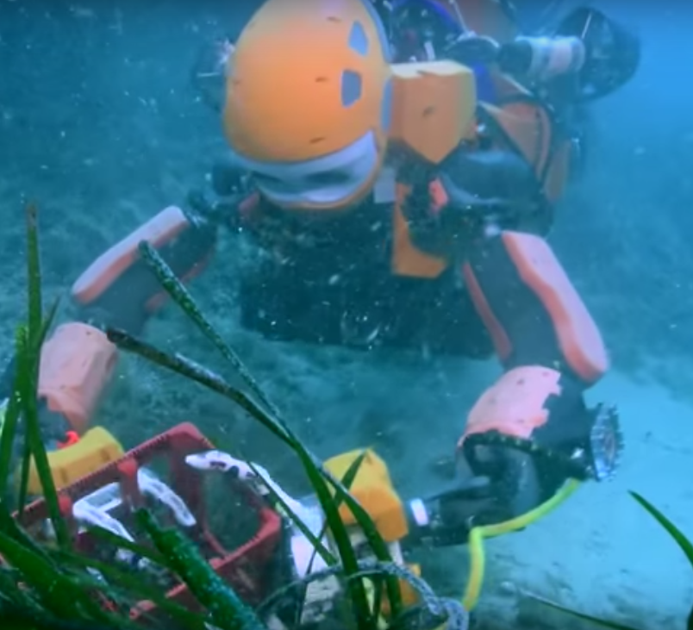
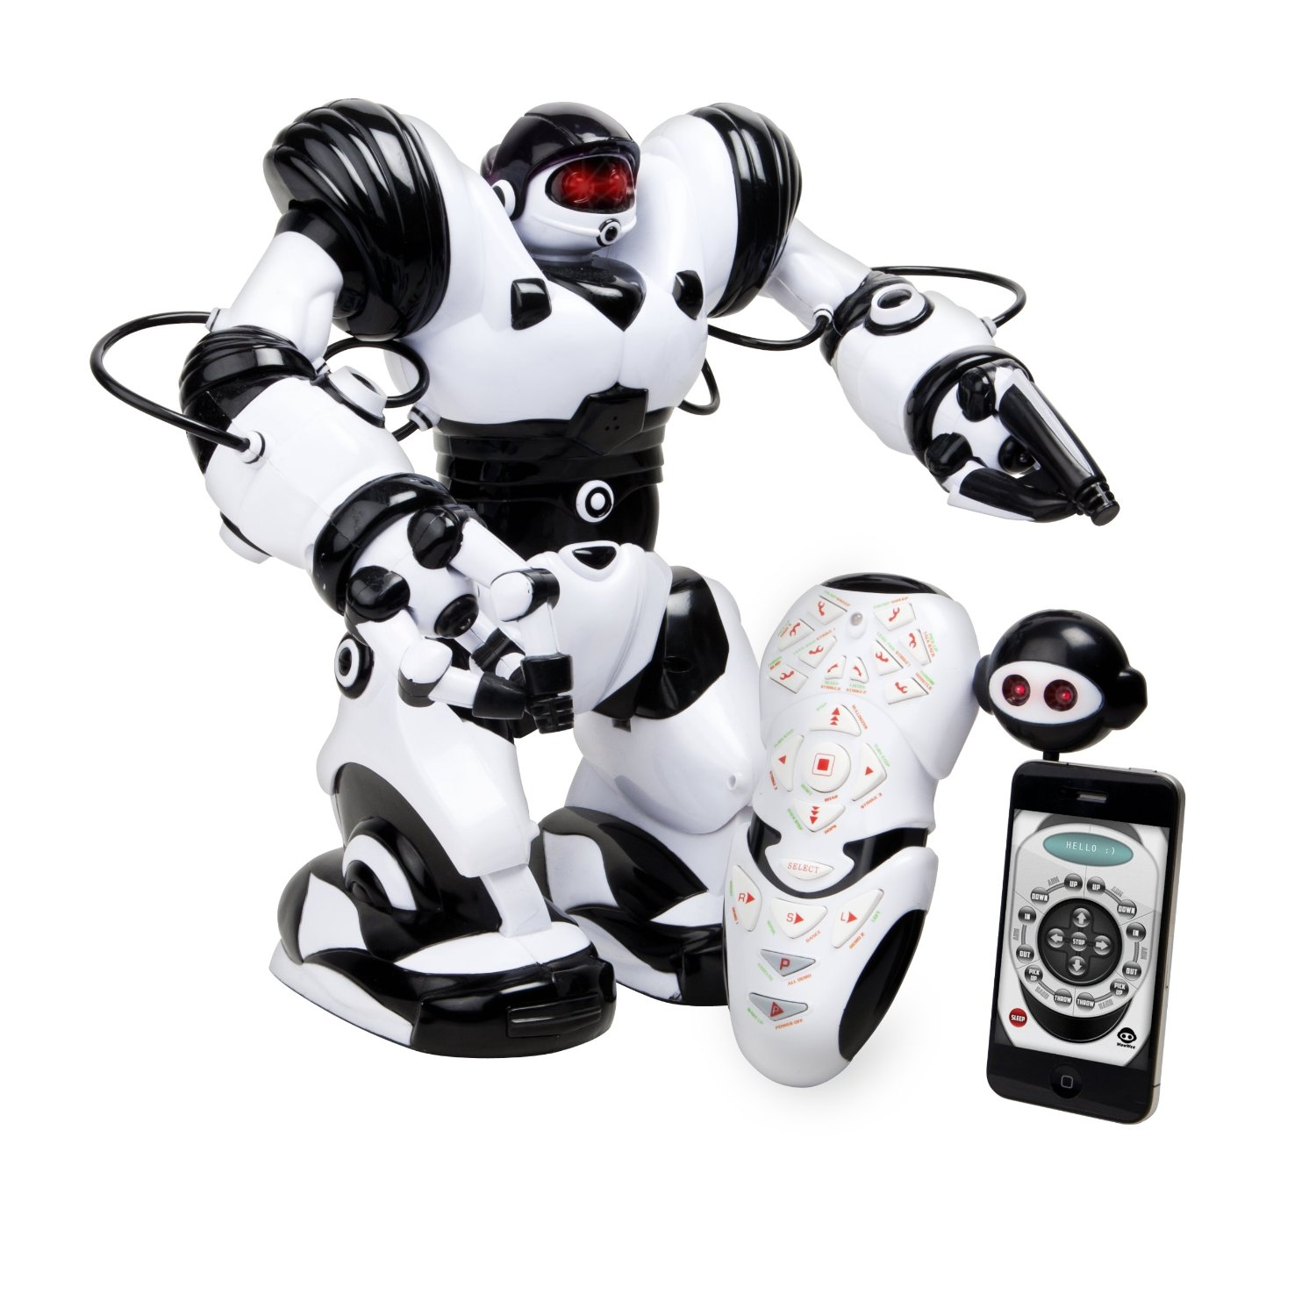
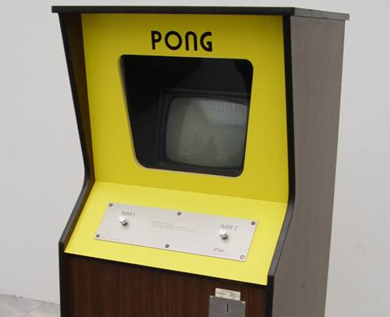
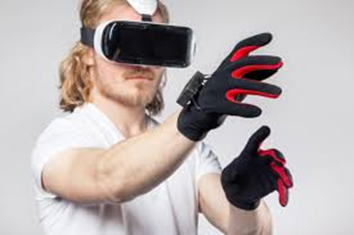
History
vs
Notes:
The question is, if this technology is something new, or if there is a technological shift in remote controlled robots: we argue yes, as especially haptics enable us to use our most useful tools to physically interact – our hands – in different, more intuitive and better ways with robots/other physical representations

