Slide 1
HCI
ImpulsVortrag
# G2 Thomas.E , Julia,
Markus, Martin.W

Slide 2
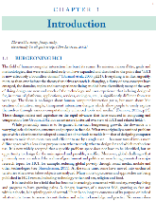
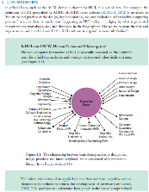
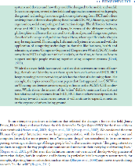
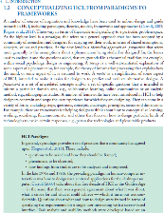
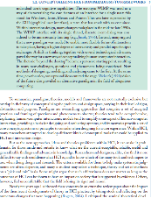
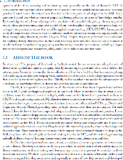
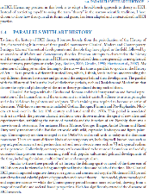

Burgeoning HCI
Domain expanding overlapping ‚interaction design‘
Conceptualizing
Paradigms terminology WIMP & Golden Age knowledge transfer
Notes:
Aufkeimende HCI
Ist eine spannende Domäne, die sich ständig ausdehnt
Überlappend ist mit anderen Bereichen (CSCW) und undeutlich abzugrenzen
Neuer Begriff statt HCI: interaction design

Slide 3
Burgeoning HCI
Domain expanding overlapping ‚interaction design‘
Conceptualizing
Paradigms terminology WIMP & Golden Age knowledge transfer
Notes:
Paradigma
Dafür zuerst Begriffe: Paradigms, Konzept, Modell, Theorie und so weiter.. -> Kennt ihr
Dann wird das veranschaulicht:
Gute alte zeit, wo noch jeder wusste was genau HCI ist:
Windows, Icons, Menüs, Pointer als Beispiel
Heute ist das inzwischen anders, neue Einflüsse.
Herausforderung wie man Wissen von einem Teilbereich in den anderen bekommt

Slide 4
Aims of the Book
Coming up
Revisit concerns consider ramifications discuss the impact
Parallels to Art
History classical modern contemporary
Notes:
1.3 Aims of the book
- revisit concerns surrounding the role of theory in this field
- consider the ramifications of this field
- discuss the impact for the advancement

Slide 5
Aims of the Book
Coming up
Revisit concerns consider ramifications discuss the impact
Paralles to Art
History classical modern contemporary
Notes:
1.4 Parallels with Art History
Classical
Import cognitive theory in a rigorous and constrained way
Modern
Broader and colorful palette of approaches and theory (social, phenomenological and cognitive science)
Contemporary
More value-led
Moralistic and societal-based perspective

Slide 6
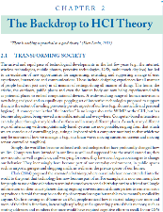
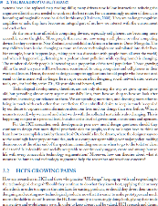
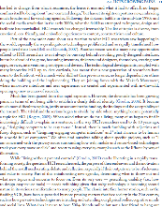
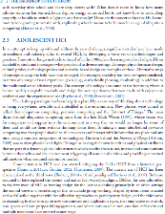
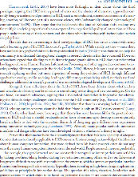
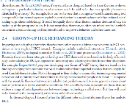
Backdrop to HCI theory
Transforming Society technological developments new opportunies
Growing pains
Challenges extended mind theory rethinking HCI
Notes:
-new opportunities enabled by technological developments
Extended Mind theory
Rethinking HCI

Slide 7
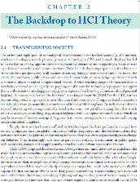
Backdrop to HCI theory
Transforming Society technological developments new opportunies
Growing pains
Challenges extended mind theory rethinking HCI
Notes:
-new opportunities enabled by technological developments
Extended Mind theory
Rethinking HCI

Slide 8
Adolescent HCI
3 waves Framing design group working non-work, non-space, non-…
Grown-up HCI
Reframing Theory… embodied interactions, ecological interaction, proxemics
Notes:
Adolescent HCI
First wave: Framing design for a user at a desktop
Second wave: includes group working
third wave: non-work, non-spaces, non-purposeful environments

Slide 9
Adolescent HCI
3 waves Framing design group working non-work, non-space, non-…
Grown-up HCI
Reframing Theory embodied interactions, ecological interaction, proxemics
Notes:
Reframing Theory!
Importing theories from other areas
-embodied interaction
-ecological rationality
-proxemics

Slide 10
Arbeitsaufteilung
 | 1.1 & 1.2 | 1.3 & 1.4 | 2.1 & 2.2 | 2.3 & 2.4 |  | .ppt
Thomas | 0% | 100% | 0% | 0% |  | 20%
Julia | 0% | 0% | 0% | 100% |  | 20%
Markus | 100% | 0% | 0% | 0% |  | 40%
Martin | 0% | 0% | 100% | 0% |  | 20%
Notes:
Jeder hat seinen Bereich alleine gemacht
Jeder seinen Präsentationsteil vorbereitet und einer hat das dann zusammengeführt
Diskussion
//nochmal klicken für Titelfolie

Slide 11
HCI
ImpulsVortrag
# G2 Thomas.E , Julia,
Markus, Martin.W

