Slide 1
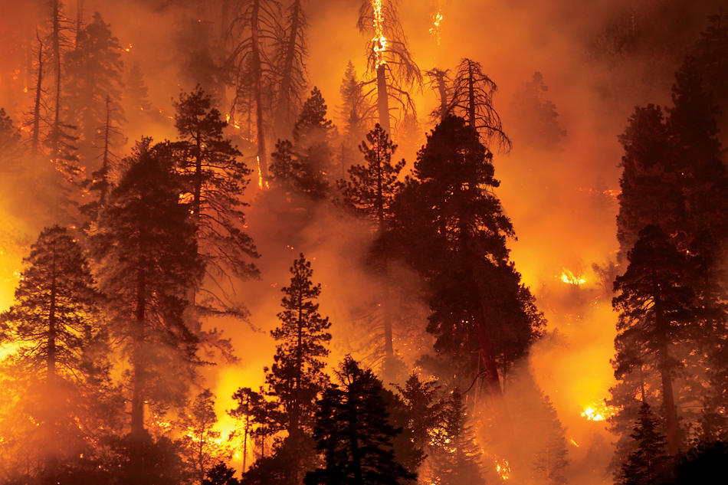
California Wildfire Analysis:
Predicting Future Wildfires via Documented Trend Analysis

Slide 2
Dataset Sources:
Skip to content
Kaggle
U.S. Wildfire Data (and other attributes):
https://www.kaggle.com/capcloudcoder/us-wildfire-data-plus-other-attributes
Data.gov
CAL Fire Facilities for Wildland Fire Protection:
https://catalog.data.gov/dataset/cal-fire-facilities-for-wildland-fire-protection
Two Data Sources were utilized to increase the number of comparable variables:
Variables:
Precipitation
Temperature
“Remoteness” or proximity to fire relief resources
Funding based on County

Slide 3
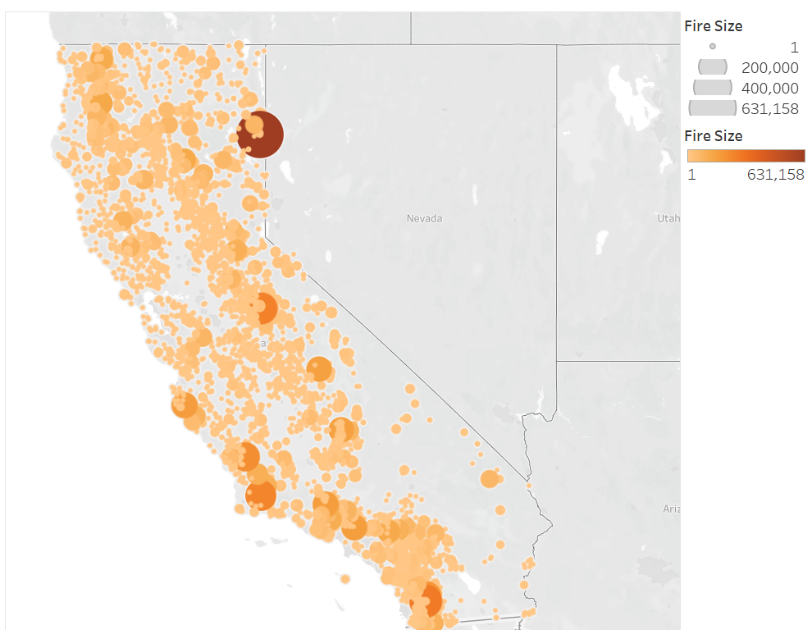
Why We Picked This Topic:
Personal Experiences;
Effect on Human Health and Welfare;
Impact on Air Quality and Ecological/Landscape Dynamics;
Insurance claim and probability models;
Prediction models for public safety.
California Wildfires Between 1990 - 2015
Notes:
Insurance companies are having issues with so many fires to be put to claim.

Slide 4
Tools and Technology Utilized for The Project:
And How Each Were Applied.
Microsoft Excel
Initial Data Exploration
Python
Jupyter Notebook
Pandas
Sklearn
Postgres SQL
Hosting Database
Github
Organization & Collaboration
Tableau
Visualization & Analysis

Slide 5
Questions We Hope to Answer:
Can past wildfires be used to predict future ones?
Which Ecological factors are the best predictors?
Does funding/availability of resources have an effect on fire fighting ability?
Notes:
Remi

Slide 6
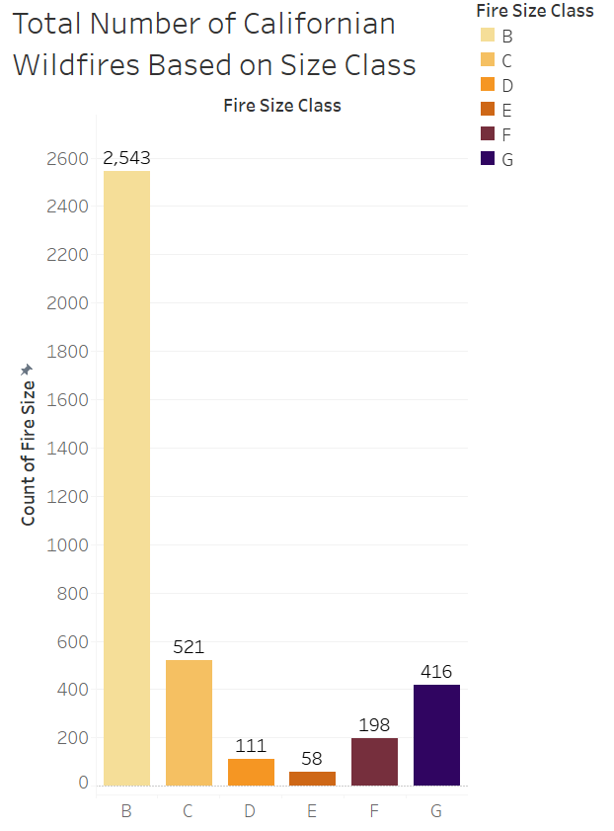
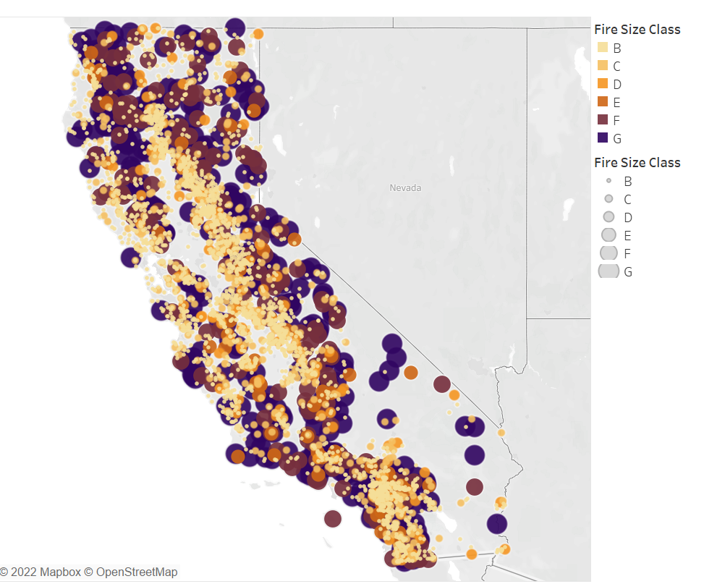
Wildfire Size Class Breakdown:
A: < 0.25 ac
B: 0.25 ac - 10.0 ac
C: 10 ac - 100 ac
D: 100 ac - 300 ac
E: 300 ac - 1,000 ac
F: 1,000 ac - 5,000 ac
G: > 5,000 ac
Notes:
Julia

Slide 7
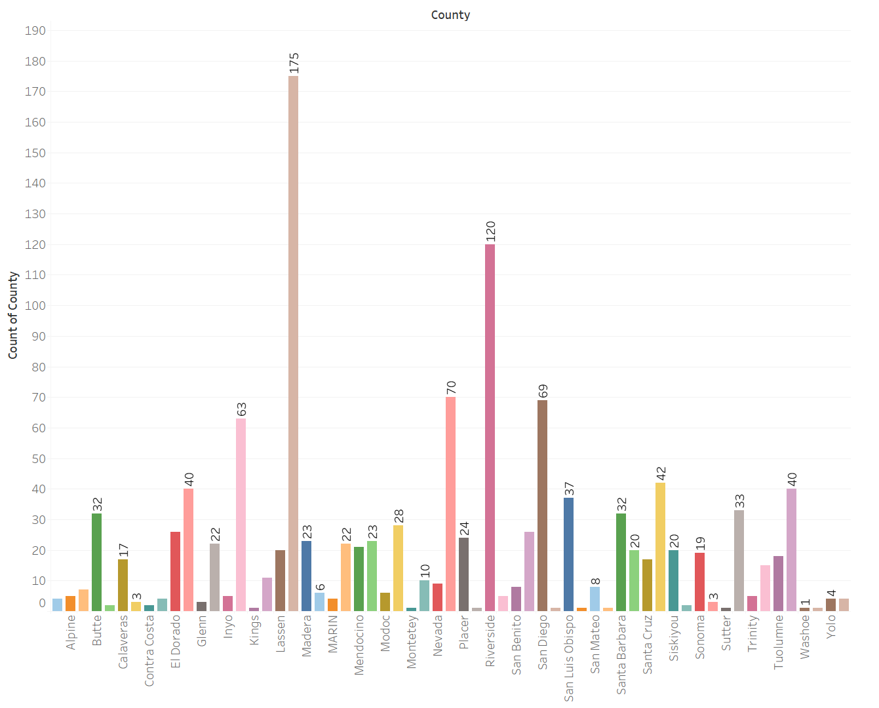
Number of Fire-Relief Resources Per Californian County

Slide 8
The Data Exploration Phase:
ETL Process
CSV file
Python data cleaning process
Export to Postgres Sql Database

Slide 9
The Analysis Phase:
Machine Learning Model
Linear Regression Model
Fire size vs remoteness
Logistical Regression Model
Random forest feature selection
Sklearn classifier
Data Visualization
Tableau
Wildfire Size & Comparative Factors
Notes:
Remi

Slide 10
Description of Communication Protocols:
Zoom
Weekly meetings outside of class
Slack
Group Text
Github

