Slide 1

Handling images in
Timothy E. Holy
Anatomy & Neurobiology
Washington University in St. Louis

Slide 3
Images.jl: history and status
Began prior to the existence of packages, as images.jl in extras/. Main authors were Jeff Bezanson and Stefan Kroboth.
Since becoming an independent package: 400+ commits, 14 contributors (rsrock and lucasb-eyer are particularly prolific)
~4300 lines for the core functionality, plus another ~1800 for file format support
Has quite a lot of functionality, but still “early” in development (it's a huge problem space!)
Developed in parallel with ImageView.jl (with major contributions from rsrock and kmsquire)

Slide 4
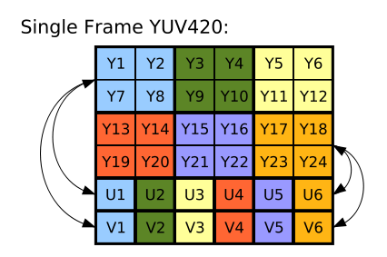
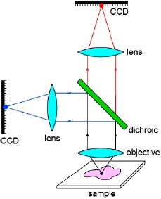
Design considerations
Two major audiences: computer vision & scientific imaging
Movies (i.e., images with a temporal dimension), three-dimensional images, huge images
Images come in many formats: 8-bit RGB,
16-bit grayscale,
transparency,
“hyperspectral” images,
YUV formats,
“multi-camera images,” etc.
Need for metadata (patient ID, celestial coordinates, camera gain, etc.)

Slide 5
Design choice: an Image is a documentation format
AbstractArray
AbstractImage
AbstractImageDirect
AbstractImageIndexed
type Image{T,N,A<:AbstractArray} <: AbstractImageDirect{T,N}
data::A
properties::Dict
end

Slide 6
Demos

Slide 7
Writing efficient algorithms
imfilter:

Slide 8
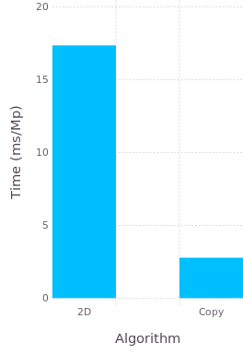
Writing efficient algorithms
Version 1 “2D”
function imfilter1(img::AbstractMatrix, kernel::AbstractMatrix)
imgpad, _ = dopadding(img, kernel)
out = similar(img, Float64)
@inbounds for j = 1:size(out, 2), i = 1:size(out, 1)
tmp = 0.0
for jj = 1:size(kernel, 2), ii = 1:size(kernel, 1)
tmp += imgpad[i+ii-1, j+jj-1]*kernel[ii,jj]
end
out[i,j] = tmp
end
out
end
function dopadding(img::AbstractMatrix, kernel::AbstractMatrix)
(isodd(size(kernel, 1)) && isodd(size(kernel, 2))) ||
error("kernel must have odd size")
halfsize = Int[s>>1 for s in size(kernel)]
imgpad = Images.padarray(img, halfsize)
imgpad, halfsize
end

Slide 9
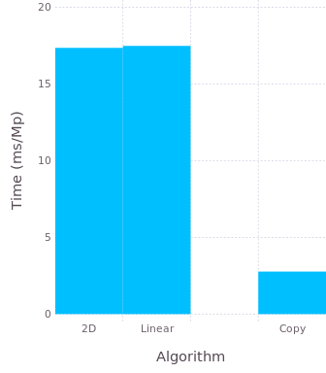
Writing efficient algorithms
Version 2 “Linear”
Replace the inner loop with:
for k = 1:length(offsets)
tmp += imgpad[index+offsets[k]] * kernel[k]
end

Slide 10
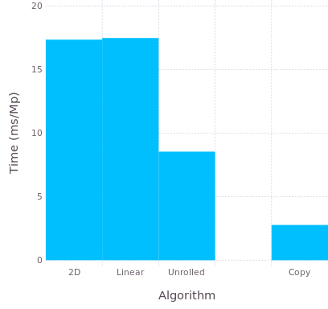
Writing efficient algorithms
Version 3 “Unrolled”
Use on-the-fly code generation:
begin
kern_1_1 = kernel[1,1]
kern_1_2 = kernel[1,2]
kern_1_3 = kernel[1,3]
end
begin
kern_2_1 = kernel[2,1]
kern_2_2 = kernel[2,2]
kern_2_3 = kernel[2,3]
end
begin
kern_3_1 = kernel[3,1]
kern_3_2 = kernel[3,2]
kern_3_3 = kernel[3,3]
end
f! = eval(quote
local imf!
function imf!(out, imgpad)
@nexprs $N1 d1->(@nexprs $N2 d2->(kern_d1_d2 = $kernel[d1,d2]))
@inbounds for j = 1:size(out, 2), i = 1:size(out, 1)
tmp = 0.0
@nexprs $N1 d1->(@nexprs $N2 d2->(tmp += imgpad[i+d1-1,j+d2-1]*kern_d1_d2))
out[i,j] = tmp
end
out
end
end)
method_cache[key] = f!
begin
tmp += imgpad[i ,j ] * kern_1_1
tmp += imgpad[i ,j+1] * kern_1_2
tmp += imgpad[i ,j+2] * kern_1_3
end
begin
tmp += imgpad[i+1,j ] * kern_2_1
tmp += imgpad[i+1,j+1] * kern_2_2
tmp += imgpad[i+1,j+2] * kern_2_3
end
begin
tmp += imgpad[i+2,j ] * kern_3_1
tmp += imgpad[i+2,j+1] * kern_3_2
tmp += imgpad[i+2,j+2] * kern_3_3
end

Slide 11
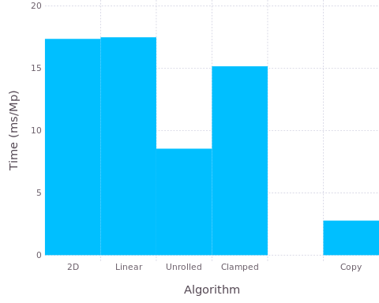
Writing efficient algorithms
Version 4 “Clamp”
Skip the padarray and just clamp the offsets:
@nexprs $N1 d1->(ii_d1 = min(max(i+d1-$hN1-1, 1), size(out, 1)))
…
@nexprs $N1 d1->(@nexprs $N2 d2->(tmp += img[ii_d1,jj_d2]*kern_d1_d2))
ii_1 = min(max(i-1,1),size(out,1))
ii_2 = min(max(i ,1),size(out,1))
ii_3 = min(max(i+1,1),size(out,1))

Slide 12
Separating the interior and the edge
r1 = 1+$hN1 : size(out, 1)-$hN1
r2 = 1+$hN2 : size(out, 2)-$hN2
# Iterate over the interior points
@inbounds for j in r2, i in r1
…
# Iterate over the edge points
# Does not even have to be terribly well optimized

Slide 13
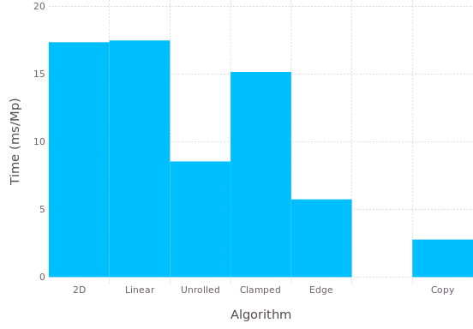
Writing efficient algorithms
Version 5 “Edge”
immutable Edge
interior::Bool
inner::UnitRange{Int}
outer::UnitRange{Int}
End
“@nedge”

Slide 14
Thanks to all who contribute!

