Slide 1

Accessibility Guidelines

Slide 2
Introduction to JuliaCon and Accessibility
Overview of JuliaCon
JuliaCon is an annual conference dedicated to the Julia programming language, bringing together developers, researchers, and enthusiasts from around the world.
Importance of Accessibility
Accessibility in technology ensures that all individuals, regardless of their abilities, can engage with content and participate fully in events like JuliaCon. It fosters inclusivity, allowing diverse audiences to benefit from shared knowledge.

Slide 3
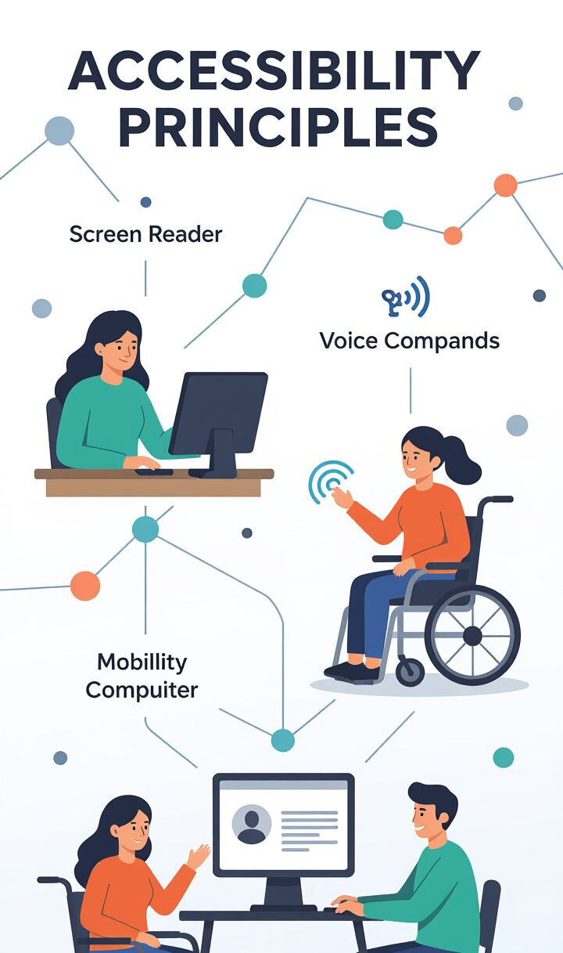
Understanding Accessibility
Definition of Accessibility:
Accessibility refers to the design of products, devices, services, or environments for people with disabilities. This includes visual, auditory, motor, and cognitive impairments.
Significance for Diverse Audiences:
Ensures equitable access to information and resources.
Promotes inclusivity in communication, allowing everyone to participate.
Enhances user experience and engagement for all attendees.

Slide 4
Key Principles of Accessible Design
Main Principles:
Perceivable: Information must be presented in ways that users can perceive, such as providing text alternatives for images.
Operable: User interface components must be operable through various means, not just mouse clicks.
Understandable: Content should be clear and understandable, using straightforward language and structure.
Robust: Content must be compatible with current and future user tools, ensuring longevity and usability.

Slide 5
Importance of Color Choices
Impact of Color on Accessibility: Color plays a crucial role in how information is perceived. Poor color choices can hinder visibility and comprehension for individuals with visual impairments.
Enhancing Visibility:
Use high-contrast color combinations to improve readability.
Avoid relying solely on color to convey important information; include text labels or patterns.

Slide 6
Color Blind Palettes
Introduction to Color Blind-Friendly Palettes
Color blind-friendly palettes help ensure that content is accessible to individuals with color vision deficiencies.
Effective Combinations
Blue and Orange: This combination is easily distinguishable for most color blind users.
Use of Tools: Tools like Color Oracle and Coblis can help test color combinations for accessibility.
Recommendations
Limit the use of colors that can be confusing, such as reds and greens.
Consider patterns or textures in addition to color for conveying information.

Slide 7
Best Practices for Using Color
Effective Use of Contrast:
Ensure sufficient contrast between text and background colors.
Use online contrast checkers to verify accessibility.
Limiting Colors:
Use a limited color palette to reduce visual clutter.
Avoid using color as the sole means of conveying information.
Information Conveyance:
Combine color with text labels or icons to enhance understanding.

Slide 8
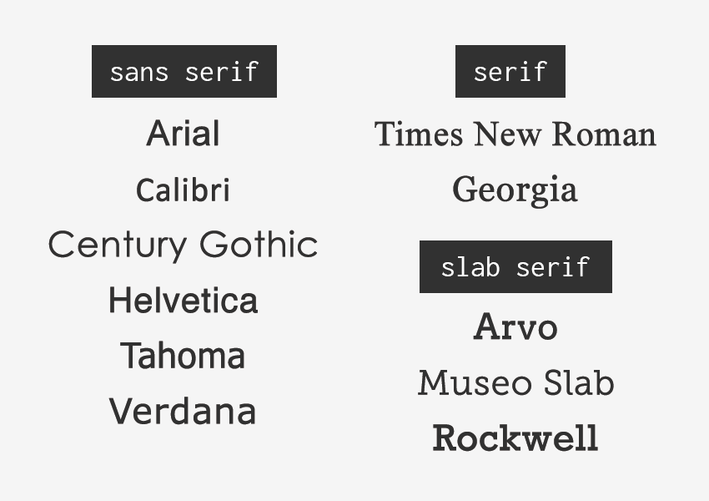

Font Selection for Accessibility
Guidelines for Choosing Fonts
Characteristics of Accessible Fonts
Opt for sans-serif fonts (e.g., Arial, Helvetica) for better readability. Avoid overly stylized fonts that can be difficult to read.
Simple, clean designs enhance legibility. Ensure that font choices are consistent throughout the presentation.

Slide 9
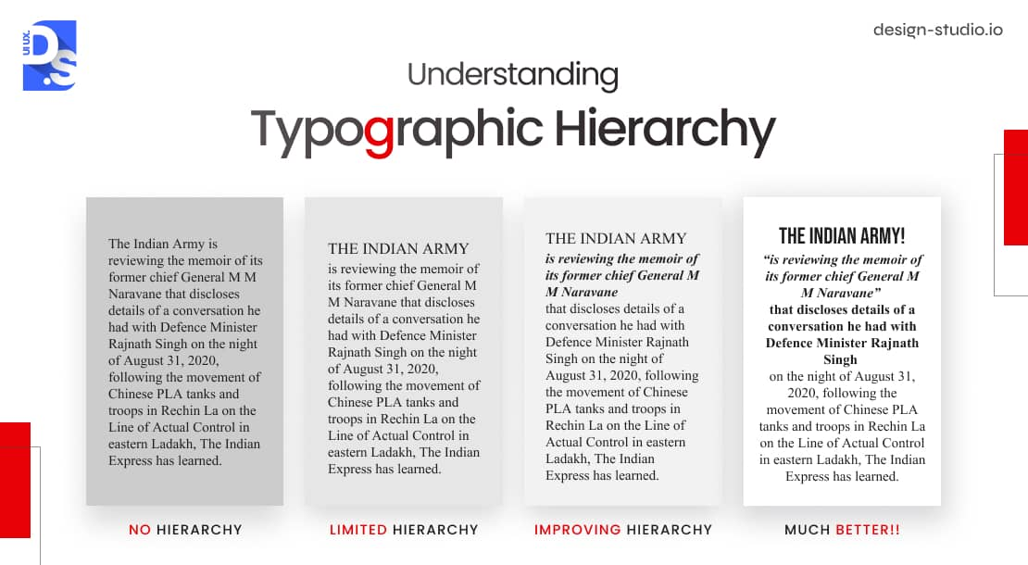

Font Size and Style Considerations
Recommendations for Font Sizes
Line Spacing and Styles
Use a minimum font size of 18-24 points for body text to ensure legibility from a distance. Headings should be larger to create a clear hierarchy.
Maintain adequate line spacing (1.5 to 2 times the font size) for improved readability. Use bold or italic styles sparingly to emphasize important points without overwhelming the reader.

Slide 10
Layout and Structure for Clarity
Best Practices for Presenting Information
Use clear headings and subheadings to organize content.
Bullet points can help break down complex information into digestible pieces.
Use of Whitespace
Incorporate whitespace to avoid clutter and enhance focus on key points.
Balance text and visuals to create an engaging layout.

Slide 11
Use of Alternative Text
Importance of Providing Alternative Text:
Alternative text (alt text) describes images, charts, and other non-text content, making it accessible for screen reader users.
Guidelines for Alt Text:
Provide concise and descriptive alt text for all visual elements.
Ensure that alt text conveys the essential information without being overly verbose.

Slide 12
Captioning and Transcriptions
Necessity of Captions and Transcriptions:
Captions and transcriptions enhance accessibility for individuals who are deaf or hard of hearing, as well as those who prefer reading.
Recommendations:
Include captions for all video content, ensuring they are synchronized with audio.
Provide transcriptions for audio content to offer an alternative for text-based engagement.

Slide 13

Color Contrast and Backgrounds
Guidelines for Background Colors:
Choose background colors that enhance text visibility and readability.
Use light backgrounds with dark text or dark backgrounds with light text for optimal contrast.
Ensuring Sufficient Contrast:
Use tools to check color contrast ratios, aiming for a minimum ratio of 4.5:1 for normal text and 3:1 for large text.

