Slide 1
Julia Gender Inclusive Learn Julia With Us
(KYLA MCCONNELL & JULIA MÜLLER)

Slide 2
TODAY’S DEMO
Who are we? Who are you? What is Julia?
Intro to Pluto notebooks
The interactive Julia REPL

Slide 3
Upcoming events
March 17 Your first Julia code
Error messages and debugging
April 14 Strings and data containers
Functions
Project: Programming mad libs prompts
May 12 Number types
User-defined functions

Slide 4
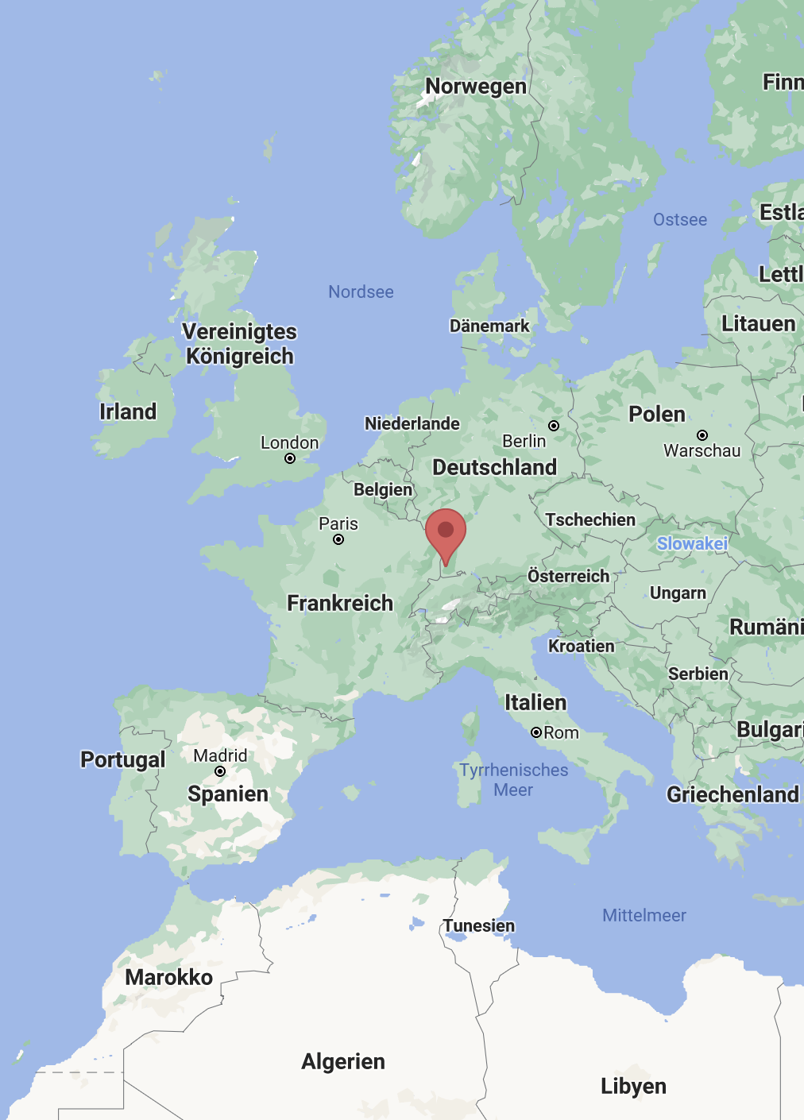
WHO ARE WE?
@McConnellKyla & @JuliaMuellerFr
Ph.D. students in linguistics at the University of Freiburg, Germany
Co-organizers of @RLadiesFreiburg
Recently discovered the joys of Julia
Our use case: academic research, incl. data wrangling, plotting & fitting statistical models (LMEs, etc.)

Slide 5
WHO ARE WE?
@McConnellKyla & @JuliaMuellerFr
Previous experience: R & Python
Invite you to learn Julia together with us, with the help of great resources on JuliaAcademy, etc.

Slide 6
WHO ARE YOU?

Slide 7

WHAT IS JULIA?
General-purpose programming language but popular in data science communities
Built with data science and machine learning in mind
Free & open source (like R and Python)
Developed to be readable like Python but compiled quickly like C
Young: < 10 years old (R is closer to 30 years old)
Note: Please don’t gender “Julia” (i.e. by using she/her)

Slide 8
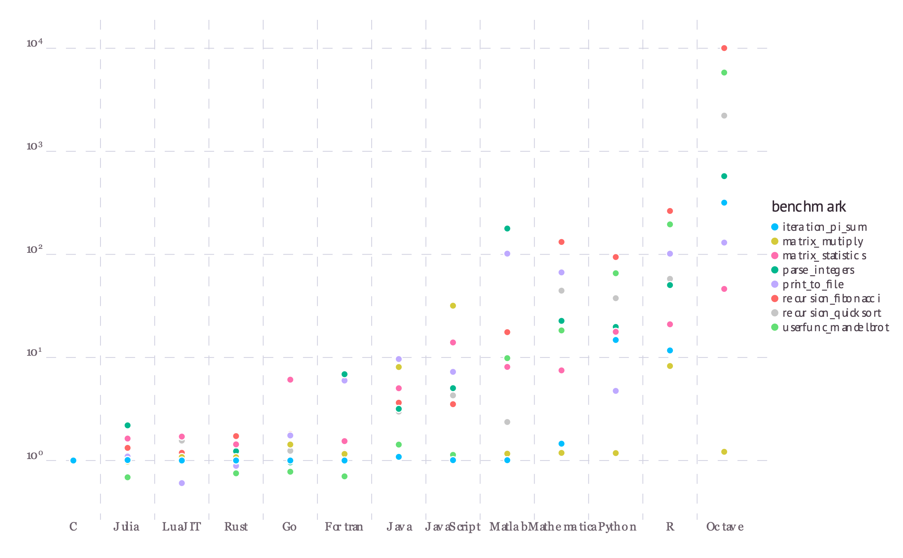
WHY JULIA?
Julia is…
Fast
Readable
Reproducible
Able to handle complex statistical models
Easy to integrate with other programming languages
“These micro-benchmarks, while not comprehensive, do test compiler performance on a range of common code patterns, such as function calls, string parsing, sorting, numerical loops, random number generation, recursion, and array operations.”
single core, Julia 1.0.0
https://julialang.org/benchmarks/

Slide 9
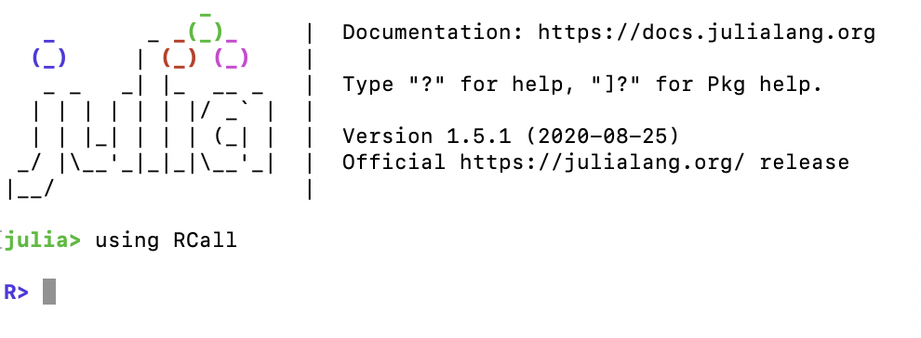
WORKING WITH JULIA
Options:
REPL (read-eval-print loop)
Julia script .jl
Julia Markdown .jmd
IDE like Visual Studio Code
Jupyter or Pluto notebooks

Slide 10
In the REPL
Read help pages about commands by entering help mode with ? (leave with backspace)
Enter the package manager with ] and leave it with backspace
add / rm to add and remove packages to base
update to update packages

Slide 11
Pluto
Enter packager manager with ]
From package manager: add Pluto
Leave package manager with backspace
Run: using Pluto
Run: Pluto.run()

