Slide 1
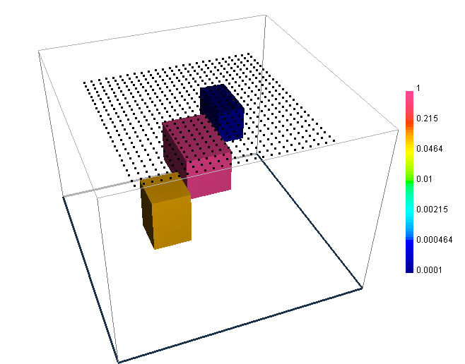
The model is made up of three blocks having conductivities of 0.1, 1.0 and 1e-4 S/m.
The background conductivity is 0.01 S/m.
The octree mesh has 31977 cells. The smallest cell is 50*50*50m
There are 25*25=625 ZTEM data locations, located 10m above the surface.

Slide 2
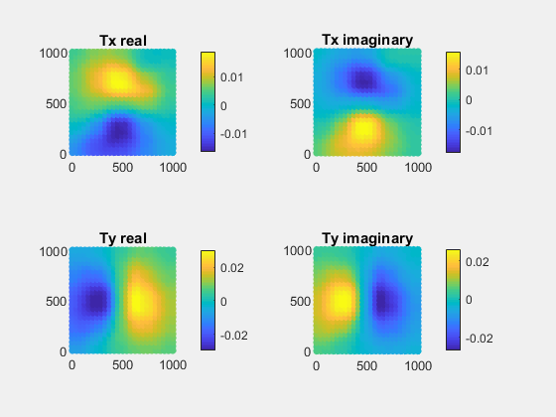

Frequency 8 Hz
Julia result
Fortran result

Slide 3
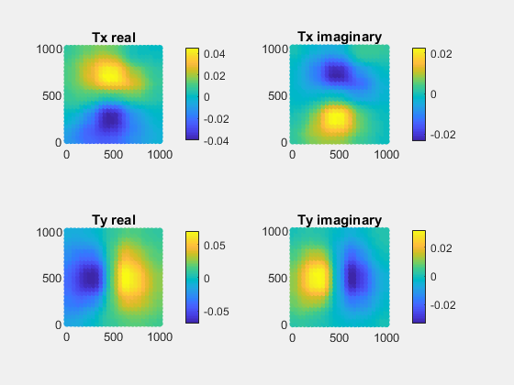

Frequency 31 Hz
Julia result
Fortran result

Slide 4
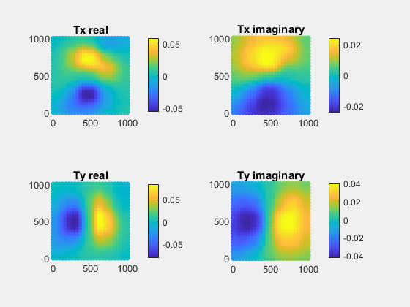

Frequency 199 Hz
Julia result
Fortran result

Slide 5
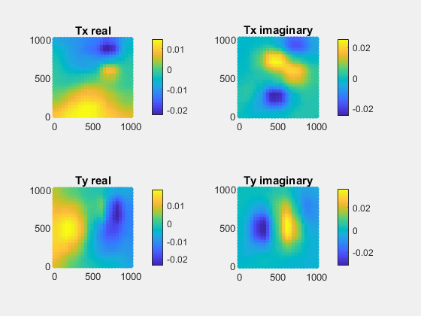
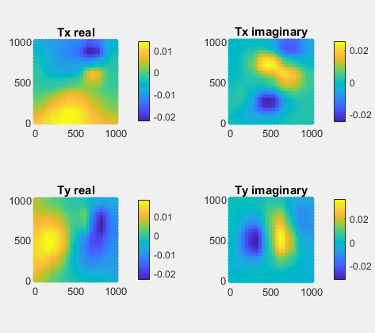
Frequency 1255 Hz
Julia result
Fortran result

