Slide 1
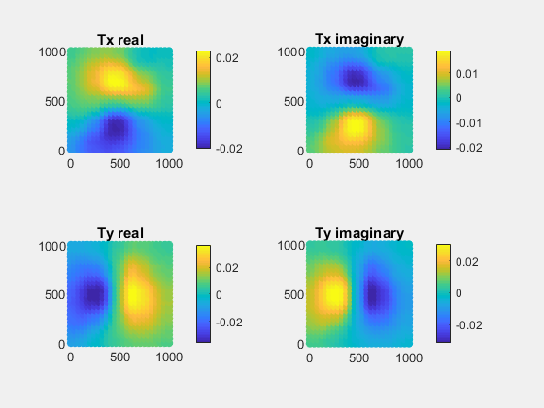

new Julia code
old Fortran code

