Slide 1
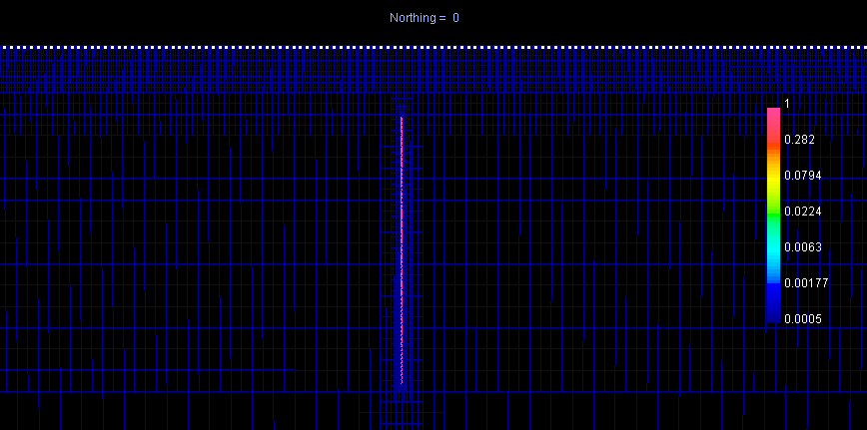
Smallest cell: 5 * 10 * 10 m
Total number of cells: 815278
Cell size on the surface: 40 * 80 * 80 m
Conductivity of the halfspace = 0.0005
Conductivity of block = 1.0 (changed from 0.05)

Slide 2
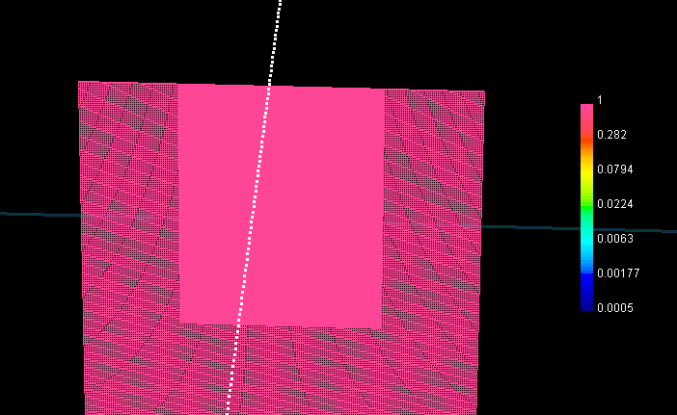
White dots are the receivers on the surface.
Near the receivers, the block is made up of small 5*10*10 cells. Thickness is 4*5=20m
Farther away, the cells are larger 10*20*20. Thickness = 2*10=20m

Slide 3
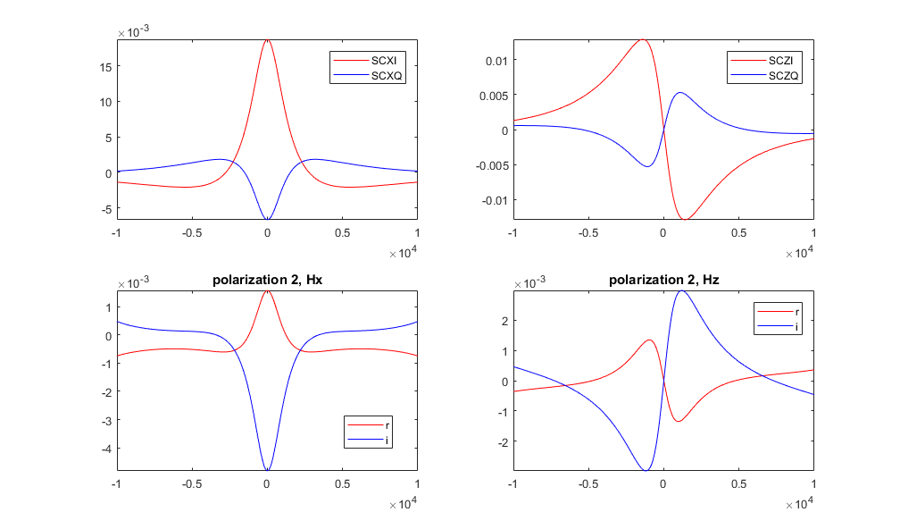
12 Hz - Top is their result, and bottom is ours.

Slide 4
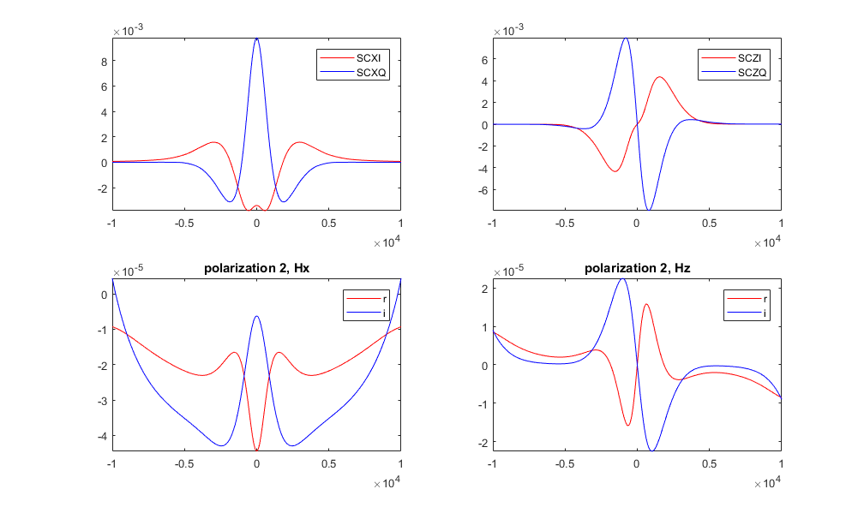
500 Hz - Top is their result, and bottom is ours.

