Slide 1

Chapter 1
Introduction to Operations Management
McGraw-Hill/Irwin
Copyright © 2012 by The McGraw-Hill Companies, Inc. All rights reserved.

Slide 2
Chapter 1: Learning Objectives
You should be able to:
Define the term operations management
Identify the three major functional areas of organizations and describe how they interrelate
Identify similarities and differences between production and service operations
Describe the operations function and the nature of the operations manager’s job
Summarize the two major aspects of process management
Explain the key aspects of operations management decision making

Slide 3
Operations Management
What is operations?
The part of a business organization that is responsible for producing goods or services
How can we define operations management?
The management of systems or processes that create goods and/or provide services
The operations function consists of all the activities directly related to producing goods or providing services
Operations Management affects:
Companies’ ability to compete
Nation’s ability to compete globally
1-3

Slide 4
Good or Service?
Goods are physical items that include raw materials, parts, subassemblies, and final products.
Automobile
Computer
Oven
Shampoo
Services are activities that provide some combination of time, location, form or psychological value.
Air travel
Education
Haircut
Legal counsel
1-4

Slide 5
Supply Chain
Supply Chain: A sequence of activities and organizations involved in producing and delivering a good or service
Suppliers’
suppliers
Direct
suppliers
Producer
Distributor
Final
Customers
1-5

Slide 6
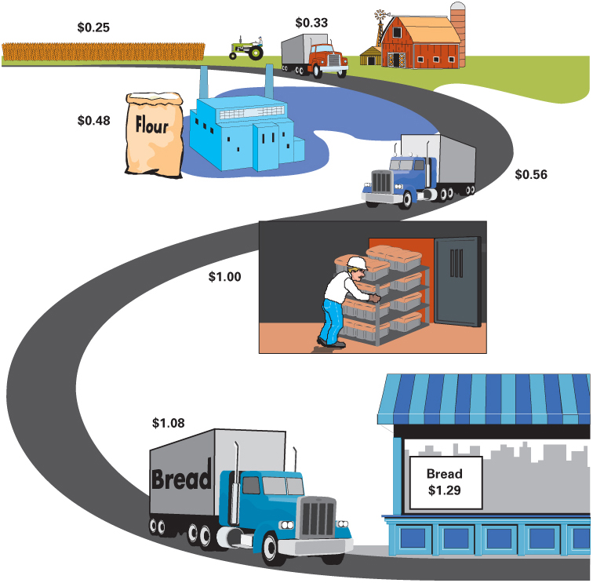
Supply Chain for Bread
1-6

Slide 7
The Need for Supply Chain Management
In the past, organizations did little to manage the supply chain beyond their own operations and immediate suppliers which led to numerous problems:
Oscillating inventory levels
Inventory stockouts
Late deliveries
Quality problems
1-7

Slide 8
Supply Chain Issues
The need to improve operations
Increasing levels of outsourcing
Increasing transportation costs
Competitive pressures
Increasing globalization
Increasing importance of e-business
The complexity of supply chains
The need to manage inventories
1-8

Slide 9
Elements of Supply Chain Management
Customers – what products/services do customers want
Forecasting – predicting timing and volume of customer demand
Design – incorporating customer wants, manufacturability, and time to market
Capacity planning – matching supply and demand
Processing – controlling quality, scheduling work
Inventory – meeting demand requirements while managing costs
Purchasing – evaluating potential suppliers, supporting the needs of operations on purchased goods and services
Suppliers – monitoring supplier quality, on-time delivery, and flexibility; maintaining supplier relations
Location – determining the location of facilities
Logistics – deciding how to best move information and materials
1-9

Slide 10
Basic Functions of the Business Organization
Finance
Sales
HRM
OM
QA
Marketing
MIS
Accounting
Engineering
1-10

Slide 11
Basic Functions of the Business Organization
Organization
Marketing
Operations
Finance
1-11

Slide 12
The Transformation Process
Value-Added
Inputs
Land
Labor
Capital
Information
Transformation/
Conversion
Process
Outputs
Goods
Services
Measurement
and Feedback
Measurement
and Feedback
Measurement
and Feedback
Control
Feedback = measurements taken at various points in the transformation process
Control = The comparison of feedback against previously established standards to determine if corrective action is needed.
1-12

Slide 13
Food Processor (Goods)
Table 1.2
Inputs
Processing
Outputs
Raw Vegetables
Metal Sheets
Water
Energy
Labor
Building
Equipment
Cleaning
Making cans
Cutting
Cooking
Packing
Labeling
Canned vegetables
1-13

Slide 14
Hospital Process (Service)
Table 1.2
Inputs
Processing
Outputs
Doctors, nurses
Examination
Healthy patients
Hospital
Surgery
Medical Supplies
Monitoring
Equipment
Medication
Laboratories
Therapy
1-14

Slide 15
Goods-service Continuum
Products are typically neither purely service- or purely goods-based.
Goods Services
Surgery, Teaching
Songwriting, Software Development
Computer Repair, Restaurant Meal
Home Remodeling, Retail Sales
Automobile Assembly, Steelmaking
1-15

Slide 16

Manufacturing vs. Service?
Manufacturing and Service Organizations differ chiefly because manufacturing is goods-oriented and service is act-oriented.
Goods
Services
Tangible
Act-Oriented
1-16

Slide 17
Manufacturing vs. Service
Goods
Service
Output Tangible Intangible
Customer contact Low High
Labor content of jobs Low High
Uniformity of input & output High Low
Measurement of productivity Easy Difficult
Production and delivery Different time Same time
Opportunity to correct problems High Low
Quality assurance Easy Difficult
Amount of inventory Large Small
Evaluation of work Easy Difficult
Wages Narrow range Wide range
Ability to patent design Usually Not usually
1-17

Slide 18
Managing Services is Challenging
Jobs in services are often less structured than in manufacturing
Customer contact is generally much higher in services compared to manufacturing
In many services, worker skill levels are low compared to those of manufacturing employees
Services are adding many new workers in low-skill, entry-level positions
Employee turnover is high in services, especially in low-skill jobs
Input variability tends to be higher in many service environments than in manufacturing
Service performance can be adversely affected by many factors outside of the manager’s control (e.g., employee and customer attitudes)
1-18

Slide 19
Scope of Operations Management
The scope of operations management ranges across the organization.
The operations function includes many interrelated activities such as:
Forecasting
Capacity planning
Facilities and layout
Scheduling
Managing inventories
Assuring quality
Motivating employees
Deciding where to locate facilities
And more . . .
1-19

Slide 20
Role of the Operations Manager
The Operations Function consists of all activities directly related to producing goods or providing services.
A primary function of the operations manager is to guide the system by decision making.
System Design Decisions
System Operation Decisions
1-20

Slide 21
System Design Decisions
System Design
These are typically strategic decisions that:
usually require long-term commitment of resources
determine parameters of system operation
Capacity
Facility location
Facility layout
Product and service planning
Acquisition and placement of equipment
1-21

Slide 22
System Operation Decisions
System Operation
These are generally tactical and operational decisions:
Management of personnel
Inventory management and control
Scheduling
Project management
Quality assurance
Operations managers spend more time on system operation decision than any other decision area
They still have a vital stake in system design
1-22

Slide 23
Why Study OM?
Every aspect of business affects or is affected
by operations.
Many service jobs are closely related to operations:
Financial services
Marketing services
Accounting services
Information services
There is a significant amount of interaction and collaboration amongst the functional areas.
It provides an excellent vehicle for understanding the world in which we live.
1-23

Slide 24
Decision Making
Most operations decisions involve many alternatives that can have quite different impacts on costs or profits.
Typical operations decisions include:
What: What resources are needed, and in what amounts?
When: When will each resource be needed? When should the work be scheduled? When should materials and other supplies be ordered?
Where: Where will the work be done?
How: How will the product or service be designed? How will the work be done? How will resources be allocated?
Who: Who will do the work?
1-24

Slide 25
General Approach to Decision Making
Modeling is a key tool used by all decision makers.
Model: An abstraction of reality; a simplification of something.
Common features of models:
They are simplifications of real-life phenomena
They omit unimportant details of the real-life systems they mimic so that attention can be focused on the most important aspects of the real-life system
1-25

Slide 26


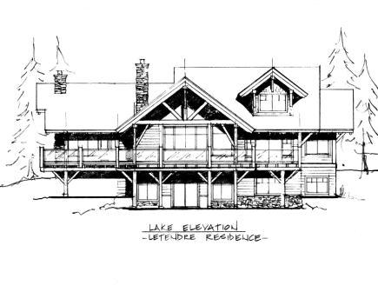

Models
Types of Models:
Physical Models
Look like their real-life counterparts
Schematic Models
Look less like their real-life counterparts than physical models
Mathematical Models
Do not look at all like their real-life counterparts
1-26

Slide 27
Benefits of Models
Models are generally easier to use and less expensive than dealing with the real system.
Require users to organize and sometimes quantify information.
Increase understanding of the problem.
Enable managers to analyze “What if?” questions.
Serve as a consistent tool for evaluation and provide a standardized format for analyzing a problem.
Enable users to bring the power of mathematics to bear on a problem.
1-27

Slide 28
Limitations of Models
Quantitative information may be emphasized at the expense of qualitative information
Models may be incorrectly applied and the results misinterpreted
The use of models does not guarantee good decisions.
1-28

Slide 29


Quantitative Methods
A decision making approach that frequently seeks to obtain a mathematically optimal solution.
Linear programming
Queuing techniques
Inventory models
Project models
Forecasting techniques
Statistical models
1-29

Slide 30
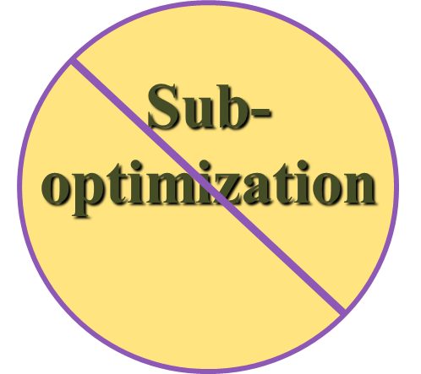
Systems Approach
System - a set of interrelated parts that
must work together
The business organization is a system composed of subsystems
marketing subsystem
operations subsystem
finance subsystem
The systems approach
Emphasizes interrelationships among subsystems
Main theme: the whole is greater than the sum of its parts
The output and objectives of the organization take precedence over those of any one subsystem
1-30

Slide 31
Key Issues for Operations Managers Today
Economic conditions
Innovating
Quality problems
Risk management
Competing in a global economy
1-31

Slide 32

Environmental Concerns
Sustainability
Using resources in ways that do not harm ecological systems that support human existence
Sustainability measures often go beyond traditional environmental and economic measures to include measures that incorporate social criteria in decision making
All areas of business will be affected.
Product and service design
Consumer education programs
Disaster preparation and response
Supply chain waste management
Outsourcing decisions
1-32

Slide 33

Ethical Issues in Operations
Ethical issues arise in many aspects of operations management:
* Financial statements * Worker safety
* Product safety * Quality
* The environment * The community
* Hiring and firing workers * Closing facilities
* Workers rights
1-33

