Slide 1
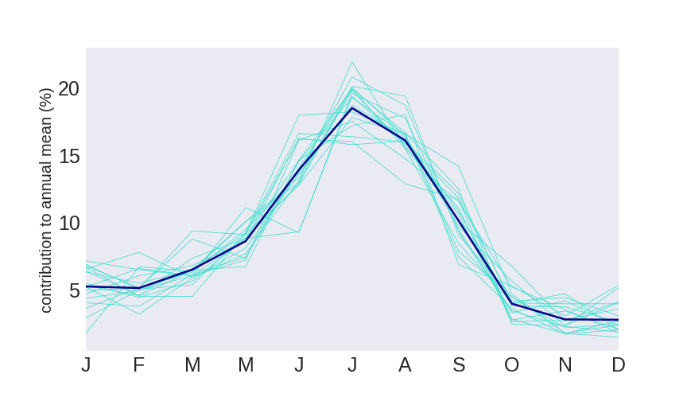
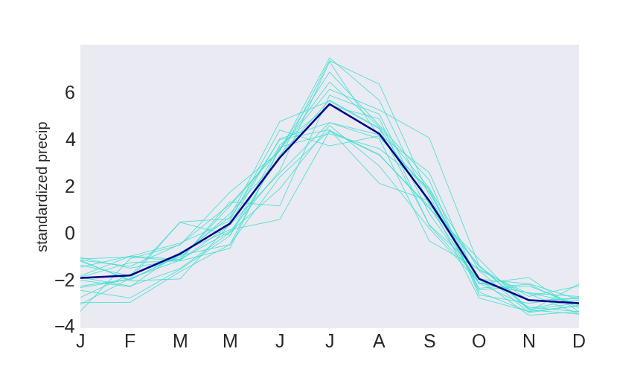
Cluster analysis based on GPM V06
K-means clustering with 3 centroids
GPM V06: Oct 2000 – Oct 2019
Domain: 25 – 45N, 65 – 105E
Training feature: normalized seasonal cycle
P_months / P_annual *100
(P_months – P_annual) / std_annual
Figures show seasonal cycles averaged over domain for all years and each individual year

Slide 2
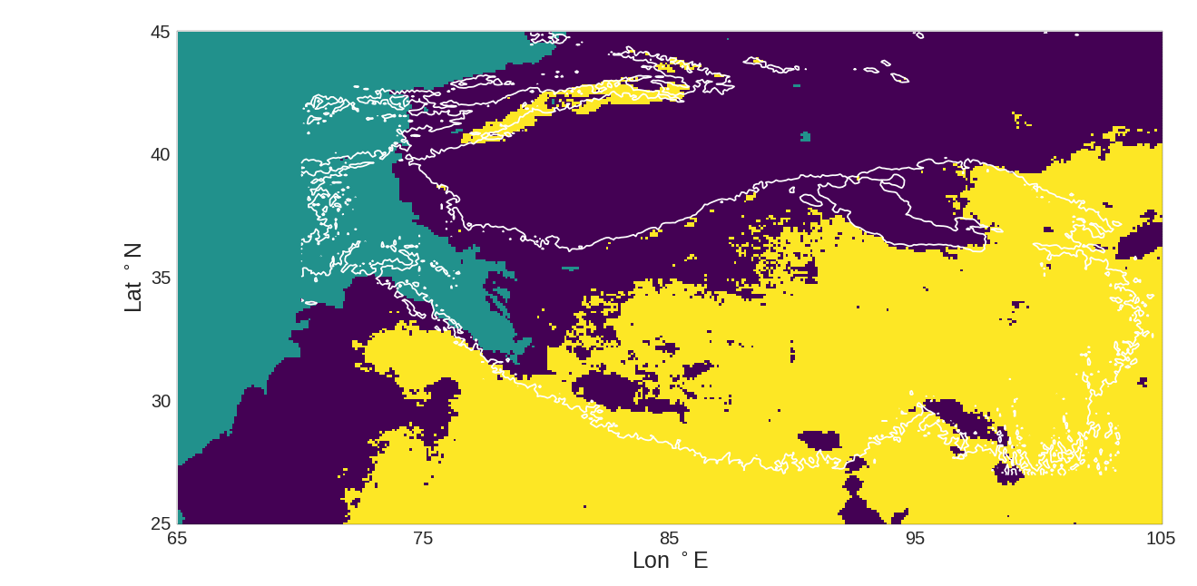
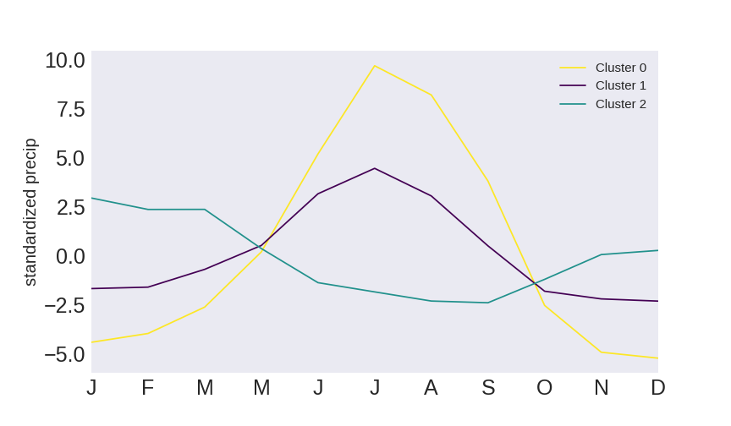
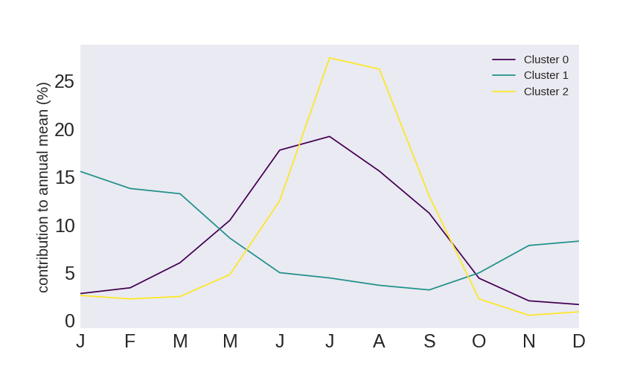
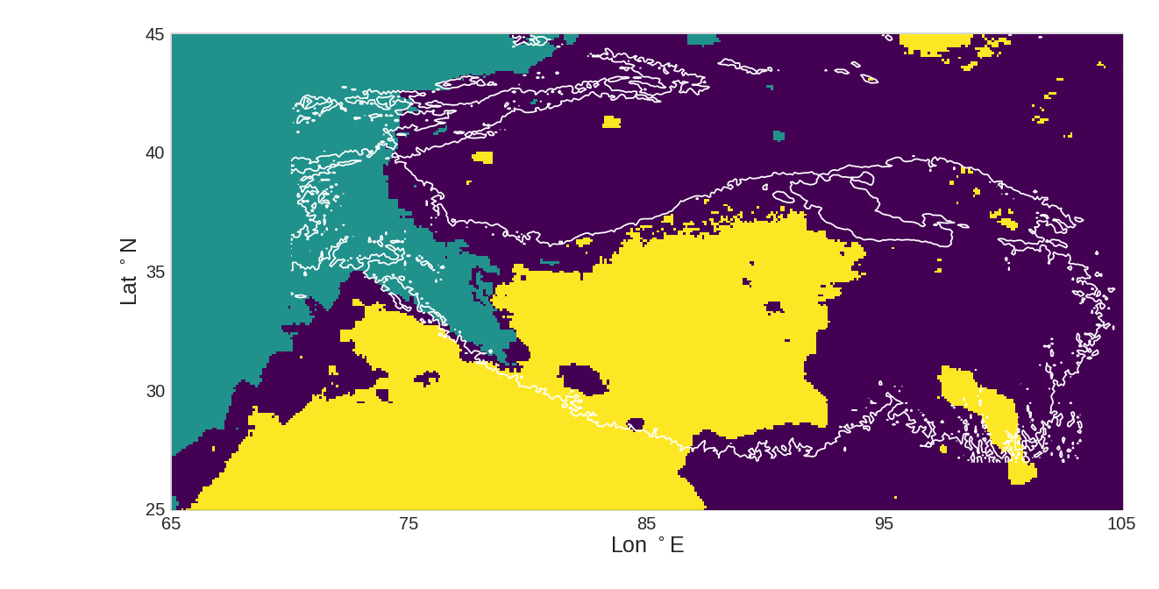
Results for 3 cluster centers
Cluster 0: 33167, Cluster 1:32810, Cluster 3: 14624
Standardized
Contributions
Cluster 0: 43694, Cluster 1: 15597, Cluster 3: 21310

Slide 3
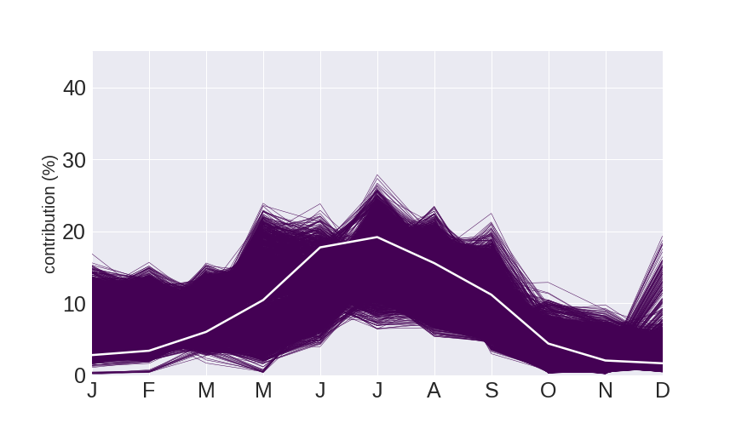
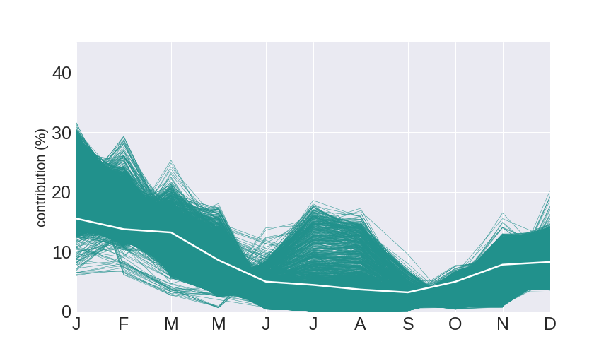
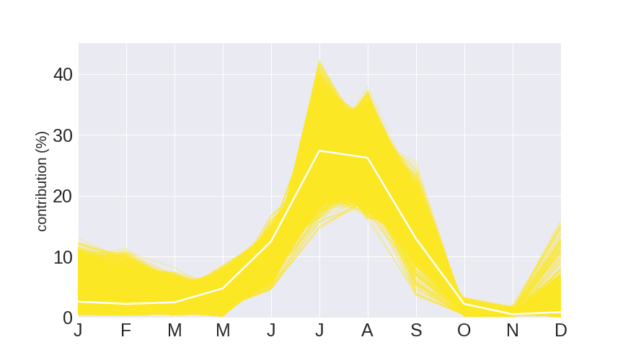
Characteristics of the 3 centroids
Cluster 0
Cluster 1
Cluster 2

Slide 4
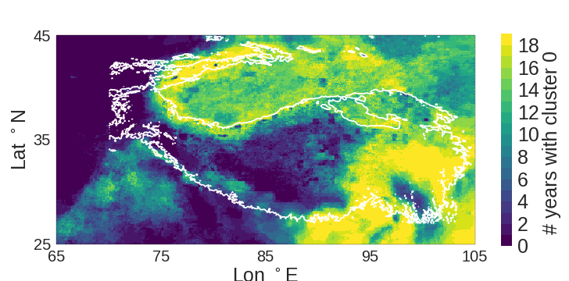
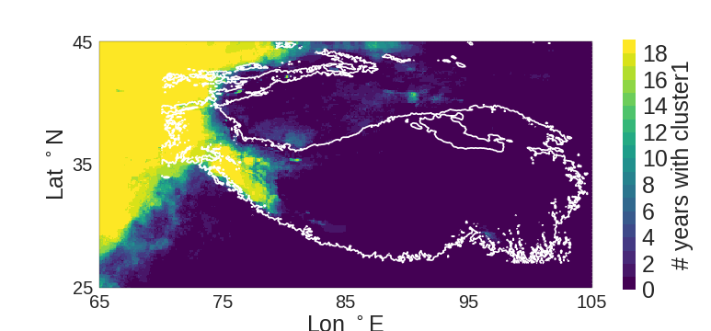
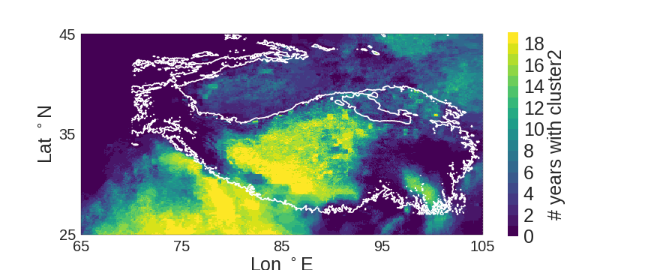
Prediction of each year
What is the closest cluster center of the seasonal curve in each year?

Slide 5
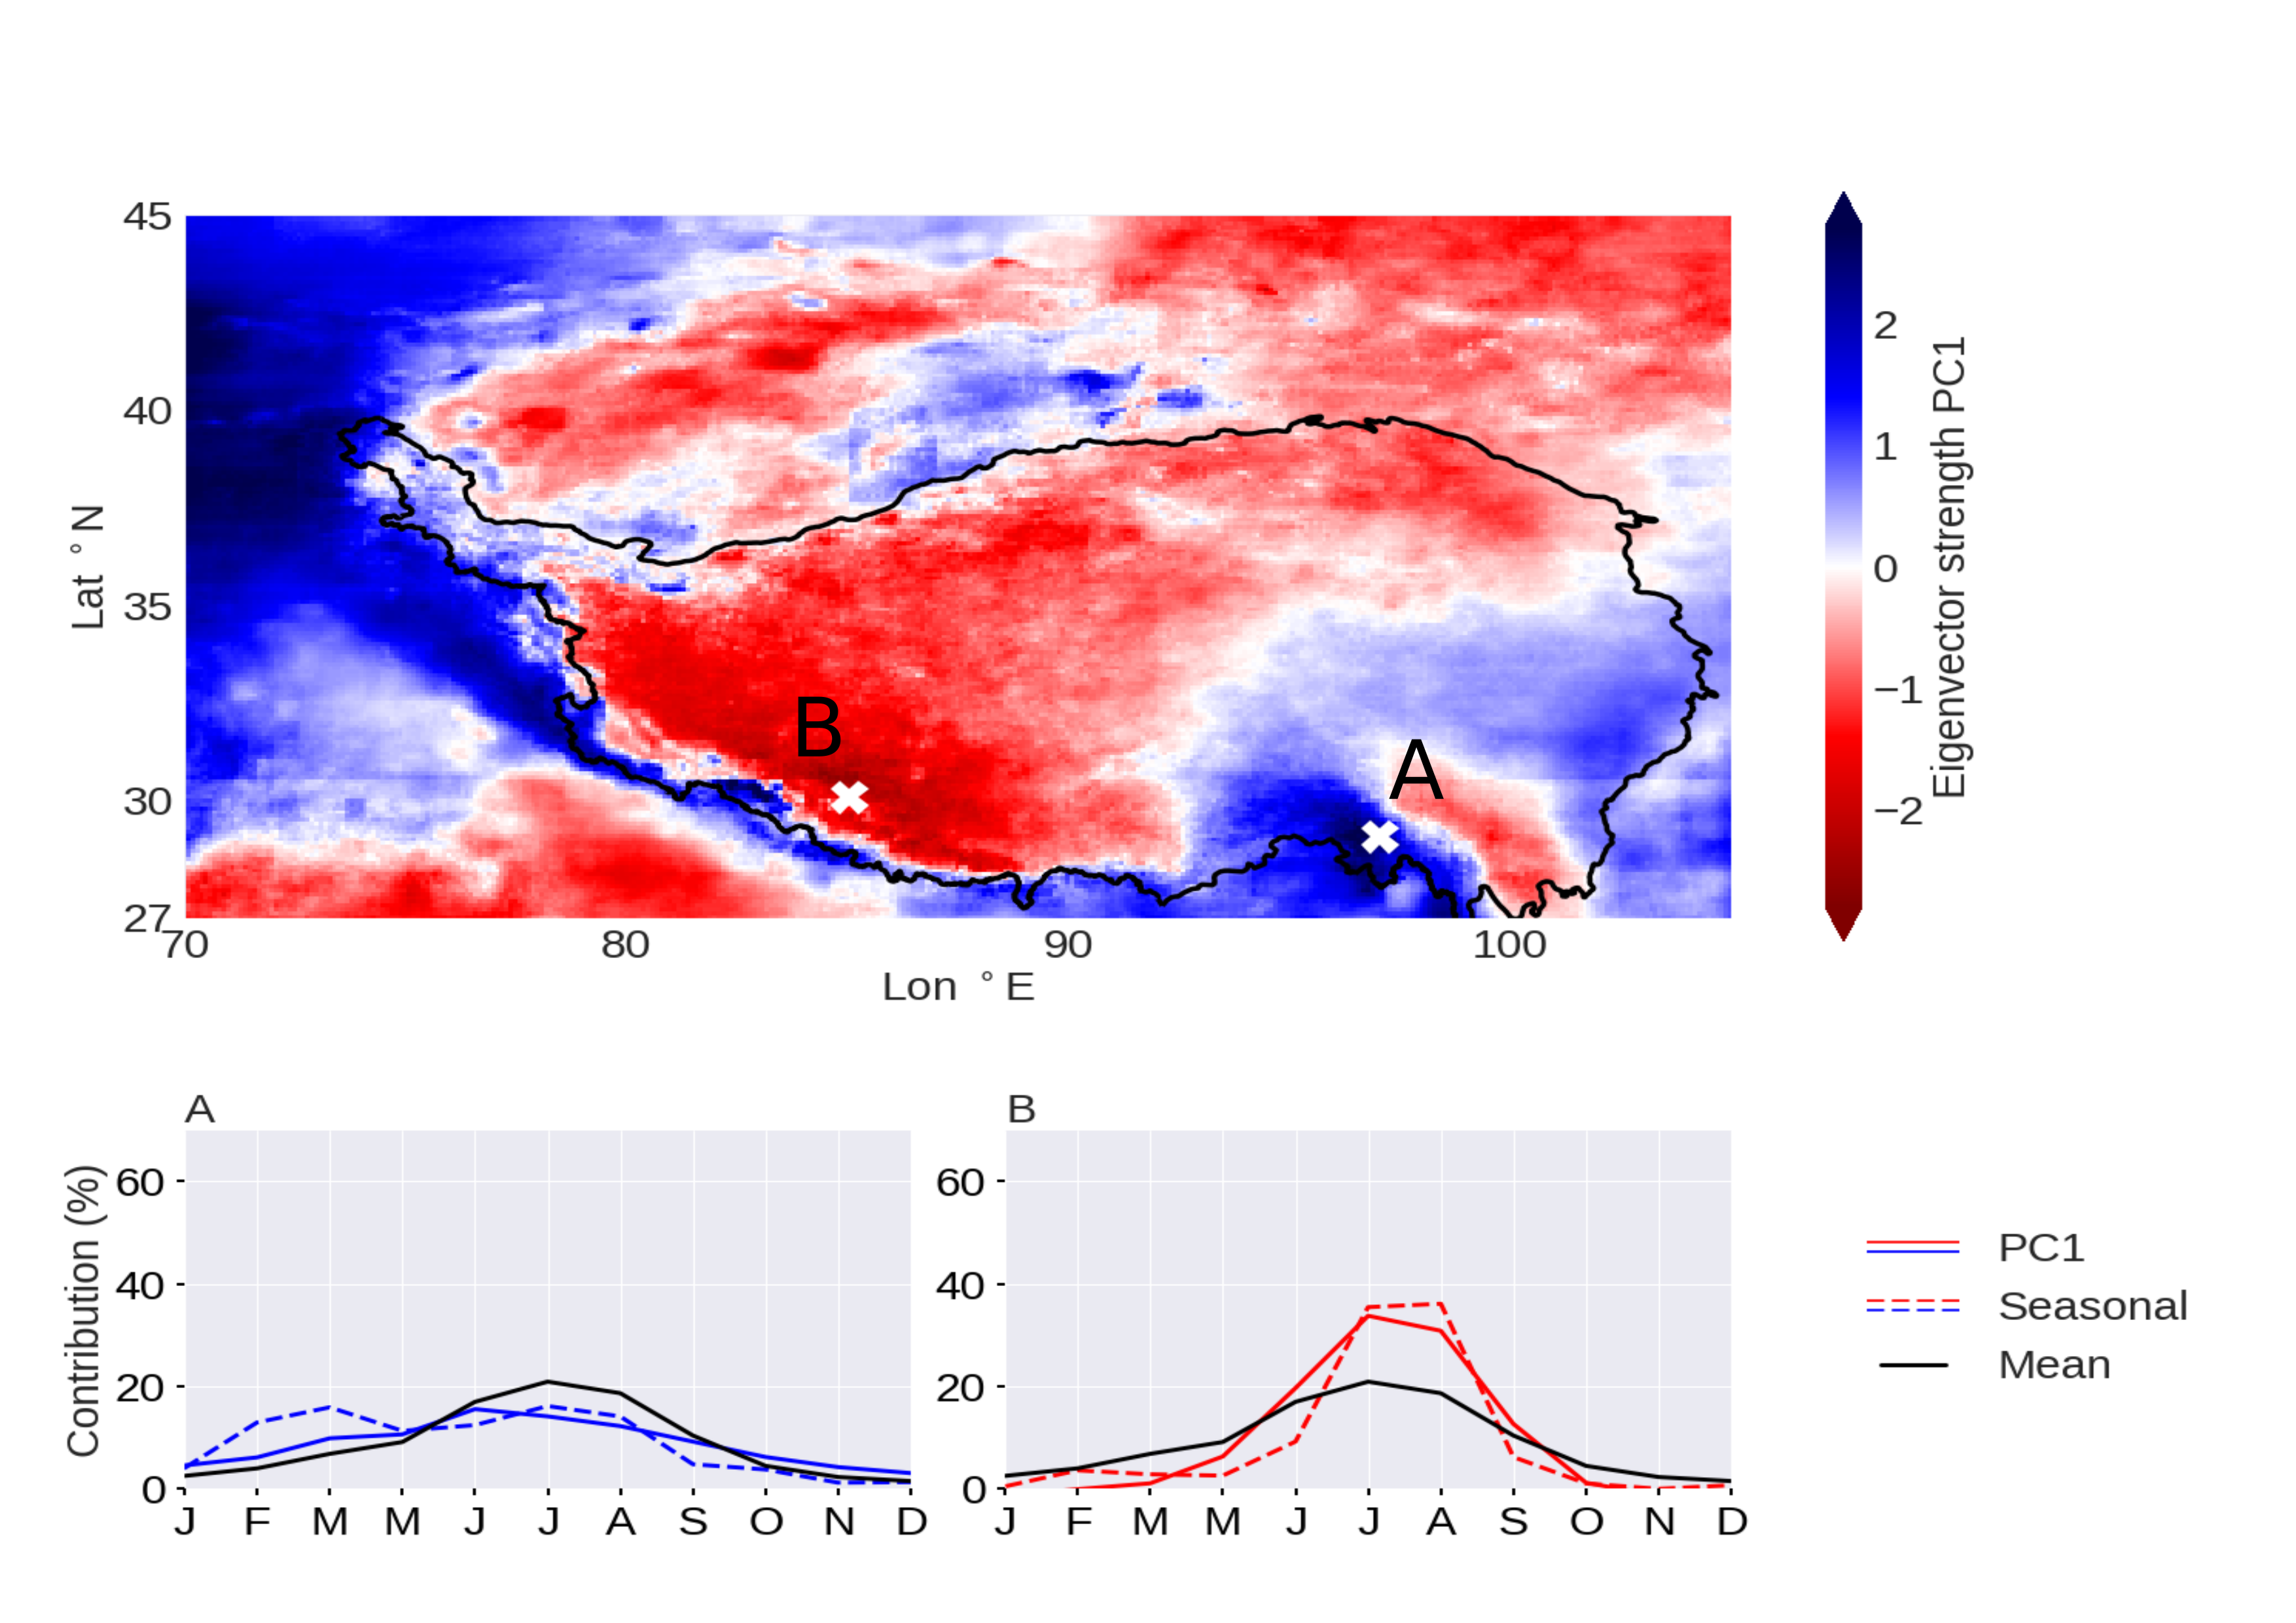
Seasonal EOF

Slide 6
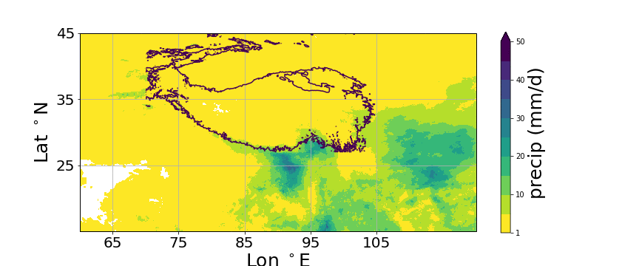
Monsoon evolution: 10-day avg
Evolution of monsoon from 01 May (10-day pentad averages of daily precip averaged over 20-years period):
Looks like precipitation from the East arrives the plateau earlier than precip which comes from the south?

Slide 7

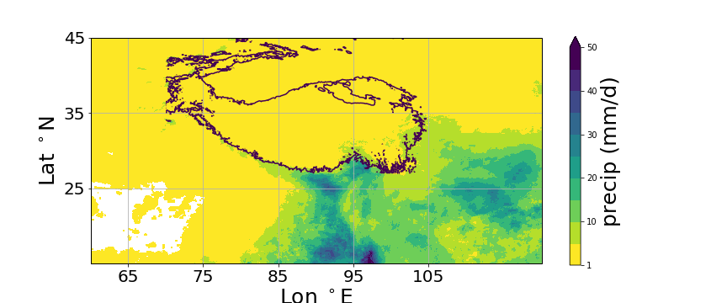
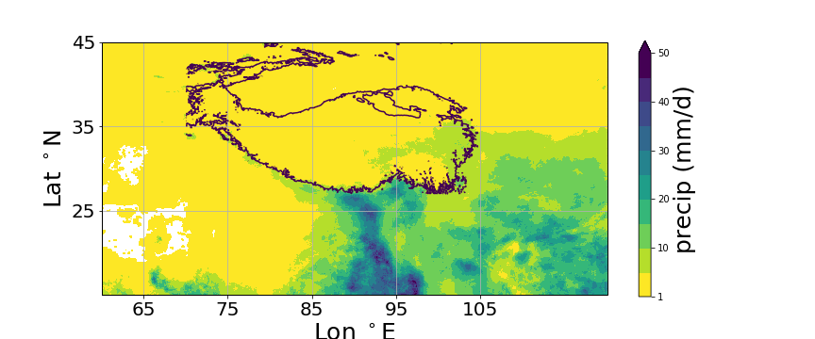
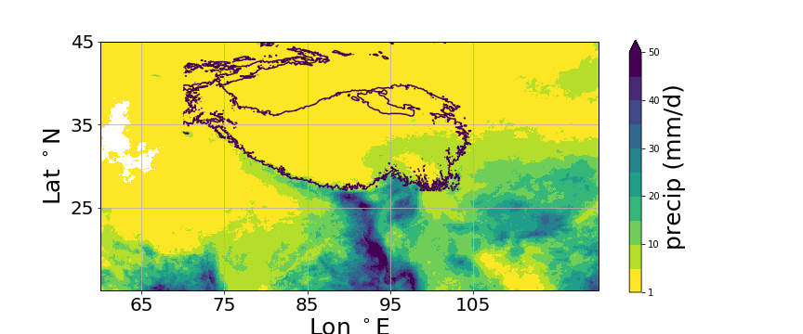
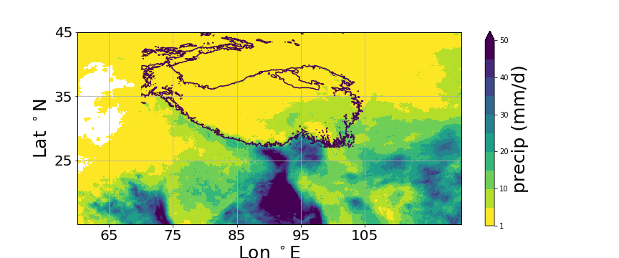
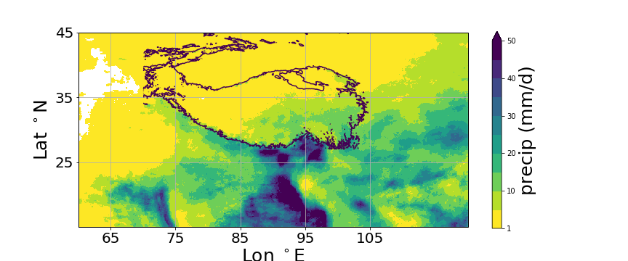
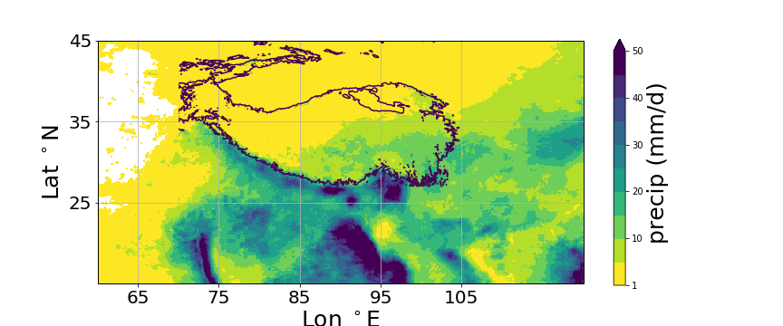
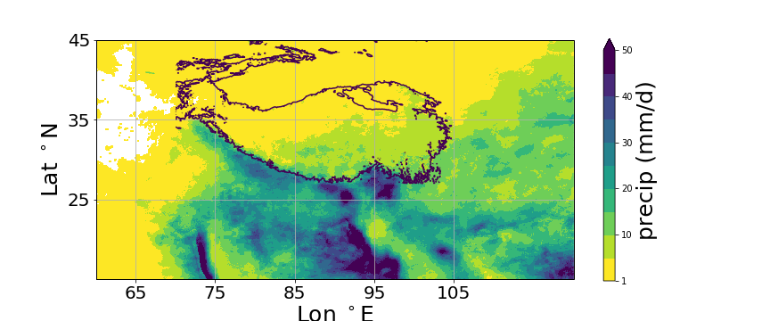
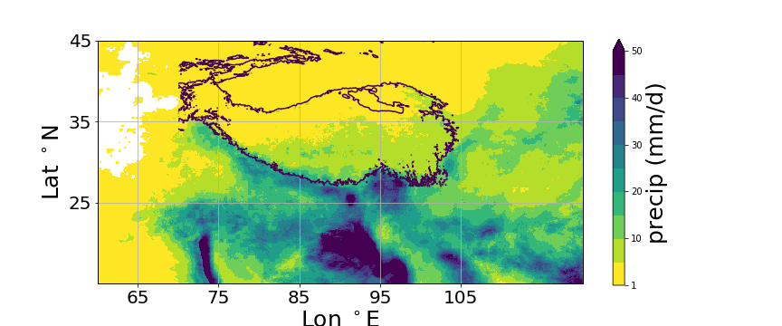
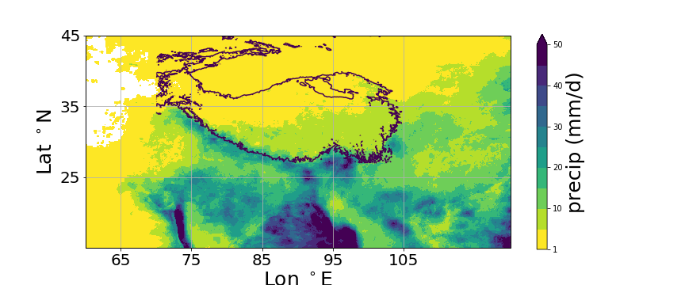
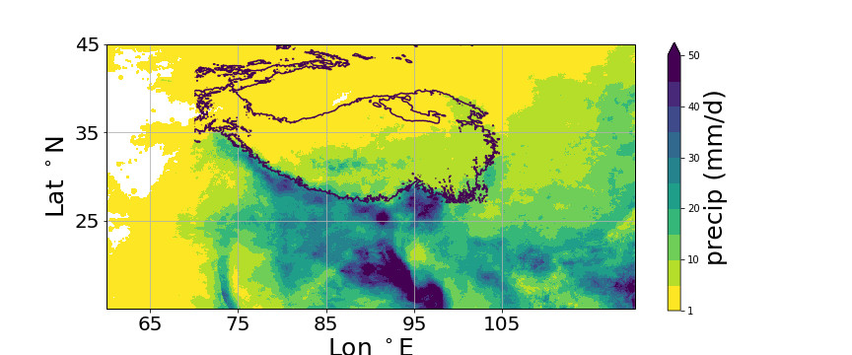
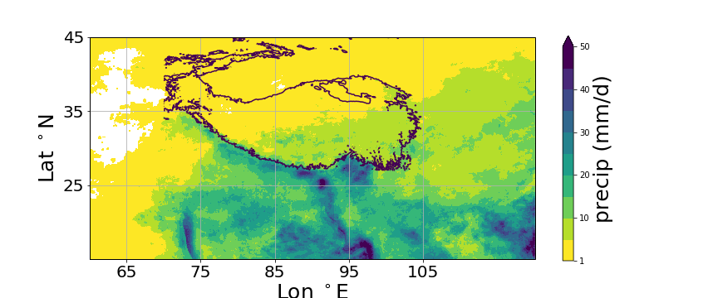
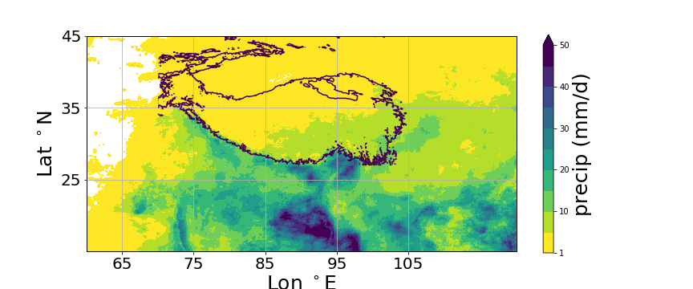
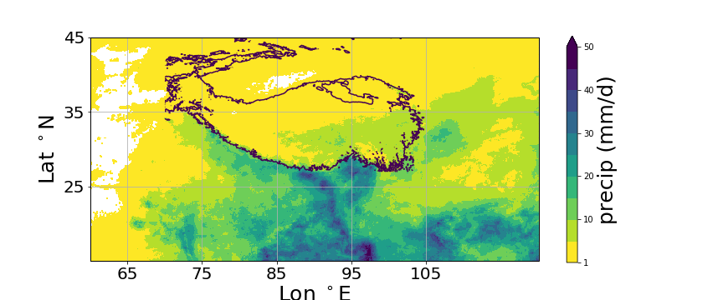
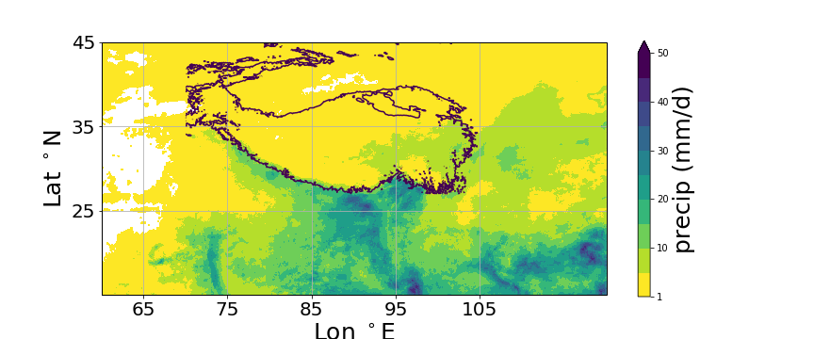
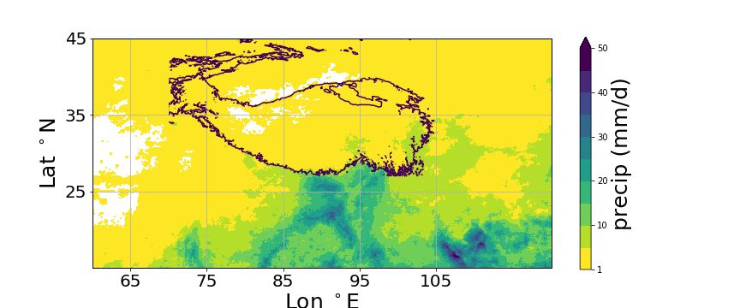
Monsoon evolution: 10-day avg

Slide 8
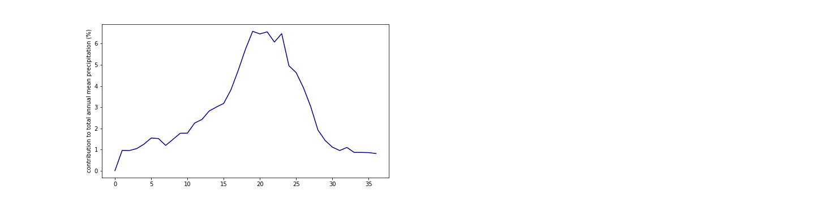
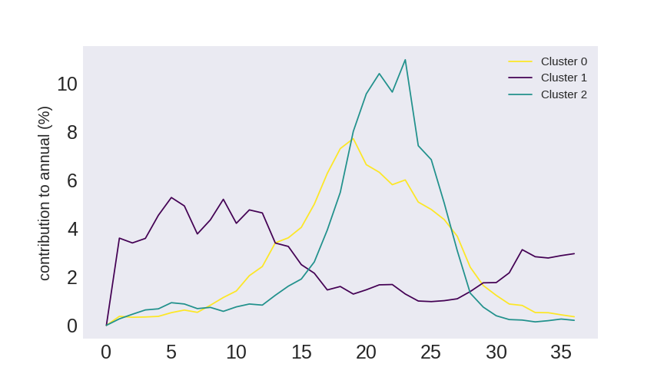
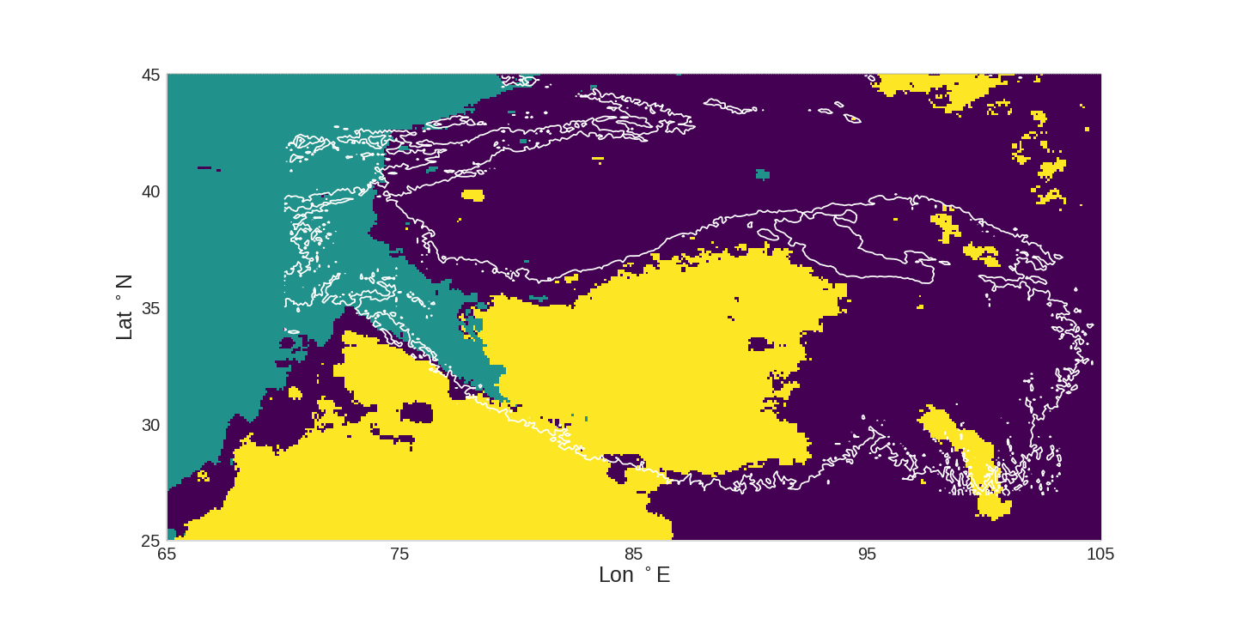
Cluster analysis with 10-day avg
Input feature: Seasonal cycle based on 10-day pentad averages

Slide 9
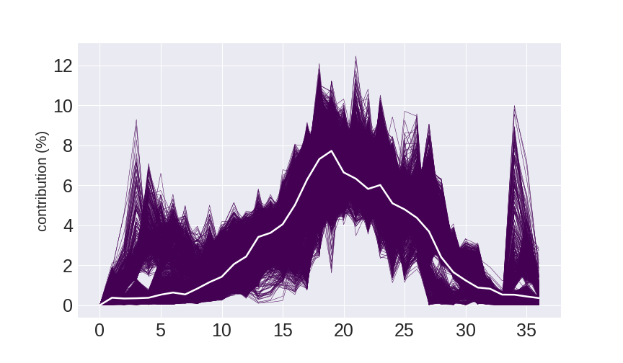
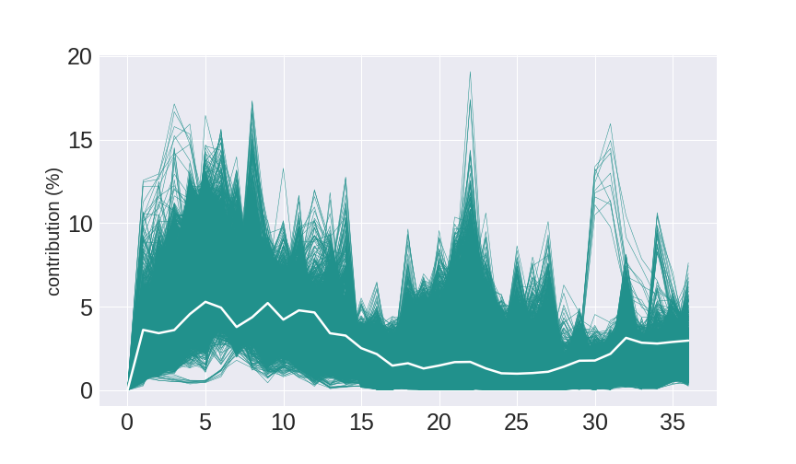
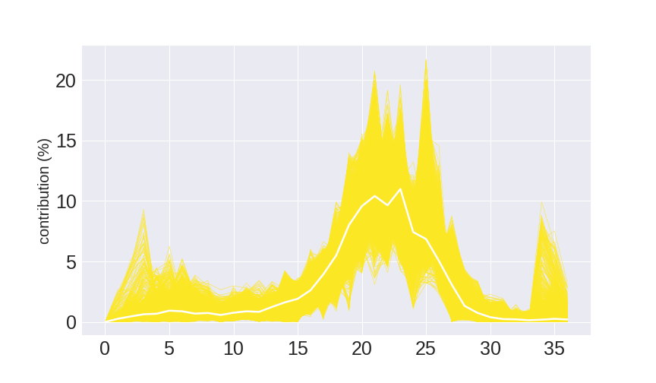
Cluster analysis with 10-day avg

Slide 10
Summary
Cluster analysis with 3 clusters based on GPM looks very similar to ERA-Interim (especially the heat maps with predictions for each year, indicating that datasets capture same interannual variability)
Small differences in spatial distribution of clusters due to different normalization method
Seasonal EOF is basically the same as Tinghai’s results (despite different normalization)
East Asian summer monsoon reaches plateau earlier – should we connect the cluster with other large-scale parameters, similar to:
Curio, J., & Scherer, D. (2016). Seasonality and spatial variability of dynamic precipitation controls on the Tibetan Plateau. Earth System Dynamics, 7(3), 767-782.
What other analyses with the 10-pentad averages could be meaningful to see whether we can connect our clusters to monsoon onset and extend?

